Slide 1
Solution Presentation
Heze Zhang
11.8 2026

Slide 2
Contents
01
Academic Background
02
Previous Research
03
Proposed PhD Research

Slide 3
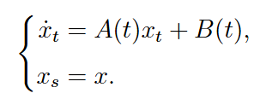
Section 1: Personal Introduction
1. Linear inhomogeneous ODE (Project 9)
Assumption: A and B are continuous on I, with s ∈ I.
Heze Zhang
1/15
Solution Presentation

Slide 4
Section 1: Personal Introduction
Heze Zhang
1/15
Solution Presentation

Slide 5
Section 1: Personal Introduction
Heze Zhang
1/15
Solution Presentation

Slide 6
Section 1: Personal Introduction
Heze Zhang
1/15
Solution Presentation

Slide 7
Section 1: Personal Introduction
Heze Zhang
1/15
Solution Presentation

Slide 8
Section 1: Personal Introduction
Heze Zhang
1/15
Solution Presentation

Slide 9

END

Slide 10
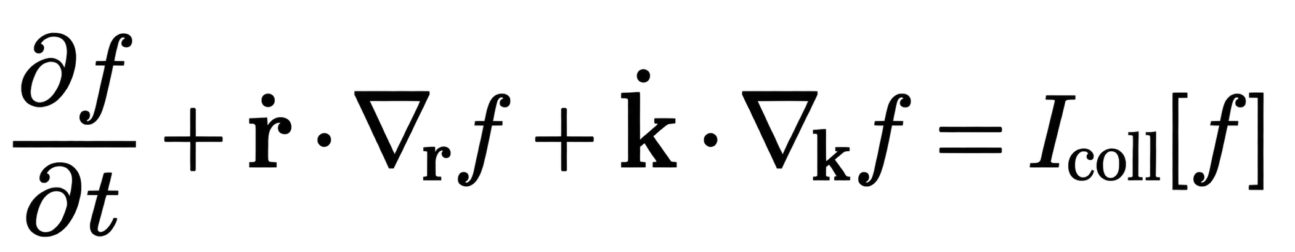
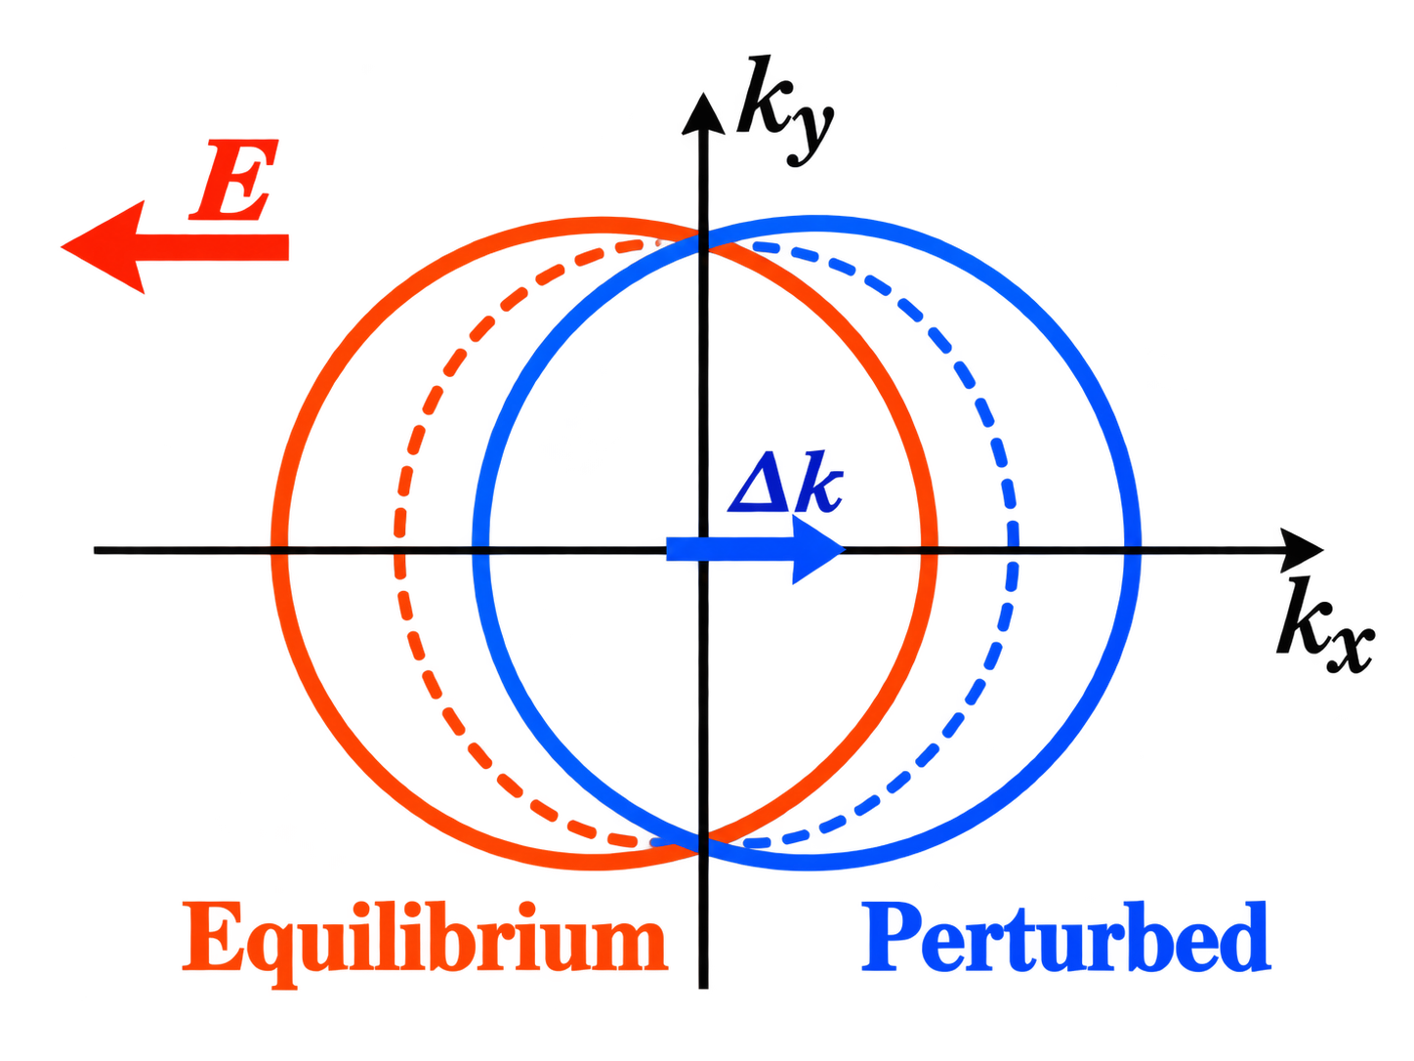
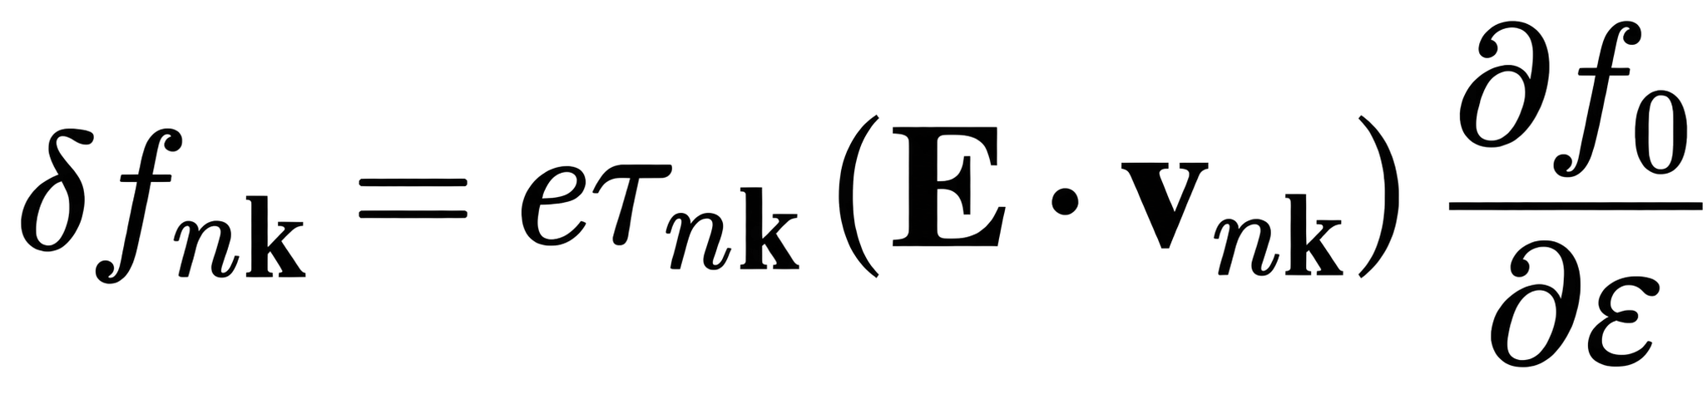
· Appendix: Boltzmann Transport Theory
Boltzmann Transport Equation
Physical mechanism
Linear response & Relaxation-time approximation
Heze Zhang
1/A
PhD Application Presentation
Notes:
The Boltzmann equation describes the evolution of the electron distribution under external fields and scattering. Within the relaxation-time approximation, we obtain the nonequilibrium distribution in the linear-response regime, which allows us to calculate the spin-dependent electrical conductivity from the electronic band structure.

