Slide 1
Caching Strategies

Slide 2
What is Caching
Caching is a mechanism to improve the performance of any type of application. A cache is a software or hardware component aimed at storing data so that future requests for the same data can be served faster.
The main reason why caching was born is that accessing data from persistent (and distant) memory locations takes a considerable amount of time. Thus, whenever data is retrieved or processed, the idea is to store it in a more efficient memory
A memory cache, which can be thought of as a high-speed data storage layer whose primary purpose is to reduce the need to access slower data storage layers.
Caches allow mechanisms to efficiently reuse previously retrieved or computed data. Whenever a new request arrives, the requested data is searched first in a cache. A cache hit occurs when the requested data can be found in a cache. On the contrary, a cache miss occurs when it cannot. Reading the required data from caches is assumed to be faster than accessing the data from the original data store.

Slide 3
Why cache?
When point of access for data (such as files) is across networks, throughput can be a significant issue and exposes code execution to latency in data retrieval. The more requests can be served from a cache, the faster the system will be.
Stuttering or delayed display of data means an end user of an application is being exposed to that latency
File processing can take considerably longer (even when threaded) as the main thread, or each worker thread, waits for data to be delivered
File processing is a significant aspect to MCC, and many third-party tools expect pointers to files, which requires downloading files to the DLVM and then loading them during execution. The exception is Dataflow, that will execute code in situ on the bucket nodes. This is one of the primary use cases I will be using in formulating a set of caching strategies: downloading files from cloud storage to local attached SSD on a DLVM, when there is more data on the cloud than local storage.

Slide 4
Use and loose Cache
Background threads started to fill cache, with a slight delay in the main thread to allow cache to fill initially, to minimize upfront cache contention
Cache contention occurs when background threads writing data and main thread reading data are neck-in-neck, so that there are many cache misses and resulting in the main thread retrieving data from the distant source.
This generally settles down when the processing time is longer than the time to fill the cache, such that the cache reaches a steady state
The calling application understands it’s data access pattern, and if the data is only needed once, then the application can call the cache manager to return data, and remove it
This is a nicely self-regulating pattern, as the time between and calls for data and the time to fill the cache should be roughly constant, ideally resulting in a “rolling buffer” of data

Slide 5
Calling application
Retrieve and remove
Cache / Cache Manager
Threads retrieve and store, until all data
Is in cache
External Source

Slide 6
Programmatic Flow: cache hit
Get data
cache
External Source
Retrieve
return
store
Fill Cache Thread
fetch
Cache Manager

Slide 7
Programmatic Flow: cache miss
Get data
cache
External Source
retrieve
Signal no data
fetch
return
store
Fill Cache Thread
Cache Manager
fetch

Slide 8
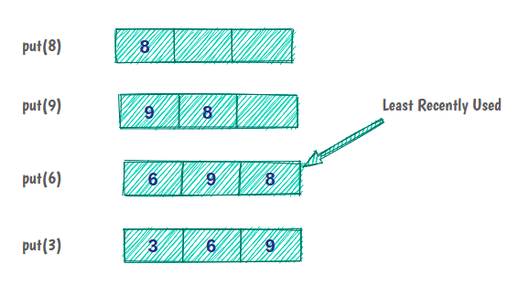
LRU Cache
The Least Recently Used (LRU) cache is a cache eviction algorithm that organizes elements in order of use. In LRU, as the name suggests, the element that hasn't been used for the longest time will be evicted from the cache.
For example, if we have a cache with a capacity of three items. Initially, the cache is empty, and we put element 8 in the cache. Elements 9 and 6 are cached as before. But now, the cache capacity is full, and to put the next element, we have to evict the least recently used element in the cache.

Slide 9
Structure of an LRU Cache
In practice, LRU cache is a kind of Queue — if an element is reaccessed, it goes to the end of the eviction order
This queue will have a specific capacity as the cache has a limited size. Whenever a new element is brought in, it is added at the head of the queue. When eviction happens, it happens from the tail of the queue.
Hitting data in the cache must be done in constant time, which isn't possible in Queue! But it is possible with HashMap data structure
Removal of the least recently used element must be done in constant time, which means for the implementation of Queue, we’ll use DoublyLinkedList instead of SingleLinkedList or an array
So, the LRU cache is nothing but a combination of the Doubly Linked List and the HashMap as shown on the next slide

Slide 10
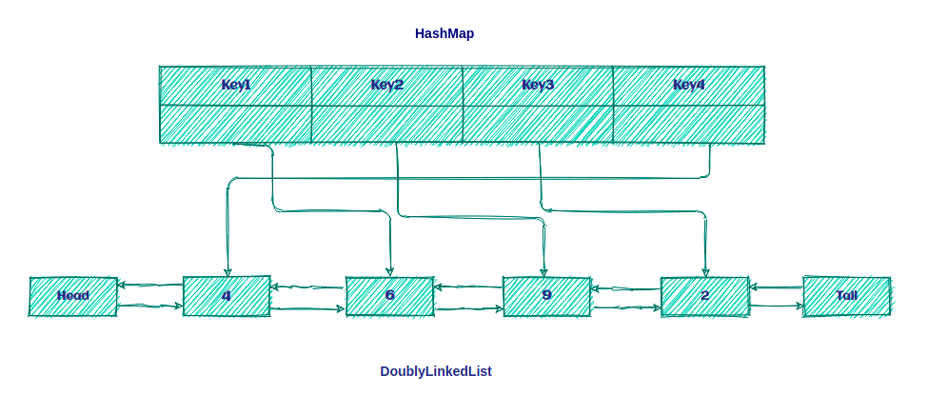

Slide 11
LRU Algorithm
If the key is present in HashMap, it's a cache hit; else, it's a cache miss. In the implementation, most recently used data is at the tail, oldest is the head
two steps after a cache miss occurs:
Add a new element in tail of the list.
Add a new entry in HashMap and refer to the tail of the list.
two steps after a cache hit:
Remove the located element and add it to the back of the list.
Update HashMap with a new reference to the tail of the list.

Slide 12
Cache eviction, when cache exceeds capacity
Characterize a low- and high- water mark. Consider a runtime environment with 16 Gby RAM. A typical high-water mark for a cache is 25% available RAM, or 4 Gby. The cache also usually has a low water mark that is keeps 50% of the cache's total capacity such that not everything in the cache is evicted. In this example the cache would never drop below 2 Gby, keeping the most recently added (or accessed) data.
The cache uses a threaded model where a background process monitors the cache’s size and evicts the least recently used data, keeping the cache’s size between the low-and-high water mark

