Slide 1

¡Bienvenido a tu nuevo Office!
Notes:
Slide purpose: Use this slide to welcome your guests and to set their expectations for the presentation.
Presentation purpose: This presentation is designed to help you introduce the new Office 365 Business to small businesses (~1-10 users). This is a SKU-specific deck so it starts with business pains, then goes into how Office 365 can solve those pains, and then goes into the new Business SKU.

Slide 2
¿Sabías lo que te ofrece Office 365?
¡Instalá tu Office en todos tus dispositivos móviles!
Colaboración en línea de tus archivos con todos tus compañeros de clase
¡Con OneNote podrás tomar apuntes en clases de manera más rápida!
1TB de almacenamiento en
OneDrive for Business
Notes:
Slide purpose: Introduce Office 365 Business. Explain what is included in the plan. (note: the following slide helps explain the benefits of Office 365, so don’t feel pressured to tell that story on this slide).
Talk track
Office 365 Business is your familiar Office, but improved. It includes:
When we say “familiar office”, first of all, we mean the full, installable Office apps that you know and love – Word, PowerPoint, Excel, Outlook, etc. With Office 365 Business, you get the most up to date desktop Office apps you have always used, along with great new additional features and capabilities.
In addition to desktop apps, you also get Office apps on your tablet and smartphones for viewing and editing on the go.
And if you forget your laptop at home, or leave it at the Office and need to access or edit your files, you have Office Online which allows you to access, edit, and share your documents by simply logging into you Office Online account from any browser.\
Lastly, with Office 365 Business you get 1TB of OneDrive for Business online storage so you can safely and securely save your files online and share them with others.
This plan is easy to set up and manage, with a financially-backed SLA and 24/7 technical phone support for critical issues.
You may be familiar with Office. Office 365 Business is that same familiar Office with new features. But more importantly, Office 365 Business provides a few great new benefits [click to the next slide].
Note for presenter: Keep in mind that most people, when they hear “Office 365”, only hear “Office” and think “Word, PowerPoint, Excel”. And when they hear “cloud”, they think “browser based apps” only, thinking this is only a browser-based version of Office, similar to Google Apps. So it’s important to take your time and labor on these 2 points specifically. Transition from previous slide by saying, “We understand what technology you need to help you manage the business challenges you are facing. We are excited that there is a new offering in the market that has been designed specifically for you….”

Slide 3

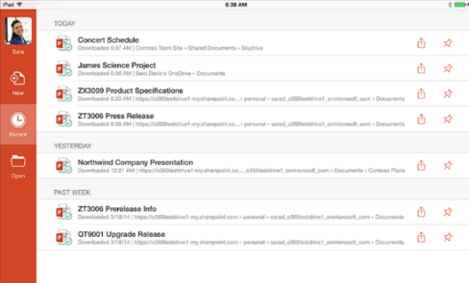
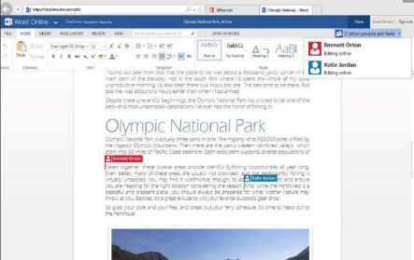

¡Tus aplicaciones de Office en todos tus dispositivos!
Instalá las aplicaciones de Office en hasta 5 dispositivos PCs/Macs. Disponible para smartphones, iPads y tabletas Windows y Android
¡Seguí trabajando en tu tesis desde cualquier lugar!
Notes:
Online or off, Office 365 Business allows you to quickly and easily access and edit your documents from anywhere so you can always be connected to your important business information. Office 365 Business includes the latest version of all the familiar Office applications – including Word, PowerPoint, Excel, Outlook, and more – for each user to install and use on up to 5 PCs or Macs. These fully-featured, rich client Office apps install and stay on your machines so you can use them online or offline, the same way you have used Office in the past.
But Office 365 Business is not just about the desktop version of Office. We certainly know that work is happening anywhere on all types of devices, and we have worked to build Office apps that are optimized for tablets and smartphones to empower businesses to have the freedom to work from anywhere, online or offline while enjoying a great mobile experience.
For a list of all the Office Mobile and Office 365 Business applications available on each device, visit: http://office.microsoft.com/en-us/mobile/
For Tablets
Office app (Word, PowerPoint, Excel, OneNote) are available for iPad. The apps have the robust capabilities and familiar look and feel that is unmistakably Office, while offering a fantastic touch experience built from the ground up for iPad. When you edit a document on the iPad, you can be sure that you won’t lose any content or formatting. Simply log in with a qualifying Office 365 Business subscription, you can view, edit and create new documents with the iPad. iPad users also have access to OneDrive for Business app to access all their files on the go.
For Smartphones
Windows Phone has always supported Office Mobile, which allows you to open or edit files in Word, PowerPoint, Excel, and take notes in OneNote, view and respond to mail with Outlook. Other apps include OneDrive for Business (built into Office Mobile).
Office Mobile is also available for iPhone and Android phones at no additional charge for Office 365 subscribers, along with OneNote Mobile. Similar to Office Mobile on Windows Phone, Office Mobile for iPhone and Android phones offers great Office content viewing and on-the-go content editing capabilities for Word, Excel and PowerPoint documents.
And of course, with all these devices, you can always log in to your Office 365 Business account from any browser and use Office Online in the browser, as well as check emails and your calendar, see all your contacts and more.

Slide 4
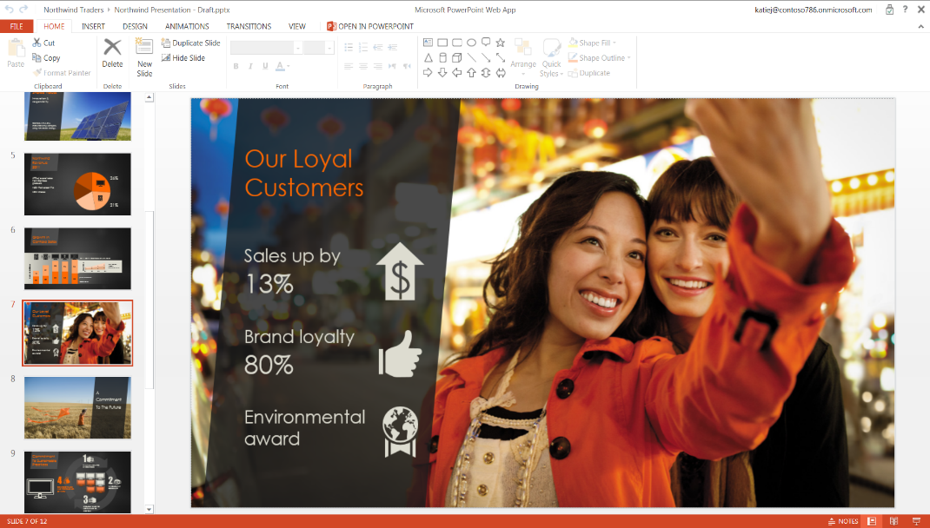
¿No estás en tu casa? ¡No te preocupes!
¡Todas las capacidades de Office, ahora también en tu navegador!
Accedé a tu cuenta de Office Online desde cualquier navegador para crear o seguir trabajando en tus archivos.
Accedé, editá, creá, guardá y compartí en linea.
¡Retomá tus trabajos prácticos universitarios justo donde los dejaste!
Notes:
You usually travel with your laptop or tablets. But on the occasion that they ran out of battery, or you accidentally pour coffee over them. Have piece of mind knowing you can still access, edit, and share your important business documents even when you don’t have access to your own device.
By simply logging into your Office account online, you can access and edit the most up to date version of your files from any browser without losing formatting. Office Online allows you to access, edit, and share all the documents you stored online, including a list of recent documents and real-time updates so you can stay current when collaborating with others, and the Outlook Web App. And when you click on any of the documents, you’ll be able to open and make edits to the documents right in the browser using Office Online.
Office Online is now improved to provide you with a great experience in your web browser so you can create new documents or edit using your favorite browser.
With the new and improved Office Online, you get more of the same ribbon experience that you are familiar with in the rich application. And more options will be added as we continue to improve in the upcoming releases.

Slide 5
Links de interés
Notes:
­­Office 365 Business gives you the freedom to be productive wherever, whenever, using the familiar Office apps. With the ability to easily access, edit, and share your files from any device, you can get work done in the office and on the go, online or off.
Let’s see how Office 365 Business can give you anywhere and anytime access to your familiar Office so you can keep your business running at all times…

Slide 6
¡Conocé las nuevas características!
Guía rápida: Excel 2016
Guía rápida: Word 2016
Guía rápida: PowerPoint 2016
Guía rápida: Outlook 2016
Guía rápida: OneNote 2016
Notes:
Slide purpose: Introduce Office 365 Business. Explain what is included in the plan. (note: the following slide helps explain the benefits of Office 365, so don’t feel pressured to tell that story on this slide).
Talk track
Office 365 Business is your familiar Office, but improved. It includes:
When we say “familiar office”, first of all, we mean the full, installable Office apps that you know and love – Word, PowerPoint, Excel, Outlook, etc. With Office 365 Business, you get the most up to date desktop Office apps you have always used, along with great new additional features and capabilities.
In addition to desktop apps, you also get Office apps on your tablet and smartphones for viewing and editing on the go.
And if you forget your laptop at home, or leave it at the Office and need to access or edit your files, you have Office Online which allows you to access, edit, and share your documents by simply logging into you Office Online account from any browser.\
Lastly, with Office 365 Business you get 1TB of OneDrive for Business online storage so you can safely and securely save your files online and share them with others.
This plan is easy to set up and manage, with a financially-backed SLA and 24/7 technical phone support for critical issues.
You may be familiar with Office. Office 365 Business is that same familiar Office with new features. But more importantly, Office 365 Business provides a few great new benefits [click to the next slide].
Note for presenter: Keep in mind that most people, when they hear “Office 365”, only hear “Office” and think “Word, PowerPoint, Excel”. And when they hear “cloud”, they think “browser based apps” only, thinking this is only a browser-based version of Office, similar to Google Apps. So it’s important to take your time and labor on these 2 points specifically. Transition from previous slide by saying, “We understand what technology you need to help you manage the business challenges you are facing. We are excited that there is a new offering in the market that has been designed specifically for you….”

Slide 7
Centro de Aprendizaje de Office
Ingresando a nuestro Centro de Aprendizaje, vas a poder obtener toda la información que necesites sobre los productos de Office
Hacé click para abrirlo en tu navegador
Notes:
Slide purpose: Introduce Office 365 Business. Explain what is included in the plan. (note: the following slide helps explain the benefits of Office 365, so don’t feel pressured to tell that story on this slide).
Talk track
Office 365 Business is your familiar Office, but improved. It includes:
When we say “familiar office”, first of all, we mean the full, installable Office apps that you know and love – Word, PowerPoint, Excel, Outlook, etc. With Office 365 Business, you get the most up to date desktop Office apps you have always used, along with great new additional features and capabilities.
In addition to desktop apps, you also get Office apps on your tablet and smartphones for viewing and editing on the go.
And if you forget your laptop at home, or leave it at the Office and need to access or edit your files, you have Office Online which allows you to access, edit, and share your documents by simply logging into you Office Online account from any browser.\
Lastly, with Office 365 Business you get 1TB of OneDrive for Business online storage so you can safely and securely save your files online and share them with others.
This plan is easy to set up and manage, with a financially-backed SLA and 24/7 technical phone support for critical issues.
You may be familiar with Office. Office 365 Business is that same familiar Office with new features. But more importantly, Office 365 Business provides a few great new benefits [click to the next slide].
Note for presenter: Keep in mind that most people, when they hear “Office 365”, only hear “Office” and think “Word, PowerPoint, Excel”. And when they hear “cloud”, they think “browser based apps” only, thinking this is only a browser-based version of Office, similar to Google Apps. So it’s important to take your time and labor on these 2 points specifically. Transition from previous slide by saying, “We understand what technology you need to help you manage the business challenges you are facing. We are excited that there is a new offering in the market that has been designed specifically for you….”

Slide 8
Ayuda de Office
¿Buscás respuestas a tus preguntas? ¡El Centro de Ayuda es tu lugar! Podrás encontrar información sobre:
Temas más populares
Introducción a Office 2016
Office 365 para el ámbito educativo
Y mucho más!
Hacé click para abrirlo en tu navegador
Notes:
Slide purpose: Introduce Office 365 Business. Explain what is included in the plan. (note: the following slide helps explain the benefits of Office 365, so don’t feel pressured to tell that story on this slide).
Talk track
Office 365 Business is your familiar Office, but improved. It includes:
When we say “familiar office”, first of all, we mean the full, installable Office apps that you know and love – Word, PowerPoint, Excel, Outlook, etc. With Office 365 Business, you get the most up to date desktop Office apps you have always used, along with great new additional features and capabilities.
In addition to desktop apps, you also get Office apps on your tablet and smartphones for viewing and editing on the go.
And if you forget your laptop at home, or leave it at the Office and need to access or edit your files, you have Office Online which allows you to access, edit, and share your documents by simply logging into you Office Online account from any browser.\
Lastly, with Office 365 Business you get 1TB of OneDrive for Business online storage so you can safely and securely save your files online and share them with others.
This plan is easy to set up and manage, with a financially-backed SLA and 24/7 technical phone support for critical issues.
You may be familiar with Office. Office 365 Business is that same familiar Office with new features. But more importantly, Office 365 Business provides a few great new benefits [click to the next slide].
Note for presenter: Keep in mind that most people, when they hear “Office 365”, only hear “Office” and think “Word, PowerPoint, Excel”. And when they hear “cloud”, they think “browser based apps” only, thinking this is only a browser-based version of Office, similar to Google Apps. So it’s important to take your time and labor on these 2 points specifically. Transition from previous slide by saying, “We understand what technology you need to help you manage the business challenges you are facing. We are excited that there is a new offering in the market that has been designed specifically for you….”

Slide 9
© 2012 Microsoft Corporation. All rights reserved. Microsoft, Windows, and other product names are or may be registered trademarks and/or trademarks in the U.S. and/or other countries.
The information herein is for informational purposes only and represents the current view of Microsoft Corporation as of the date of this presentation. Because Microsoft must respond to changing market conditions, it should not be interpreted to be a commitment on the
part of Microsoft, and Microsoft cannot guarantee the accuracy of any information provided after the date of this presentation. MICROSOFT MAKES NO WARRANTIES, EXPRESS, IMPLIED OR STATUTORY, AS TO THE INFORMATION IN THIS PRESENTATION.

