Slide 1
ENEL 895AK
Elliptic Curve Cryptography

Slide 2
Security Motivation
Most communications are not private
Packets are free to travel through public internet
Packets are broadcast within LANs
Wireless communications are broadcast and do not require physical access
A solution to help secure information is encryption
Encrypt information at the source
Decrypt information at the sink
Requires both source and sink have a shared secret
Requires that no intermediate nodes can break this shared secret

Slide 3
Applications of Encryption
Obscure information
By encryption of information at source and decryption at sink
Authentication
Prove identity to another node
Sign information to verify source
A signature is generated using the shared secret
Signatures can only originate from the party with the correct key
Verify identity of third parties
Trusted sources can sign certificates of others to verify identity

Slide 4
Asymmetric and Symmetric Keys
Two types of keys exist for encryption:
Symmetric keys
Both nodes have the same secret
The secret can be used to either encrypt or decrypt
Asymmetric keys
A private and public key exist
The public key is published
Only the private key is held by the source of the pair
One key is needed to encrypt, while either the other or both are needed to decrypt

Slide 5
Symmetric Keys
Symmetric keys are generated and shared by both source and sink
The same key used to encrypt is also used to decrypt
Advantages:
Faster than asymmetric algorithms
Less energy intensive than asymmetric algorithms
Disadvantages:
A shared secret must be transmitted to both parties before they can be used
Vulnerable to man-in-the-middle attacks to obtain the shared key
Example of symmetric key algorithm: AES

Slide 6
Asymmetric Keys
Asymmetric keys generate a private secret key and a public key
This requires a trapdoor function
This function transforms input to output easily
Finding input given output and function is very difficult
Some common trapdoor functions:
Rivest-Shamir-Adleman (RSA) relies on factoring primes being difficult
Elliptic-Curve-Cryptography (ECC) relies on finding the logarithm of operations done on an elliptic curve being difficult
Diffie-Hellman Algorithm relies on mixing two public symmetric keys to produce a private shared key, it is easy to mix, but difficult to separate without prior knowledge

Slide 7
RSA Implementation
RSA generates a public and private key by multiplying two prime numbers together within a modulus
The trapdoor function in this case is multiplication/factoring
Multiplying numbers is efficient and fast
Factoring primes is difficult
It is assumed that given the public key, deriving the private key is infeasible due to this factoring problem [1]

Slide 8
Problems with RSA
The assumption that factoring is a difficult problem is based on brute force attempts to factor
Several algorithms have been introduced that can factor primes efficiently [1]
With these algorithms and increasing computing power available, RSA key security has dropped rapidly
For the same level of security, a larger key size is required, which is more computationally expensive to use in encryption/decryption

Slide 9

Elliptic Curve Cryptography - Theory
Elliptic Curve Cryptography is based on the problem of finding the discrete logarithm of operations done on an elliptic curve
An Elliptic curve is any curve defined by the following formula:
An operation on an elliptic curve is defined as the resulting point found by the intersection of a line drawn between any other two points on the curve when all operations are taken within a modulus

Slide 10
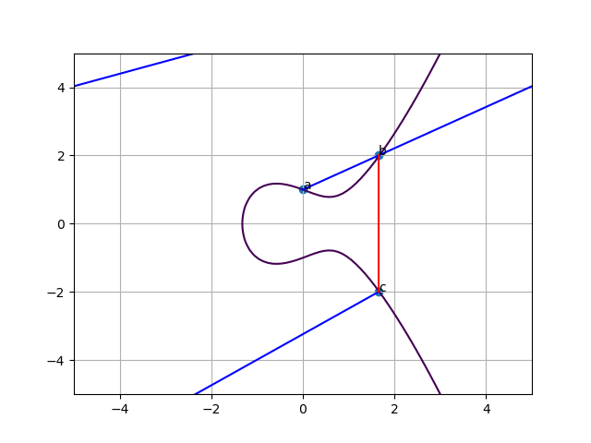
Elliptic Curve Cryptography - Intuition
One round of an operation on an elliptic curve with a modulus of 5 (a = -1, b = 1)
a: starting point
c: end point
n: number of rounds (1)
b: intermediate point
The curve and start/end points are public knowledge
The number of rounds to reach the end (n) and intermediate points (b, …) are secret
The next operation (n==2) would find the intersection of a and c

Slide 11
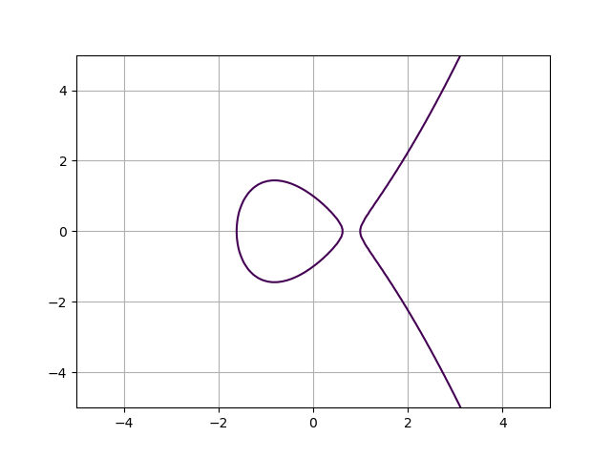
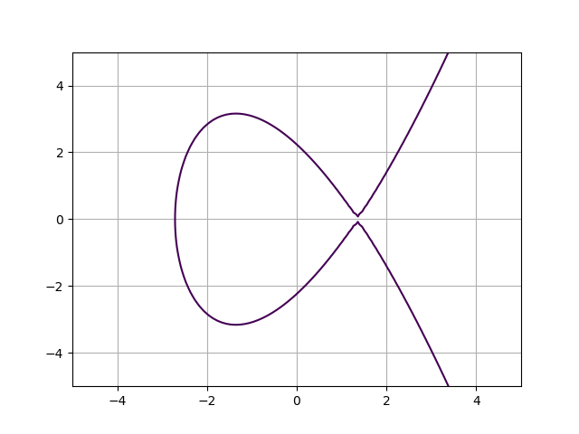
Variations of Curves
Both of these curves fit the equation
Both of these curves are viable for use in cryptography

Slide 12
Shared Secret with ECC
There are many methods to establish a shared secret using the asymmetric ECC keys
One such method is Elliptic Curve Diffie Hellman (ECDH) [2]
This method requires that two nodes each have a unique public and private key, and that the public keys are published
It also requires that the elliptic curve and generator point G (starting point) are public knowledge
The shared secret is derived as follows:
(public, private): node A (Ga, n_a), node B (Gb, n_b)
Shared secret is found by finding the point on the elliptic curve (x, y) by performing G*Gb n_a times, or G*Ga n_b times

Slide 13
ECC/RSA Comparison
ECC differs from RSA in that there are no known algorithms that can efficiently find the logarithm (n) of a point Ga given the curve and the generator point G
This means that the only way to find the private key (n) is a brute force method of guess and check
For this reason, ECC is more secure than RSA for a given key size, and for RSA to be as secure as ECC, it requires a larger key size [3]
Ex. 2048-bit RSA is equivalent to 224-bit ECC
ECC gives an advantage in terms of computing power required due to the smaller key size

Slide 14
Disadvantages of ECC
The field of Elliptic Curve Cryptography is not as advanced as RSA and number theory [2]
ECC and RSA share some weaknesses, such as:
Security of the scheme is ultimately set by choice of curve, modulus, and generator point, and like RSA the choice of random number generator is important [2]
In contrast to symmetric key schemes, two keys are required to be stored, rather than one

Slide 15
Optimizing ECC Security
ECC Curves have different parameters:
a, b: The curves coefficients (slope and intercept)
modulus: The curve modulus
Not all curves have the same level of security
Some factors to take into account when selecting a curve and generator: [2]
a, b, modulus should be sufficiently large to reduce the ability of a brute force attack
Curves built on a prime modulus are more efficient to work with and are more resistant to certain attacks [2]
Standards associations provide lists of standard curves (ex. NIST) [4]
These curves are optimized for various metrics, such as security or speed

Slide 16
Wireless Sensor Networks and ECC
Wireless Sensor Networks (WSN) are resource constrained and have less storage, computational power, bandwidth, and energy than a typical network
Elliptic Key Cryptography is useful to add more security to a WSN for the following reasons: [5]
For comparable security to a typical RSA key, ECC is able to have a much smaller key size
Smaller key size required less memory for storage and less bandwidth to transmit
Requires less energy to derive key and use key for encryption/decryption
Efficient asymmetric algorithms for dynamic key exchange exist (ECDH)

Slide 17
References
W. Diffie, "The first ten years of public-key cryptography," in Proceedings of the IEEE, vol. 76, no. 5, pp. 560-577, May 1988. doi: 10.1109/5.4442
A. Cilardo, L. Coppolino, N. Mazzocca and L. Romano, "Elliptic Curve Cryptography Engineering," in Proceedings of the IEEE, vol. 94, no. 2, pp. 395-406, Feb. 2006. doi: 10.1109/JPROC.2005.862438
F. Mallouli, A. Hellal, N. Sharief Saeed, and F. Abdulraheem Alzahrani,“A survey on cryptography: Comparative study between rsa vs ecc algo-rithms, and rsa vs el-gamal algorithms,” in2019 6th IEEE InternationalConference on Cyber Security and Cloud Computing (CSCloud)/ 2019 5thIEEE International Conference on Edge Computing and Scalable Cloud(EdgeCom), June 2019, pp. 173–176
Hankerson D., Menezes A. (2011) NIST Elliptic Curves. In: van Tilborg H.C.A., Jajodia S. (eds) Encyclopedia of Cryptography and Security. Springer, Boston, MA
K. Lauter, "The advantages of elliptic curve cryptography for wireless security," in IEEE Wireless Communications, vol. 11, no. 1, pp. 62-67, Feb. 2004. doi: 10.1109/MWC.2004.1269719

