Slide 1
ENEL 895AK
Elliptic Curve Cryptography

Slide 2

Elliptic Curve Cryptography - Review
Elliptic Curve Cryptography is based on the problem of finding the discrete logarithm of operations done on an elliptic curve
An Elliptic curve is any curve defined by the following formula:
An operation on an elliptic curve is defined as the resulting point found by the intersection of a line drawn between any other two points on the curve when all operations are taken within a modulus

Slide 3
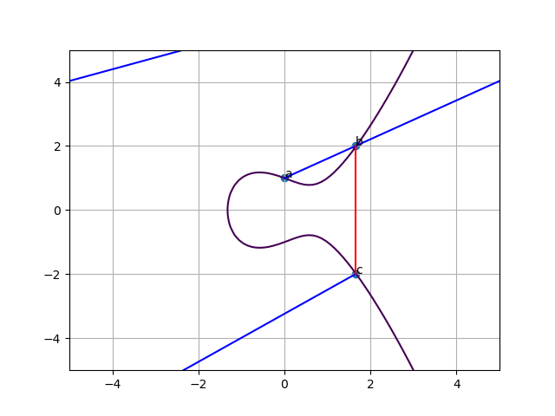
Elliptic Curve Cryptography - Intuition
One round of an operation on an elliptic curve with a modulus of 5 (a = -1, b = 1)
a: starting point
c: end point
n: number of rounds (1)
b: intermediate point
The curve and start/end points are public knowledge
The number of rounds to reach the end (n) and intermediate points (b, …) are secret
The next operation (n==2) would find the intersection of a and c

Slide 4
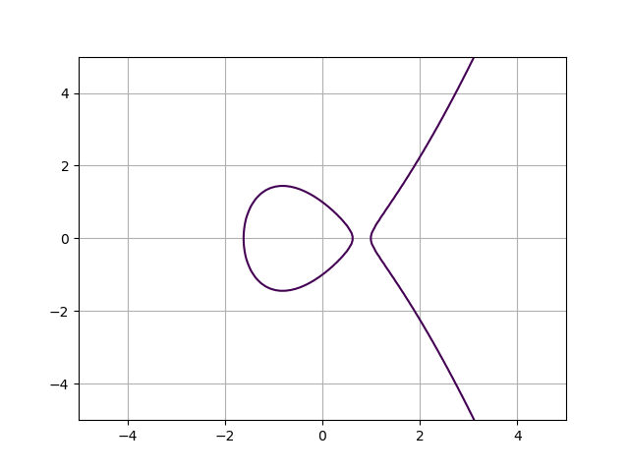
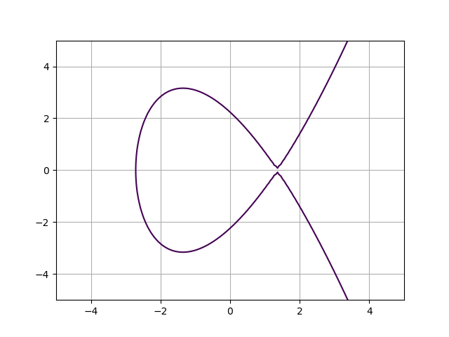
Variations of Curves
Both of these curves fit the equation
Both of these curves are viable for use in cryptography

Slide 5
Wireless Sensor Networks and Security
Wireless Sensor Networks (WSN) are resource constrained and have less storage, computational power, bandwidth, and energy than a typical network
Due to these limitations, implementing security features on a WSN node is an optimization problem.
There is a trade-off between computational power and security in encryption algorithms, where larger security generally requires larger key size, which in turn requires more CPU time to encrypt.
The constrained nature of a WSN further compounds this, where larger key size requires more bandwidth for distribution and more memory for storage, more CPU time causes longer network delays and requires more energy.

Slide 6
Elliptic-Curve Cryptography in WSN’s
In Wireless Sensor Networks, ECC provides an advantage over other forms of encryption for several reasons:
Smaller key size for equivalent security
There is no known factoring algorithm for the elliptic-curve discrete logarithm problem, meaning that ECC security systems can use smaller key sizes without fear of an adversary factoring out the private key
This smaller key size also improves a WSN’s energy consumption, network delay, and storage requirements when compared to a typical RSA key
Lightweight key distribution algorithms exist (ECDH) that allow two nodes to generate a pair-wise shared secret using ECC
Lightweight signing and verifying algorithms exist (ECDSA) that allow a node to verify the identity of another node
The algorithm is built on addition, multiplication, and modulus operations, making it no more complicated than a typical RSA implementation

Slide 7
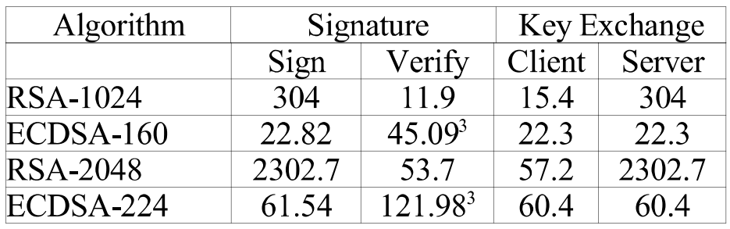
Energy Use of ECC and RSA – Sign/Verify
Experiments performed in [2] show that an typical ECC implementation performs better in terms of power consumption than a similar RSA implementation.
The results show that a sign/verify operation in RSA-2048 takes 2356.4 mJ of energy, where the equivalent ECDSA-224 only takes 183.52 mJ
A key exchange operation for RSA-2048 takes a collective 2359.9 mJ while the equivalent operation in ECDSA-224 takes 120.8 mJ
Adapted from [2]
[2] A. S. Wander, N. Gura, H. Eberle, V. Gupta and S. C. Shantz, "Energy analysis of public-key cryptography for wireless sensor networks," Third IEEE International Conference on Pervasive Computing and Communications, Kauai Island, HI, 2005, pp. 324-328

Slide 8
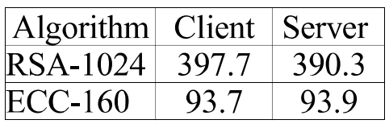
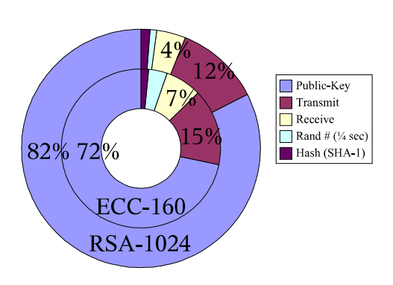
Energy Use of ECC and RSA – Handshake
ECC/RSA handshake operations show similar results
The experiment takes into account the energy used during a handshake operation
The results show that a handshake operation using RSA-1024 results in a total energy consumption of 788.0 mJ where the key generation operation takes ~82% of that energy
Using ECC-160 the total energy consumption was shown to be 187.6 mJ where the key generation operation takes ~72% of that energy
These results show that ECC outperforms RSA in terms of power consumption for common cryptographic operations
It also shows that the bulk of the energy spent in common public key implementations is spent calculating the public key
Taken from [2]
[2] A. S. Wander, N. Gura, H. Eberle, V. Gupta and S. C. Shantz, "Energy analysis of public-key cryptography for wireless sensor networks," Third IEEE International Conference on Pervasive Computing and Communications, Kauai Island, HI, 2005, pp. 324-328

Slide 9
ECC Implementations in WSN’s - TinyECC
TinyECC [3] is a library written for TinyOS, an operating system meant to run on low-power wireless sensor nodes.
The TinyECC library consists of several optimizations meant for constrained environments, such as:
Large Number Optimizations:
Barrett Reduction
Hybrid Multiplication and Squaring
ECC Specific Optimizations:
Projective Coordinate System
Sliding Window for Scalar Multiplication
Shamirs Trick
Curve Specific Optimization
A. Liu and P. Ning, "TinyECC: A Configurable Library for Elliptic Curve Cryptography in Wireless Sensor Networks," 2008 International Conference on Information Processing in Sensor Networks (ipsn 2008), St. Louis, MO, 2008, pp. 245-256.

Slide 10
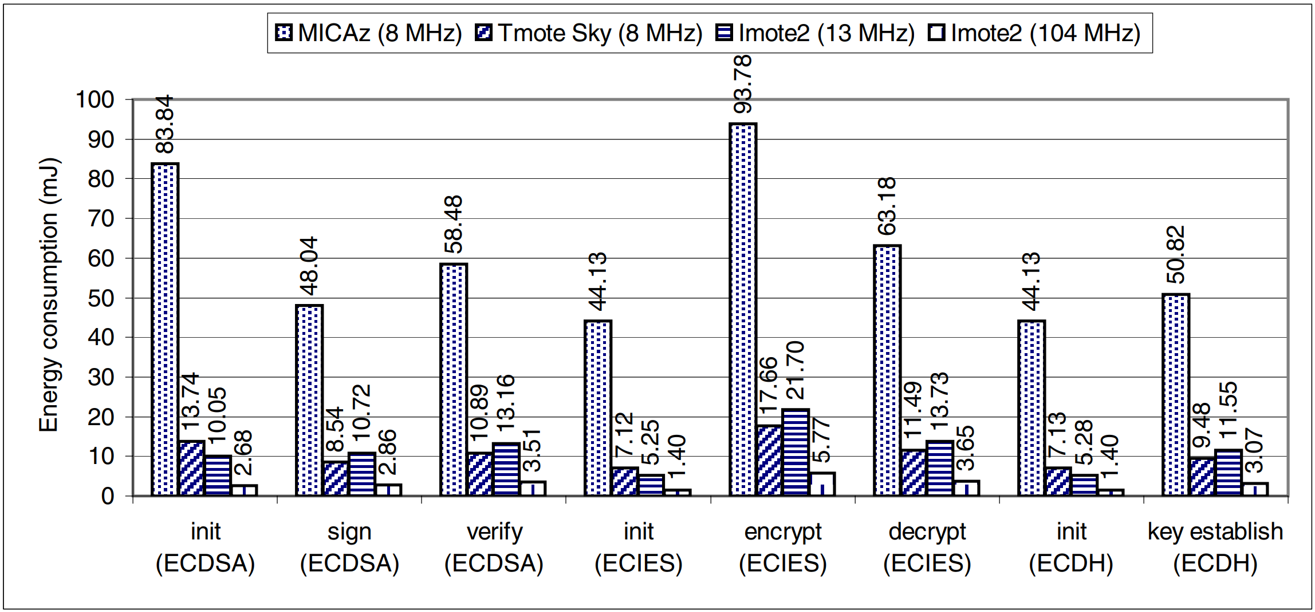
ECC Implementations in WSN’s - TinyECC
The paper [3] also benchmarks the library with the following results:
A. Liu and P. Ning, "TinyECC: A Configurable Library for Elliptic Curve Cryptography in Wireless Sensor Networks," 2008 International Conference on Information Processing in Sensor Networks (ipsn 2008), St. Louis, MO, 2008, pp. 245-256.

Slide 11
ECC Implementations in WSN’s: Routing-Driven ECC Key Management
[4] suggests a routing-driven key management system based on ECC certificates.
The system depends on the existence of many restricted-function devices (L nodes) and a few higher-function devices (H nodes). The H nodes are used as cluster-heads in the network.
During network setup, each node generates a key pair and shares the public key with its cluster head.
Finally, the cluster head generates signed certificates for each node and acts as a Certificate Authority during transmissions.
X. Du, M. Guizani, Y. Xiao and H. Chen, "Transactions papers a routing-driven Elliptic Curve Cryptography based key management scheme for Heterogeneous Sensor Networks," in IEEE Transactions on Wireless Communications, vol. 8, no. 3, pp. 1223-1229, March 2009.

Slide 12
Routing-Driven ECC Key Management
Alternatively, if the network is extremely resource constrained, key-pairs can either be loaded on the cluster head or on each node.
If pairs are loaded on the nodes, each node shares it’s public key with the cluster head
If pairs are loaded on the cluster head, the cluster head distributes private keys to each node on startup.
After the initial sharing stage, the cluster head still creates and signs certificates and acts as a certificate authority for it’s cluster
X. Du, M. Guizani, Y. Xiao and H. Chen, "Transactions papers a routing-driven Elliptic Curve Cryptography based key management scheme for Heterogeneous Sensor Networks," in IEEE Transactions on Wireless Communications, vol. 8, no. 3, pp. 1223-1229, March 2009.

Slide 13
Routing-Driven ECC Key Management
Using this system, if a node fails, other nodes only need to examine their routing table and collect the proper certificates from their cluster head.
If a cluster head fails, the network needs to initiate a setup event with another cluster head to build new clusters
The system can be used with pre-loaded ECC pairs to save energy or can be used with dynamically generated keys.
X. Du, M. Guizani, Y. Xiao and H. Chen, "Transactions papers a routing-driven Elliptic Curve Cryptography based key management scheme for Heterogeneous Sensor Networks," in IEEE Transactions on Wireless Communications, vol. 8, no. 3, pp. 1223-1229, March 2009.

Slide 14
Routing-Driven ECC Key Management
A key advantage of using a Certificate Authority is the ability to revoke certificates
If a node A is compromised and an IDS detects the intrusion, how does the network handle this.
A cluster head can issue a revocation message to each node it sent a certificate for node A
This revocation message indicates to other nodes that they need to invalidate the current certificate they have and request a new one
If the cluster head decides that the node is still compromised, it refuses to issue a certificate.
X. Du, M. Guizani, Y. Xiao and H. Chen, "Transactions papers a routing-driven Elliptic Curve Cryptography based key management scheme for Heterogeneous Sensor Networks," in IEEE Transactions on Wireless Communications, vol. 8, no. 3, pp. 1223-1229, March 2009.

Slide 15
Routing-Driven ECC Key Management
An issue with the key management system is accounting for the keys on the cluster head level.
This can be addressed by expanding the scheme to manage cluster heads in the same way using a tiered system.
This way, a gateway will become the end Certificate Authority, who is responsible for each node in its cluster. Each node is also a cluster head for a smaller cluster of nodes.
This system helps scale the responsibilities so that the same level of security is maintained, but cluster heads in dense networks are not punished with large amounts of traffic
An important hyperparameter for this scheme is node density before splitting clusters. This tunes how many nodes a cluster head is responsible for and how many clusters a network of n-size has. Additional complexity is introduced as clusters c approaches network size n, meaning that eventually this can be abstracted as every node in a network is a cluster head of it’s own.

Slide 16
References
K. Lauter, "The advantages of elliptic curve cryptography for wireless security," in IEEE Wireless Communications, vol. 11, no. 1, pp. 62-67, Feb. 2004.
A. S. Wander, N. Gura, H. Eberle, V. Gupta and S. C. Shantz, "Energy analysis of public-key cryptography for wireless sensor networks," Third IEEE International Conference on Pervasive Computing and Communications, Kauai Island, HI, 2005, pp. 324-328.
A. Liu and P. Ning, "TinyECC: A Configurable Library for Elliptic Curve Cryptography in Wireless Sensor Networks," 2008 International Conference on Information Processing in Sensor Networks (ipsn 2008), St. Louis, MO, 2008, pp. 245-256.
X. Du, M. Guizani, Y. Xiao and H. Chen, "Transactions papers a routing-driven Elliptic Curve Cryptography based key management scheme for Heterogeneous Sensor Networks," in IEEE Transactions on Wireless Communications, vol. 8, no. 3, pp. 1223-1229, March 2009.

