Slide 1
ENEL895AK
Encryption Algorithms
Brant Geddes

Slide 2
Encryption Algorithm
Encryption algorithms are used to authenticate data and keep it confidential
These algorithms are built on cryptographic ciphers
A cipher is a technique used to transform a readable message (called the plaintext) to a hidden message (called the ciphertext) with the help of a key
The plaintext should be recoverable from the ciphertext if the cipher and key are known
Otherwise an attacker should not be able to recover the plaintext

Slide 3
Types of Ciphers
Cryptographic ciphers come in two varieties, Block and Stream
A block cipher requires a key and operates on chunks of data
This cipher takes the key and generates a pseudorandom keystream.
This keystream is used to encrypt each block of data
Some block ciphers encrypt each block evenly, while others use feedback to encrypt each block differently depending on previous input
Some examples are DES, AES, or Blowfish
A stream cipher requires a key and operates on a stream of data
This cipher takes a key and generates a pseudorandom keystream
The cipher encrypts as the stream is generated, meaning that the encryption can be started before the algorithm has the end of the message
Some examples are substitution ciphers or XOR ciphers

Slide 4
Encryption Primitives
Block ciphers can be used to build any type of encryption primitive needed, such as:
Stream ciphers (by setting the block size to the size of the stream symbol)
Hash functions
Hybrid ciphers
Block ciphers are used in this way to make testing and security analysis easier. This way the block can be tested once then re-used in many applications with the knowledge that the underlying algorithm is secure

Slide 5
Mode of Operation
Block ciphers alone are only able to encrypt a single block
Modes of Operation provide instructions on how to use block ciphers to perform more advanced work, such as encrypting multiple blocks or encrypting a stream [1]
Modes specify things such as the Initialization Vector, Padding, and procedure
Some examples are: [1]
(ECB) Electronic Codebook
(CBC) Cipher Block Chaining
(CFB) Cipher Feedback
(OFB) Output Feedback
(CTR) Counter
[1] - Y. W. Law, J. Doumen and P. Hartel, "Benchmarking block ciphers for wireless sensor networks," 2004 IEEE International Conference on Mobile Ad-hoc and Sensor Systems (IEEE Cat. No.04EX975), Fort Lauderdale, FL, USA, 2004, pp. 447-456.

Slide 6
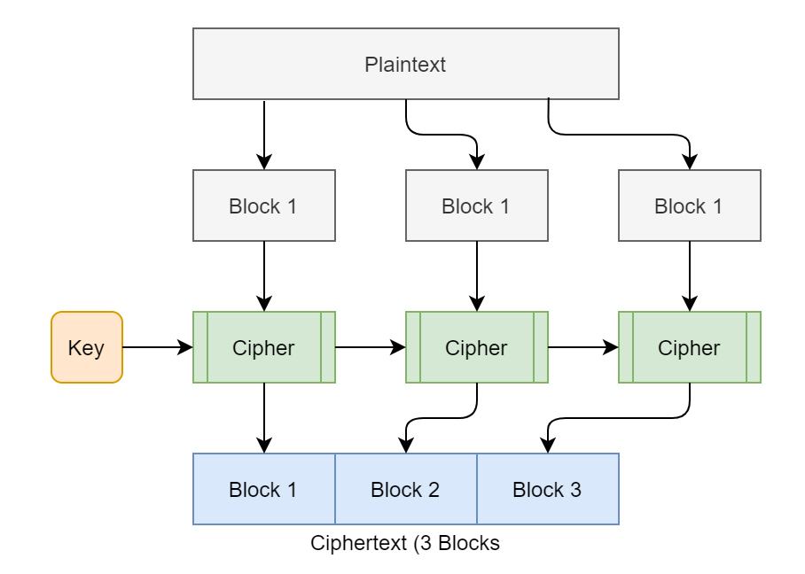
Examples of Modes - ECB
Adapted from: https://en.wikipedia.org/wiki/Block_cipher_mode_of_operation#Electronic_Codebook_(ECB)

Slide 7
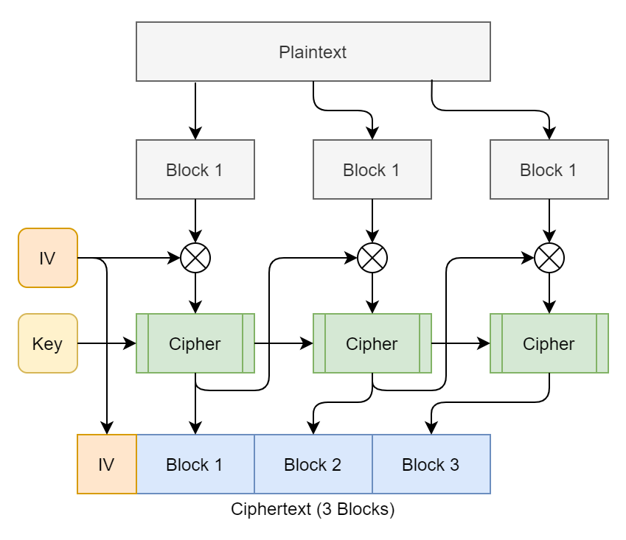
Examples of Modes - CBC
Adapted from: https://en.wikipedia.org/wiki/Block_cipher_mode_of_operation#Electronic_Codebook_(ECB)

Slide 8
Types of Block Ciphers
DES - Data Encryption Standard
The Data Encryption Standard is an algorithm with 64-bit block size and a key size of 56 bits [2]
It was found to be insecure due to the small key size, and it is no longer listed as a standard
AES - Advanced Encryption Standard
The Advanced Encryption Standard is a block cipher with a 128-bit block size and a key size of either 128-bit, 192-bit, or 256-bit [2]
Blowfish
Blowfish has a 64-bit block size and a variable key size of 32-bit up to 448-bit [2]
[2] - S. Surendran, A. Nassef and B. D. Beheshti, "A survey of cryptographic algorithms for IoT devices," 2018 IEEE Long Island Systems, Applications and Technology Conference (LISAT), Farmingdale, NY, 2018, pp. 1-8

Slide 9
Cryptanalysis
Cryptanalysis is the field of study related to the security of encryption algorithms and techniques used to break them
This is mostly concerned with how an attacker may acquire the plaintext or key and how easily it can be accomplished
If a vulnerability is found, methods to fix the problem or prevent an attack are also a concern
There are several methods used to perform cryptanalysis, but generally the researcher needs knowledge of either the algorithm in use or the system performing the encryption
Some forms require physical access to the system performing the encryption as well

Slide 10

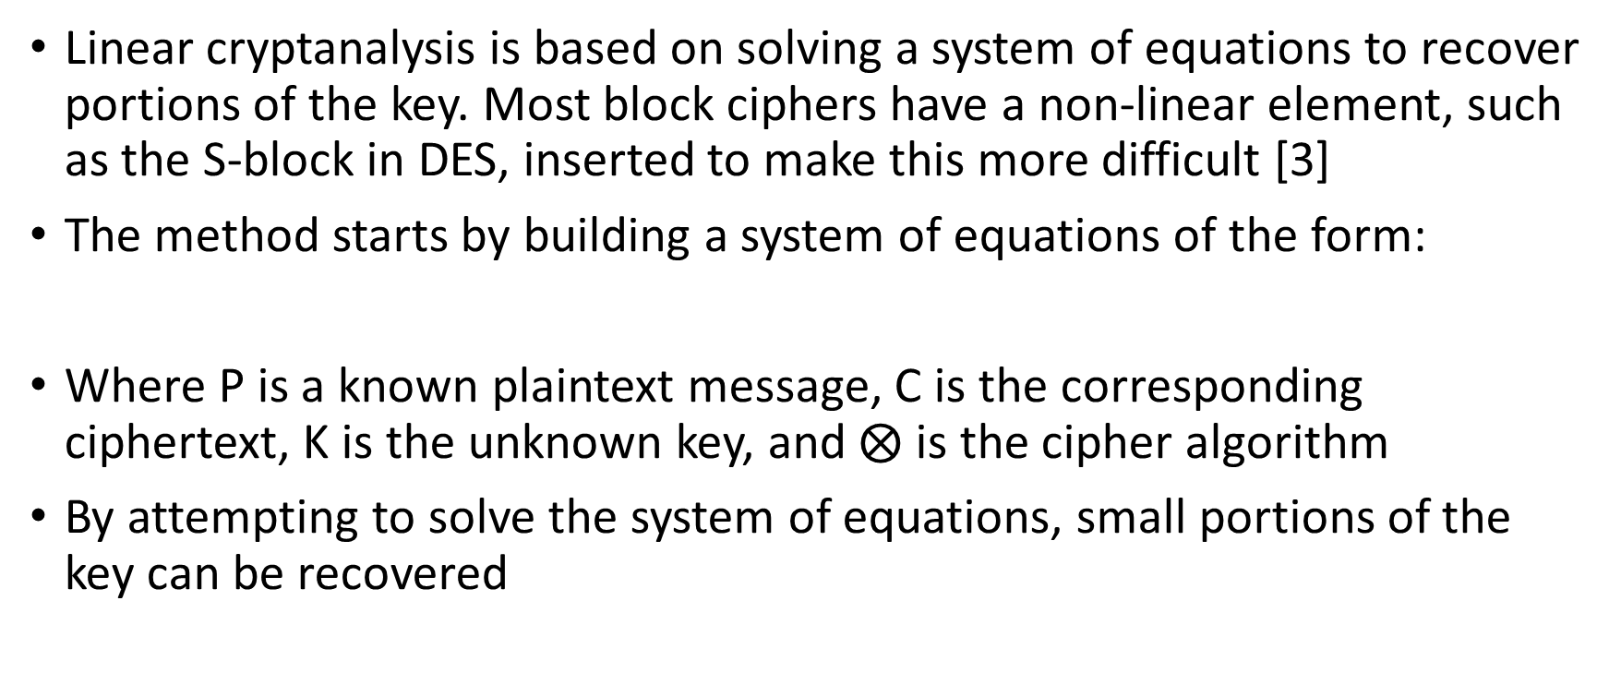
Linear Cryptanalysis
Linear cryptanalysis is based on solving a system of equations to recover portions of the key. Most block ciphers have a non-linear element, such as the S-block in DES, inserted to make this more difficult [3]
The method starts by building a system of equations of the form:
Where P is a known plaintext message, C is the corresponding ciphertext, K is the unknown key, and $⨂$ is the cipher algorithm
By attempting to solve the system of equations, small portions of the key can be recovered
[3] - R. C. -. Phan and M. U. Siddiqi, "A Framework for Describing Block Cipher Cryptanalysis," in IEEE Transactions on Computers, vol. 55, no. 11, pp. 1402-1409, Nov. 2006

Slide 11
Differential Cryptanalysis
Differential Cryptanalysis looks for patterns and attempts to recover the plaintext from those patterns
Differential Cryptanalysis can analyze patterns across different blocks of the same block cipher operation to recover the plaintext or key
It can also analyze the output of different cipher operations to recover the key
For these reasons it is important to initialize each block in a cipher with a separate initialization vector, and to never use the same vector and key to encrypt two messages [3]
For a cipher to be secure, a block encrypted twice with the same key should use different initialization vectors and yield different ciphertext
In most cases, the initialization vector can be public without affecting the cipher security
[3] - R. C. -. Phan and M. U. Siddiqi, "A Framework for Describing Block Cipher Cryptanalysis," in IEEE Transactions on Computers, vol. 55, no. 11, pp. 1402-1409, Nov. 2006

Slide 12
Side-Channel Attacks
Side-Channel attacks are a special form of differential cryptanalysis
Side-Channel attacks generally require access to the physical system
The attacks analyze patterns in the underlying system to recover the plaintext message
Variables open to attack are:
Power consumption
Encryption time
Fault Analysis
Sound
For this reason, it is important that a cipher be optimized to always consume the same power and take the same time, even if it means a slower, less efficient algorithm [4]
[4] - M. Kar, A. Singh, S. Mathew, A. Rajan, V. De and S. Mukhopadhyay, "Invited paper: Low power requirements and side-channel protection of encryption engines: Challenges and opportunities," 2017 IEEE/ACM International Symposium on Low Power Electronics and Design (ISLPED), Taipei, 2017, pp. 1-2.

Slide 13
References
Y. W. Law, J. Doumen and P. Hartel, "Benchmarking block ciphers for wireless sensor networks," 2004 IEEE International Conference on Mobile Ad-hoc and Sensor Systems (IEEE Cat. No.04EX975), Fort Lauderdale, FL, USA, 2004, pp. 447-456.
S. Surendran, A. Nassef and B. D. Beheshti, "A survey of cryptographic algorithms for IoT devices," 2018 IEEE Long Island Systems, Applications and Technology Conference (LISAT), Farmingdale, NY, 2018, pp. 1-8.
R. C. -. Phan and M. U. Siddiqi, "A Framework for Describing Block Cipher Cryptanalysis," in IEEE Transactions on Computers, vol. 55, no. 11, pp. 1402-1409, Nov. 2006.
M. Kar, A. Singh, S. Mathew, A. Rajan, V. De and S. Mukhopadhyay, "Invited paper: Low power requirements and side-channel protection of encryption engines: Challenges and opportunities," 2017 IEEE/ACM International Symposium on Low Power Electronics and Design (ISLPED), Taipei, 2017, pp. 1-2.

