Slide 1
ENEL 895AK
Key Exchange Methods
Brant Geddes

Slide 2
Overview of Algorithms
Key exchange algorithms are required to efficiently and securely share an encryption key between two nodes
It is important that an eavesdropper between the two nodes cannot derive the key by listening to the transmissions
It is also important that the algorithms do not supply too much overhead to transmissions
Some common key-sharing algorithms are:
Diffie-Hellman
Elliptic-Curve Diffie-Hellman
RSA Encryption Key Sharing

Slide 3
Static and Ephemeral Algorithms
Key exchange algorithms can either be static or ephemeral
A static algorithm is used to setup a long-term secret key
This key is stored by both hosts and used to communicate over multiple messages
An ephemeral algorithm is used to setup a single use secret key
This key is used for a single message and is re-generated each time a message needs to be sent
An ephemeral algorithm requires more computation but provides forward-secrecy
Forward-secrecy is a property of an algorithm that states that if an old key is found by an adversary it won’t compromise future messages

Slide 4
Diffie-Hellman Algorithm
Used to derive a shared secret using a common base and modulus and two separate private secrets
Modulus p should be prime
Base g should be a primitive prime of p
A primitive prime is a value such that g^{x} (mod p) is different for all x in range [0, p – 2]
Secrets a and b should be kept private and are used to derive mixed secrets A and B which are public
Mixed secrets A and B are used to derive private shared secret s

Slide 5
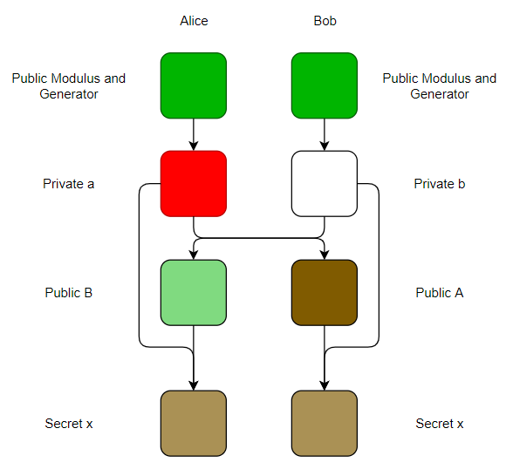
Diffie-Hellman Intuition
Both nodes start with a common paint, which is a mixture of:
The public modulus
The public generator
In ECDH, a public elliptic curve
They also start with a private paint
The common paint and private paint are mixed to form the public paint
This is done using discrete exponentiation in DH or discrete point multiplication in ECDH
The public paint is mixed with the private paint to form a secret shared paint between the nodes
The algorithm depends on the fact that splitting the public paint into the private paint and common paint is computationally expensive
Adapted From [1]

Slide 6
Diffie-Hellman Example
Alice and Bob are communicating, and Doug is eavesdropping
Alice and Bob use a modulus of 89 and a base of 13
p = 89, g = 13
Alice decides on a secret of 10
a = 4
Bob decides on a secret of 7
B = 6
Alice computes A and transmits to Bob:
A = gª (mod p) = 81
Bob computes B and transmits to Alice
B = g^{b} (mod p) = 72
Alice and Bob compute s:
s = Bª (mod p) = 39
s = A^{b} (mod p) = 39
Doug does not have a or b and cannot derive s

Slide 7
Elliptic-Curve Diffie-Hellman (ECDH)
Elliptic Curve Diffie-Helman works in the same way as Diffie-Hellman, except it is built on the problem of discrete logarithms on elliptic curves rather than on finite fields
The problem of discrete logarithms on elliptic curves is hard and no known algorithm exists to quickly factor [2]
Curve selection is important as it is possible to reduce certain curves to a finite-field, which makes factoring algorithms used to break RSA keys possible [3]
It requires a public modulus p, public generator point g, and two secret points a and b
The algorithm requires that a and b be kept secret, and mixed with p and g to form A and B, which are the public keys
Public keys A and B are used to derive x, which is the shared secret between the two hosts.

Slide 8
RSA Key Exchange
Rivest-Shamir-Adleman (RSA) algorithm can be used as a way to share a private key between hosts
This method requires that both hosts generate an RSA key pair, and one host generates a shared secret to be used by both hosts.
The public keys are published, and used to encrypt and transmit the shared key
This method allows the shared key to be transmitted over a public medium but still allows the two hosts to use a less computationally expensive symmetric key for future encryption

Slide 9
RSA Key Exchange Example
Alice and Bob generate RSA key pairs (A, a) and (B, b) and publish the public keys
Bob wants to communicate with Alice, so he generates a shared private key s and encrypts it with Alice’s public key A
Alice receives the encrypted shared key and decrypts it with her private key a. Alice replies to Bob with an acknowledgement showing she received the secret key. Now Alice and Bob have a shared secret to use with a symmetric encryption algorithm

Slide 10
Shamir’s Three Pass Protocol
This is an alternative to key exchange, and relies on having an encryption algorithm that is commutive
If m is a message, m* is an encrypted message, A and B are encryption algorithms, and AA* = I, a commutive algorithm is defined as:
m* = ABm then m = A*B*m* = B*A*m*
Shamir’s algorithm encrypts the message twice, transmits it three times, and decrypts it twice to successfully transmit a message across a public medium without exposing it to an eavesdropper and without first sharing encryption keys
This algorithm can be used to directly send a message or to share a private key between two nodes before the message is sent

Slide 11
Shamir’s Algorithm Example
Alice and Bob each have a private encryption key, a and b
Alice wants to transmit to Bob, so she encrypts message m with her key a to create m*_{a} (m*_{a} = Am)
Bob receives m*_{a} but cannot decrypt it without Alice’s key. He instead encrypts it with his key b to create m*_{ab} and returns it to Alice (m*_{ab} = Bm*_{a})
Alice decrypts the message with a to form m*_{b} and returns it to Bob (m*_{b} = A*m*_{ab})
Bob finally decrypts the message with b to form m (m = B*m*_{b})
Both nodes have communicated a private encrypted message across a public medium without sharing an encryption key

Slide 12
Comparison - Efficiency
The smaller key size required in the ECDH algorithm corresponds to less time encrypting, less space for storage, and less bandwidth for transmission compared to the finite-field based algorithms
Shamir’s Three Pass Protocol is very inefficient when used to transmit a message between hosts because the whole message needs to be transmitted three times. The protocol can be made more efficient by using it to transmit a shared key, then encrypting and transmitting the message only once

Slide 13
Comparison - Security
The algorithms are all based on a discrete logarithm problem
RSA, DH, and the Three Pass Protocol are based on solving the discrete logarithm over a finite field
ECDH is based on solving the discrete logarithm over an elliptic curve
The problem of finding a discrete logarithm over a finite-field is easy thanks to several factoring algorithms [4] such as:
Number Field Sieve
Quadratic Sieve
Shor’s Algorithm [5]
The problem of finding a discrete logarithm over an elliptic curve is hard given that the curve is chosen correctly. Otherwise it can break down to the problem of factoring over a finite-field [3]
For this reason, a properly setup ECDH algorithm is able to have a smaller key size for the same level of security as an algorithm based on finite-fields

Slide 14
References
A.J. Han Vinck, “Introduction to public key cryptography”, pg. 16, retrieved from https://www.uni-due.de/imperia/md/images/dc/crypto_chapter_5_public_key.pdf, May 12 2012
A. Cilardo, L. Coppolino, N. Mazzocca and L. Romano, "Elliptic Curve Cryptography Engineering," in Proceedings of the IEEE, vol. 94, no. 2, pp. 395-406, Feb. 2006. doi: 10.1109/JPROC.2005.862438
A. J. Menezes, T. Okamoto and S. A. Vanstone, "Reducing elliptic curve logarithms to logarithms in a finite field," in IEEE Transactions on Information Theory, vol. 39, no. 5, pp. 1639-1646, Sept. 1993. doi: 10.1109/18.259647
Eric Bach. 1984. Discrete Logarithms and Factoring. Technical Report. University of California at Berkeley, USA
Jozsa, R. “Quantum Factoring, Discrete Logarithms, and the Hidden Subgroup Problem.” Computing in Science & Engineering 3.2 (2001): 34–43

