Slide 1
Applying Dimensionality Reduction and Deep Learning to Network Intrusion Detection
Presented By:
Brant Geddes

Slide 2
Network Intrusion Detection
Types of attacks
Denial of Service, Scan & Enumeration, Remote Access, Privilege Escalation
Early Warning: Intrusion detection system
Existing solutions
Signature Detection
Programmed to detect certain attack signatures
Fails at detecting new types of attacks
Anomaly Detection
Baselines normal operation and flags any abnormal operation as an attack
Susceptible to false positives as normal operation shift
Both methods built as expert systems, not data driven
Data-driven approaches such as Deep Learning are becoming more common

Slide 3
Dataset: NSL-KDD
The dataset contains ~150,000 records
The data is made up of 41 features, such as:
Protocol: tcp, udp, icmp
Service: http, telnet, ssh…
Duration
Packet information
It also contains two labels:
Type is a label of the type of attack detected
Score is a label of how severe the attack was

Slide 4
Dataset: Description
Class Representation:
Very low U2R representation caused network to ignore those records
This gave a 0% classification score for that record
Oversampling allowed network to see U2R more often
Oversampled U2R records in the training set by a factor of 10

Slide 5
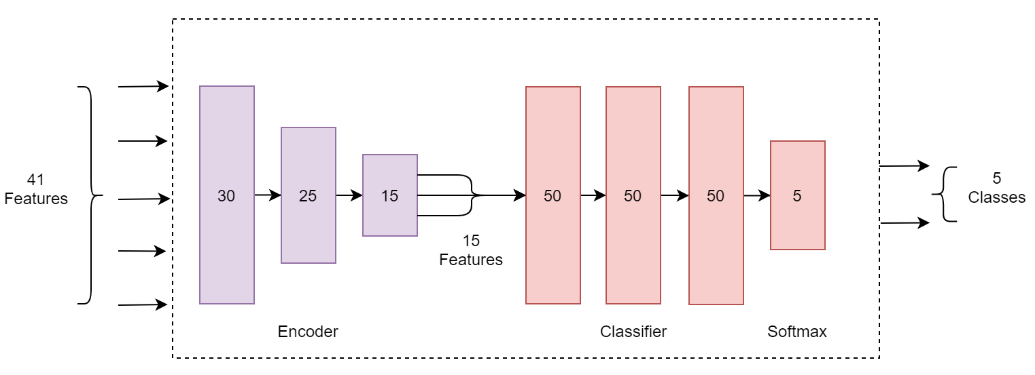
Network Architecture

Slide 6
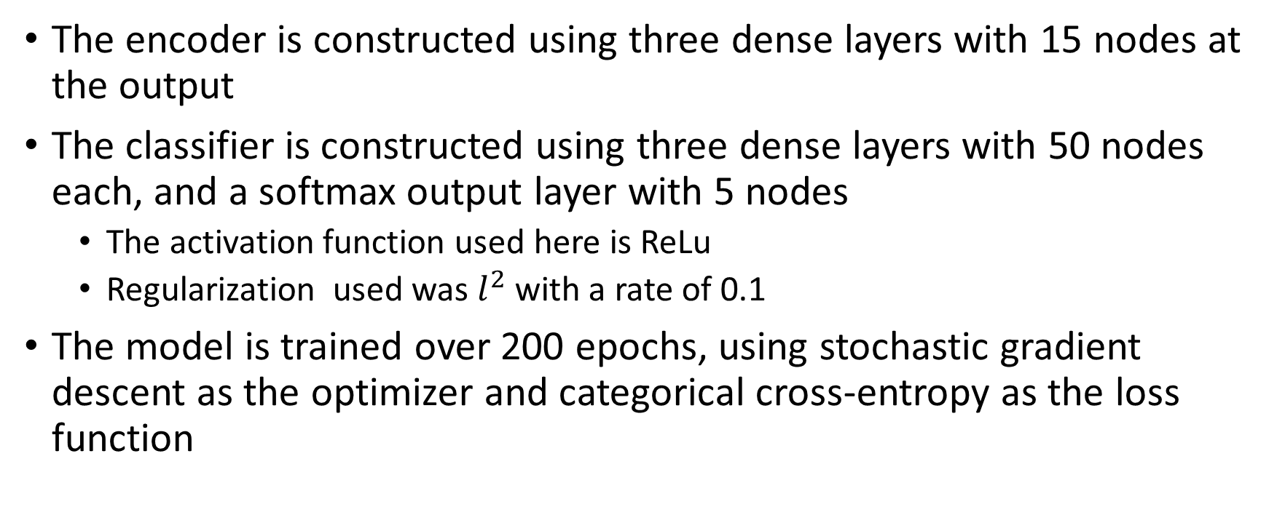
Network Design
The encoder is constructed using three dense layers with 15 nodes at the output
The classifier is constructed using three dense layers with 50 nodes each, and a softmax output layer with 5 nodes
The activation function used here is ReLu
Regularization used was $l^{2}$ with a rate of 0.1
The model is trained over 200 epochs, using stochastic gradient descent as the optimizer and categorical cross-entropy as the loss function

Slide 7
Implementation
Experiments were performed using Tensorflow and Keras in Python
Other resources used were:
Pandas for data storage and manipulation
Numpy for data manipulation
Sklearn for data manipulation and model evaluation
Matplotlib for model visualization and evaluation
Results were stored in the following formats:
Plot of accuracy and loss against epochs
CSV of metrics including accuracy, precision, recall, and f1-score

Slide 8
Code

Slide 9
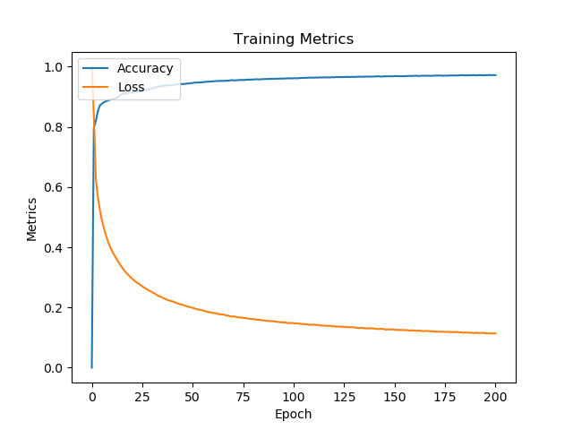
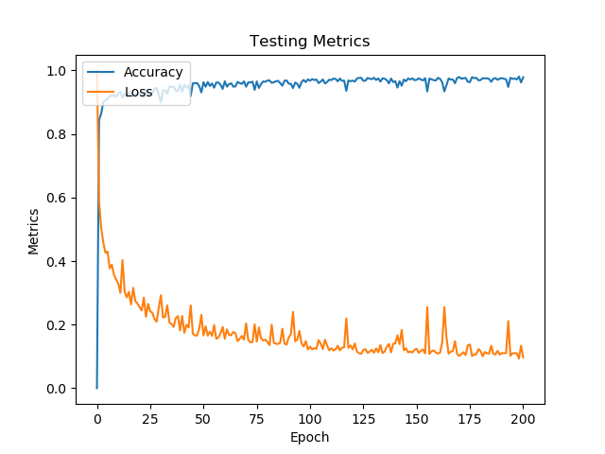
Results – Training and Validation

Slide 10
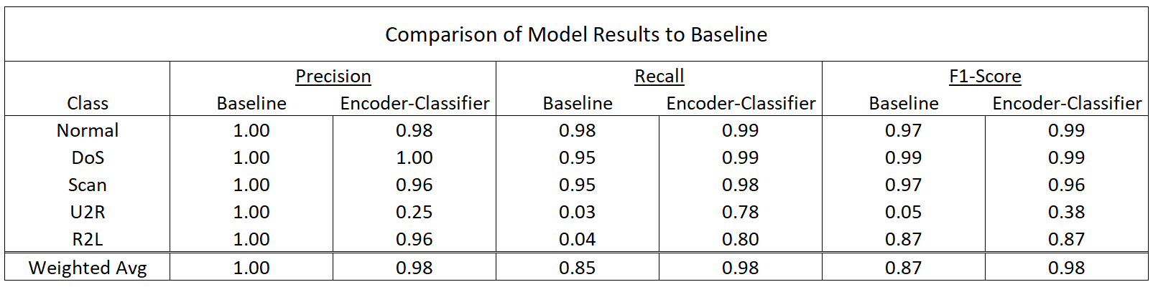
Results - Comparison
Baseline model^{[1]} performed better in terms of precision
Encoder-Classifier model performed better in terms of recall and overall score
Encoder-Classifier has an overall score of 98%
Random Forest Algorithm as an overall score of 87%
N. Shone, T. N. Ngoc, V. D. Phai and Q. Shi, "A Deep Learning Approach to Network Intrusion Detection," in IEEE Transactions on Emerging Topics in Computational Intelligence, vol. 2, no. 1, pp. 41-50, Feb. 2018

Slide 11
References
N. Shone, T. N. Ngoc, V. D. Phai and Q. Shi, "A Deep Learning Approach to Network Intrusion Detection," in IEEE Transactions on Emerging Topics in Computational Intelligence, vol. 2, no. 1, pp. 41-50, Feb. 2018

