Slide 1





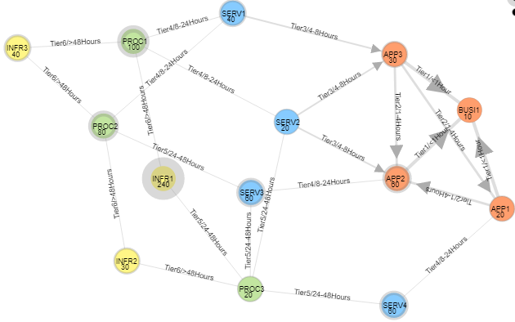
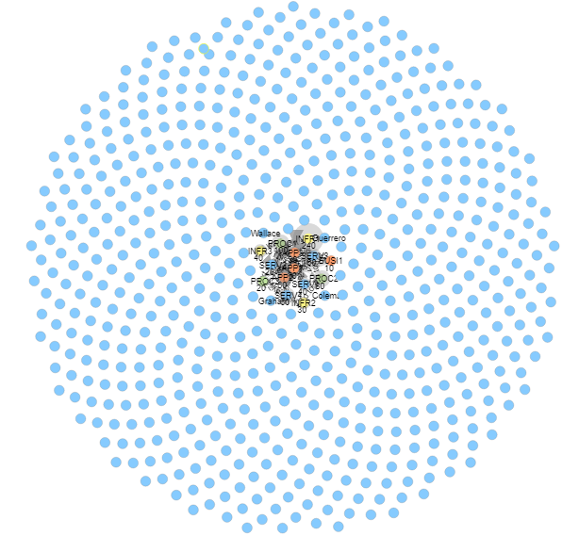
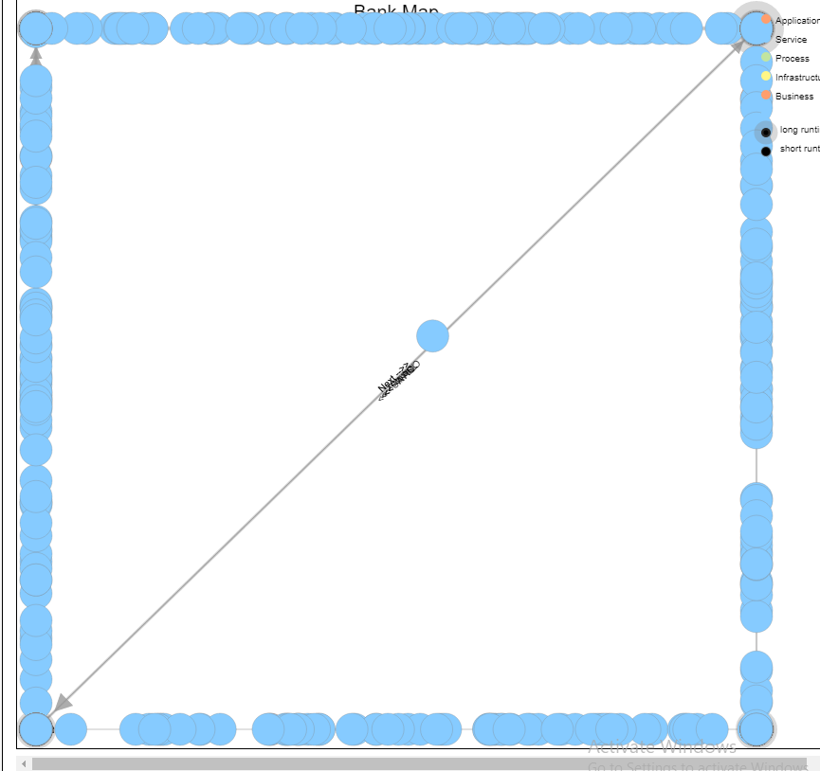
320
Visualizing the Behavior of a Complex System
Team members: Brian Zhang, Saurav Chatterjee, Zachary Stephens | Faculty adviser: John Leonard | Sponsor: Bank of America | Mentor: Michael Karafotis
The System Complexity
This system consists of five technological layers:
Business – A holistic representation of all components which act together to achieve a set of similar goals.
Service – A service abstractly represents a literal service that is provided to customers
Application – An application acts as an interface which can be interacted with externally or internally in order to provide some service(s).
Process – A process functions as a programmatic connection between a given input and a given output.
Infrastructure – Infrastructure represents the physical hardware on which all of this technology must run.
The complexity comes from the connections between and within these layers. While each layer in this system is designed to directly contribute to the layer above it, there is communication going in both an upward and downward direction. As such, we consider the data linage to be one-directional but a system failure propagates bidirectional consequences.
Furthering the complexity, the application layer can be abstracted away from the other layers to have a myriad of interconnections internal to the layer. As a result, it becomes incredibly difficult to visualize both the holistic 5-layer behavior and the internal application layer behavior concurrently.
Our biggest design choices derived from a need to be flexible enough to accommodate both subsections of the system.
The Behavior
We considered many different behavioral metrics when designing our visualization, focusing primarily on which Key Performance Indicators (KPI) would be most beneficial in our use cases. The constants between our iterations are that each node in the system should reflect a KPI inherently and that each connection between nodes should reflect a KPI.
Some KPIs we considered include:
Profit/Cost for each node and how those values contribute downstream
Active/Inactive nodes, and how those influence accessibility of services
Inactive downtime, and how long it takes for nodes to propagate consequences
Initially, we wanted to be able to reflect all three of these (and possibly others) concurrently, but as we explored the depth of the complexity, it became clear that these KPIs would need to be displayed in mutually exclusive visualizations in order to minimize overcrowding in the visual representation.
Here we can see how overcrowded a system of 14 nodes gets when showing all of these KPIs at once. Edges overlap with nodes and edges, names are cut to be fewer than four characters, and values are visually concealed in the crowding.
The Visualization
We looked at the broad scope of D3 JavaScript libraries and the Force-Directed Diagram was most reflective of the dataset provided, though we also considered the Sankey model as an alternative that would be viable for other types of data in this same system.
Per the previous diagram, you can see the 14 nodes spanning various layers and featuring information like name, connection type, an arbitrary value, and neighboring connections/connection strength. The caveat of the actual system is that it spans a set of many hundreds of nodes and connections instead of a mere fourteen. As we expanded our dataset, we found the following anomalies were quite common.
The circle anomaly occurs when there is too much data for the browser to load all the movement effectively. We’ve removed a few hundred links to provide this visual. The center of the cluster shows nodes and connections naturally, without any removals.
The rectangle anomaly occurs when there are so many nodes that all of the nodes are forced out towards the edge. Reducing the force between nodes does not stop this problem, it only postpones it.
The Use Cases
We applied a few different perspectives to the tool, spanning from technician to application manager, to CEO. We wanted to make sure this tool could be used at many levels so that accessibility would be nearly universal.
For our technician use cases, we assumed a user was experiencing a problem and needed to contact the nodes upstream or downstream to solve a problem. When you click on a node, it highlights these neighbors with different colors so you can quickly select out the neighbors and view their information.
For our application manager use cases, we put more focus on things going correctly but needing to be optimized. Through our visualization, you can quickly view which components of the system carry the greater burdens and which ones are less useful. This allows an application manager to diversify their understanding of their systems and make adjustments as needed.
For our CEO use cases, we wanted to ensure that the system never got too visually complicated to understand at a glance. This became our greatest struggle in the end, as this model does not effectively scale up with larger systems. To counter this problem, we developed a dashboard in which key highlights would be accessible from the data without ever needing to go into the model. In this way, A higher up can see the highlights without all the miscellaneous information.

