Slide 1

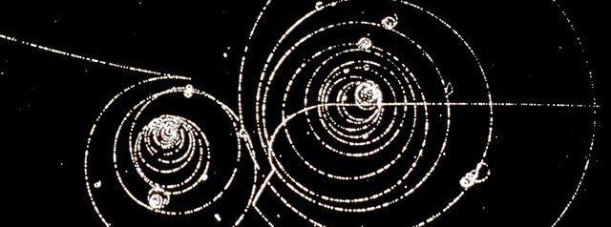


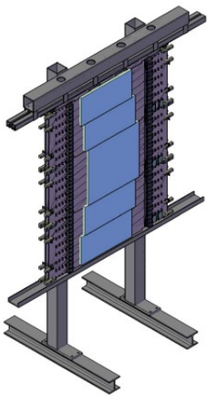
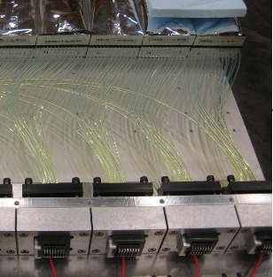
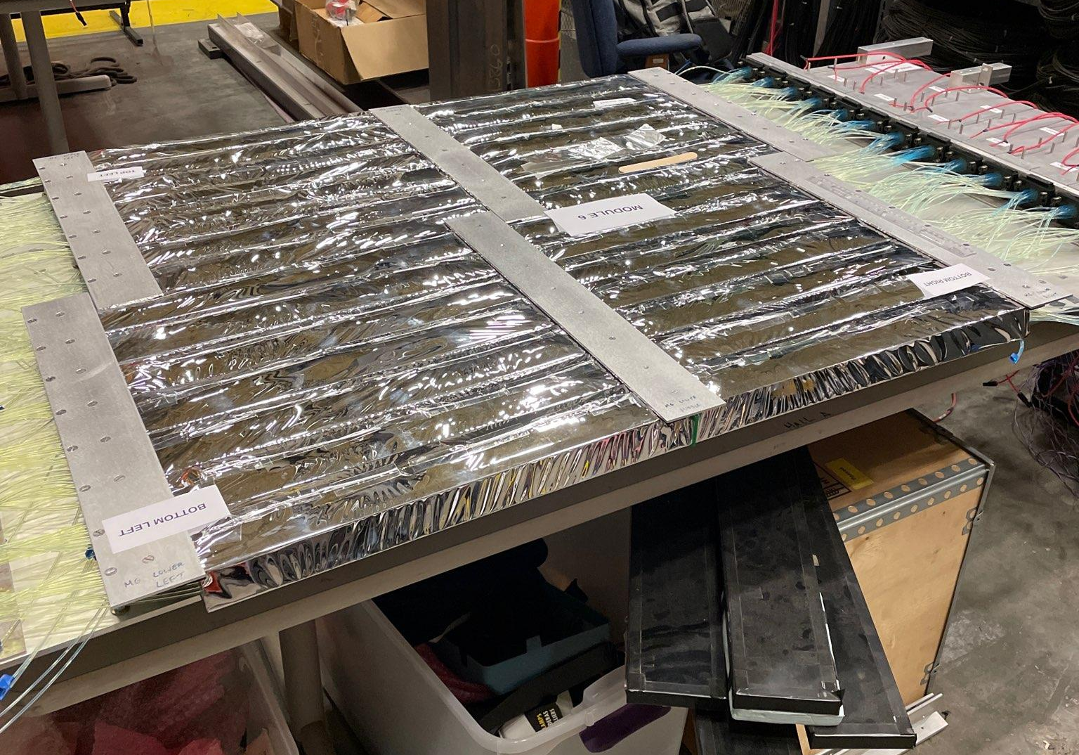
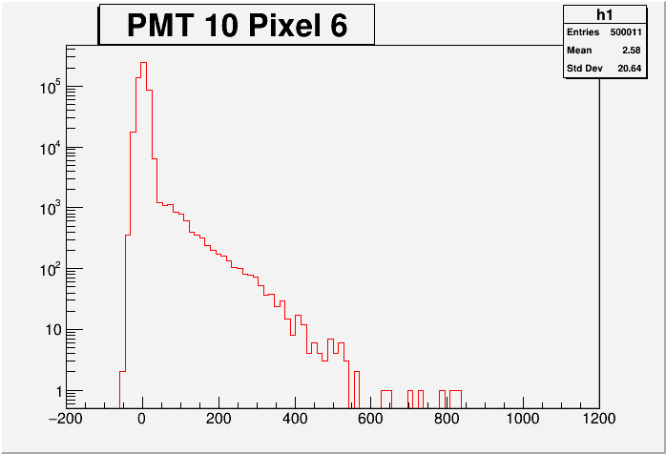
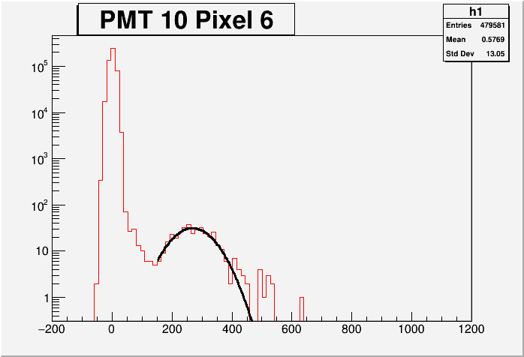
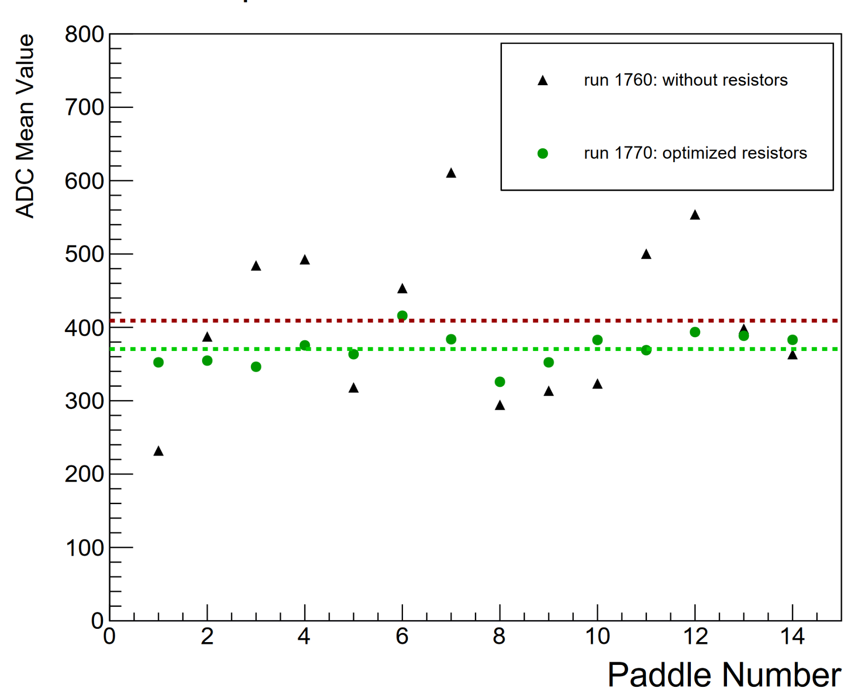
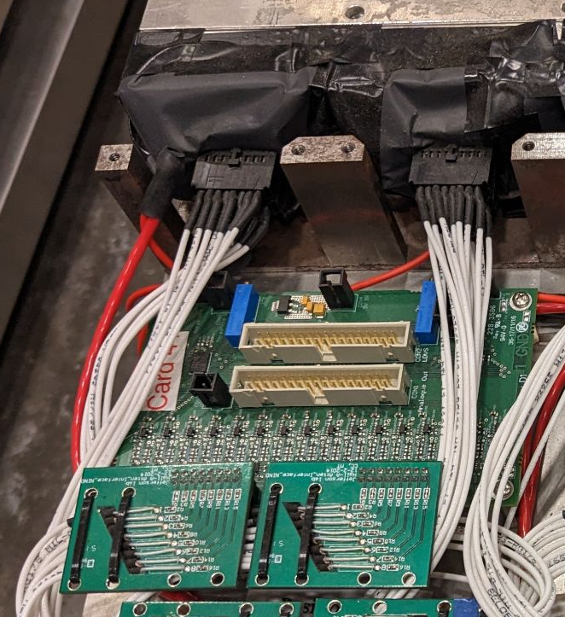
The Coordinate Detector (CDet)
Michael Lowry, Angelo Rosso, Dr. Peter Monaghan
Christopher Newport University
What is CDet?
Module Commissioning Steps
Progress
A plastic scintillator hodoscope that will provide supplemental charged particle tracking data for SBS experiments. In the GEp-5 experiment, it will stand in front of the ECAL in the electron arm.
Charge Normalization
Each module needs to be commissioned using cosmics (left). Charge normalization ensures pixels of each PMT give similar ADC charge response. Crosstalk reduction minimizes parasitic signals between pixels by dropping short TDC events. Determine TDC threshold by fitting a line to known bad TDC events and cutting events close to that line. Efficiency analysis plots # events kept over # total events vs voltage to find appropriate voltage level for PMT’s. Current work is on commissioning final module of the detector, module #6.
Normalize photoelectron response of pixels in each PMT
CDet Design
Crosstalk Reduction
Six modules form two layers of scintillator paddles angled towards target. Each module consists of (A) 28 bars split into left and right sides by central mirrors. Each bar is made of 14 scintillating paddles. Mirrors are staggered to match acceptance from target. Bars are connected by (B) 14 optical fibers each to (C) 28 PMT’s with 16 pixels each. 2 anodes unused for each bar → 2352 channels. PMT’s are connected to (D) NINO cards via (E) resistor cards.
Remove events caused by light bleed between pixels
My Work
Efficiency
Analysis
Working with the charge normalization of module #6: “Cut” ADC of each pixel with ADC of neighboring pixels - reject events that are not present in lower range of channels in both pixels. This isolates events unique to that pixel and reveals the ADC peak (mean). Tune resistors such that peak in all pixels of a PMT are around the same channel number.
Choose PMT voltage with best efficiency
B
ADC Before Cut
C
A
ADC After Cut
Comparison of Pixel Means after Adjusting Resistors
D
NINO cards act as discriminators and amplifiers for PMT signals
Acknowledgements
E
Resistor cards used to normalize pixel signals
This work is supported by NSF Award PHY-2209995. My thanks to Dr. Monaghan and Angelo Rosso for their help in preparing this poster.

