Slide 1



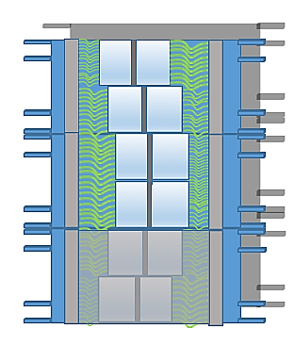
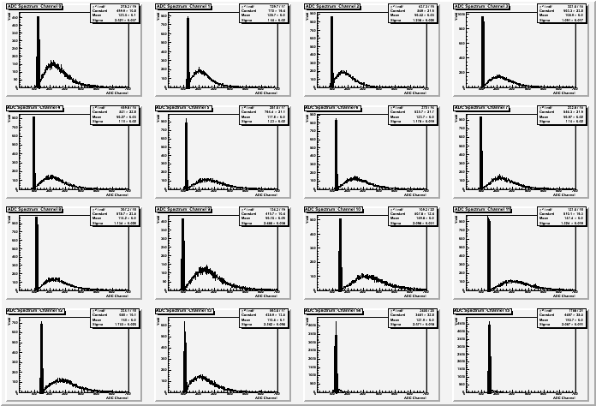
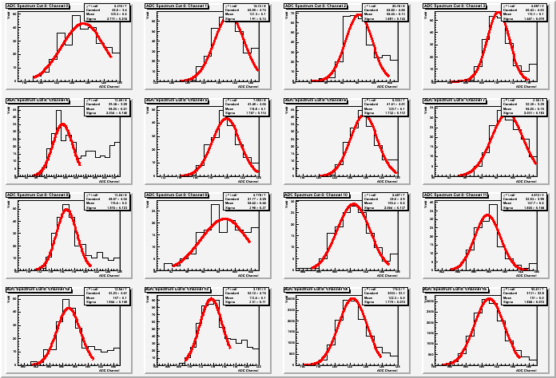
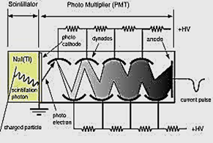

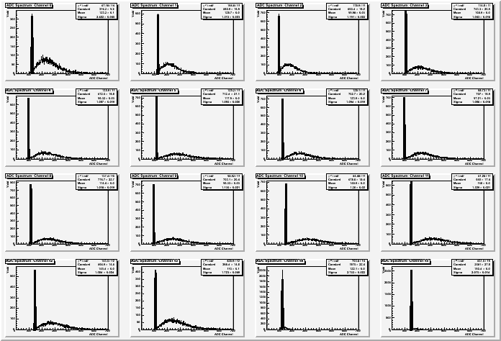
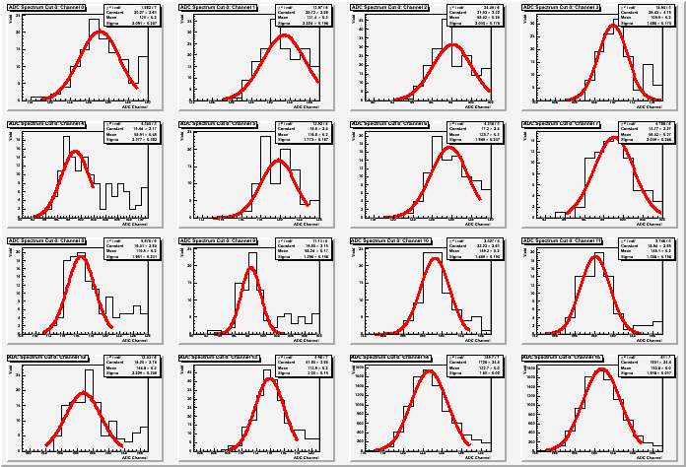
Ralph Marinaro
Supervisors: Dr. Peter Monaghan, Dr. Bogdan Wojtekhowski
Photomultiplier Tubes & Photoelectric Effect:
The multi-anode PMTs utilize properties of the photoelectric effect by taking in light from cosmic ray events and amplifying these events into a
tightness during
testing reduces the potential of interference with the signals.
Scintillating Bars:
The bars are made by attaching fourteen individual paddles together and each bar has different edge angles depending on where the bar is positioned in the detector relative to the target. When a cosmic ray hits the material a shower of photons is created which is then picked up by the optical fibers.
Cosmic Ray Tests Results:
The data from each run of the individual test bars was analyzed and used to calculate the average number of photoelectrons in each event for each scintillating paddle. The average number of photoelectrons for each paddle were then averaged together to get an average number for the whole test bar.
HV
HV
HV
scintillating bars
reflecting mirrors
signal. The sixteen pixels allow for testing of multiple fibers at once. In this case, only fourteen are used. Light
Test Box
Scintillating Bar
Trigger System
front side
back side
13
14
15
16
16
* * * * * * * *
* * * * * * * *
9
9
11
12
10
* * * * * * * *
* * * * * * * *
5
6
7
8
8
1
counter
amplifier
1
2
3
4
translator
discriminator
MVME
QDC
delays
console
optical fibers
photomultiplier tubes
14 scintillating paddles
Data Acquisition System (DAQ):
The system is set up with the test bar in a light tight test box with trigger paddles above and below the test bar. The fibers are against a mirror on one side and the PMT on the other.
The signals from the PMT are run through a series of different units that filter out the unwanted events and converts the signals into usable data files.
Coordinate Detector:
The detector is part of the larger Super BigBite Spectrometer collaboration for Experimental Hall A. The same bars from the individual cosmic ray tests are now stacked to cover a larger area of particles coming out of the target. Signals from certain scintillating paddles show positions of particles as they pass through the detector.
particles from target
14 optical fibers

