Slide 1


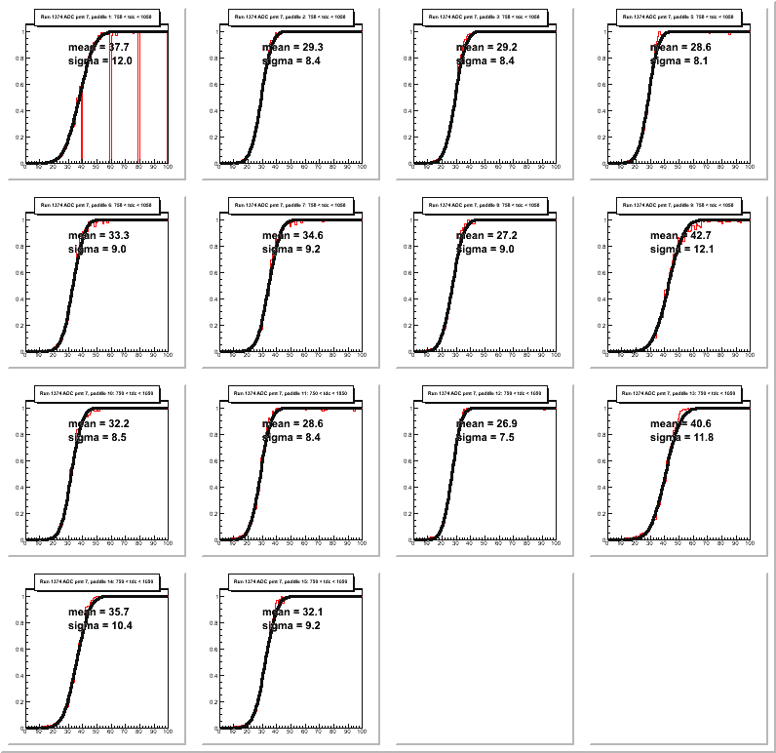
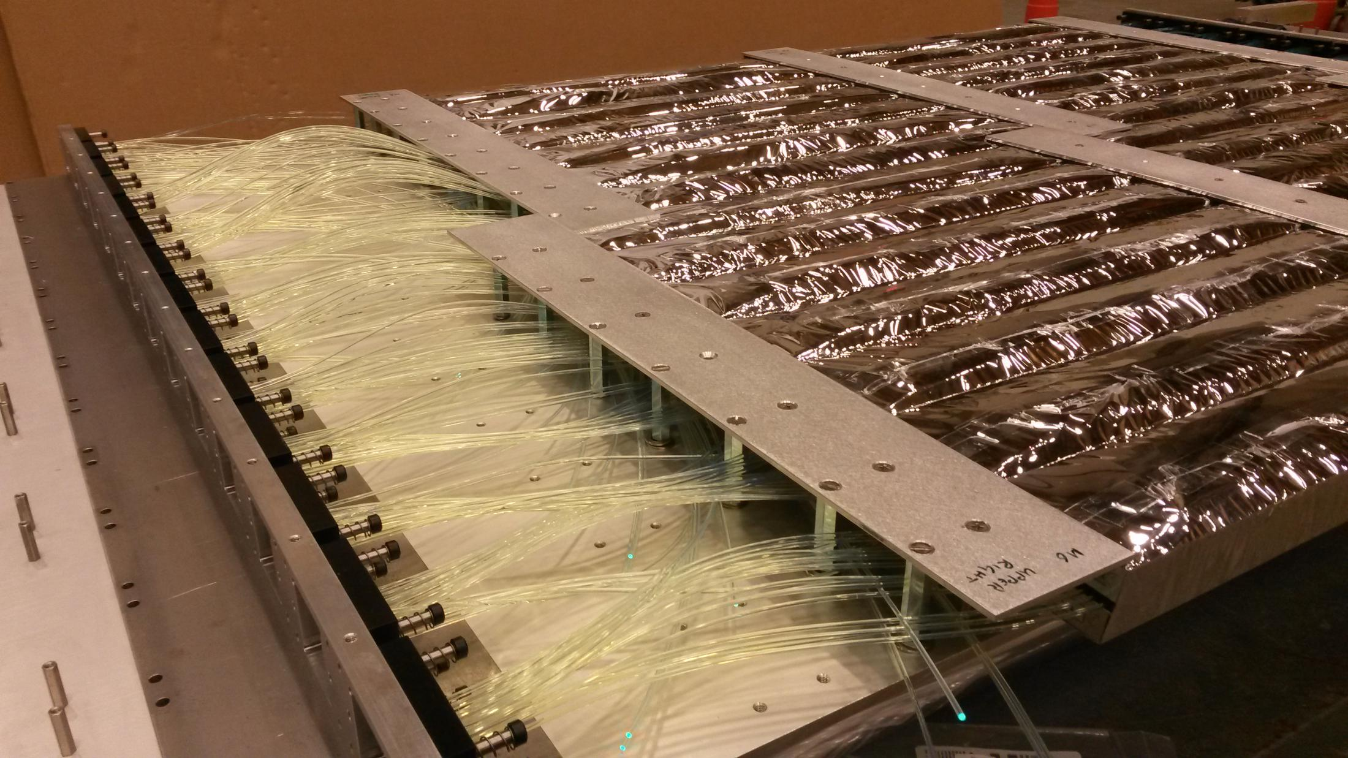
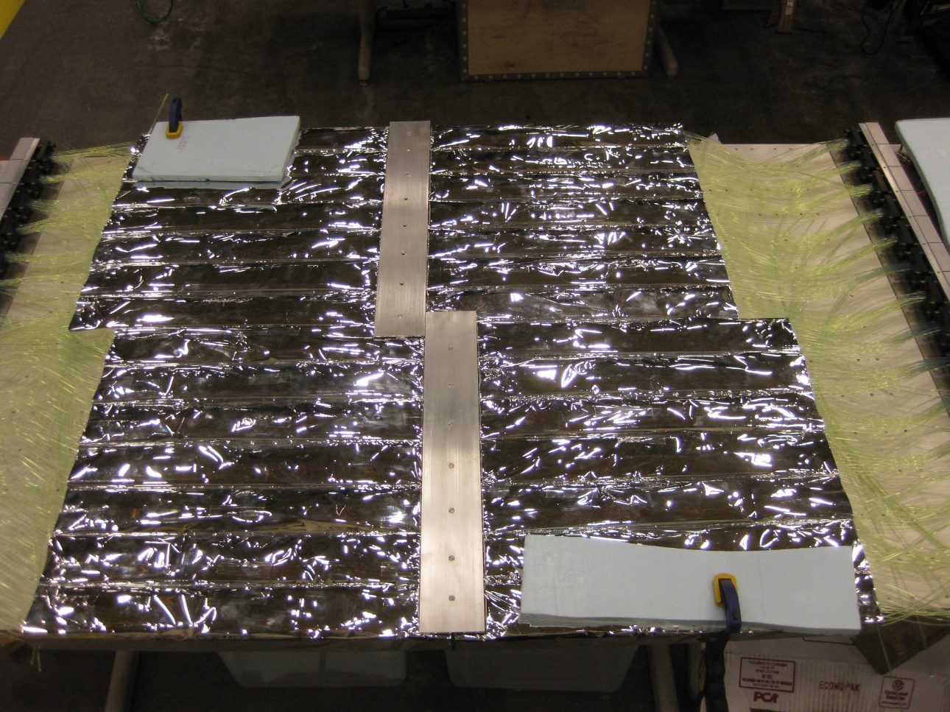
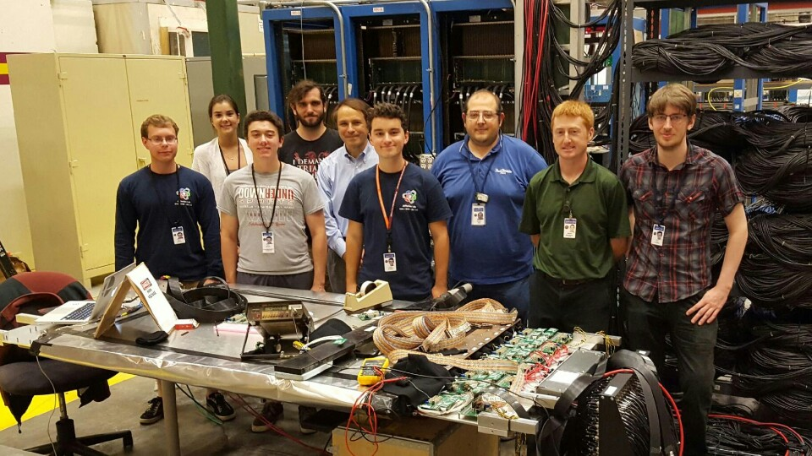
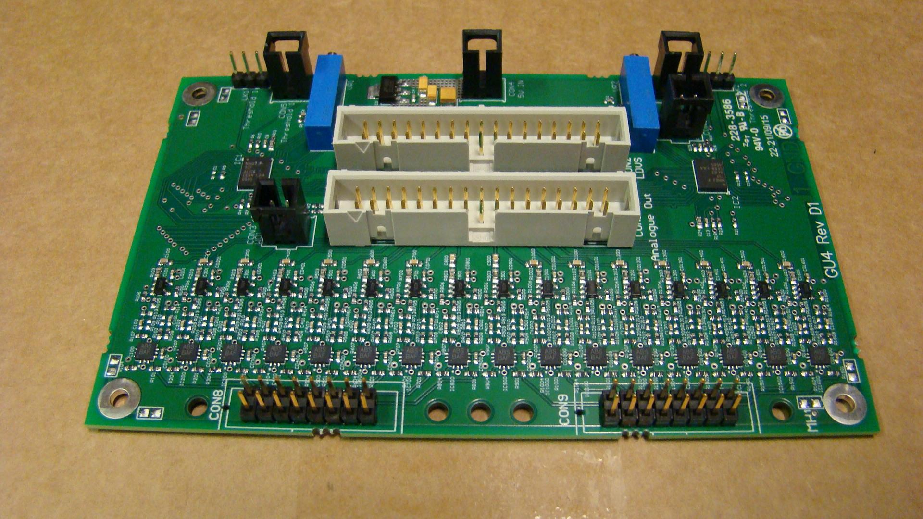
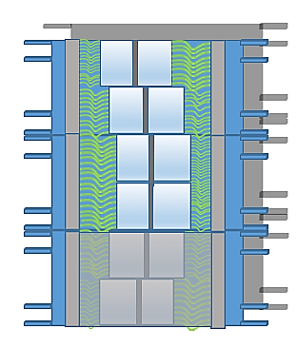
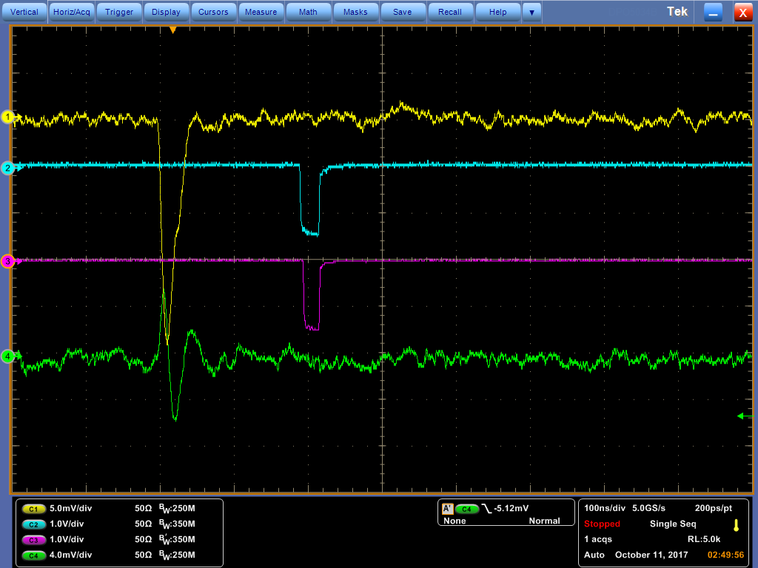
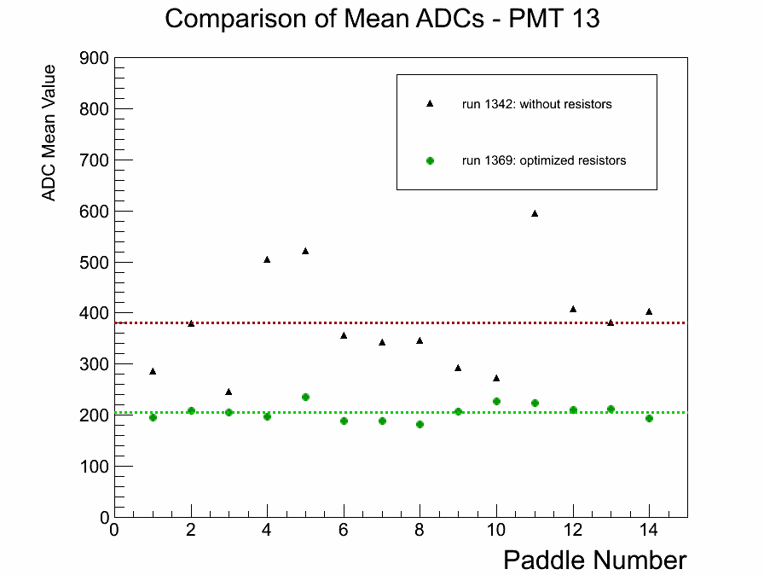
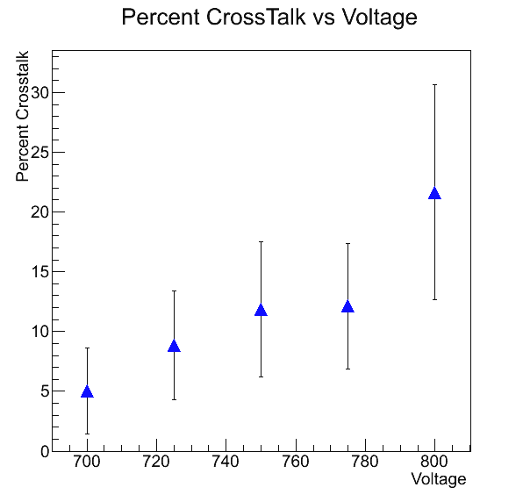
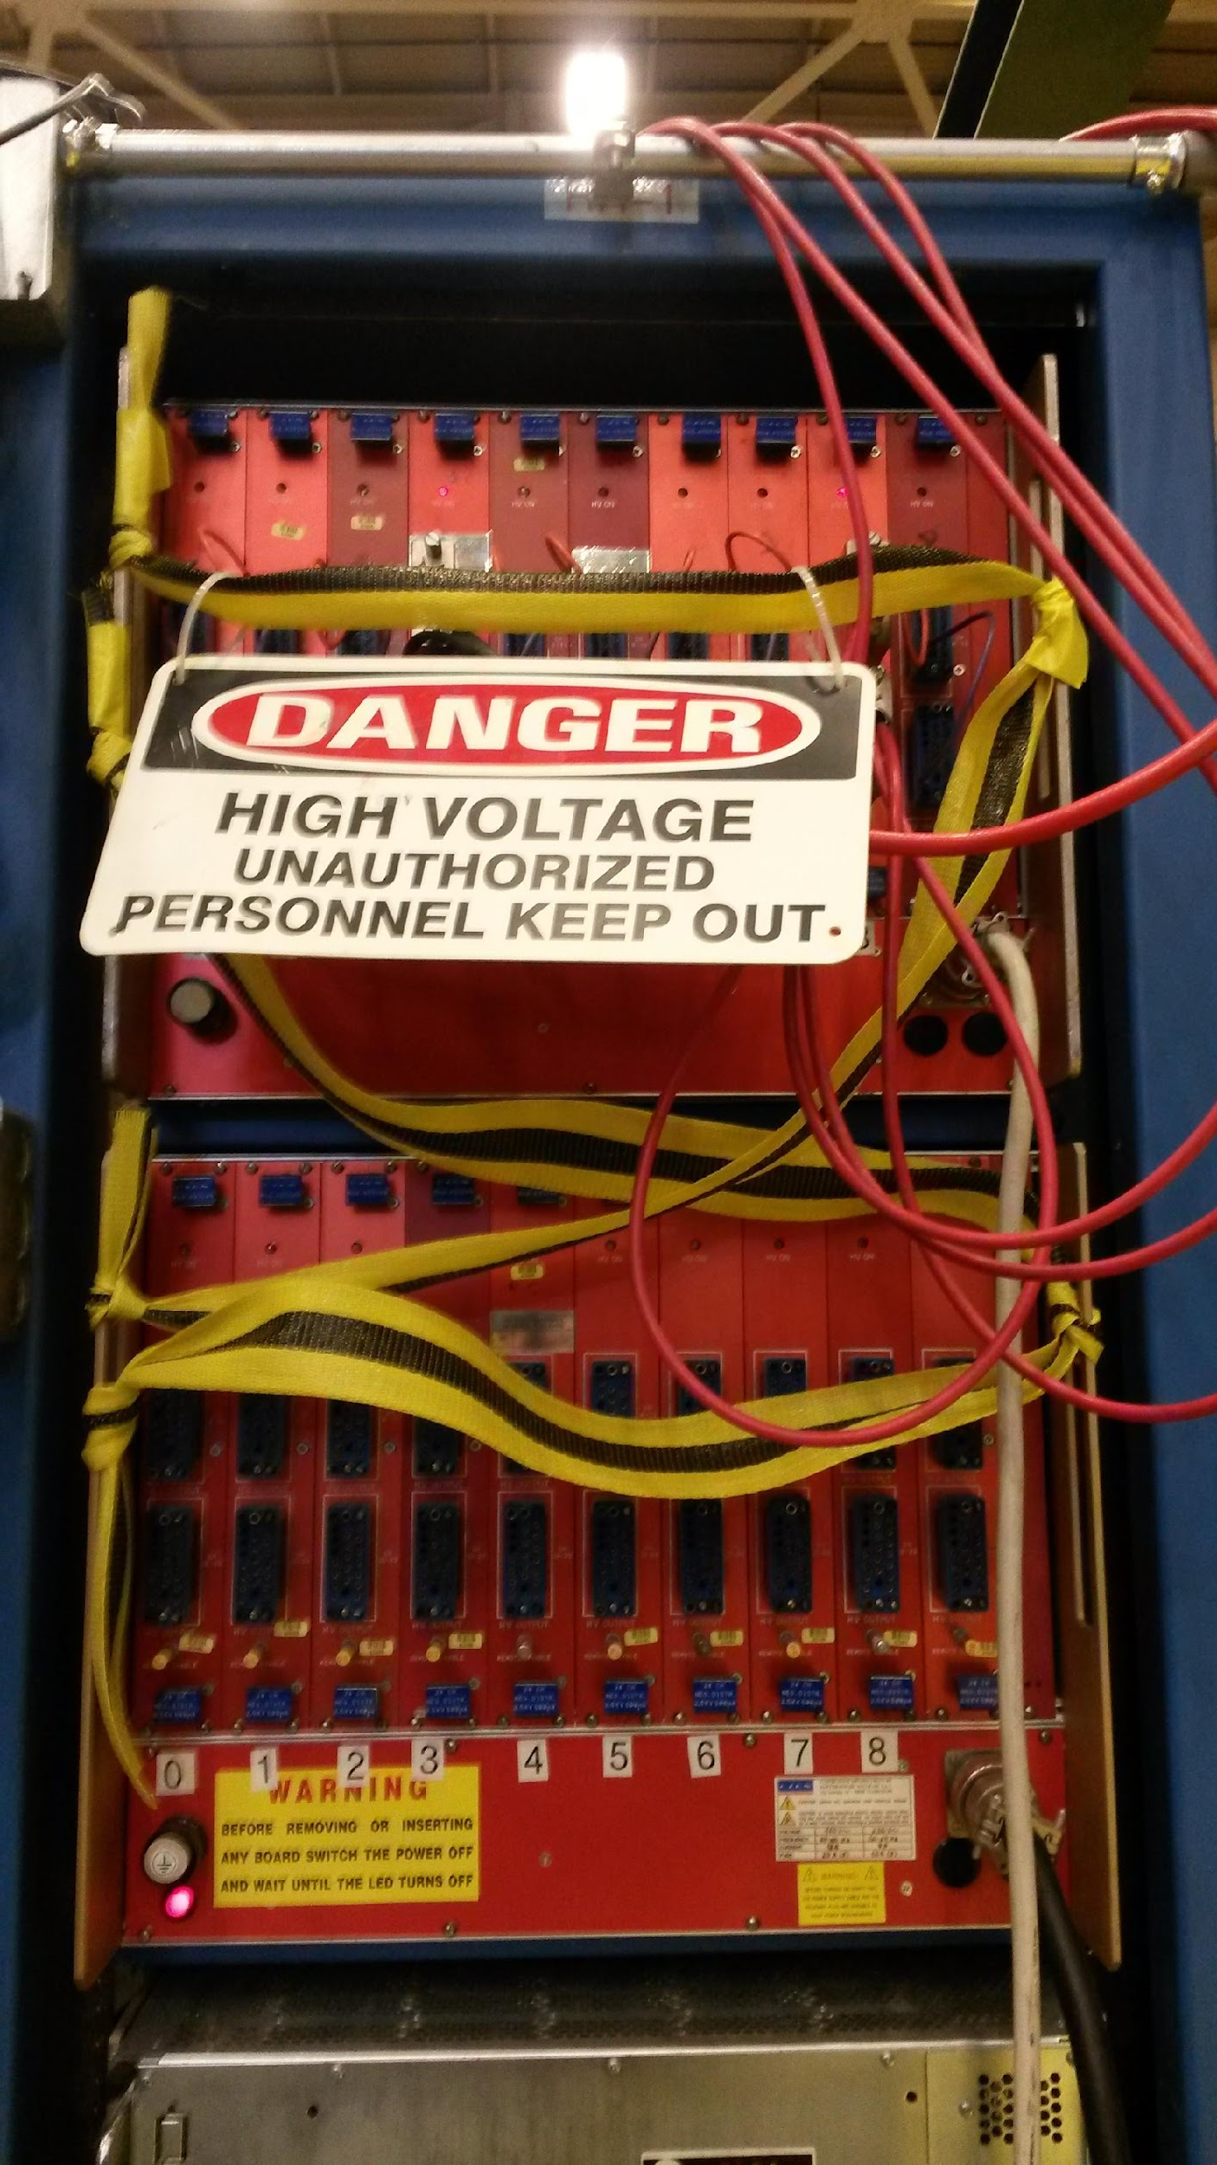
The Coordinate Detector: Internship Oveview
Ralph Marinaro
Applied Physics, Class of 2019
Supervisors: Dr. Peter Monaghan (CNU), Dr. Bogdan Wojtsekhowski (JLab)
Coordinate Detector
The Coordinate Detector (CDet) is a scintillator detector which will form part of the charged particle tracking system for the SuperBigBite Spectrometer (SBS). This will be used in experiments in Hall A at Jefferson Lab to measure
nucleon structure functions.
Groups of 14 optical fibers with scintillating bars are connected to a single PMT. The light collected by each optical fiber is detected by a photomultiplier tube (PMT). The PMT turns detected light into a charge signal, which is read out by the data acquisition system (DAQ).
Internship Info
Graphs and Photos
Where: How has the experience shaped your career path?
Thomas Jefferson National Accelerator The skills and experience that I have developed
Facility (J-Labs, Jefferson Labs) will last me the rest of my future as a scientific
researcher and will be a useful resource in future
When: Sping of 2016 to present job interviews.
Position: Student Researcher What advice do you have for new students in your
major?
Was the internship paid and for academic I would first say that grades come before anything
credit? else. Before you can be selected for research you
Yes, the internship was paid and fulfilled must prove your intelligence and ability to think
some Honors Program requirements. critically. Second, I would say that you have to
network and always be on the look out for new
opportunities. You have to tell people what you
want in order to get it.
What resources were used to find this internship?
Dr. Peter Monaghan, my first physics professor at
CNU, helped a lot my first year with
recommendations and then offered me a postion
with the CNU Nuclear Physics Group at J-Labs.
What did you do at your internship?
I tested, constructed, and am currently What was the most valuable lesson taken from
working on commissioning the Coordinate this experience?
Detector. This involves advanced scientific Never say no to anything. Every new challenge is
nalysis and experimentation in one of an oppotunity for improvement and an expanded
the world's leading electron beam understanding in your field of study.
accelerator facilities.
What made you successful in your
internship?
My greatest asset was my dedication to
putting forth only the best quality work.
I was also always willing to do the work no
one else wanted to do.
The detector consists of six modules stacked in two layers of three modules each. Each module consists of 28 bars and each bar consists of 14 scintillator paddles. This means in total the detector has 2352 channels and each one is individually read out in the DAQ.
scintillating bars
reflecting mirrors
optical fibers
photomultiplier tubes
Each bar consists of fourteen individual scintillator paddles, each one with a single optical fiber through its middle. When a charged particle goes through the material, it causes a small amount of light to be emitted from the material. The photons generated are then collected by the optical fiber in each scintillator. All of the paddles are individually wrapped in reflective mylar to aid collection of the emitted light.

