Slide 1
C-Det Crosstalk Analysis
Dr. Peter Monaghan
Parker Reid
Ralph Marinaro
Jefferson Labs
St. Mary's University
Christopher Newport University

Slide 2
Define Cuts
ADC spectrum cut defined on adjancent paddles as having no signal (<10) and in signal paddle with large amplitude of channels (>200)
To test for crosstalk, check for large TDC value (>500) firing in adjacent paddle not from signal paddle
High voltage for PMT set to 775V. Then reduced to 750V.

Slide 3
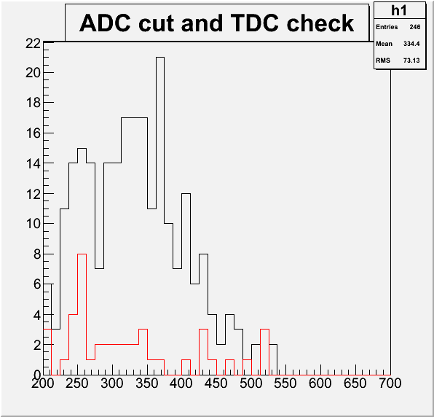
Ex. PMT #7 Pixel #13
Black – ADC > 200
Adj. ADCs < 10
        Num. Of Events: 246
Red – ADC > 200
Adj. ADC < 10
Adj. TDC > 500
        Num. Of Events: 42 (17.1%)
Num.
of Events
Channels
Ideally Red events should be ~ 0.

Slide 4
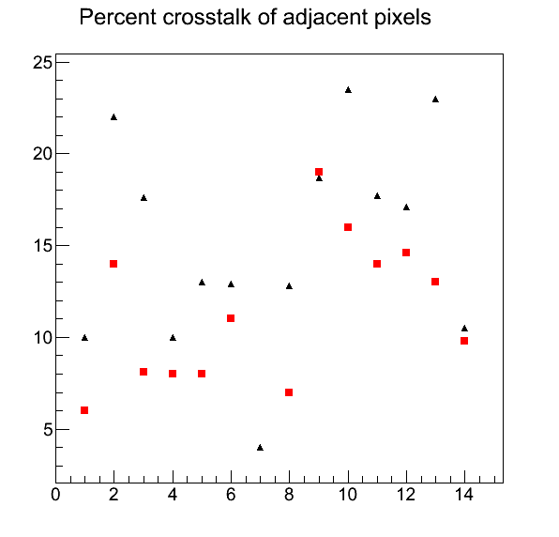
PMT #7: % Crosstalk per Pixel
Black – PMT set at 775V
Red – PMT set at 750V
Only analyzes effects of adjacent paddles in scintillating bar.
Further analysis needed to see crosstalk effects of all pixels in PMT.
Percent Crosstalk
Pixel #

Slide 5
Going Forward
Gathering more statistics ( 1e6 events)
Further reduction of High Voltage
Investigating regions of high cross talk percentages (opening up the detector)

