Slide 1


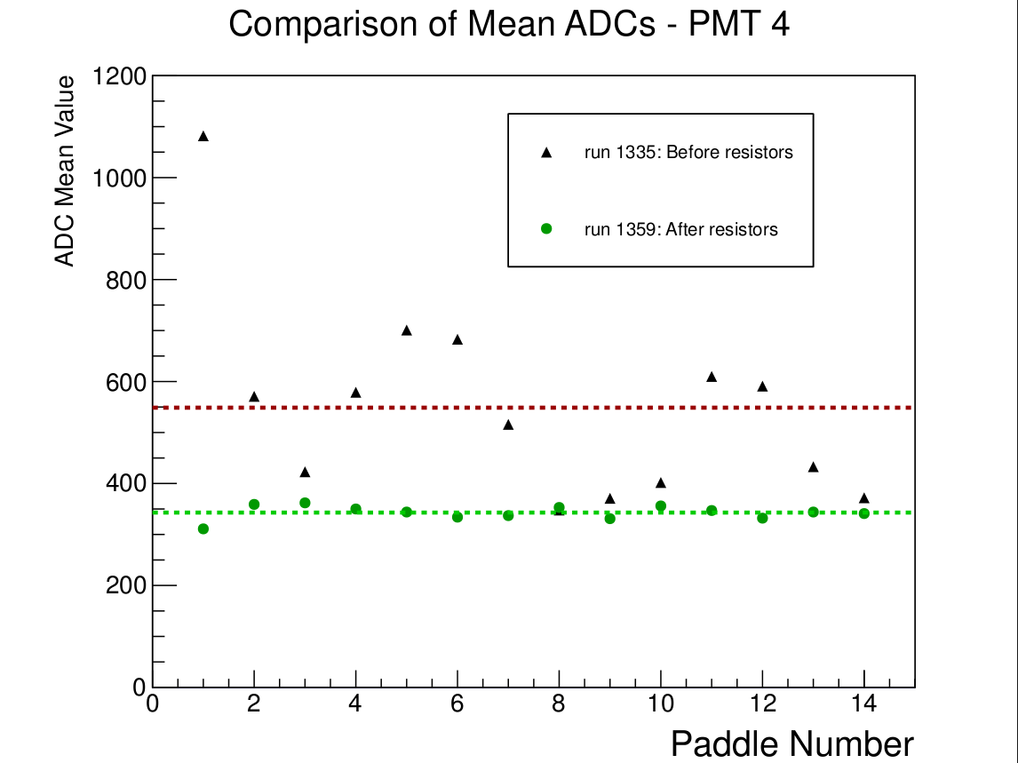
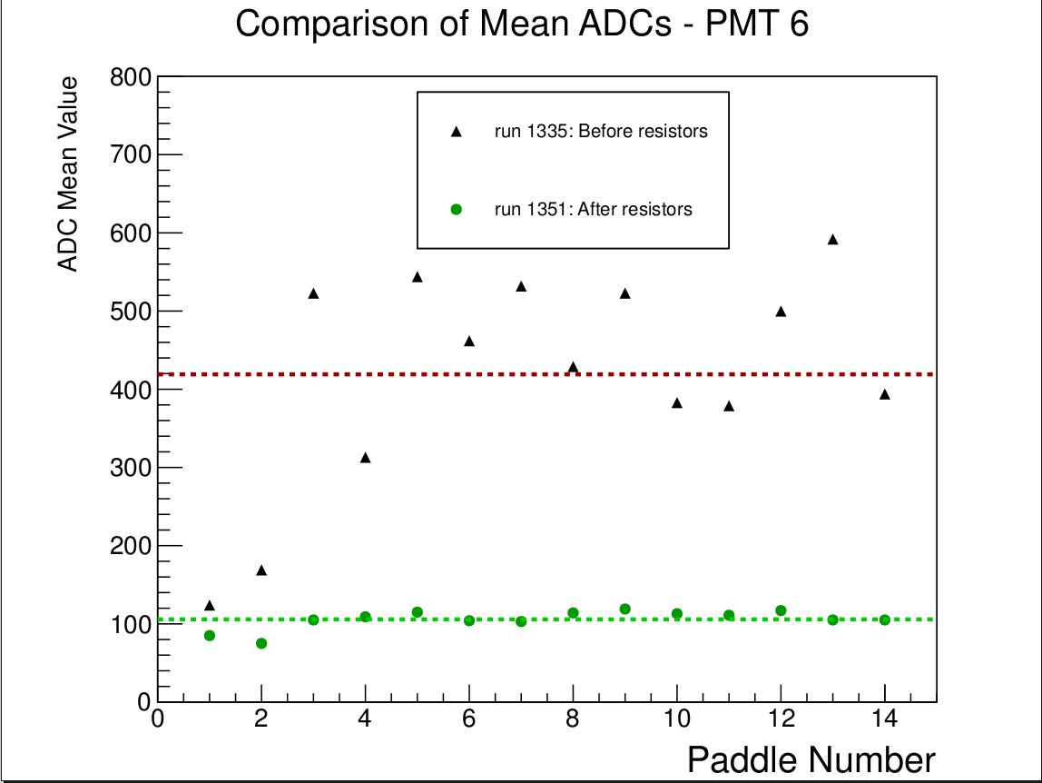
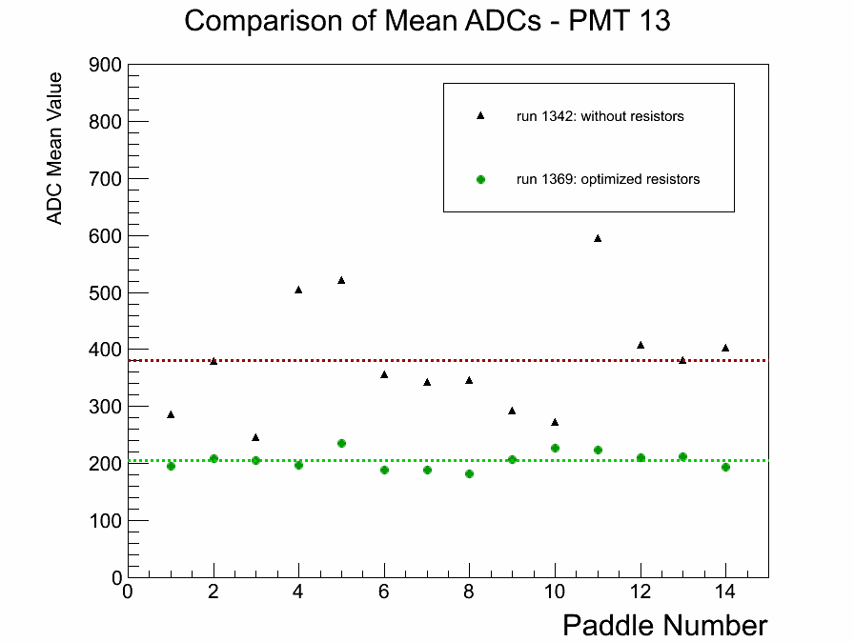
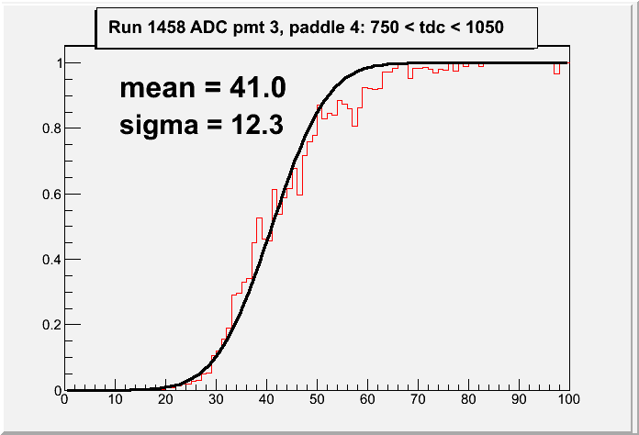
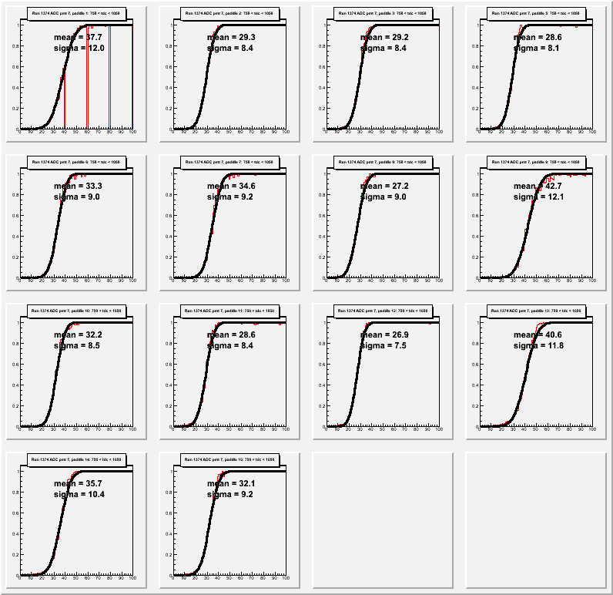
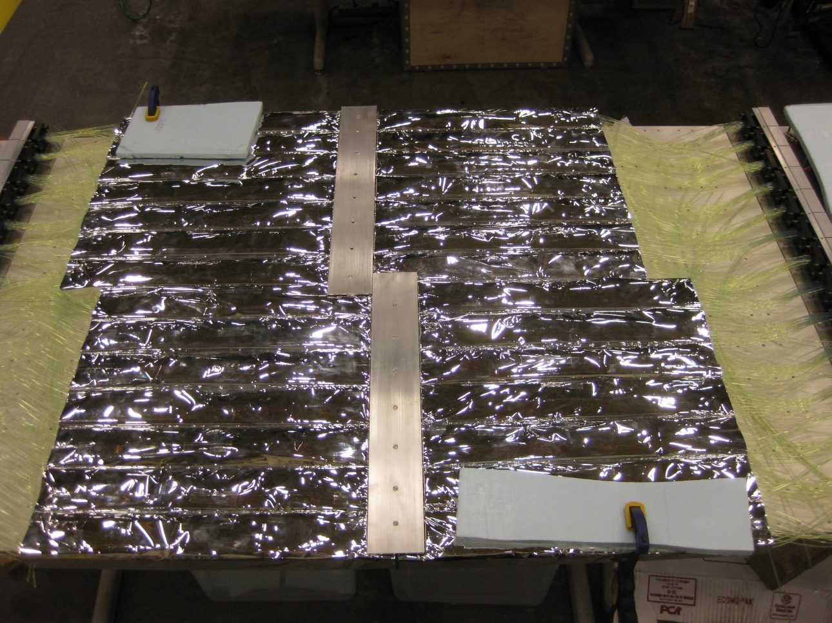
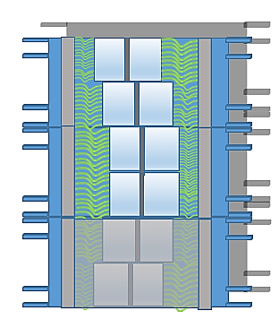
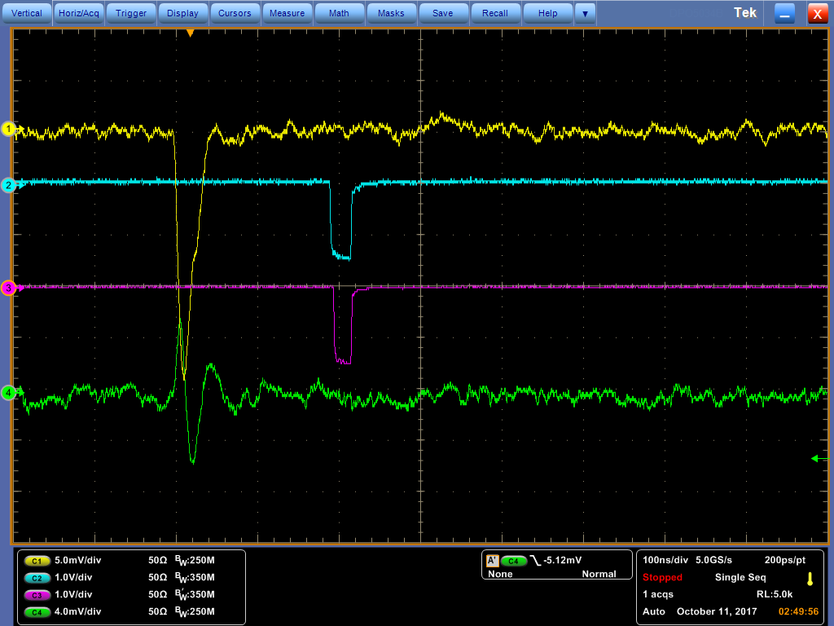
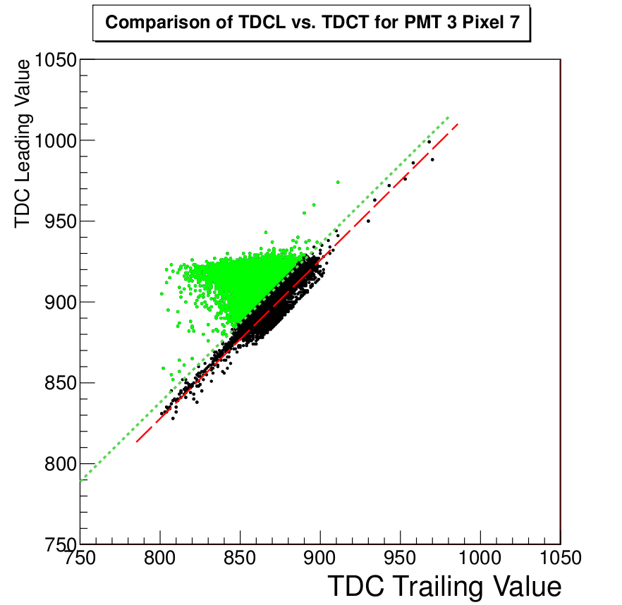
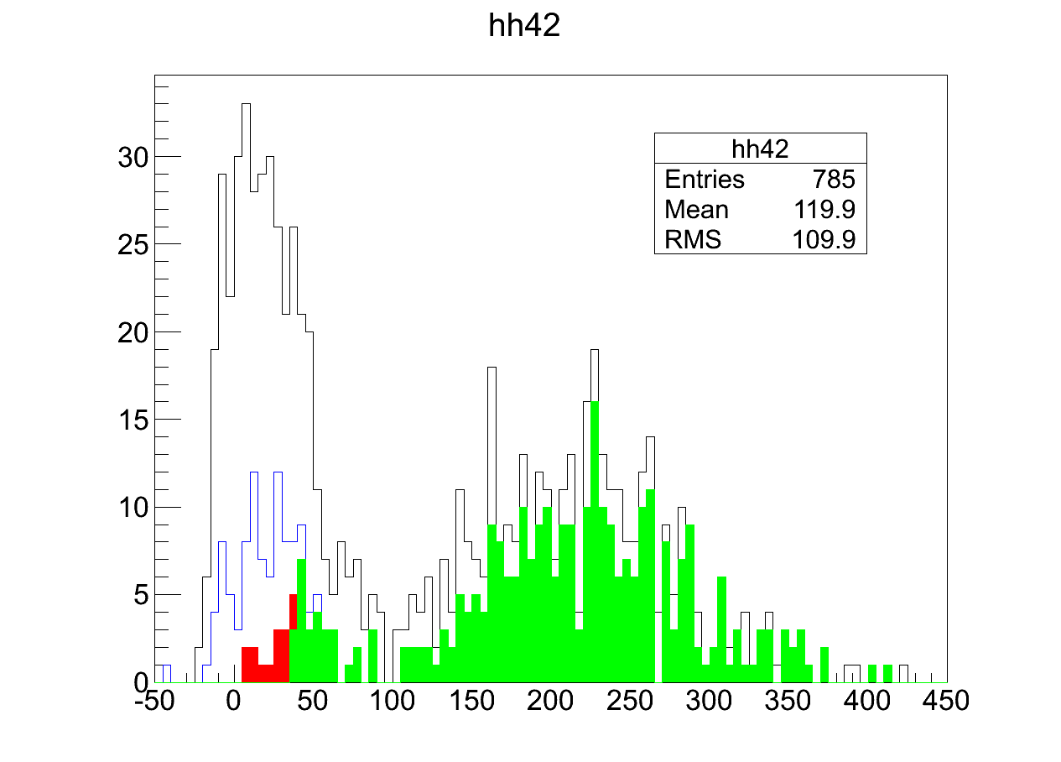
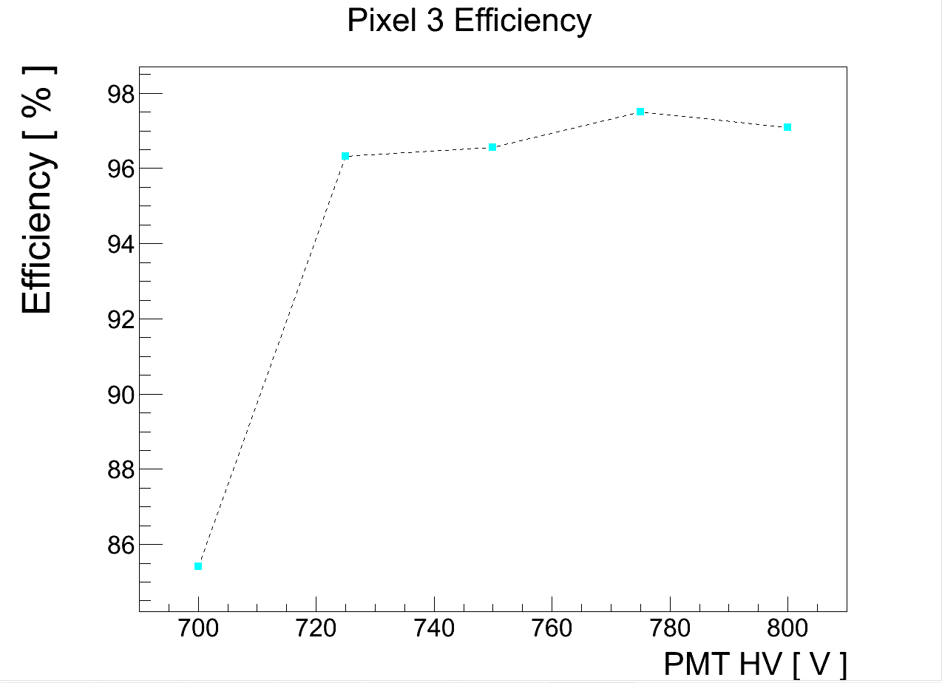
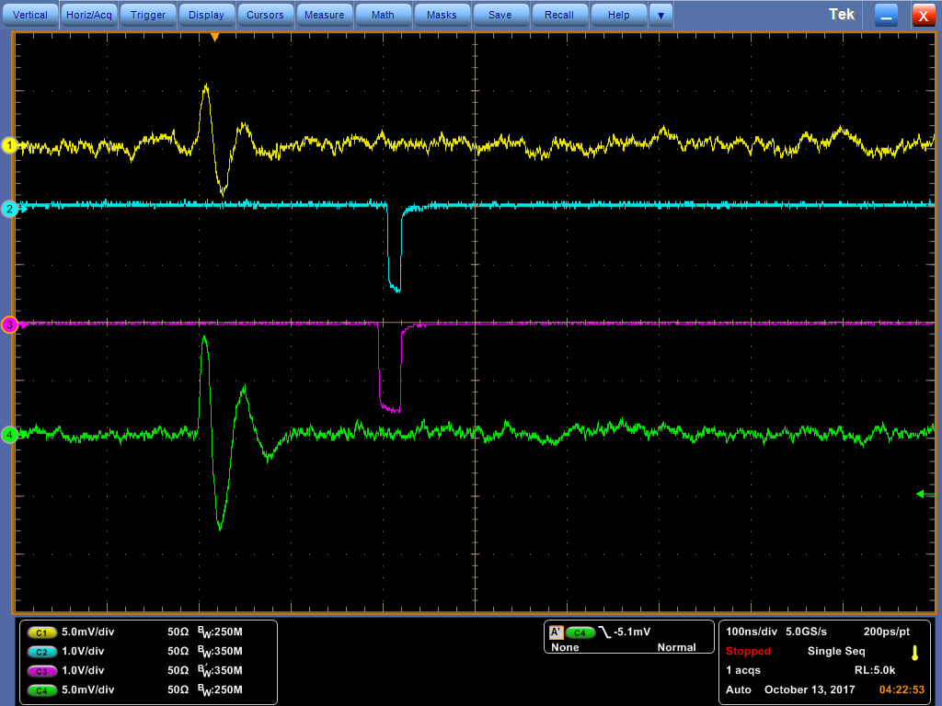
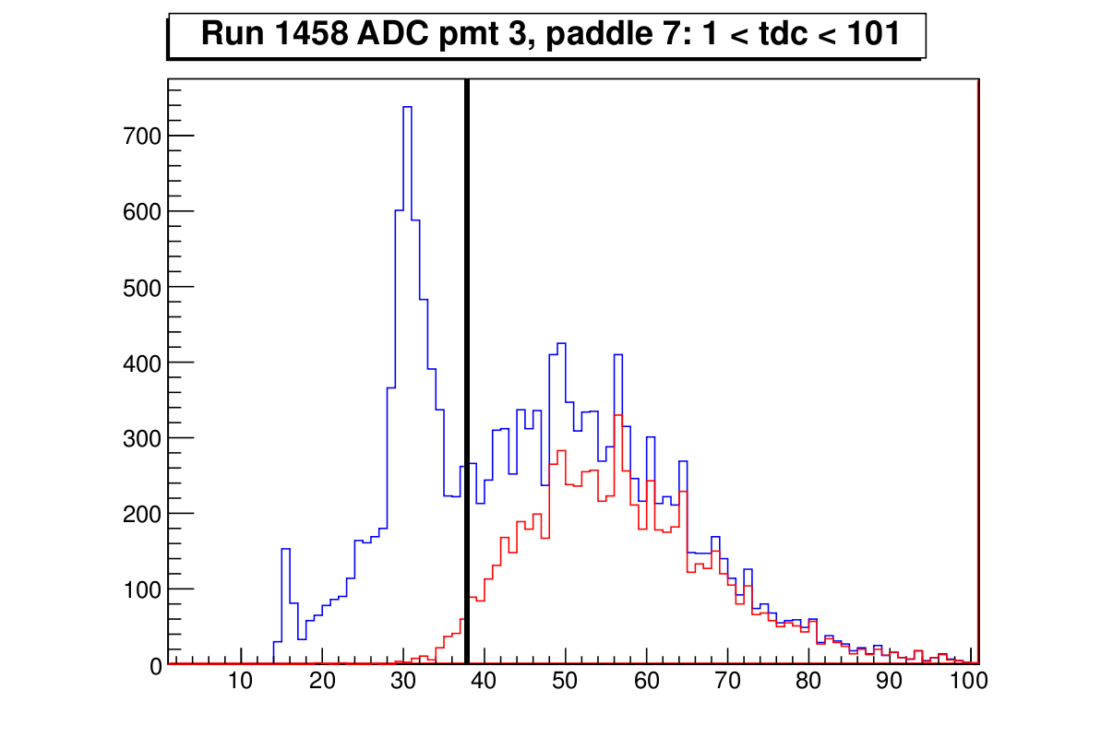
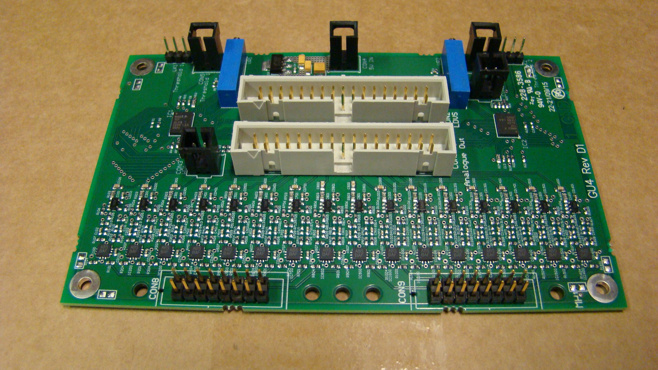
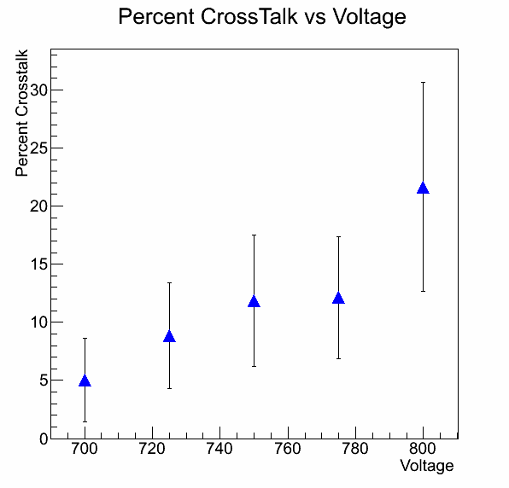

Commissioning of a Coordinate Detector for the Hall A Super BigBite Spectrometer
Ralph Marinaro
Mentor: Dr. Peter Monaghan (JLab, CNU), Supervisor: Dr. Bogdan Wojtsekhowski (JLab)
Abstract: The Super BigBite Spectrometer (SBS) will be supplemented by the Coordinate Detector (C-Det) to provide particle position and trajectory data. C-Det uses scintillating paddles that interact with particles to collect light events in separate channels. This allows experimenters to know where particles pass through the detector. The focus of this project was to develop the commissioning process and determine the efficiency and crosstalk percentages of each channel in C-Det at different high voltage (HV) values before installation of C-Det in Hall A. Using cosmic rays, a half-module data acquisition system (DAQ) collects ADC and TDC data so that crosstalk and efficiency percentages for each channel can be calculated. Through this process C-Det can be commissioned for use in experimentation. After application of all cuts to remove unwanted events, every channel in the first module of C-Det has crosstalk and efficiency percentages for every channel at the selected HV values which are considered acceptable for the commissioning process. Using the ADC value, crosstalk, and efficiency data, the optimal HV settings for each PMT in Module 1 were determined and Module 1 was proven ready for use in experimentation. This process will be applied to all six of C-Det’s modules before final installation for experimental use in Jefferson Lab's Hall A.
Coordinate Detector
The Coordinate Detector (CDet) is a scintillator detector which will form part of the charged particle tracking system for the Super BigBite Spectrometer (SBS). This will be used in experiments in Experimental Hall A at Jefferson Lab to measure nucleon structure functions.
Groups of 14 optical fibers in scintillating bars are connected to the PMTs. The light collected by each optical fiber is
detected by a
photomultiplier tube (PMT). The PMT uses the photoelectric effect to turn detected light into a charge signal, which is collected by the half-module DAQ.
Commissioning Process
Efficiency Analysis
The ADC threshold value for each channel is calculated to be fifty percent of the ADC rate for the channel being analyzed. These threshold cuts are used to calculate the efficency percentages.
A good event is defined as being a cosmic ray that passes straight, or vertically through the paddle and is not a crosstalk event. Cuts are placed on the ADC and TDC data in four stages. The first stage defines a vertical cosmic ray track in the analyzed channel. The second stage is crosstalk cuts on all other channels in the PMT other than the channel being analyzed. The TDC width cut is the third stage to remove a large portion of the crosstalk remaining.
The remaining data is defined as good events. The efficency percentage for each channel is the number of good events above the ADC threshold cut over the number of total good events. This ADC threshold cut is the fourth stage of cuts to calculate efficiency.
Conclusion
The efficiency and crosstalk percentages calculated at the optimal HV values for Module 1 of CDet are considered acceptable for the commissioning process. Using the efficiency, crosstalk, and ADC value data, the optimal high voltage settings for each PMT in Module 1 of CDet have been determined and Module 1 is ready for use in experimentation to supplement the SBS detector system. This commissioning process will be applied to all six of CDet's modules before CDet's final installation in Jefferson Lab's Hall A.
Acknowledgements
Dr. Bogdan Wojtsekhowski (JLabs) Katie Whitcomb (CNU)
Dr. Edward Brash (JLabs, CNU) Parker Reid (SMU)
Dr. Peter Monaghan (JLabs, CNU) Abbie Salyzyn (SMU)
Dr. John Annand (UOG)
Dr. Vitaly Baturin (JLabs)
Dr. Francesco Tortoricci ((UNICT)
.
The signal wires from the PMT are attached to the NINO card via a small circuit board. A pair of resistors for each channel are placed on the board in order to siphon off some of the charge. This means all of the channels can have their signal amplitude normalized in the resulting ADC spectrum. This charge normalization is shown for all 14 channels from three PMTs in the graphs below. The values for each resistor were determined by calculating a reduction coefficient between the ADC signal values for each channel in the PMT and the lowest ADC signal value in that PMT.
In this detector, each bar of fourteen paddles is read out by a single PMT. Each PMT has sixteen pixels and is called a multi-anode PMT. The sixteen optical fibers are connected to a collar which rests on the face of the PMT. Crosstalk is the parasitic, artificial correlation of events between channels in the PMT which generates incorrect data events that did not really occur.
ADC Rate PMT 3, Paddle 4
ADC Rate
ADC Value
The detector consists of six
modules stacked in two
layers of three modules
each. Each module consists
of 28 bars and each bar
consists of 14 scintillator
paddles. This means in total
the detector has 2352
channel and each one is
individually read out in the
DAQ. Each bar consists of
fourteen individual scintillator
paddles, each one with a
single optical fiber through
its middle. When a charged
particle goes through the
material, it causes a small
amount of light to be emitted
from the material. The
photons generated are then collected by the optical fiber in each scintillator. All of the paddles are individually wrapped in shiny, reflective mylar to aid collection of the emitted light by the fibers.
For each PMT
in the detector
there is a
corresponding
NINO card.
A NINO card
(right) is an
amplifier-
discriminator
card which
takes in the
charge signals
from the PMT
and turns them into corresponding analogue (ADC) and logic (TDC) signals. These signals are read into data files by the DAQ.
scintillating bars
reflecting mirrors
A crosstalk event occurs
when a signal in one
channel is also registered
in another channel due to
capacitive coupling
within the PMT. A
multichannel oscilloscope
was used to observe
crosstalk events, as
shown to the right. The
crosstalk events in one
pixel were observed by
triggering on other
channels within the PMT.
A crosstalk event is
characterized as having a
bipolar signal pulse which
results in a low or close to
zero ADC signal value.
Most crosstalk events also
have a shorter TDC signal
width between the leading
and trailing edge.
The percent crosstalk for each PMT was also observed at different high voltage levels. The amount of crosstalk increases with the high voltage, and the ADC signal values also increase.
An optimal high voltage value has low crosstalk and a sufficient ADC value.
Using the short
TDC widths which
characterize a
crosstalk event, a
TDC width cut
can be used to
analytically
reduce crosstalk
percentages for
every channel at
every high voltage
value. A linear fit
(red) is applied to
the TDC value outliers and a shift is used to determine the final TDC width cut value (green). This TDC width cut is compared to the TDC width spectrum (below) to see how well the cut removes unwanted crosstalk data (blue).
Supplemental crosstalk cuts are also placed on the TDC of every other channel in the same PMT as the channel being analyzed. These cuts remove some crosstalk, but the TDC width cut is most effective at removing crosstalk.
Normal Event
ADC Four Stage Cuts
PMT 7, Pixel 3 Efficiency
Crosstalk Event
Bin Number
Black: Vertical Track Cuts
Blue: Crosstalk Cuts
Red: TDC Width Cut
Green: Threshold Cut
optical fibers
photomultiplier tubes
ADC Value
Shorter TDC Widths
TDC Width PMT3, Paddle 7
Bin Number
Red: Good events
Blue: All events
TDC Width Value

