Slide 1
G_{Ep}/G_{Mp} with an 11 GeV Electron Beam in Hall C
E.J. Brash, M.K. Jones,
C.F. Perdrisat, V. Punjabi
and the Gep-IV Collaboration
Based on LoI 12-06-103 to PAC30

Slide 2
Elastic EM Form Factors
Fundamental to our understanding of nucleon structure
  At low Q² (larger distance), they shed information on the pion cloud.
  At intermediate/large Q² (shorter distance), they contain information on the quark and gluon structure
At JLab energies, we gain knowledge about the non-perturbative structure of the nucleon
Together with other observables (in DIS, SIDIS, DVCS, RCS, etc.), we develop a greater understanding of the nucleon’s rich internal structure

Slide 3
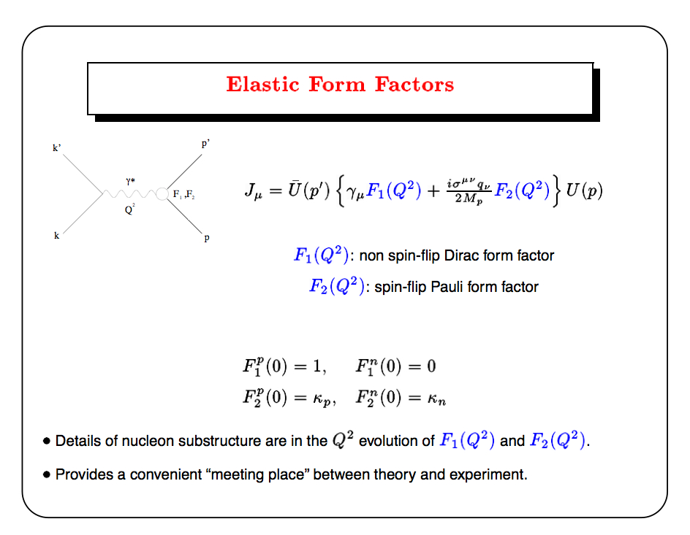
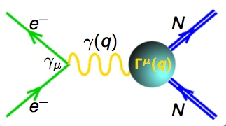


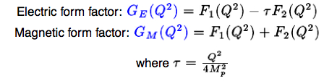

(Born Term)

Slide 4
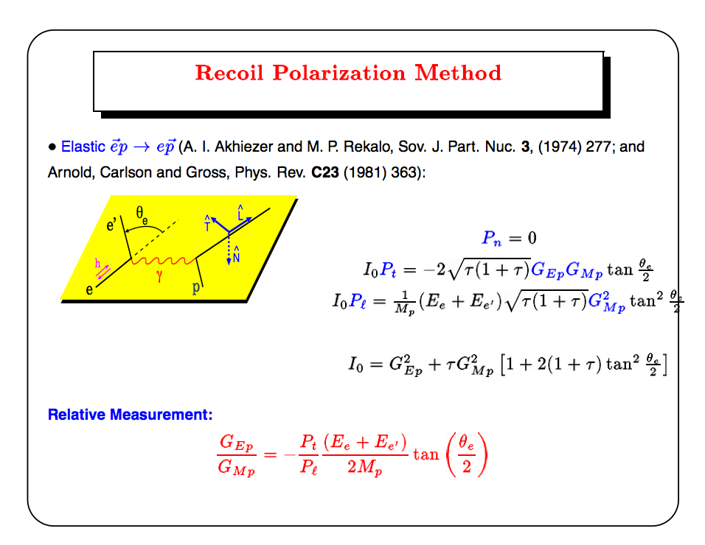

Slide 5
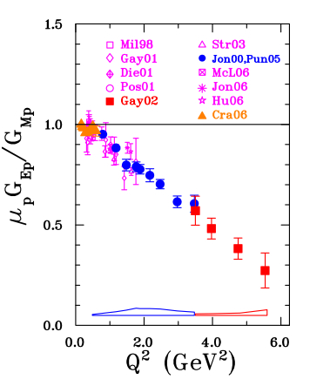
Recoil Polarization Measurements
Famous Papers (250-499 citations)
M.K. Jones et al., Phys.Rev.Lett., 84 (2000) 1398 (G_{Ep}-I)
O. Gayou et al., Phys.Rev.Lett., 88 (2002) 092301. (G_{Ep}-II)
(829 total citations, 2 Ph.D.’s, 3 Masters, ~8 UG theses,
several tenure track faculty and staff appointments)

Slide 6
Theoretical Progress
VMD-based models
  Describe all four nucleon FF’s well
  Tend to favour ratio reaching a constant value at intermediate Q²
rCQM
  Show the importance of relativistic dymamics
pQCD-inspired models
  Predict logarithmic scaling behaviour of F₂/F₁ at intermediate Q² (Belitsky and Ji) -> related to quark OAM
GPD-inspired models
  Show a connection with OAM of the quarks in the nucleon
  FF’s provide important constraints on GPD’s
  Behaviour of G_{Ep}/G_{Mp} at intermediate Q² related to u/d ratio at small distances (Miller)
Lattice QCD Models
  Good progress already, and will get much better in the future

Slide 7
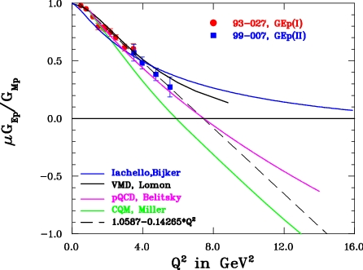
Recoil Polarization Measurements

Slide 8
G_{Ep}–III Experiment at JLab
  The ratio G_{Ep}/G_{Mp} was measured with the recoil polarization technique at Q² of 5.2, 6.8 and 8.54 GeV² in Hall C at JLab, between October 2007 and June 2008. Also G_{Ep}/G_{Mp} at a constant Q² of 2.49 GeV² for 3 kinematics (3 values of ε).
  These experiments used the High Momentum Spectrometer (HMS) to detect proton; a new double focal plane polarimeter (FPP) in the focal plane of the HMS measured the polarization of the recoil proton.
  A large area Electromagnetic Calorimeter (BigCal) assembled for the experiment was used to detect the elastically scattered electrons in coincidence with the protons.

Slide 9
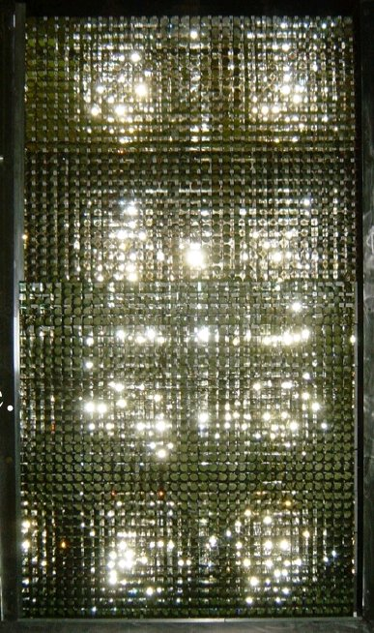
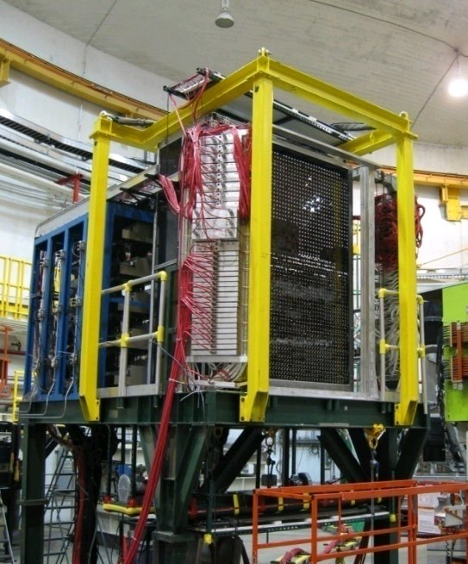
BigCal in Hall C
BigCal glass

Slide 10
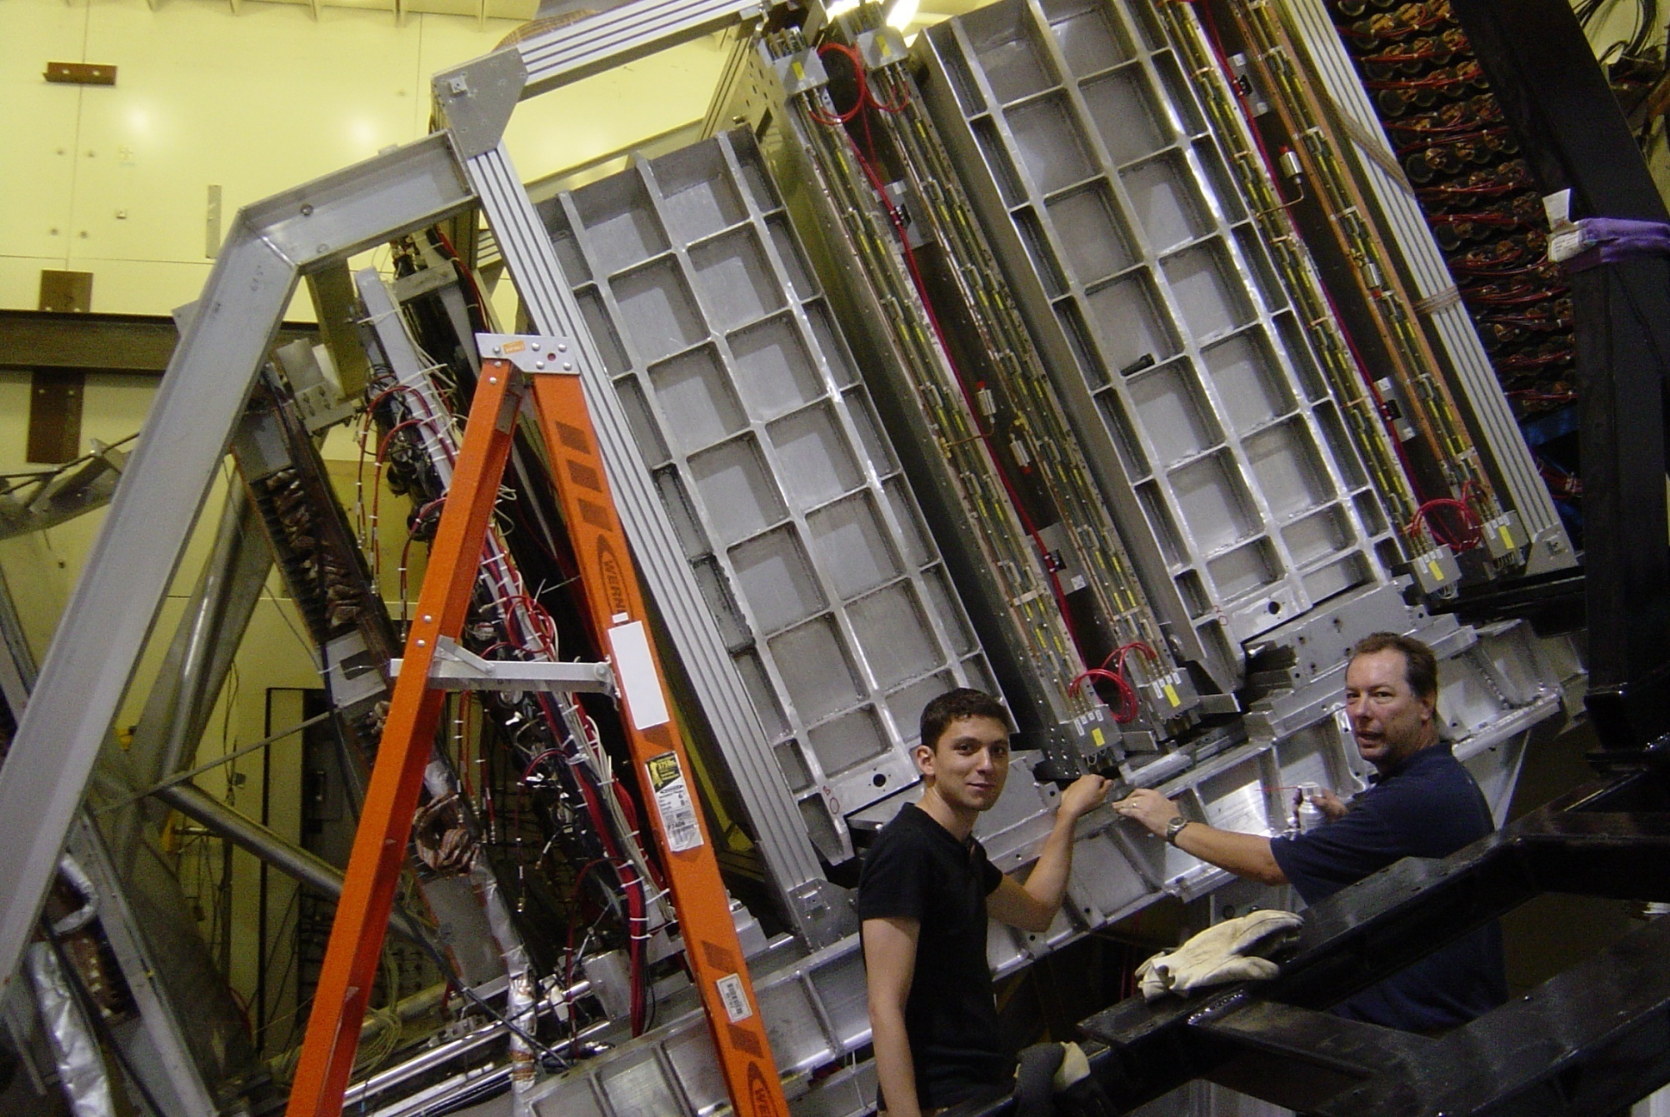
Double Focal Plane Polarimeter
Trigger Scintillators
Second Pair FPP Chambers
Second CH2
Analyzer
First Pair FPP Chambers
First CH2
Analyzer
Two Focal Plane chambers

Slide 11
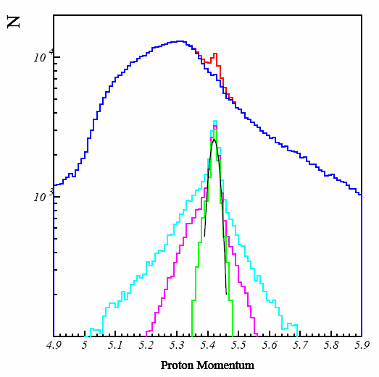
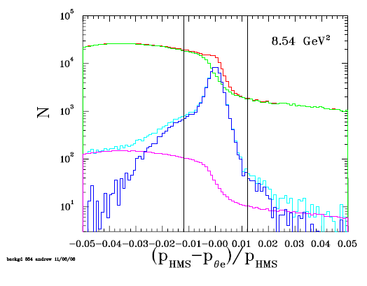
Identification of Elastic Events:
Proton Momentum Spectrum
Q²=8.5 GeV²
Red : all events,
Cyan: with δ-θ cut,
Magenta: requiring co-planarity,
Green: loc. in BigCal and polar angle correlation
Blue: Non-elastic
Red : all events,
Cyan: x-y localization in BigCal
Blue: with Background subtraction
Magenta: Background Estimate … ~1%

Slide 12
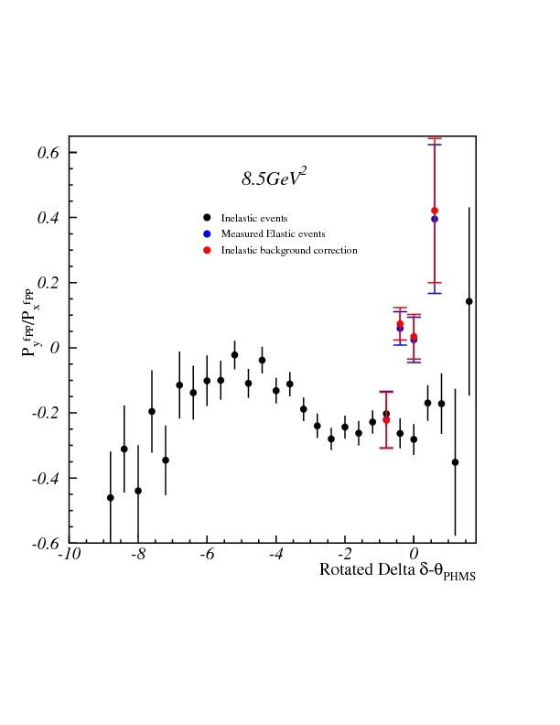
Identification of Elastic Events:
Proton Momentum Spectrum

Slide 13
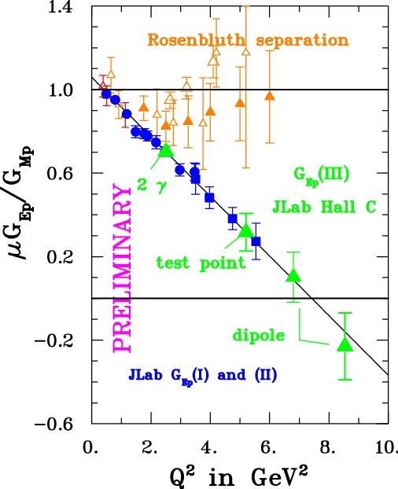

Slide 14
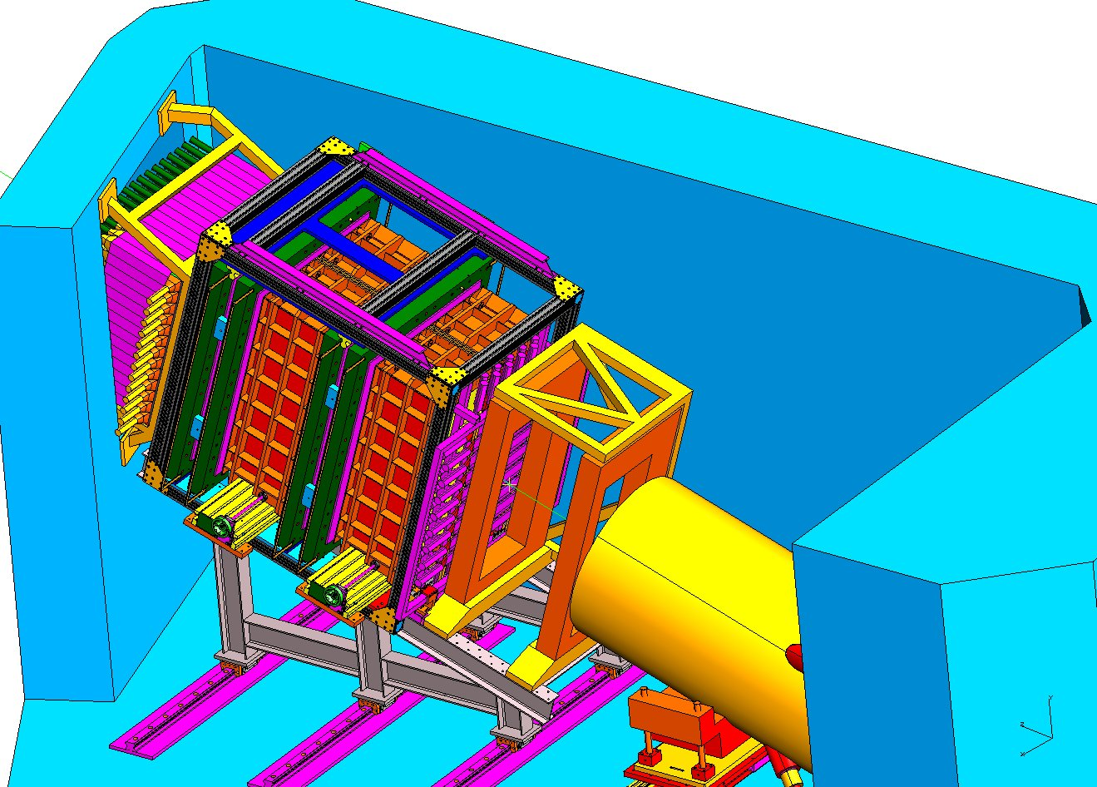
Gep-IV: Basic Plan
Extend the measurement of G_{Ep}/G_{Mp} to the largest value of Q² possible using base equipment together with existing dectectors in Hall C
  Hall C SHMS, equipped with the existing Hall C FPP, for proton detection
  The existing BigCal detector for electron detector - perfect match to the SHMS

Slide 15
Gep-IV: Issues for Consideration
1. Spin Precession in the SHMS
2. Radiation Damage to BigCal
3. CH₂ Analyzing Power

Slide 16
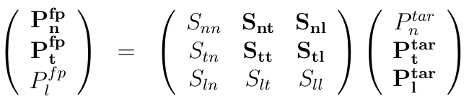
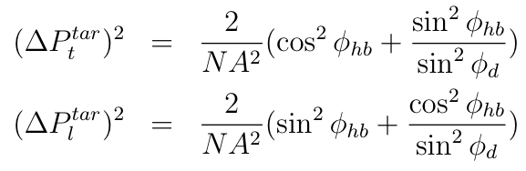
Gep-IV: Spin Precession in the SHMS
The proton spin components precess in the magnetic elements of the SHMS, so that:
Horizontal bender leads to mixing of long. and transverse components

Slide 17
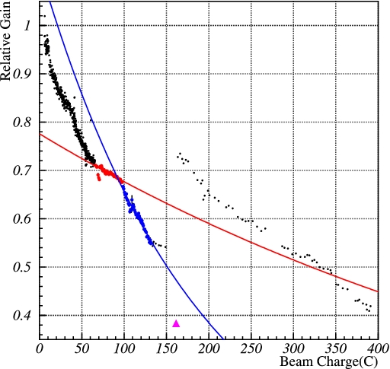
Gep-IV:BigCal Radiation Damage
Affects energy resolution
  we are fairly insensitive to this.
Main concern:
  relatively high hardware threshold to keep the BigCal rates low
Result of GEANT Simulation:
  Curing about once per week in Gep-IV
Use maintenance days -
  need four hours of curing to recover one week of damage

Slide 18
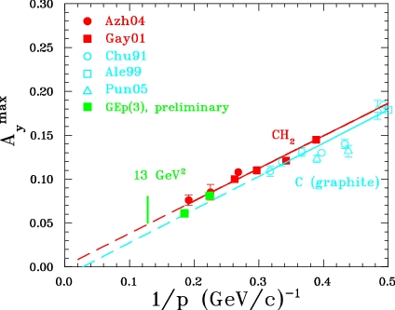
Gep-IV: CH₂ Analyzing Power
As a by-product of the polarization transfer experiments, we can extract the (average/maximum) CH₂ analyzing power in the FPP
Empirically, the maximum analyzing power scales as 1/p, the shape of the distribution scales in a similar manner; this allows us to make accurate predictions of the analyzing power at various momenta
In addition, full GEANT3 simulations have been performed to estimate the scattering efficiency (describes Gep-III data well)

Slide 19
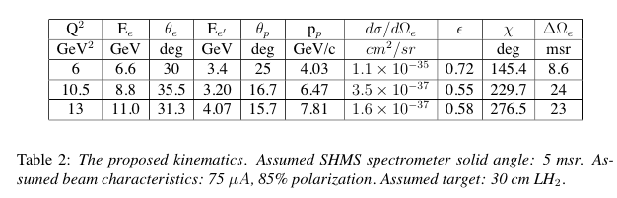
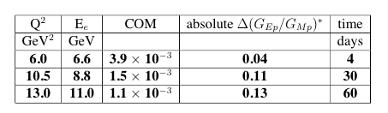
Gep-IV: Kinematics

Slide 20
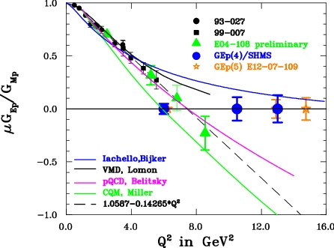
Gep-IV: Predictions

Slide 21
Gep-IV vs. Gep-V
Clean identification of elastic events is of crucial importance
  SHMS has better momentum resolution
  SBS has better angular resolution and y_target resolution
As a result, elastic identification will be accomplished in very different ways in the two experiments, resulting in different systematics
SHMS will have much lower level of random/accidental background
Gep-IV uses existing/base Hall C equipment - this has technical as well as financial/funding advantages
Gep-IV can be run very early post-upgrade
Software algorithms are refined and well-tested

Slide 22
Conclusions
Many competing/complementary theoretical models, with different approaches
While most modern calculations describe the data well in the lower Q² regime, they begin to diverge significantly beyond the currently available data
New data at higher Q² (for both proton and neutron) will place stringent constraints on available models, and will continue to motivate more advanced calculations
Gep-IV will provide high quality data on the form factor ratio up to Q² = 13 GeV², using existing/base equipment. The experiment can be carried out as soon as the 11 GeV electron beam is available in Hall C - could even be used as a commissioning experiment for the SHMS
No major technical issues face this experiment - hardware and software are “ready to go”

Slide 23
Gep-IV: Predictions

Slide 24
Backup Slides

Slide 25
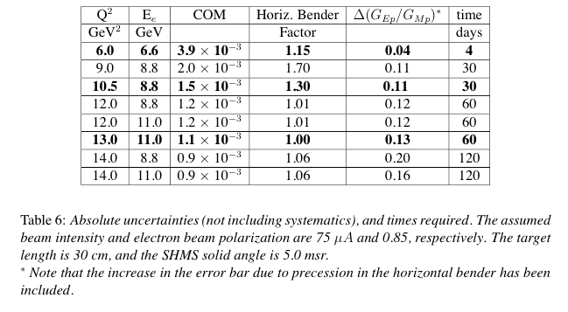

Slide 26
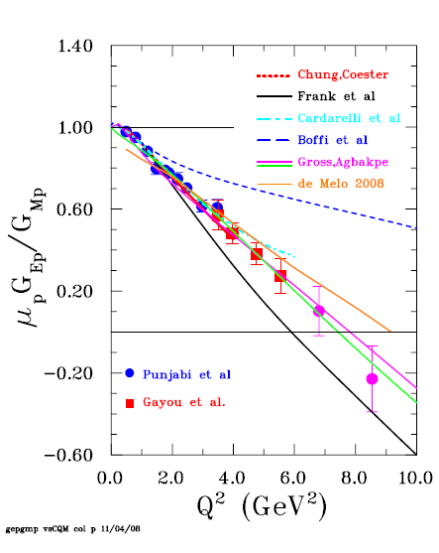
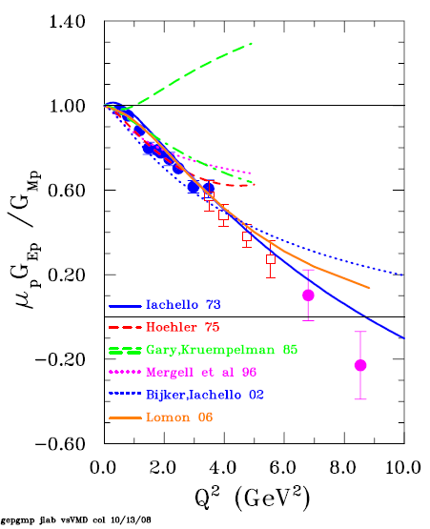
VMD and CQM

Slide 27
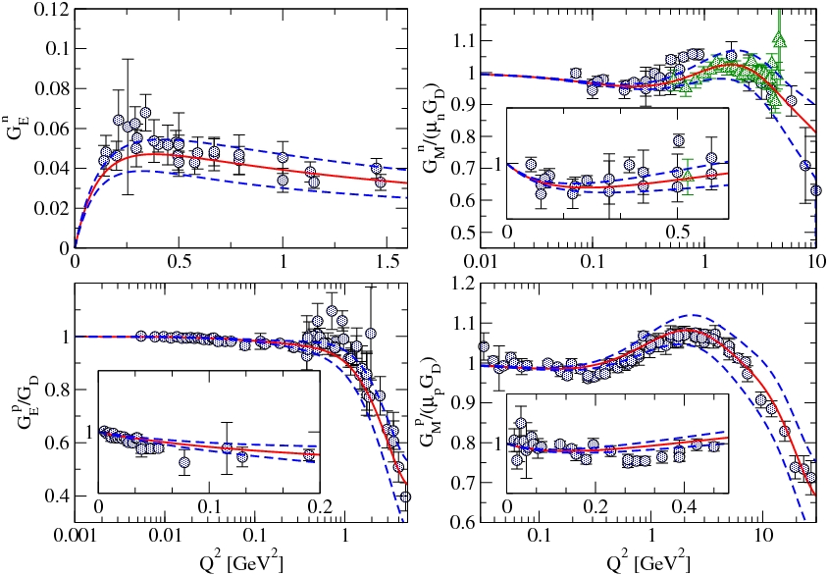
Dispersion Relation Fits (Belushkin et al.)

Slide 28
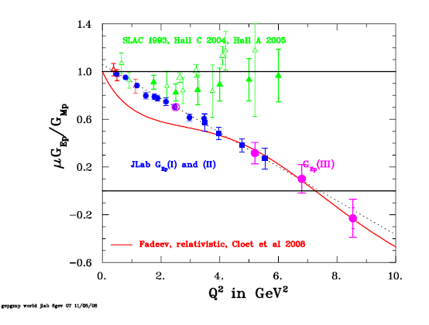
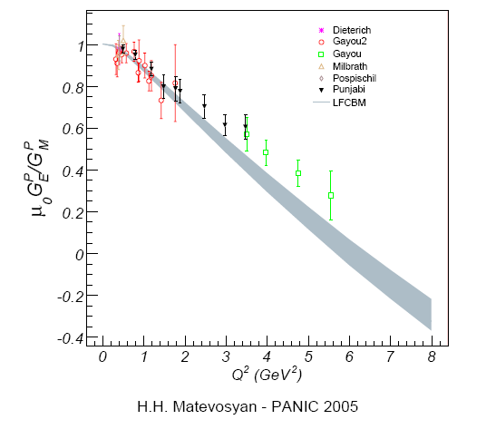
Lattice QCD, Fadeev
For example:
Poincare invariant Faddeev equation
solution.
Arrington,C. Roberts and Zanetti et al.
J. Phys. G34, S23 (2007)
Cloet et al t b p 2008
Matevosyan, Thomas,Miller(AIP 2005)
Use LFCBM (Light Front Cloudy Bag model, rCQM) to extrapolate QCDSF ‘data’ to physical pion mass, (Gloeckeler et al 2005)
Parameters: diquark magnetic dipole and quadrupole moments, scalar to vector EM transition strength.

Slide 29
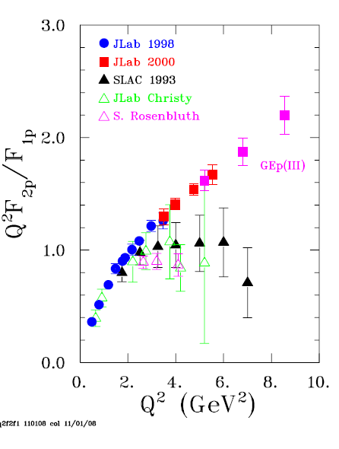
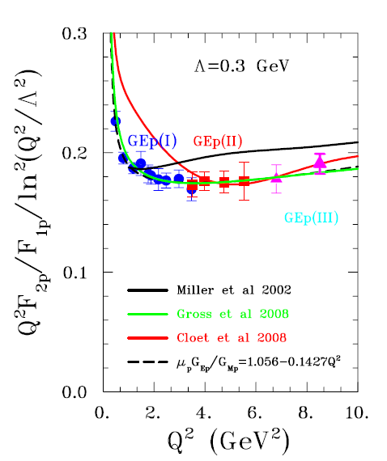
Proton: F2 /F1 and pQCD
Brodsky and Farrar (75):
Belitsky, Ji and Yuan (03):
Q²F₂/F₁ constant
→
Q²F₂/F₁ → ln²(Q²/Λ²)

Slide 30
2γ-Gamma Models and Data
PRELIMINARY
The inclusion of hard 2γ exchange:
Chen et al (2003) with GPDs,
Blunden et al (2003) in hadronic model
Several other calculations exist!
Predictions range between no effect
and approximative reproduction of data.
Expt. Jlab 04-019 measured
Ratio at 3 values of ε for Q²=2.49
GeV²; no ε-dependence at 0.01 level
_{<number>}
Notes:
_{<number>}

Slide 31
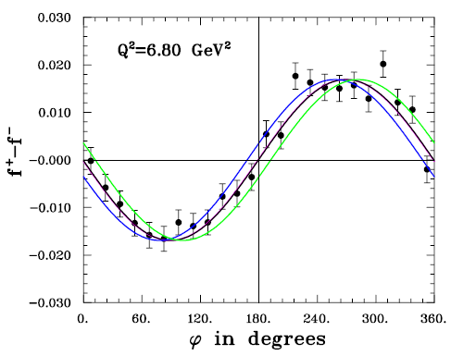
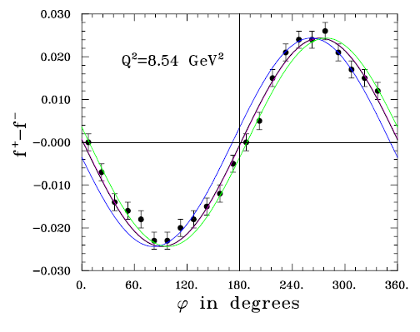
Physical Asymmetries at Q²
of 6.8 and 8.5 GeV2

Slide 32
Constituent Quark Models (Understanding the Dynamics)
Initially proposed by Isgur & Karl (78)
Early non-relativistic CQM
Relativistic CQM: 3 forms of
dynamics: instant, point like and
light-front
Point-like: Chung & Coester (91)
Cardarelli et al (00)
Front form:
Frank,Jennings, Miller (96)
G.A. Miller, Frank (02)
Goldstone boson: Boffi et al (01)
Cov. spectator: Gross,Agbakpe (04)
Gross,Ramalho,Pena (06)
Conclusion: Relativistic CQ are relevant degrees of freedom

Slide 33
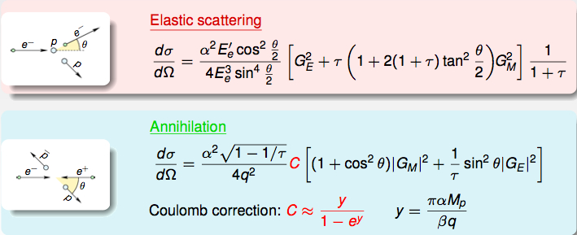
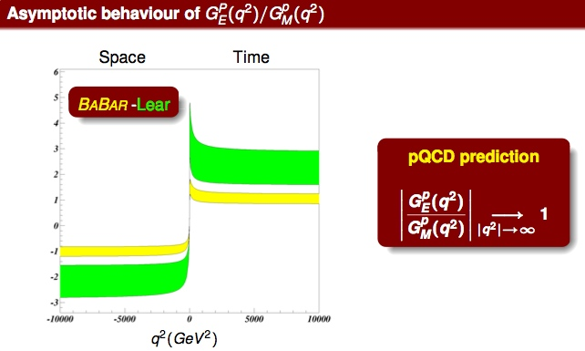
Rinaldo Baldini
Jlab Exclusive Workshop 2007

