Slide 1
Gep-IV
Electron Calorimeter Requirements

Slide 2
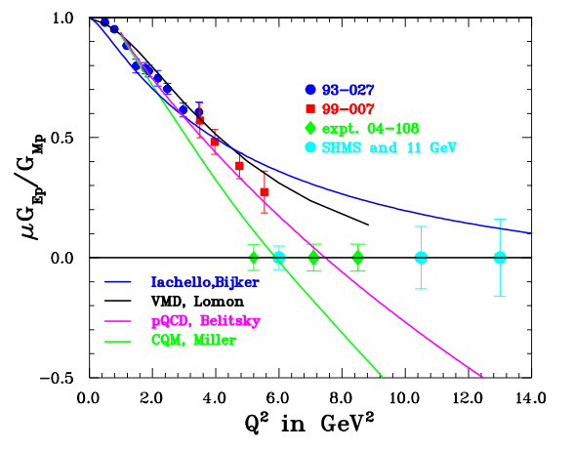
Gep-III and Gep-IV

Slide 3
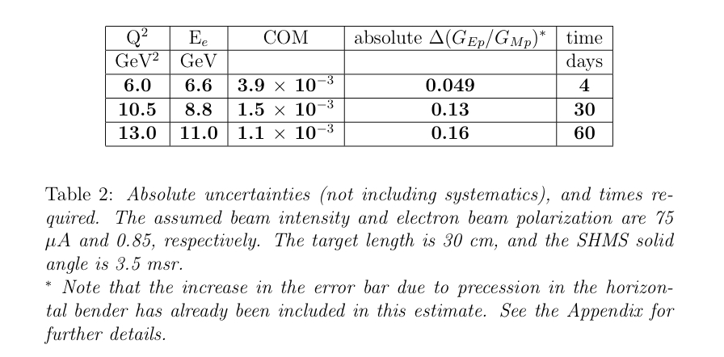
Beam Time Estimates

Slide 4
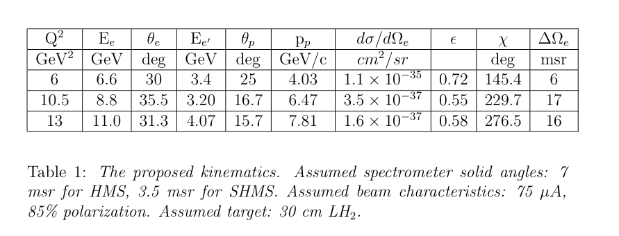
Kinematics

Slide 5
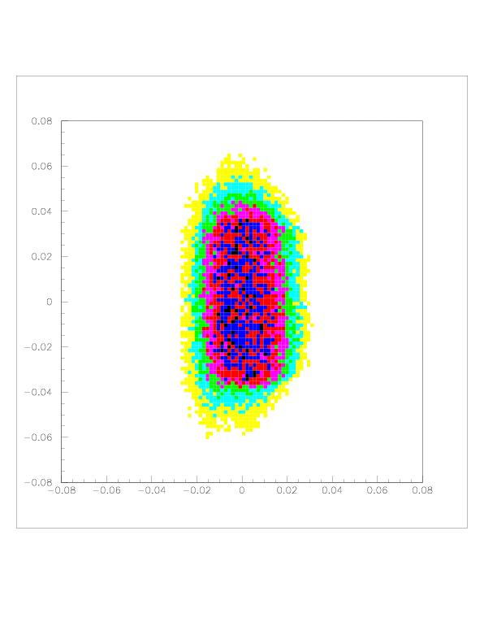
SHMS Angular Acceptance
Xptar vs. Yptar
Momentum resolution = 1%
Angular resolution = 0.5 mr

Slide 6
Electron Kinematics
Q² (GeV²) | Jacobian | (mr) | (mr)
6.0 | 1.71 | +/- 32.7 | +/- 65.4
10.5 | 4.86 | +/- 55.1 | +/- 110
13.0 | 4.57 | +/- 53.4 | +/- 107

Slide 7
Electron Kinematics (Cont’d)
Target-Detector Distance = 4.5m
Target Length = 30 cm
Q² (GeV²)
6.0 | 44.9 | 58.9
10.5 | 68.0 | 99.6
13.0 | 64.5 | 96.6

Slide 8
Conclusions
Electron energy 3-4 GeV
Electron Angle 30º
1m x 1m detector at 4.5m distance
  Angular resolution with
  (2x2cm² blocks) = 1.3 mr
  - Need to look at background rates, etc.

