Slide 1
12 GeV Trigger Workshop
Session II - DAQ System
July 8th, 2009 – Christopher Newport Univ.
David Abbott

Slide 2

Outline
DAQ/DATA Readout
  Front-End requirements
  CODA 3 changes for the front-end
  CODA Event I/O changes

Slide 3
Front-End Issues/Requirements
Front-end hardware is evolving. Real-time processing is moving from the CPU to FPGAs.
CPU-Based real-time readout on a per event basis limits the maximum accepted L1 trigger rate (~10 KHz).
Computing platform and OS changes (Multi-core, more memory, 64 bit systems etc…) are not taken advantage of at the Front-End.
The v2 CODA ROC relies on older third-party technologies that are becoming impossible to upkeep on both vxWorks and Unix platforms.
12 GeV Experiments: 200 kHz Level 1 Trigger rates, 3 GB/s data rates

Slide 4
CODA V3 Front-End
OS (vxWorks, LINUX)
other
Libs
DMA
Lib
VME
Lib
PCI
ROC
USB
Process
Thread
Readout
Thread
Buffer
Pool
FIFO
Modules
User
FIFO
USER
Lib
Trigger Thread
VME
Control
Output Thread
to EMU
cMsg

Slide 5
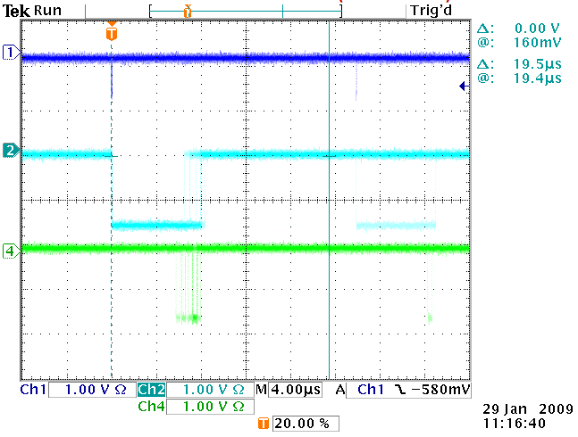
CTP
L1 Trigger
(optional)
SD
Clock/Trigger
Distribution
Linux on the
Front End
CPU – GE FANUC 7865
Intel Core 2 Duo
(2.1GHz)
Dual GigE
TI (ver 3)
CODA 2 & 3
support
FADC
F1TDC
VXS Crate
110 MB/s off the CPU on a
single GigE link uses only 6%
of a single CPU and minimal
jitter on front-end response.
Front End System

Slide 6
VME Readout
Interrupt Response:
V7865 MV6100
Time from external signal
In the TI to the IACK cycle
On the VME bus : 22-23µs 6.0µs
Time from IACK cycle to
Execution of Callback (or ISR): 14-15µs 1.5µs
Total: 36-38µs 7.5µs
VME Write (using SDK Library) 760 ns N/A
VME Write (using memory map) 350 ns 460ns
VME Read (using SDK Library) 3.2 µs N/A
VME Read (using memory map) 2.6 µs 1.0 µs

Slide 7
VME Readout Cont…
DMA Transfers:
V7865 MV6100 Theoretical Minimum
Time for 400 byte transfer Max Size
Over the VME Bus: BLT: 16.0 µs (25 MB/s) 40 MB/s 4 bytes/mod
MBLT: 7.5 µs (53 MB/s) 80 MB/s 8 bytes/mod
2eVME 3.7 µs (108 MB/s) 160 MB/s 16 bytes/mod
2eSST: 2.6 µs (154 MB/s) 160/270/320 16 bytes/mod
Overhead to move data to (Mbytes/s)
User accessible buffer: 45-75 µs 0 µs
Network Performance:
Max Transfer rate: 117 MB/s 79 MB/s
CPU %: 6-10% (of 1) 100%

Slide 8
DAQ Issues
For 200 kHz triggers -> ~ 1 kHz readout
At 200 MB/s we can only average about
50 bytes/module/event for a full crate
Data from CTP and SD must be retrieved
through the TI. Do we need this per Event.
All front-end modules must be able to buffer
events to support pipelined triggers. If one also
wants asynchronous DMA readout they must
support the JLAB multi-board token passing
(VXS only).
VXS crates via the SD will distribute clock and triggers and
collect busy/error status info. Currently there is no solution for
standard VME crates to do this (for more than a few boards).
C
P
U
C
T
P
S
D
T
I
FADC
F1TDC

Slide 9

Event Blocking
Readout Data every N triggers
length
} CODA Bank Header
C
P
U
M1
M2
M3
TI
TI (1-N)
M1 (1-N)
M2 (1-N)
Max 256 Events/block
Read Trigger Info first (Data ID)
All modules must buffer for pipelined triggers
Multi-board DMA allows for asynchronous readout
M3 (1-N)

Slide 10

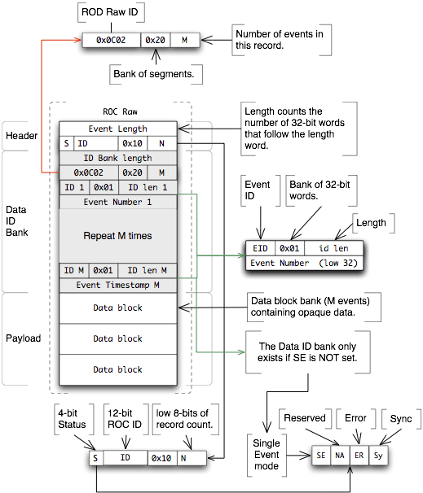
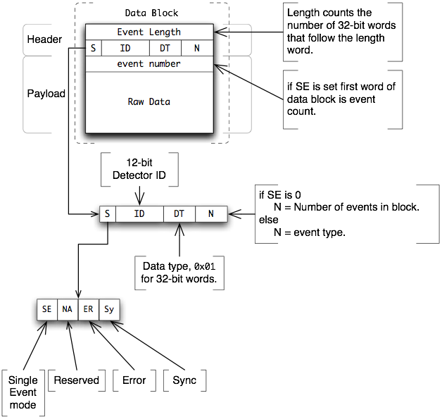
CODA Event I/O
DATA BLOCK
ROC RAW DATA

