Slide 1
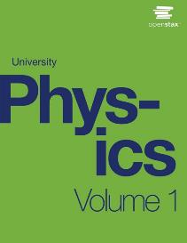

UNIVERSITY Physics
Chapter 1 UNITS AND MEASUREMENT
PowerPoint Image Slideshow

Slide 2

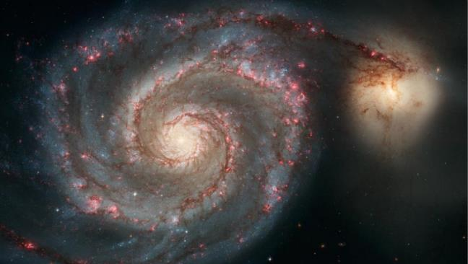
Figure 1.1
This image might be showing any number of things. It might be a whirlpool in a tank of water or perhaps a collage of paint and shiny beads done for art class. Without knowing the size of the object in units we all recognize, such as meters or inches, it is difficult to know what we’re looking at. In fact, this image shows the Whirlpool Galaxy (and its companion galaxy), which is about 60,000 light-years in diameter (about 6 × 10¹⁷ km across). (credit: S. Beckwith (STScI) Hubble Heritage Team, (STScI/AURA), ESA, NASA)

Slide 3
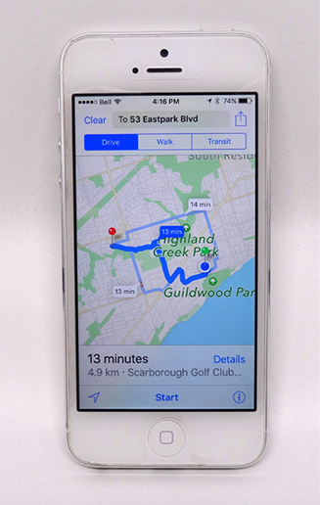
Figure 1.2
The Apple iPhone is a common smartphone with a GPS function. Physics describes the way that electricity flows through the circuits of this device. Engineers use their knowledge of physics to construct an iPhone with features that consumers will enjoy. One specific feature of an iPhone is the GPS function. A GPS uses physics equations to determine the drive time between two locations on a map.

Slide 4
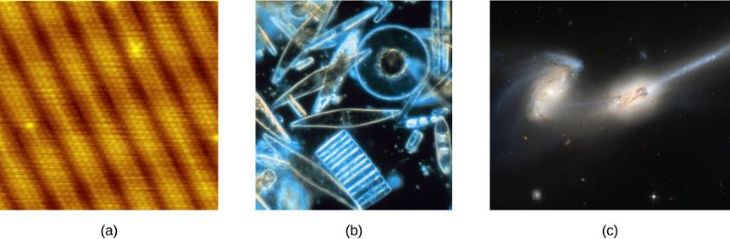
Figure 1.3
Using a scanning tunneling microscope, scientists can see the individual atoms (diameters around 10^{–10} m) that compose this sheet of gold.
Tiny phytoplankton swim among crystals of ice in the Antarctic Sea. They range from a few micrometers (1 μm is 10^{–6} m) to as much as 2 mm (1 mm is 10^{–2} m) in length.
These two colliding galaxies, known as NGC 4676A (right) and NGC 4676B (left), are nicknamed “The Mice” because of the tail of gas emanating from each one. They are located 300 million light-years from Earth in the constellation Coma Berenices. Eventually, these two galaxies will merge into one. (credit a: modification of work by Erwinrossen; credit b: modification of work by Prof. Gordon T. Taylor, Stony Brook University; NOAA Corps Collections; credit c: modification of work by NASA, H. Ford (JHU), G. Illingworth (UCSC/LO), M. Clampin (STScI), G. Hartig (STScI), the ACS Science Team, and ESA)

Slide 5
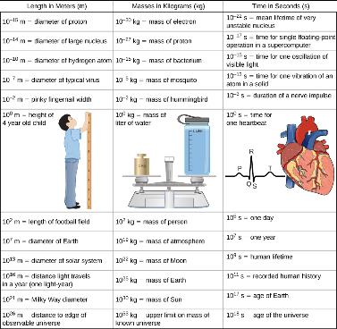
Figure 1.4
This table shows the orders of magnitude of length, mass, and time.

Slide 6
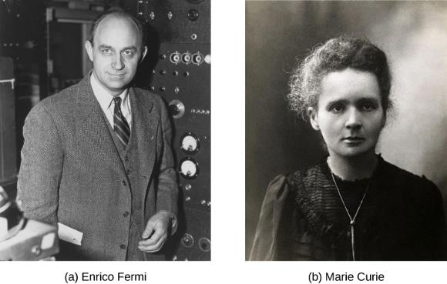
Figure 1.5
Enrico Fermi (1901–1954) was born in Italy. On accepting the Nobel Prize in Stockholm in 1938 for his work on artificial radioactivity produced by neutrons, he took his family to America rather than return home to the government in power at the time. He became an American citizen and was a leading participant in the Manhattan Project.
Marie Curie (1867–1934) sacrificed monetary assets to help finance her early research and damaged her physical well-being with radiation exposure. She is the only person to win Nobel prizes in both physics and chemistry. One of her daughters also won a Nobel Prize. (credit a: United States Department of Energy)

Slide 7
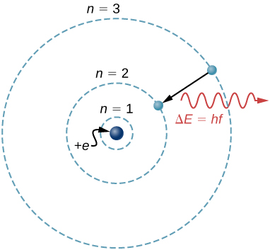
Figure 1.6
What is a model? The Bohr model of a single-electron atom shows the electron orbiting the nucleus in one of several possible circular orbits. Like all models, it captures some, but not all, aspects of the physical system.

Slide 8
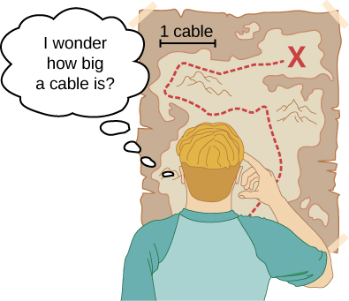
Figure 1.7
Distances given in unknown units are maddeningly useless.

Slide 9
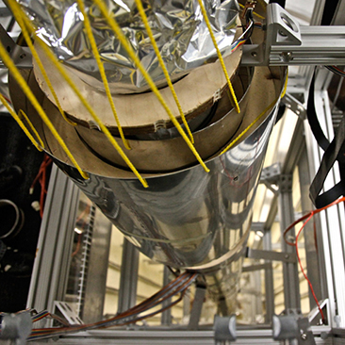
Figure 1.8
An atomic clock such as this one uses the vibrations of cesium atoms to keep time to a precision of better than a microsecond per year. The fundamental unit of time, the second, is based on such clocks. This image looks down from the top of an atomic fountain nearly 30 feet tall. (credit: Steve Jurvetson)

Slide 10
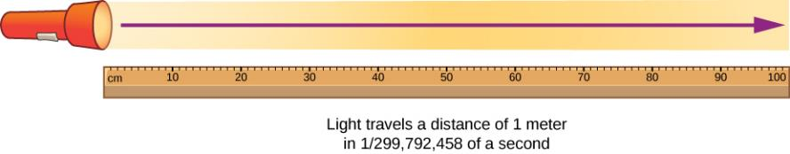
Figure 1.9
The meter is defined to be the distance light travels in 1/299,792,458 of a second in a vacuum. Distance traveled is speed multiplied by time.

Slide 11
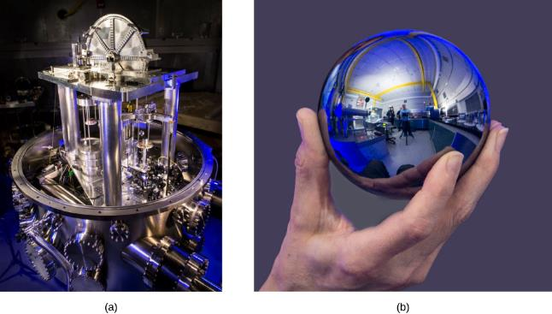
Figure 1.10
Redefining the SI unit of mass. Complementary methods are being investigated for use in an upcoming redefinition of the SI unit of mass.
The U.S. National Institute of Standards and Technology’s watt balance is a machine that balances the weight of a test mass against the current and voltage (the “watt”) produced by a strong system of magnets.
The International Avogadro Project is working to redefine the kilogram based on the dimensions, mass, and other known properties of a silicon sphere. (credit a and credit b: National Institute of Standards and Technology)

Slide 12
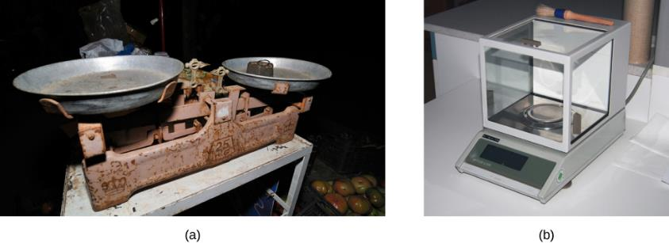
Figure 1.11
A double-pan mechanical balance is used to compare different masses. Usually an object with unknown mass is placed in one pan and objects of known mass are placed in the other pan. When the bar that connects the two pans is horizontal, then the masses in both pans are equal. The “known masses” are typically metal cylinders of standard mass such as 1 g, 10 g, and 100 g.
Many mechanical balances, such as double-pan balances, have been replaced by digital scales, which can typically measure the mass of an object more precisely. A mechanical balance may read only the mass of an object to the nearest tenth of a gram, but many digital scales can measure the mass of an object up to the nearest thousandth of a gram. (credit a: modification of work by Serge Melki; credit b: modification of work by Karel Jakubec)

Slide 13
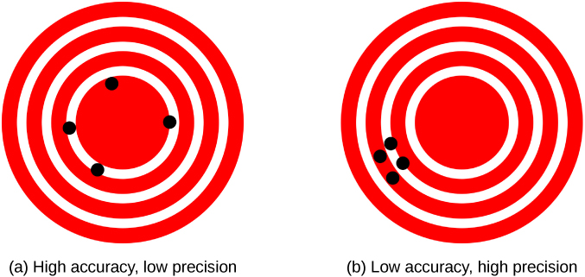
Figure 1.12
A GPS attempts to locate a restaurant at the center of the bull’s-eye. The black dots represent each attempt to pinpoint the location of the restaurant.
The dots are spread out quite far apart from one another, indicating low precision, but they are each rather close to the actual location of the restaurant, indicating high accuracy.
The dots are concentrated rather closely to one another, indicating high precision, but they are rather far away from the actual location of the restaurant, indicating low accuracy. (credit a and credit b: modification of works by Dark Evil)

Slide 14
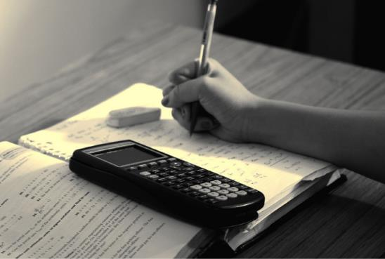
Figure 1.13
Problem-solving skills are essential to your success in physics. (credit: “scui3asteveo”/Flickr)

Slide 15
This OpenStax ancillary resource is © Rice University under a CC-BY 4.0 International license; it may be reproduced or modified but must be attributed to OpenStax, Rice University and any changes must be noted.

