Slide 1
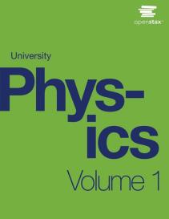

UNIVERSITY Physics
Chapter 2 VECTORS
PowerPoint Image Slideshow

Slide 2


Figure 2.1
A signpost gives information about distances and directions to towns or to other locations relative to the location of the signpost. Distance is a scalar quantity. Knowing the distance alone is not enough to get to the town; we must also know the direction from the signpost to the town. The direction, together with the distance, is a vector quantity commonly called the displacement vector. A signpost, therefore, gives information about displacement vectors from the signpost to towns. (credit: modification of work by “studio tdes”/Flickr)

Slide 3
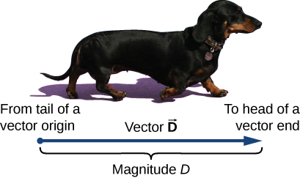
Figure 2.2
We draw a vector from the initial point or origin (called the “tail” of a vector) to the end or terminal point (called the “head” of a vector), marked by an arrowhead. Magnitude is the length of a vector and is always a positive scalar quantity. (credit: modification of work by Cate Sevilla)

Slide 4
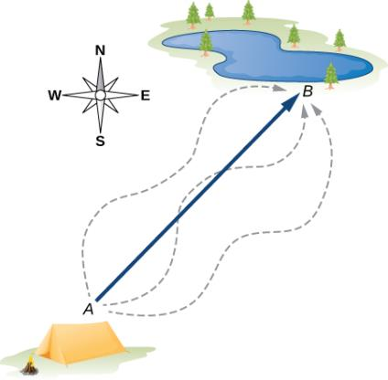
Figure 2.3
The displacement vector from point A (the initial position at the campsite) to point B (the final position at the fishing hole) is indicated by an arrow with origin at point A and end at point B. The displacement is the same for any of the actual paths (dashed curves) that may be taken between points A and B.

Slide 5
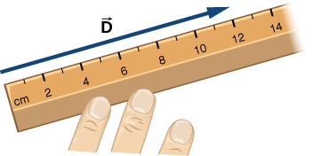
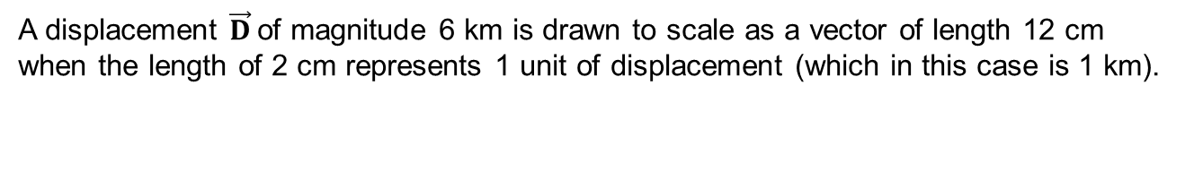
Figure 2.4
A displacement $\vec{D}$of magnitude 6 km is drawn to scale as a vector of length 12 cm when the length of 2 cm represents 1 unit of displacement (which in this case is 1 km).

Slide 6
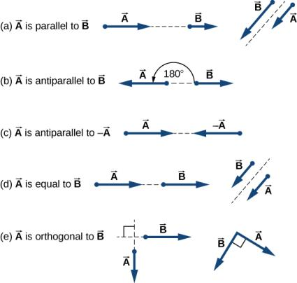
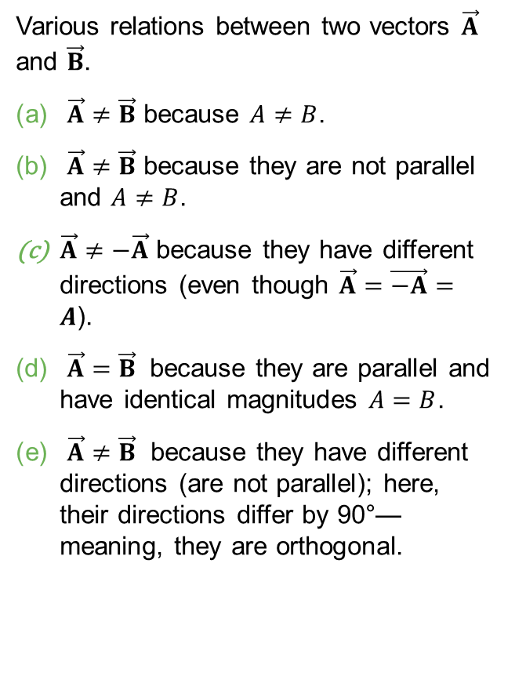
Figure 2.5
Various relations between two vectors $\vec{A}$ and $\vec{B}$.
$\vec{A}≠\vec{B}$ because $A≠B$.
$\vec{A}≠\vec{B}$ because they are not parallel and $A≠B$.
$\vec{A}≠−\vec{A}$ because they have different directions (even though $\vec{A}=\vec{−A}=A$).
$\vec{A}=\vec{B}$ because they are parallel and have identical magnitudes $A=B$.
$\vec{A}≠\vec{B}$ because they have different directions (are not parallel); here, their directions differ by 90°—meaning, they are orthogonal.

Slide 7
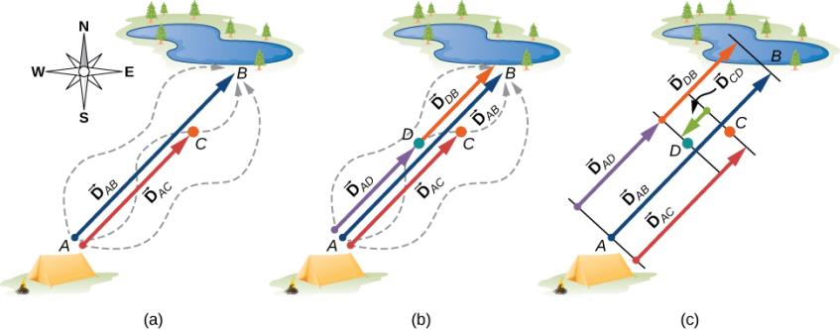
Figure 2.6
Displacement vectors for a fishing trip.
Stopping to rest at point C while walking from camp (point A) to the pond (point B).
Going back for the dropped tackle box (point D).
Finishing up at the fishing pond.

Slide 8
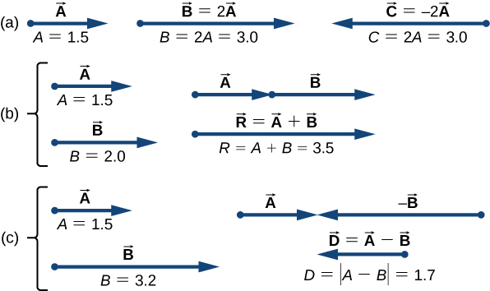
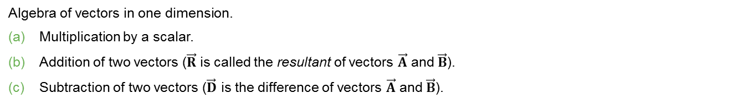
Figure 2.7
Algebra of vectors in one dimension.
Multiplication by a scalar.
Addition of two vectors ($\vec{R}$ is called the resultant of vectors $\vec{A}$ and $\vec{B}$).
Subtraction of two vectors ($\vec{D}$ is the difference of vectors $\vec{A}$ and $\vec{B}$).

Slide 9
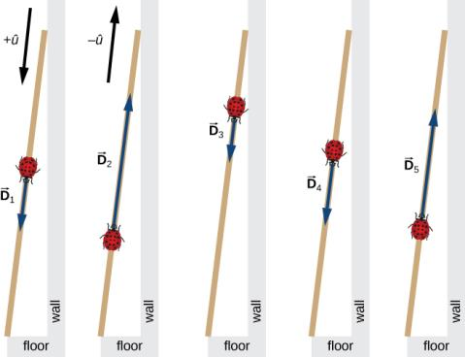
Figure 2.8
Five displacements of the ladybug. Note that in this schematic drawing, magnitudes of displacements are not drawn to scale. (credit: modification of work by “Persian Poet Gal”/Wikimedia Commons)

Slide 10
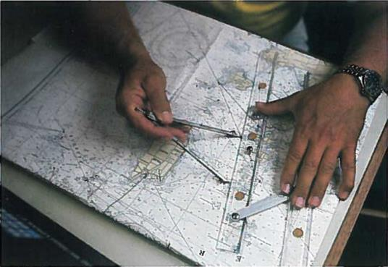
Figure 2.9
In navigation, the laws of geometry are used to draw resultant displacements on nautical maps.

Slide 11
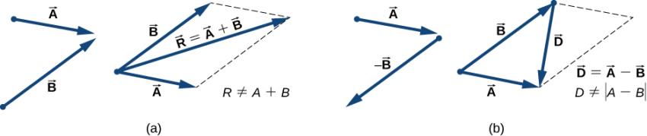
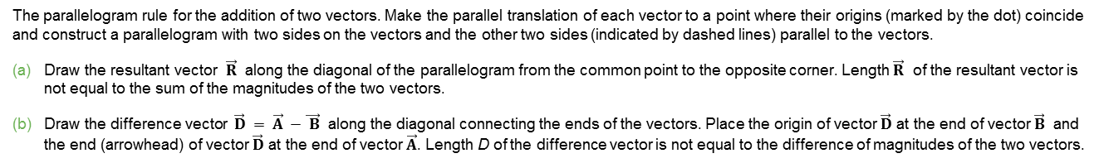
Figure 2.10
The parallelogram rule for the addition of two vectors. Make the parallel translation of each vector to a point where their origins (marked by the dot) coincide and construct a parallelogram with two sides on the vectors and the other two sides (indicated by dashed lines) parallel to the vectors.
Draw the resultant vector $\vec{R}$ along the diagonal of the parallelogram from the common point to the opposite corner. Length $\vec{R}$ of the resultant vector is not equal to the sum of the magnitudes of the two vectors.
Draw the difference vector $\vec{D} = \vec{A} −\vec{ B}$ along the diagonal connecting the ends of the vectors. Place the origin of vector $\vec{D}$ at the end of vector $\vec{B}$ and the end (arrowhead) of vector $\vec{D}$ at the end of vector $\vec{A}$. Length D of the difference vector is not equal to the difference of magnitudes of the two vectors.

Slide 12
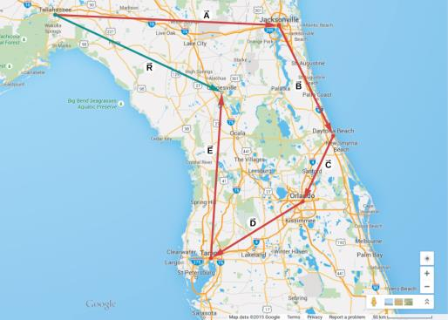
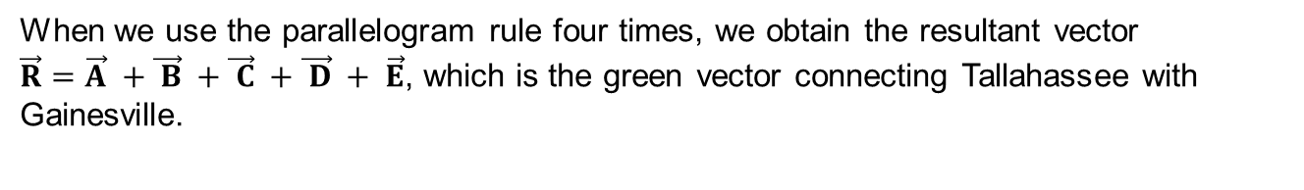
Figure 2.11
When we use the parallelogram rule four times, we obtain the resultant vector $\vec{R}=\vec{A} +\vec{ B} +\vec{ C} +\vec{ D} + \vec{E}$, which is the green vector connecting Tallahassee with Gainesville.

Slide 13
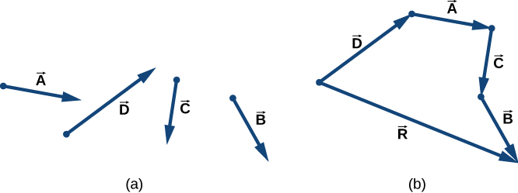
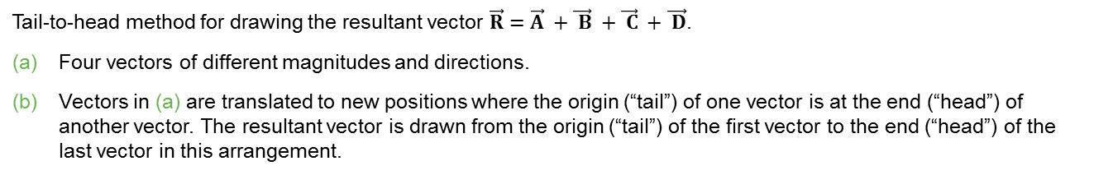
Figure 2.12
Tail-to-head method for drawing the resultant vector $\vec{R}=\vec{A} +\vec{ B} +\vec{ C} +\vec{ D}$.
Four vectors of different magnitudes and directions.
Vectors in (a) are translated to new positions where the origin (“tail”) of one vector is at the end (“head”) of another vector. The resultant vector is drawn from the origin (“tail”) of the first vector to the end (“head”) of the last vector in this arrangement.

Slide 14
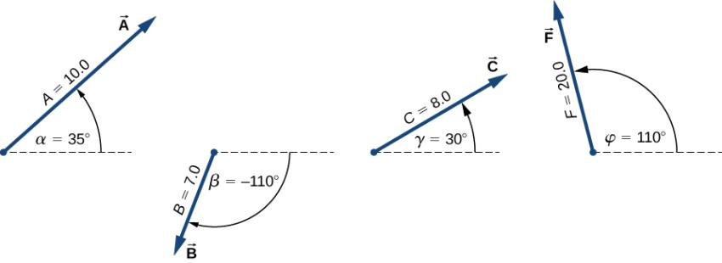
Figure 2.13
Vectors used in Example 2.2 and in the Check Your Understanding feature that follows.

Slide 15
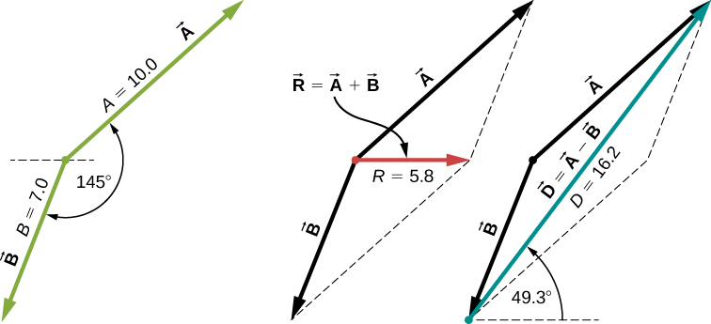
Figure 2.14
Using the parallelogram rule to solve (a) (finding the resultant, red) and (b) (finding the difference, blue).

Slide 16
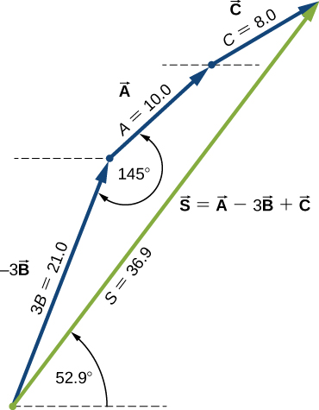

Figure 2.15
Using the tail-to-head method to solve (c) (finding vector $\vec{S}$, green).

Slide 17
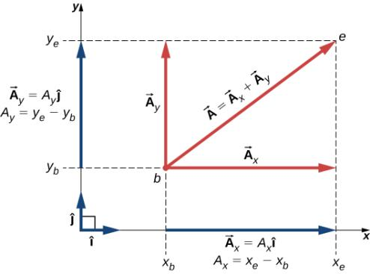
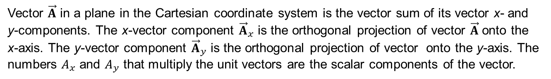
Figure 2.16
Vector $\vec{A}$ in a plane in the Cartesian coordinate system is the vector sum of its vector x- and y-components. The x-vector component ${\vec{A}}_{x}$ is the orthogonal projection of vector $\vec{A}$ onto the x-axis. The y-vector component ${\vec{A}}_{y}$ is the orthogonal projection of vector onto the y-axis. The numbers $A_{x}$ and $A_{y}$ that multiply the unit vectors are the scalar components of the vector.

Slide 18
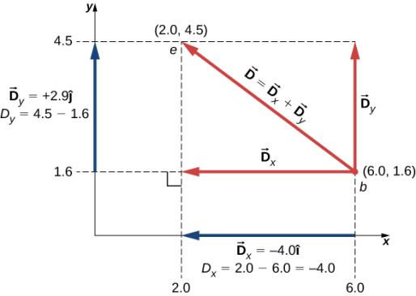
Figure 2.17
The graph of the displacement vector. The vector points from the origin point at b to the end point at e.

Slide 19

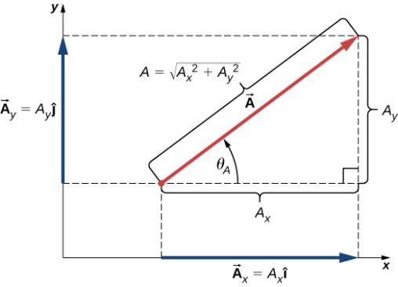
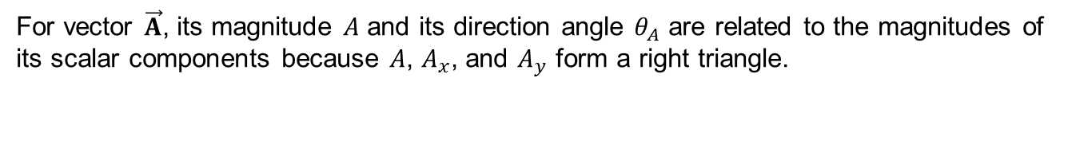
Figure 2.18
For vector $\vec{A}$, its magnitude $A$ and its direction angle $θ_{A}$ are related to the magnitudes of its scalar components because $A$, $A_{x}$, and $A_{y}$ form a right triangle.

Slide 20
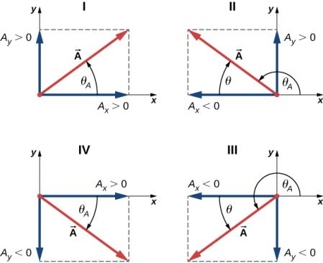
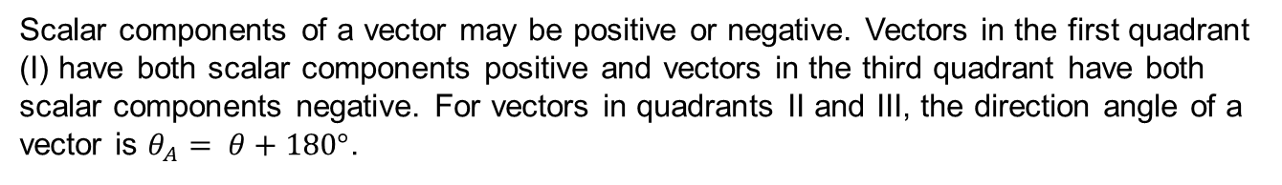
Figure 2.19
Scalar components of a vector may be positive or negative. Vectors in the first quadrant (I) have both scalar components positive and vectors in the third quadrant have both scalar components negative. For vectors in quadrants II and III, the direction angle of a vector is $θ_{A}= θ+180°$.

Slide 21
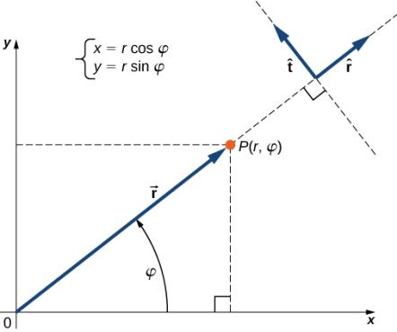
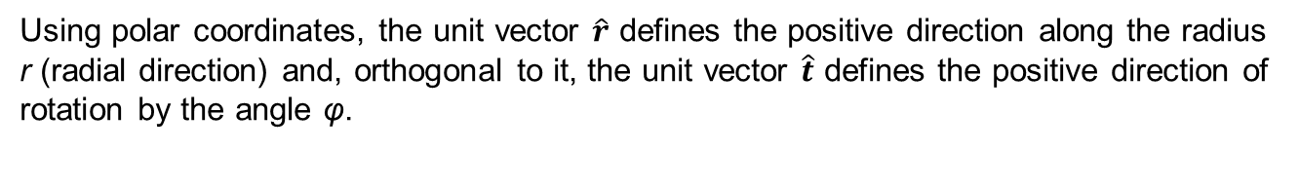
Figure 2.20
Using polar coordinates, the unit vector $\hat{r}$ defines the positive direction along the radius r (radial direction) and, orthogonal to it, the unit vector $\hat{t}$ defines the positive direction of rotation by the angle φ.

Slide 22
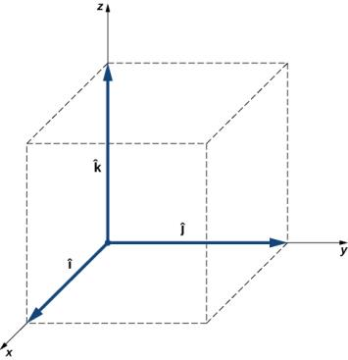
Figure 2.21
Three unit vectors define a Cartesian system in three-dimensional space. The order in which these unit vectors appear defines the orientation of the coordinate system. The order shown here defines the right-handed orientation.

Slide 23
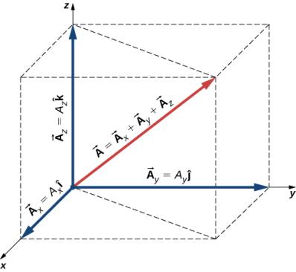
Figure 2.22
A vector in three-dimensional space is the vector sum of its three vector components.

Slide 24
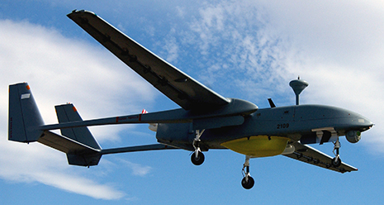
Figure 2.23
The drone IAI Heron in flight. (credit: SSgt Reynaldo Ramon, USAF)

Slide 25
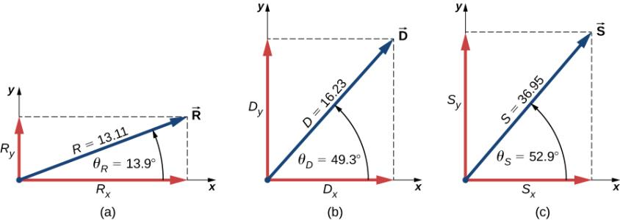
Figure 2.24
Graphical illustration of the solutions obtained analytically in Example 2.9.

Slide 26
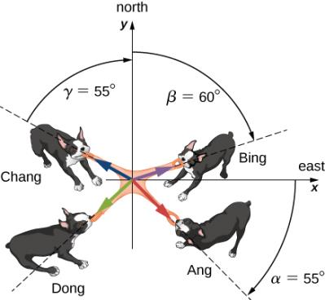
Figure 2.25
Four dogs play a tug-of-war game with a toy.

Slide 27
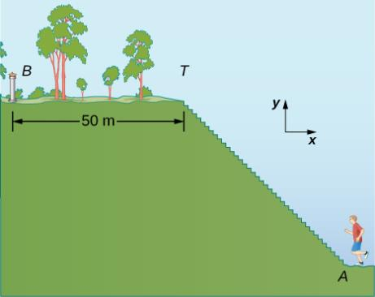
Figure 2.26
A jogger runs up a flight of steps.

Slide 28
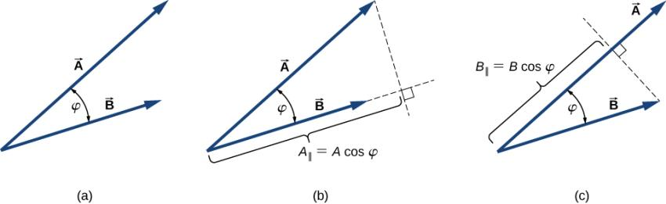
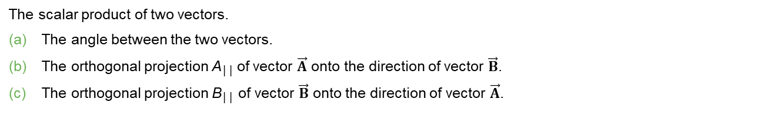
Figure 2.27
The scalar product of two vectors.
The angle between the two vectors.
The orthogonal projection A││ of vector $\vec{A}$ onto the direction of vector $\vec{B}$.
The orthogonal projection B││ of vector $\vec{B}$ onto the direction of vector $\vec{A}$.

Slide 29
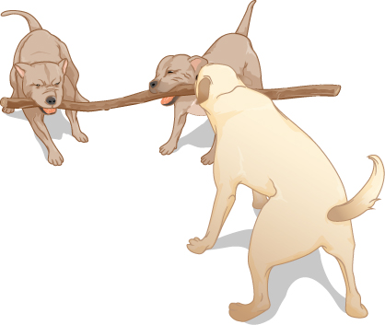
Figure 2.28
Three dogs are playing with a stick.

Slide 30
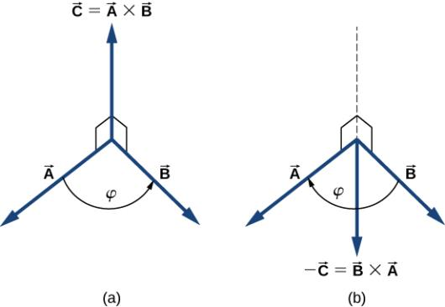
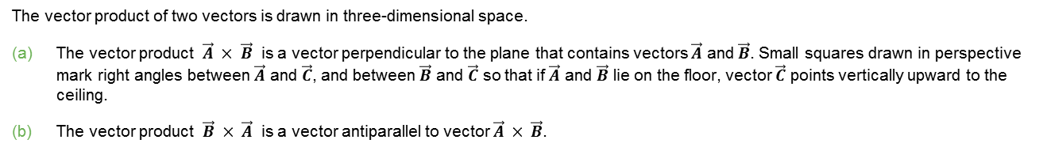
Figure 2.29
The vector product of two vectors is drawn in three-dimensional space.
The vector product $\vec{A} × \vec{B}$ is a vector perpendicular to the plane that contains vectors $\vec{A}$ and $\vec{B}$. Small squares drawn in perspective mark right angles between $\vec{A}$ and $\vec{C}$, and between $\vec{B}$ and $\vec{C}$ so that if $\vec{A}$ and $\vec{B}$ lie on the floor, vector $\vec{C}$ points vertically upward to the ceiling.
The vector product $\vec{B} × \vec{A}$ is a vector antiparallel to vector $\vec{A} × \vec{B}$.

Slide 31
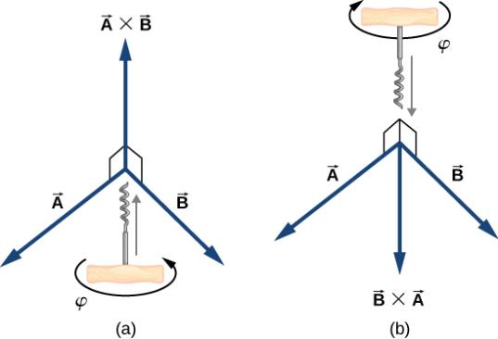
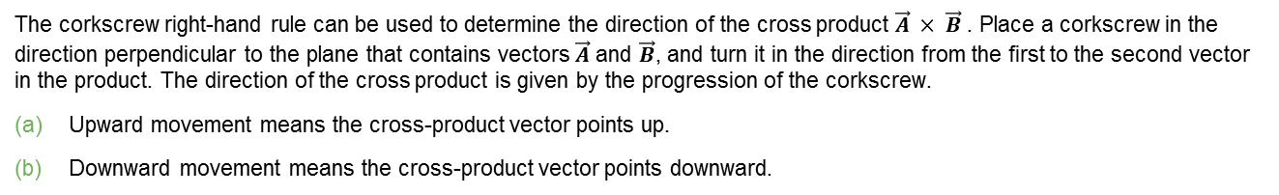
Figure 2.30
The corkscrew right-hand rule can be used to determine the direction of the cross product $\vec{A} × \vec{B}$ . Place a corkscrew in the direction perpendicular to the plane that contains vectors $\vec{A}$ and $\vec{B}$, and turn it in the direction from the first to the second vector in the product. The direction of the cross product is given by the progression of the corkscrew.
Upward movement means the cross-product vector points up.
Downward movement means the cross-product vector points downward.

Slide 32
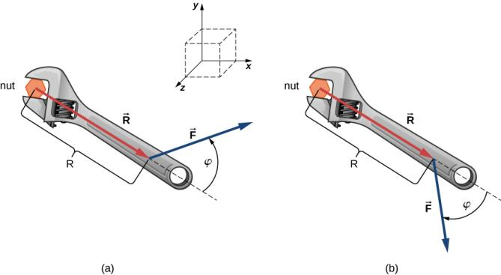
Figure 2.31
A wrench provides grip and mechanical advantage in applying torque to turn a nut.
Turn counterclockwise to loosen the nut.
Turn clockwise to tighten the nut.

Slide 33
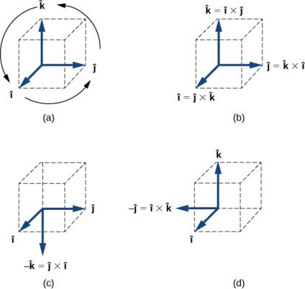
Figure 2.32
The diagram of the cyclic order of the unit vectors of the axes.
The only cross products where the unit vectors appear in the cyclic order. These products have the positive sign.
(d) Two examples of cross products where the unit vectors do not appear in the cyclic order. These products have the negative sign.

Slide 34
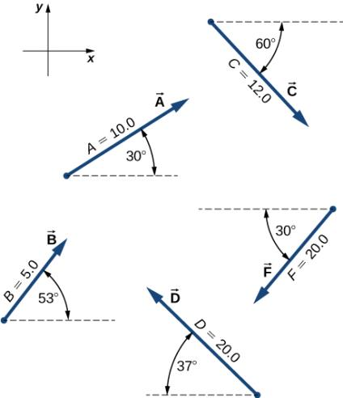
EXERCISE 28

Slide 35
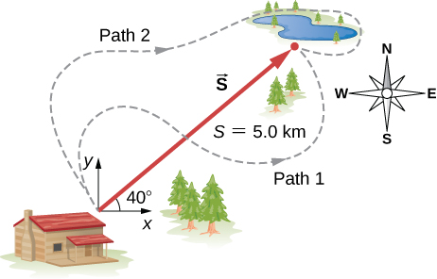
EXERCISE 33

Slide 36
EXERCISE 41

Slide 37
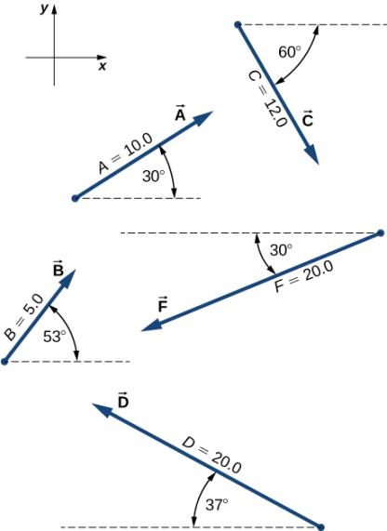
EXERCISE 62

Slide 38
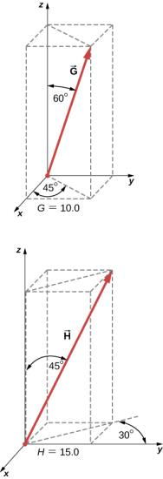
EXERCISE 82

Slide 39
EXERCISE 86

Slide 40

EXERCISE 87

Slide 41

EXERCISE 90

Slide 42

EXERCISE 91

Slide 43
This OpenStax ancillary resource is © Rice University under a CC-BY 4.0 International license; it may be reproduced or modified but must be attributed to OpenStax, Rice University and any changes must be noted.

