Slide 1


UNIVERSITY Physics
Chapter 3 MOTION ALONG A STRAIGHT LINE
PowerPoint Image Slideshow

Slide 2

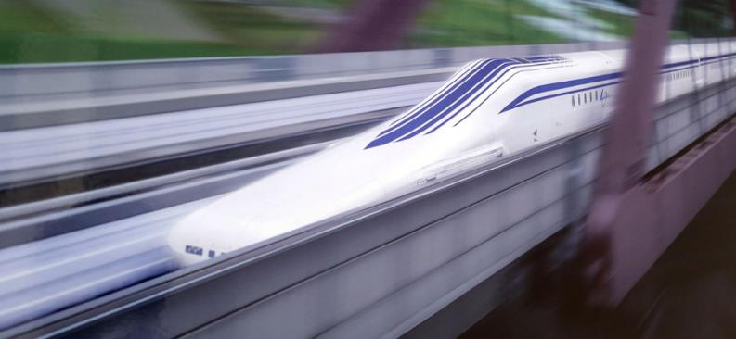
Figure 3.1
A JR Central L0 series five-car maglev (magnetic levitation) train undergoing a test run on the Yamanashi Test Track. The maglev train’s motion can be described using kinematics, the subject of this chapter. (credit: modification of work by “Maryland GovPics”/Flickr)

Slide 3

Figure 3.2
These cyclists in Vietnam can be described by their position relative to buildings or a canal. Their motion can be described by their change in position, or displacement, in a frame of reference. (credit: Suzan Black)

Slide 4
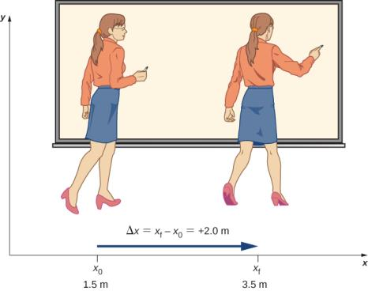
Figure 3.3
A professor paces left and right while lecturing. Her position relative to Earth is given by x. The +2.0-m displacement of the professor relative to Earth is represented by an arrow pointing to the right.

Slide 5
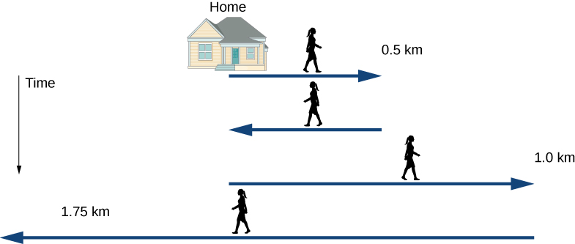
Figure 3.4
Timeline of Jill’s movements.

Slide 6
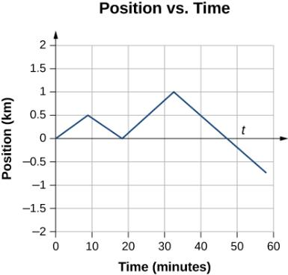
Figure 3.5
This graph depicts Jill’s position versus time. The average velocity is the slope of a line connecting the initial and final points.

Slide 7

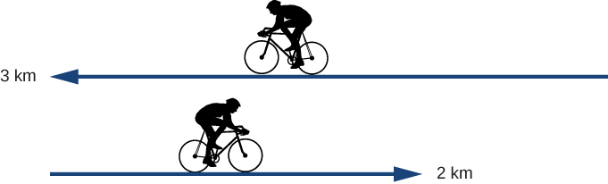
EXAMPLE 3.1

Slide 8
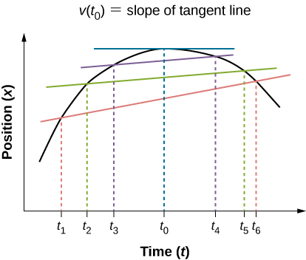
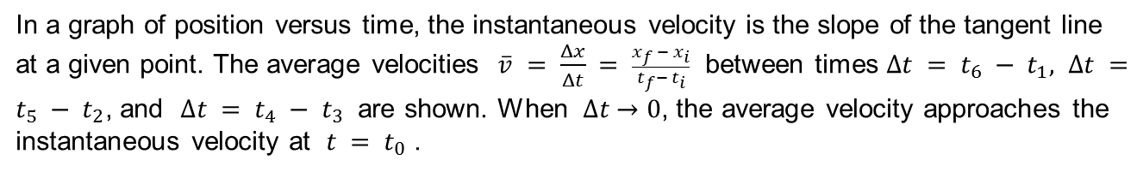
Figure 3.6
In a graph of position versus time, the instantaneous velocity is the slope of the tangent line at a given point. The average velocities $\overline{v} = \frac{Δx}{Δt} = \frac{x_{f }− x_{i}}{t_{f}−{ t}_{i}}$ between times $∆t = t_{6} − t_{1}, ∆t =t_{5} − t_{2}$, and $∆t = t_{4} −{ t}_{3}$ are shown. When $∆t$ → 0, the average velocity approaches the instantaneous velocity at $t = t_{0}$ .

Slide 9
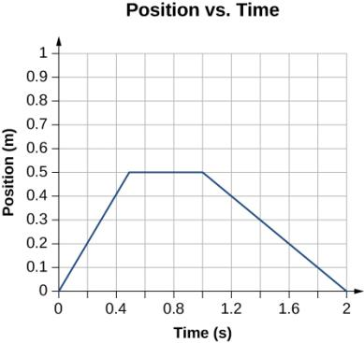
Figure 3.7
The object starts out in the positive direction, stops for a short time, and then reverses direction, heading back toward the origin. Notice that the object comes to rest instantaneously, which would require an infinite force. Thus, the graph is an approximation of motion in the real world. (The concept of force is discussed in Newton’s Laws of Motion.)

Slide 10
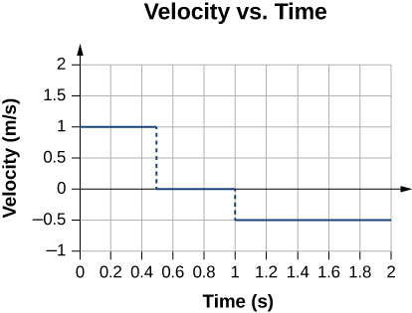
Figure 3.8
The velocity is positive for the first part of the trip, zero when the object is stopped, and negative when the object reverses direction.

Slide 11
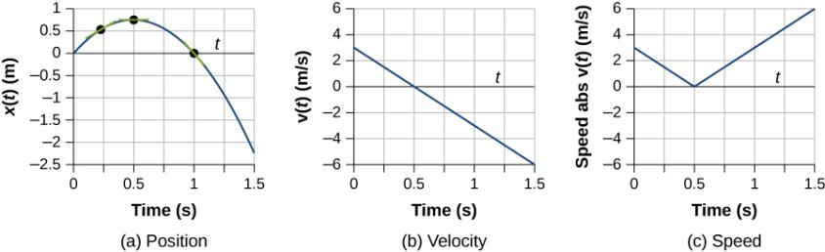
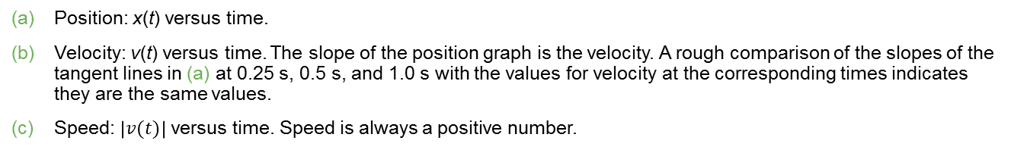
Figure 3.9
Position: x(t) versus time.
Velocity: v(t) versus time. The slope of the position graph is the velocity. A rough comparison of the slopes of the tangent lines in (a) at 0.25 s, 0.5 s, and 1.0 s with the values for velocity at the corresponding times indicates they are the same values.
Speed: $\left|v(t)\right|$ versus time. Speed is always a positive number.

Slide 12
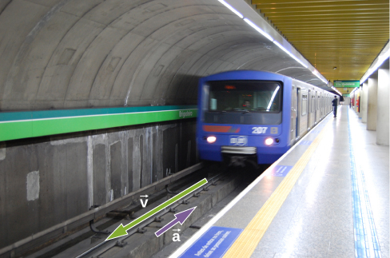
Figure 3.10
A subway train in Sao Paulo, Brazil, decelerates as it comes into a station. It is accelerating in a direction opposite to its direction of motion. (credit: Yusuke Kawasaki)

Slide 13
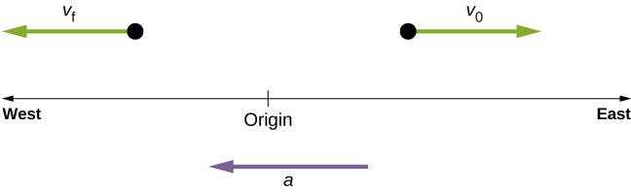
Figure 3.11
An object in motion with a velocity vector toward the east under negative acceleration comes to a rest and reverses direction. It passes the origin going in the opposite direction after a long enough time.

Slide 14
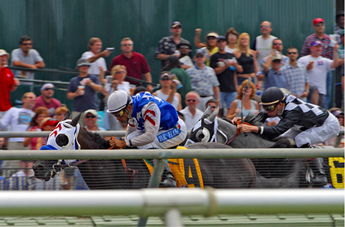
Figure 3.12
Racehorses accelerating out of the gate. (credit: Jon Sullivan)

Slide 15
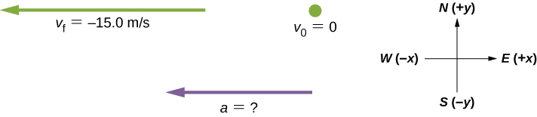
Figure 3.13
Identify the coordinate system, the given information, and what you want to determine.

Slide 16
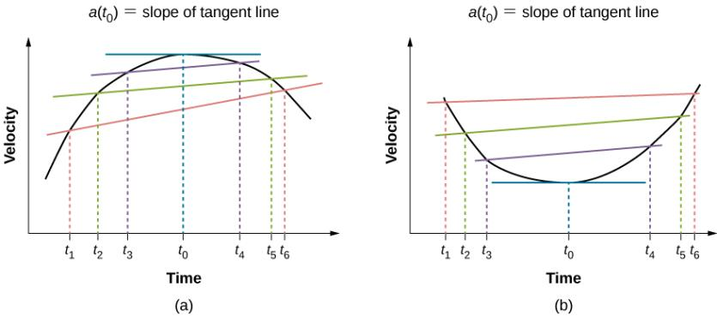
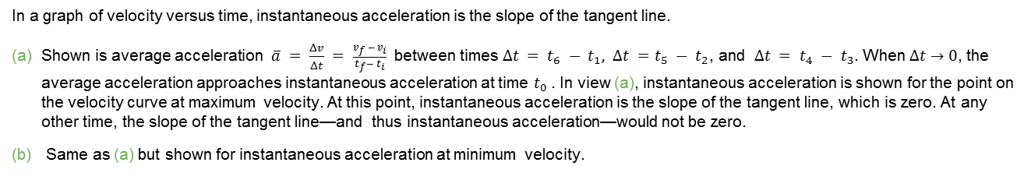
Figure 3.14
In a graph of velocity versus time, instantaneous acceleration is the slope of the tangent line.
Shown is average acceleration $\overline{a} = \frac{Δv}{Δt} = \frac{v_{f }− v_{i}}{t_{f}−{ t}_{i}}$ between times $∆t = t_{6} − t_{1}, ∆t =t_{5} − t_{2}$, and $∆t = t_{4} −{ t}_{3}$. When $∆t$ → 0, the average acceleration approaches instantaneous acceleration at time $t_{0}$. In view (a), instantaneous acceleration is shown for the point on the velocity curve at maximum velocity. At this point, instantaneous acceleration is the slope of the tangent line, which is zero. At any other time, the slope of the tangent line—and thus instantaneous acceleration—would not be zero.
Same as (a) but shown for instantaneous acceleration at minimum velocity.

Slide 17
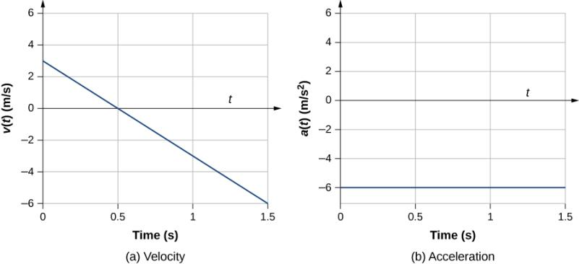
Figure 3.15
(a, b) The velocity-versus-time graph is linear and has a negative constant slope (a) that is equal to acceleration, shown in (b).

Slide 18
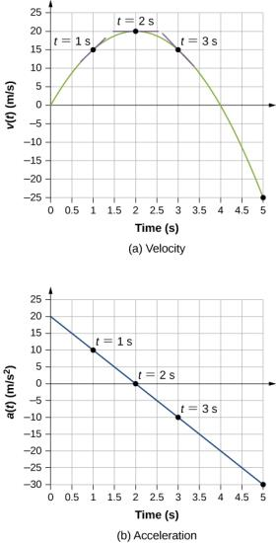
Figure 3.16
Velocity versus time. Tangent lines are indicated at times 1, 2, and 3 s. The slopes of the tangents lines are the accelerations. At t = 3 s, velocity is positive. At t = 5 s, velocity is negative, indicating the particle has reversed direction.
Acceleration versus time. Comparing the values of accelerations given by the black dots with the corresponding slopes of the tangent lines (slopes of lines through black dots) in (a), we see they are identical.

Slide 19
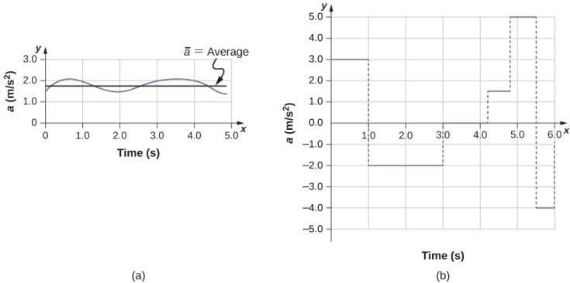
Figure 3.17
Graphs of instantaneous acceleration versus time for two different one-dimensional motions.
Acceleration varies only slightly and is always in the same direction, since it is positive. The average over the interval is nearly the same as the acceleration at any given time.
Acceleration varies greatly, perhaps representing a package on a post office conveyor belt that is accelerated forward and backward as it bumps along. It is necessary to consider small time intervals (such as from 0–1.0 s) with constant or nearly constant acceleration in such a situation.

Slide 20
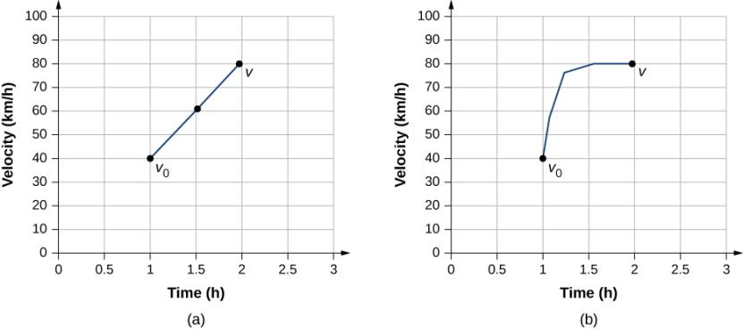
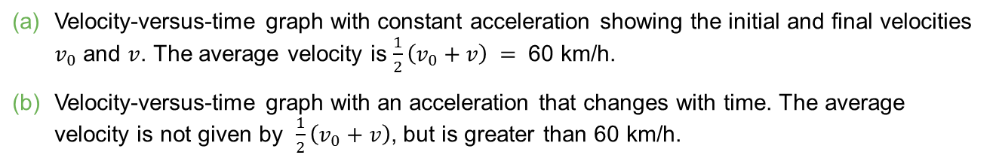
Figure 3.18
Velocity-versus-time graph with constant acceleration showing the initial and final velocities $v_{0}$ and $v$. The average velocity is $\frac{1}{2}\left(v_{0}+v\right) =$ 60 km/h.
Velocity-versus-time graph with an acceleration that changes with time. The average velocity is not given by $\frac{1}{2}\left(v_{0}+v\right)$, but is greater than 60 km/h.

Slide 21
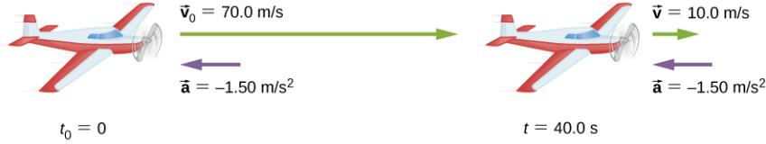
Figure 3.19
The airplane lands with an initial velocity of 70.0 m/s and slows to a final velocity of 10.0 m/s before heading for the terminal. Note the acceleration is negative because its direction is opposite to its velocity, which is positive.

Slide 22
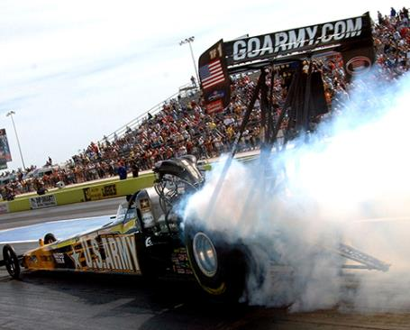
Figure 3.20
U.S. Army Top Fuel pilot Tony “The Sarge” Schumacher begins a race with a controlled burnout. (credit: Lt. Col. William Thurmond. Photo Courtesy of U.S. Army.)

Slide 23
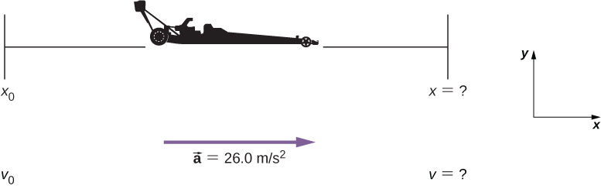
Figure 3.21
Sketch of an accelerating dragster.

Slide 24
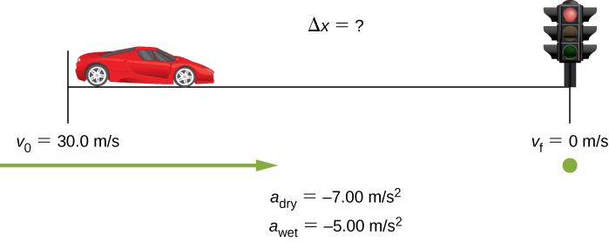
Figure 3.22
Sample sketch to visualize deceleration and stopping distance of a car.

Slide 25
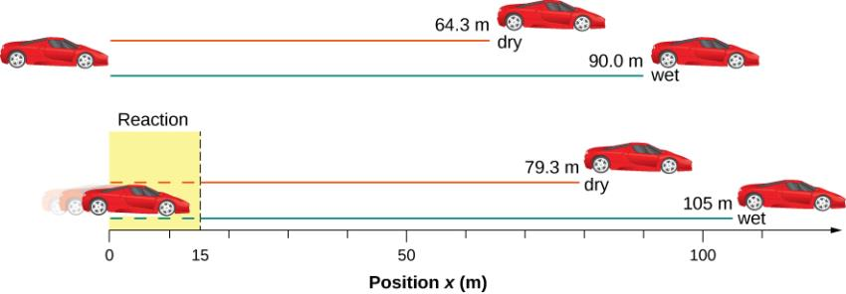
Figure 3.23
The distance necessary to stop a car varies greatly, depending on road conditions and driver reaction time. Shown here are the braking distances for dry and wet pavement, as calculated in this example, for a car traveling initially at 30.0 m/s. Also shown are the total distances traveled from the point when the driver first sees a light turn red, assuming a 0.500-s reaction time.

Slide 26
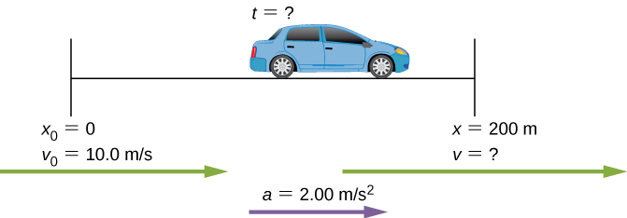
Figure 3.24
Sketch of a car accelerating on a freeway ramp.

Slide 27
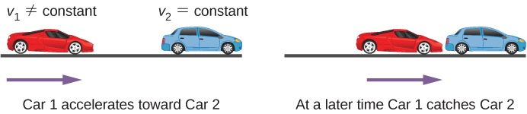
Figure 3.25
A two-body pursuit scenario where car 2 has a constant velocity and car 1 is behind with a constant acceleration. Car 1 catches up with car 2 at a later time.

Slide 28
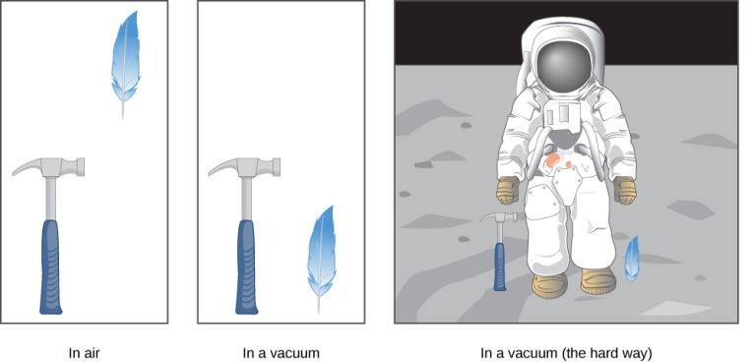
Figure 3.26
A hammer and a feather fall with the same constant acceleration if air resistance is negligible. This is a general characteristic of gravity not unique to Earth, as astronaut David R. Scott demonstrated in 1971 on the Moon, where the acceleration from gravity is only 1.67 m/s² and there is no atmosphere.

Slide 29
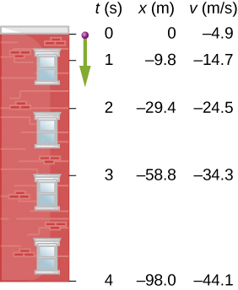
Figure 3.27
The positions and velocities at 1-s intervals of a ball thrown downward from a tall building at 4.9 m/s.

Slide 30
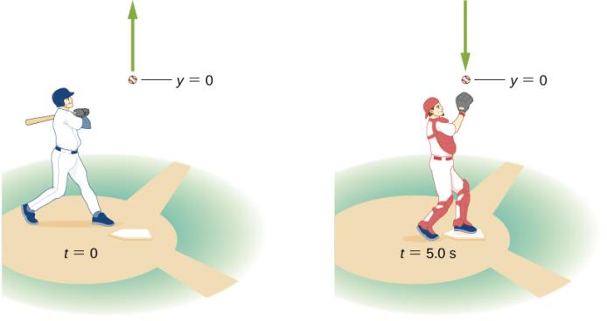
Figure 3.28
A baseball hit straight up is caught by the catcher 5.0 s later.

Slide 31
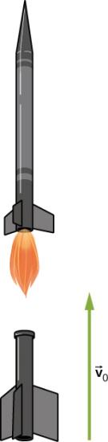
Figure 3.29
A rocket releases its booster at a given height and velocity. How high and how fast does the booster go?

Slide 32
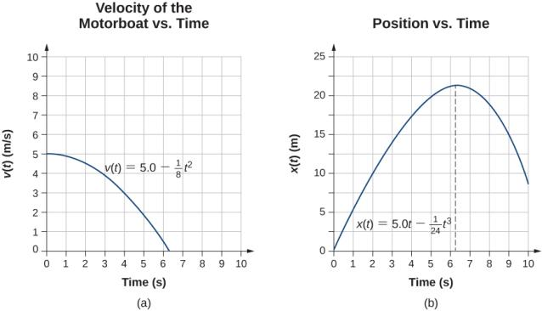
Figure 3.30
Velocity of the motorboat as a function of time. The motorboat decreases its velocity to zero in 6.3 s. At times greater than this, velocity becomes negative—meaning, the boat is reversing direction.
Position of the motorboat as a function of time. At t = 6.3 s, the velocity is zero and the boat has stopped. At times greater than this, the velocity becomes negative—meaning, if the boat continues to move with the same acceleration, it reverses direction and heads back toward where it originated.

Slide 33

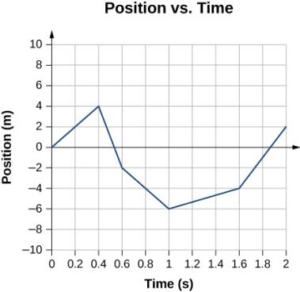
EXERCISE 31

Slide 34
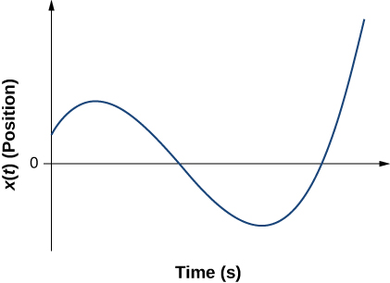
EXERCISE 32

Slide 35
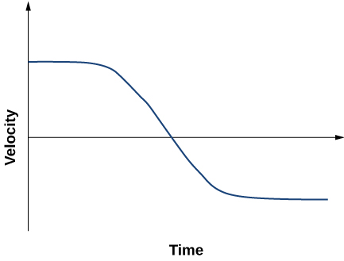
EXERCISE 33

Slide 36
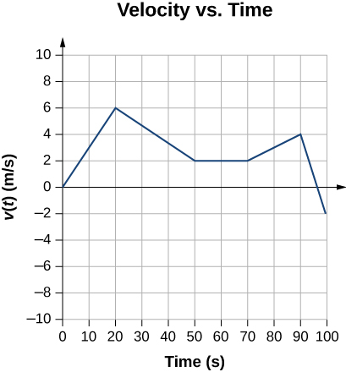
EXERCISE 39

Slide 37
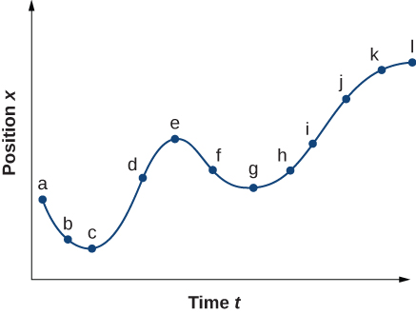
EXERCISE 46

Slide 38
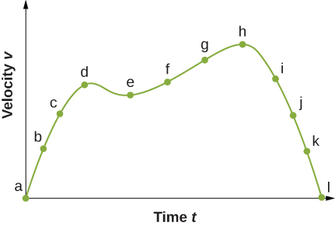
EXERCISE 47

Slide 39
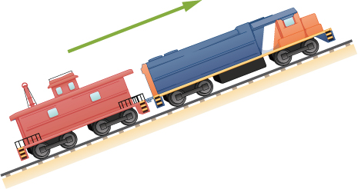
EXERCISE 88

Slide 40
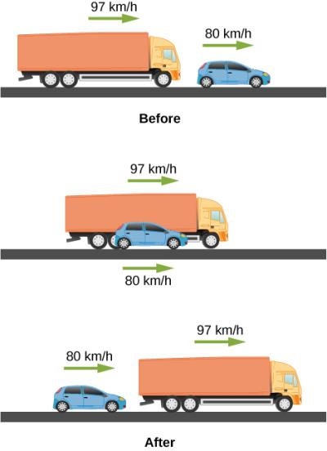
EXERCISE 94

Slide 41
This OpenStax ancillary resource is © Rice University under a CC-BY 4.0 International license; it may be reproduced or modified but must be attributed to OpenStax, Rice University and any changes must be noted.

