Slide 1


University Physics
Chapter 7 WORK AND KINETIC ENERGY
PowerPoint Image Slideshow

Slide 2

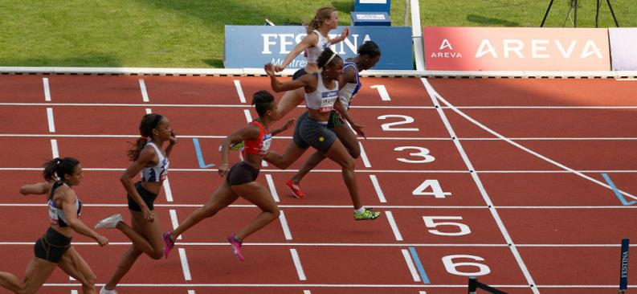
Figure 7.1
A sprinter exerts her maximum power to do as much work on herself as possible in the short time that her foot is in contact with the ground. This adds to her kinetic energy, preventing her from slowing down during the race. Pushing back hard on the track generates a reaction force that propels the sprinter forward to win at the finish. (credit: modification of work by Marie-Lan Nguyen)

Slide 3

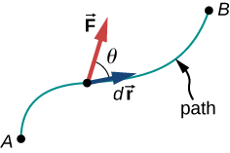
Figure 7.2
Vectors used to define work. The force acting on a particle and its infinitesimal displacement are shown at one point along the path between A and B. The infinitesimal work is the dot product of these two vectors; the total work is the integral of the dot product along the path.

Slide 4
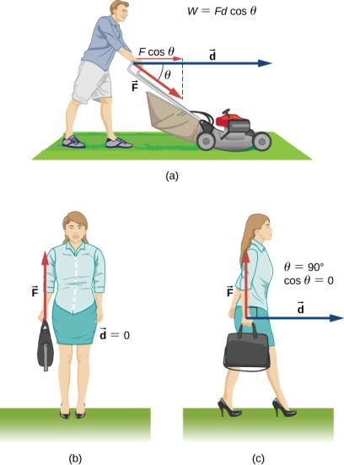
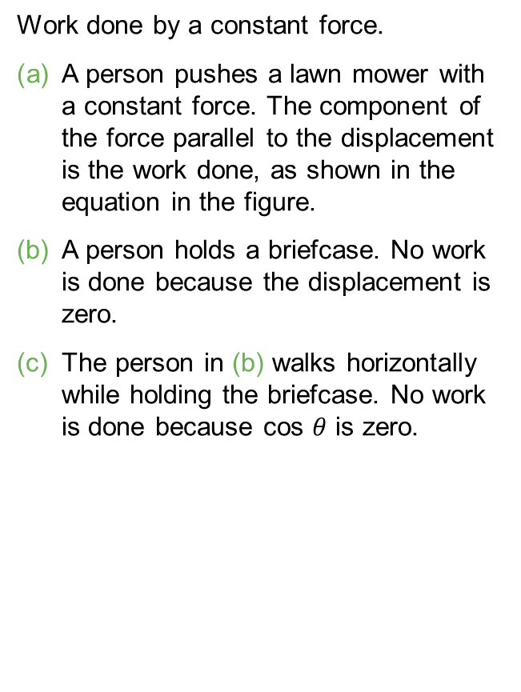
Figure 7.3
Work done by a constant force.
A person pushes a lawn mower with a constant force. The component of the force parallel to the displacement is the work done, as shown in the equation in the figure.
A person holds a briefcase. No work is done because the displacement is zero.
The person in (b) walks horizontally while holding the briefcase. No work is done because cos $θ$ is zero.

Slide 5
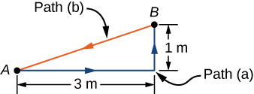
Figure 7.4
Top view of paths for moving a couch.

Slide 6
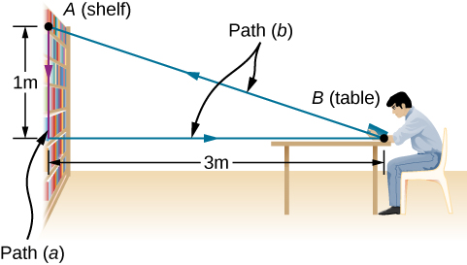
Figure 7.5
Side view of the paths for moving a book to and from a shelf.

Slide 7
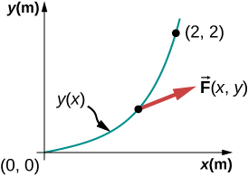
Figure 7.6
The parabolic path of a particle acted on by a given force.

Slide 8
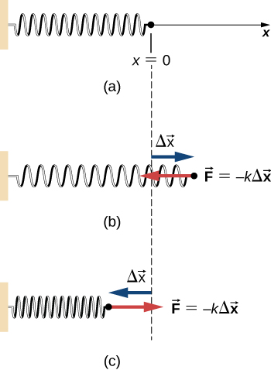
Figure 7.7
(a) The spring exerts no force at its equilibrium position. The spring exerts a force in the opposite direction to (b) an extension or stretch, and (c) a compression.

Slide 9
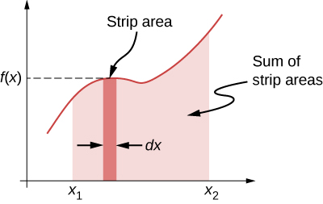
Figure 7.8
A curve of f(x) versus x showing the area of an infinitesimal strip, f(x)dx, and the sum of such areas, which is the integral of f(x) from x₁ to x₂.

Slide 10
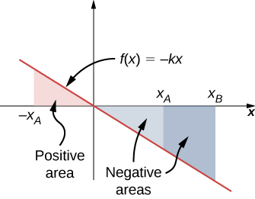
Figure 7.9
Curve of the spring force f (x) = −kx versus x, showing areas under the line, between x_{A} and x_{B} , for both positive and negative values of x_{A} . When x_{A} is negative, the total area under the curve for the integral in Equation 7.5 is the sum of positive and negative triangular areas. When x_{A} is positive, the total area under the curve is the difference between two negative triangles.

Slide 11
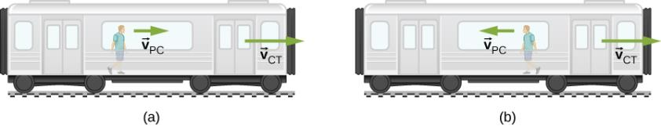
Figure 7.10
The possible motions of a person walking in a train are (a) toward the front of the car and (b) toward the back of the car.

Slide 12
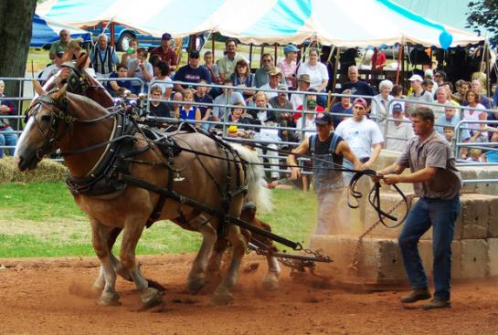
Figure 7.11
Horse pulls are common events at state fairs. The work done by the horses pulling on the load results in a change in kinetic energy of the load, ultimately going faster. (credit: “Jassen”/ Flickr)

Slide 13
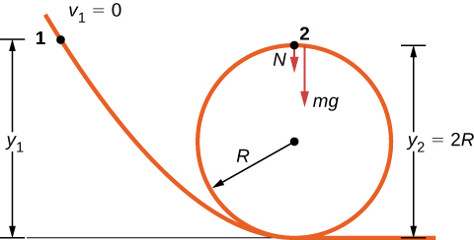
Figure 7.12
A frictionless track for a toy car has a loop-the-loop in it. How high must the car start so that it can go around the loop without falling off?

Slide 14
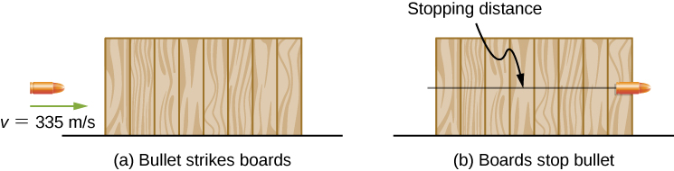
Figure 7.13
The boards exert a force to stop the bullet. As a result, the boards do work and the bullet loses kinetic energy.

Slide 15
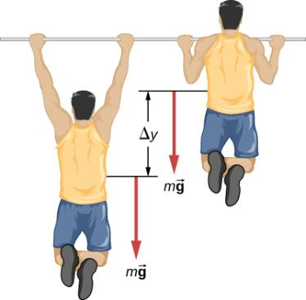
Figure 7.14
What is the power expended in doing ten pull-ups in ten seconds?

Slide 16
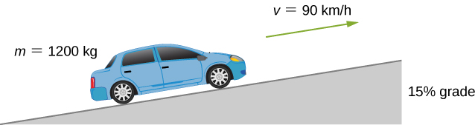
Figure 7.15
We want to calculate the power needed to move a car up a hill at constant speed.

Slide 17
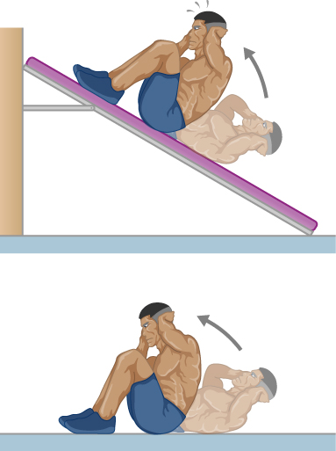
EXERCISE 6

Slide 18
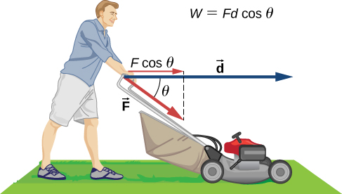
EXERCISE 11

Slide 19
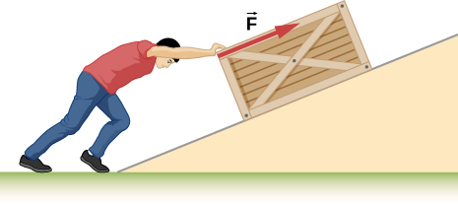
EXERCISE 27

Slide 20
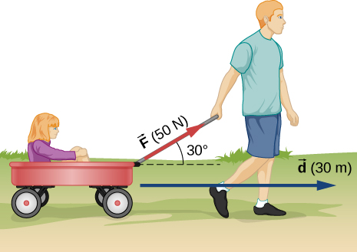
EXERCISE 28

Slide 21
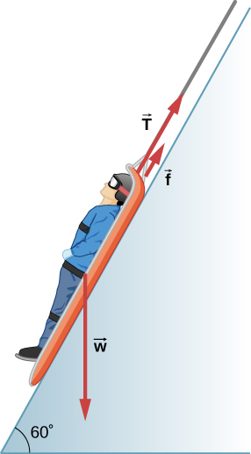
EXERCISE 30

Slide 22
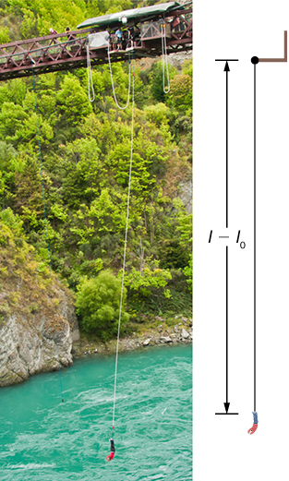
Figure 7.16
(credit: Graeme Churchard)

Slide 23
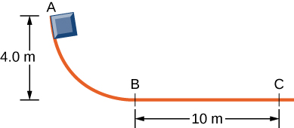
EXERCISE 62

Slide 24
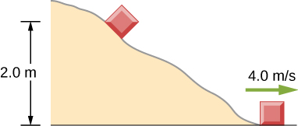
EXERCISE 64

Slide 25
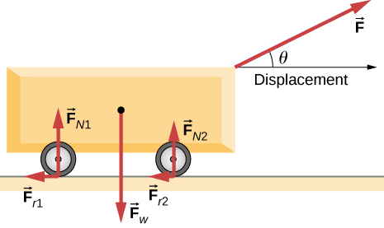
EXERCISE 84

Slide 26
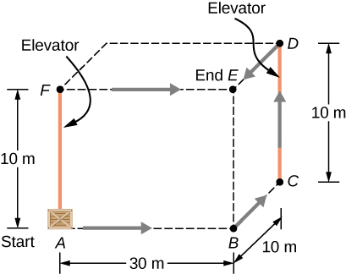
EXERCISE 90

Slide 27
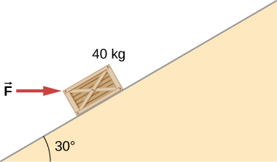
EXERCISE 99

Slide 28
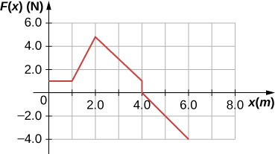
EXERCISE 101

Slide 29
This OpenStax ancillary resource is © Rice University under a CC-BY 4.0 International license; it may be reproduced or modified but must be attributed to OpenStax, Rice University and any changes must be noted.

