Slide 1
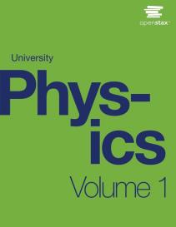

University Physics
Chapter 8 POTENTIAL ENERGY AND CONSERVATION OF ENERGY
PowerPoint Image Slideshow

Slide 2

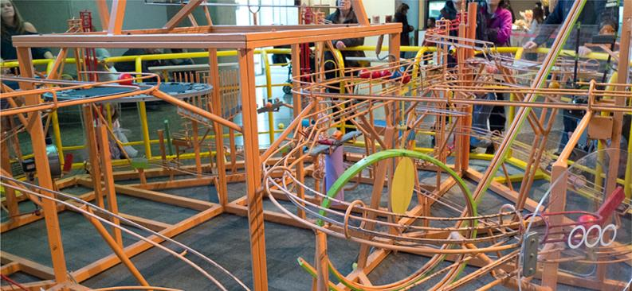
Figure 8.1
Shown here is part of a Ball Machine sculpture by George Rhoads. A ball in this contraption is lifted, rolls, falls, bounces, and collides with various objects, but throughout its travels, its kinetic energy changes in definite, predictable amounts, which depend on its position and the objects with which it interacts. (credit: modification of work by Roland Tanglao)

Slide 3
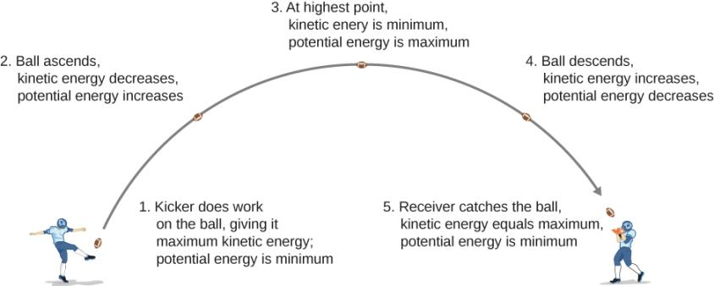
Figure 8.2
As a football starts its descent toward the wide receiver, gravitational potential energy is converted back into kinetic energy.

Slide 4
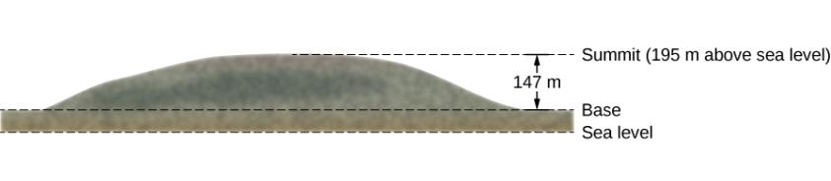
Figure 8.3
Sketch of the profile of Great Blue Hill, Milton, MA. The altitudes of the three levels are indicated.

Slide 5

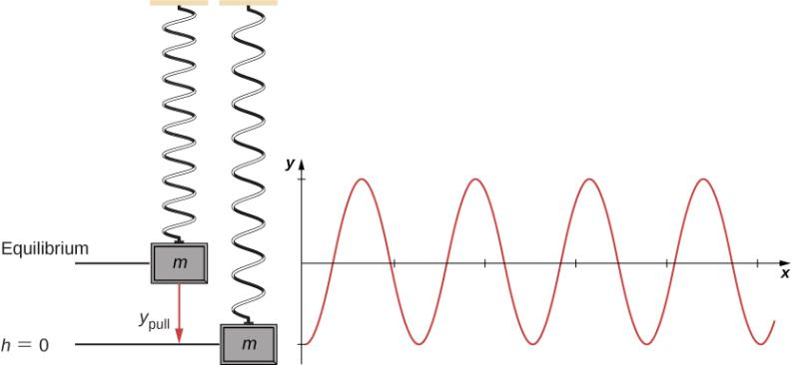
Figure 8.4
A vertical mass-spring system, with the y-axis pointing upward. The mass is initially at an equilibrium position and pulled downward to y_{pull}. An oscillation begins, centered at the equilibrium position.

Slide 6
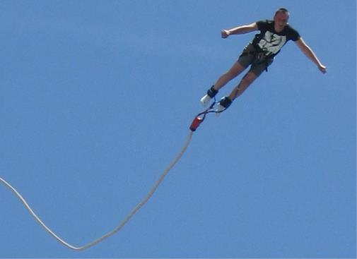
Figure 8.5
A bungee jumper transforms gravitational potential energy at the start of the jump into elastic potential energy at the bottom of the jump.

Slide 7
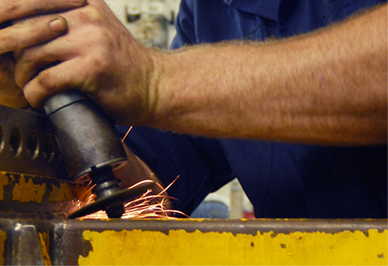
Figure 8.6
A grinding wheel applies a non-conservative force, because the work done depends on how many rotations the wheel makes, so it is path-dependent.

Slide 8
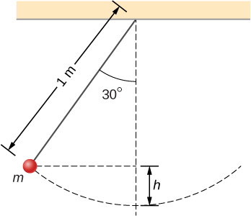
Figure 8.7
A particle hung from a string constitutes a simple pendulum. It is shown when released from rest, along with some distances used in analyzing the motion.

Slide 9
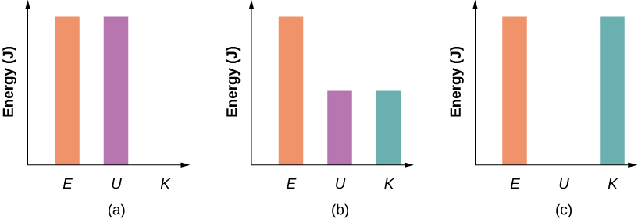
Figure 8.8
Bar graphs representing the total energy (E), potential energy (U), and kinetic energy (K) of the particle in different positions.
The total energy of the system equals the potential energy and the kinetic energy is zero, which is found at the highest point the particle reaches.
The particle is midway between the highest and lowest point, so the kinetic energy plus potential energy bar graphs equal the total energy.
The particle is at the lowest point of the swing, so the kinetic energy bar graph is the highest and equal to the total energy of the system.

Slide 10
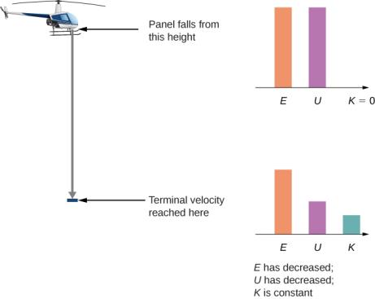
Figure 8.9
A helicopter loses a panel that falls until it reaches terminal velocity of 45 m/s. How much did air resistance contribute to the dissipation of energy in this problem?

Slide 11

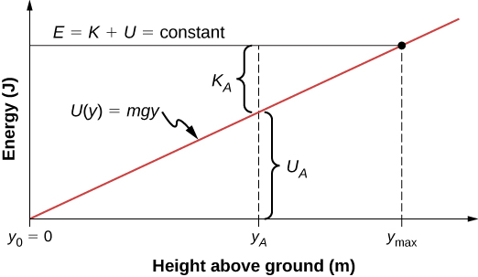
Figure 8.10
The potential energy graph for an object in vertical free fall, with various quantities indicated.

Slide 12
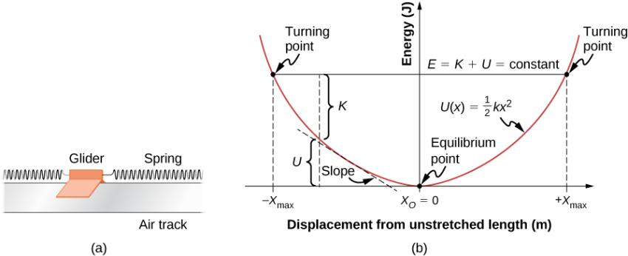
Figure 8.11
A glider between springs on an air track is an example of a horizontal mass-spring system.
The potential energy diagram for this system, with various quantities indicated.

Slide 13
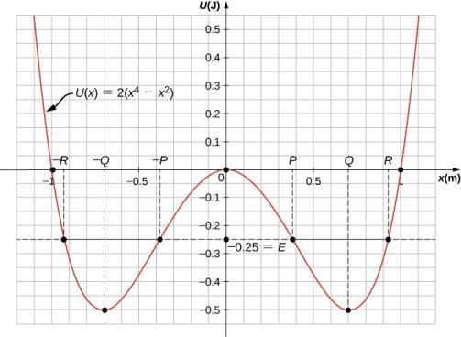
Figure 8.12
The potential energy graph for a one-dimensional, quartic and quadratic potential energy, with various quantities indicated.

Slide 14
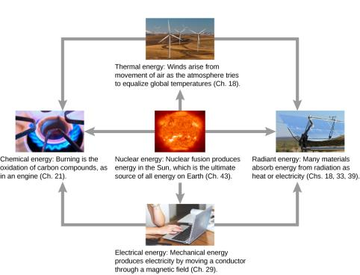
Figure 8.13
Energy that we use in society takes many forms, which be converted from one into another depending on the process involved. We will study many of these forms of energy in later chapters in this text. (credit “sun”: EIT SOHO Consortium, ESA, NASA; credit “solar panels”: “kjkolb”/Wikimedia Commons; credit “gas burner”: Steven Depolo)

Slide 15
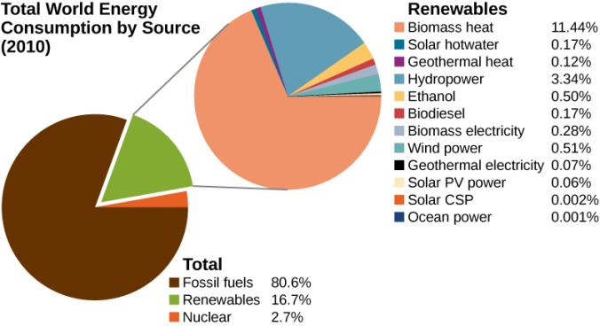
Figure 8.14
World energy consumption by source; the percentage of renewables is increasing, accounting for 19% in 2012.

Slide 16
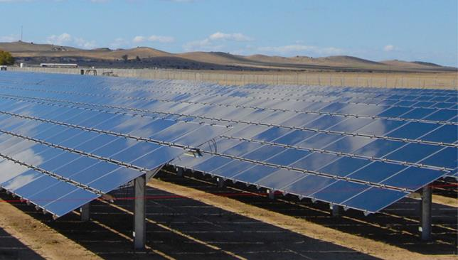
Figure 8.15
Solar cell arrays found in a sunny area converting the solar energy into stored electrical energy. (credit: Sarah Swenty)

Slide 17
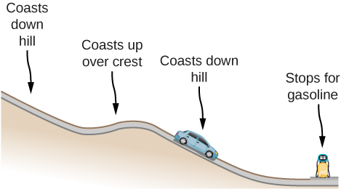
EXERCISE 11

Slide 18
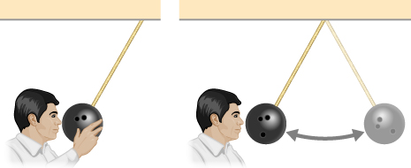
EXERCISE 14

Slide 19
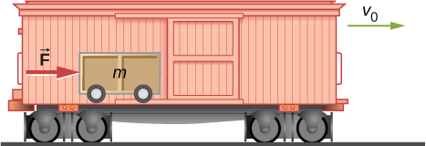
EXERCISE 30

Slide 20
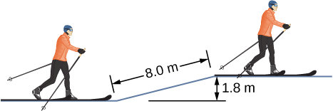
EXERCISE 38

Slide 21
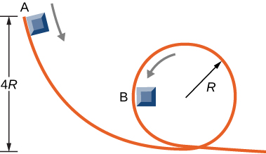
Exercise 42

Slide 22
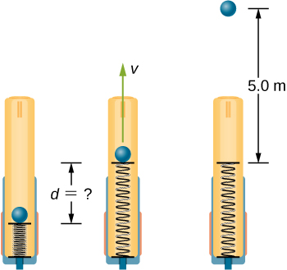
EXERCISE 43

Slide 23
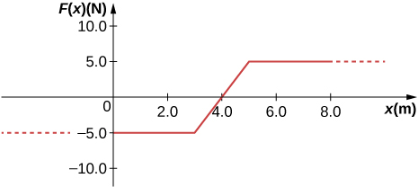
Exercise 49

Slide 24
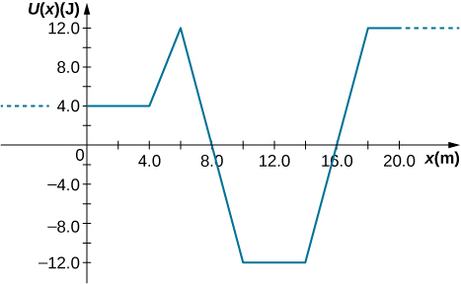
Exercise 50

Slide 25
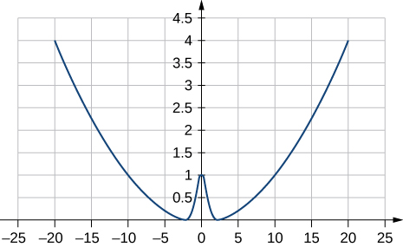
Exercise 51

Slide 26
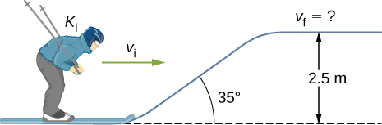
EXERCISE 60

Slide 27
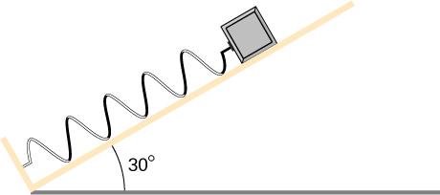
Exercise 64

Slide 28
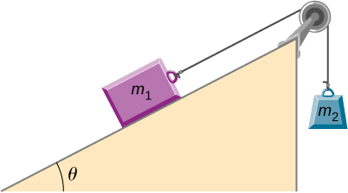
EXERCISE 68

Slide 29
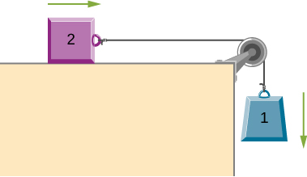
EXERCISE 71

Slide 30
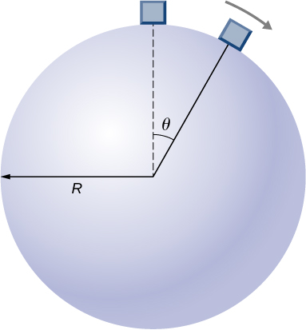
EXERCISE 72

Slide 31
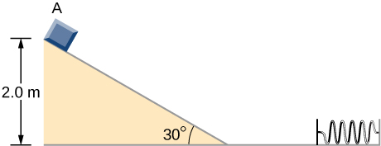
EXERCISE 74

Slide 32
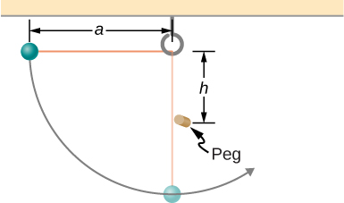
Exercise 75

Slide 33
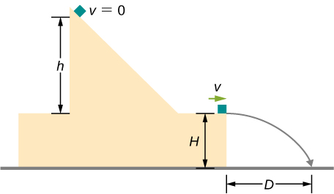
EXERCISE 76

Slide 34
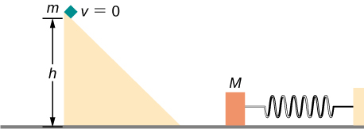
EXERCISE 77

Slide 35
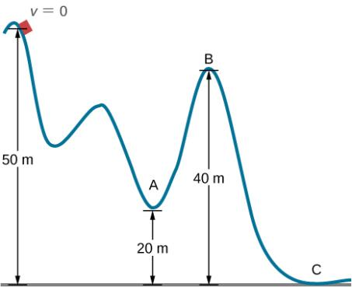
EXERCISE 83

Slide 36
This OpenStax ancillary resource is © Rice University under a CC-BY 4.0 International license; it may be reproduced or modified but must be attributed to OpenStax, Rice University and any changes must be noted.

