Slide 1


UNIVERSITY Physics
Chapter 9 LINEAR MOMENTUM AND COLLISIONS
PowerPoint Image Slideshow

Slide 2

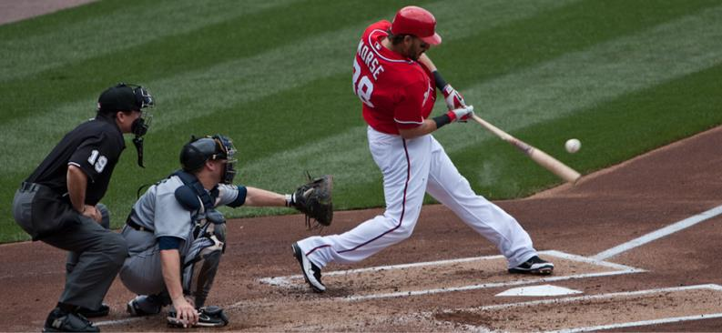
Figure 9.1
The concepts of impulse, momentum, and center of mass are crucial for a major-league baseball player to successfully get a hit. If he misjudges these quantities, he might break his bat instead. (credit: modification of work by “Cathy T”/Flickr)

Slide 3
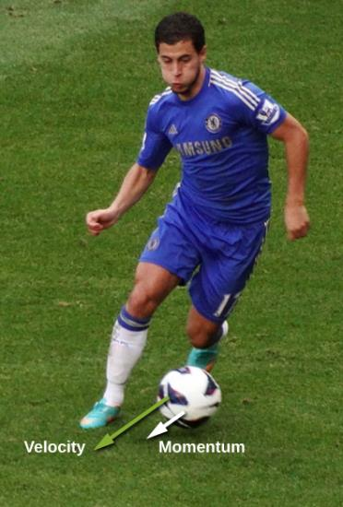
Figure 9.2
The velocity and momentum vectors for the ball are in the same direction. The mass of the ball is about 0.5 kg, so the momentum vector is about half the length of the velocity vector because momentum is velocity time mass. (credit: modification of work by Ben Sutherland)

Slide 4

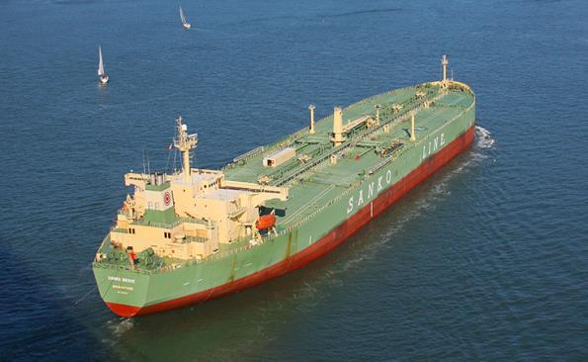
Figure 9.3
This supertanker transports a huge mass of oil; as a consequence, it takes a long time for a force to change its (comparatively small) velocity. (credit: modification of work by “the_tahoe_guy”/Flickr)

Slide 5
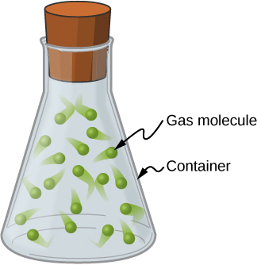
Figure 9.4
Gas molecules can have very large velocities, but these velocities change nearly instantaneously when they collide with the container walls or with each other. This is primarily because their masses are so tiny.

Slide 6
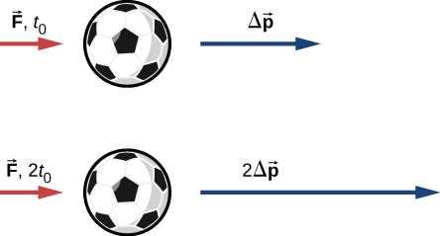
Figure 9.5
The change in momentum of an object is proportional to the length of time during which the force is applied. If a force is exerted on the lower ball for twice as long as on the upper ball, then the change in the momentum of the lower ball is twice that of the upper ball.

Slide 7
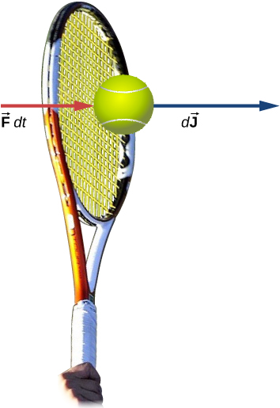
Figure 9.6
A force applied by a tennis racquet to a tennis ball over a time interval generates an impulse acting on the ball.

Slide 8
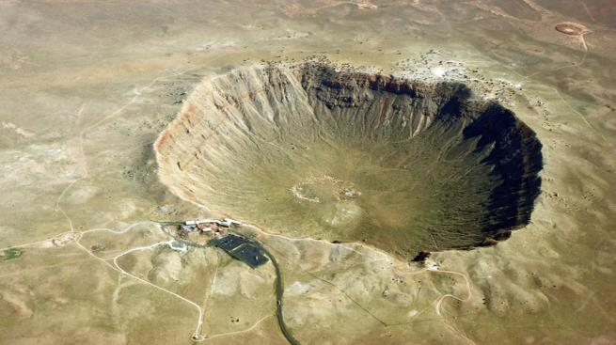
Figure 9.7
The Arizona Meteor Crater in Flagstaff, Arizona (often referred to as the Barringer Crater after the person who first suggested its origin and whose family owns the land). (credit: “Shane.torgerson”/Wikimedia Commons)

Slide 9
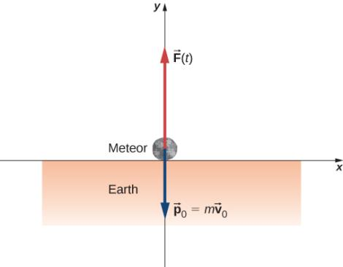
EXAMPLE 9.1

Slide 10
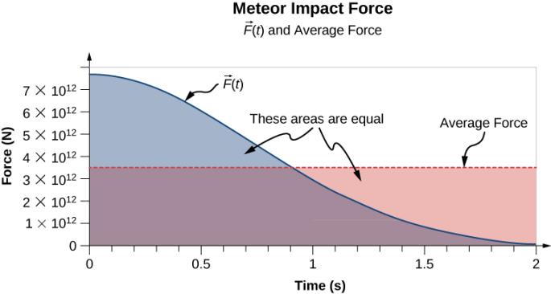
Figure 9.8
A graph of the average force (in red) and the force as a function of time (blue) of the meteor impact. The areas under the curves are equal to each other, and are numerically equal to the applied impulse.

Slide 11
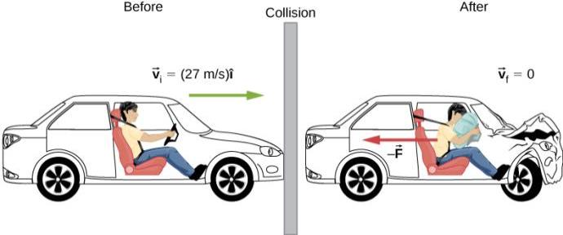
Figure 9.9
The motion of a car and its driver at the instant before and the instant after colliding with the wall. The restrained driver experiences a large backward force from the seatbelt and airbag, which causes his velocity to decrease to zero. (The forward force from the seatback is much smaller than the backward force, so we neglect it in the solution.)

Slide 12
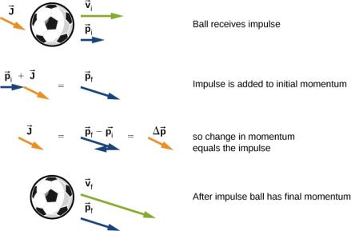
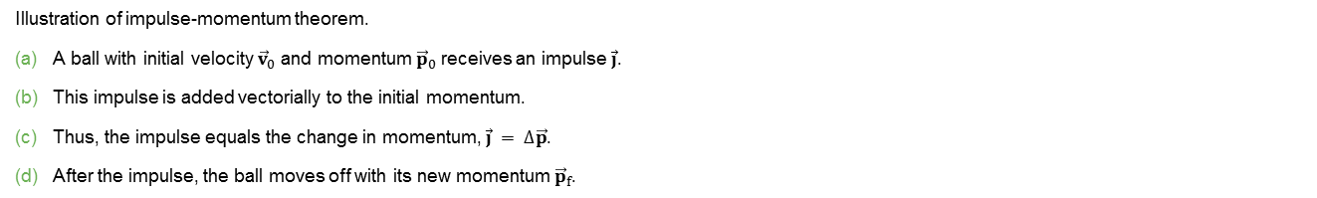
Figure 9.10
Illustration of impulse-momentum theorem.
A ball with initial velocity ${\vec{v}}_{0}$ and momentum ${\vec{p}}_{0}$ receives an impulse $\vec{j}$.
This impulse is added vectorially to the initial momentum.
Thus, the impulse equals the change in momentum, $\vec{j} = ∆\vec{p}$.
After the impulse, the ball moves off with its new momentum ${\vec{p}}_{f}$.

Slide 13
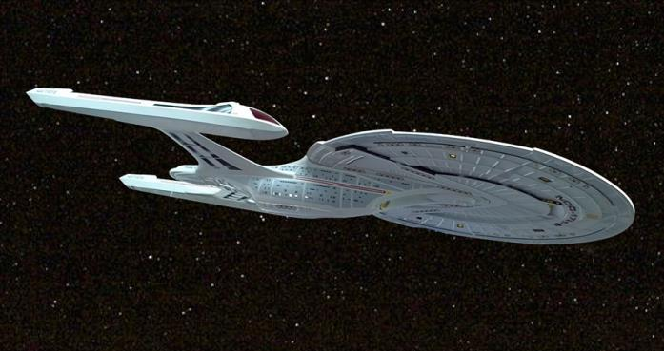
Figure 9.11
The fictional starship Enterprise from the Star Trek adventures operated on so-called “impulse engines” that combined matter with antimatter to produce energy.

Slide 14
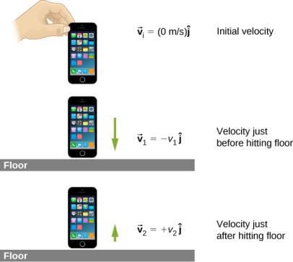
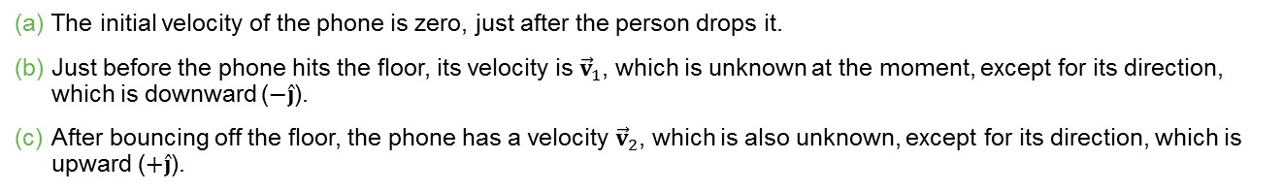
Figure 9.12
The initial velocity of the phone is zero, just after the person drops it.
Just before the phone hits the floor, its velocity is ${\vec{v}}_{1}$, which is unknown at the moment, except for its direction, which is downward ($−\hat{j}$).
After bouncing off the floor, the phone has a velocity ${\vec{v}}_{2}$, which is also unknown, except for its direction, which is upward ($+\hat{j}$).

Slide 15
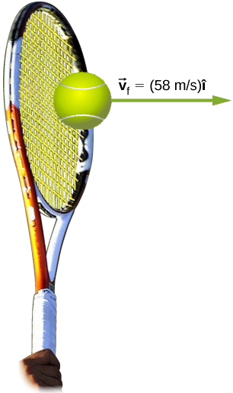

Figure 9.13
The final velocity of the tennis ball is ${\vec{v}}_{f}=$ (58 m/s)$\hat{i}$

Slide 16
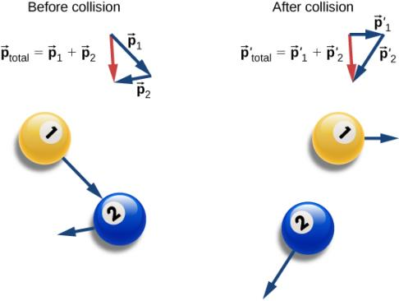
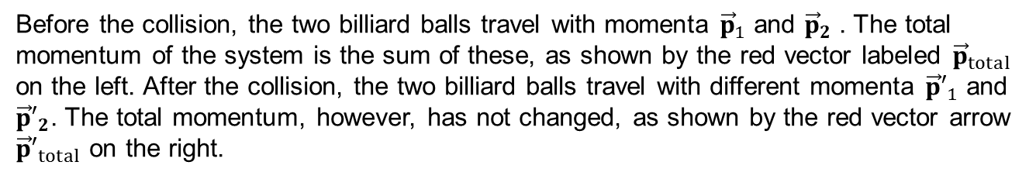
Figure 9.14
Before the collision, the two billiard balls travel with momenta ${\vec{p}}_{1}$ and ${\vec{p}}_{2}$ . The total momentum of the system is the sum of these, as shown by the red vector labeled ${\vec{p}}_{total}$ on the left. After the collision, the two billiard balls travel with different momenta ${\vec{p}′}_{1}$ and ${\vec{p}′}_{2}$. The total momentum, however, has not changed, as shown by the red vector arrow ${\vec{p}′}_{total}$ on the right.

Slide 17
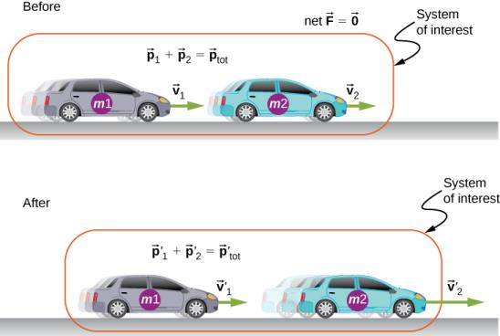
Figure 9.15
The two cars together form the system that is to be analyzed. It is important to remember that the contents (the mass) of the system do not change before, during, or after the objects in the system interact.

Slide 18
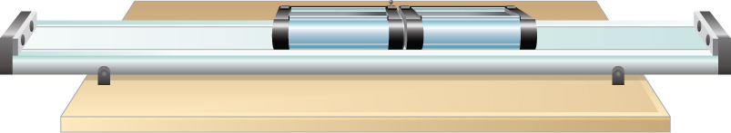
Figure 9.16
Two lab carts collide and stick together after the collision.

Slide 19
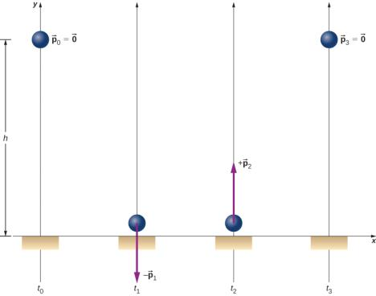
Figure 9.17
A superball is dropped to the floor (t₀), hits the floor (t₁), bounces (t₂), and returns to its initial height (t₃).

Slide 20
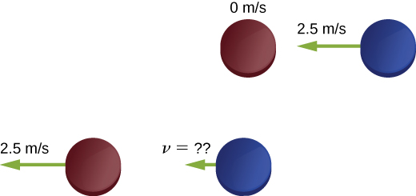
Figure 9.18
Two identical hockey pucks colliding. The top diagram shows the pucks the instant before the collision, and the bottom diagram show the pucks the instant after the collision. The net external force is zero.

Slide 21
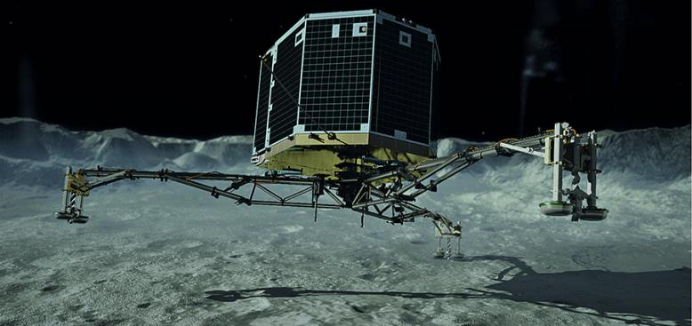
Figure 9.19
An artist’s rendering of Philae landing on a comet. (credit: modification of work by “DLR German Aerospace Center”/Flickr)

Slide 22
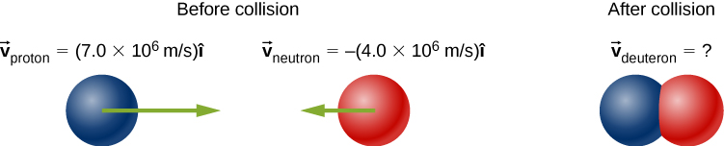
EXAMPLE 9.10

Slide 23
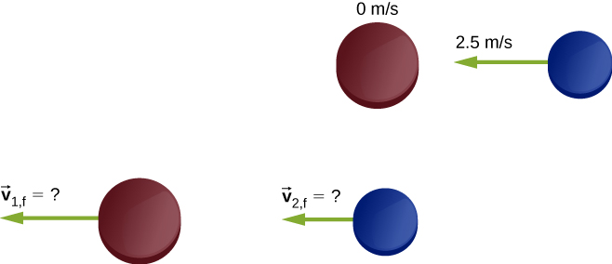
Figure 9.20
Two different hockey pucks colliding. The top diagram shows the pucks the instant before the collision, and the bottom diagram show the pucks the instant after the collision. The net external force is zero.

Slide 24
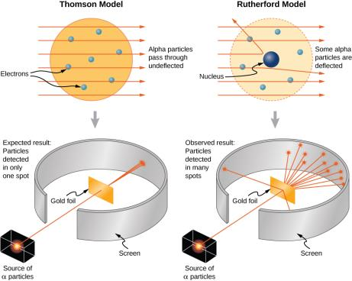
Figure 9.21
The Thomson and Rutherford models of the atom. The Thomson model predicted that nearly all of the incident alpha-particles would be scattered and at small angles. Rutherford and Geiger found that nearly none of the alpha particles were scattered, but those few that were deflected did so through very large angles. The results of Rutherford’s experiments were inconsistent with the Thomson model. Rutherford used conservation of momentum and energy to develop a new, and better model of the atom—the nuclear model.

Slide 25
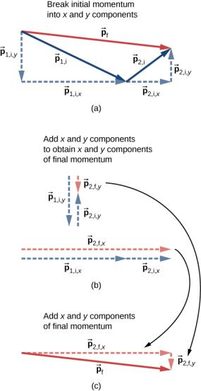
Figure 9.22
For two-dimensional momentum problems, break the initial momentum vectors into their x- and y-components.
Add the x- and y-components together separately. This gives you the x- and y-components of the final momentum, which are shown as red dashed vectors.
Adding these components together gives the final momentum.

Slide 26
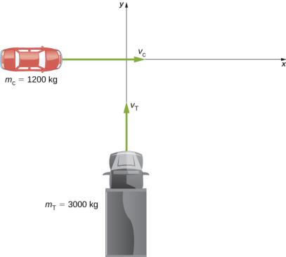
Figure 9.23
A large truck moving north is about to collide with a small car moving east. The final momentum vector has both x- and y-components.

Slide 27
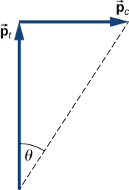
Figure 9.24
Graphical addition of momentum vectors. Notice that, although the car’s velocity is larger than the truck’s, its momentum is smaller.

Slide 28
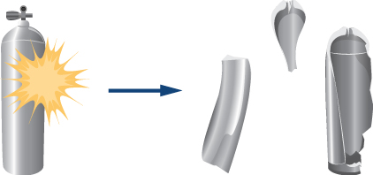
Figure 9.25
A scuba tank explodes into three pieces.

Slide 29
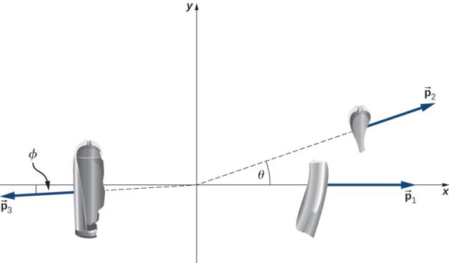
EXAMPLE 9.15

Slide 30
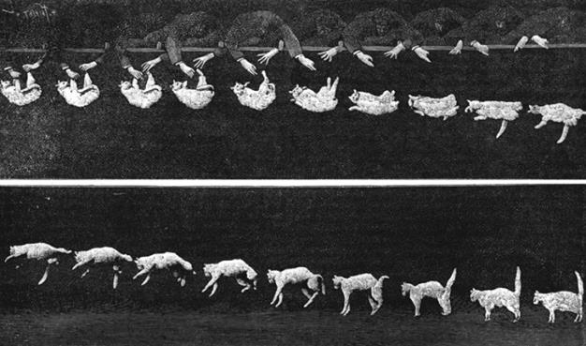
Figure 9.26
As the cat falls, its body performs complicated motions so it can land on its feet, but one point in the system moves with the simple uniform acceleration of gravity.

Slide 31
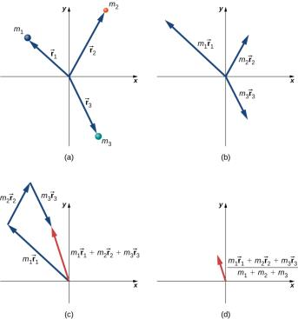
Figure 9.27
Finding the center of mass of a system of three different particles.
Position vectors are created for each object.
The position vectors are multiplied by the mass of the corresponding object.
The scaled vectors from part (b) are added together.
The final vector is divided by the total mass. This vector points to the center of mass of the system. Note that no mass is actually present at the center of mass of this system.

Slide 32
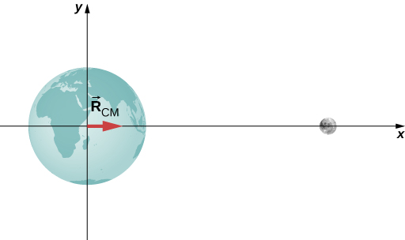
EXAMPLE 9.16

Slide 33
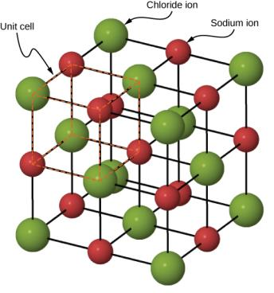
Figure 9.28
A drawing of a sodium chloride (NaCl) crystal.

Slide 34
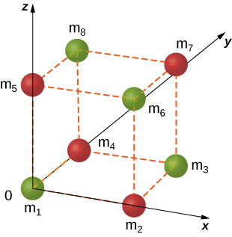
Figure 9.29
A single unit cell of a NaCl crystal.

Slide 35
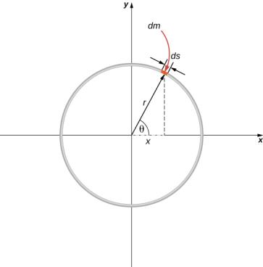
Figure 9.30
Finding the center of mass of a uniform hoop. We express the coordinates of a differential piece of the hoop, and then integrate around the hoop.

Slide 36
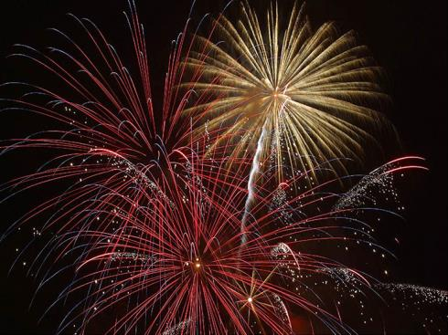
Figure 9.31
These exploding fireworks are a vivid example of conservation of momentum and the motion of the center of mass.

Slide 37
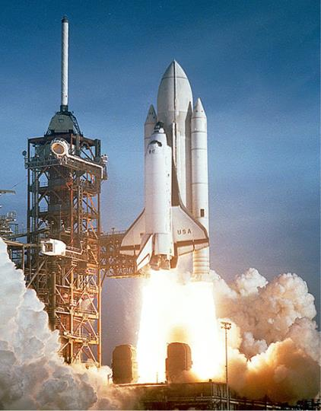
Figure 9.32
The space shuttle had a number of reusable parts. Solid fuel boosters on either side were recovered and refueled after each flight, and the entire orbiter returned to Earth for use in subsequent flights. The large liquid fuel tank was expended. The space shuttle was a complex assemblage of technologies, employing both solid and liquid fuel, and pioneering ceramic tiles as reentry heat shields. As a result, it permitted multiple launches as opposed to single-use rockets. (credit: modification of work by NASA)

Slide 38
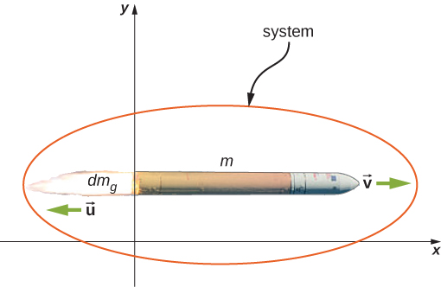
Figure 9.33
The rocket accelerates to the right due to the expulsion of some of its fuel mass to the left. Conservation of momentum enables us to determine the resulting change of velocity. The mass m is the instantaneous total mass of the rocket (i.e., mass of rocket body plus mass of fuel at that point in time). (credit: modification of work by NASA/Bill Ingalls)

Slide 39
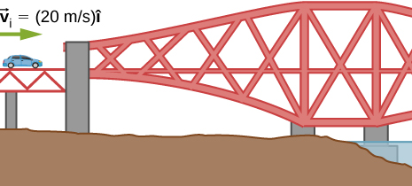
EXERCISE 25

Slide 40
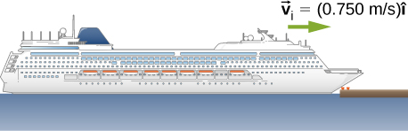
EXERCISE 27

Slide 41
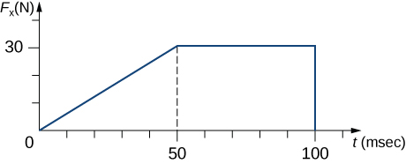
EXERCISE 32

Slide 42
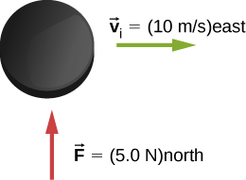
EXERCISE 33

Slide 43
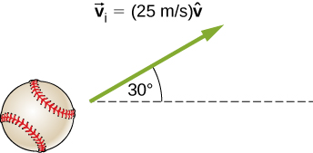
EXERCISE 34

Slide 44
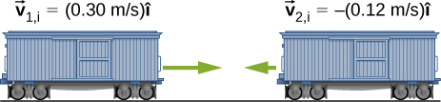
EXERCISE 35

Slide 45
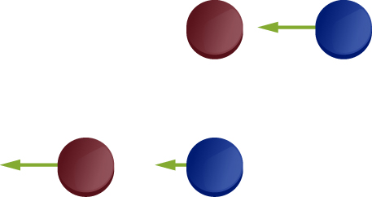
EXERCISE 36

Slide 46
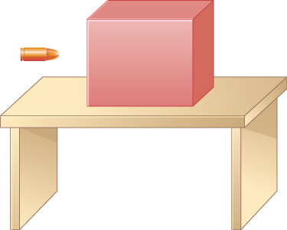
EXERCISE 37

Slide 47
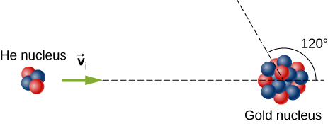
EXERCISE 44

Slide 48

Figure 9.34
(credit “hawk”: modification of work by “USFWS Mountain-Prairie”/Flickr; credit “dove”: modification of work by Jacob Spinks)

Slide 49

EXERCISE 55

Slide 50

EXERCISE 63

Slide 51

Figure 72

Slide 52

EXERCISE 76

Slide 53

EXERCISE 114

Slide 54

Exercise 117

Slide 55

EXERCISE 118

Slide 56
This OpenStax ancillary resource is © Rice University under a CC-BY 4.0 International license; it may be reproduced or modified but must be attributed to OpenStax, Rice University and any changes must be noted.

