Slide 1


University Physics
Chapter 10 FIXED-AXIS ROTATION
PowerPoint Image Slideshow

Slide 2

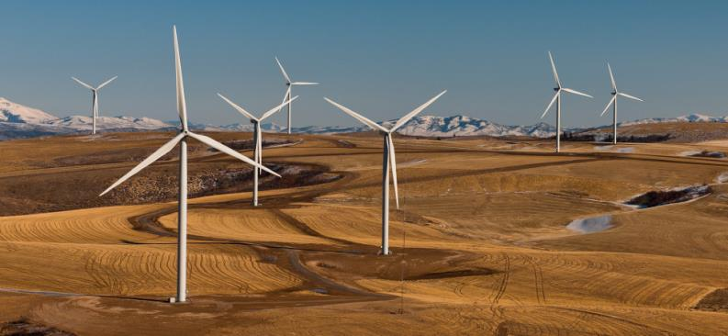
Figure 10.1
Brazos wind farm in west Texas. During 2019, wind farms in the United States had an average power output of 34 gigawatts, which is enough to power 28 million homes. (credit: modification of work by “ENERGY.GOV”/Flickr)

Slide 3
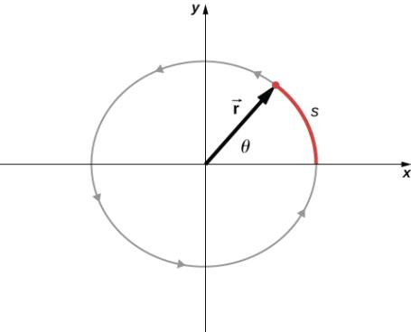
Figure 10.2
A particle follows a circular path. As it moves counterclockwise, it sweeps out a positive angle θ with respect to the x-axis and traces out an arc length s.

Slide 4
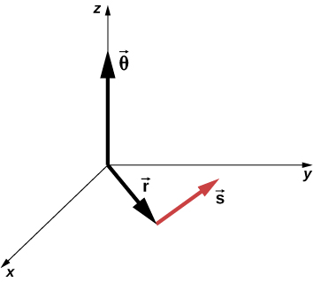
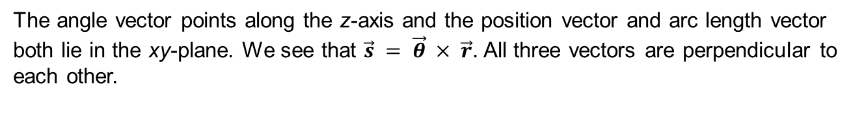
Figure 10.3
The angle vector points along the z-axis and the position vector and arc length vector both lie in the xy-plane. We see that $\vec{s} = \vec{θ} × \vec{r}$. All three vectors are perpendicular to each other.

Slide 5
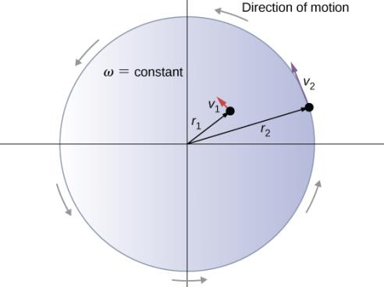
Figure 10.4
Two particles on a rotating disk have different tangential speeds, depending on their distance to the axis of rotation.

Slide 6
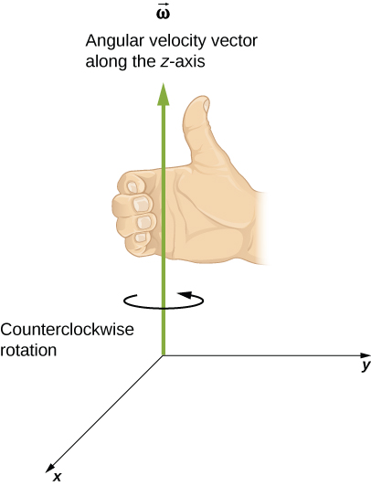
Figure 10.5
For counterclockwise rotation in the coordinate system shown, the angular velocity points in the positive z-direction by the right-hand-rule.

Slide 7
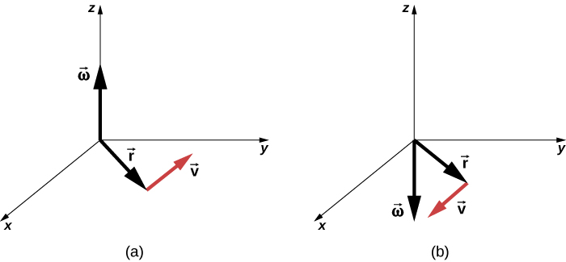
Figure 10.6
The vectors shown are the angular velocity, position, and tangential velocity.
The angular velocity points in the positive z-direction, giving a counterclockwise rotation in the xy-plane.
The angular velocity points in the negative z-direction, giving a clockwise rotation.

Slide 8
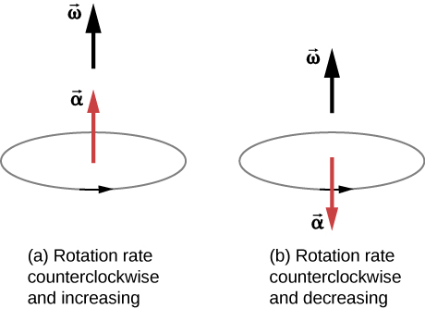
Figure 10.7
The rotation is counterclockwise in both (a) and (b) with the angular velocity in the same direction.
The angular acceleration is in the same direction as the angular velocity, which increases the rotation rate.
The angular acceleration is in the opposite direction to the angular velocity, which decreases the rotation rate.

Slide 9
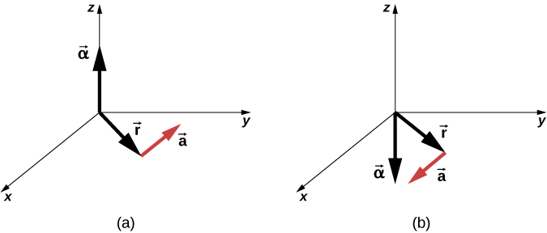
Figure 10.8
The angular acceleration is the positive z-direction and produces a tangential acceleration in a counterclockwise sense.
The angular acceleration is in the negative z-direction and produces a tangential acceleration in the clockwise sense.

Slide 10
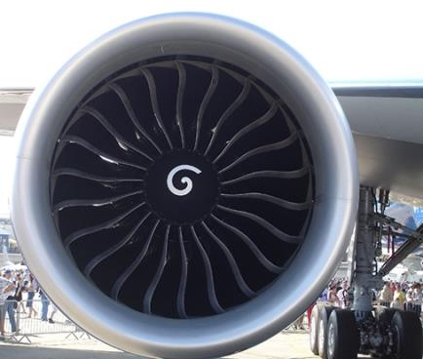
Figure 10.9
(credit: “Bubinator”/ Wikimedia Commons)

Slide 11
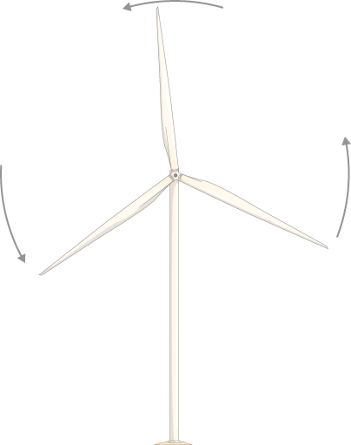
Figure 10.10
A wind turbine that is rotating counterclockwise, as seen head on.

Slide 12
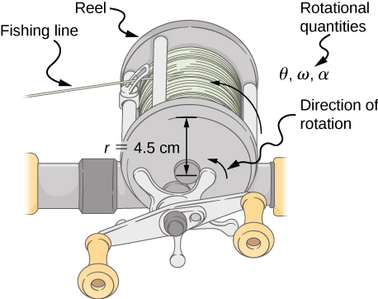
Figure 10.11
Fishing line coming off a rotating reel moves linearly.

Slide 13
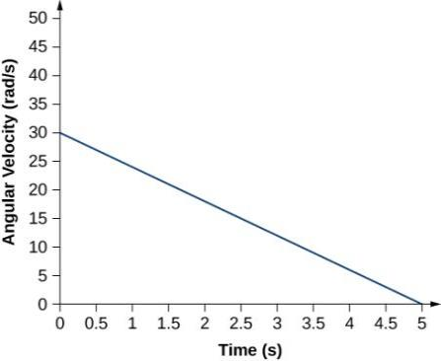
Figure 10.12
A graph of the angular velocity of a propeller versus time.

Slide 14
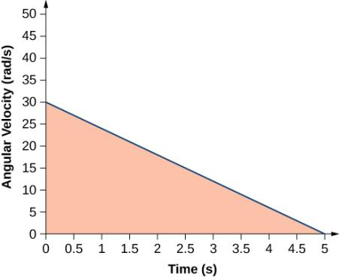
Figure 10.13
The area under the curve is the area of the right triangle.

Slide 15
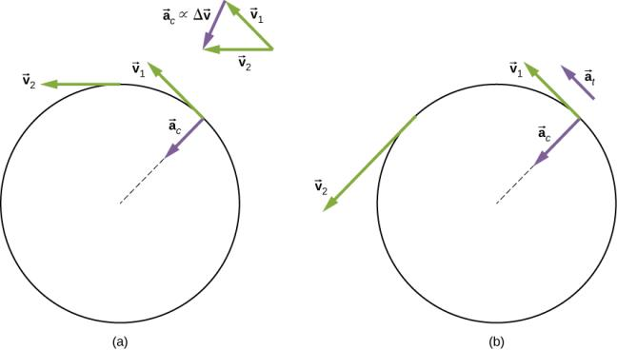
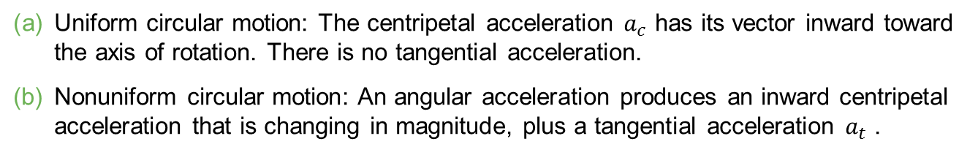
Figure 10.14
Uniform circular motion: The centripetal acceleration $a_{c}$ has its vector inward toward the axis of rotation. There is no tangential acceleration.
Nonuniform circular motion: An angular acceleration produces an inward centripetal acceleration that is changing in magnitude, plus a tangential acceleration $a_{t}$ .

Slide 16
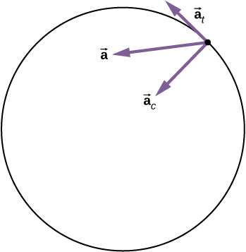
Figure 10.15
A particle is executing circular motion and has an angular acceleration. The total linear acceleration of the particle is the vector sum of the centripetal acceleration and tangential acceleration vectors. The total linear acceleration vector is at an angle in between the centripetal and tangential accelerations.

Slide 17
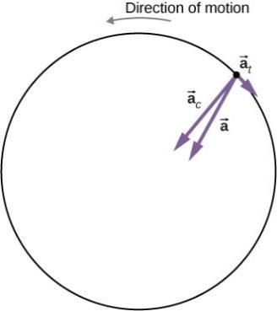
Figure 10.16
The centripetal, tangential, and total acceleration vectors. The centrifuge is slowing down, so the tangential acceleration is clockwise, opposite the direction of rotation (counterclockwise).

Slide 18
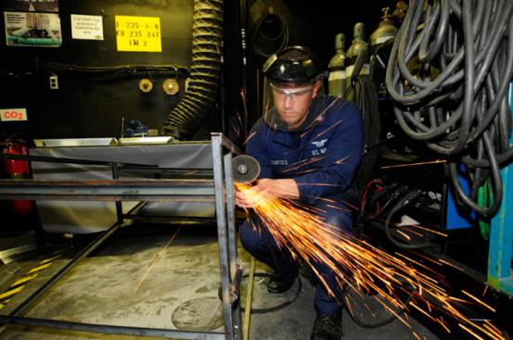
Figure 10.17
The rotational kinetic energy of the grindstone is converted to heat, light, sound, and vibration. (credit: Zachary David Bell, US Navy)

Slide 19
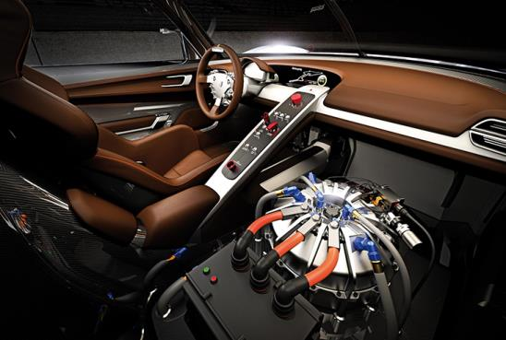
Figure 10.18
A KERS (kinetic energy recovery system) flywheel used in cars. (credit: “cmonville”/Flickr)

Slide 20
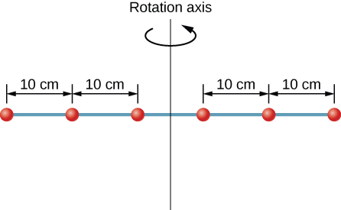
Figure 10.19
Six washers are spaced 10 cm apart on a rod of negligible mass and rotating about a vertical axis.

Slide 21
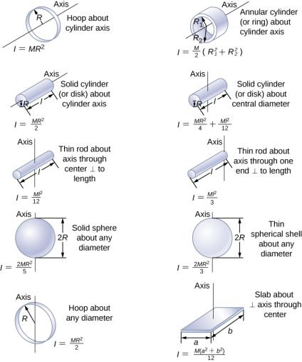
Figure 10.20
Values of rotational inertia for common shapes of objects.

Slide 22
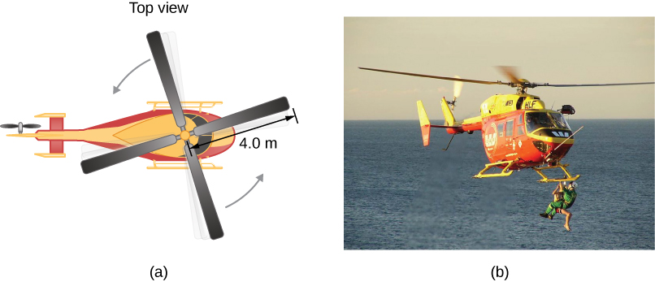
Figure 10.21
Sketch of a four-blade helicopter.
A water rescue operation featuring a helicopter from the Auckland Westpac Rescue Helicopter Service. (credit b: “111 Emergency”/Flickr)

Slide 23
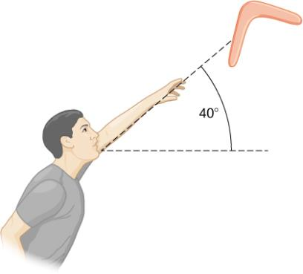
Figure 10.22
A boomerang is hurled into the air at an initial angle of 40°.

Slide 24
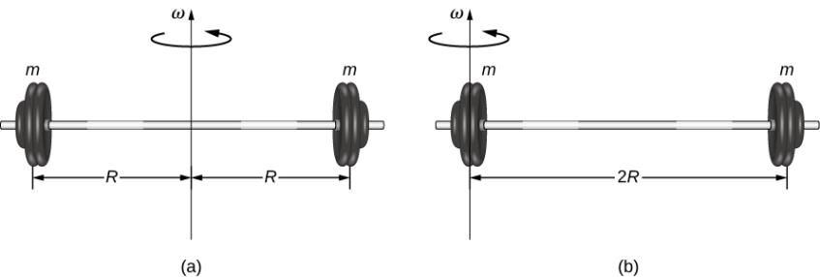
Figure 10.23
(a) A barbell with an axis of rotation through its center; (b) a barbell with an axis of rotation through one end.

Slide 25
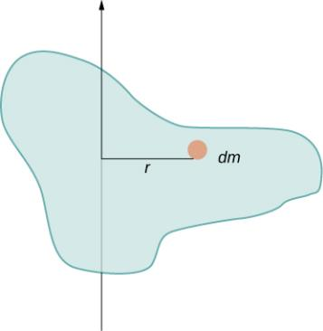
Figure 10.24
Using an infinitesimally small piece of mass to calculate the contribution to the total moment of inertia.

Slide 26
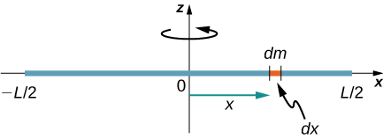
Figure 10.25
Calculation of the moment of inertia I for a uniform thin rod about an axis through the center of the rod.

Slide 27
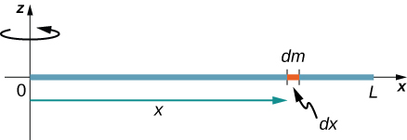
Figure 10.26
Calculation of the moment of inertia I for a uniform thin rod about an axis through the end of the rod.

Slide 28

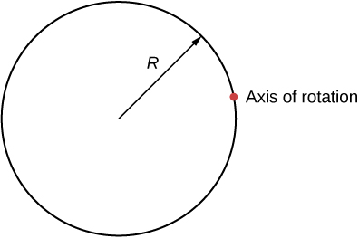
Exercise 10.5

Slide 29
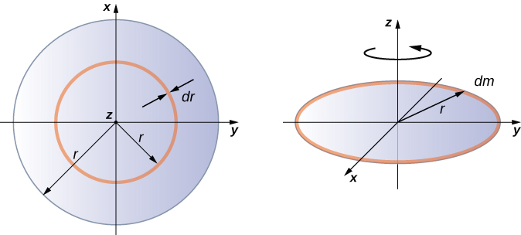
Figure 10.27
Calculating the moment of inertia for a thin disk about an axis through its center.

Slide 30
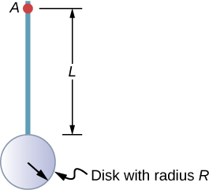
Figure 10.28
Compound object consisting of a disk at the end of a rod. The axis of rotation is located at A.

Slide 31
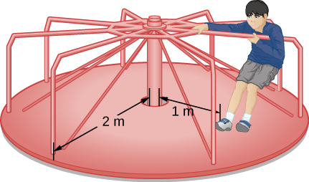
Figure 10.29
Calculating the moment of inertia for a child on a merry-go-round.

Slide 32
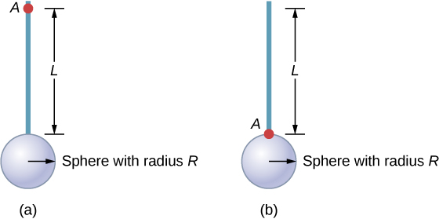
Example 10.12

Slide 33
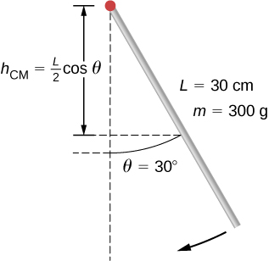
Figure 10.30
A pendulum in the form of a rod is released from rest at an angle of 30°.

Slide 34
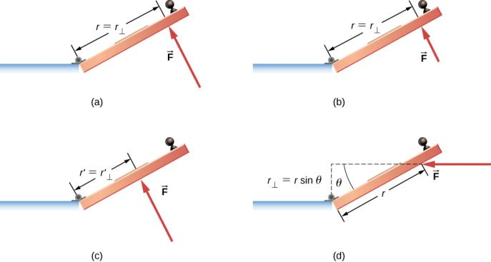
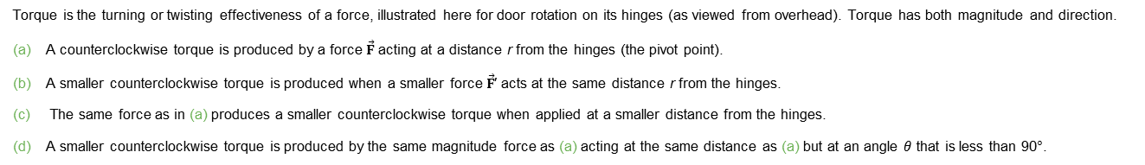
Figure 10.31
Torque is the turning or twisting effectiveness of a force, illustrated here for door rotation on its hinges (as viewed from overhead). Torque has both magnitude and direction.
A counterclockwise torque is produced by a force $\vec{F}$ acting at a distance r from the hinges (the pivot point).
A smaller counterclockwise torque is produced when a smaller force $\vec{F}$′ acts at the same distance r from the hinges.
The same force as in (a) produces a smaller counterclockwise torque when applied at a smaller distance from the hinges.
A smaller counterclockwise torque is produced by the same magnitude force as (a) acting at the same distance as (a) but at an angle $θ$ that is less than 90°.

Slide 35
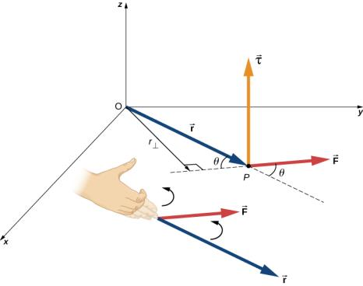
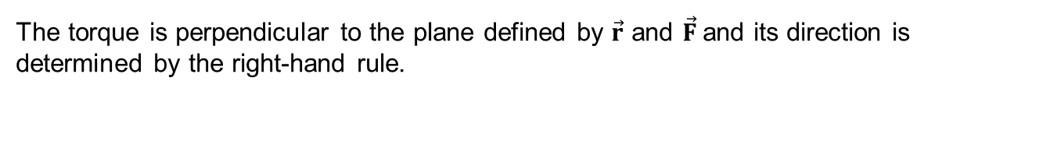
Figure 10.32
The torque is perpendicular to the plane defined by $\vec{r}$ and $\vec{F}$and its direction is determined by the right-hand rule.

Slide 36
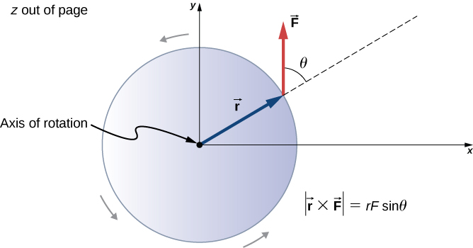
Figure 10.33
A disk is free to rotate about its axis through the center. The magnitude of the torque on the disk is rF sinθ. When θ = 0°, the torque is zero and the disk does not rotate. When θ = 90°, the torque is maximum and the disk rotates with maximum angular acceleration.

Slide 37
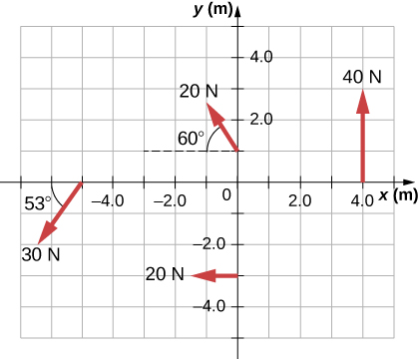
Figure 10.34
Four forces producing torques.

Slide 38
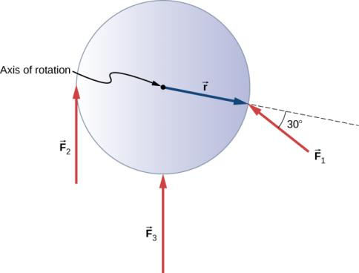
Figure 10.35
Three forces acting on a flywheel.

Slide 39
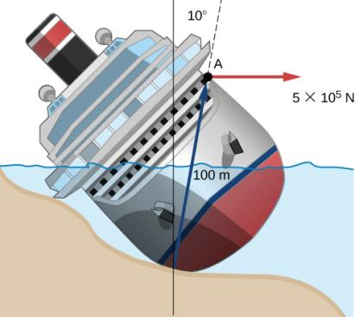
Figure 10.36
A ship runs aground and tilts, requiring torque to be applied to return the vessel to an upright position.

Slide 40
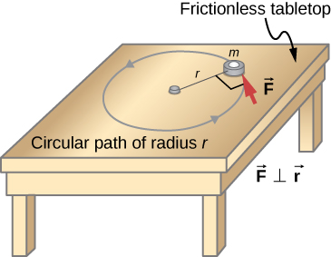
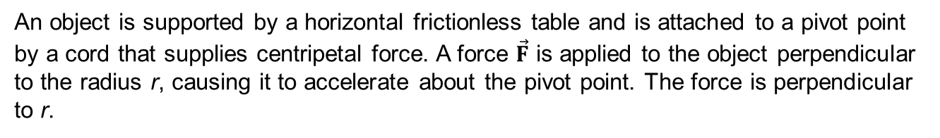
Figure 10.37
An object is supported by a horizontal frictionless table and is attached to a pivot point by a cord that supplies centripetal force. A force $\vec{F}$ is applied to the object perpendicular to the radius r, causing it to accelerate about the pivot point. The force is perpendicular to r.

Slide 41
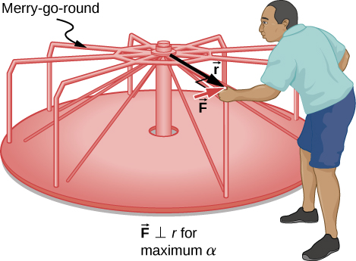
Figure 10.38
A father pushes a playground merry-go-round at its edge and perpendicular to its radius to achieve maximum torque.

Slide 42
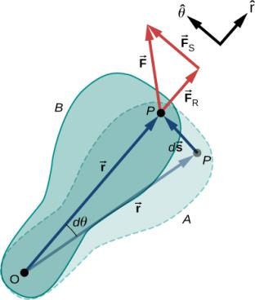
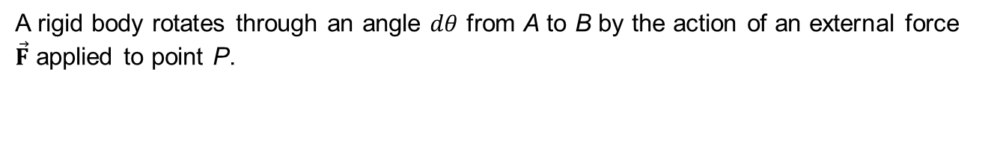
Figure 10.39
A rigid body rotates through an angle $dθ$ from A to B by the action of an external force $\vec{F}$ applied to point P.

Slide 43
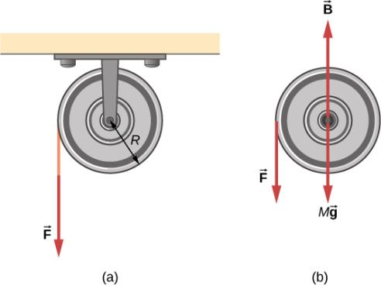
Figure 10.40
A string is wrapped around a pulley of radius R.
The free-body diagram.

Slide 44
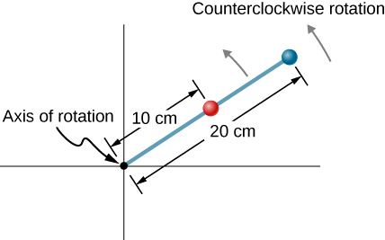
EXERCISE 36

Slide 45

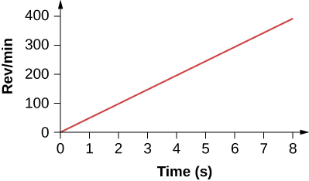
EXERCISE 44

Slide 46

EXERCISE 54

Slide 47

EXERCISE 63

Slide 48

EXERCISE 65

Slide 49

EXERCISE 67

Slide 50

EXERCISE 68

Slide 51

EXERCISE 69

Slide 52

Exercise 70

Slide 53

EXERCISE 71

Slide 54

EXERCISE 75

Slide 55

EXERCISE 77

Slide 56

EXERCISE 78

Slide 57

EXERCISE 80

Slide 58

EXERCISE 81

Slide 59


EXERCISE 92

Slide 60

EXERCISE 93

Slide 61

EXERCISE 94

Slide 62


EXERCISE 95

Slide 63

EXERCISE 96

Slide 64

EXERCISE 100

Slide 65

EXERCISE 102

Slide 66

EXERCISE 103

Slide 67

EXERCISE 105

Slide 68

EXERCISE 106

Slide 69

EXERCISE 114

Slide 70

EXERCISE 115

Slide 71

EXERCISE 116

Slide 72

EXERCISE 123

Slide 73

EXERCISE 125

Slide 74
This OpenStax ancillary resource is © Rice University under a CC-BY 4.0 International license; it may be reproduced or modified but must be attributed to OpenStax, Rice University and any changes must be noted.

