Slide 1
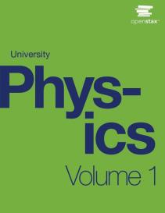

University Physics
Chapter 11 ANGULAR MOMENTUM
PowerPoint Image Slideshow

Slide 2

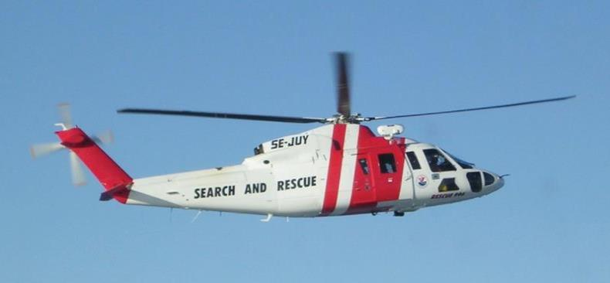
Figure 11.1
A helicopter has its main lift blades rotating to keep the aircraft airborne. Due to conservation of angular momentum, the body of the helicopter would want to rotate in the opposite sense to the blades, if it were not for the small rotor on the tail of the aircraft, which provides thrust to stabilize it.

Slide 3
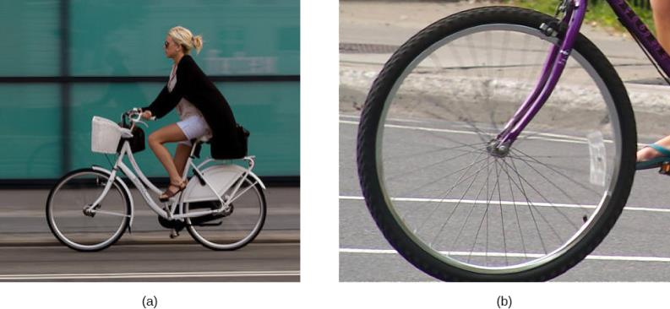
Figure 11.2
The bicycle moves forward, and its tires do not slip. The bottom of the slightly deformed tire is at rest with respect to the road surface for a measurable amount of time.
This image shows that the top of a rolling wheel appears blurred by its motion, but the bottom of the wheel is instantaneously at rest. (credit a: modification of work by Nelson Lourenço; credit b: modification of work by Colin Rose)

Slide 4
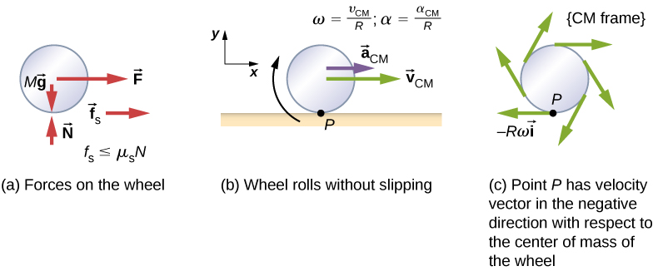
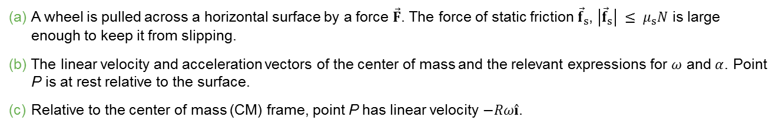
Figure 11.3
A wheel is pulled across a horizontal surface by a force $\vec{F}$. The force of static friction ${\vec{f}}_{s}$, $\left|{\vec{f}}_{s}\right| ≤ μ_{s}N$ is large enough to keep it from slipping.
The linear velocity and acceleration vectors of the center of mass and the relevant expressions for $ω$ and $α$. Point P is at rest relative to the surface.
Relative to the center of mass (CM) frame, point P has linear velocity $−Rω\hat{i}$.

Slide 5

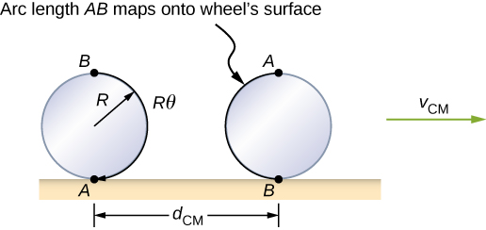
Figure 11.4
As the wheel rolls on the surface, the arc length Rθ from A to B maps onto the surface, corresponding to the distance d_{CM} that the center of mass has moved.

Slide 6
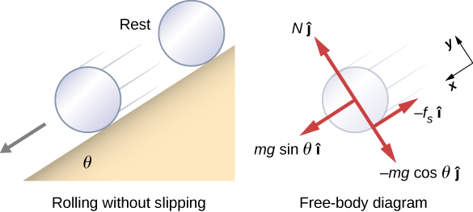
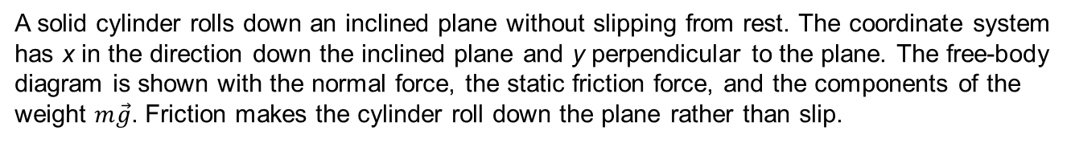
Figure 11.5
A solid cylinder rolls down an inclined plane without slipping from rest. The coordinate system has x in the direction down the inclined plane and y perpendicular to the plane. The free-body diagram is shown with the normal force, the static friction force, and the components of the weight $m\vec{g}$. Friction makes the cylinder roll down the plane rather than slip.

Slide 7
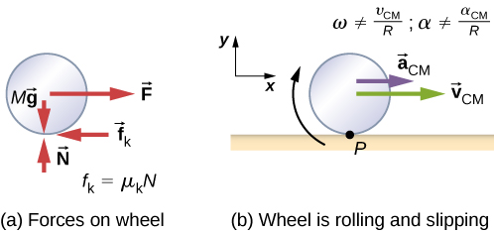
Figure 11.6
Kinetic friction arises between the wheel and the surface because the wheel is slipping.
The simple relationships between the linear and angular variables are no longer valid.

Slide 8
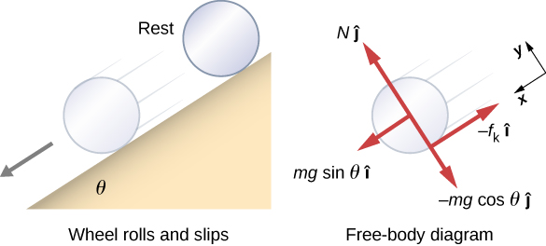
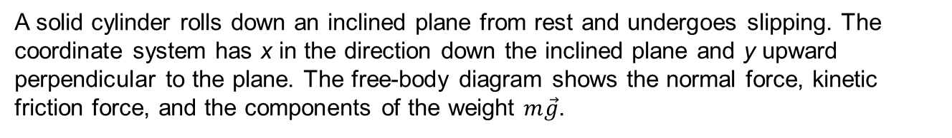
Figure 11.7
A solid cylinder rolls down an inclined plane from rest and undergoes slipping. The coordinate system has x in the direction down the inclined plane and y upward perpendicular to the plane. The free-body diagram shows the normal force, kinetic friction force, and the components of the weight $m\vec{g}$.

Slide 9
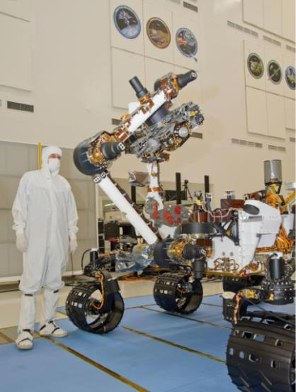
Figure 11.8
The NASA Mars Science Laboratory rover Curiosity during testing on June 3, 2011. The location is inside the Spacecraft Assembly Facility at NASA’s Jet Propulsion Laboratory in Pasadena, California. (credit: NASA/JPL-Caltech)

Slide 10
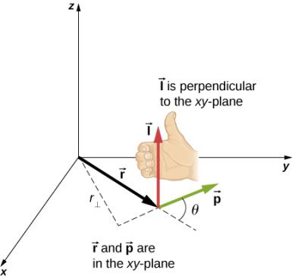
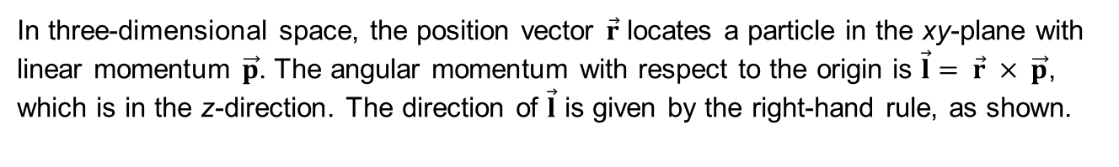
Figure 11.9
In three-dimensional space, the position vector $\vec{r}$ locates a particle in the xy-plane with linear momentum $\vec{p}$. The angular momentum with respect to the origin is $\vec{l}= \vec{r} × \vec{p}$, which is in the z-direction. The direction of $\vec{l}$ is given by the right-hand rule, as shown.

Slide 11
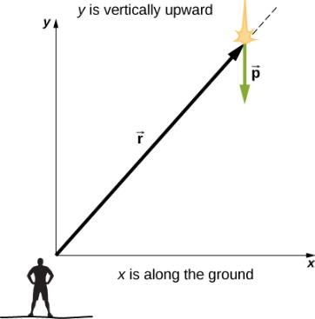
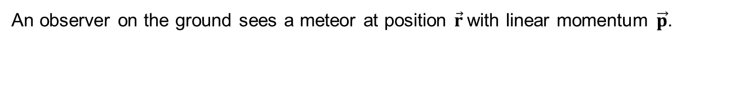
Figure 11.10
An observer on the ground sees a meteor at position $\vec{r}$with linear momentum $\vec{p}$.

Slide 12
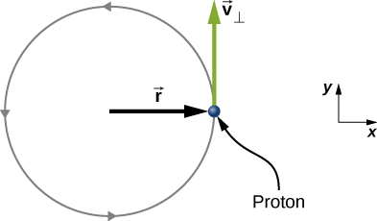
EXERCISE 11.2

Slide 13
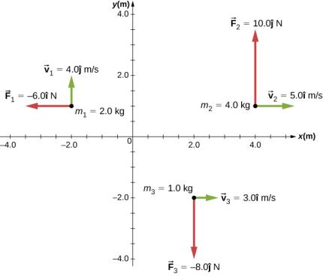
Figure 11.11
Three particles in the xy-plane with different position and momentum vectors.

Slide 14
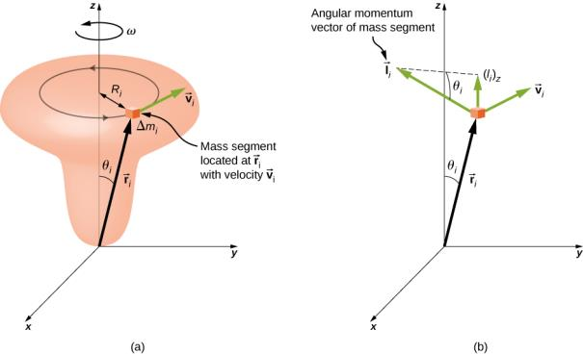
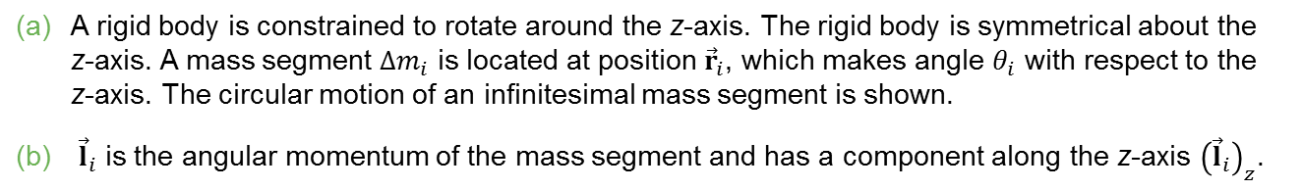
Figure 11.12
A rigid body is constrained to rotate around the z-axis. The rigid body is symmetrical about the z-axis. A mass segment $∆m_{i}$ is located at position ${\vec{r}}_{i}$, which makes angle $θ_{i}$ with respect to the z-axis. The circular motion of an infinitesimal mass segment is shown.
${\vec{l}}_{i}$ is the angular momentum of the mass segment and has a component along the z-axis ${\left({\vec{l}}_{i}\right)}_{z}$.

Slide 15
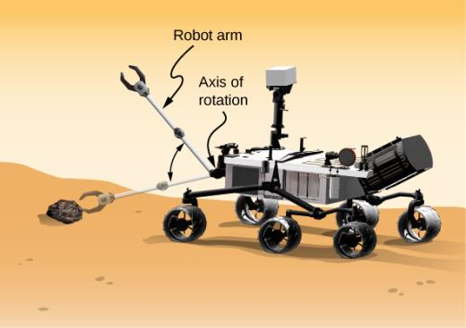
Figure 11.13
A robot arm on a Mars rover swings down and picks up a Mars rock. (credit: modification of work by NASA/JPL-Caltech)

Slide 16
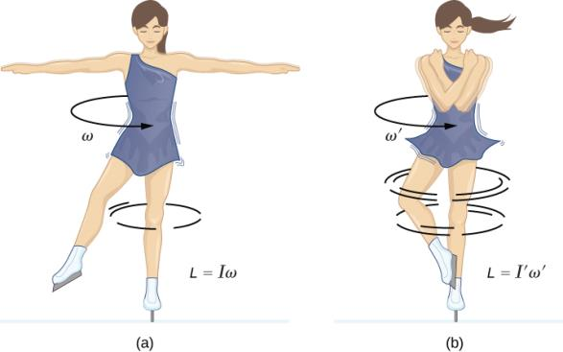
Figure 11.14
An ice skater is spinning on the tip of her skate with her arms extended. Her angular momentum is conserved because the net torque on her is negligibly small.
Her rate of spin increases greatly when she pulls in her arms, decreasing her moment of inertia. The work she does to pull in her arms results in an increase in rotational kinetic energy.

Slide 17
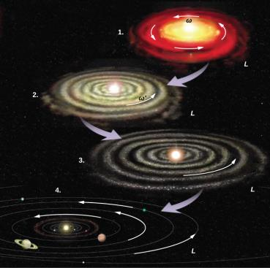
Figure 11.15
The solar system coalesced from a cloud of gas and dust that was originally rotating. The orbital motions and spins of the planets are in the same direction as the original spin and conserve the angular momentum of the parent cloud. (credit: modification of work by NASA)

Slide 18
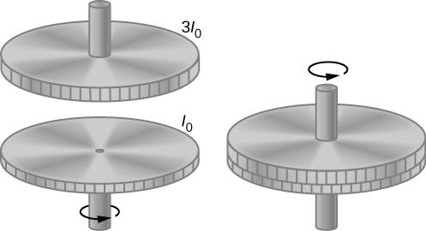
Figure 11.16
Two flywheels are coupled and rotate together.

Slide 19
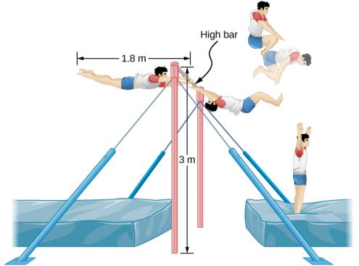
Figure 11.17
A gymnast dismounts from a high bar and executes a number of revolutions in the tucked position before landing upright.

Slide 20
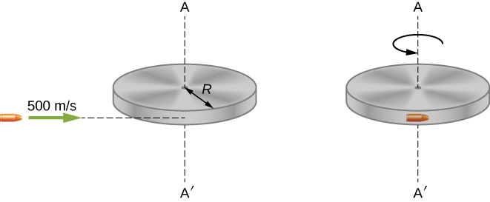
Figure 11.18
A bullet is fired horizontally and becomes embedded in the edge of a disk that is free to rotate about its vertical axis.

Slide 21
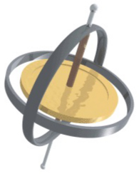
Figure 11.19
A gyroscope consists of a spinning disk about an axis that is free to assume any orientation.

Slide 22
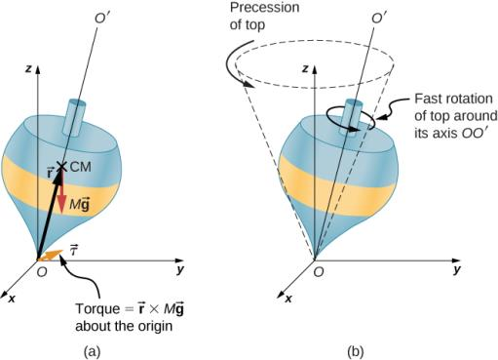
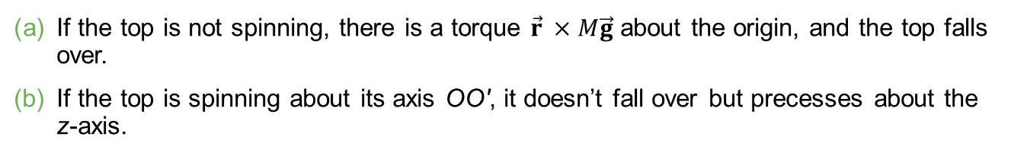
Figure 11.20
If the top is not spinning, there is a torque $\vec{r} ×M\vec{g}$ about the origin, and the top falls over.
If the top is spinning about its axis OO′, it doesn’t fall over but precesses about the z-axis.

Slide 23
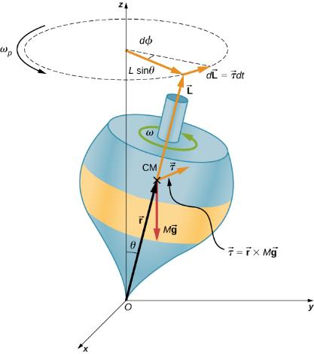

Figure 11.21
The force of gravity acting on the center of mass produces a torque $\vec{τ}$ in the direction perpendicular to $\vec{L}$. The magnitude of $\vec{L}$ doesn’t change but its direction does, and the top precesses about the z-axis.

Slide 24
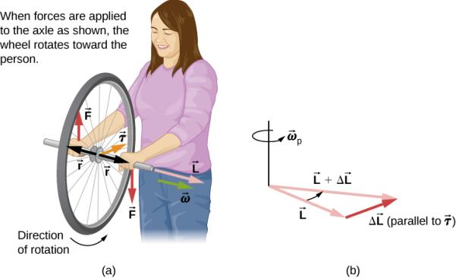
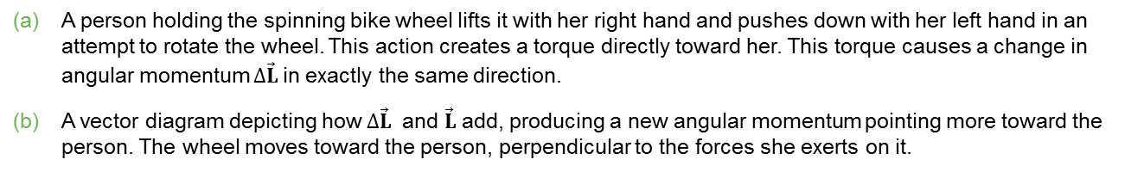
Figure 11.22
A person holding the spinning bike wheel lifts it with her right hand and pushes down with her left hand in an attempt to rotate the wheel. This action creates a torque directly toward her. This torque causes a change in angular momentum $∆\vec{L}$in exactly the same direction.
A vector diagram depicting how $∆\vec{L}$ and $\vec{L}$add, producing a new angular momentum pointing more toward the person. The wheel moves toward the person, perpendicular to the forces she exerts on it.

Slide 25

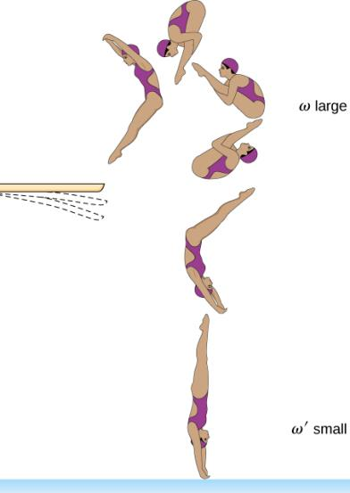
EXERCISE 16

Slide 26
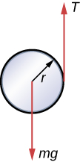
EXERCISE 27

Slide 27
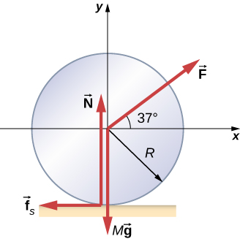
EXERCISE 32

Slide 28
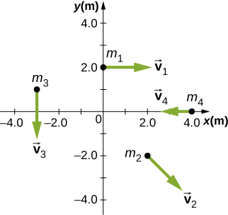
EXERCISE 38

Slide 29
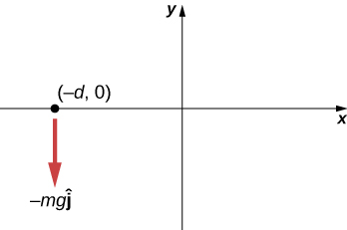
EXERCISE 43

Slide 30
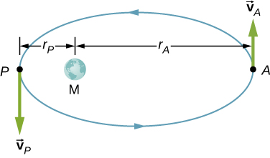
EXERCISE 56

Slide 31
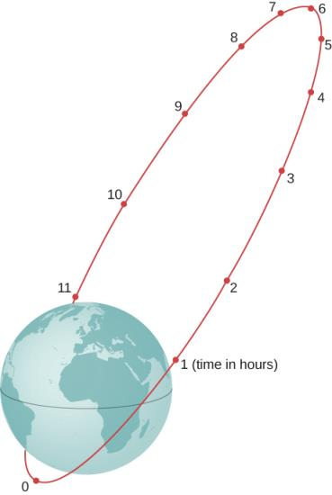
EXERCISE 57

Slide 32
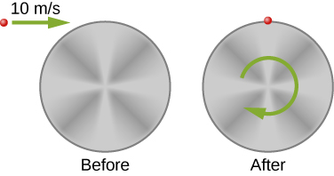
EXERCISE 58

Slide 33
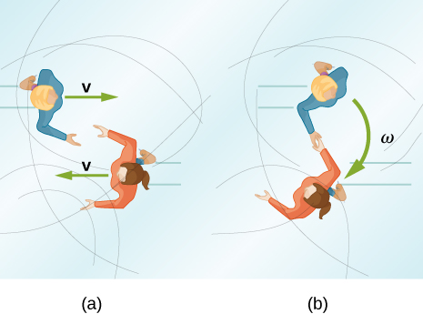
EXERCISE 65

Slide 34
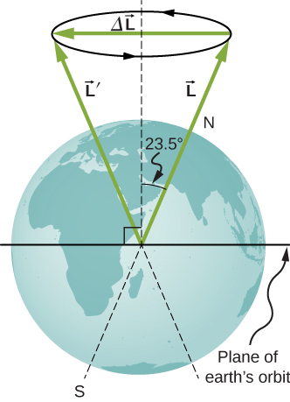
EXERCISE 77

Slide 35
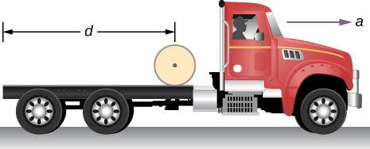
EXERCISE 95

Slide 36
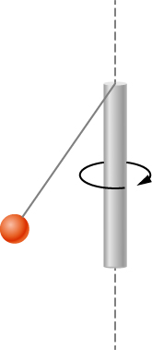
EXERCISE 97

Slide 37
This OpenStax ancillary resource is © Rice University under a CC-BY 4.0 International license; it may be reproduced or modified but must be attributed to OpenStax, Rice University and any changes must be noted.

