Slide 1
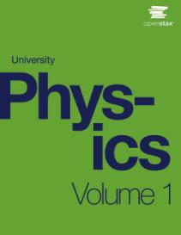

University Physics
Chapter 12 STATIC EQUILIBRIUM AND ELASTICITY
PowerPoint Image Slideshow

Slide 2

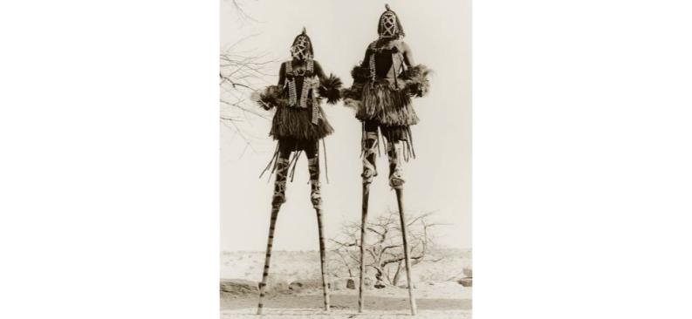
Figure 12.1
Two stilt walkers in standing position. All forces acting on each stilt walker balance out; neither changes its translational motion. In addition, all torques acting on each person balance out, and thus neither of them changes its rotational motion. The result is static equilibrium. (credit: modification of work by Stuart Redler)

Slide 3
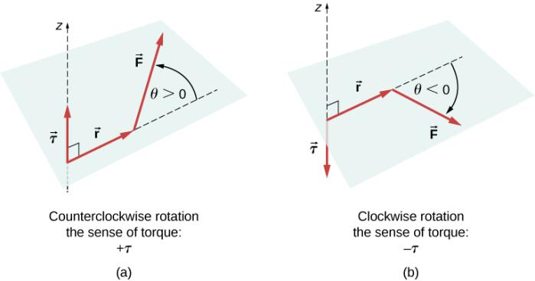
Figure 12.2
Torque of a force:
When the torque of a force causes counterclockwise rotation about the axis of rotation, we say that its sense is positive, which means the torque vector is parallel to the axis of rotation.
When torque of a force causes clockwise rotation about the axis, we say that its sense is negative, which means the torque vector is antiparallel to the axis of rotation.

Slide 4
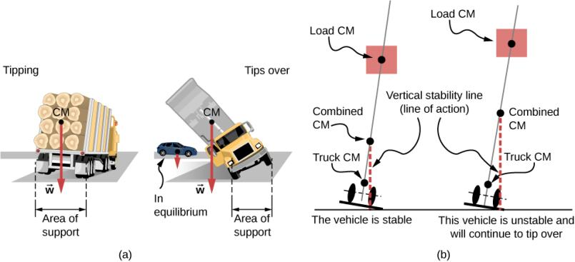
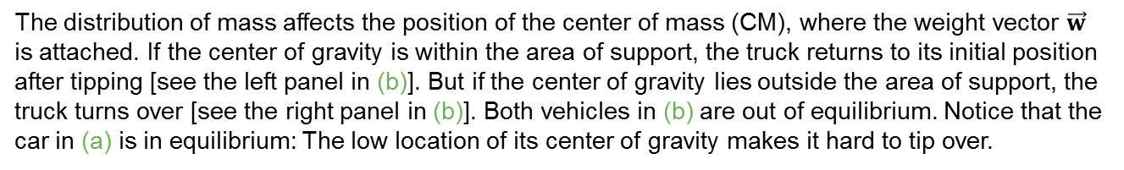
Figure 12.3
The distribution of mass affects the position of the center of mass (CM), where the weight vector $\vec{w}$ is attached. If the center of gravity is within the area of support, the truck returns to its initial position after tipping [see the left panel in (b)]. But if the center of gravity lies outside the area of support, the truck turns over [see the right panel in (b)]. Both vehicles in (b) are out of equilibrium. Notice that the car in (a) is in equilibrium: The low location of its center of gravity makes it hard to tip over.

Slide 5
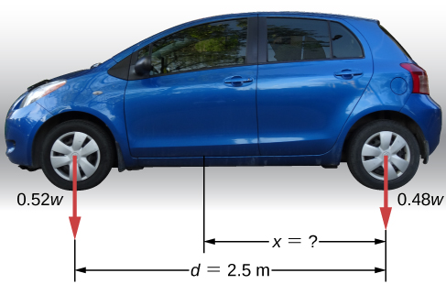
Figure 12.4
The weight distribution between the axles of a car. Where is the center of gravity located?

Slide 6
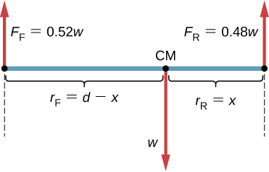
Figure 12.5
The free-body diagram for the car clearly indicates force vectors acting on the car and distances to the center of mass (CM). When CM is selected as the pivot point, these distances are lever arms of normal reaction forces. Notice that vector magnitudes and lever arms do not need to be drawn to scale, but all quantities of relevance must be clearly labeled.

Slide 7
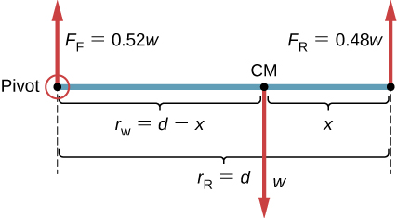
Figure 12.6
The equivalent free-body diagram for the car; the pivot is clearly indicated.

Slide 8
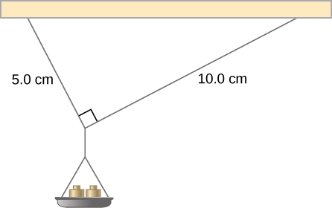
Figure 12.7
Mass is added gradually to the pan until one of the strings snaps.

Slide 9
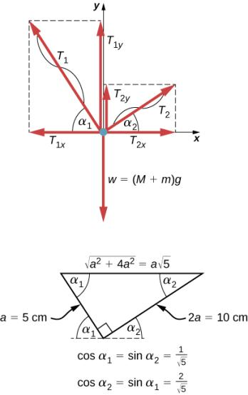
Figure 12.8
Free-body diagram for the knot in Example 12.2.

Slide 10
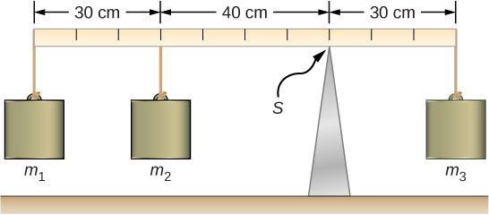
Figure 12.9
In a torque balance, a horizontal beam is supported at a fulcrum (indicated by S) and masses are attached to both sides of the fulcrum. The system is in static equilibrium when the beam does not rotate. It is balanced when the beam remains level.

Slide 11
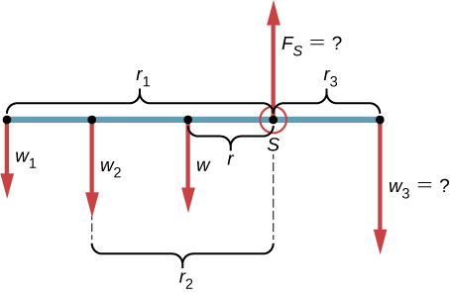
Figure 12.10
Free-body diagram for the meter stick. The pivot is chosen at the support point S.

Slide 12

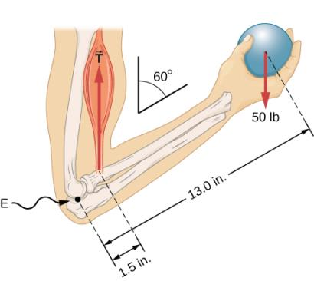
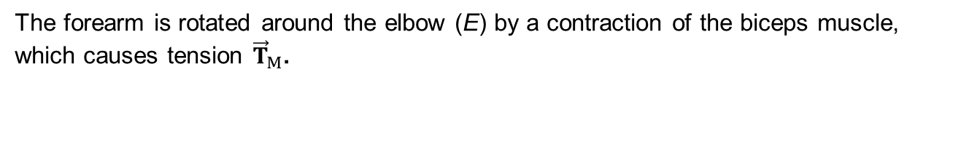
Figure 12.11
The forearm is rotated around the elbow (E) by a contraction of the biceps muscle, which causes tension ${\vec{T}}_{M}$.

Slide 13
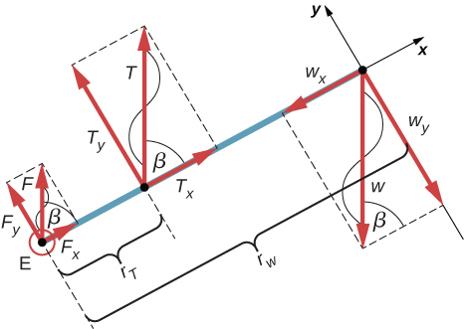
Figure 12.12
Free-body diagram for the forearm: The pivot is located at point E (elbow).

Slide 14
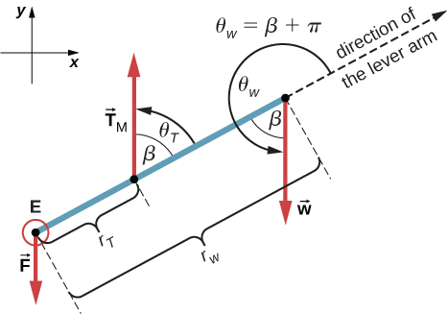
Figure 12.13
Free-body diagram for the forearm for the equivalent solution. The pivot is located at point E (elbow).

Slide 15
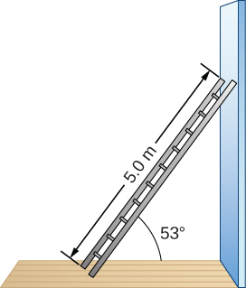
Figure 12.14
A 5.0-m-long ladder rests against a frictionless wall.

Slide 16
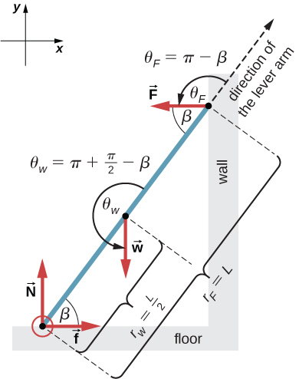
Figure 12.15
Free-body diagram for a ladder resting against a frictionless wall.

Slide 17
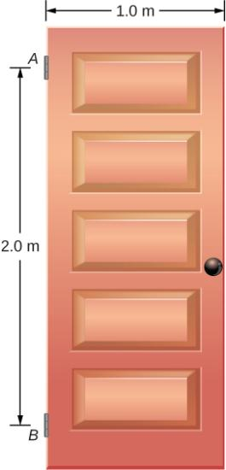
Figure 12.16
A 400-N swinging vertical door is supported by two hinges attached at points A and B.

Slide 18
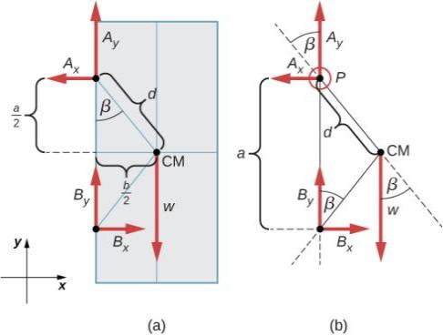
Figure 12.17
(a) Geometry and (b) free-body diagram for the door.

Slide 19
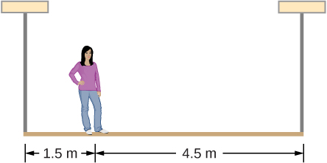
Exercise 12.7

Slide 20
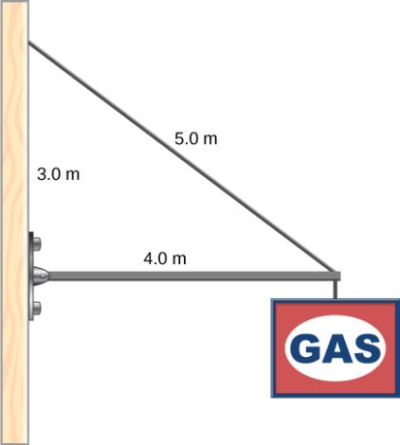
Exercise 12.8

Slide 21

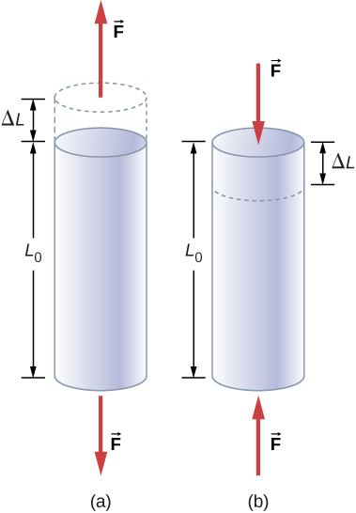
Figure 12.18
When an object is in either tension or compression, the net force on it is zero, but the object deforms by changing its original length L₀.
Tension: The rod is elongated by ΔL.
Compression: The rod is contracted by ΔL. In both cases, the deforming force acts along the length of the rod and perpendicular to its cross-section. In the linear range of low stress, the cross-sectional area of the rod does not change.

Slide 22
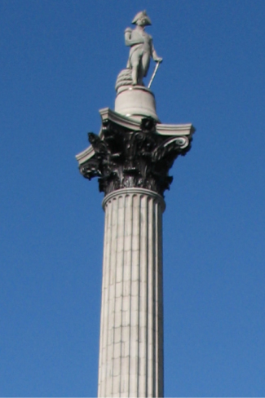
Figure 12.19
Nelson’s Column in Trafalgar Square, London, England. (credit: modification of work by Cristian Bortes)

Slide 23
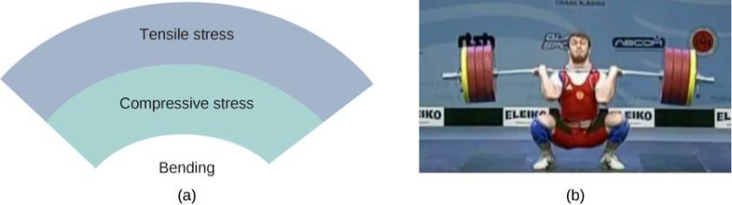
Figure 12.20
An object bending downward experiences tensile stress (stretching) in the upper section and compressive stress (compressing) in the lower section.
Elite weightlifters often bend iron bars temporarily during lifting, as in the 2012 Olympics competition. (credit b: modification of work by Oleksandr Kocherzhenko)

Slide 24
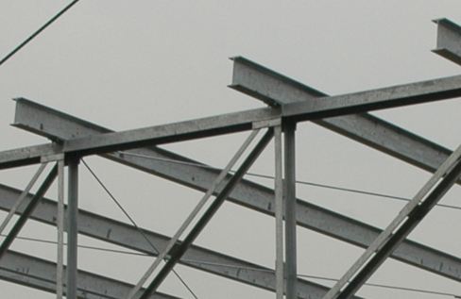
Figure 12.21
Steel I-beams are used in construction to reduce bending strains. (credit: modification of work by “US Army Corps of Engineers Europe District”/Flickr)

Slide 25
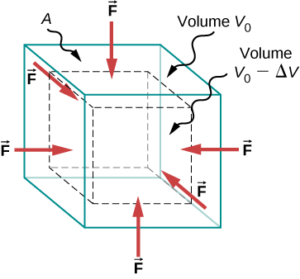
Figure 12.22
An object under increasing bulk stress always undergoes a decrease in its volume. Equal forces perpendicular to the surface act from all directions. The effect of these forces is to decrease the volume by the amount ΔV compared to the original volume, V₀.

Slide 26
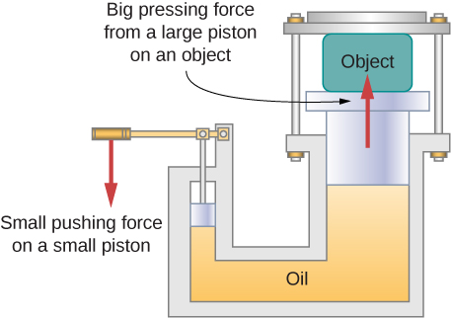
Figure 12.23
In a hydraulic press, when a small piston is displaced downward, the pressure in the oil is transmitted throughout the oil to the large piston, causing the large piston to move upward. A small force applied to a small piston causes a large pressing force, which the large piston exerts on an object that is either lifted or squeezed. The device acts as a mechanical lever.

Slide 27
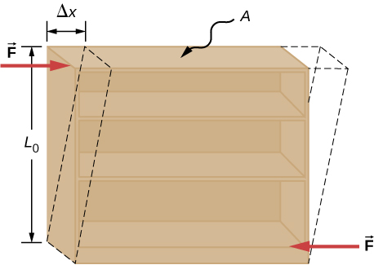
Figure 12.24
An object under shear stress: Two antiparallel forces of equal magnitude are applied tangentially to opposite parallel surfaces of the object. The dashed-line contour depicts the resulting deformation. There is no change in the direction transverse to the acting forces and the transverse length L₀ is unaffected. Shear deformation is characterized by a gradual shift Δx of layers in the direction tangent to the forces.

Slide 28
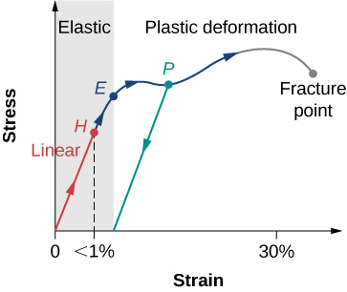
Figure 12.25
Typical stress-strain plot for a metal under a load: The graph ends at the fracture point. The arrows show the direction of changes under an ever-increasing load. Points H and E are the linearity and elasticity limits, respectively. Between points H and E, the behavior is nonlinear. The green line originating at P illustrates the metal’s response when the load is removed. The permanent deformation has a strain value at the point where the green line intercepts the horizontal axis.

Slide 29
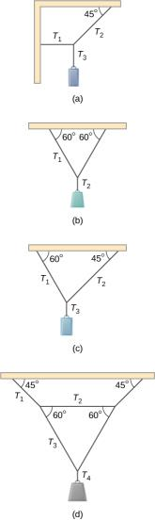
EXERCISE 26

Slide 30

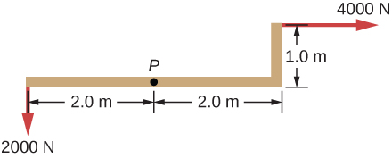
EXERCISE 27

Slide 31
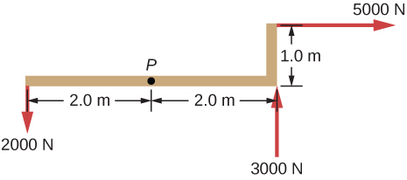
EXERCISE 28

Slide 32
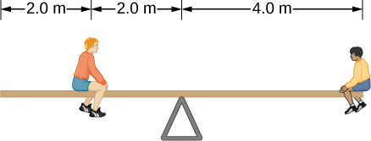
EXERCISE 31

Slide 33
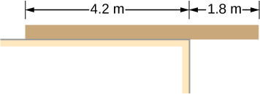
EXERCISE 32

Slide 34
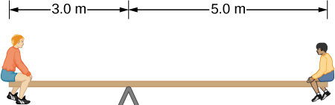
EXERCISE 33

Slide 35
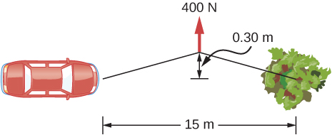
EXERCISE 34

Slide 36
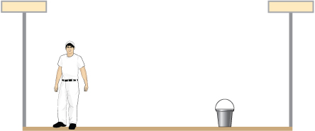
EXERCISE 35

Slide 37
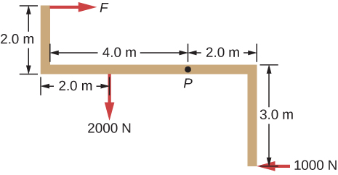
EXERCISE 36

Slide 38
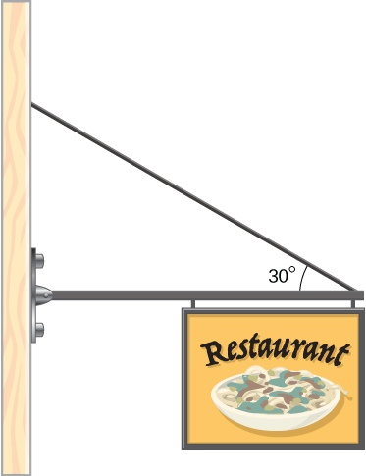
EXERCISE 38

Slide 39
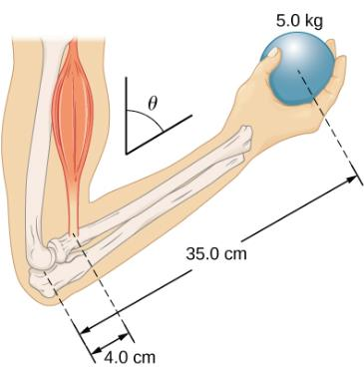
Exercise 39

Slide 40
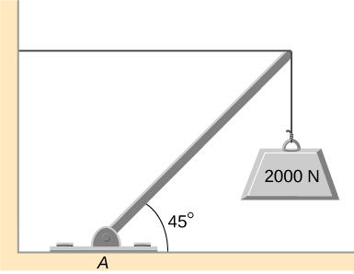
EXERCISE 40

Slide 41
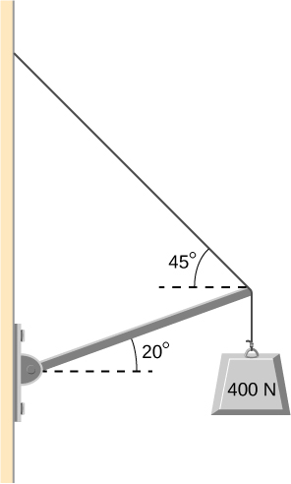
EXERCISE 41

Slide 42
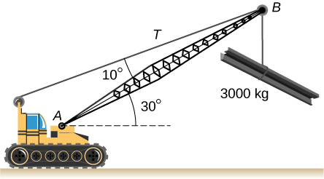
EXERCISE 42

Slide 43
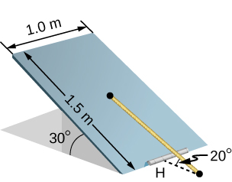
EXERCISE 43

Slide 44
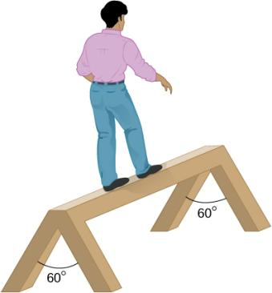
EXERCISE 44

Slide 45
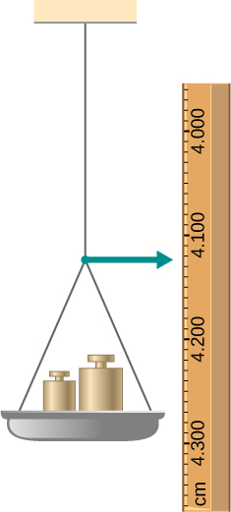
EXERCISE 67

Slide 46
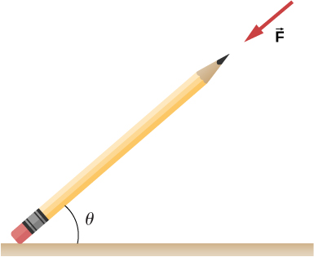
EXERCISE 69

Slide 47
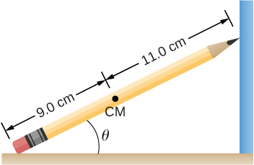
EXERCISE 70

Slide 48
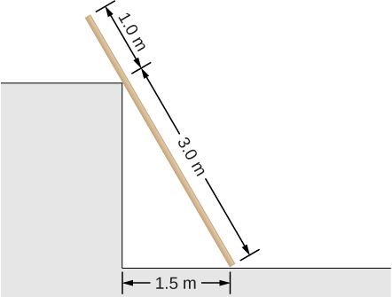
EXERCISE 71

Slide 49

EXERCISE 75

Slide 50

EXERCISE 76

Slide 51

EXERCISE 77

Slide 52

EXERCISE 78

Slide 53

EXERCISE 79

Slide 54

EXERCISE 80

Slide 55

EXERCISE 81

Slide 56
This OpenStax ancillary resource is © Rice University under a CC-BY 4.0 International license; it may be reproduced or modified but must be attributed to OpenStax, Rice University and any changes must be noted.

