Slide 1
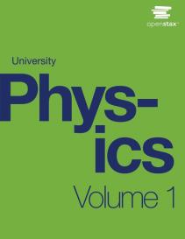

University Physics
Chapter 13 GRAVITATION
PowerPoint Image Slideshow

Slide 2

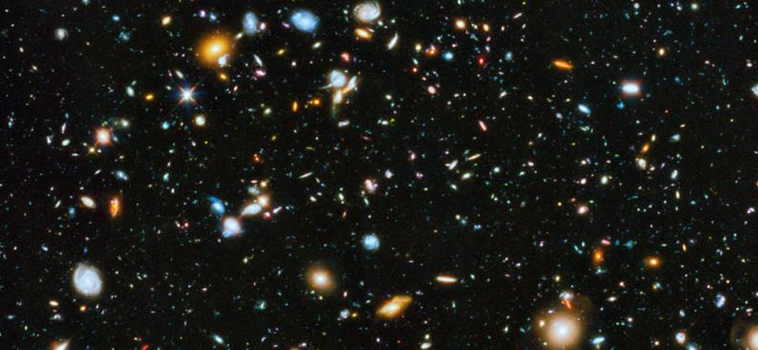
Figure 13.1
Our visible Universe contains billions of galaxies, whose very existence is due to the force of gravity. Gravity is ultimately responsible for the energy output of all stars—initiating thermonuclear reactions in stars, allowing the Sun to heat Earth, and making galaxies visible from unfathomable distances. Most of the dots you see in this image are not stars, but galaxies. (credit: modification of work by NASA)

Slide 3
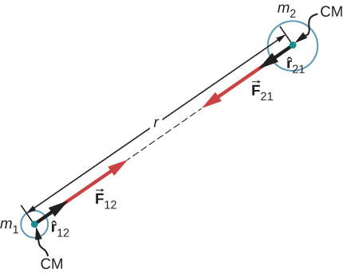
Figure 13.2
Gravitational force acts along a line joining the centers of mass of two objects.

Slide 4
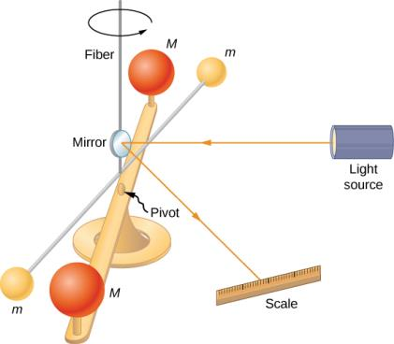
Figure 13.3
Cavendish used an apparatus similar to this to measure the gravitational attraction between two spheres (m) suspended from a wire and two stationary spheres (M). This is a common experiment performed in undergraduate laboratories, but it is quite challenging. Passing trucks outside the laboratory can create vibrations that overwhelm the gravitational forces.

Slide 5
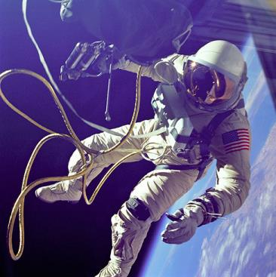
Figure 13.4
This photo shows Ed White tethered to the Space Shuttle during a spacewalk. (credit: NASA)

Slide 6
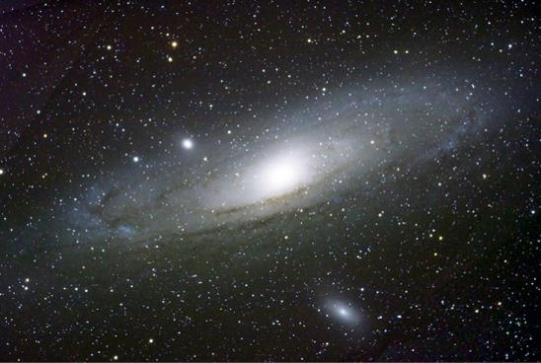
Figure 13.5
Galaxies interact gravitationally over immense distances. The Andromeda galaxy is the nearest spiral galaxy to the Milky Way, and they will eventually collide. (credit: Boris Štromar)

Slide 7
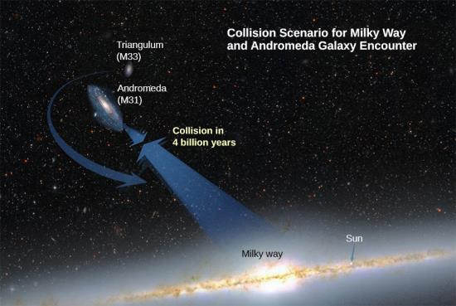
Figure 13.6
Based on the results of this example, plus what astronomers have observed elsewhere in the Universe, our galaxy will collide with the Andromeda Galaxy in about 4 billion years. (credit: NASA)

Slide 8
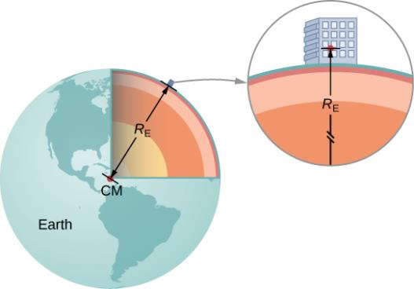
Figure 13.7
We can take the distance between the centers of mass of Earth and an object on its surface to be the radius of Earth, provided that its size is much less than the radius of Earth.

Slide 9
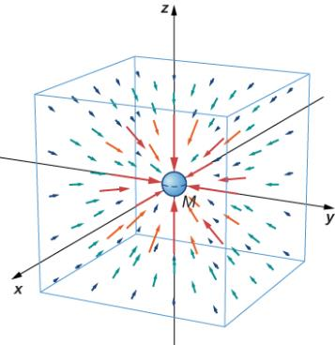
Figure 13.8
A three-dimensional representation of the gravitational field created by mass M. Note that the lines are uniformly distributed in all directions. (The box has been added only to aid in visualization.)

Slide 10
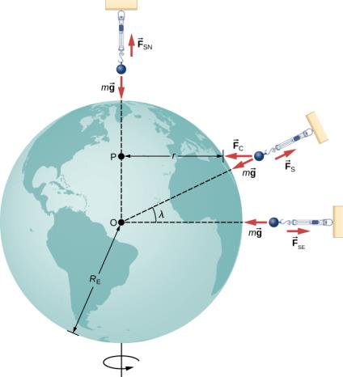
Figure 13.9
For a person standing at the equator, the centripetal acceleration (a_{c}) is in the same direction as the force of gravity. At latitude λ, the angle the between a_{c} and the force of gravity is λ and the magnitude of a_{c} decreases with cosλ .

Slide 11
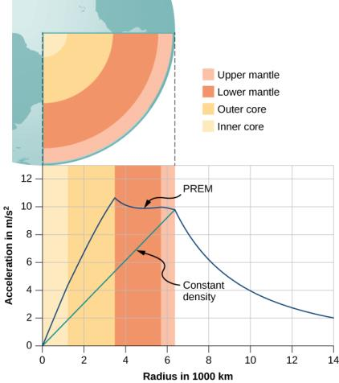
Figure 13.10
For r < R_{E} , the value of g for the case of constant density is the straight green line. The blue line from the PREM (Preliminary Reference Earth Model) is probably closer to the actual profile for g.

Slide 12
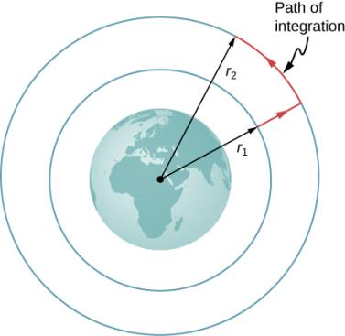
Figure 13.11
The work integral, which determines the change in potential energy, can be evaluated along the path shown in red.

Slide 13
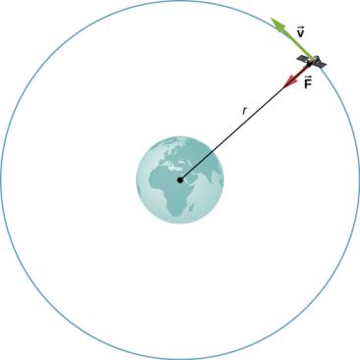
Figure 13.12
A satellite of mass m orbiting at radius r from the center of Earth. The gravitational force supplies the centripetal acceleration.

Slide 14
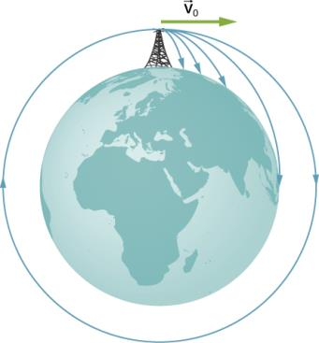
Figure 13.13
A circular orbit is the result of choosing a tangential velocity such that Earth’s surface curves away at the same rate as the object falls toward Earth.

Slide 15
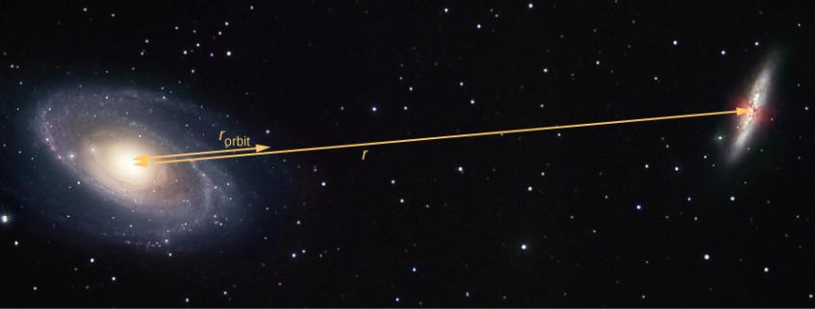
Figure 13.14
The distance between two galaxies, which determines the gravitational force between them, is r, and is different from r_{orbit}, which is the radius of orbit for each. For equal masses, r_{orbit} = 1/2r . (credit: modification of work by Marc Van Norden)

Slide 16
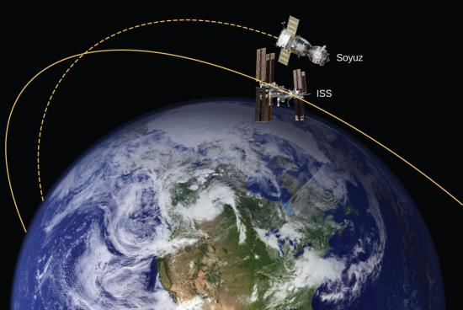
Figure 13.15
The Soyuz in a rendezvous with the ISS. Note that this diagram is not to scale; the Soyuz is very small compared to the ISS and its orbit is much closer to Earth. (credit: modification of works by NASA)

Slide 17
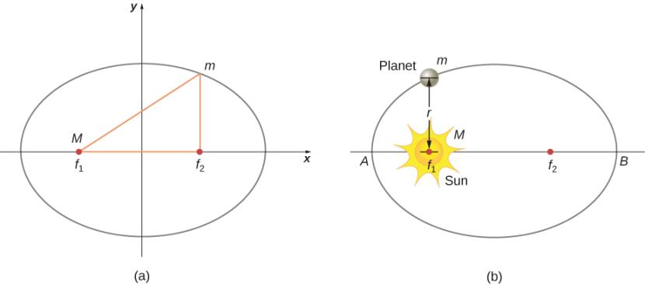
Figure 13.16
An ellipse is a curve in which the sum of the distances from a point on the curve to two foci ( f₁ and f₂) is a constant. From this definition, you can see that an ellipse can be created in the following way. Place a pin at each focus, then place a loop of string around a pencil and the pins. Keeping the string taught, move the pencil around in a complete circuit. If the two foci occupy the same place, the result is a circle—a special case of an ellipse.
For an elliptical orbit, if m ≪ M, then m follows an elliptical path with M at one focus. More exactly, both m and M move in their own ellipse about the common center of mass.

Slide 18
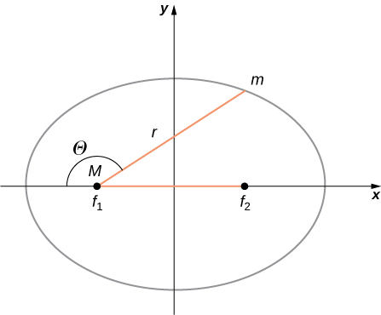
Figure 13.17
As before, the distance between the planet and the Sun is r, and the angle measured from the x-axis, which is along the major axis of the ellipse, is θ.

Slide 19
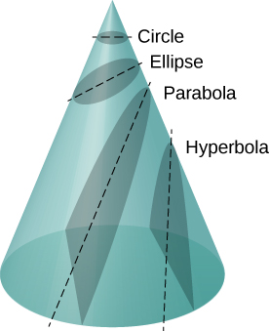
Figure 13.18
All motion caused by an inverse square force is one of the four conic sections and is determined by the energy and direction of the moving body.

Slide 20
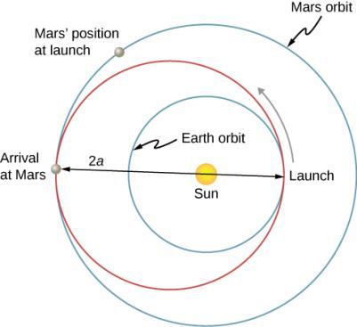
Figure 13.19
The transfer ellipse has its perihelion at Earth’s orbit and aphelion at Mars’ orbit.

Slide 21
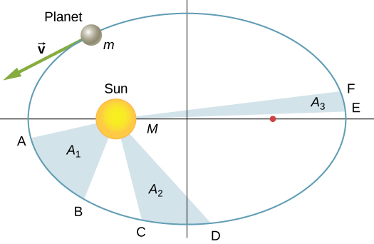
Figure 13.20
The shaded regions shown have equal areas and represent the same time interval.

Slide 22
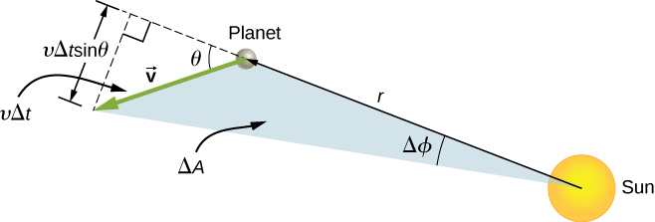
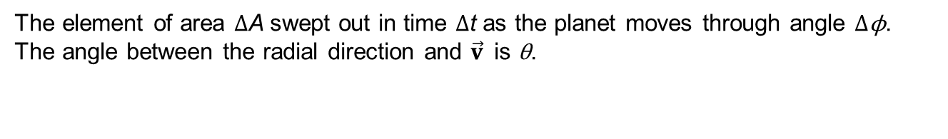
Figure 13.21
The element of area ΔA swept out in time Δt as the planet moves through angle Δϕ. The angle between the radial direction and $\vec{v}$is θ.

Slide 23
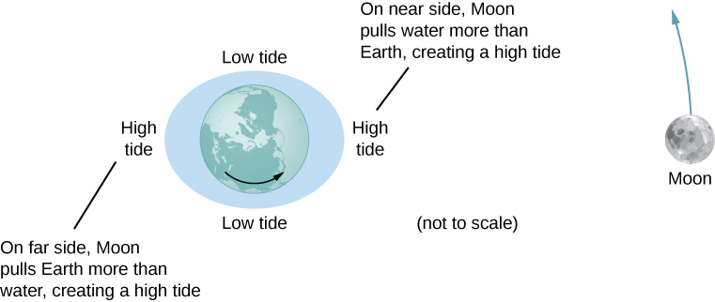
Figure 13.22
The tidal force stretches Earth along the line between Earth and the Moon. It is the difference between the gravitational force from the far side to the near side that creates the tidal bulge on both sides of the planet. Tidal variations of the oceans are on the order of few meters; hence, this diagram is greatly exaggerated.

Slide 24
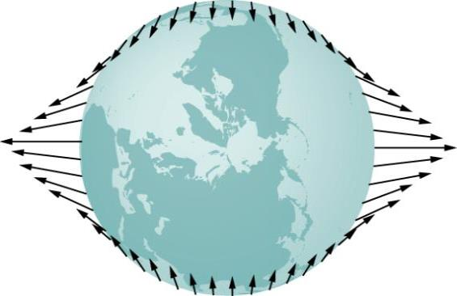
Figure 13.23
The tidal force is the difference between the gravitational force at the center and that elsewhere. In this figure, the tidal forces are shown at the ocean surface. These forces would diminish to zero as you approach Earth’s center.

Slide 25
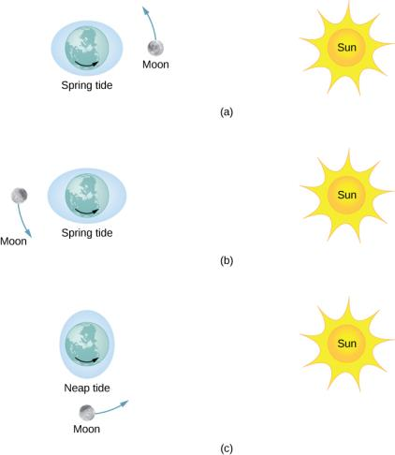
Figure 13.24
(a and b) The spring tides occur when the Sun and the Moon are aligned, whereas (c) the neap tides occur when the Sun and Moon make a right triangle with Earth. (Figure is not drawn to scale.)

Slide 26
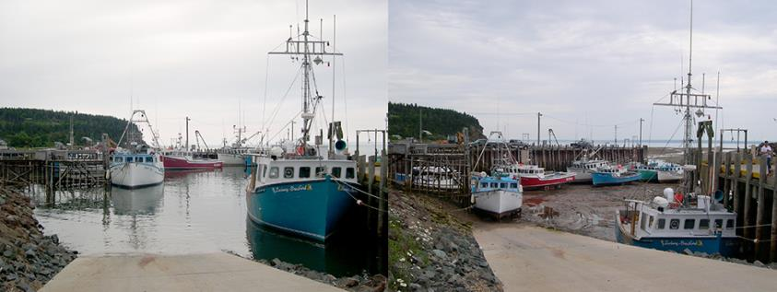
Figure 13.25
Boats in the Bay of Fundy at high and low tides. The twice-daily change in sea level creates a real challenge to the safe mooring of boats. (credit: Dylan Kereluk)

Slide 27
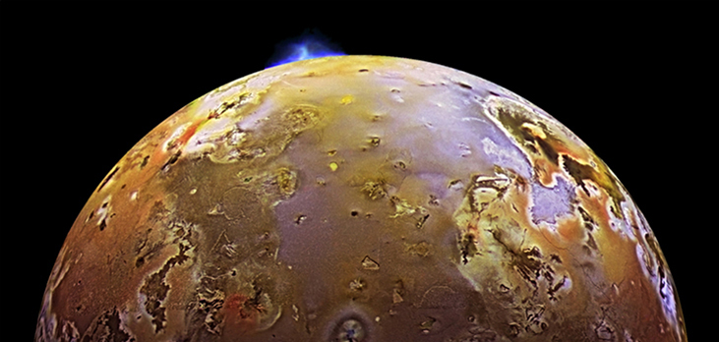
Figure 13.26
Dramatic evidence of tidal forces can be seen on Io. The eruption seen in blue is due to the internal heat created by the tidal forces exerted on Io by Jupiter.

Slide 28
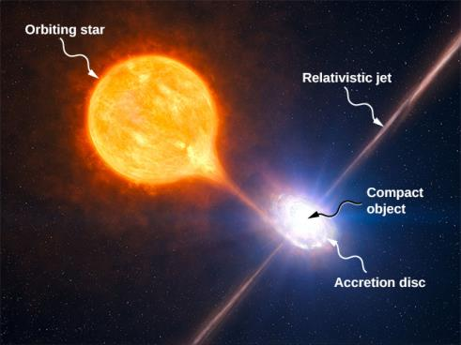
Figure 13.27
Tidal forces from a compact object can tear matter away from an orbiting star. In addition to the accretion disc orbiting the compact object, material is often ejected along relativistic jets as shown. (credit: modification of work by European Southern Observatory (ESO))

Slide 29
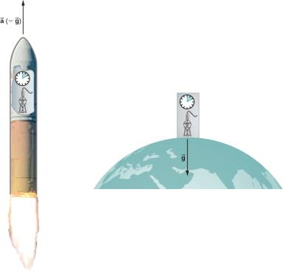
Figure 13.28
According to the principle of equivalence, the results of all experiments performed in a laboratory in a uniform gravitational field are identical to the results of the same experiments performed in a uniformly accelerating laboratory.

Slide 30
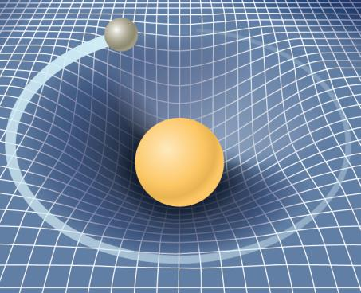
Figure 13.29
A smaller mass orbiting in the distorted space-time of a larger mass. In fact, all mass or energy distorts space-time.

Slide 31
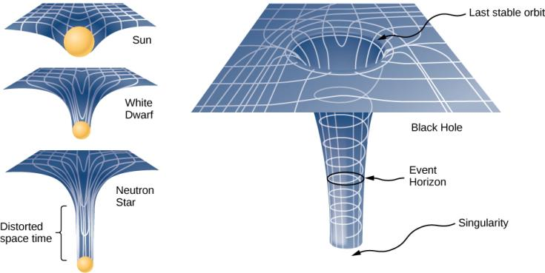
Figure 13.30
The space distortion becomes more noticeable around increasingly larger masses. Once the mass density reaches a critical level, a black hole forms and the fabric of space-time is torn. The curvature of space is greatest at the surface of each of the first three objects shown and is finite. The curvature then decreases (not shown) to zero as you move to the center of the object. But the black hole is different. The curvature becomes infinite: The surface has collapsed to a singularity, and the cone extends to infinity. (Note: These diagrams are not to any scale.)

Slide 32
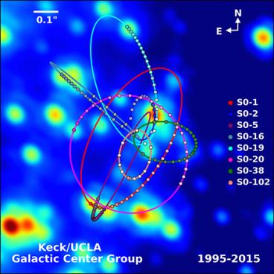
Figure 13.31
Paths of stars orbiting about a mass at the center of our Milky Way galaxy. From their motion, it is estimated that a black hole of about 4 million solar masses resides at the center. (credit: UCLA Galactic Center Group – W.M. Keck Observatory Laser Team)

Slide 33

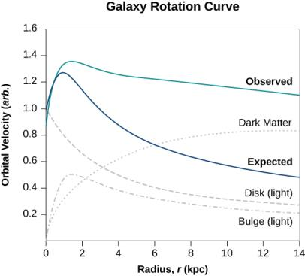
Figure 13.32
The blue curve shows the expected orbital velocity of stars in the Milky Way based upon the visible stars we can see. The green curve shows that the actually velocities are higher, suggesting additional matter that cannot be seen. (credit: modification of work by Matthew Newby)

Slide 34
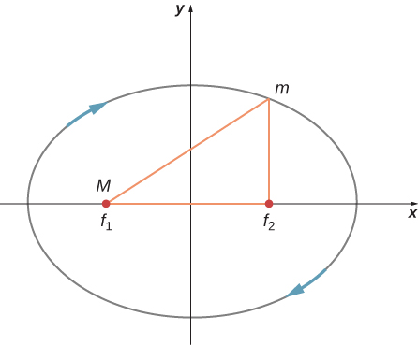
Exercise 9

Slide 35
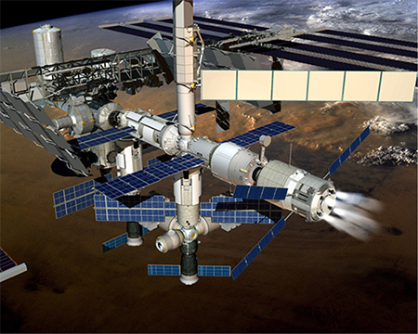
FIGURE 13.33
(credit: ©ESA–David Ducros)

Slide 36
This OpenStax ancillary resource is © Rice University under a CC-BY 4.0 International license; it may be reproduced or modified but must be attributed to OpenStax, Rice University and any changes must be noted.

