Slide 1


University Physics
Chapter 14 FLUID MECHANICS
PowerPoint Image Slideshow

Slide 2

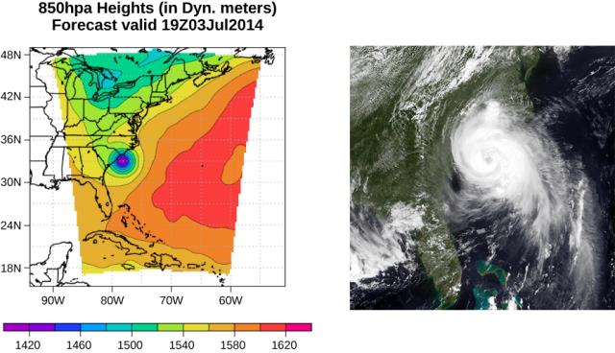
Figure 14.1
This pressure map (left) and satellite photo (right) were used to model the path and impact of Hurricane Arthur as it traveled up the East Coast of the United States in July 2014. Computer models use force and energy equations to predict developing weather patterns. Scientists numerically integrate these time-dependent equations, along with the energy budgets of long- and short-wave solar energy, to model changes in the atmosphere. The pressure map on the left was created using the Weather Research and Forecasting Model designed at the National Center for Atmospheric Research. The colors represent the height of the 850-mbar pressure surface. (credit left: modification of work by The National Center for Atmospheric Research; credit right: modification of work by NRL Monterey Marine Meteorology Division, The National Oceanic and Atmospheric Administration)

Slide 3
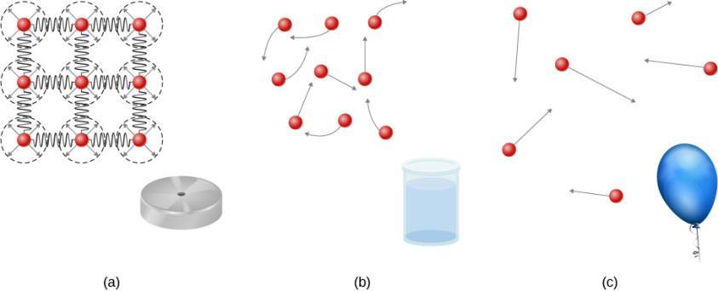
Figure 14.2
Atoms in a solid are always in close contact with neighboring atoms, held in place by forces represented here by springs.
Atoms in a liquid are also in close contact but can slide over one another. Forces between the atoms strongly resist attempts to compress the atoms.
Atoms in a gas move about freely and are separated by large distances. A gas must be held in a closed container to prevent it from expanding freely and escaping.

Slide 4
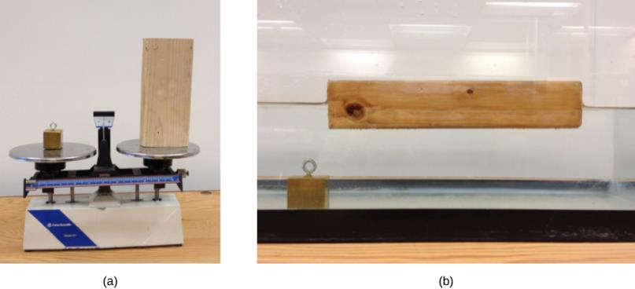
Figure 14.3
A block of brass and a block of wood both have the same weight and mass, but the block of wood has a much greater volume.
When placed in a fish tank filled with water, the cube of brass sinks and the block of wood floats. (The block of wood is the same in both pictures; it was turned on its side to fit on the scale.)

Slide 5
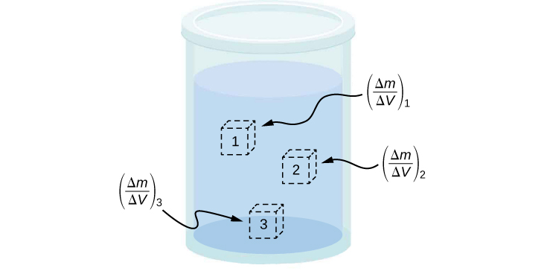
Figure 14.4
Density may vary throughout a heterogeneous mixture. Local density at a point is obtained from dividing mass by volume in a small volume around a given point.

Slide 6
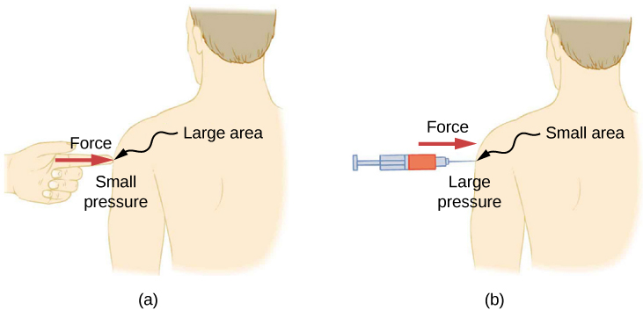
Figure 14.5
A person being poked with a finger might be irritated, but the force has little lasting effect.
In contrast, the same force applied to an area the size of the sharp end of a needle is enough to break the skin.

Slide 7

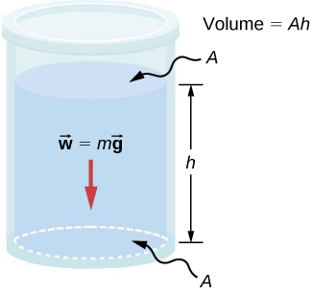
Figure 14.6
The bottom of this container supports the entire weight of the fluid in it. The vertical sides cannot exert an upward force on the fluid (since it cannot withstand a shearing force), so the bottom must support it all.

Slide 8
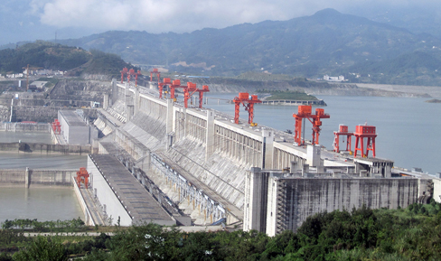
Figure 14.7
The Three Gorges Dam, erected on the Yangtze River in central China in 2008, created a massive reservoir that displaced more than one million people. (credit: “Le Grand Portage”/Flickr)

Slide 9
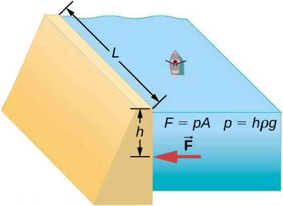
Example 14.1

Slide 10
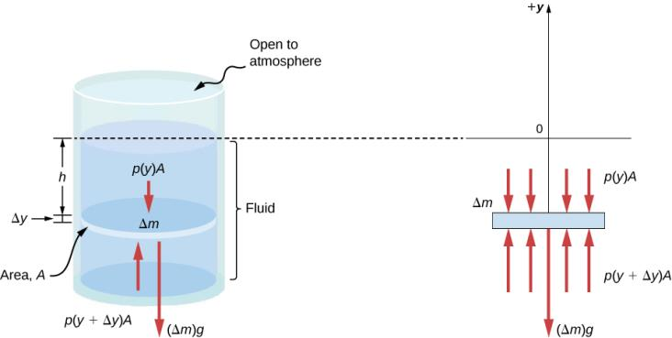
Figure 14.8
Forces on a mass element inside a fluid. The weight of the element itself is shown in the free-body diagram.

Slide 11

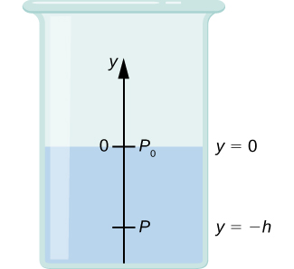

Slide 12
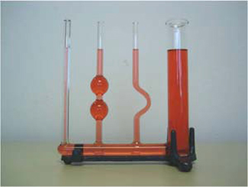
Figure 14.9
If a fluid can flow freely between parts of a container, it rises to the same height in each part. In the container pictured, the pressure at the bottom of each column is the same; if it were not the same, the fluid would flow until the pressures became equal.

Slide 13
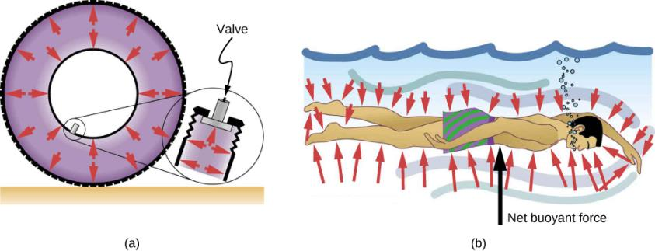
Figure 14.10
Pressure inside this tire exerts forces perpendicular to all surfaces it contacts. The arrows represent directions and magnitudes of the forces exerted at various points.
Pressure is exerted perpendicular to all sides of this swimmer, since the water would flow into the space he occupies if he were not there. The arrows represent the directions and magnitudes of the forces exerted at various points on the swimmer. Note that the forces are larger underneath, due to greater depth, giving a net upward or buoyant force. The net vertical force on the swimmer is equal to the sum of the buoyant force and the weight of the swimmer.

Slide 14
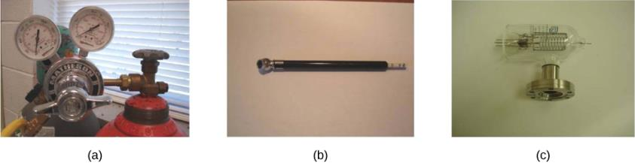
Figure 14.11
Gauges are used to measure and monitor pressure in gas cylinders. Compressed gases are used in many industrial as well as medical applications.
Tire pressure gauges come in many different models, but all are meant for the same purpose: to measure the internal pressure of the tire. This enables the driver to keep the tires inflated at optimal pressure for load weight and driving conditions.
An ionization gauge is a high-sensitivity device used to monitor the pressure of gases in an enclosed system. Neutral gas molecules are ionized by the release of electrons, and the current is translated into a pressure reading. Ionization gauges are commonly used in industrial applications that rely on vacuum systems.

Slide 15
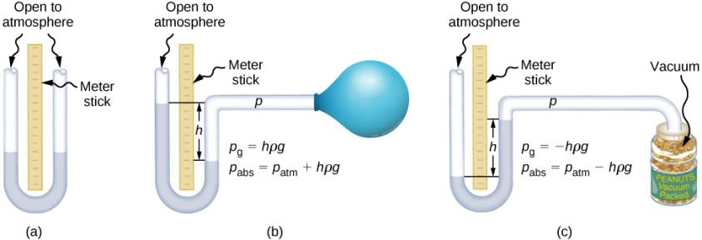
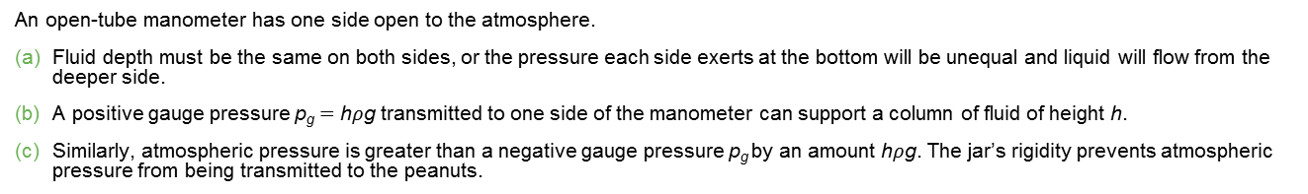
Figure 14.12
An open-tube manometer has one side open to the atmosphere.
Fluid depth must be the same on both sides, or the pressure each side exerts at the bottom will be unequal and liquid will flow from the deeper side.
A positive gauge pressure p_{g} = h$ρ$g transmitted to one side of the manometer can support a column of fluid of height h.
Similarly, atmospheric pressure is greater than a negative gauge pressure p_{g} by an amount h$ρ$g. The jar’s rigidity prevents atmospheric pressure from being transmitted to the peanuts.

Slide 16
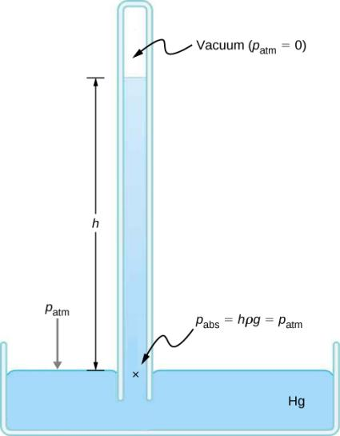

Figure 14.13
A mercury barometer measures atmospheric pressure. The pressure due to the mercury’s weight, h$ρ$g, equals atmospheric pressure. The atmosphere is able to force mercury in the tube to a height h because the pressure above the mercury is zero.

Slide 17
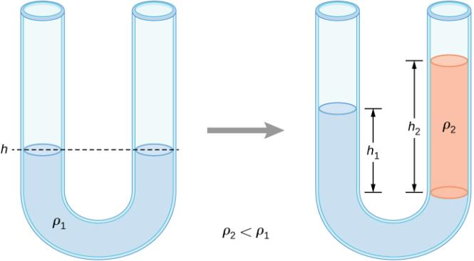
Figure 14.14
Two liquids of different densities are shown in a U-tube.

Slide 18
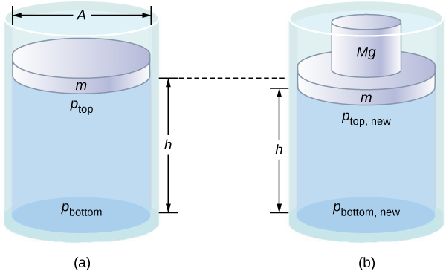
Figure 14.15
Pressure in a fluid changes when the fluid is compressed.
The pressure at the top layer of the fluid is different from pressure at the bottom layer.
The increase in pressure by adding weight to the piston is the same everywhere, for example, p_{top} _{new} − p_{top} = p_{bottom} _{new} − p_{bottom}.

Slide 19
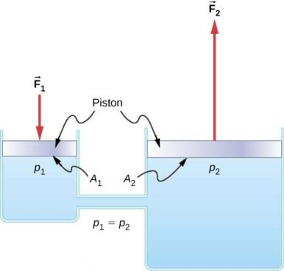
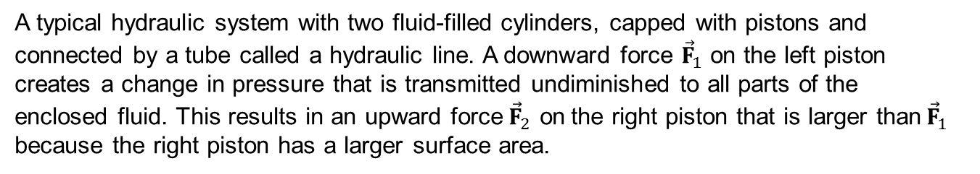
Figure 14.16
A typical hydraulic system with two fluid-filled cylinders, capped with pistons and connected by a tube called a hydraulic line. A downward force ${\vec{F}}_{1}$ on the left piston creates a change in pressure that is transmitted undiminished to all parts of the enclosed fluid. This results in an upward force${\vec{F}}_{2}$ on the right piston that is larger than${\vec{F}}_{1}$ because the right piston has a larger surface area.

Slide 20
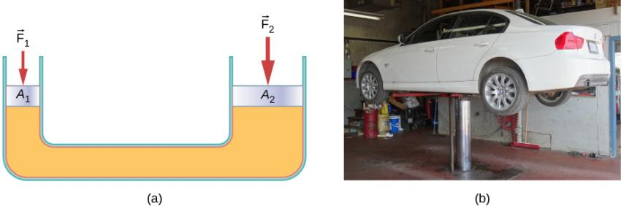
Figure 14.17
A hydraulic jack operates by applying forces (F₁ , F₂) to an incompressible fluid in a U-tube, using a movable piston (A₁, A₂) on each side of the tube.
Hydraulic jacks are commonly used by car mechanics to lift vehicles so that repairs and maintenance can be performed.

Slide 21
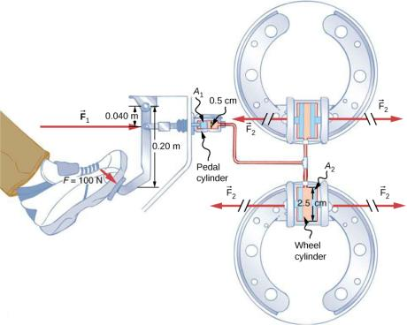
Figure 14.18
Hydraulic brakes use Pascal’s principle. The driver pushes the brake pedal, exerting a force that is increased by the simple lever and again by the hydraulic system. Each of the identical wheel cylinders receives the same pressure and, therefore, creates the same force output F₂. The circular cross-sectional areas of the pedal and wheel cylinders are represented by A₁ and A₂, respectively.

Slide 22
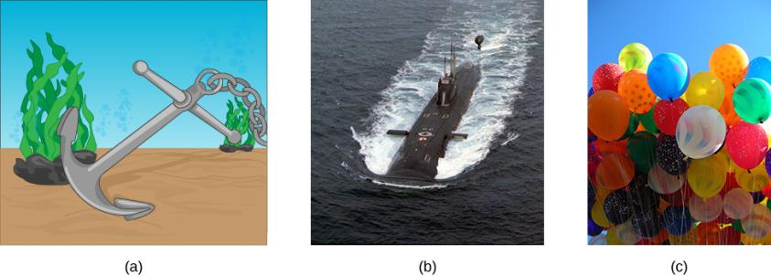
Figure 14.19
Even objects that sink, like this anchor, are partly supported by water when submerged.
Submarines have adjustable density (ballast tanks) so that they may float or sink as desired.
Helium-filled balloons tug upward on their strings, demonstrating air’s buoyant effect.(credit b: modification of work by Allied Navy; credit c: modification of work by “Crystl”/Flickr)

Slide 23
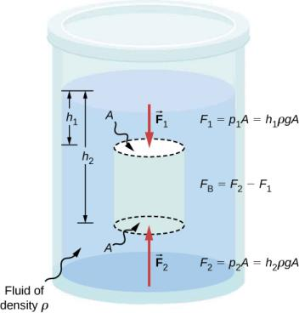
Figure 14.20
Pressure due to the weight of a fluid increases with depth because p = hpg. This change in pressure and associated upward force on the bottom of the cylinder are greater than the downward force on the top of the cylinder. The differences in the force results in the buoyant force F_{B}. (Horizontal forces cancel.)

Slide 24
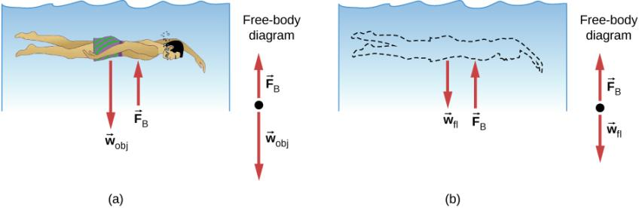
Figure 14.21
An object submerged in a fluid experiences a buoyant force F_{B}. If F_{B} is greater than the weight of the object, the object rises. If F_{B} is less than the weight of the object, the object sinks.
If the object is removed, it is replaced by fluid having weight w_{fl}. Since this weight is supported by surrounding fluid, the buoyant force must equal the weight of the fluid displaced.

Slide 25
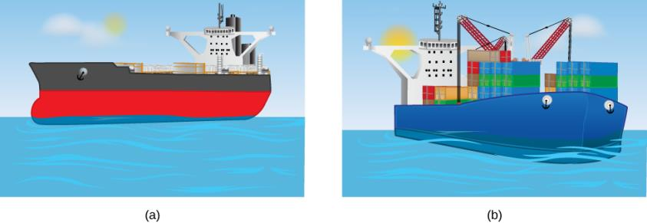
Figure 14.22
An unloaded ship (a) floats higher in the water than a loaded ship (b).

Slide 26
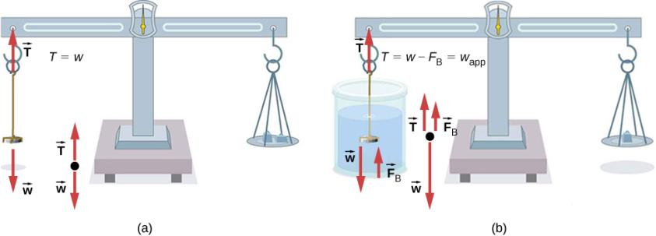
Figure 14.23
A coin is weighed in air.
The apparent weight of the coin is determined while it is completely submerged in a fluid of known density. These two measurements are used to calculate the density of the coin.

Slide 27
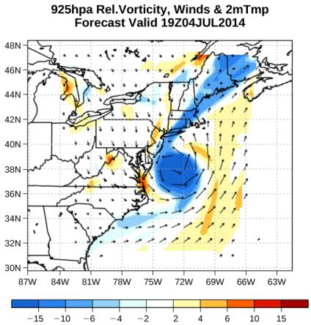
Figure 14.24
The velocity vectors show the flow of wind in Hurricane Arthur. Notice the circulation of the wind around the eye of the hurricane. Wind speeds are highest near the eye. The colors represent the relative vorticity, a measure of turning or spinning of the air.

Slide 28
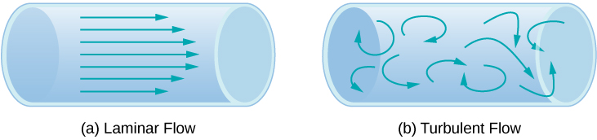
Figure 14.25
Laminar flow can be thought of as layers of fluid moving in parallel, regular paths.
In turbulent flow, regions of fluid move in irregular, colliding paths, resulting in mixing and swirling.

Slide 29
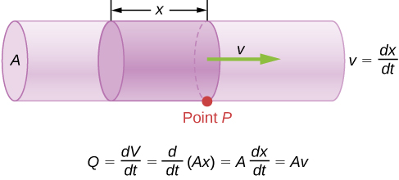
Figure 14.26
Flow rate is the volume of fluid flowing past a point through the area A per unit time. Here, the shaded cylinder of fluid flows past point P in a uniform pipe in time t.

Slide 30
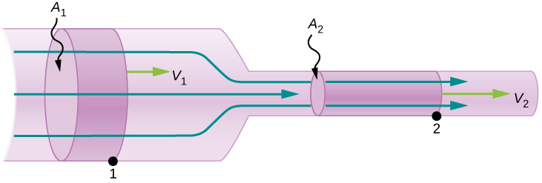
Figure 14.27
When a tube narrows, the same volume occupies a greater length. For the same volume to pass points 1 and 2 in a given time, the speed must be greater at point 2. The process is exactly reversible. If the fluid flows in the opposite direction, its speed decreases when the tube widens. (Note that the relative volumes of the two cylinders and the corresponding velocity vector arrows are not drawn to scale.)

Slide 31

Figure 14.28
Geometry for deriving the equation of continuity. The amount of liquid entering the cross-sectional (shaded) area must equal the amount of liquid leaving the cross-sectional area if the liquid is incompressible.

Slide 32
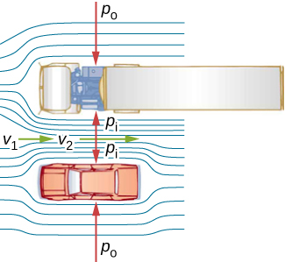
Figure 14.29
An overhead view of a car passing a truck on a highway. Air passing between the vehicles flows in a narrower channel and must increase its speed (v₂ is greater than v₁), causing the pressure between them to drop (p_{i} is less than p_{o}). Greater pressure on the outside pushes the car and truck together.

Slide 33
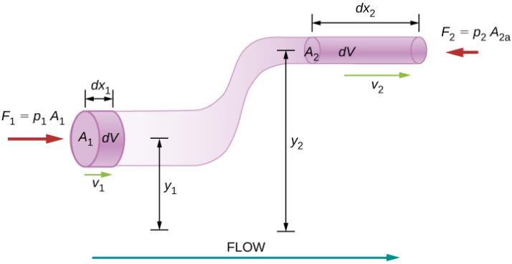
Figure 14.30
The geometry used for the derivation of Bernoulli’s equation.

Slide 34
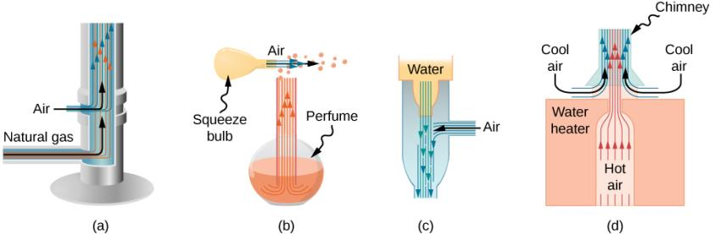
Figure 14.31
Entrainment devices use increased fluid speed to create low pressures, which then entrain one fluid into another.
A Bunsen burner uses an adjustable gas nozzle, entraining air for proper combustion.
An atomizer uses a squeeze bulb to create a jet of air that entrains drops of perfume. Paint sprayers and carburetors use very similar techniques to move their respective liquids.
A common aspirator uses a high-speed stream of water to create a region of lower pressure. Aspirators may be used as suction pumps in dental and surgical situations or for draining a flooded basement or producing a reduced pressure in a vessel.
The chimney of a water heater is designed to entrain air into the pipe leading through the ceiling.

Slide 35
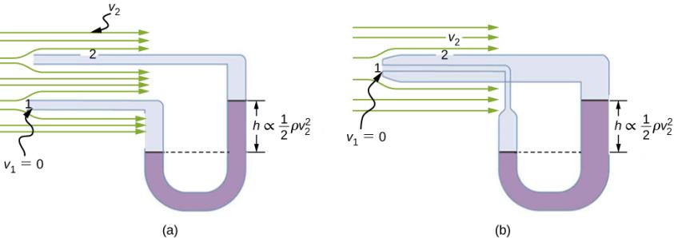
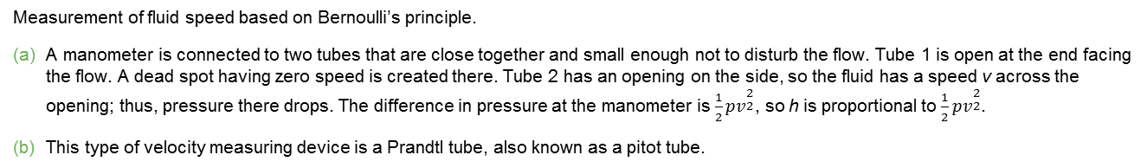
Figure 14.32
Measurement of fluid speed based on Bernoulli’s principle.
A manometer is connected to two tubes that are close together and small enough not to disturb the flow. Tube 1 is open at the end facing the flow. A dead spot having zero speed is created there. Tube 2 has an opening on the side, so the fluid has a speed v across the opening; thus, pressure there drops. The difference in pressure at the manometer is $\frac{1}{2}{pv}_{}^{\begin{aligned}2 \\ 2\end{aligned}}$, so h is proportional to $\frac{1}{2}{pv}_{}^{\begin{aligned}2 \\ 2\end{aligned}}$.
This type of velocity measuring device is a Prandtl tube, also known as a pitot tube.

Slide 36
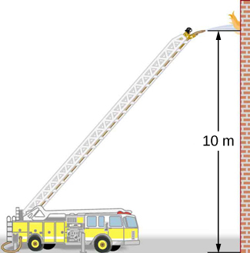
Figure 14.33
Pressure in the nozzle of this fire hose is less than at ground level for two reasons: The water has to go uphill to get to the nozzle, and speed increases in the nozzle. In spite of its lowered pressure, the water can exert a large force on anything it strikes by virtue of its kinetic energy. Pressure in the water stream becomes equal to atmospheric pressure once it emerges into the air.

Slide 37
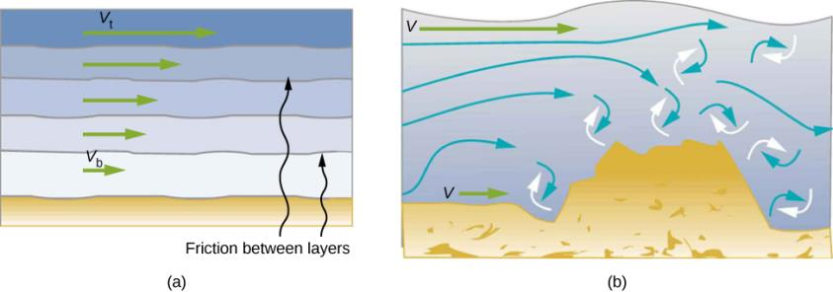
Figure 14.34
Laminar flow occurs in layers without mixing. Notice that viscosity causes drag between layers as well as with the fixed surface. The speed near the bottom of the flow (v_{b}) is less than speed near the top (v_{t}) because in this case, the surface of the containing vessel is at the bottom.
An obstruction in the vessel causes turbulent flow. Turbulent flow mixes the fluid. There is more interaction, greater heating, and more resistance than in laminar flow.

Slide 38
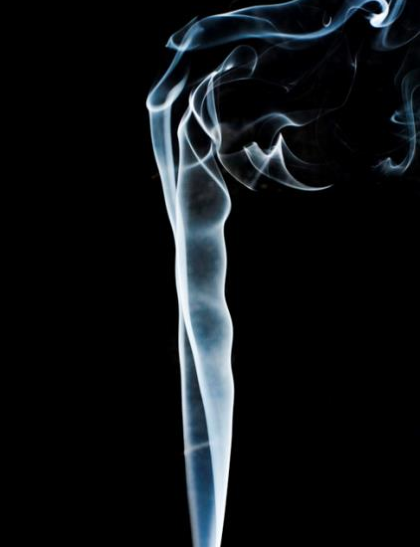
Figure 14.35
Smoke rises smoothly for a while and then begins to form swirls and eddies. The smooth flow is called laminar flow, whereas the swirls and eddies typify turbulent flow. Smoke rises more rapidly when flowing smoothly than after it becomes turbulent, suggesting that turbulence poses more resistance to flow. (credit: “Creativity103”/Flickr)

Slide 39
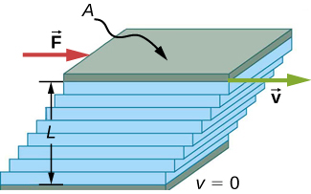
Figure 14.36
Measurement of viscosity for laminar flow of fluid between two plates of area A. The bottom plate is fixed. When the top plate is pushed to the right, it drags the fluid along with it.

Slide 40
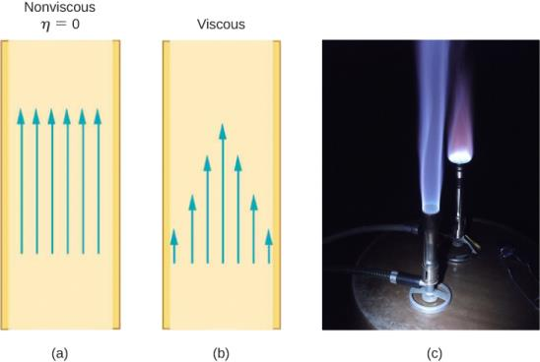
Figure 14.37
If fluid flow in a tube has negligible resistance, the speed is the same all across the tube.
When a viscous fluid flows through a tube, its speed at the walls is zero, increasing steadily to its maximum at the center of the tube.
The shape of a Bunsen burner flame is due to the velocity profile across the tube. (credit c: modification of work by Jason Woodhead)

Slide 41
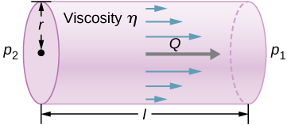
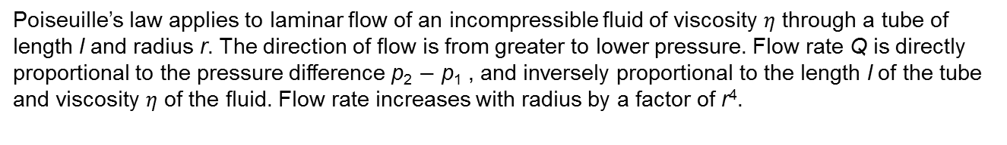
Figure 14.38
Poiseuille’s law applies to laminar flow of an incompressible fluid of viscosity $η$ through a tube of length l and radius r. The direction of flow is from greater to lower pressure. Flow rate Q is directly proportional to the pressure difference p₂ − p₁ , and inversely proportional to the length l of the tube and viscosity $η$ of the fluid. Flow rate increases with radius by a factor of r⁴.

Slide 42
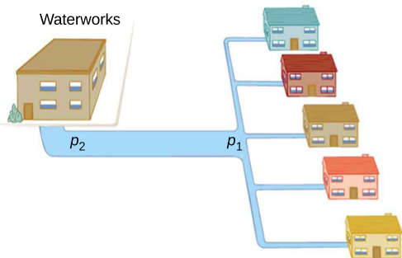
Figure 14.39
During times of heavy use, there is a significant pressure drop in a water main, and p₁ supplied to users is significantly less than p₂ created at the water works. If the flow is very small, then the pressure drop is negligible, and p₂ ≈ p₁.

Slide 43
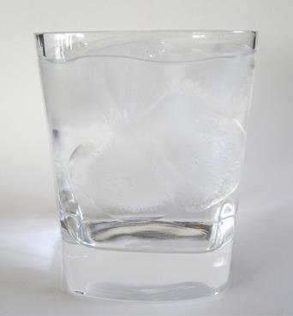
EXERCISE 4

Slide 44
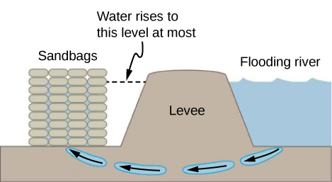
EXERCISE 11

Slide 45
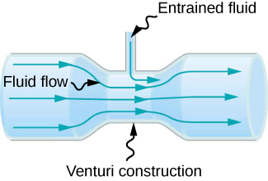
EXERCISE 25

Slide 46
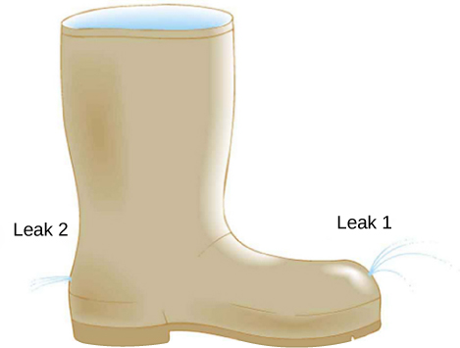
EXERCISE 34

Slide 47
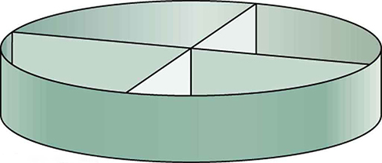
EXERCISE 40

Slide 48

EXERCISE 55

Slide 49

EXERCISE 89

Slide 50

EXERCISE 90

Slide 51

Exercise 128

Slide 52
This OpenStax ancillary resource is © Rice University under a CC-BY 4.0 International license; it may be reproduced or modified but must be attributed to OpenStax, Rice University and any changes must be noted.

