Slide 1


University Physics
Chapter 15 OSCILLATIONS
PowerPoint Image Slideshow

Slide 2

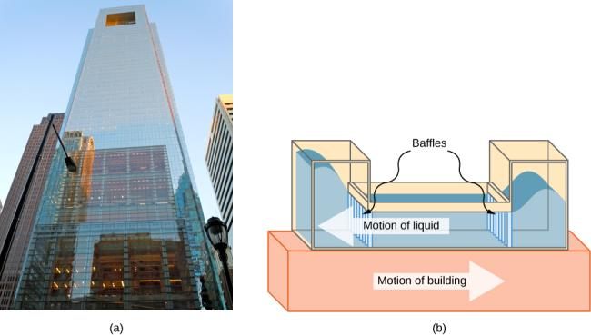
Figure 15.1
The Comcast Building in Philadelphia, Pennsylvania, looming high above the skyline, is approximately 305 meters (1000 feet) tall. At this height, the top floors can oscillate back and forth due to seismic activity and fluctuating winds.
Shown above is a schematic drawing of a tuned, liquid-column mass damper, installed at the top of the Comcast, consisting of a 300,000-gallon reservoir of water to reduce oscillations.

Slide 3
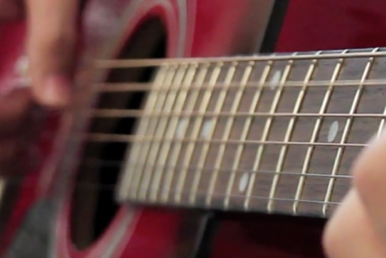
Figure 15.2
When a guitar string is plucked, the string oscillates up and down in periodic motion. The vibrating string causes the surrounding air molecules to oscillate, producing sound waves. (credit: Yutaka Tsutano)

Slide 4
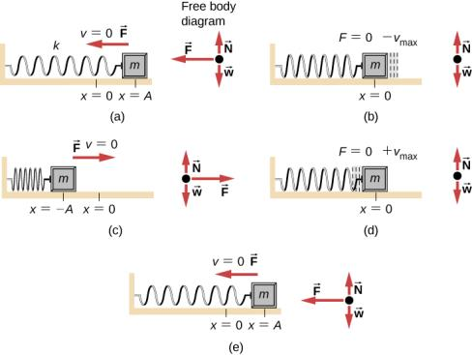
Figure 15.3
An object attached to a spring sliding on a frictionless surface is an uncomplicated simple harmonic oscillator. In the above set of figures, a mass is attached to a spring and placed on a frictionless table. The other end of the spring is attached to the wall. The position of the mass, when the spring is neither stretched nor compressed, is marked as x = 0 and is the equilibrium position. (a) The mass is displaced to a position x = A and released from rest. (b) The mass accelerates as it moves in the negative x-direction, reaching a maximum negative velocity at x = 0. (c) The mass continues to move in the negative x-direction, slowing until it comes to a stop at x = −A. (d) The mass now begins to accelerate in the positive x-direction, reaching a positive maximum velocity at x = 0. (e) The mass then continues to move in the positive direction until it stops at x = A. The mass continues in SHM that has an amplitude A and a period T. The object’s maximum speed occurs as it passes through equilibrium. The stiffer the spring is, the smaller the period T. The greater the mass of the object is, the greater the period T.

Slide 5
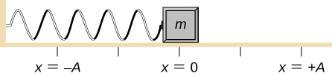
Figure 15.4
A block is attached to a spring and placed on a frictionless table. The equilibrium position, where the spring is neither extended nor compressed, is marked as x = 0.

Slide 6
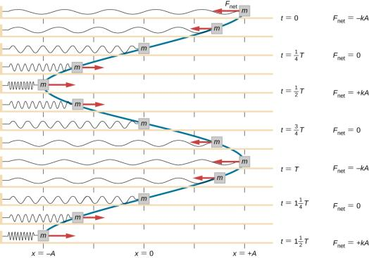
Figure 15.5
A block is attached to one end of a spring and placed on a frictionless table. The other end of the spring is anchored to the wall. The equilibrium position, where the net force equals zero, is marked as x = 0 m. Work is done on the block, pulling it out to x = +A, and the block is released from rest. The block oscillates between x = +A and x = −A. The force is also shown as a vector.

Slide 7
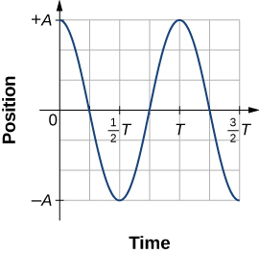
Figure 15.6
A graph of the position of the block shown in Figure 15.5 as a function of time. The position can be modeled as a periodic function, such as a cosine or sine function.

Slide 8
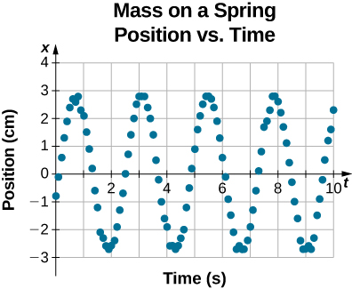
Figure 15.7
Data collected by a student in lab indicate the position of a block attached to a spring, measured with a sonic range finder. The data are collected starting at time t = 0.00s, but the initial position is near position x ≈ −0.80 cm ≠ 3.00 cm , so the initial position does not equal the amplitude x₀ = +A. The velocity is the time derivative of the position, which is the slope at a point on the graph of position versus time. The velocity is not v = 0.00 m/s at time t = 0.00 s, as evident by the slope of the graph of position versus time, which is not zero at the initial time.

Slide 9
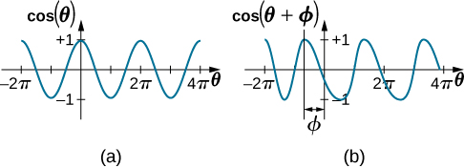
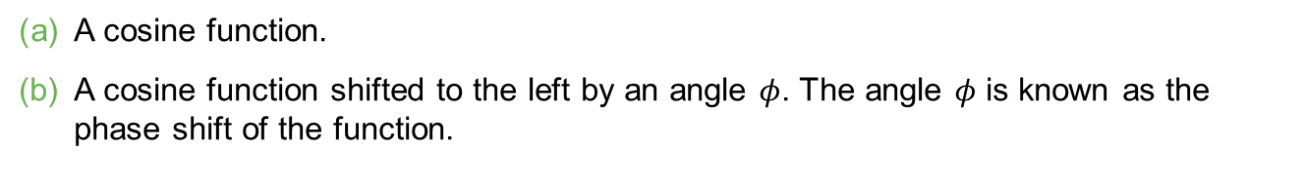
Figure 15.8
A cosine function.
A cosine function shifted to the left by an angle $φ$. The angle $φ$ is known as the phase shift of the function.

Slide 10
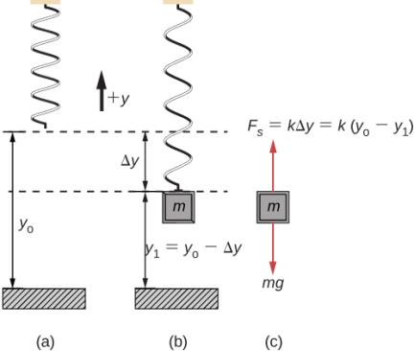
Figure 15.9
A spring is hung from the ceiling. When a block is attached, the block is at the equilibrium position where the weight of the block is equal to the force of the spring.
The spring is hung from the ceiling and the equilibrium position is marked as y_{o}.
A mass is attached to the spring and a new equilibrium position is reached (y₁ = y_{o} − Δ_{y}) when the force provided by the spring equals the weight of the mass.
The free-body diagram of the mass shows the two forces acting on the mass: the weight and the force of the spring.

Slide 11
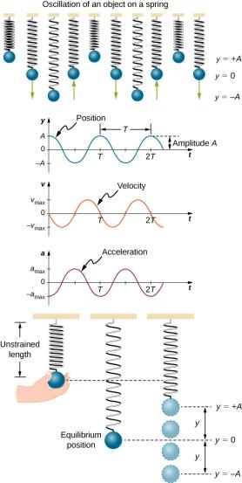
Figure 15.10
Graphs of y(t), v(t), and a(t) versus t for the motion of an object on a vertical spring. The net force on the object can be described by Hooke’s law, so the object undergoes SHM. Note that the initial position has the vertical displacement at its maximum value A; v is initially zero and then negative as the object moves down; the initial acceleration is negative, back toward the equilibrium position and becomes zero at that point.

Slide 12
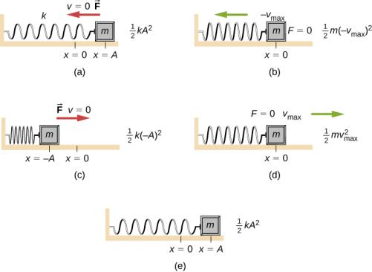
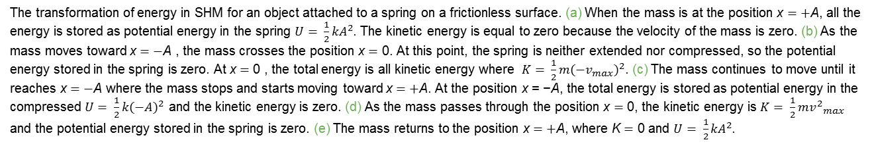
Figure 15.11
The transformation of energy in SHM for an object attached to a spring on a frictionless surface. (a) When the mass is at the position x = +A, all the energy is stored as potential energy in the spring $U= \frac{1}{2}{kA}^{2}$. The kinetic energy is equal to zero because the velocity of the mass is zero. (b) As the mass moves toward x = −A , the mass crosses the position x = 0. At this point, the spring is neither extended nor compressed, so the potential energy stored in the spring is zero. At x = 0 , the total energy is all kinetic energy where $K= \frac{1}{2}{m(−v_{max})}^{2}$. (c) The mass continues to move until it reaches x = −A where the mass stops and starts moving toward x = +A. At the position x = −A, the total energy is stored as potential energy in the compressed $U= \frac{1}{2}{k(−A)}^{2}$ and the kinetic energy is zero. (d) As the mass passes through the position x = 0, the kinetic energy is $K= \frac{1}{2}{{mv}^{2}}_{max}$ and the potential energy stored in the spring is zero. (e) The mass returns to the position x = +A, where K = 0 and $U= \frac{1}{2}{kA}^{2}$.

Slide 13
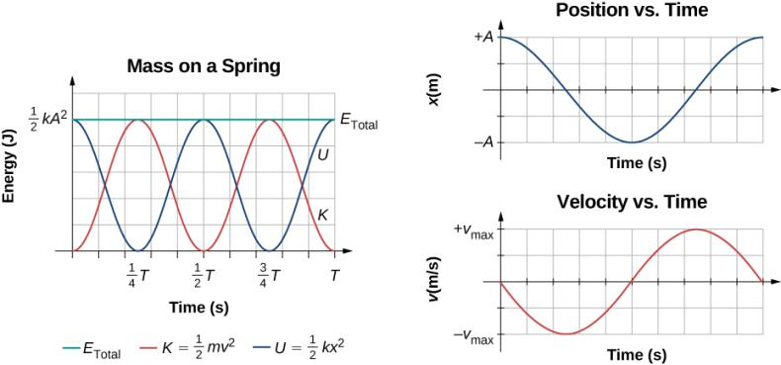
Figure 15.12
Graph of the kinetic energy, potential energy, and total energy of a block oscillating on a spring in SHM. Also shown are the graphs of position versus time and velocity versus time. The total energy remains constant, but the energy oscillates between kinetic energy and potential energy. When the kinetic energy is maximum, the potential energy is zero. This occurs when the velocity is maximum and the mass is at the equilibrium position. The potential energy is maximum when the speed is zero. The total energy is the sum of the kinetic energy plus the potential energy and it is constant.

Slide 14
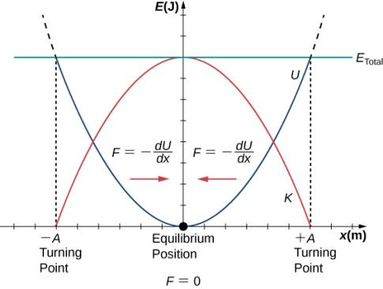
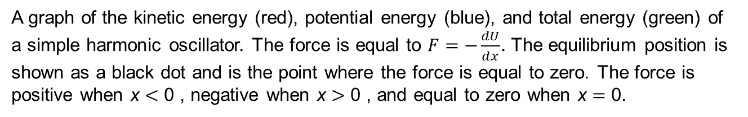
Figure 15.13
A graph of the kinetic energy (red), potential energy (blue), and total energy (green) of a simple harmonic oscillator. The force is equal to $F=−\frac{dU}{dx}$. The equilibrium position is shown as a black dot and is the point where the force is equal to zero. The force is positive when x < 0 , negative when x > 0 , and equal to zero when x = 0.

Slide 15
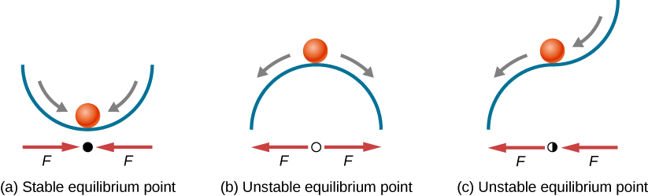
Figure 15.14
Examples of equilibrium points. (a) Stable equilibrium point; (b) unstable equilibrium point; (c) unstable equilibrium point (sometimes referred to as a half-stable equilibrium point).

Slide 16
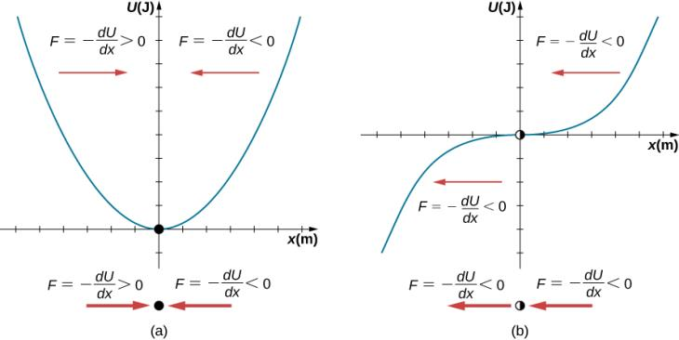
Figure 15.15
Two examples of a potential energy function. The force at a position is equal to the negative of the slope of the graph at that position.
A potential energy function with a stable equilibrium point.
A potential energy function with an unstable equilibrium point. This point is sometimes called half-stable because the force on one side points toward the fixed point.

Slide 17
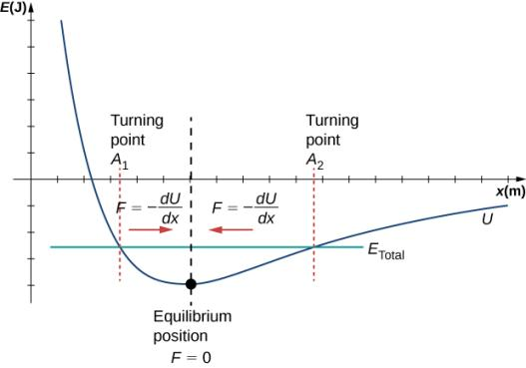
Figure 15.16
The Lennard-Jones potential energy function for a system of two neutral atoms. If the energy is below some maximum energy, the system oscillates near the equilibrium position between the two turning points.

Slide 18
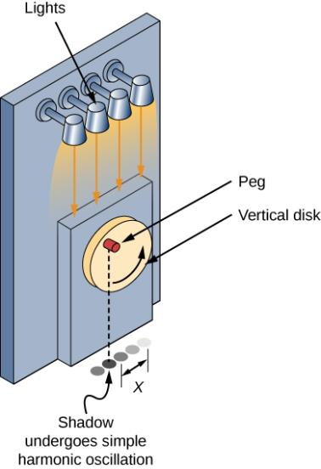
Figure 15.17
SHM can be modeled as rotational motion by looking at the shadow of a peg on a wheel rotating at a constant angular frequency.

Slide 19
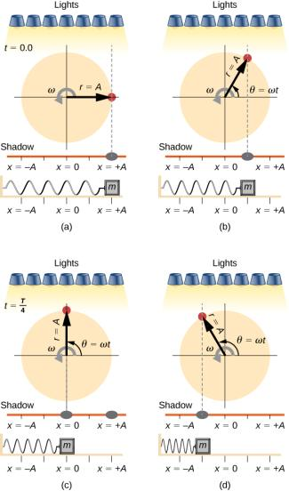
Figure 15.18
Light shines down on the disk so that the peg makes a shadow. If the disk rotates at just the right angular frequency, the shadow follows the motion of the block on a spring. If there is no energy dissipated due to nonconservative forces, the block and the shadow will oscillate back and forth in unison. In this figure, four snapshots are taken at four different times.
The wheel starts at θ = 0º and the shadow of the peg is at x = +A, representing the mass at position x = +A.
As the disk rotates through an angle θ = ωt , the shadow of the peg is between x = +A and x = 0.
The disk continues to rotate until θ = 90º, at which the shadow follows the mass to x = 0.
The disk continues to rotate, the shadow follows the position of the mass.

Slide 20
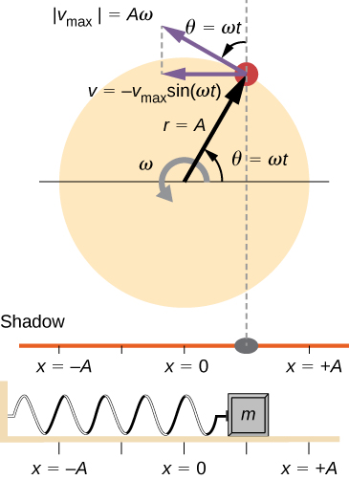
Figure 15.19
A peg moving on a circular path with a constant angular velocity ω is undergoing uniform circular motion. Its projection on the x-axis undergoes SHM. Also shown is the velocity of the peg around the circle, v_{max}, and its projection, which is v. Note that these velocities form a similar triangle to the displacement triangle.

Slide 21

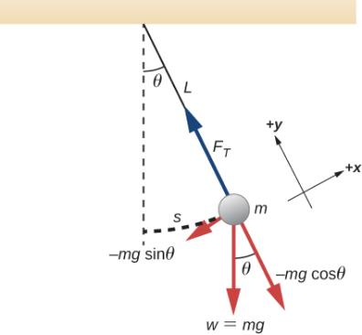
Figure 15.20
A simple pendulum has a small-diameter bob and a string that has a very small mass but is strong enough not to stretch appreciably. The linear displacement from equilibrium is s, the length of the arc. Also shown are the forces on the bob, which result in a net force of −mg sinθ toward the equilibrium position—that is, a restoring force.

Slide 22
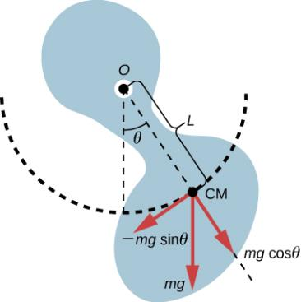
Figure 15.21
A physical pendulum is any object that oscillates as a pendulum, but cannot be modeled as a point mass on a string. The force of gravity acts on the center of mass (CM) and provides the restoring force that causes the object to oscillate. The minus sign on the component of the weight that provides the restoring force is present because the force acts in the opposite direction of the increasing angle θ.

Slide 23
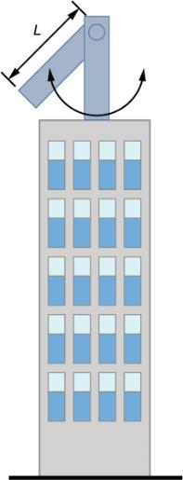
example 15.4

Slide 24
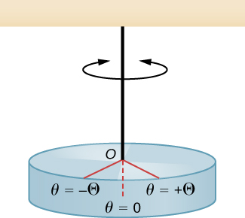
Figure 15.22
A torsional pendulum consists of a rigid body suspended by a string or wire. The rigid body oscillates between θ = +Θ and θ = –Θ.

Slide 25
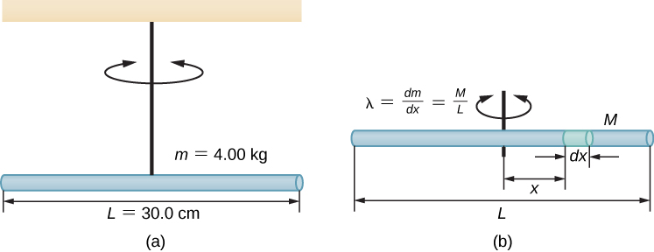
Figure 15.23
A rod suspended by a string from the ceiling.
Finding the rod’s moment of inertia.

Slide 26

Figure 15.24
To counteract dampening forces, you need to keep pumping a swing. (credit: Bob Mical)

Slide 27
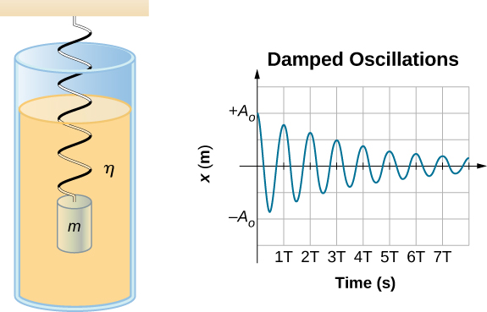
Figure 15.25
For a mass on a spring oscillating in a viscous fluid, the period remains constant, but the amplitudes of the oscillations decrease due to the damping caused by the fluid.

Slide 28
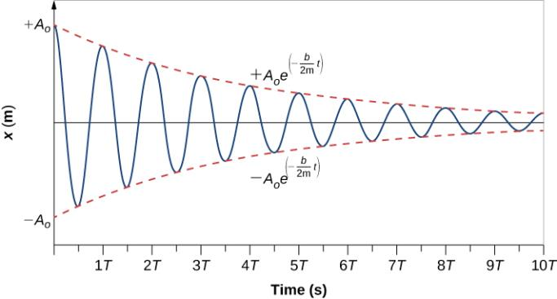
Figure 15.26
Position versus time for the mass oscillating on a spring in a viscous fluid. Notice that the curve appears to be a cosine function inside an exponential envelope.

Slide 29
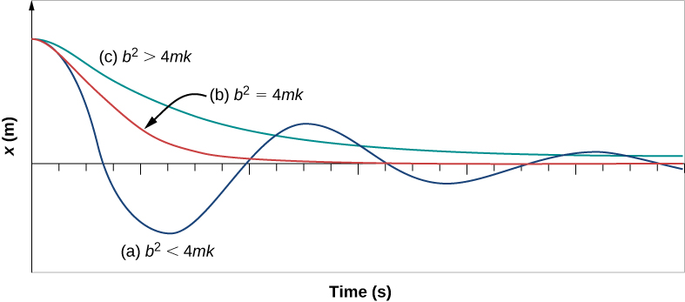
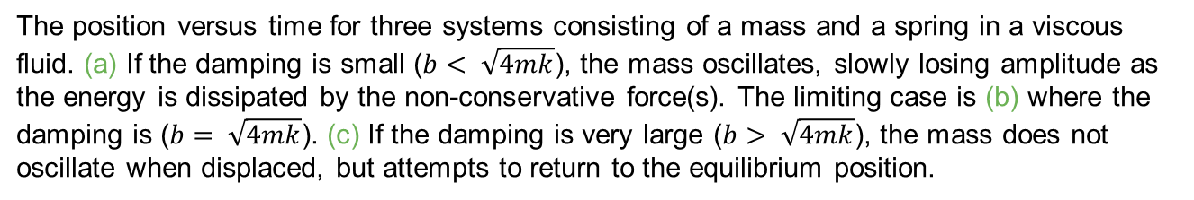
Figure 15.27
The position versus time for three systems consisting of a mass and a spring in a viscous fluid. (a) If the damping is small ($b< \sqrt{4mk}$), the mass oscillates, slowly losing amplitude as the energy is dissipated by the non-conservative force(s). The limiting case is (b) where the damping is ($b= \sqrt{4mk}$). (c) If the damping is very large ($b> \sqrt{4mk}$), the mass does not oscillate when displaced, but attempts to return to the equilibrium position.

Slide 30

Figure 15.28
You can cause the strings in a piano to vibrate simply by producing sound waves from your voice.

Slide 31
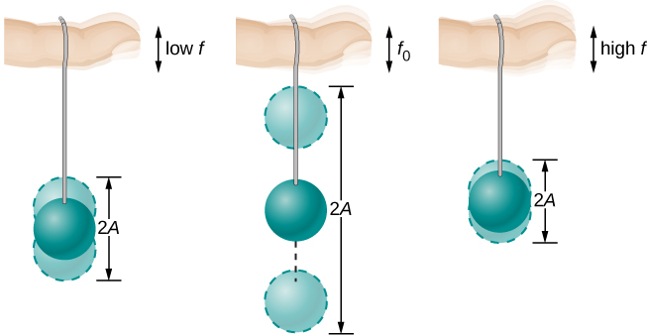
Figure 15.29
The paddle ball on its rubber band moves in response to the finger supporting it. If the finger moves with the natural frequency f₀ of the ball on the rubber band, then a resonance is achieved, and the amplitude of the ball’s oscillations increases dramatically. At higher and lower driving frequencies, energy is transferred to the ball less efficiently, and it responds with lower-amplitude oscillations.

Slide 32
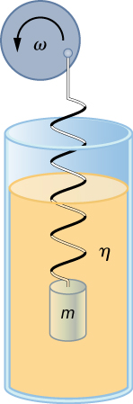
Figure 15.30
Forced, damped harmonic motion produced by driving a spring and mass with a disk driven by a variable-speed motor.

Slide 33
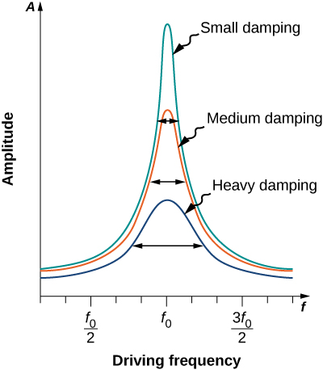
Figure 15.31
Amplitude of a harmonic oscillator as a function of the frequency of the driving force. The curves represent the same oscillator with the same natural frequency but with different amounts of damping. Resonance occurs when the driving frequency equals the natural frequency, and the greatest response is for the least amount of damping. The narrowest response is also for the least damping.

Slide 34
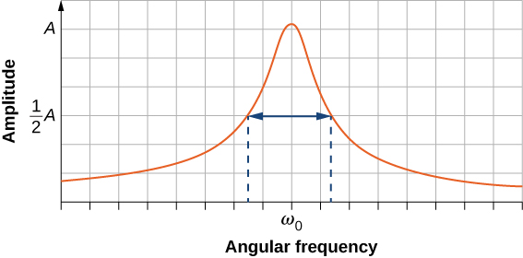
Figure 15.32
The quality of a system is defined as the spread in the frequencies at half the amplitude divided by the natural frequency.

Slide 35
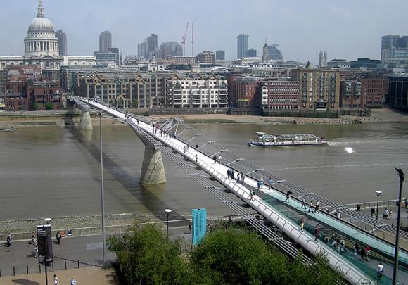
Figure 15.33
Initially when people crossed the London Millennium Footbridge, they experienced a swaying motion. People continuing to cross reinforced the oscillation’s amplitude, thereby increasing the problematic swaying. (credit: Adrian Pingstone/Wikimedia Commons)

Slide 36
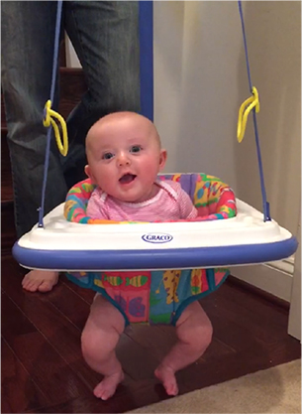
Figure 15.34
(credit: Lisa Doehnert)

Slide 37
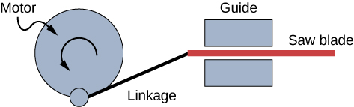
Exercise 40

Slide 38
This OpenStax ancillary resource is © Rice University under a CC-BY 4.0 International license; it may be reproduced or modified but must be attributed to OpenStax, Rice University and any changes must be noted.

