Slide 1


University Physics
Chapter 16 WAVES
PowerPoint Image Slideshow

Slide 2

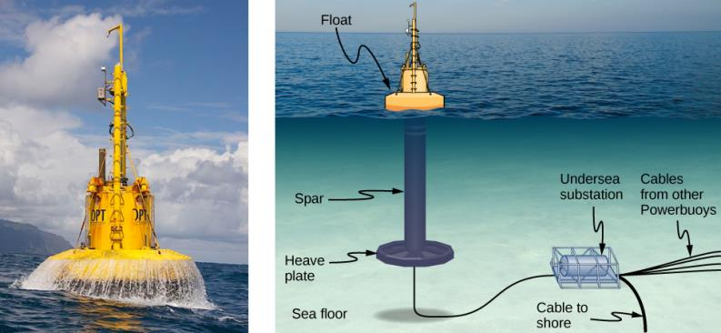
Figure 16.1
From the world of renewable energy sources comes the electric power-generating buoy. Although there are many versions, this one converts the up-and-down motion, as well as side-to-side motion, of the buoy into rotational motion in order to turn an electric generator, which stores the energy in batteries.

Slide 3
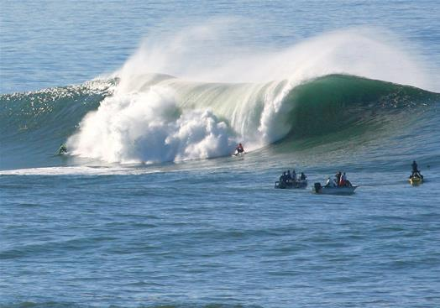
Figure 16.2
An ocean wave is probably the first picture that comes to mind when you hear the word “wave.” Although this breaking wave, and ocean waves in general, have apparent similarities to the basic wave characteristics we will discuss, the mechanisms driving ocean waves are highly complex and beyond the scope of this chapter. It may seem natural, and even advantageous, to apply the concepts in this chapter to ocean waves, but ocean waves are nonlinear, and the simple models presented in this chapter do not fully explain them. (credit: Steve Jurvetson)

Slide 4
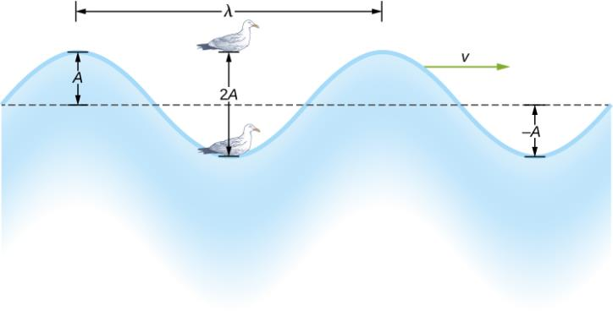
Figure 16.3
An idealized surface water wave passes under a seagull that bobs up and down in simple harmonic motion. The wave has a wavelength λ , which is the distance between adjacent identical parts of the wave. The amplitude A of the wave is the maximum displacement of the wave from the equilibrium position, which is indicated by the dotted line. In this example, the medium moves up and down, whereas the disturbance of the surface propagates parallel to the surface at a speed v.

Slide 5
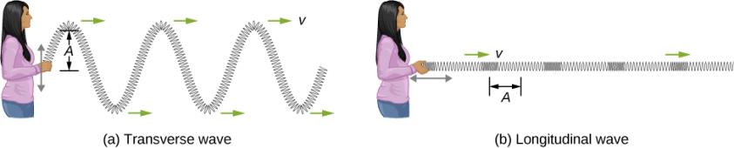
Figure 16.4
In a transverse wave, the medium oscillates perpendicular to the wave velocity. Here, the spring moves vertically up and down, while the wave propagates horizontally to the right.
In a longitudinal wave, the medium oscillates parallel to the propagation of the wave. In this case, the spring oscillates back and forth, while the wave propagates to the right.

Slide 6
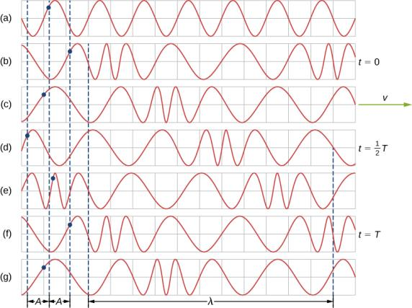
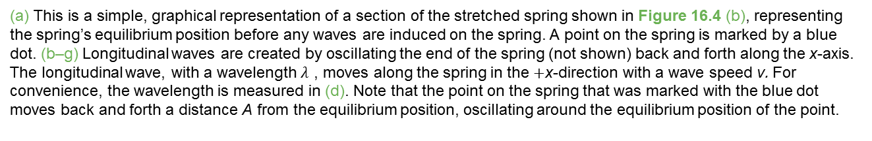
Figure 16.5
(a) This is a simple, graphical representation of a section of the stretched spring shown in Figure 16.4 (b), representing the spring’s equilibrium position before any waves are induced on the spring. A point on the spring is marked by a blue dot. (b–g) Longitudinal waves are created by oscillating the end of the spring (not shown) back and forth along the x-axis. The longitudinal wave, with a wavelength $λ$ , moves along the spring in the +x-direction with a wave speed v. For convenience, the wavelength is measured in (d). Note that the point on the spring that was marked with the blue dot moves back and forth a distance A from the equilibrium position, oscillating around the equilibrium position of the point.

Slide 7
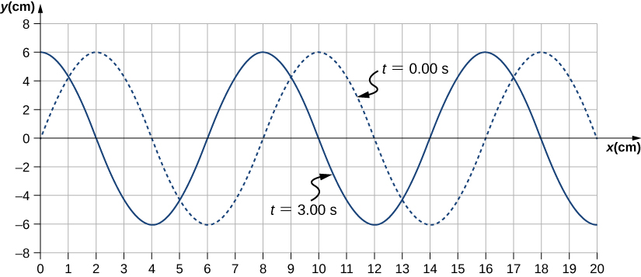
Figure 16.6
A transverse wave shown at two instants of time.

Slide 8
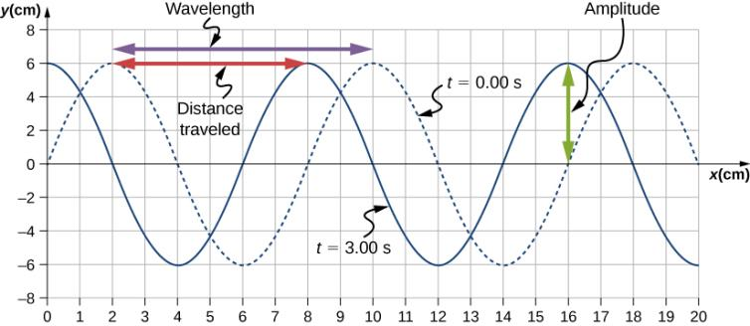
Figure 16.7
Characteristics of the wave marked on a graph of its displacement.

Slide 9
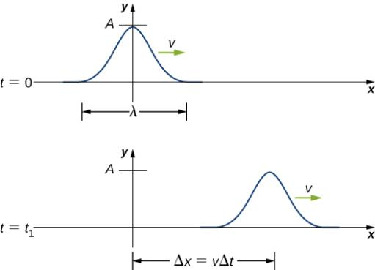
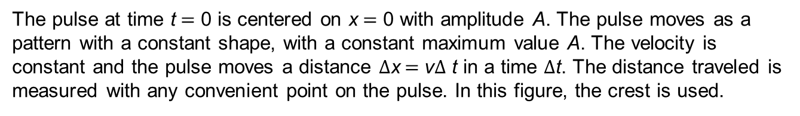
Figure 16.8
The pulse at time t = 0 is centered on x = 0 with amplitude A. The pulse moves as a pattern with a constant shape, with a constant maximum value A. The velocity is constant and the pulse moves a distance $Δ$x = v$Δ$ t in a time $Δ$t. The distance traveled is measured with any convenient point on the pulse. In this figure, the crest is used.

Slide 10
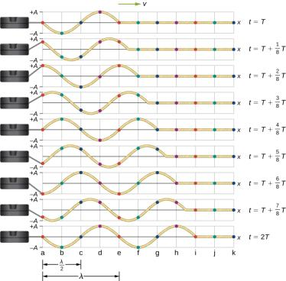
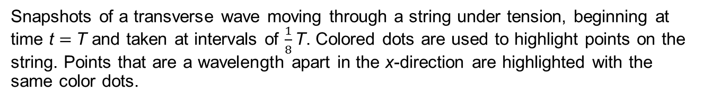
Figure 16.9
Snapshots of a transverse wave moving through a string under tension, beginning at time t = T and taken at intervals of $\frac{1}{8}\text{T}$. Colored dots are used to highlight points on the string. Points that are a wavelength apart in the x-direction are highlighted with the same color dots.

Slide 11
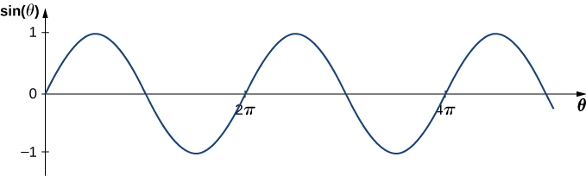
Figure 16.10
A sine function oscillates between +1 and −1 every 2π radians.

Slide 12
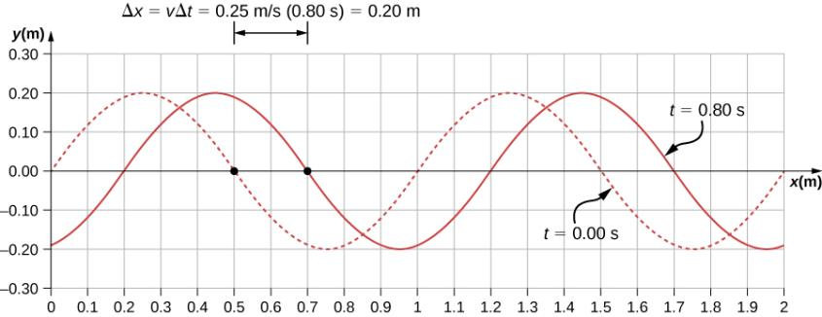
Figure 16.11
A graph of height of the wave y as a function of position x for snapshots of the wave at two times. The dotted line represents the wave at time t = 0.00 s and the solid line represents the wave at t = 0.80 s. Since the wave velocity is constant, the distance the wave travels is the wave velocity times the time interval. The black dots indicate the points used to measure the displacement of the wave. The medium moves up and down, whereas the wave moves to the right.

Slide 13
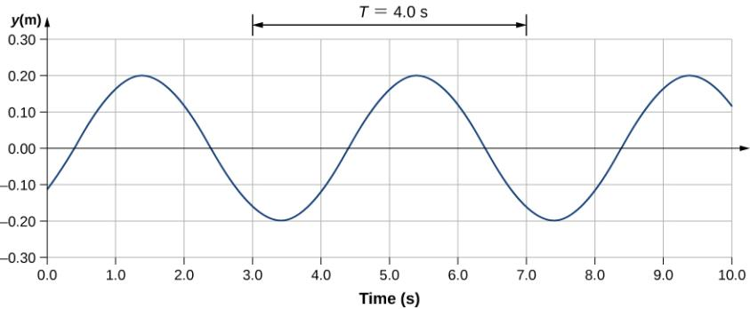
Figure 16.12
A graph of height of the wave y as a function of time t for the position x = 0.6 m. The medium oscillates between y = +0.20 m and y = −0.20 m every period. The period represented picks two convenient points in the oscillations to measure the period. The period can be measured between any two adjacent points with the same amplitude and the same velocity, (∂y/∂t). The velocity can be found by looking at the slope tangent to the point on a y-versus-t plot. Notice that at times t = 3.00 s and t = 7.00s, the heights and the velocities are the same and the period of the oscillation is 4.00 s.

Slide 14

Figure 16.13
Mass element of a string kept taut with a tension F_{T}. The mass element is in static equilibrium, and the force of tension acting on either side of the mass element is equal in magnitude and opposite in direction.

Slide 15
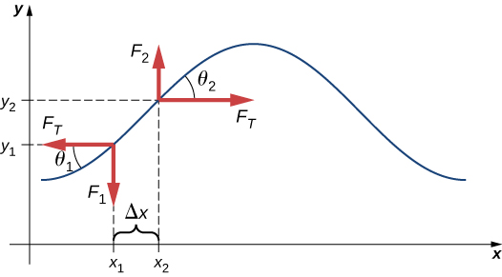
Figure 16.14
A string under tension is plucked, causing a pulse to move along the string in the positive x-direction.

Slide 16

Figure 16.15
The destructive effect of an earthquake is observable evidence of the energy carried in these waves. The Richter scale rating of earthquakes is a logarithmic scale related to both their amplitude and the energy they carry.

Slide 17
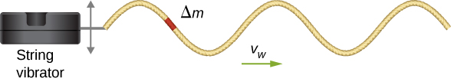
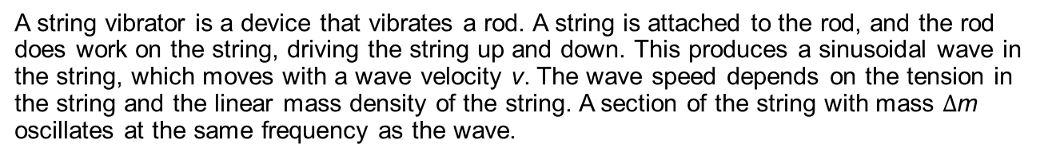
Figure 16.16
A string vibrator is a device that vibrates a rod. A string is attached to the rod, and the rod does work on the string, driving the string up and down. This produces a sinusoidal wave in the string, which moves with a wave velocity v. The wave speed depends on the tension in the string and the linear mass density of the string. A section of the string with mass $Δ$m oscillates at the same frequency as the wave.

Slide 18
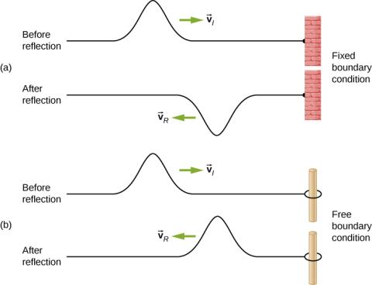
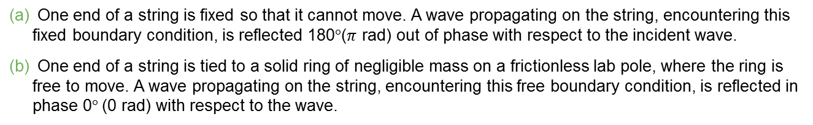
Figure 16.17
One end of a string is fixed so that it cannot move. A wave propagating on the string, encountering this fixed boundary condition, is reflected 180°($π$ rad) out of phase with respect to the incident wave.
One end of a string is tied to a solid ring of negligible mass on a frictionless lab pole, where the ring is free to move. A wave propagating on the string, encountering this free boundary condition, is reflected in phase 0° (0 rad) with respect to the wave.

Slide 19
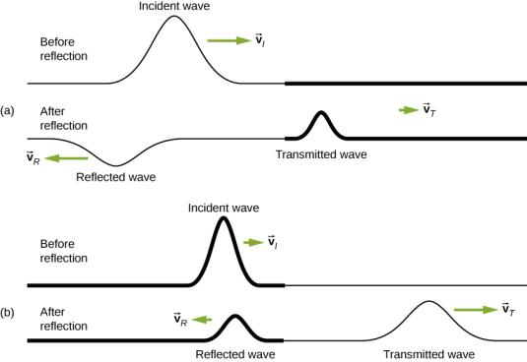
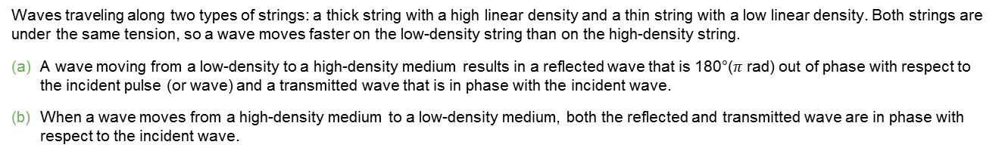
Figure 16.18
Waves traveling along two types of strings: a thick string with a high linear density and a thin string with a low linear density. Both strings are under the same tension, so a wave moves faster on the low-density string than on the high-density string.
A wave moving from a low-density to a high-density medium results in a reflected wave that is 180°($π$ rad) out of phase with respect to the incident pulse (or wave) and a transmitted wave that is in phase with the incident wave.
When a wave moves from a high-density medium to a low-density medium, both the reflected and transmitted wave are in phase with respect to the incident wave.

Slide 20
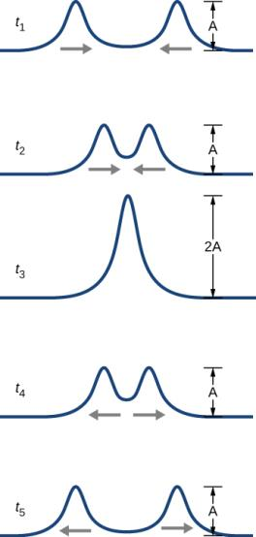
Figure 16.19
Two pulses moving toward one another experience interference. The term interference refers to what happens when two waves overlap.

Slide 21
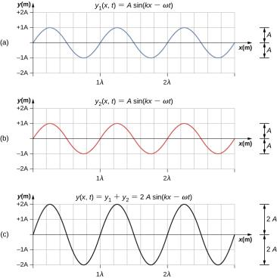
Figure 16.20
Constructive interference of two identical waves produces a wave with twice the amplitude, but the same wavelength.

Slide 22
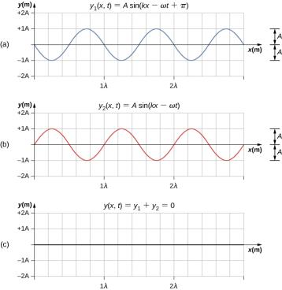
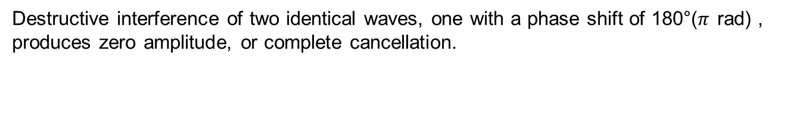
Figure 16.21
Destructive interference of two identical waves, one with a phase shift of 180°($π$ rad) , produces zero amplitude, or complete cancellation.

Slide 23
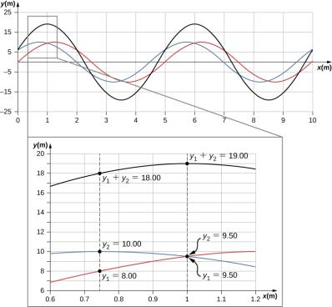
Figure 16.22
When two linear waves in the same medium interfere, the height of resulting wave is the sum of the heights of the individual waves, taken point by point. This plot shows two waves (red and blue) added together, along with the resulting wave (black). These graphs represent the height of the wave at each point. The waves may be any linear wave, including ripples on a pond, disturbances on a string, sound, or electromagnetic waves.

Slide 24
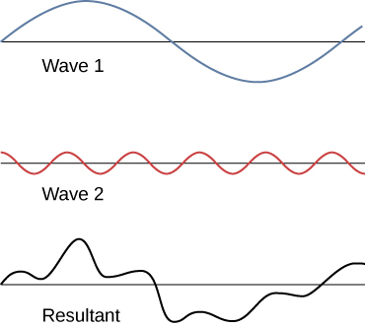
Figure 16.23
Superposition of nonidentical waves exhibits both constructive and destructive interference.

Slide 25
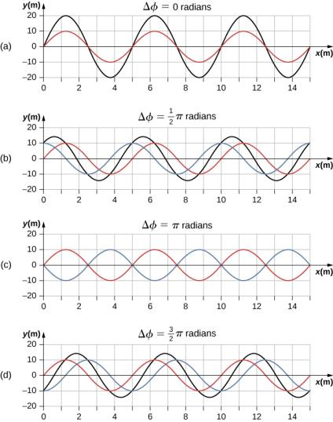
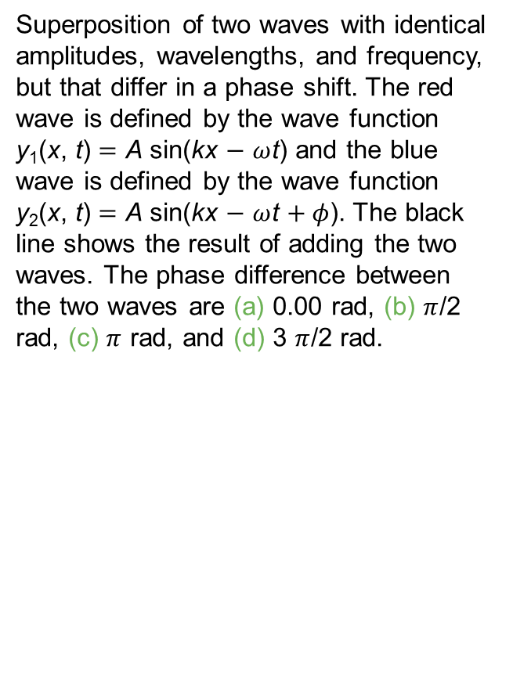
Figure 16.24
Superposition of two waves with identical amplitudes, wavelengths, and frequency, but that differ in a phase shift. The red wave is defined by the wave function y₁(x, t) = A sin(kx − $ω$t) and the blue wave is defined by the wave function y₂(x, t) = A sin(kx − $ω$t + $φ$). The black line shows the result of adding the two waves. The phase difference between the two waves are (a) 0.00 rad, (b) $π$/2 rad, (c) $π$ rad, and (d) 3 $π$/2 rad.

Slide 26
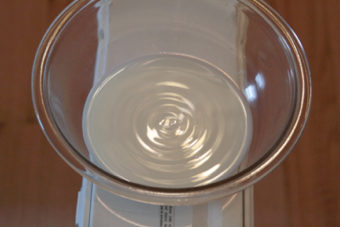
Figure 16.25
Standing waves are formed on the surface of a bowl of milk sitting on a box fan. The vibrations from the fan causes the surface of the milk to oscillate. The waves are visible due to the reflection of light from a lamp.

Slide 27
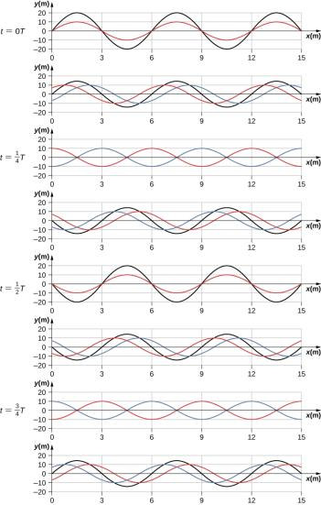
Figure 16.26
Time snapshots of two sine waves. The red wave is moving in the −x-direction and the blue wave is moving in the +x-direction. The resulting wave is shown in black. Consider the resultant wave at the points x = 0 m, 3 m, 6 m, 9 m, 12 m, 15 m and notice that the resultant wave always equals zero at these points, no matter what the time is. These points are known as fixed points (nodes). In between each two nodes is an antinode, a place where the medium oscillates with an amplitude equal to the sum of the amplitudes of the individual waves.

Slide 28
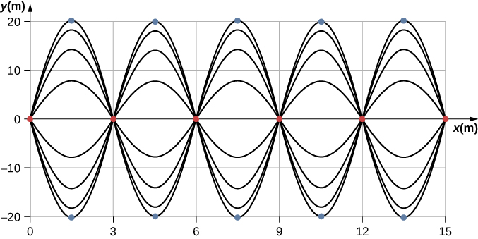
Figure 16.27
When two identical waves are moving in opposite directions, the resultant wave is a standing wave. Nodes appear at integer multiples of half wavelengths. Antinodes appear at odd multiples of quarter wavelengths, where they oscillate between y = ±A. The nodes are marked with red dots and the antinodes are marked with blue dots.

Slide 29
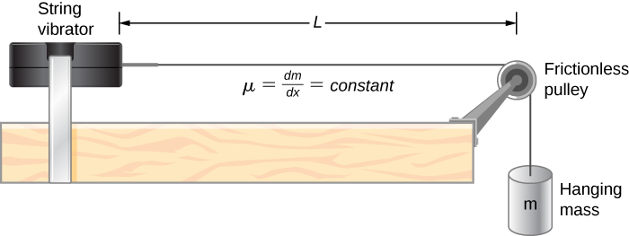
Figure 16.28
A lab setup for creating standing waves on a string. The string has a node on each end and a constant linear density. The length between the fixed boundary conditions is L. The hanging mass provides the tension in the string, and the speed of the waves on the string is proportional to the square root of the tension divided by the linear mass density.

Slide 30
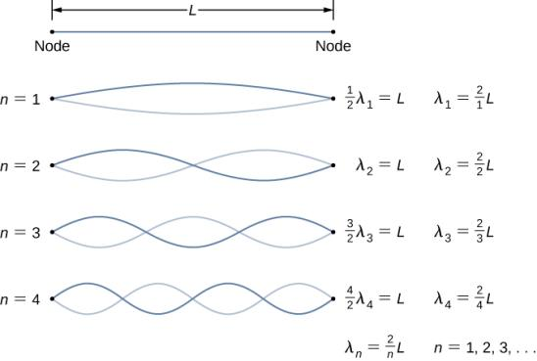
Figure 16.29
Standing waves created on a string of length L. A node occurs at each end of the string. The nodes are boundary conditions that limit the possible frequencies that excite standing waves. (Note that the amplitudes of the oscillations have been kept constant for visualization. The standing wave patterns possible on the string are known as the normal modes. Conducting this experiment in the lab would result in a decrease in amplitude as the frequency increases.)

Slide 31
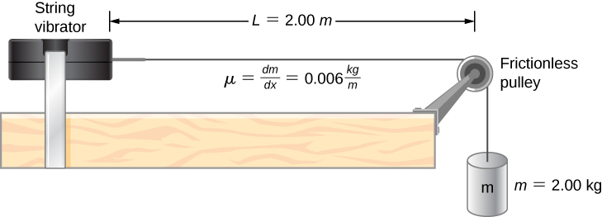
Figure 16.30
A string attached to an adjustable-frequency string vibrator.

Slide 32
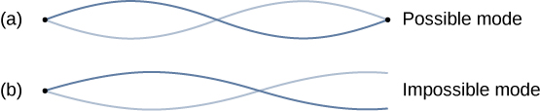
Figure 16.31
The figure represents the second mode of the string that satisfies the boundary conditions of a node at each end of the string.
This figure could not possibly be a normal mode on the string because it does not satisfy the boundary conditions. There is a node on one end, but an antinode on the other.

Slide 33
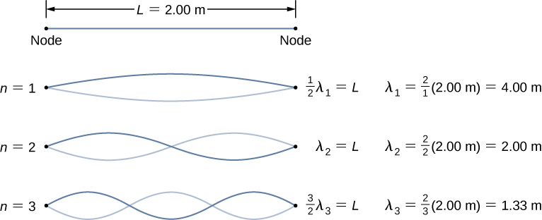
Example 16.7

Slide 34
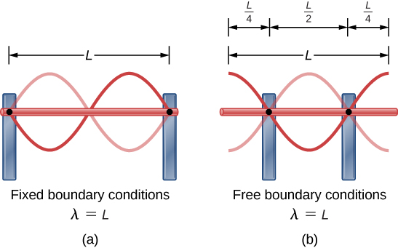
Figure 16.32
A metallic rod of length L (red) supported by two supports (blue) on each end. When driven at the proper frequency, the rod can resonate with a wavelength equal to the length of the rod with a node on each end.
The same metallic rod of length L (red) supported by two supports (blue) at a position a quarter of the length of the rod from each end. When driven at the proper frequency, the rod can resonate with a wavelength equal to the length of the rod with an antinode on each end.

Slide 35
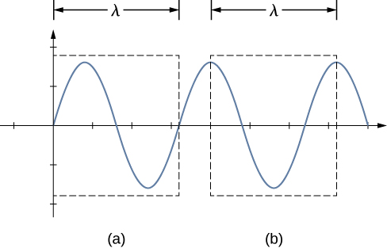
Figure 16.33
A wavelength may be measure between the nearest two repeating points. On the wave on a string, this means the same height and slope.
The wavelength is measured between the two nearest points where the height is zero and the slope is maximum and positive.
The wavelength is measured between two identical points where the height is maximum and the slope is zero.

Slide 36
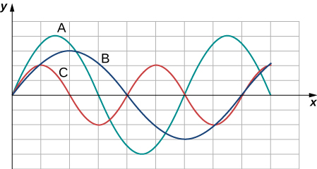
Exercise 16

Slide 37
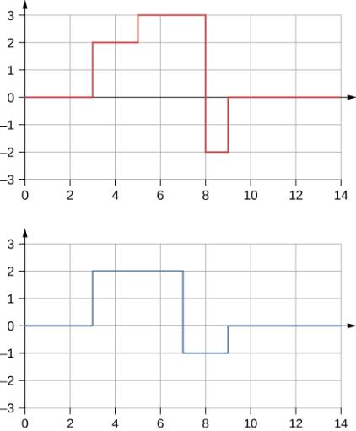
Exercise 27

Slide 38
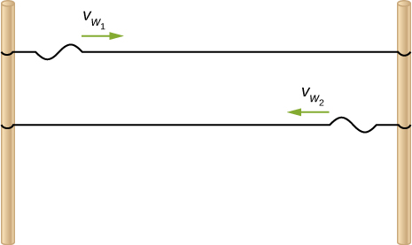
Exercise 69

Slide 39
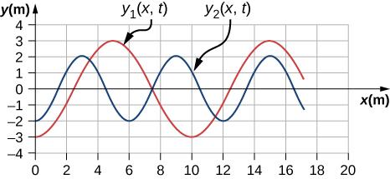
Exercise 72

Slide 40
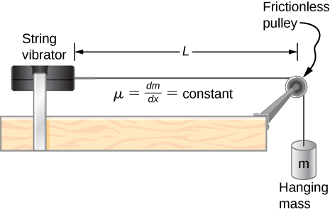
Exercise 104

Slide 41
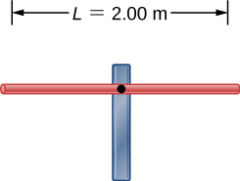
Exercise 106

Slide 42
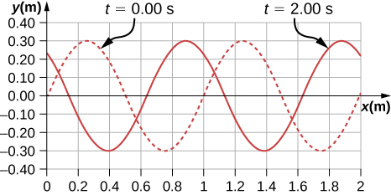
Exercise 118

Slide 43
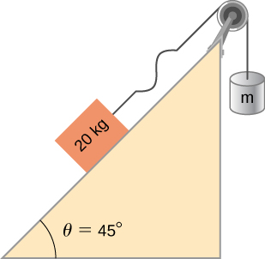
Exercise 139

Slide 44
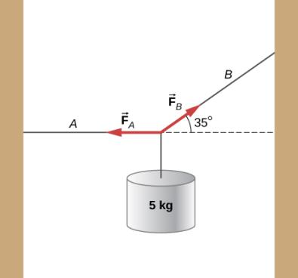
Exercise 146

Slide 45

This OpenStax ancillary resource is © Rice University under a CC-BY 4.0 International license; it may be reproduced or modified but must be attributed to OpenStax, Rice University and any changes must be noted.

