Slide 1


University Physics
Chapter 17 SOUND
PowerPoint Image Slideshow

Slide 2

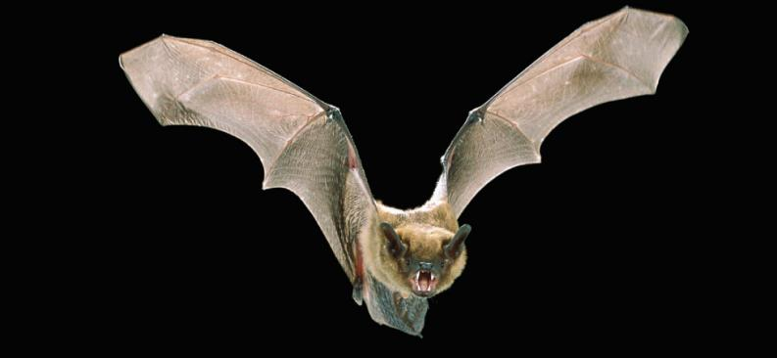
Figure 17.1
Hearing is an important human sense that can detect frequencies of sound, ranging between 20 Hz and 20 kHz. However, other species have very different ranges of hearing. Bats, for example, emit clicks in ultrasound, using frequencies beyond 20 kHz. They can detect nearby insects by hearing the echo of these ultrasonic clicks. Ultrasound is important in several human applications, including probing the interior structures of human bodies, Earth, and the Sun. Ultrasound is also useful in industry for nondestructive testing. (credit: modification of work by Angell Williams)

Slide 3
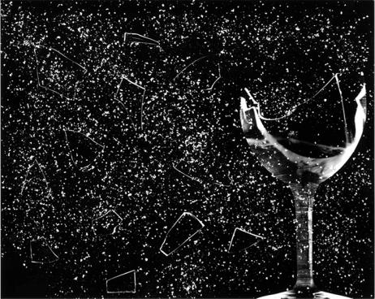
Figure 17.2
This glass has been shattered by a high-intensity sound wave of the same frequency as the resonant frequency of the glass. (credit: “||read||”/Flickr)

Slide 4
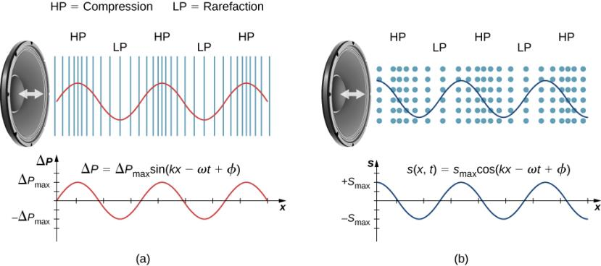
Figure 17.3
A vibrating cone of a speaker, moving in the positive x-direction, compresses the air in front of it and expands the air behind it. As the speaker oscillates, it creates another compression and rarefaction as those on the right move away from the speaker. After many vibrations, a series of compressions and rarefactions moves out from the speaker as a sound wave. The red graph shows the gauge pressure of the air versus the distance from the speaker. Pressures vary only slightly from atmospheric pressure for ordinary sounds. Note that gauge pressure is modeled with a sine function, where the crests of the function line up with the compressions and the troughs line up with the rarefactions.
Sound waves can also be modeled using the displacement of the air molecules. The blue graph shows the displacement of the air molecules versus the position from the speaker and is modeled with a cosine function. Notice that the displacement is zero for the molecules in their equilibrium position and are centered at the compressions and rarefactions. Compressions are formed when molecules on either side of the equilibrium molecules are displaced toward the equilibrium position. Rarefactions are formed when the molecules are displaced away from the equilibrium position.

Slide 5
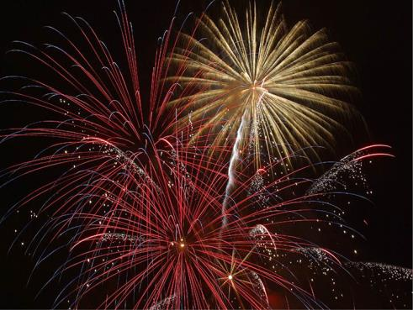
Figure 17.4
When a firework shell explodes, we perceive the light energy before the sound energy because sound travels more slowly than light does.

Slide 6
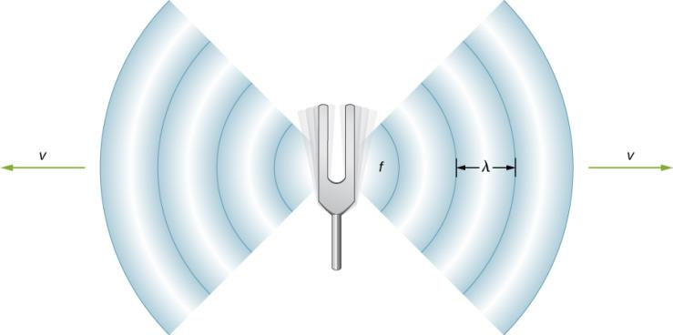
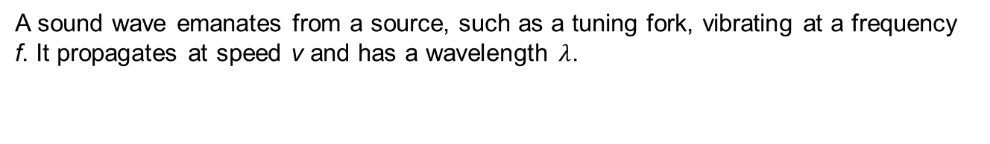
Figure 17.5
A sound wave emanates from a source, such as a tuning fork, vibrating at a frequency f. It propagates at speed v and has a wavelength $λ$.

Slide 7
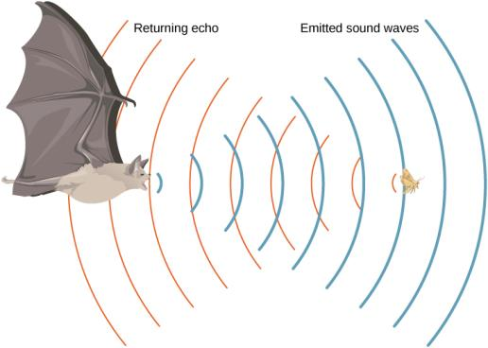
Figure 17.6
A bat uses sound echoes to find its way about and to catch prey. The time for the echo to return is directly proportional to the distance.

Slide 8
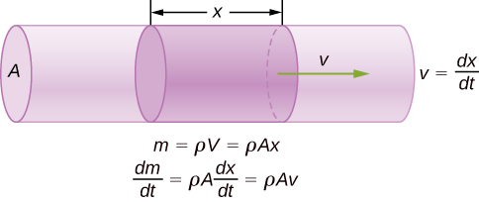
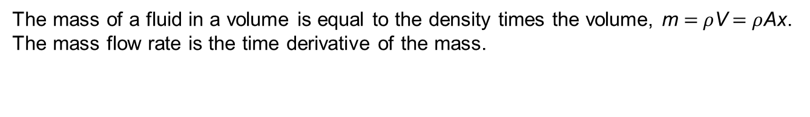
Figure 17.7
The mass of a fluid in a volume is equal to the density times the volume, m = $ρ$V = $ρ$Ax. The mass flow rate is the time derivative of the mass.

Slide 9
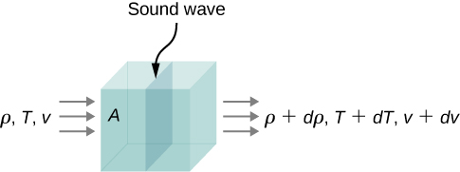
Figure 17.8
A sound wave moves through a volume of fluid. The density, temperature, and velocity of the fluid change from one side to the other.

Slide 10
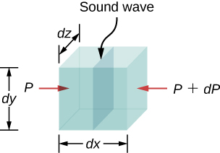
Figure 17.9
A sound wave moves through a volume of fluid. The force on each face can be found by the pressure times the area.

Slide 11
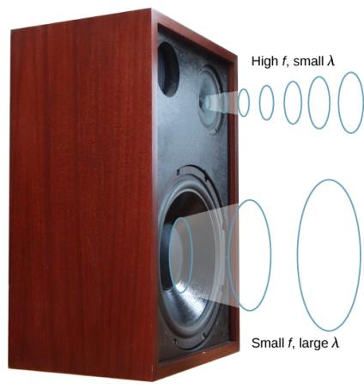
Figure 17.10
Because they travel at the same speed in a given medium, low-frequency sounds must have a greater wavelength than high-frequency sounds. Here, the lower-frequency sounds are emitted by the large speaker, called a woofer, whereas the higher-frequency sounds are emitted by the small speaker, called a tweeter.

Slide 12
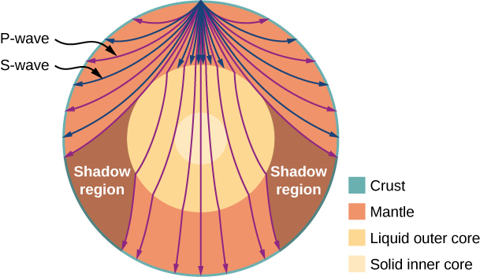
Figure 17.11
Earthquakes produce both longitudinal waves (P-waves) and transverse waves (S-waves), and these travel at different speeds. Both waves travel at different speeds in the different regions of Earth, but in general, P-waves travel faster than S-waves. S-waves cannot be supported by the liquid core, producing shadow regions.

Slide 13
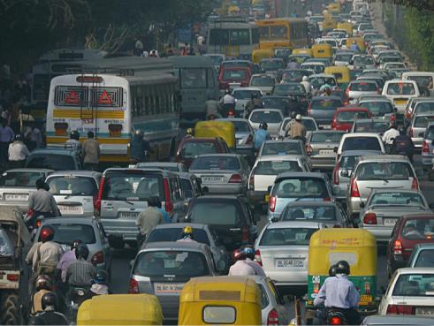
Figure 17.12
Noise on crowded roadways, like this one in Delhi, makes it hard to hear others unless they shout. (credit: “Lingaraj G J”/Flickr)

Slide 14
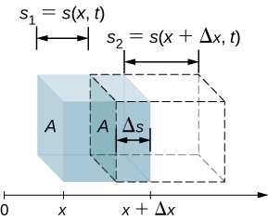
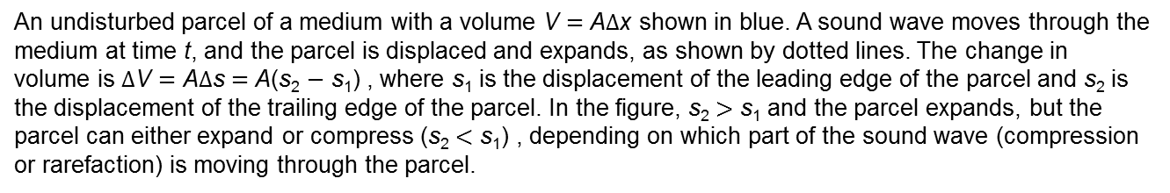
Figure 17.13
An undisturbed parcel of a medium with a volume V = A$Δ$x shown in blue. A sound wave moves through the medium at time t, and the parcel is displaced and expands, as shown by dotted lines. The change in volume is $Δ$V = A$Δ$s = A(s₂ − s₁) , where s₁ is the displacement of the leading edge of the parcel and s₂ is the displacement of the trailing edge of the parcel. In the figure, s₂ > s₁ and the parcel expands, but the parcel can either expand or compress (s₂ < s₁) , depending on which part of the sound wave (compression or rarefaction) is moving through the parcel.

Slide 15
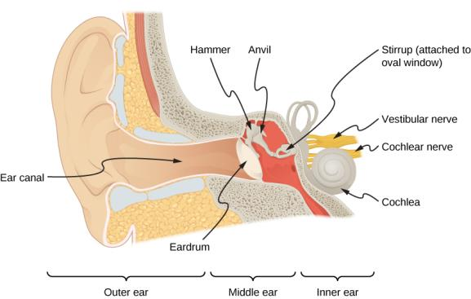
Figure 17.14
The anatomy of the human ear.

Slide 16
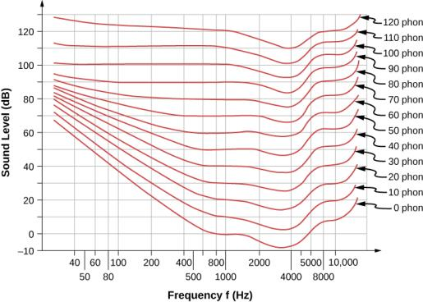
Figure 17.15
The relationship of loudness in phons to intensity level (in decibels) and intensity (in watts per meter squared) for persons with normal hearing. The curved lines are equal-loudness curves—all sounds on a given curve are perceived as equally loud. Phons and decibels are defined to be the same at 1000 Hz.

Slide 17
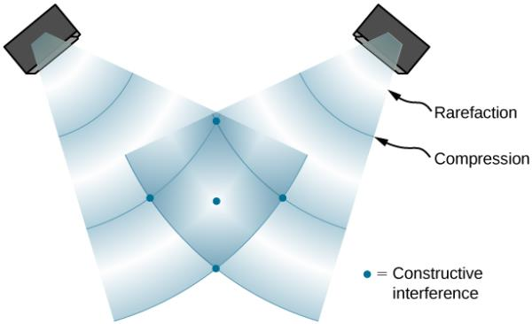
Figure 17.16
When sound waves are produced by a speaker, they travel at the speed of sound and move out as spherical waves. Here, two speakers produce the same steady tone (frequency). The result is points of high-intensity sound (highlighted), which result from two crests (compression) or two troughs (rarefaction) overlapping. Destructive interference results from a crest and trough overlapping. The points where there is constructive interference in the figure occur because the two waves are in phase at those points. Points of destructive interference (Figure 17.17) are the result of the two waves being out of phase.

Slide 18
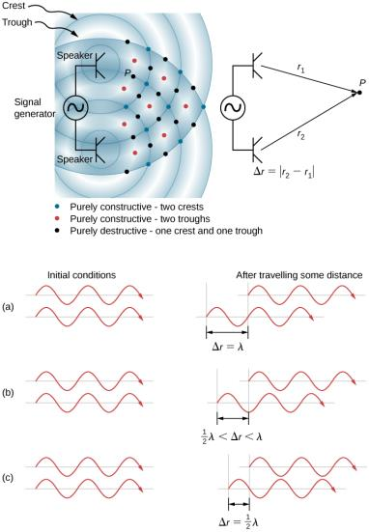
Figure 17.17
Two speakers being driven by a single signal generator. The sound waves produced by the speakers are in phase and are of a single frequency. The sound waves interfere with each other. When two crests or two troughs coincide, there is constructive interference, marked by the red and blue dots. When a trough and a crest coincide, destructive interference occurs, marked by black dots. The phase difference is due to the path lengths traveled by the individual waves. Two identical waves travel two different path lengths to a point P.
The difference in the path lengths is one wavelength, resulting in total constructive interference and a resulting amplitude equal to twice the original amplitude.
The difference in the path lengths is less than one wavelength but greater than one half a wavelength, resulting in an amplitude greater than zero and less than twice the original amplitude.
The difference in the path lengths is one half of a wavelength, resulting in total destructive interference and a resulting amplitude of zero.

Slide 19
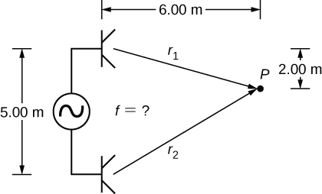
Example 17.5.1

Slide 20
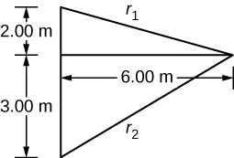
Example 17.5.2

Slide 21
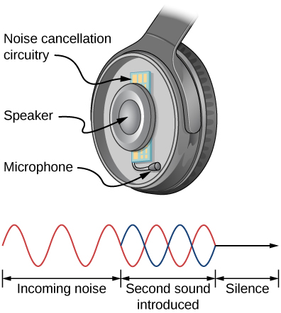
Figure 17.18
Headphones designed to cancel noise with destructive interference create a sound wave exactly opposite to the incoming sound. These headphones can be more effective than the simple passive attenuation used in most ear protection. Such headphones were used on the record-setting, around-the-world nonstop flight of the Voyager aircraft in 1986 to protect the pilots’ hearing from engine noise.

Slide 22
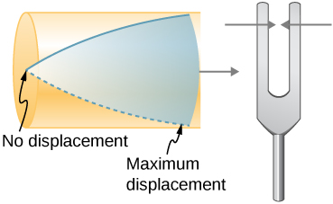
Figure 17.19
Resonance of air in a tube closed at one end, caused by a tuning fork that vibrates at the lowest frequency that can produce resonance (the fundamental frequency). A node exists at the closed end and an antinode at the open end.

Slide 23
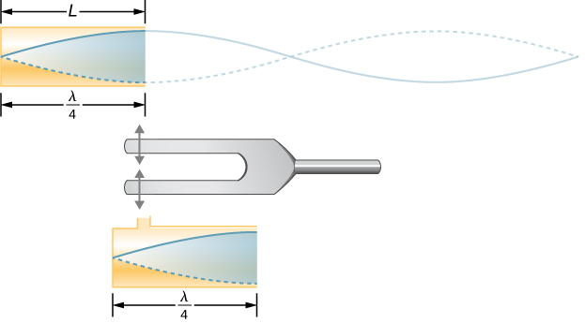
Figure 17.20
The same standing wave is created in the tube by a vibration introduced near its closed end.

Slide 24
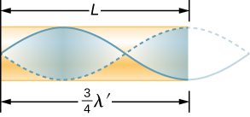
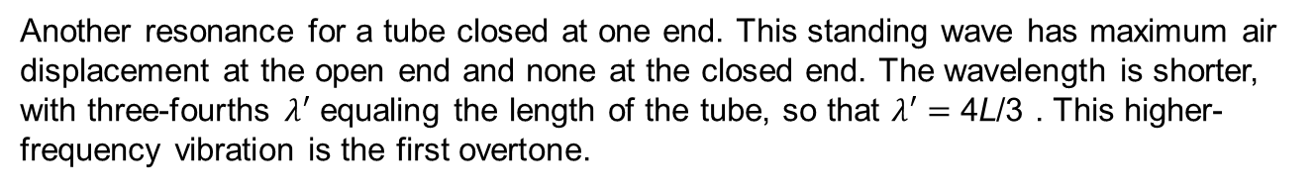
Figure 17.21
Another resonance for a tube closed at one end. This standing wave has maximum air displacement at the open end and none at the closed end. The wavelength is shorter, with three-fourths $λ$′ equaling the length of the tube, so that $λ$′ = 4L/3 . This higher-frequency vibration is the first overtone.

Slide 25
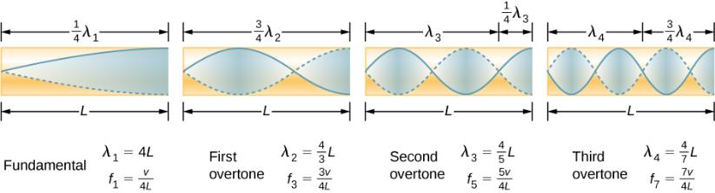
Figure 17.22
The fundamental and three lowest overtones for a tube closed at one end. All have maximum air displacements at the open end and none at the closed end.

Slide 26
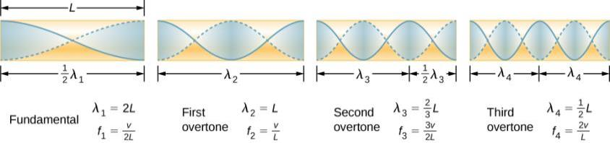
Figure 17.23
The resonant frequencies of a tube open at both ends, including the fundamental and the first three overtones. In all cases, the maximum air displacements occur at both ends of the tube, giving it different natural frequencies than a tube closed at one end.

Slide 27
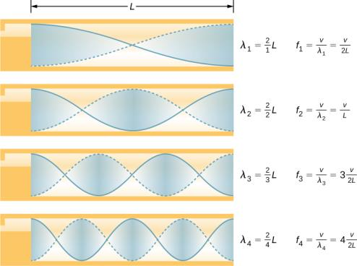
Figure 17.24
Some musical instruments can be modeled as a pipe open at both ends.

Slide 28
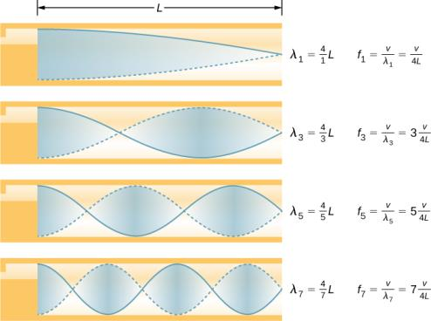
Figure 17.25
Some musical instruments can be modeled as a pipe closed at one end.

Slide 29
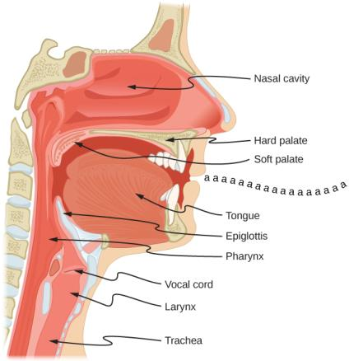
Figure 17.26
The throat and mouth form an air column closed at one end that resonates in response to vibrations in the voice box. The spectrum of overtones and their intensities vary with mouth shaping and tongue position to form different sounds. The voice box can be replaced with a mechanical vibrator, and understandable speech is still possible. Variations in basic shapes make different voices recognizable.

Slide 30
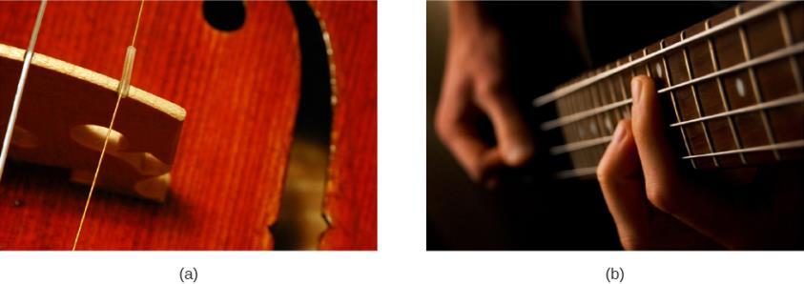
Figure 17.27
String instruments such as (a) violins and (b) guitars use resonance in their sounding boxes to amplify and enrich the sound created by their vibrating strings. The bridge and supports couple the string vibrations to the sounding boxes and air within. (credit a: modification of work by Feliciano Guimares; credit b: modification of work by Steve Snodgrass)

Slide 31
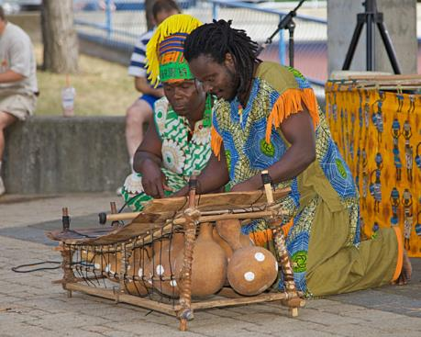
Figure 17.28
Resonance has been used in musical instruments since prehistoric times. This marimba uses gourds as resonance chambers to amplify its sound. (credit: “APC Events”/Flickr)

Slide 32
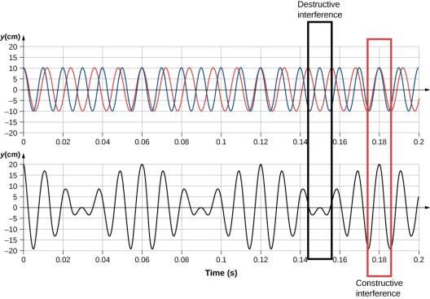
Figure 17.29
Beats produced by the constructive and destructive interference of two sound waves that differ in frequency.

Slide 33
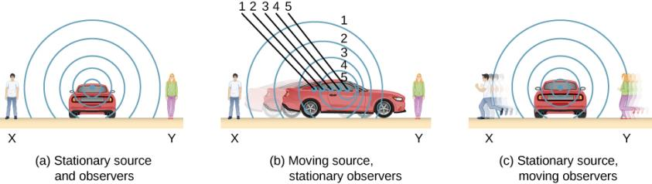
Figure 17.30
Sounds emitted by a source spread out in spherical waves. (a) When the source, observers, and air are stationary, the wavelength and frequency are the same in all directions and to all observers. (b) Sounds emitted by a source moving to the right spread out from the points at which they were emitted. The wavelength is reduced, and consequently, the frequency is increased in the direction of motion, so that the observer on the right hears a higher-pitched sound. The opposite is true for the observer on the left, where the wavelength is increased and the frequency is reduced. (c) The same effect is produced when the observers move relative to the source. Motion toward the source increases frequency as the observer on the right passes through more wave crests than she would if stationary. Motion away from the source decreases frequency as the observer on the left passes through fewer wave crests than he would if stationary.

Slide 34
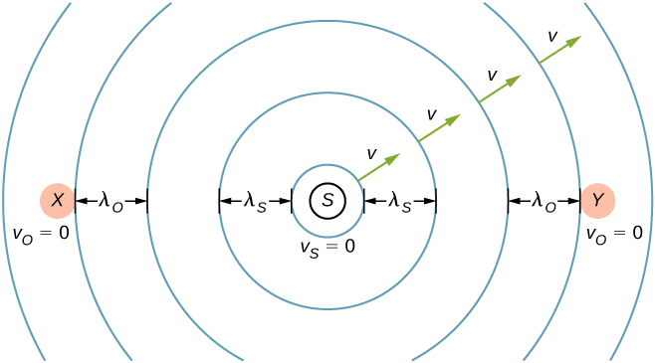
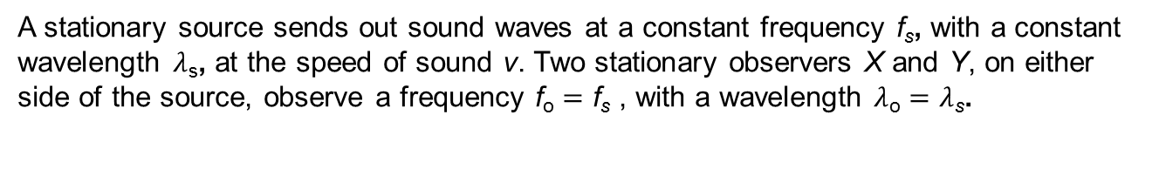
Figure 17.31
A stationary source sends out sound waves at a constant frequency f_{s}, with a constant wavelength $λ$_{s}, at the speed of sound v. Two stationary observers X and Y, on either side of the source, observe a frequency f_{o} = f_{s} , with a wavelength $λ$_{o} = $λ$_{s}.

Slide 35
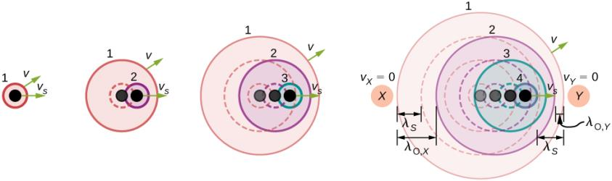
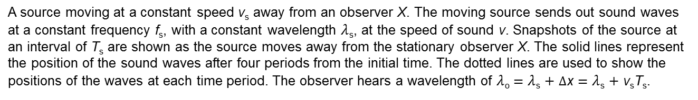
Figure 17.32
A source moving at a constant speed v_{s} away from an observer X. The moving source sends out sound waves at a constant frequency f_{s}, with a constant wavelength $λ$_{s}, at the speed of sound v. Snapshots of the source at an interval of T_{s} are shown as the source moves away from the stationary observer X. The solid lines represent the position of the sound waves after four periods from the initial time. The dotted lines are used to show the positions of the waves at each time period. The observer hears a wavelength of $λ$_{o} = $λ$_{s} + $Δ$x = $λ$_{s} + v_{s}T_{s}.

Slide 36
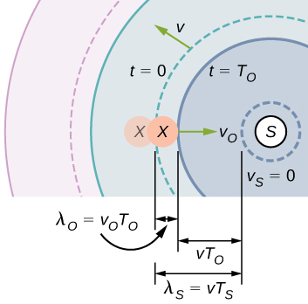
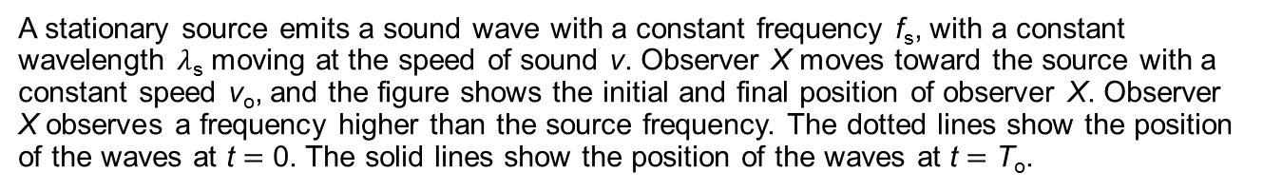
Figure 17.33
A stationary source emits a sound wave with a constant frequency f_{s}, with a constant wavelength $λ$_{s} moving at the speed of sound v. Observer X moves toward the source with a constant speed v_{o}, and the figure shows the initial and final position of observer X. Observer X observes a frequency higher than the source frequency. The dotted lines show the position of the waves at t = 0. The solid lines show the position of the waves at t = T_{o}.

Slide 37
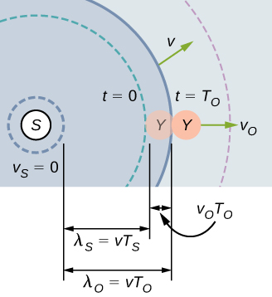
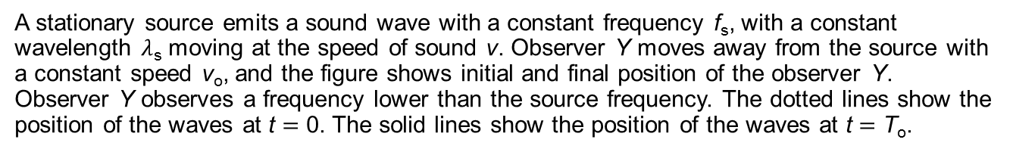
Figure 17.34
A stationary source emits a sound wave with a constant frequency f_{s}, with a constant wavelength $λ$_{s} moving at the speed of sound v. Observer Y moves away from the source with a constant speed v_{o}, and the figure shows initial and final position of the observer Y. Observer Y observes a frequency lower than the source frequency. The dotted lines show the position of the waves at t = 0. The solid lines show the position of the waves at t = T_{o}.

Slide 38
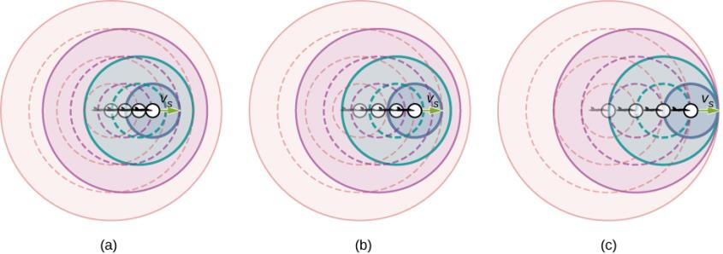
Figure 17.35
Because of the Doppler shift, as a moving source approaches a stationary observer, the observed frequency is higher than the source frequency. The faster the source is moving, the higher the observed frequency. In this figure, the source in (b) is moving faster than the source in (a). Shown are four time steps, the first three shown as dotted lines. (c) If a source moves at the speed of sound, each successive wave interfere with the previous one and the observer observes them all at the same instant.

Slide 39
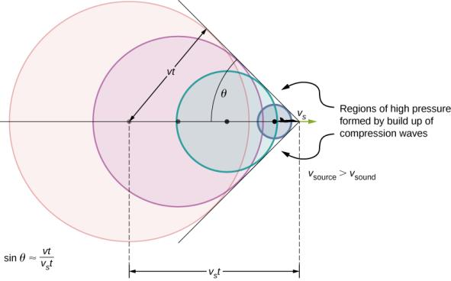
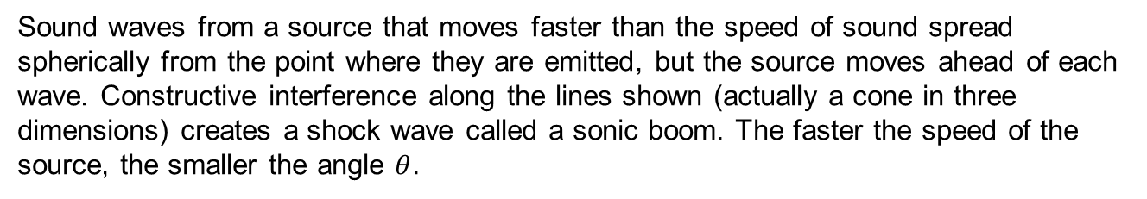
Figure 17.36
Sound waves from a source that moves faster than the speed of sound spread spherically from the point where they are emitted, but the source moves ahead of each wave. Constructive interference along the lines shown (actually a cone in three dimensions) creates a shock wave called a sonic boom. The faster the speed of the source, the smaller the angle $θ$.

Slide 40
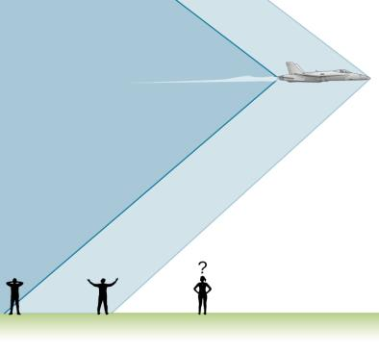
Figure 17.37
Two sonic booms experienced by observers, created by the nose and tail of an aircraft as the shock wave sweeps along the ground, are observed on the ground after the plane has passed by.

Slide 41

Figure 17.38
Bow wake created by a duck. Constructive interference produces the rather structured wake, whereas relatively little wave action occurs inside the wake, where interference is mostly destructive. (credit: Horia Varlan)

Slide 42
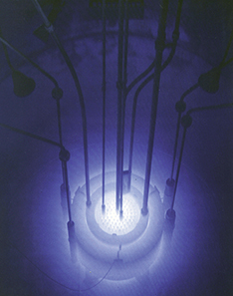
Figure 17.39
The blue glow in this research reactor pool is Cerenkov radiation caused by subatomic particles traveling faster than the speed of light in water. (credit: U.S. Nuclear Regulatory Commission)

Slide 43
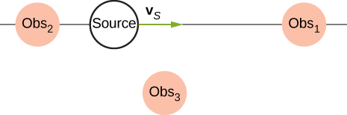
Exercise 23

Slide 44

Exercise 24

Slide 45

Exercise 41

Slide 46

Exercise 53

Slide 47

Exercise 55

Slide 48

Exercise 96

Slide 49

Exercise 130

Slide 50

Exercise 131

Slide 51

Exercise 140

Slide 52

Exercise 141

Slide 53

This OpenStax ancillary resource is © Rice University under a CC-BY 4.0 International license; it may be reproduced or modified but must be attributed to OpenStax, Rice University and any changes must be noted.

