Slide 1


University Physics
APPENDIX E MATHEMATICAL FORMULA
PowerPoint Image Slideshow

Slide 2

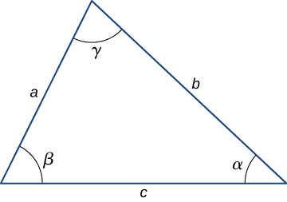

Slide 3
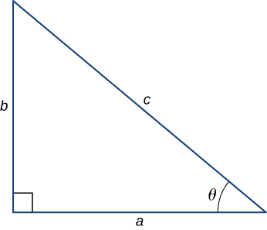

Slide 4
University Physics
APPENDIX F CHEMISTRY
PowerPoint Image Slideshow

Slide 5
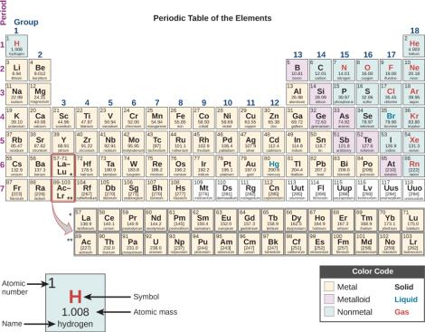

Slide 6

This OpenStax ancillary resource is © Rice University under a CC-BY 4.0 International license; it may be reproduced or modified but must be attributed to OpenStax, Rice University and any changes must be noted.

