Slide 1


University Physics
Chapter 1 TEMPERATURE AND HEAT
PowerPoint Image Slideshow

Slide 2

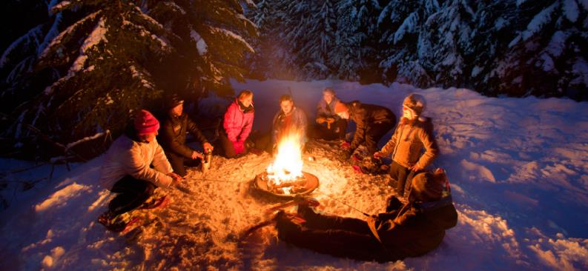
Figure 1.1
These snowshoers on Mount Hood in Oregon are enjoying the heat flow and light caused by high temperature. All three mechanisms of heat transfer are relevant to this picture. The heat flowing out of the fire also turns the solid snow to liquid water and vapor. (credit: “Mt. Hood Territory”/Flickr)

Slide 3
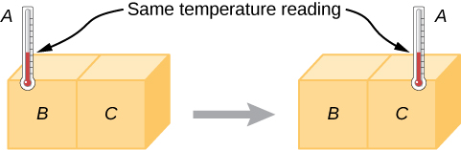
Figure 1.2
If thermometer A is in thermal equilibrium with object B, and B is in thermal equilibrium with C, then A is in thermal equilibrium with C. Therefore, the reading on A stays the same when A is moved over to make contact with C.

Slide 4
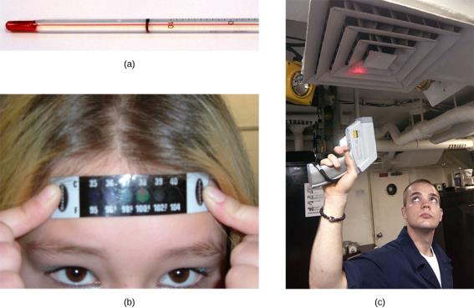
Figure 1.3
Because many physical properties depend on temperature, the variety of thermometers is remarkable. (a) In this common type of thermometer, the alcohol, containing a red dye, expands more rapidly than the glass encasing it. When the thermometer’s temperature increases, the liquid from the bulb is forced into the narrow tube, producing a large change in the length of the column for a small change in temperature. (b) Each of the six squares on this plastic (liquid crystal) thermometer contains a film of a different heat-sensitive liquid crystal material. Below 95 °F , all six squares are black. When the plastic thermometer is exposed to a temperature of 95 °F , the first liquid crystal square changes color. When the temperature reaches above 96.8 °F , the second liquid crystal square also changes color, and so forth. (c) A firefighter uses a pyrometer to check the temperature of an aircraft carrier’s ventilation system. The pyrometer measures infrared radiation (whose emission varies with temperature) from the vent and quickly produces a temperature readout. Infrared thermometers are also frequently used to measure body temperature by gently placing them in the ear canal. Such thermometers are more accurate than the alcohol thermometers placed under the tongue or in the armpit. (credit b: modification of work by Tess Watson; credit c: modification of work by Lamel J. Hinton)

Slide 5
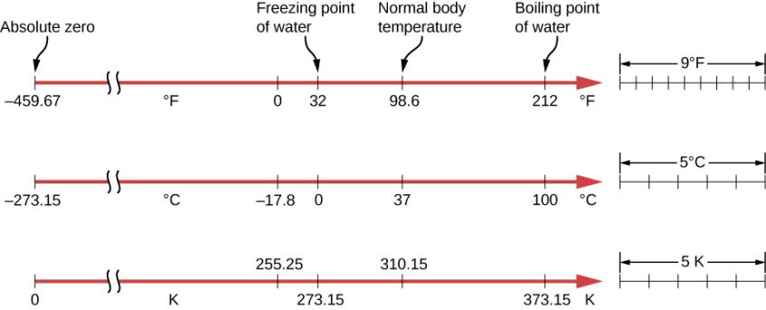
Figure 1.4
Relationships between the Fahrenheit, Celsius, and Kelvin temperature scales are shown. The relative sizes of the scales are also shown.

Slide 6
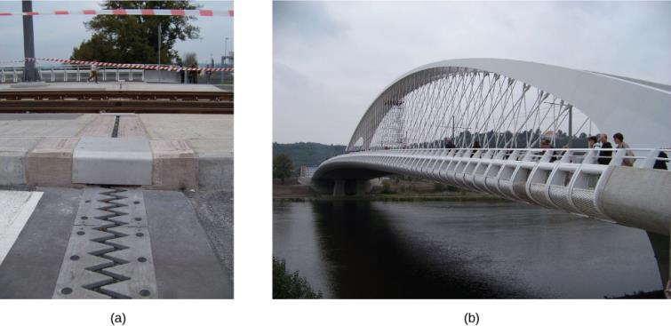
Figure 1.5
(a) Thermal expansion joints like these in the (b) Auckland Harbour Bridge in New Zealand allow bridges to change length without buckling. (credit: “ŠJů”/Wikimedia Commons)

Slide 7
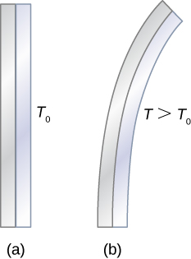
Figure 1.6
The curvature of a bimetallic strip depends on temperature.
The strip is straight at the starting temperature, where its two components have the same length.
At a higher temperature, this strip bends to the right, because the metal on the left has expanded more than the metal on the right. At a lower temperature, the strip would bend to the left.

Slide 8
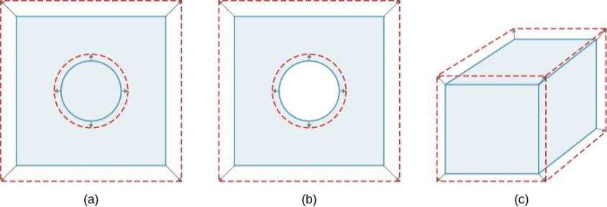
Figure 1.7
In general, objects expand in all directions as temperature increases. In these drawings, the original boundaries of the objects are shown with solid lines, and the expanded boundaries with dashed lines.
Area increases because both length and width increase. The area of a circular plug also increases.
If the plug is removed, the hole it leaves becomes larger with increasing temperature, just as if the expanding plug were still in place.
Volume also increases, because all three dimensions increase.

Slide 9
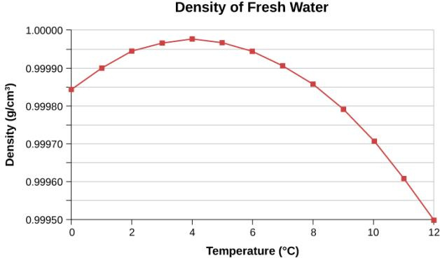
Figure 1.8
This curve shows the density of water as a function of temperature. Note that the thermal expansion at low temperatures is very small. The maximum density at 4 °C is only 0.0075% greater than the density at 2 °C, and 0.012% greater than that at 0 °C. The decrease of density below 4 °C occurs because the liquid water approachs the solid crystal form of ice, which contains more empty space than the liquid.

Slide 10
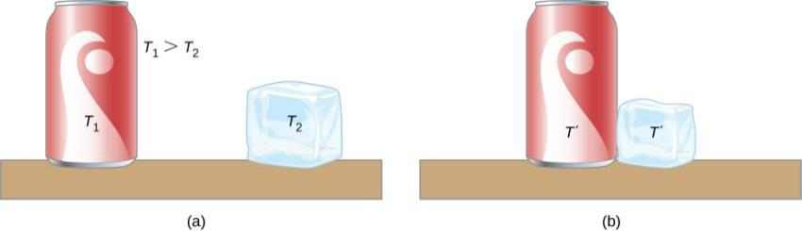
Figure 1.9
Here, the soft drink has a higher temperature than the ice, so they are not in thermal equilibrium.
When the soft drink and ice are allowed to interact, heat is transferred from the drink to the ice due to the difference in temperatures until they reach the same temperature, T′, achieving equilibrium. In fact, since the soft drink and ice are both in contact with the surrounding air and the bench, the ultimate equilibrium temperature will be the same as that of the surroundings.

Slide 11
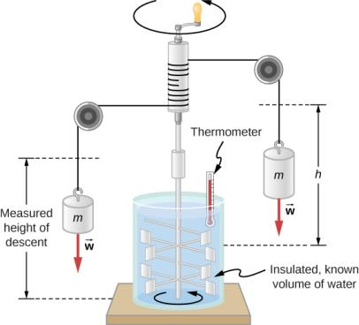
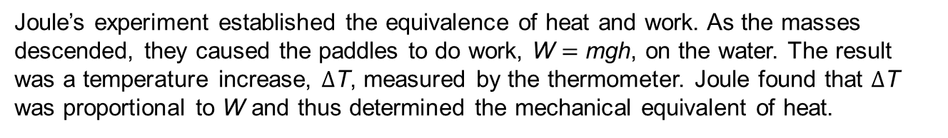
Figure 1.10
Joule’s experiment established the equivalence of heat and work. As the masses descended, they caused the paddles to do work, W = mgh, on the water. The result was a temperature increase, $Δ$T, measured by the thermometer. Joule found that $Δ$T was proportional to W and thus determined the mechanical equivalent of heat.

Slide 12
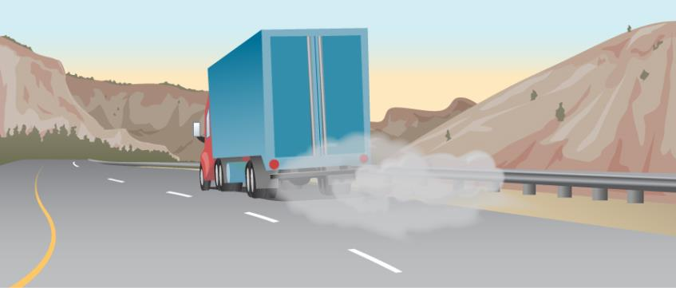
Figure 1.11
The smoking brakes on a braking truck are visible evidence of the mechanical equivalent of heat.

Slide 13
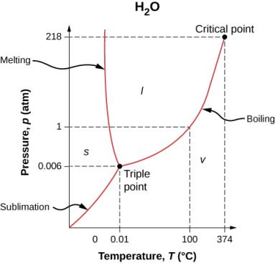
Figure 1.12
The phase diagram (pT graph) for water shows solid (s), liquid (l), and vapor (v) phases. At temperatures and pressure above those of the critical point, there is no distinction between liquid and vapor. Note that the axes are nonlinear and the graph is not to scale. This graph is simplified—it omits several exotic phases of ice at higher pressures. The phase diagram of water is unusual because the melting-point curve has a negative slope, showing that you can melt ice by increasing the pressure.

Slide 14
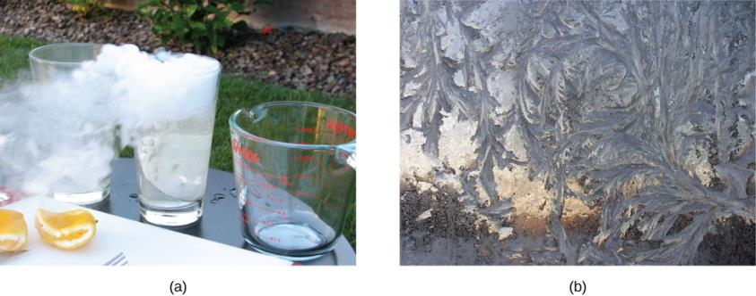
Figure 1.13
Direct transitions between solid and vapor are common, sometimes useful, and even beautiful.
Dry ice sublimes directly to carbon dioxide gas. The visible “smoke” consists of water droplets that condensed in the air cooled by the dry ice.
Frost forms patterns on a very cold window, an example of a solid formed directly from a vapor. (credit a: modification of work by Windell Oskay; credit b: modification of work by Liz West)

Slide 15
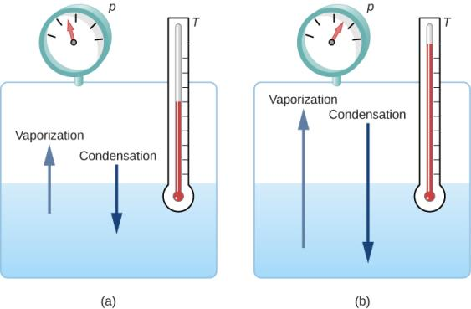
Figure 1.14
Equilibrium between liquid and gas at two different boiling points inside a closed container.
The rates of boiling and condensation are equal at this combination of temperature and pressure, so the liquid and gas phases are in equilibrium.
At a higher temperature, the boiling rate is faster, that is, the rate at which molecules leave the liquid and enter the gas is faster. This increases the number of molecules in the gas, which increases the gas pressure, which in turn increases the rate at which gas molecules condense and enter the liquid. The pressure stops increasing when it reaches the point where the boiling rate and the condensation rate are equal. The gas and liquid are in equilibrium again at this higher temperature and pressure.

Slide 16
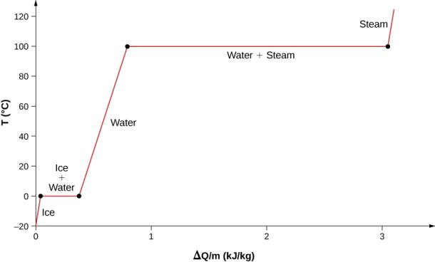
Figure 1.15
Temperature versus heat. The system is constructed so that no vapor evaporates while ice warms to become liquid water, and so that, when vaporization occurs, the vapor remains in the system. The long stretches of constant temperatures at 0 °C and 100 °C reflect the large amounts of heat needed to cause melting and vaporization, respectively.

Slide 17
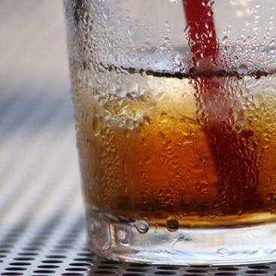
Figure 1.16
Condensation forms on this glass of iced tea because the temperature of the nearby air is reduced. The air cannot hold as much water as it did at room temperature, so water condenses. Energy is released when the water condenses, speeding the melting of the ice in the glass. (credit: Jenny Downing)

Slide 18
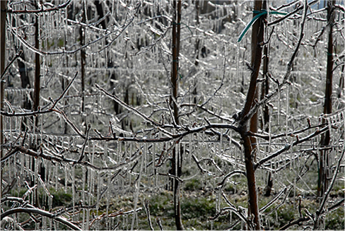
Figure 1.17
The ice on these trees released large amounts of energy when it froze, helping to prevent the temperature of the trees from dropping below 0 °C . Water is intentionally sprayed on orchards to help prevent hard frosts. (credit: Hermann Hammer)

Slide 19
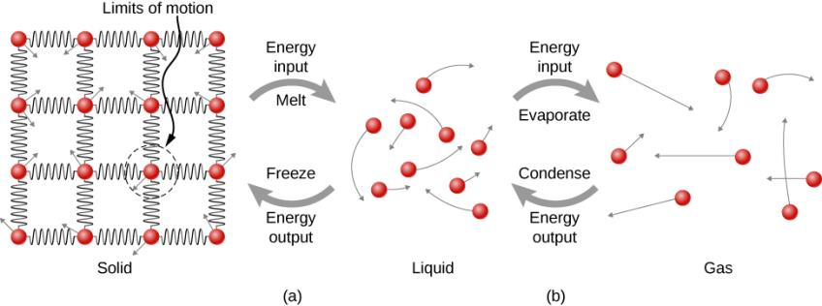
Figure 1.18
Energy is required to partially overcome the attractive forces (modeled as springs) between molecules in a solid to form a liquid. That same energy must be removed from the liquid for freezing to take place.
Molecules become separated by large distances when going from liquid to vapor, requiring significant energy to completely overcome molecular attraction. The same energy must be removed from the vapor for condensation to take place.

Slide 20
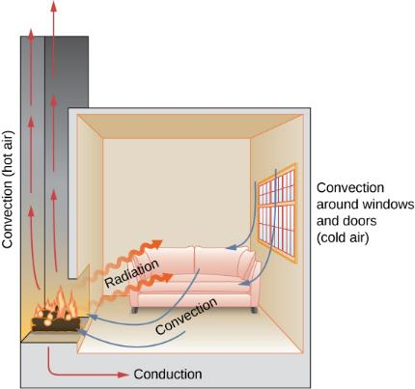
Figure 1.19
In a fireplace, heat transfer occurs by all three methods: conduction, convection, and radiation. Radiation is responsible for most of the heat transferred into the room. Heat transfer also occurs through conduction into the room, but much slower. Heat transfer by convection also occurs through cold air entering the room around windows and hot air leaving the room by rising up the chimney.

Slide 21
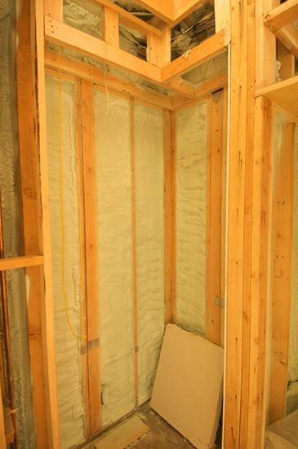
Figure 1.20
Insulation is used to limit the conduction of heat from the inside to the outside (in winter) and from the outside to the inside (in summer). (credit: Giles Douglas)

Slide 22
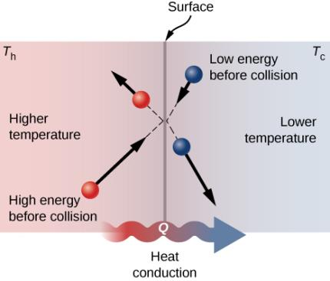
Figure 1.21
Molecules in two bodies at different temperatures have different average kinetic energies. Collisions occurring at the contact surface tend to transfer energy from high-temperature regions to low-temperature regions. In this illustration, a molecule in the lower-temperature region (right side) has low energy before collision, but its energy increases after colliding with a high-energy molecule at the contact surface. In contrast, a molecule in the higher-temperature region (left side) has high energy before collision, but its energy decreases after colliding with a low-energy molecule at the contact surface.

Slide 23
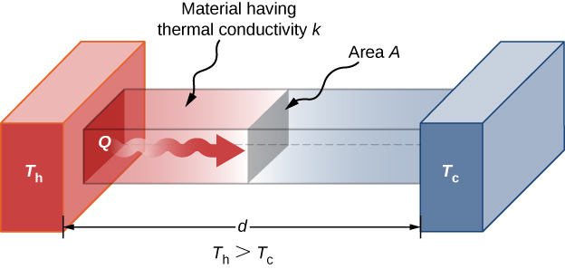
Figure 1.22
Heat conduction occurs through any material, represented here by a rectangular bar, whether window glass or walrus blubber.

Slide 24
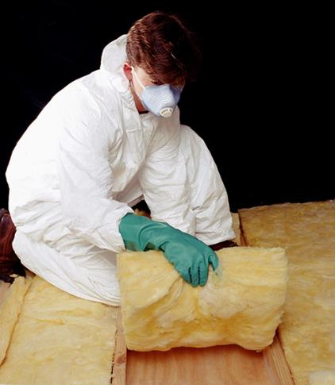
Figure 1.23
The fiberglass batt is used for insulation of walls and ceilings to prevent heat transfer between the inside of the building and the outside environment. (credit: Tracey Nicholls)

Slide 25
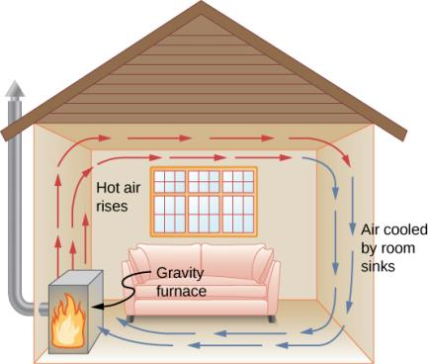
Figure 1.24
Air heated by a so-called gravity furnace expands and rises, forming a convective loop that transfers energy to other parts of the room. As the air is cooled at the ceiling and outside walls, it contracts, eventually becoming denser than room air and sinking to the floor. A properly designed heating system using natural convection, like this one, can heat a home quite efficiently.

Slide 26
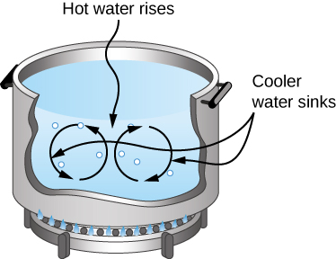
Figure 1.25
Natural convection plays an important role in heat transfer inside this pot of water. Once conducted to the inside, heat transfer to other parts of the pot is mostly by convection. The hotter water expands, decreases in density, and rises to transfer heat to other regions of the water, while colder water sinks to the bottom. This process keeps repeating.

Slide 27
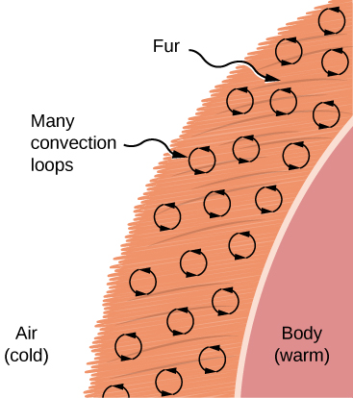
Figure 1.26
Fur is filled with air, breaking it up into many small pockets. Convection is very slow here, because the loops are so small. The low conductivity of air makes fur a very good lightweight insulator.

Slide 28
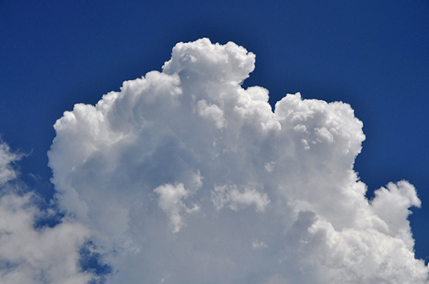
Figure 1.27
Cumulus clouds are caused by water vapor that rises because of convection. The rise of clouds is driven by a positive feedback mechanism. (credit: “Amada44”/Wikimedia Commons)

Slide 29
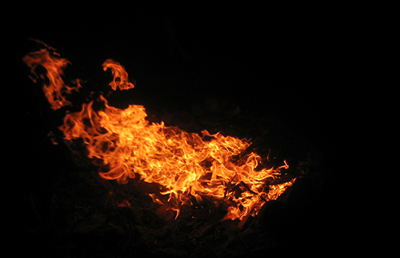
Figure 1.28
Most of the heat transfer from this fire to the observers occurs through infrared radiation. The visible light, although dramatic, transfers relatively little thermal energy. Convection transfers energy away from the observers as hot air rises, while conduction is negligibly slow here. Skin is very sensitive to infrared radiation, so you can sense the presence of a fire without looking at it directly. (credit: Daniel O’Neil)

Slide 30
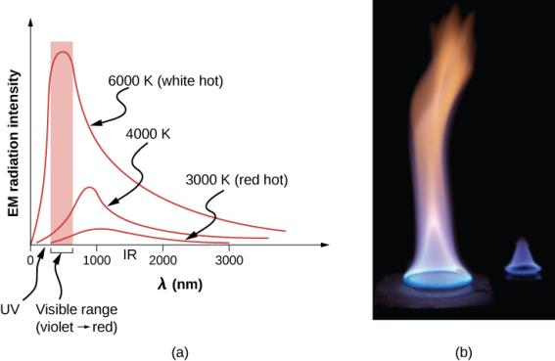
Figure 1.29
A graph of the spectrum of electromagnetic waves emitted from an ideal radiator at three different temperatures. The intensity or rate of radiation emission increases dramatically with temperature, and the spectrum shifts down in wavelength toward the visible and ultraviolet parts of the spectrum. The shaded portion denotes the visible part of the spectrum. It is apparent that the shift toward the ultraviolet with temperature makes the visible appearance shift from red to white to blue as temperature increases.
Note the variations in color corresponding to variations in flame temperature.

Slide 31
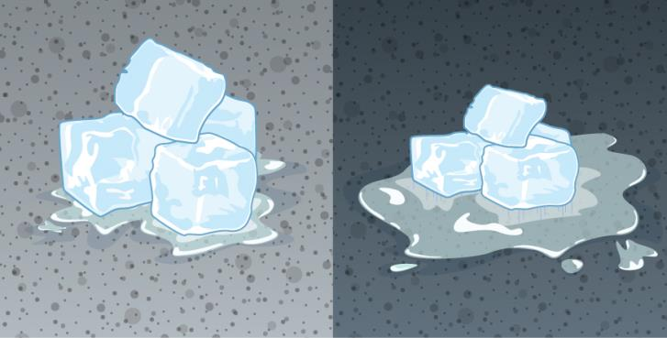
Figure 1.30
The darker pavement is hotter than the lighter pavement (much more of the ice on the right has melted), although both have been in the sunlight for the same time. The thermal conductivities of the pavements are the same.

Slide 32
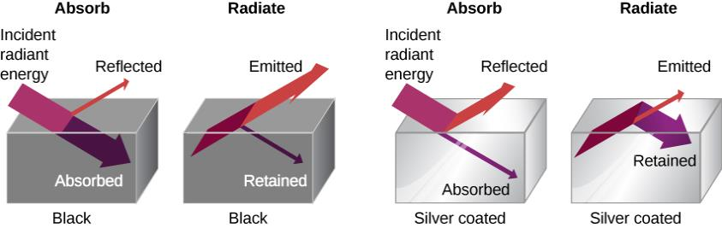
Figure 1.31
A black object is a good absorber and a good radiator, whereas a white, clear, or silver object is a poor absorber and a poor radiator.

Slide 33
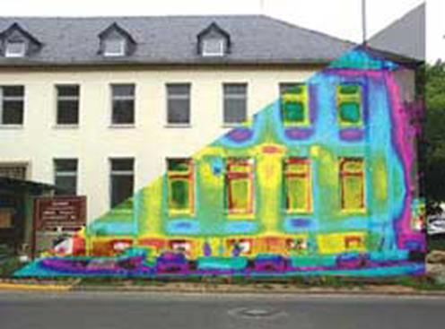
Figure 1.32
A thermograph of part of a building shows temperature variations, indicating where heat transfer to the outside is most severe. Windows are a major region of heat transfer to the outside of homes. (credit: US Army)

Slide 34
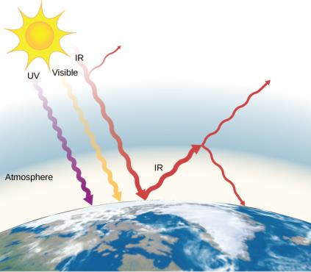
Figure 1.33
The greenhouse effect is the name given to the increase of Earth’s temperature due to absorption of radiation in the atmosphere. The atmosphere is transparent to incoming visible radiation and most of the Sun’s infrared. The Earth absorbs that energy and re-emits it. Since Earth’s temperature is much lower than the Sun’s, it re-emits the energy at much longer wavelengths, in the infrared. The atmosphere absorbs much of that infrared radiation and radiates about half of the energy back down, keeping Earth warmer than it would otherwise be. The amount of trapping depends on concentrations of trace gases such as carbon dioxide, and an increase in the concentration of these gases increases Earth’s surface temperature.

Slide 35
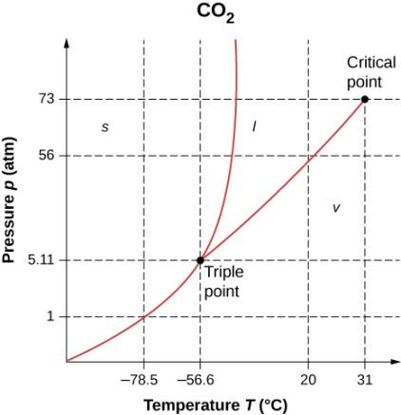
Exercise 16

Slide 36
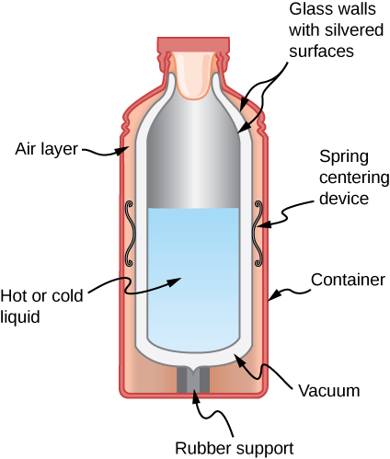
Exercise 30

Slide 37
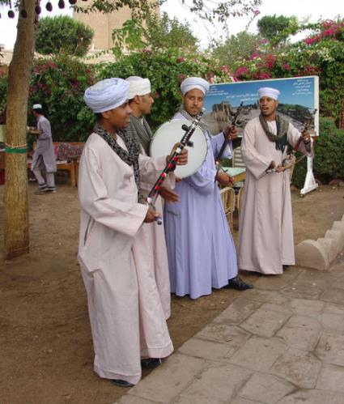
Exercise 32

Slide 38
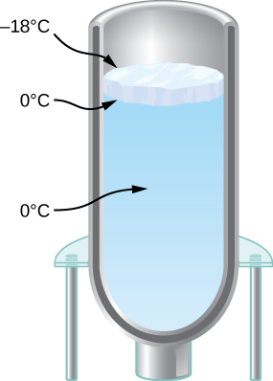
Exercise 120

Slide 39

This OpenStax ancillary resource is © Rice University under a CC-BY 4.0 International license; it may be reproduced or modified but must be attributed to OpenStax, Rice University and any changes must be noted.

