Slide 1


University Physics
Chapter 2 THE KINETIC THEORY OF GASES
PowerPoint Image Slideshow

Slide 2

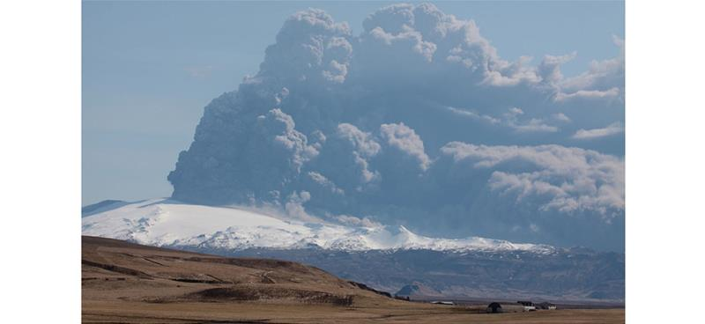
Figure 2.1
A volcanic eruption releases tons of gas and dust into the atmosphere. Most of the gas is water vapor, but several other gases are common, including greenhouse gases such as carbon dioxide and acidic pollutants such as sulfur dioxide. However, the emission of volcanic gas is not all bad: Many geologists believe that in the earliest stages of Earth’s formation, volcanic emissions formed the early atmosphere. (credit: modification of work by “Boaworm”/Wikimedia Commons)

Slide 3
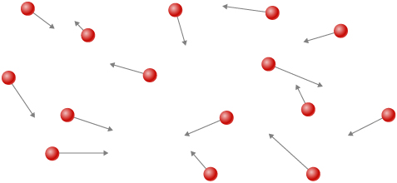
Figure 2.2
Atoms and molecules in a gas are typically widely separated. Because the forces between them are quite weak at these distances, the properties of a gas depend more on the number of atoms per unit volume and on temperature than on the type of atom.

Slide 4
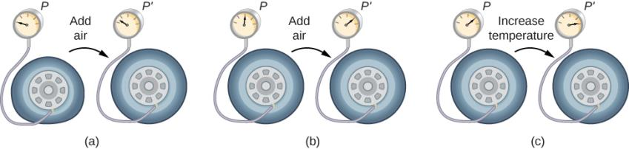
Figure 2.3
When air is pumped into a deflated tire, its volume first increases without much increase in pressure.
When the tire is filled to a certain point, the tire walls resist further expansion, and the pressure increases with more air.
Once the tire is inflated, its pressure increases with temperature.

Slide 5
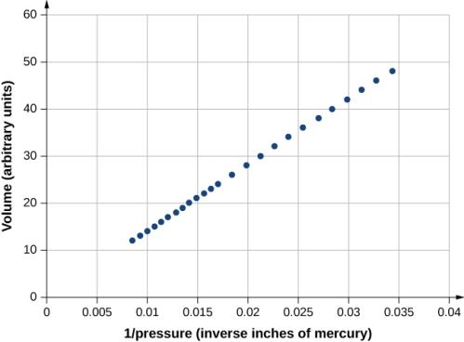
Figure 2.4
Robert Boyle and his assistant found that volume and pressure are inversely proportional. Here their data are plotted as V versus 1/p; the linearity of the graph shows the inverse proportionality. The number shown as the volume is actually the height in inches of air in a cylindrical glass tube. The actual volume was that height multiplied by the cross-sectional area of the tube, which Boyle did not publish. The data are from Boyle’s book A Defence of the Doctrine Touching the Spring and Weight of the Air…, p. 60.^{[1]}

Slide 6
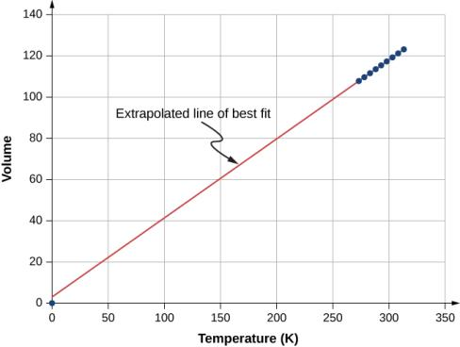
Figure 2.5
Experimental data showing that at constant pressure, volume is approximately proportional to temperature. The best-fit line passes approximately through the origin.^{[2]}

Slide 7
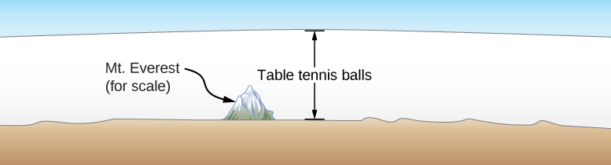
Figure 2.6
How big is a mole? On a macroscopic level, Avogadro’s number of table tennis balls would cover Earth to a depth of about 40 km.

Slide 8
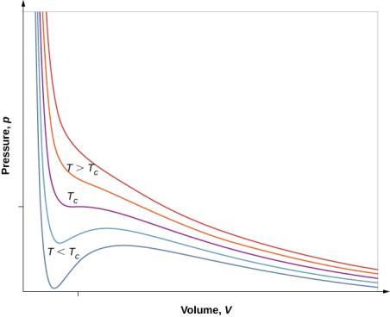
Figure 2.7
pV diagram for a Van der Waals gas at various temperatures. The red curves are calculated at temperatures above the critical temperature and the blue curves at temperatures below it. The blue curves have an oscillation in which volume (V) increases with increasing pressure (p), an impossible situation, so they must be corrected as in Figure 2.8. (credit: “Eman”/Wikimedia Commons)

Slide 9
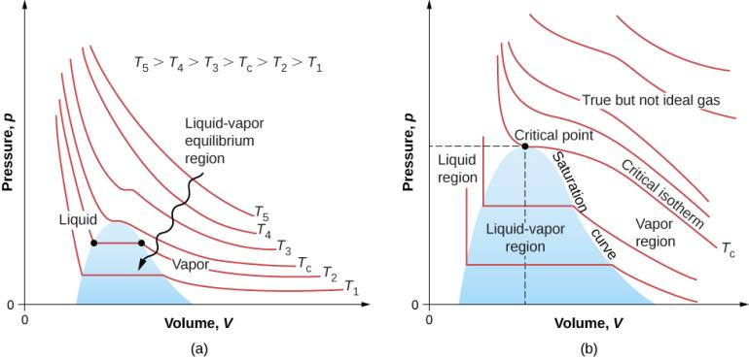
Figure 2.8
pV diagrams.
Each curve (isotherm) represents the relationship between p and V at a fixed temperature; the upper curves are at higher temperatures. The lower curves are not hyperbolas because the gas is no longer an ideal gas.
An expanded portion of the pV diagram for low temperatures, where the phase can change from a gas to a liquid. The term “vapor” refers to the gas phase when it exists at a temperature below the boiling temperature.

Slide 10
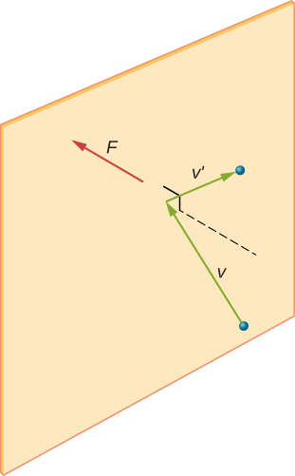
Figure 2.9
When a molecule collides with a rigid wall, the component of its momentum perpendicular to the wall is reversed. A force is thus exerted on the wall, creating pressure.

Slide 11
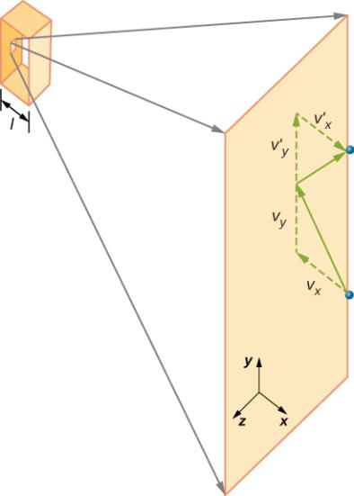
Figure 2.10
Gas in a box exerts an outward pressure on its walls. A molecule colliding with a rigid wall has its velocity and momentum in the x-direction reversed. This direction is perpendicular to the wall. The components of its velocity momentum in the y- and z-directions are not changed, which means there is no force parallel to the wall.

Slide 12
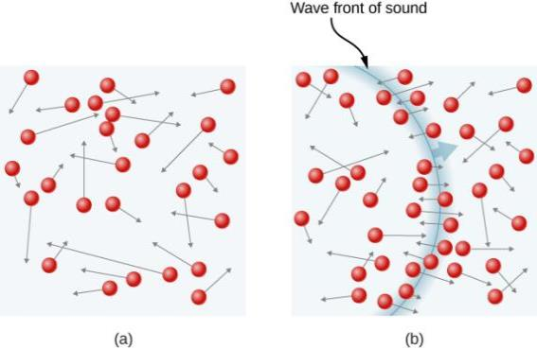
Figure 2.11
In an ordinary gas, so many molecules move so fast that they collide billions of times every second.
Individual molecules do not move very far in a small amount of time, but disturbances like sound waves are transmitted at speeds related to the molecular speeds.

Slide 13
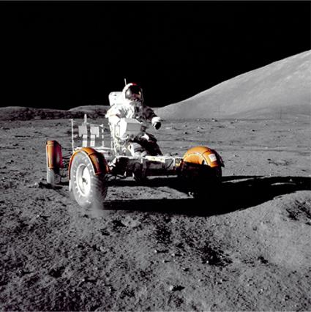
Figure 2.12
This photograph of Apollo 17 Commander Eugene Cernan driving the lunar rover on the Moon in 1972 looks as though it was taken at night with a large spotlight. In fact, the light is coming from the Sun. Because the acceleration due to gravity on the Moon is so low (about 1/6 that of Earth), the Moon’s escape velocity is much smaller. As a result, gas molecules escape very easily from the Moon, leaving it with virtually no atmosphere. Even during the daytime, the sky is black because there is no gas to scatter sunlight. (credit: Harrison H. Schmitt/NASA)

Slide 14
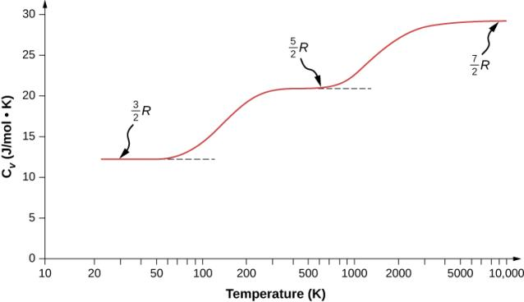
Figure 2.13
The molar heat capacity of hydrogen as a function of temperature (on a logarithmic scale). The three “steps” or “plateaus” show different numbers of degrees of freedom that the typical energies of molecules must achieve to activate. Translational kinetic energy corresponds to three degrees of freedom, rotational to another two, and vibrational to yet another two.

Slide 15
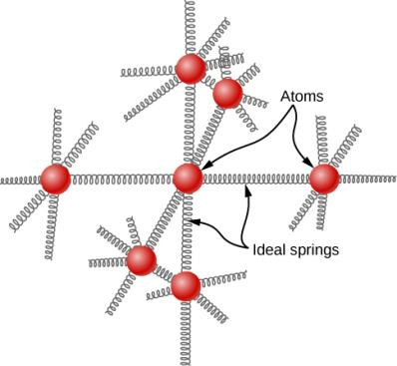
Figure 2.14
In a simple model of a solid element, each atom is attached to others by six springs, two for each possible motion: x, y, and z. Each of the three motions corresponds to two degrees of freedom, one for kinetic energy and one for potential energy. Thus d = 6.

Slide 16
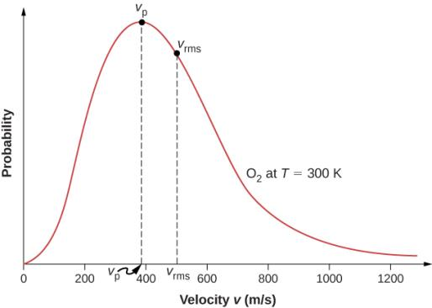
Figure 2.15
The Maxwell-Boltzmann distribution of molecular speeds in an ideal gas. The most likely speed v_{p} is less than the rms speed v_{rms}. Although very high speeds are possible, only a tiny fraction of the molecules have speeds that are an order of magnitude greater than v_{rms}.

Slide 17
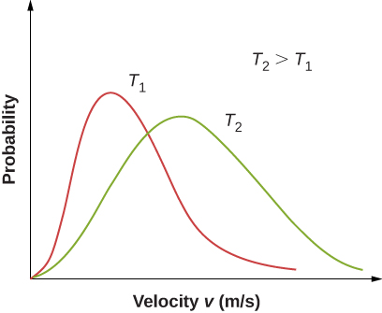
Figure 2.16
The Maxwell-Boltzmann distribution is shifted to higher speeds and broadened at higher temperatures.

Slide 18
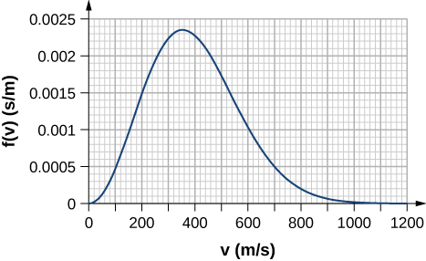
Exercise 69

Slide 19

This OpenStax ancillary resource is © Rice University under a CC-BY 4.0 International license; it may be reproduced or modified but must be attributed to OpenStax, Rice University and any changes must be noted.

