Slide 1
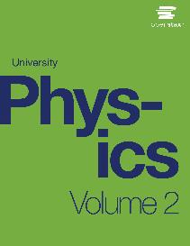

University Physics
Chapter 3 THE FIRST LAW OF THERMODYNAMICS
PowerPoint Image Slideshow

Slide 2

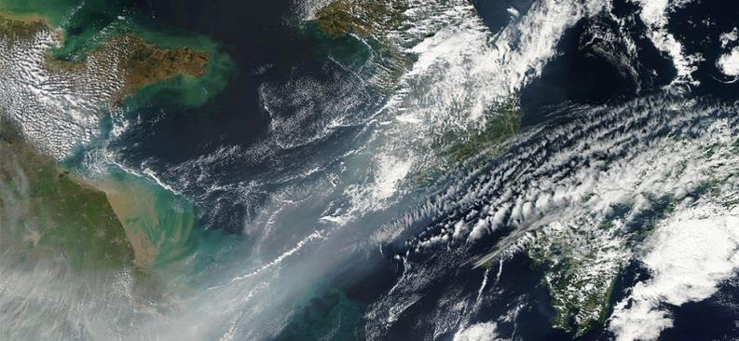
Figure 3.1
A weak cold front of air pushes all the smog in northeastern China into a giant smog blanket over the Yellow Sea, as captured by NASA’s Terra satellite in 2012. To understand changes in weather and climate, such as the event shown here, you need a thorough knowledge of thermodynamics. (credit: modification of work by NASA)

Slide 3
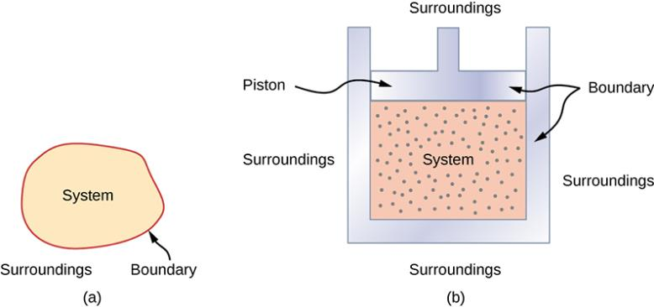
Figure 3.2
A system, which can include any relevant process or value, is self-contained in an area. The surroundings may also have relevant information; however, the surroundings are important to study only if the situation is an open system.
The burning gasoline in the cylinder of a car engine is an example of a thermodynamic system.

Slide 4
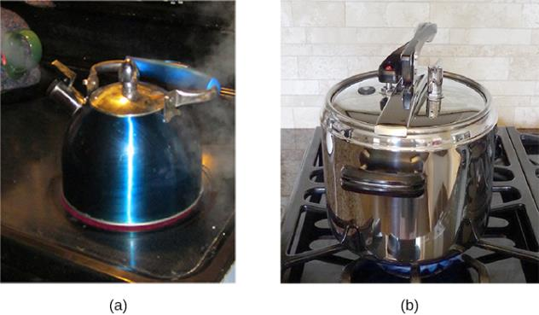
Figure 3.3
This boiling tea kettle is an open thermodynamic system. It transfers heat and matter (steam) to its surroundings.
A pressure cooker is a good approximation to a closed system. A little steam escapes through the top valve to prevent explosion. (credit a: modification of work by Gina Hamilton)

Slide 5
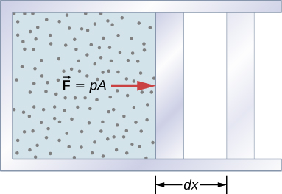
Figure 3.4
The work done by a confined gas in moving a piston a distance dx is given by dW = Fdx = pdV.

Slide 6
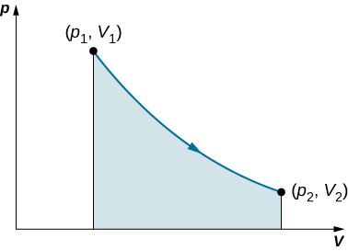
Figure 3.5
When a gas expands slowly from V₁ to V₂, the work done by the system is represented by the shaded area under the pV curve.

Slide 7
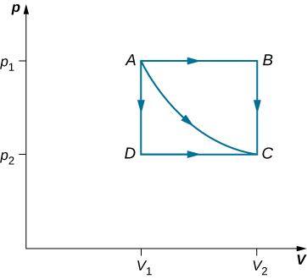
Figure 3.6
The paths ABC, AC, and ADC represent three different quasi-static transitions between the equilibrium states A and C.

Slide 8
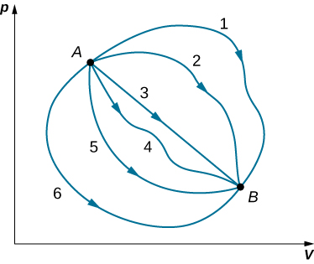
Figure 3.7
Different thermodynamic paths taken by a system in going from state A to state B. For all transitions, the change in the internal energy of the system ΔE_{int} = Q − W is the same.

Slide 9
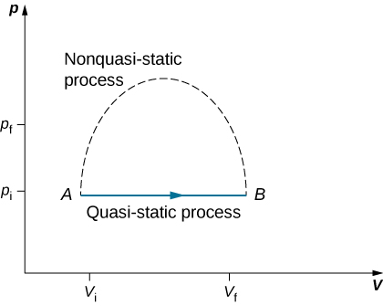
Figure 3.8
Quasi-static and non-quasi-static processes between states A and B of a gas. In a quasi-static process, the path of the process between A and B can be drawn in a state diagram since all the states that the system goes through are known. In a non-quasi-static process, the states between A and B are not known, and hence no path can be drawn. It may follow the dashed line as shown in the figure or take a very different path.

Slide 10
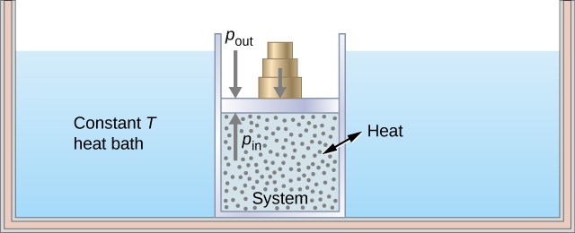
Figure 3.9
Expanding a system at a constant temperature. Removing weights on the piston leads to an imbalance of forces on the piston, which causes the piston to move up. As the piston moves up, the temperature is lowered momentarily, which causes heat to flow from the heat bath to the system. The energy to move the piston eventually comes from the heat bath.

Slide 11
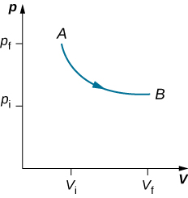
Figure 3.10
An isothermal expansion from a state labeled A to another state labeled B on a pV diagram. The curve represents the relation between pressure and volume in an ideal gas at constant temperature.

Slide 12
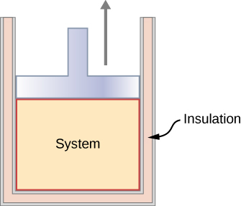
Figure 3.11
An insulated piston with a hot, compressed gas is released. The piston moves up, the volume expands, and the pressure and temperature decrease. The internal energy goes into work. If the expansion occurs within a time frame in which negligible heat can enter the system, then the process is called adiabatic. Ideally, during an adiabatic process no heat enters or exits the system.

Slide 13
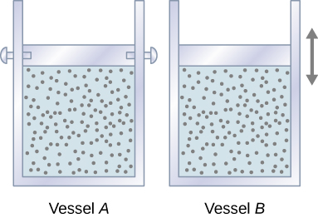
Figure 3.12
Two vessels are identical except that the piston at the top of A is fixed, whereas that atop B is free to move against a constant external pressure p.

Slide 14
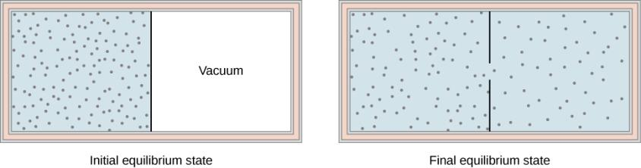
Figure 3.13
The gas in the left chamber expands freely into the right chamber when the membrane is punctured.

Slide 15
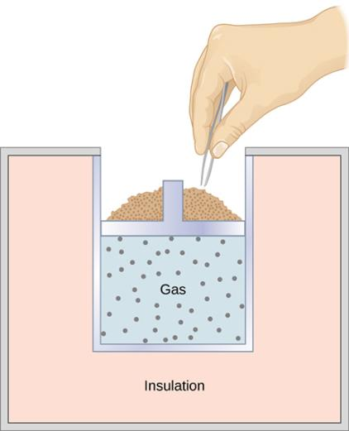
Figure 3.14
When sand is removed from the piston one grain at a time, the gas expands adiabatically and quasi-statically in the insulated vessel.

Slide 16
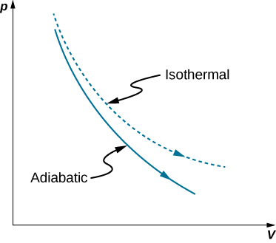
Figure 3.15
Quasi-static adiabatic and isothermal expansions of an ideal gas.

Slide 17
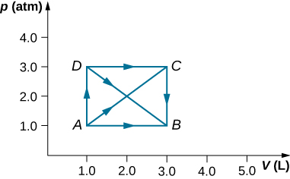
Exercise 28

Slide 18
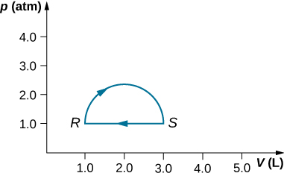
Exercise 29

Slide 19
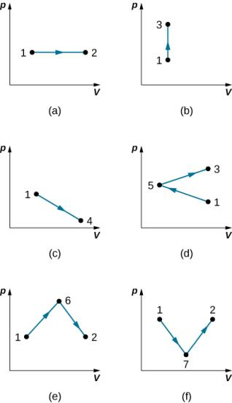
Exercise 37

Slide 20
Exercise 41

Slide 21
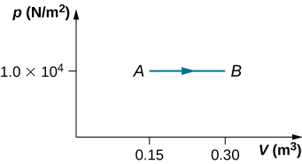
Exercise 42

Slide 22
Exercise 43

Slide 23
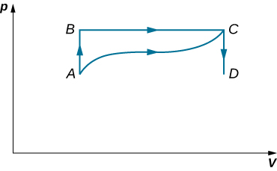
Exercise 44

Slide 24
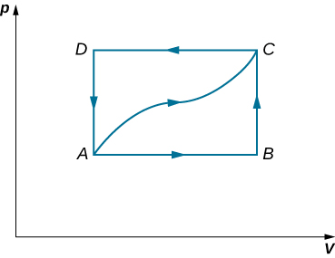
Exercise 45

Slide 25

Exercise 46

Slide 26
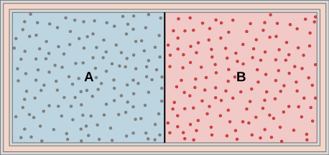
Exercise 47

Slide 27
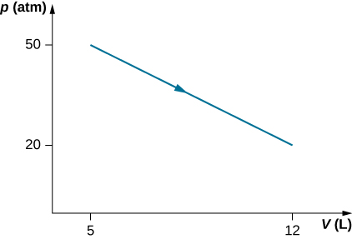
Exercise 49

Slide 28
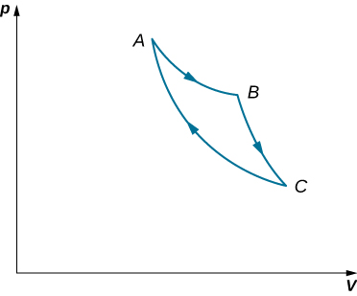
Exercise 57

Slide 29
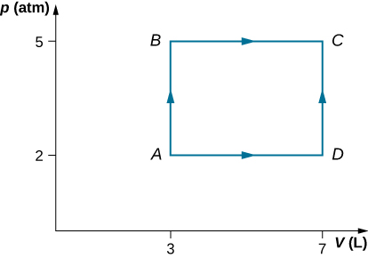
Exercise 58

Slide 30
Exercise 79

Slide 31
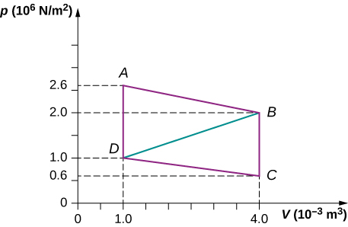
Exercise 84

Slide 32
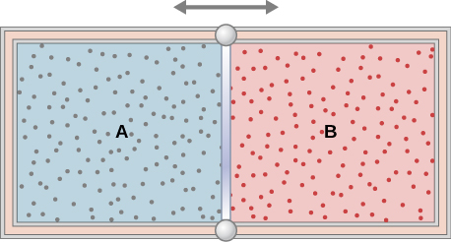
Exercise 97

Slide 33

This OpenStax ancillary resource is © Rice University under a CC-BY 4.0 International license; it may be reproduced or modified but must be attributed to OpenStax, Rice University and any changes must be noted.

