Slide 1


University Physics
Chapter 4 THE SECOND LAW OF THERMODYNAMICS
PowerPoint Image Slideshow

Slide 2

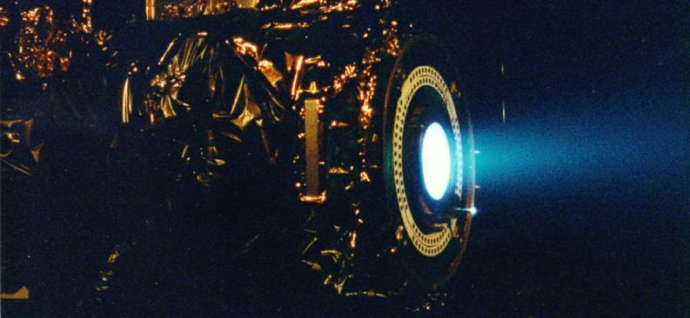
Figure 4.1
A xenon ion engine from the Jet Propulsion Laboratory shows the faint blue glow of charged atoms emitted from the engine. The ion propulsion engine is the first nonchemical propulsion to be used as the primary means of propelling a spacecraft.

Slide 3
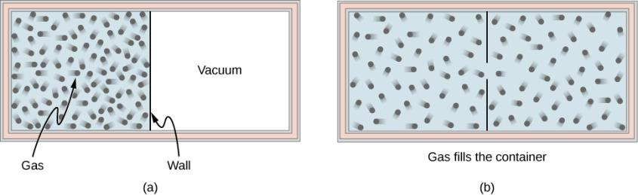
Figure 4.2
A gas expanding from half of a container to the entire container (a) before and (b) after the wall in the middle is removed.

Slide 4
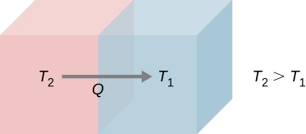
Figure 4.3
Spontaneous heat flow from an object at higher temperature T₂ to another at lower temperature T₁.

Slide 5
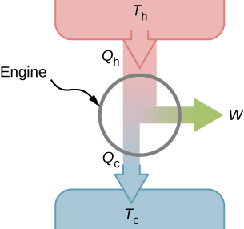
Figure 4.4
A schematic representation of a heat engine. Energy flows from the hot reservoir to the cold reservoir while doing work.

Slide 6
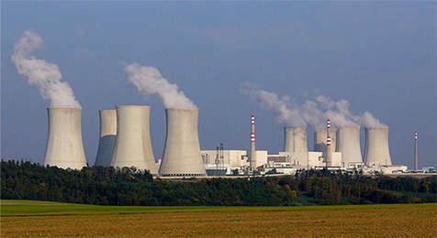
Figure 4.5
The heat exhausted from a nuclear power plant goes to the cooling towers, where it is released into the atmosphere.

Slide 7
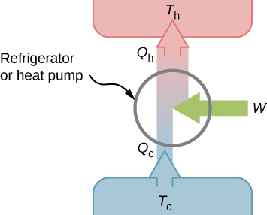
Figure 4.6
A schematic representation of a refrigerator (or a heat pump). The arrow next to work (W) indicates work being put into the system.

Slide 8
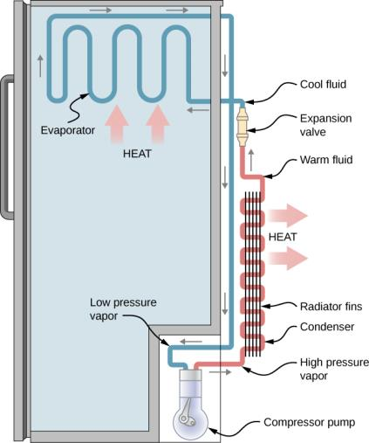
Figure 4.7
A schematic diagram of a household refrigerator. A coolant with a boiling temperature below the freezing point of water is sent through the cycle (clockwise in this diagram). The coolant extracts heat from the refrigerator at the evaporator, causing coolant to vaporize. It is then compressed and sent through the condenser, where it exhausts heat to the outside.

Slide 9
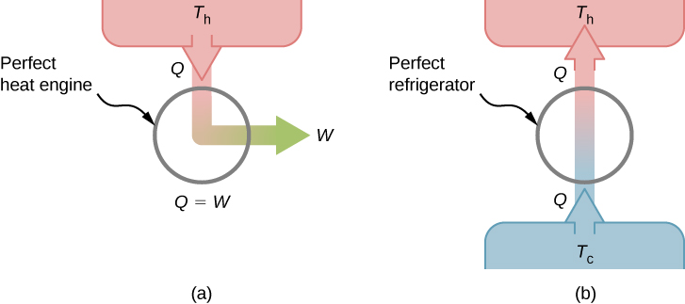
Figure 4.8
A “perfect heat engine” converts all input heat into work.
A “perfect refrigerator” transports heat from a cold reservoir to a hot reservoir without work input. Neither of these devices is achievable in reality.

Slide 10
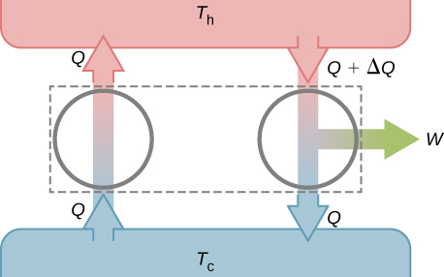
Figure 4.9
Combining a perfect refrigerator and a real heat engine yields a perfect heat engine because W = ΔQ.

Slide 11
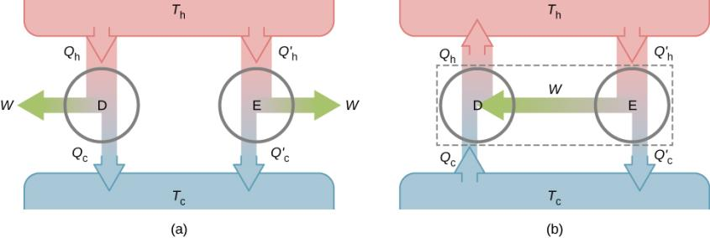
Figure 4.10
Two uncoupled engines D and E working between the same reservoirs.
The coupled engines, with D working in reverse.

Slide 12
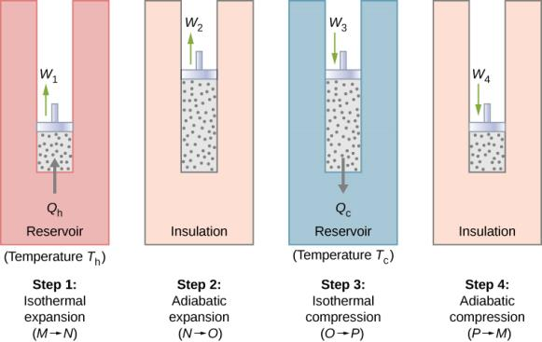
Figure 4.11
The four processes of the Carnot cycle. The working substance is assumed to be an ideal gas whose thermodynamic path MNOP is represented in Figure 4.12.

Slide 13
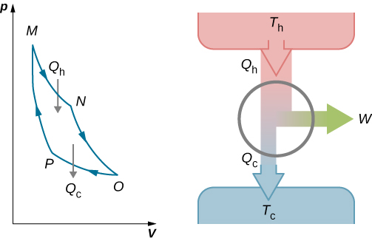
Figure 4.12
The total work done by the gas in the Carnot cycle is shown and given by the area enclosed by the loop MNOPM.

Slide 14
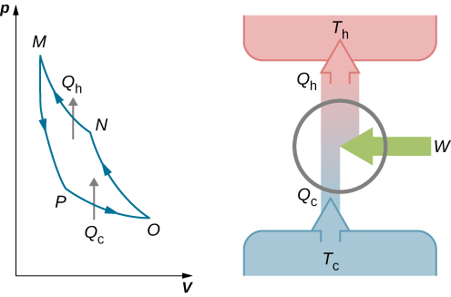
Figure 4.13
The work done on the gas in one cycle of the Carnot refrigerator is shown and given by the area enclosed by the loop MPONM.

Slide 15
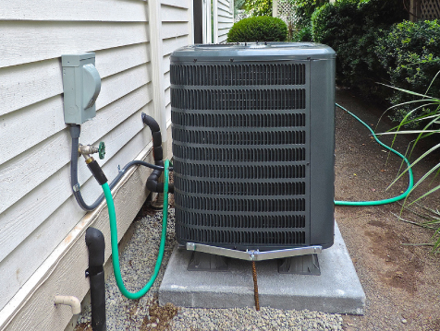
Figure 4.14
A photograph of a heat pump (large box) located outside a house. This heat pump is located in a warm climate area, like the southern United States, since it would be far too inefficient located in the northern half of the United States. (credit: modification of work by Peter Stevens)

Slide 16
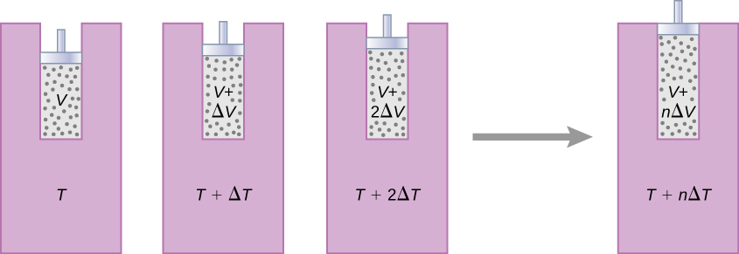
Figure 4.15
The gas expands at constant pressure as its temperature is increased in small steps through the use of a series of heat reservoirs.

Slide 17
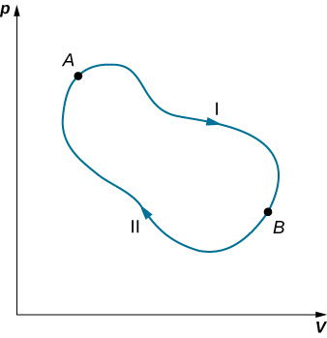
Figure 4.16
The closed loop passing through states A and B represents a reversible cycle.

Slide 18
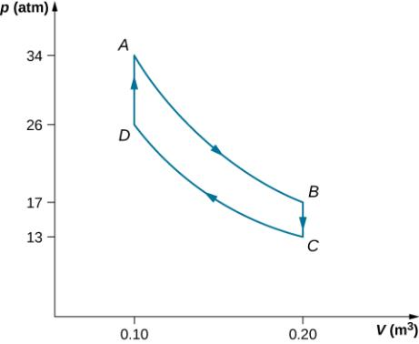
Example 4.6

Slide 19
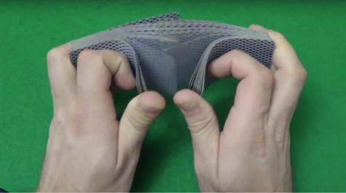
Figure 4.17
The entropy of a new deck of cards goes up after the dealer shuffles them. (credit: “Rommel SK”/YouTube)

Slide 20
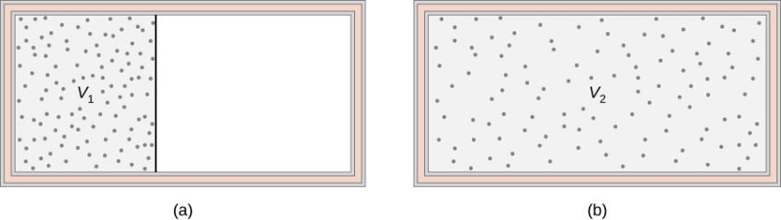
Figure 4.18
The adiabatic free expansion of an ideal gas from volume V₁ to volume V₂.

Slide 21
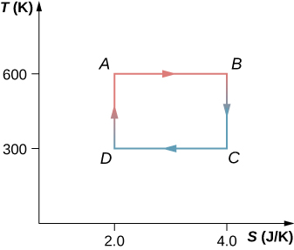
Exercise 61

Slide 22
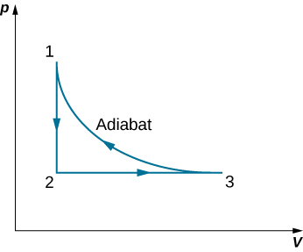
Exercise 63

Slide 23

Exercise 74

Slide 24
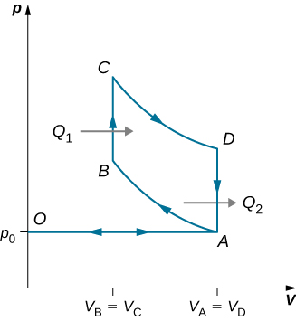
Exercise 88

Slide 25
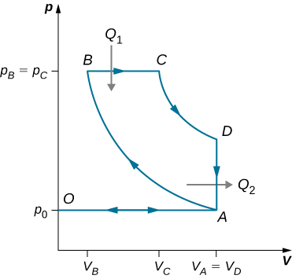
Exercise 89

Slide 26
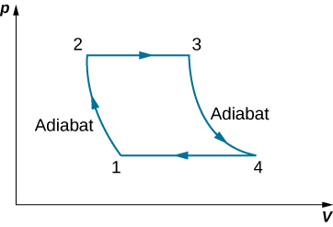
Exercise 90

Slide 27
Exercise 91

Slide 28

This OpenStax ancillary resource is © Rice University under a CC-BY 4.0 International license; it may be reproduced or modified but must be attributed to OpenStax, Rice University and any changes must be noted.

