Slide 1
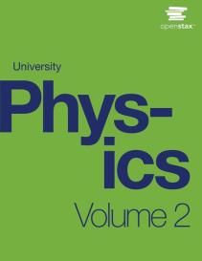

University Physics
Chapter 5 ELECTRIC CHARGES AND FIELDS
PowerPoint Image Slideshow

Slide 2

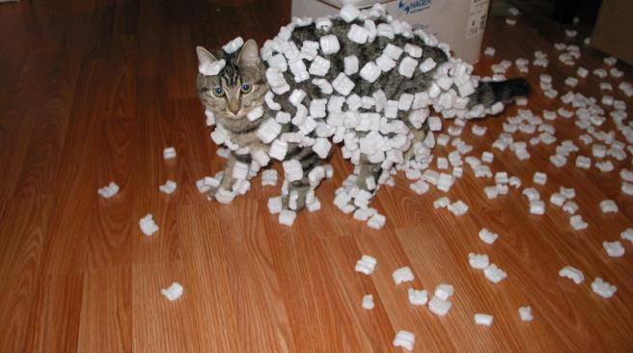
Figure 5.1
Electric charges exist all around us. They can cause objects to be repelled from each other or to be attracted to each other. (credit: modification of work by Sean McGrath)

Slide 3
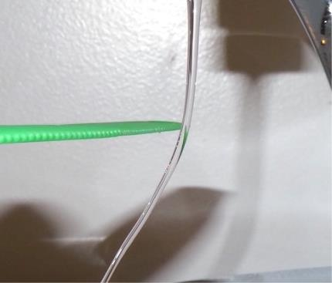
Figure 5.2
An electrically charged comb attracts a stream of water from a distance. Note that the water is not touching the comb. (credit: Jane Whitney)

Slide 4
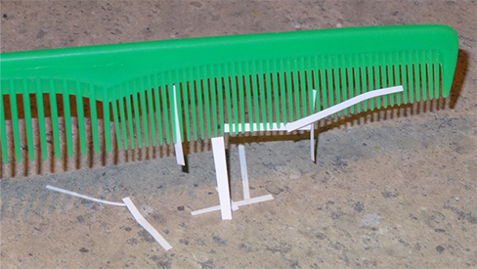
Figure 5.3
After being used to comb hair, this comb attracts small strips of paper from a distance, without physical contact. Investigation of this behavior helped lead to the concept of the electric force.

Slide 5
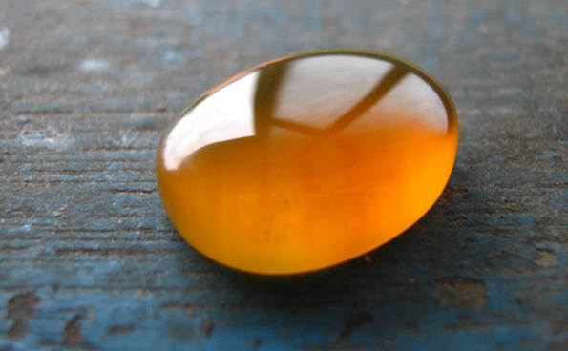
Figure 5.4
Borneo amber is mined in Sabah, Malaysia, from shale-sandstone-mudstone veins. When a piece of amber is rubbed with a piece of fur, the amber gains more electrons, giving it a net negative charge. At the same time, the fur, having lost electrons, becomes positively charged. (credit: “Sebakoamber”/Wikimedia Commons)

Slide 6
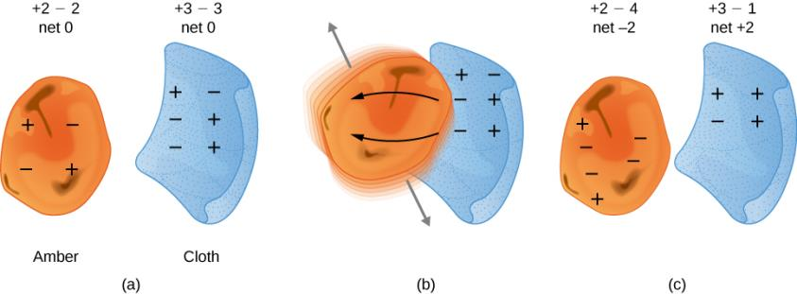
Figure 5.5
When materials are rubbed together, charges can be separated, particularly if one material has a greater affinity for electrons than another.
Both the amber and cloth are originally neutral, with equal positive and negative charges. Only a tiny fraction of the charges are involved, and only a few of them are shown here.
When rubbed together, some negative charge is transferred to the amber, leaving the cloth with a net positive charge.
When separated, the amber and cloth now have net charges, but the absolute value of the net positive and negative charges will be equal.

Slide 7
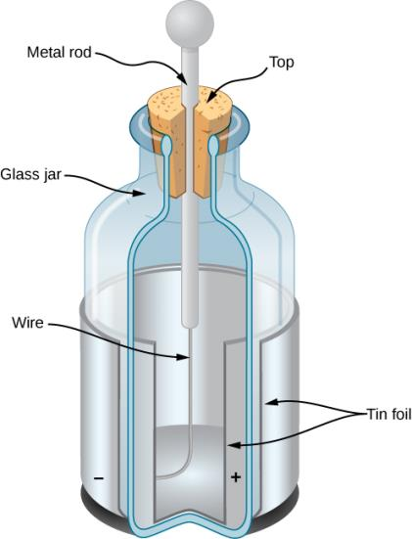
Figure 5.6
A Leyden jar (an early version of what is now called a capacitor) allowed experimenters to store large amounts of electric charge. Benjamin Franklin used such a jar to demonstrate that lightning behaved exactly like the electricity he got from the equipment in his laboratory.

Slide 8
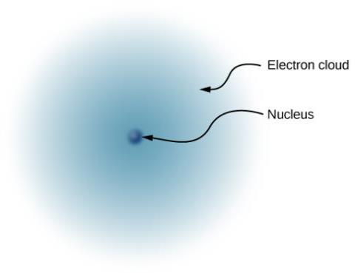
Figure 5.7
This simplified model of a hydrogen atom shows a positively charged nucleus (consisting, in the case of hydrogen, of a single proton), surrounded by an electron “cloud.” The charge of the electron cloud is equal (and opposite in sign) to the charge of the nucleus, but the electron does not have a definite location in space; hence, its representation here is as a cloud. Normal macroscopic amounts of matter contain immense numbers of atoms and molecules, and, hence, even greater numbers of individual negative and positive charges.

Slide 9
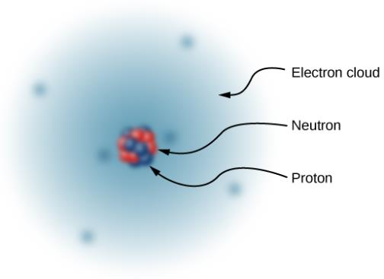
Figure 5.8
The nucleus of a carbon atom is composed of six protons and six neutrons. As in hydrogen, the surrounding six electrons do not have definite locations and so can be considered to be a sort of cloud surrounding the nucleus.

Slide 10
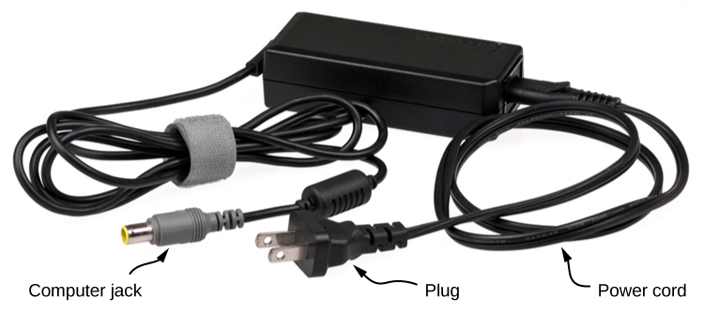
Figure 5.9
This power adapter uses metal wires and connectors to conduct electricity from the wall socket to a laptop computer. The conducting wires allow electrons to move freely through the cables, which are shielded by rubber and plastic. These materials act as insulators that don’t allow electric charge to escape outward. (credit: modification of work by “Evan-Amos”/Wikimedia Commons)

Slide 11
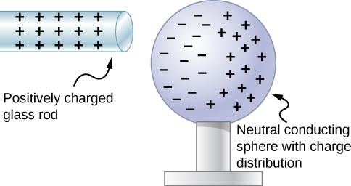
Figure 5.10
Induced polarization. A positively charged glass rod is brought near the left side of the conducting sphere, attracting negative charge and leaving the other side of the sphere positively charged. Although the sphere is overall still electrically neutral, it now has a charge distribution, so it can exert an electric force on other nearby charges. Furthermore, the distribution is such that it will be attracted to the glass rod.

Slide 12
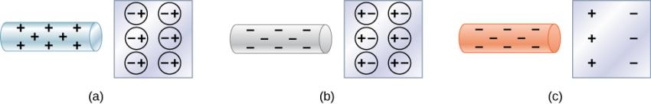
Figure 5.11
Both positive and negative objects attract a neutral object by polarizing its molecules.
A positive object brought near a neutral insulator polarizes its molecules. There is a slight shift in the distribution of the electrons orbiting the molecule, with unlike charges being brought nearer and like charges moved away. Since the electrostatic force decreases with distance, there is a net attraction.
A negative object produces the opposite polarization, but again attracts the neutral object.
The same effect occurs for a conductor; since the unlike charges are closer, there is a net attraction.

Slide 13
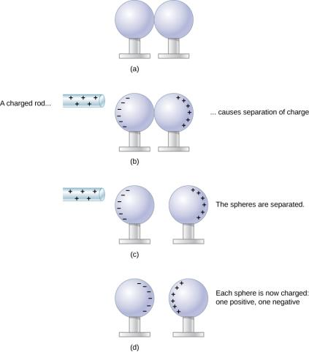
Figure 5.12
Charging by induction.
Two uncharged or neutral metal spheres are in contact with each other but insulated from the rest of the world.
A positively charged glass rod is brought near the sphere on the left, attracting negative charge and leaving the other sphere positively charged.
The spheres are separated before the rod is removed, thus separating negative and positive charges.
The spheres retain net charges after the inducing rod is removed—without ever having been touched by a charged object.

Slide 14
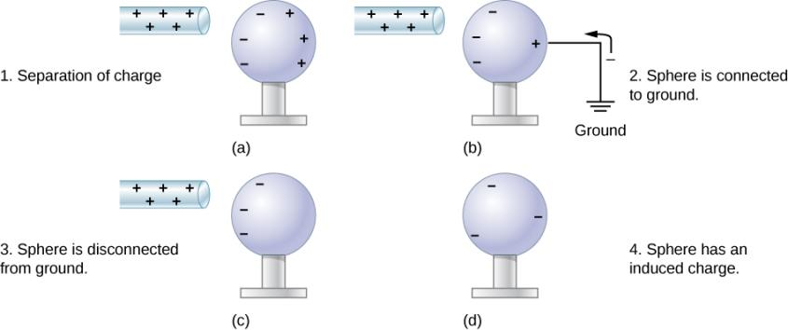
Figure 5.13
Charging by induction using a ground connection.
A positively charged rod is brought near a neutral metal sphere, polarizing it.
The sphere is grounded, allowing electrons to be attracted from Earth’s ample supply.
The ground connection is broken.
The positive rod is removed, leaving the sphere with an induced negative charge.

Slide 15
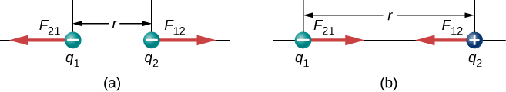
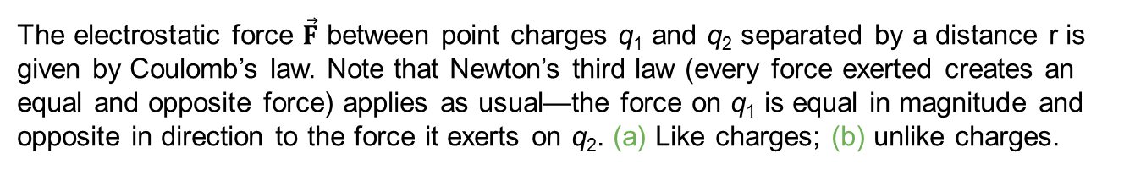
Figure 5.14
The electrostatic force $\vec{F}$ between point charges q₁ and q₂ separated by a distance r is given by Coulomb’s law. Note that Newton’s third law (every force exerted creates an equal and opposite force) applies as usual—the force on q₁ is equal in magnitude and opposite in direction to the force it exerts on q₂. (a) Like charges; (b) unlike charges.

Slide 16
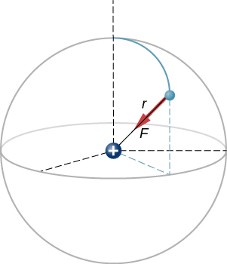
Figure 5.15
A schematic depiction of a hydrogen atom, showing the force on the electron. This depiction is only to enable us to calculate the force; the hydrogen atom does not really look like this. Recall Figure 5.7.

Slide 17
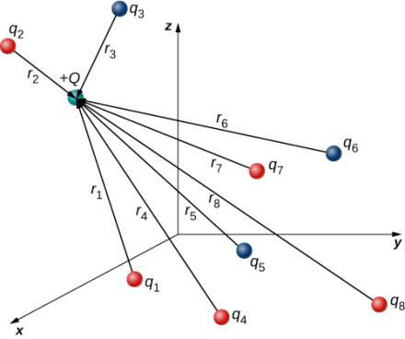
Figure 5.16
The eight source charges each apply a force on the single test charge Q. Each force can be calculated independently of the other seven forces. This is the essence of the superposition principle.

Slide 18
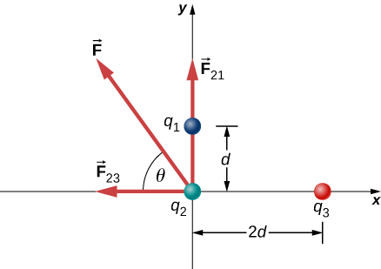
Figure 5.17
Source charges q₁ and q₃ each apply a force on q₂.

Slide 19
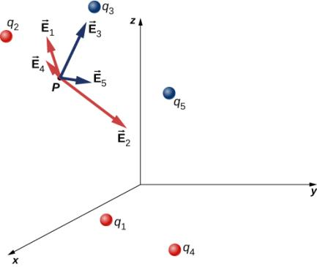
Figure 5.18
Each of these eight source charges creates its own electric field at every point in space; shown here are the field vectors at an arbitrary point P. Like the electric force, the net electric field obeys the superposition principle.

Slide 20
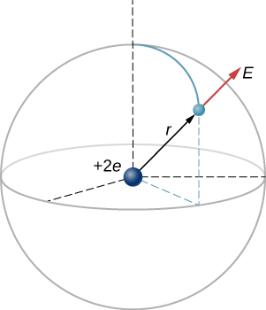
Figure 5.19
A schematic representation of a helium atom. Again, helium physically looks nothing like this, but this sort of diagram is helpful for calculating the electric field of the nucleus.

Slide 21
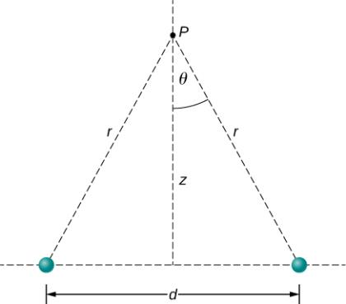
Figure 5.20
Finding the field of two identical source charges at the point P. Due to the symmetry, the net field at P is entirely vertical. (Notice that this is not true away from the midline between the charges.)

Slide 22
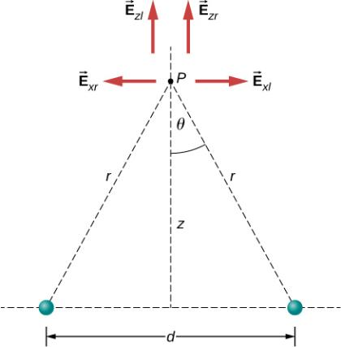
Figure 5.21
Note that the horizontal components of the electric fields from the two charges cancel each other out, while the vertical components add together.

Slide 23
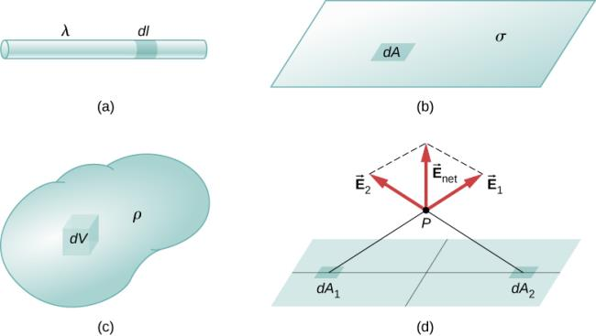
Figure 5.22
The configuration of charge differential elements for a (a) line charge, (b) sheet of charge, and (c) a volume of charge. Also note that (d) some of the components of the total electric field cancel out, with the remainder resulting in a net electric field.

Slide 24
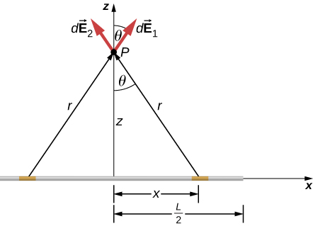
Figure 5.23
A uniformly charged segment of wire. The electric field at point P can be found by applying the superposition principle to symmetrically placed charge elements and integrating.

Slide 25
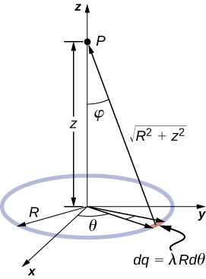
Figure 5.24
The system and variable for calculating the electric field due to a ring of charge.

Slide 26
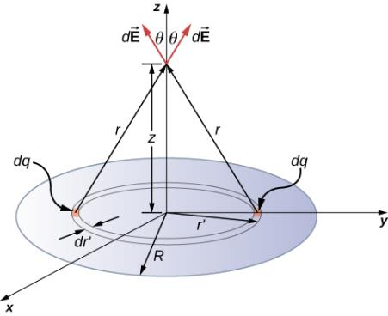
Figure 5.25
A uniformly charged disk. As in the line charge example, the field above the center of this disk can be calculated by taking advantage of the symmetry of the charge distribution.

Slide 27
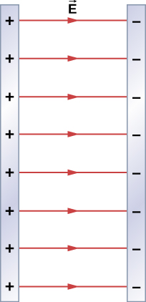
Figure 5.26
Two charged infinite planes. Note the direction of the electric field.

Slide 28
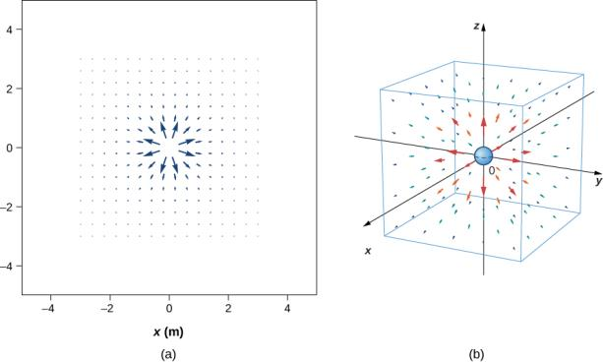
Figure 5.27
The electric field of a positive point charge. A large number of field vectors are shown. Like all vector arrows, the length of each vector is proportional to the magnitude of the field at each point. (a) Field in two dimensions; (b) field in three dimensions.

Slide 29
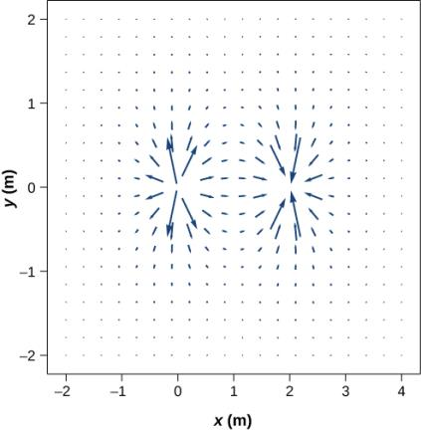
Figure 5.28
The vector field of a dipole. Even with just two identical charges, the vector field diagram becomes difficult to understand.

Slide 30
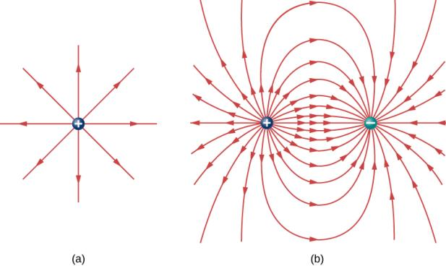
Figure 5.29
The electric field line diagram of a positive point charge.
The field line diagram of a dipole. In both diagrams, the magnitude of the field is indicated by the field line density. The field vectors (not shown here) are everywhere tangent to the field lines.

Slide 31
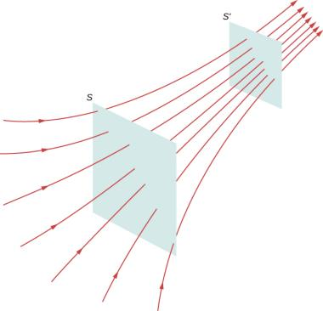
Figure 5.30
Electric field lines passing through imaginary areas. Since the number of lines passing through each area is the same, but the areas themselves are different, the field line density is different. This indicates different magnitudes of the electric field at these points.

Slide 32
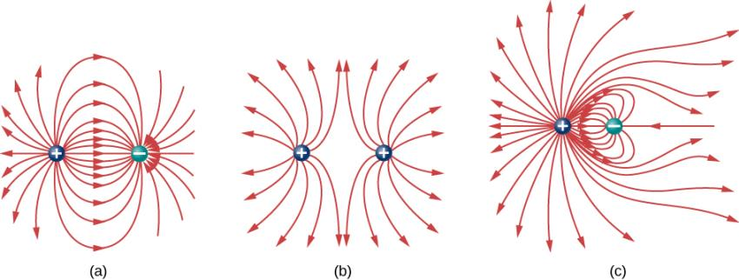
Figure 5.31
Three typical electric field diagrams.
A dipole.
Two identical charges.
Two charges with opposite signs and different magnitudes. Can you tell from the diagram which charge has the larger magnitude?

Slide 33
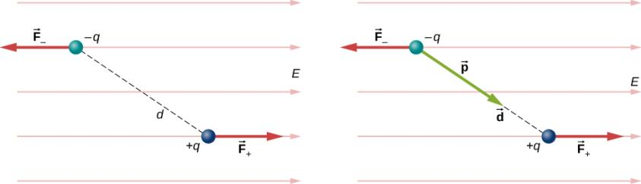
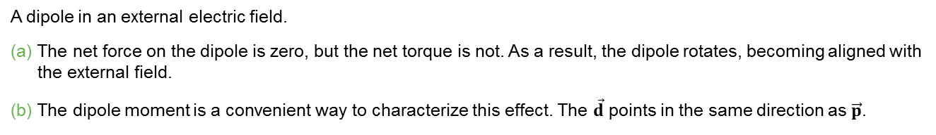
Figure 5.32
A dipole in an external electric field.
The net force on the dipole is zero, but the net torque is not. As a result, the dipole rotates, becoming aligned with the external field.
The dipole moment is a convenient way to characterize this effect. The $\vec{d}$ points in the same direction as $\vec{p}$.

Slide 34
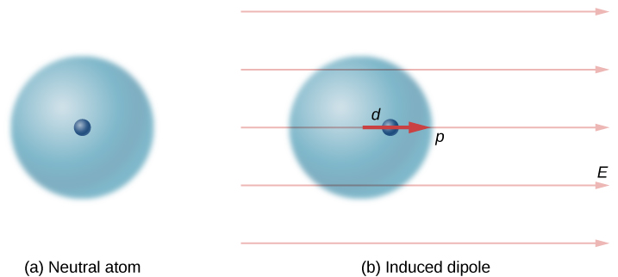
Figure 5.33
A dipole is induced in a neutral atom by an external electric field. The induced dipole moment is aligned with the external field.

Slide 35
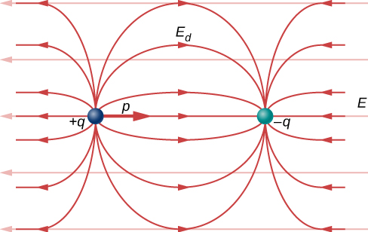
Figure 5.34
The net electric field is the vector sum of the field of the dipole plus the external field.

Slide 36
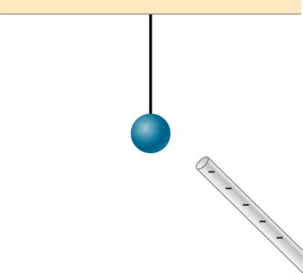
Exercise 9

Slide 37
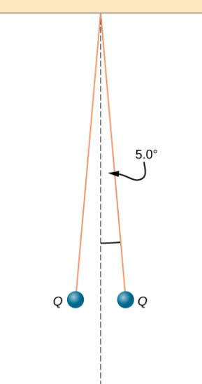
Exercise 55

Slide 38

Exercise 59

Slide 39
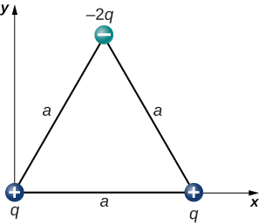
Exercise 60

Slide 40
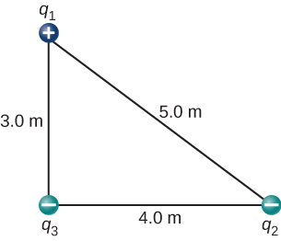
Exercise 62

Slide 41
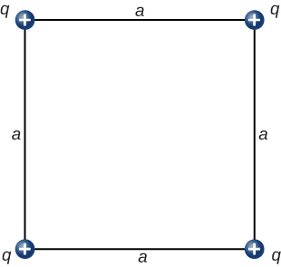
Exercise 63

Slide 42
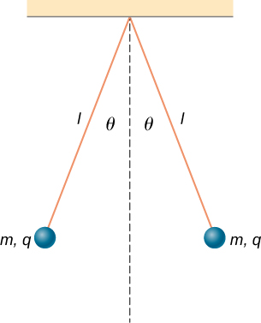
Exercise 68

Slide 43

Exercise 83

Slide 44
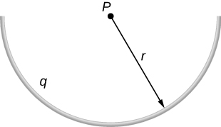
Exercise 84

Slide 45
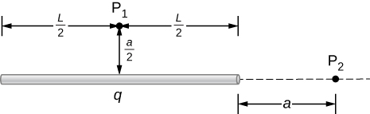
Exercise 87

Slide 46
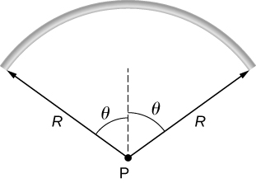
Exercise 90

Slide 47
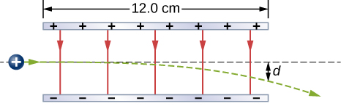
Exercise 94

Slide 48
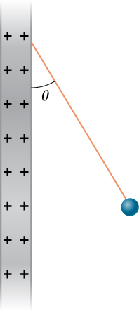
Exercise 95

Slide 49
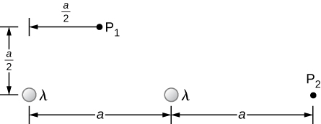
Exercise 96

Slide 50
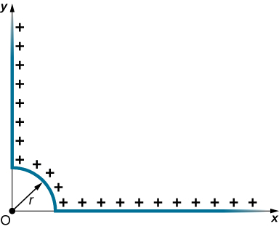
Exercise 97

Slide 51

Exercise 98

Slide 52

Exercise 100

Slide 53

Exercise 103

Slide 54

Exercise 105

Slide 55

Exercise 107

Slide 56

Exercise 109

Slide 57

Exercise 110

Slide 58

Exercise 111

Slide 59

Exercise 112

Slide 60

Exercise 114

Slide 61

Exercise 115

Slide 62

Exercise 116

Slide 63

Exercise 117

Slide 64

Exercise 118

Slide 65

Exercise 122

Slide 66

Exercise 124

Slide 67

Exercise 125

Slide 68

Exercise 126

Slide 69

This OpenStax ancillary resource is © Rice University under a CC-BY 4.0 International license; it may be reproduced or modified but must be attributed to OpenStax, Rice University and any changes must be noted.

