Slide 1


University Physics
Chapter 6 GAUSS’S LAW
PowerPoint Image Slideshow

Slide 2


Figure 6.1
This chapter introduces the concept of flux, which relates a physical quantity and the area through which it is flowing. Although we introduce this concept with the electric field, the concept may be used for many other quantities, such as fluid flow. (credit: modification of work by “Alessandro”/Flickr)

Slide 3
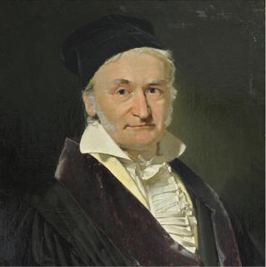
Figure 6.2
Karl Friedrich Gauss (1777–1855) was a legendary mathematician of the nineteenth century. Although his major contributions were to the field of mathematics, he also did important work in physics and astronomy.

Slide 4
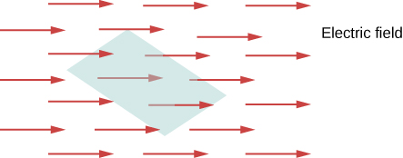
Figure 6.3
The flux of an electric field through the shaded area captures information about the “number” of electric field lines passing through the area. The numerical value of the electric flux depends on the magnitudes of the electric field and the area, as well as the relative orientation of the area with respect to the direction of the electric field.

Slide 5
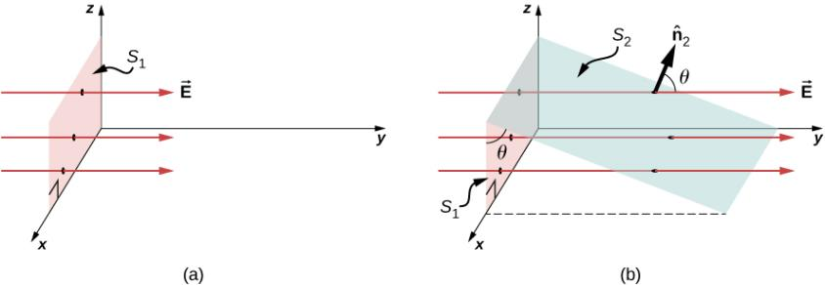
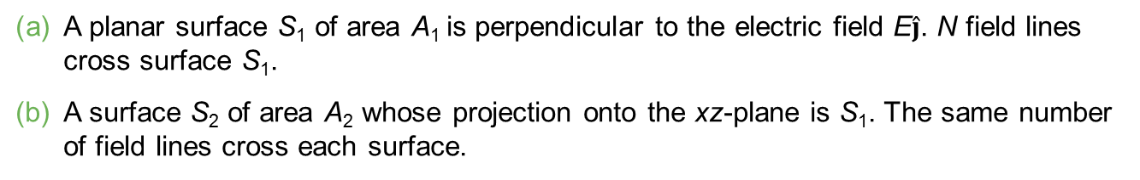
Figure 6.4
A planar surface S₁ of area A₁ is perpendicular to the electric field E$\hat{j}$. N field lines cross surface S₁.
A surface S₂ of area A₂ whose projection onto the xz-plane is S₁. The same number of field lines cross each surface.

Slide 6
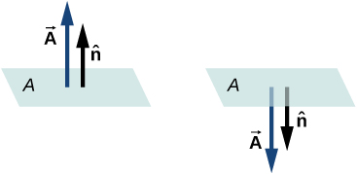
Figure 6.5
The direction of the area vector of an open surface needs to be chosen; it could be either of the two cases displayed here. The area vector of a part of a closed surface is defined to point from the inside of the closed space to the outside. This rule gives a unique direction.

Slide 7
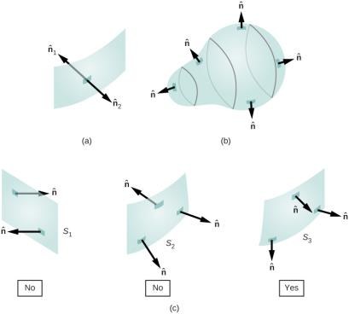
Figure 6.6
Two potential normal vectors arise at every point on a surface.
The outward normal is used to calculate the flux through a closed surface.
Only S₃ has been given a consistent set of normal vectors that allows us to define the flux through the surface.

Slide 8
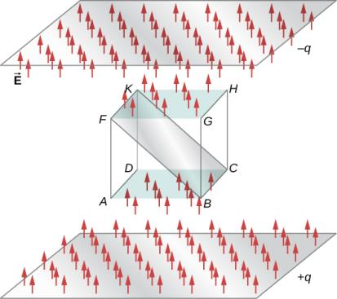
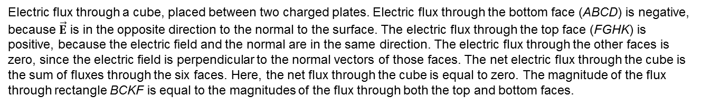
Figure 6.7
Electric flux through a cube, placed between two charged plates. Electric flux through the bottom face (ABCD) is negative, because $\vec{E}$ is in the opposite direction to the normal to the surface. The electric flux through the top face (FGHK) is positive, because the electric field and the normal are in the same direction. The electric flux through the other faces is zero, since the electric field is perpendicular to the normal vectors of those faces. The net electric flux through the cube is the sum of fluxes through the six faces. Here, the net flux through the cube is equal to zero. The magnitude of the flux through rectangle BCKF is equal to the magnitudes of the flux through both the top and bottom faces.

Slide 9
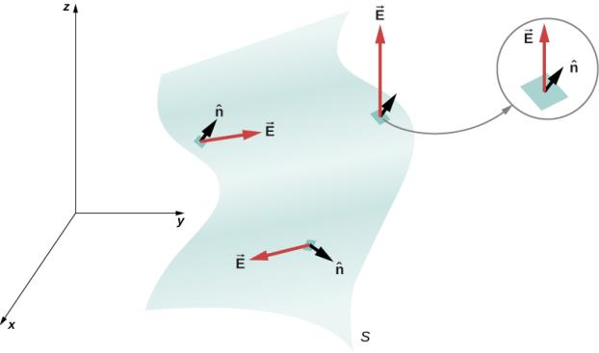
Figure 6.8
A surface is divided into patches to find the flux.

Slide 10
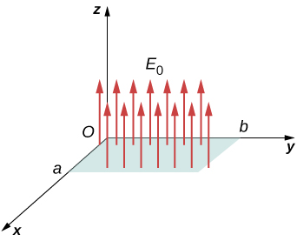
Figure 6.9
Calculating the flux of E₀ through a rectangular surface.

Slide 11
Figure 6.10
Calculating the flux of E₀ through a closed cubic surface.

Slide 12
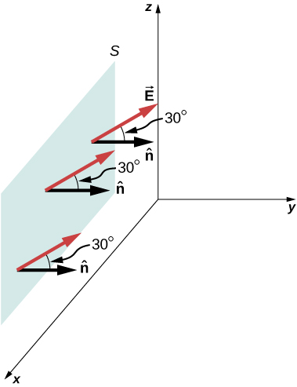
Figure 6.11
The electric field produces a net electric flux through the surface S.

Slide 13
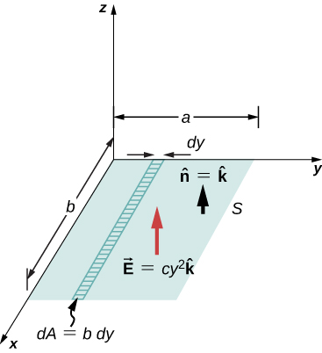
Figure 6.12
Since the electric field is not constant over the surface, an integration is necessary to determine the flux.

Slide 14
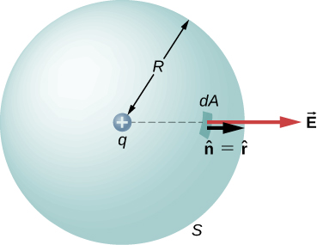
Figure 6.13
A closed spherical surface surrounding a point charge q.

Slide 15
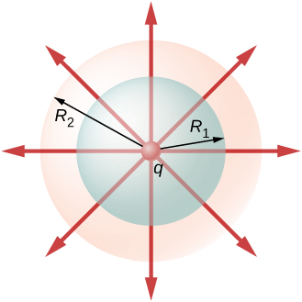
Figure 6.14
Flux through spherical surfaces of radii R₁ and R₂ enclosing a charge q are equal, independent of the size of the surface, since all E-field lines that pierce one surface from the inside to outside direction also pierce the other surface in the same direction.

Slide 16
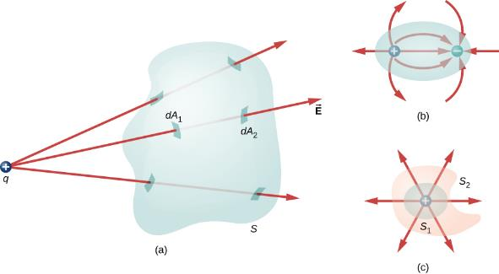
Figure 6.15
Understanding the flux in terms of field lines.
The electric flux through a closed surface due to a charge outside that surface is zero.
Charges are enclosed, but because the net charge included is zero, the net flux through the closed surface is also zero.
The shape and size of the surfaces that enclose a charge does not matter because all surfaces enclosing the same charge have the same flux.

Slide 17
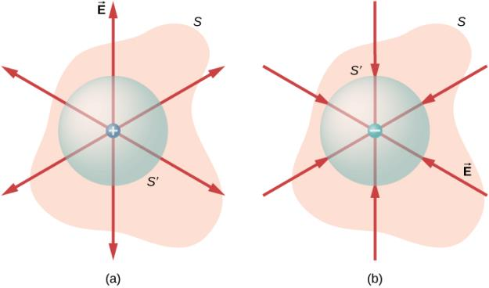
Figure 6.16
The electric flux through any closed surface surrounding a point charge q is given by Gauss’s law.
Enclosed charge is positive.
Enclosed charge is negative.

Slide 18
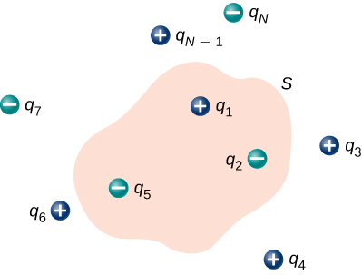
Figure 6.17
The flux through the Gaussian surface shown, due to the charge distribution, is Φ = (q1 – q2 – q5)/ε₀.

Slide 19

Figure 6.18
A Klein bottle partially filled with a liquid. Could the Klein bottle be used as a Gaussian surface?

Slide 20
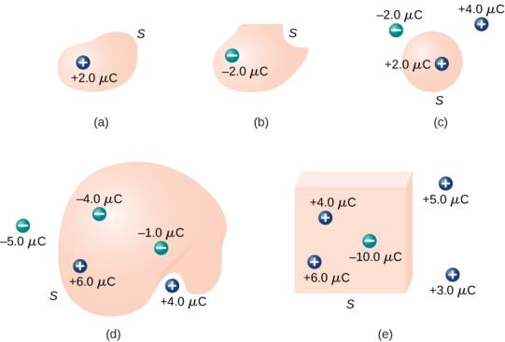
Figure 6.19
Various Gaussian surfaces and charges.

Slide 21
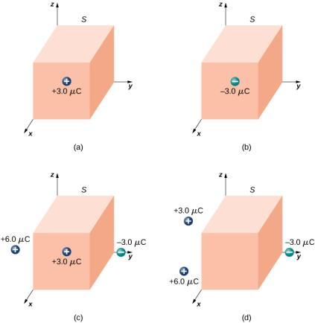
Figure 6.20
A cubical Gaussian surface with various charge distributions.

Slide 22
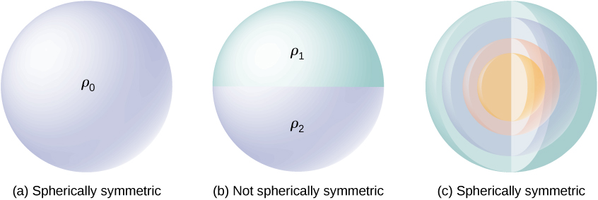
Figure 6.21
Illustrations of spherically symmetrical and nonsymmetrical systems. Different shadings indicate different charge densities. Charges on spherically shaped objects do not necessarily mean the charges are distributed with spherical symmetry. The spherical symmetry occurs only when the charge density does not depend on the direction. In (a), charges are distributed uniformly in a sphere. In (b), the upper half of the sphere has a different charge density from the lower half; therefore, (b) does not have spherical symmetry. In (c), the charges are in spherical shells of different charge densities, which means that charge density is only a function of the radial distance from the center; therefore, the system has spherical symmetry.

Slide 23
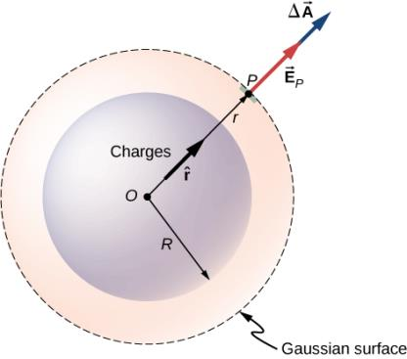
Figure 6.22
The electric field at any point of the spherical Gaussian surface for a spherically symmetrical charge distribution is parallel to the area element vector at that point, giving flux as the product of the magnitude of electric field and the value of the area. Note that the radius R of the charge distribution and the radius r of the Gaussian surface are different quantities.

Slide 24
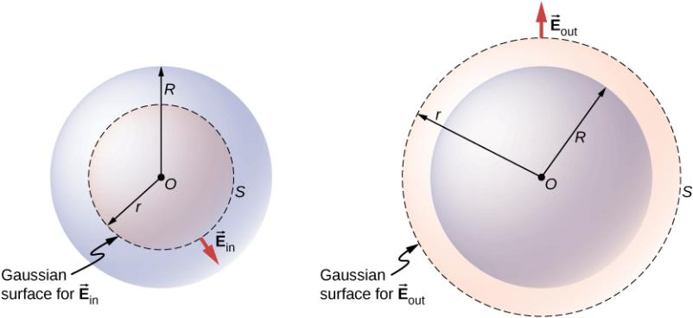
Figure 6.23
A spherically symmetrical charge distribution and the Gaussian surface used for finding the field (a) inside and (b) outside the distribution.

Slide 25
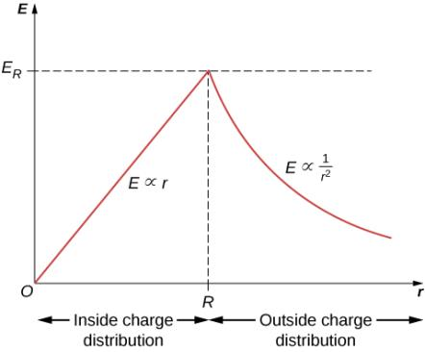
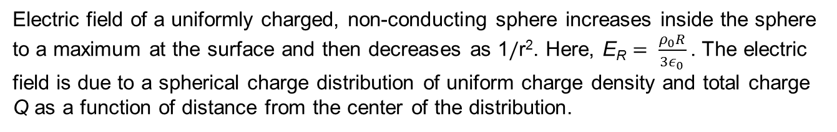
Figure 6.24
Electric field of a uniformly charged, non-conducting sphere increases inside the sphere to a maximum at the surface and then decreases as 1/r². Here, E_{R} $= \frac{ρ_{0}R}{{3ε}_{0}}$. The electric field is due to a spherical charge distribution of uniform charge density and total charge Q as a function of distance from the center of the distribution.

Slide 26
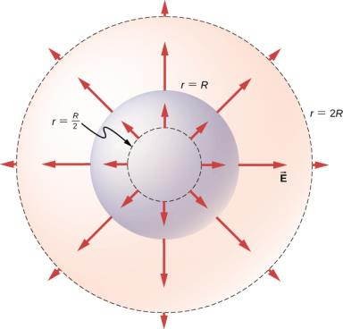
Figure 6.25
Electric field vectors inside and outside a uniformly charged sphere.

Slide 27
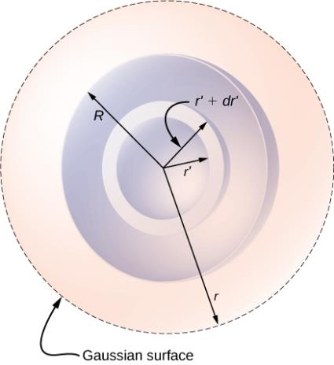
Figure 6.26
Spherical symmetry with non-uniform charge distribution. In this type of problem, we need four radii: R is the radius of the charge distribution, r is the radius of the Gaussian surface, r′ is the inner radius of the spherical shell, and r′ + dr′ is the outer radius of the spherical shell. The spherical shell is used to calculate the charge enclosed within the Gaussian surface. The range for r′ is from 0 to r for the field at a point inside the charge distribution and from 0 to R for the field at a point outside the charge distribution. If r > R, then the Gaussian surface encloses more volume than the charge distribution, but the additional volume does not contribute to q_{enc}.

Slide 28
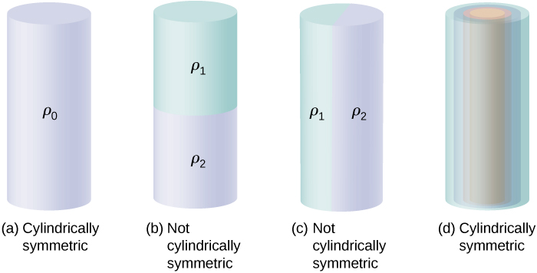
Figure 6.27
To determine whether a given charge distribution has cylindrical symmetry, look at the cross-section of an “infinitely long” cylinder. If the charge density does not depend on the polar angle of the cross-section or along the axis, then you have cylindrical symmetry. (a) Charge density is constant in the cylinder; (b) upper half of the cylinder has a different charge density from the lower half; (c) left half of the cylinder has a different charge density from the right half; (d) charges are constant in different cylindrical rings, but the density does not depend on the polar angle. Cases (a) and (d) have cylindrical symmetry, whereas (b) and (c) do not.

Slide 29
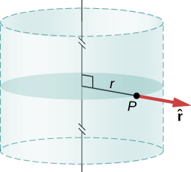
Figure 6.28
The electric field in a cylindrically symmetrical situation depends only on the distance from the axis. The direction of the electric field is pointed away from the axis for positive charges and toward the axis for negative charges.

Slide 30
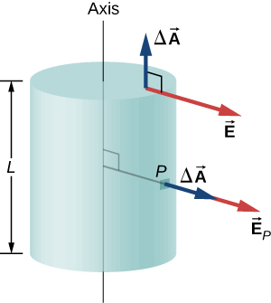
Figure 6.29
The Gaussian surface in the case of cylindrical symmetry. The electric field at a patch is either parallel or perpendicular to the normal to the patch of the Gaussian surface.

Slide 31
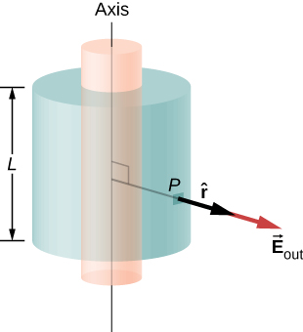
Figure 6.30
A Gaussian surface surrounding a cylindrical shell.

Slide 32
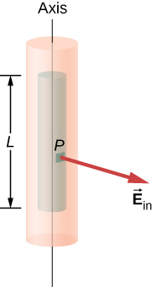
Figure 6.31
A Gaussian surface within a cylindrical shell.

Slide 33
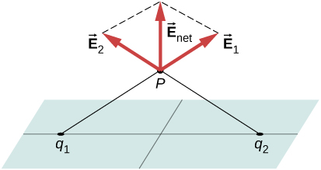
Figure 6.32
The components of the electric field parallel to a plane of charges cancel out the two charges located symmetrically from the field point P. Therefore, the field at any point is pointed vertically from the plane of charges. For any point P and charge q₁, we can always find a q₂ with this effect.

Slide 34
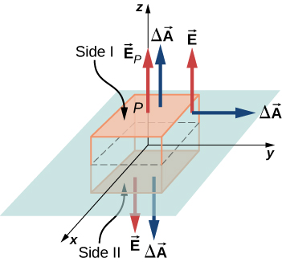
Figure 6.33
A thin charged sheet and the Gaussian box for finding the electric field at the field point P. The normal to each face of the box is from inside the box to outside. On two faces of the box, the electric fields are parallel to the area vectors, and on the other four faces, the electric fields are perpendicular to the area vectors.

Slide 35
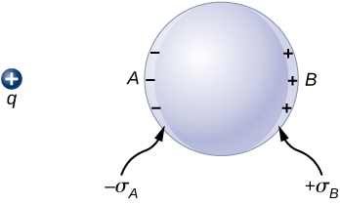
Figure 6.34
Polarization of a metallic sphere by an external point charge +q. The near side of the metal has an opposite surface charge compared to the far side of the metal. The sphere is said to be polarized. When you remove the external charge, the polarization of the metal also disappears.

Slide 36
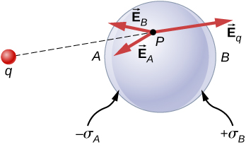
Figure 6.35
In the presence of an external charge q, the charges in a metal redistribute. The electric field at any point has three contributions, from +q and the induced charges −σ_{A} and +σ_{B}. Note that the surface charge distribution will not be uniform in this case.

Slide 37
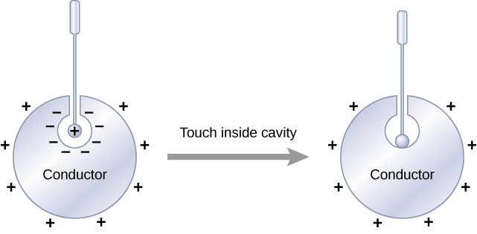
Figure 6.36
Electric charges on a conductor migrate to the outside surface no matter where you put them initially.

Slide 38
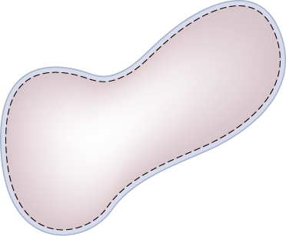
Figure 6.37
The dashed line represents a Gaussian surface that is just beneath the actual surface of the conductor.

Slide 39
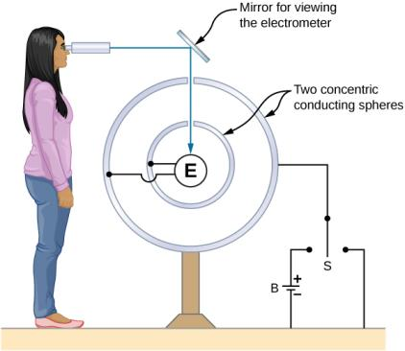
Figure 6.38
A representation of the apparatus used by Plimpton and Lawton. Any transfer of charge between the spheres is detected by the electrometer E.

Slide 40
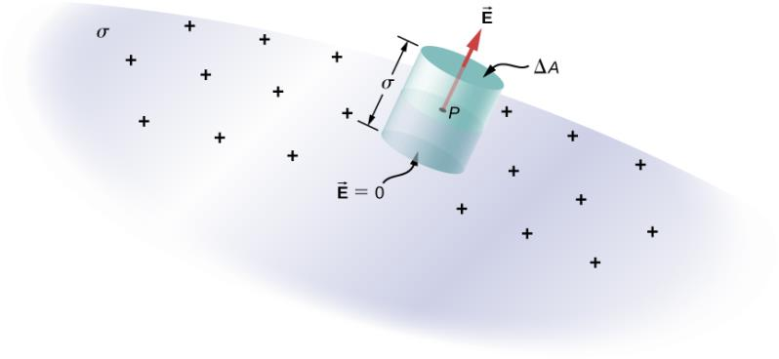
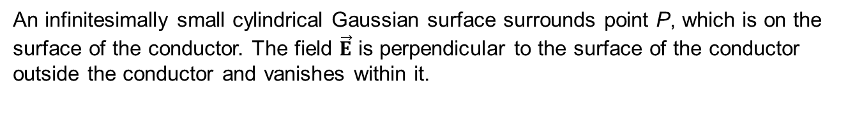
Figure 6.39
An infinitesimally small cylindrical Gaussian surface surrounds point P, which is on the surface of the conductor. The field $\vec{E}$ is perpendicular to the surface of the conductor outside the conductor and vanishes within it.

Slide 41
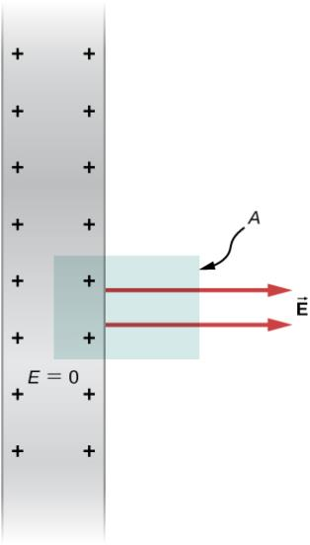
Figure 6.40
A side view of an infinite conducting plate and Gaussian cylinder with cross-sectional area A.

Slide 42
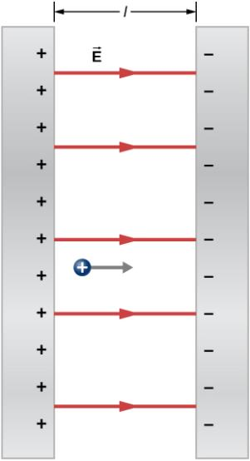
Figure 6.41
The electric field between oppositely charged parallel plates. A test charge is released at the positive plate.

Slide 43
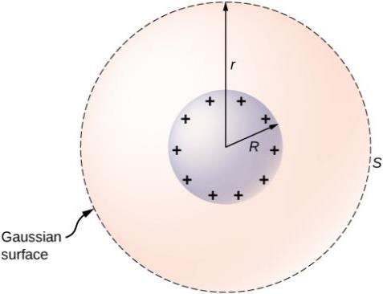
Figure 6.42
An isolated conducting sphere.

Slide 44
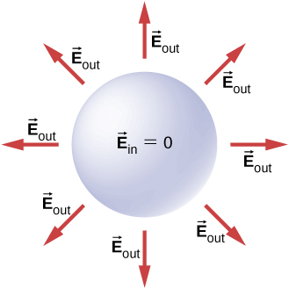
Figure 6.43
Electric field of a positively charged metal sphere. The electric field inside is zero, and the electric field outside is same as the electric field of a point charge at the center, although the charge on the metal sphere is at the surface.

Slide 45
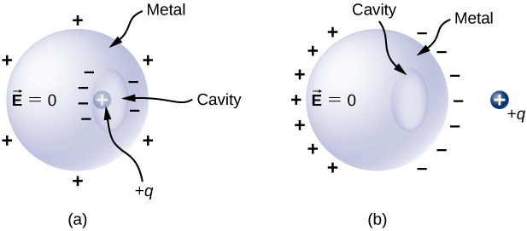
Figure 6.44
A charge inside a cavity in a metal. The distribution of charges at the outer surface does not depend on how the charges are distributed at the inner surface, since the E-field inside the body of the metal is zero. That magnitude of the charge on the outer surface does depend on the magnitude of the charge inside, however.
A charge outside a conductor containing an inner cavity. The cavity remains free of charge. The polarization of charges on the conductor happens at the surface.

Slide 46
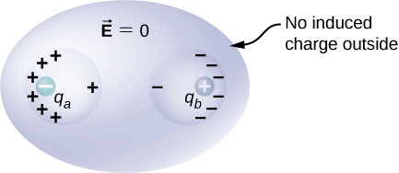
Figure 6.45
The charges induced by two equal and opposite charges in two separate cavities of a conductor. If the net charge on the cavity is nonzero, the external surface becomes charged to the amount of the net charge.

Slide 47
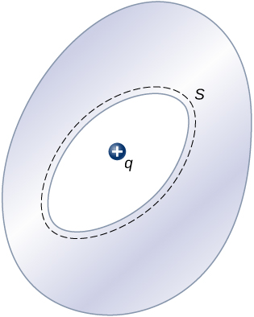
Exercise 18

Slide 48
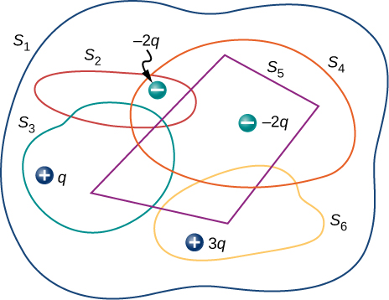
Exercise 30

Slide 49
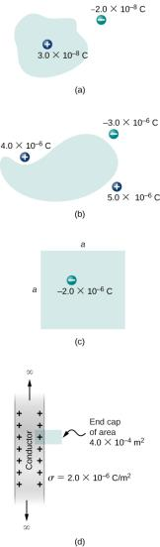
Exercise 31

Slide 50
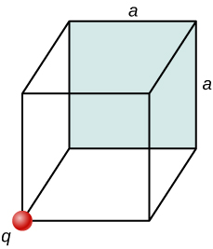
Exercise 35

Slide 51

Figure 6.46
A charge inside a cavity of a metal. Charges at the outer surface do not depend on how the charges are distributed at the inner surface since E field inside the body of the metal is zero.

Slide 52

Exercise 61

Slide 53

Exercise 62

Slide 54

Exercise 69

Slide 55

Exercise 72

Slide 56

Exercise 75

Slide 57

Exercise 77

Slide 58

Exercise 78

Slide 59

Exercise 82

Slide 60

Exercise 83

Slide 61

Exercise 84

Slide 62

Exercise 85

Slide 63

Exercise 86

Slide 64

Exercise 87

Slide 65

Exercise 88

Slide 66

Exercise 89

Slide 67

Exercise 93

Slide 68

Exercise 95

Slide 69

This OpenStax ancillary resource is © Rice University under a CC-BY 4.0 International license; it may be reproduced or modified but must be attributed to OpenStax, Rice University and any changes must be noted.

