Slide 1
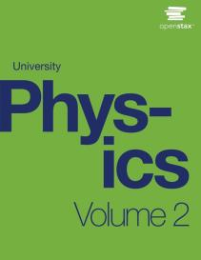

University Physics
Chapter 7 ELECTRIC POTENTIAL
PowerPoint Image Slideshow

Slide 2

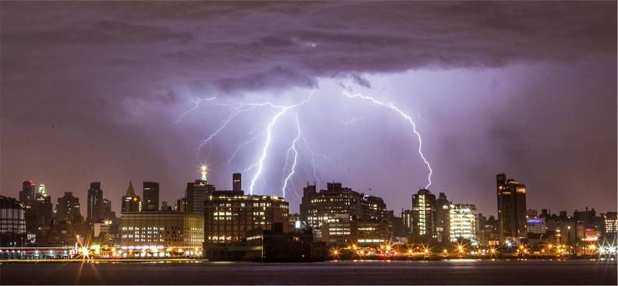
Figure 7.1
The energy released in a lightning strike is an excellent illustration of the vast quantities of energy that may be stored and released by an electric potential difference. In this chapter, we calculate just how much energy can be released in a lightning strike and how this varies with the height of the clouds from the ground. (credit: Anthony Quintano)

Slide 3
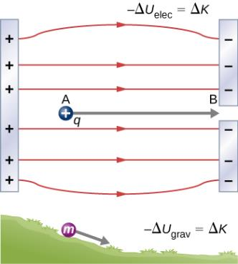
Figure 7.2
A charge accelerated by an electric field is analogous to a mass going down a hill. In both cases, potential energy decreases as kinetic energy increases, –ΔU = ΔK. Work is done by a force, but since this force is conservative, we can write W = –ΔU.

Slide 4

Figure 7.3
Displacement of “test” charge Q in the presence of fixed “source” charge q.

Slide 5

Figure 7.4
The charge Q is repelled by q, thus having work done on it and gaining kinetic energy.

Slide 6
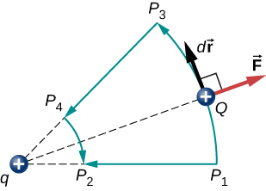
Figure 7.5
Two paths for displacement P₁ to P₂. The work on segments P₁P₃ and P₄P₂ are zero due to the electrical force being perpendicular to the displacement along these paths. Therefore, work on paths P₁P₂ and P₁P₃P₄P₂ are equal.

Slide 7

Figure 7.6
A closed path in an electric field. The net work around this path is zero.

Slide 8
Figure 7.7
The charge Q is repelled by q, thus having work done on it and losing potential energy.

Slide 9
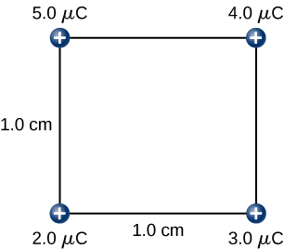
Figure 7.8
How much work is needed to assemble this charge configuration?

Slide 10
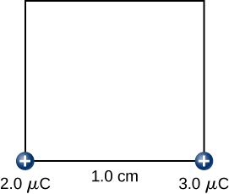

Figure 7.9
Step 2. Work W₂ to bring the +3.0–$μ$C charge from infinity.

Slide 11
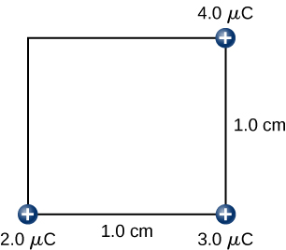

Figure 7.10
Step 3. Work W₃ to bring the +4.0–$μ$C charge from infinity.

Slide 12

Figure 7.11
Step 4. Work W₄ to bring the +5.0–$μ$C charge from infinity.

Slide 13
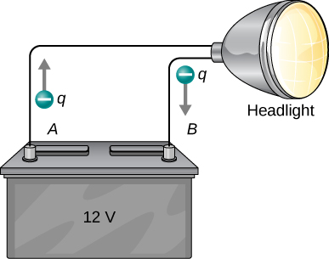
Figure 7.12
A battery moves negative charge from its negative terminal through a headlight to its positive terminal. Appropriate combinations of chemicals in the battery separate charges so that the negative terminal has an excess of negative charge, which is repelled by it and attracted to the excess positive charge on the other terminal. In terms of potential, the positive terminal is at a higher voltage than the negative terminal. Inside the battery, both positive and negative charges move.

Slide 14
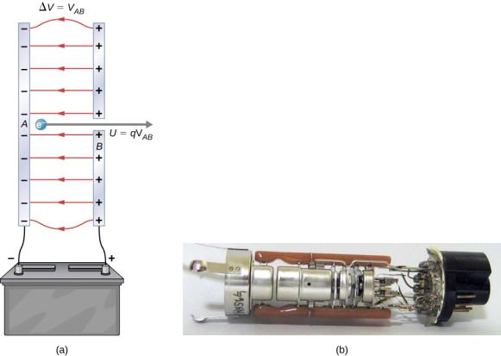
Figure 7.13
A typical electron gun accelerates electrons using a potential difference between two separated metal plates. By conservation of energy, the kinetic energy has to equal the change in potential energy, so KE = qV. The energy of the electron in electron-volts is numerically the same as the voltage between the plates. For example, a 5000-V potential difference produces 5000-eV electrons. The conceptual construct, namely two parallel plates with a hole in one, is shown in (a), while a real electron gun is shown in (b).

Slide 15
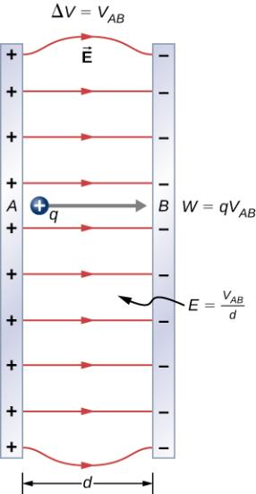
Figure 7.14
The relationship between V and E for parallel conducting plates is E = V/d. (Note that ΔV = V_{AB} in magnitude. For a charge that is moved from plate A at higher potential to plate B at lower potential, a minus sign needs to be included as follows: −ΔV = V_{A} − V_{B} = V_{AB}.)

Slide 16
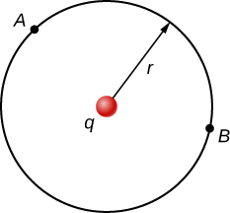
Figure 7.15
The arc for calculating the potential difference between two points that are equidistant from a point charge at the origin.

Slide 17
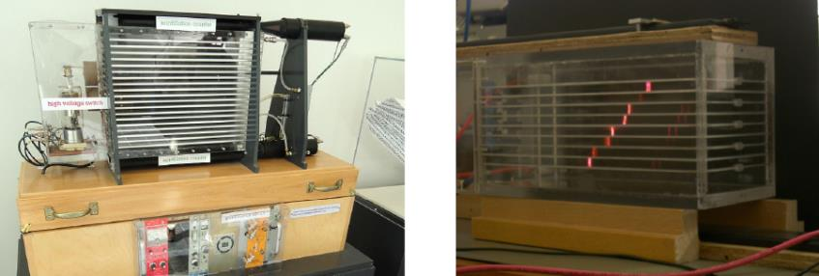
Figure 7.16
A spark chamber is used to trace the paths of high-energy particles. Ionization created by the particles as they pass through the gas between the plates allows a spark to jump. The sparks are perpendicular to the plates, following electric field lines between them. The potential difference between adjacent plates is not high enough to cause sparks without the ionization produced by particles from accelerator experiments (or cosmic rays). This form of detector is now archaic and no longer in use except for demonstration purposes. (credit b: modification of work by Jack Collins)

Slide 18
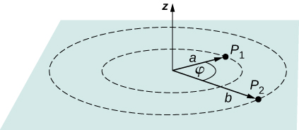
Figure 7.17
Find the difference in potential between P₁ and P₂.

Slide 19
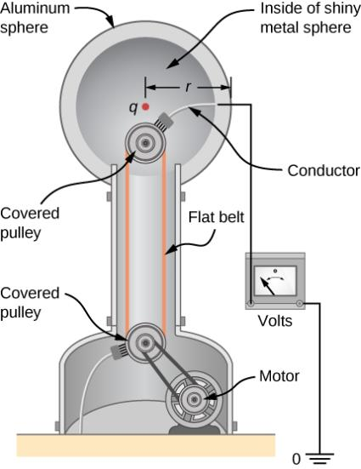
Figure 7.18
The voltage of this demonstration Van de Graaff generator is measured between the charged sphere and ground. Earth’s potential is taken to be zero as a reference. The potential of the charged conducting sphere is the same as that of an equal point charge at its center.

Slide 20
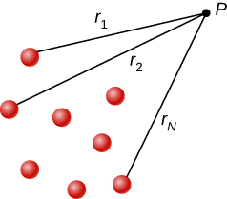
Figure 7.19
Notation for direct distances from charges to a space point P.

Slide 21
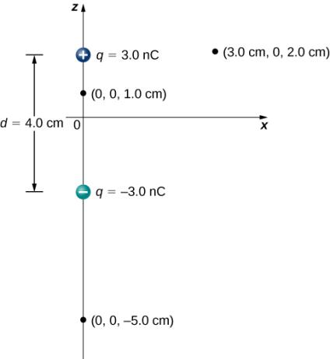
Figure 7.20
A general diagram of an electric dipole, and the notation for the distances from the individual charges to a point P in space.

Slide 22
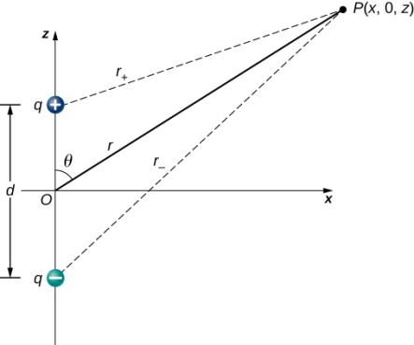
Figure 7.21
A general diagram of an electric dipole, and the notation for the distances from the individual charges to a point P in space.

Slide 23
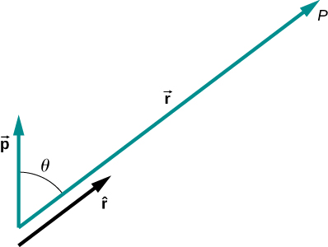
Figure 7.22
The geometry for the application of the potential of a dipole.

Slide 24
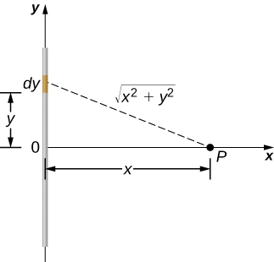
Figure 7.23
We want to calculate the electric potential due to a line of charge.

Slide 25
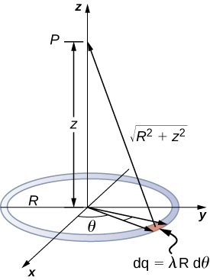
Figure 7.24
We want to calculate the electric potential due to a ring of charge.

Slide 26
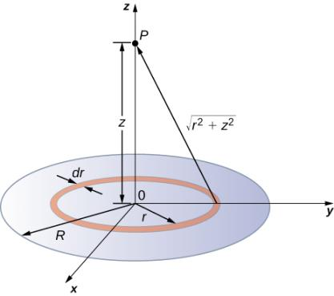
Figure 7.25
We want to calculate the electric potential due to a disk of charge.

Slide 27
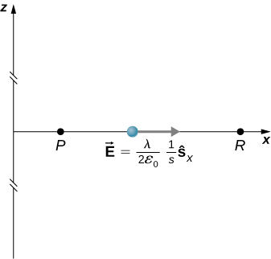
Figure 7.26
Points of interest for calculating the potential of an infinite line of charge.

Slide 28
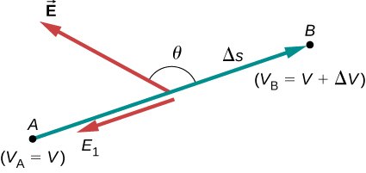
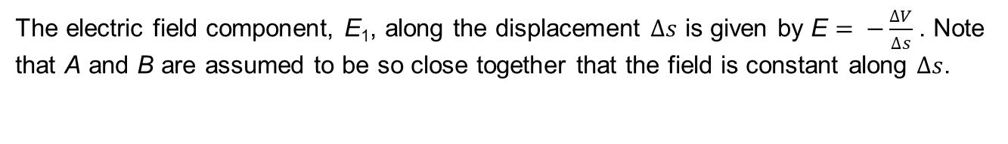
Figure 7.27
The electric field component, E₁, along the displacement $∆s$ is given by E $= −\frac{∆V}{∆s}$. Note that A and B are assumed to be so close together that the field is constant along $∆s$.

Slide 29
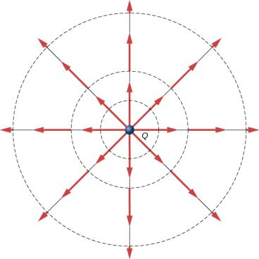
Figure 7.28
Electric field vectors inside and outside a uniformly charged sphere.

Slide 30
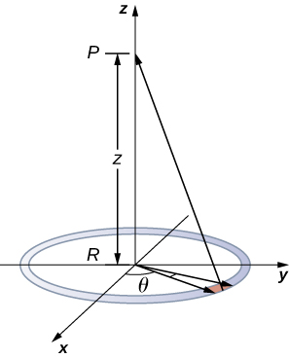
Figure 7.29
We want to calculate the electric field from the electric potential due to a ring charge.

Slide 31
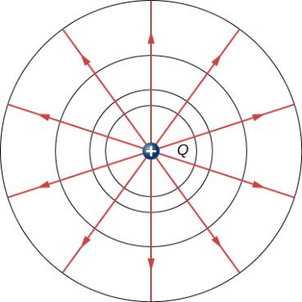
Figure 7.30
An isolated point charge Q with its electric field lines in blue and equipotential lines in green. The potential is the same along each equipotential line, meaning that no work is required to move a charge anywhere along one of those lines. Work is needed to move a charge from one equipotential line to another. Equipotential lines are perpendicular to electric field lines in every case. For a three-dimensional version, explore the first media link.

Slide 32
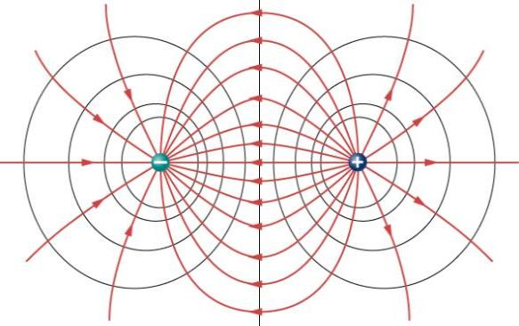
Figure 7.31
The electric field lines and equipotential lines for two equal but opposite charges. The equipotential lines can be drawn by making them perpendicular to the electric field lines, if those are known. Note that the potential is greatest (most positive) near the positive charge and least (most negative) near the negative charge. For a three-dimensional version, explore the first media link.

Slide 33
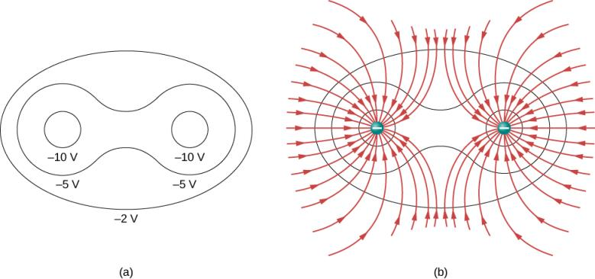
Figure 7.32
These equipotential lines might be measured with a voltmeter in a laboratory experiment.
The corresponding electric field lines are found by drawing them perpendicular to the equipotentials. Note that these fields are consistent with two equal negative charges. For a three-dimensional version, play with the first media link.

Slide 34
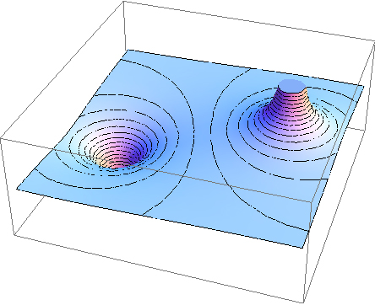
Figure 7.33
Electric potential map of two opposite charges of equal magnitude on conducting spheres. The potential is negative near the negative charge and positive near the positive charge.

Slide 35
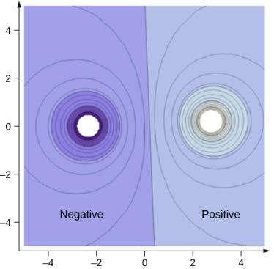
Figure 7.34
A cross-section of the electric potential map of two opposite charges of equal magnitude. The potential is negative near the negative charge and positive near the positive charge.

Slide 36
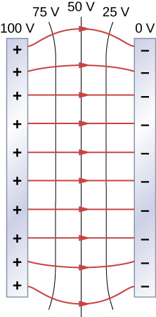
Figure 7.35
The electric field and equipotential lines between two metal plates. Note that the electric field is perpendicular to the equipotentials and hence normal to the plates at their surface as well as in the center of the region between them.

Slide 37
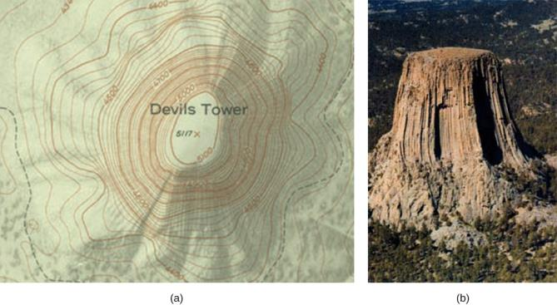
Figure 7.36
A topographical map along a ridge has roughly parallel elevation lines, similar to the equipotential lines in Figure 7.35.
A topographical map of Devil’s Tower, Wyoming. Lines that are close together indicate very steep terrain.
A perspective photo of Devil’s Tower shows just how steep its sides are. Notice the top of the tower has the same shape as the center of the topographical map.

Slide 38
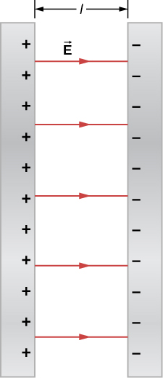
Figure 7.37
The electric field between oppositely charged parallel plates. A portion is released at the positive plate.

Slide 39
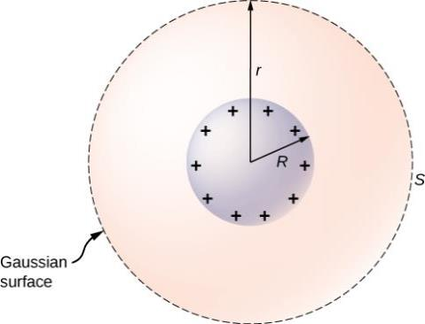
Figure 7.38
An isolated conducting sphere.

Slide 40
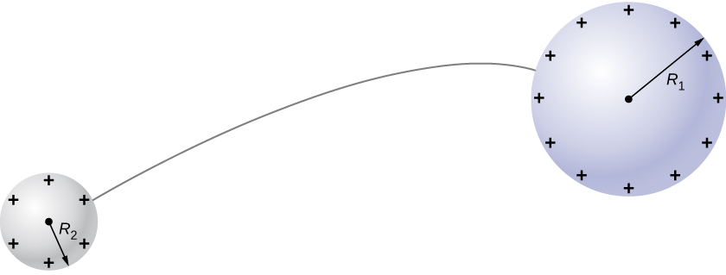
Figure 7.39
Two conducting spheres are connected by a thin conducting wire.

Slide 41
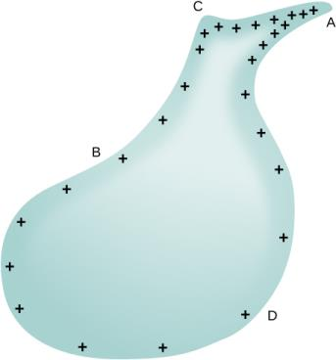
Figure 7.40
The surface charge density and the electric field of a conductor are greater at regions with smaller radii of curvature.

Slide 42
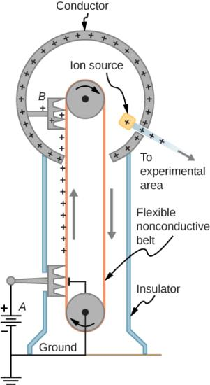
Figure 7.41
Schematic of Van de Graaff generator. A battery (A) supplies excess positive charge to a pointed conductor, the points of which spray the charge onto a moving insulating belt near the bottom. The pointed conductor (B) on top in the large sphere picks up the charge. (The induced electric field at the points is so large that it removes the charge from the belt.) This can be done because the charge does not remain inside the conducting sphere but moves to its outside surface. An ion source inside the sphere produces positive ions, which are accelerated away from the positive sphere to high velocities.

Slide 43
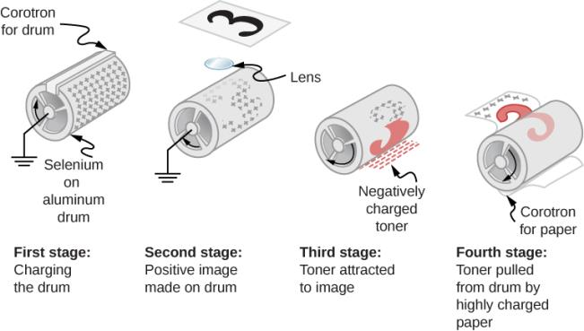
Figure 7.42
Xerography is a dry copying process based on electrostatics. The major steps in the process are the charging of the photoconducting drum, transfer of an image, creating a positive charge duplicate, attraction of toner to the charged parts of the drum, and transfer of toner to the paper. Not shown are heat treatment of the paper and cleansing of the drum for the next copy.

Slide 44
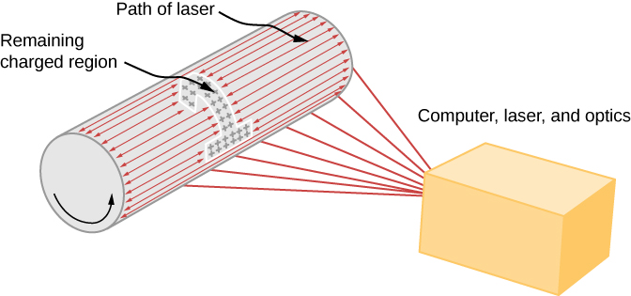
Figure 7.43
In a laser printer, a laser beam is scanned across a photoconducting drum, leaving a positively charged image. The other steps for charging the drum and transferring the image to paper are the same as in xerography. Laser light can be very precisely controlled, enabling laser printers to produce high-quality images.

Slide 45
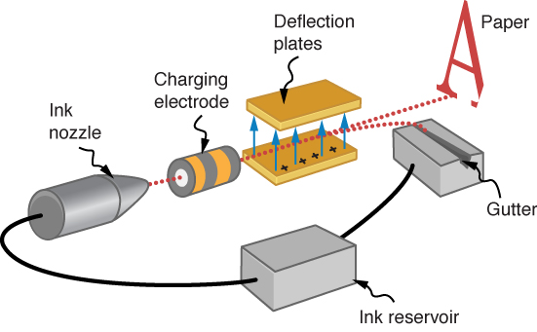
Figure 7.44
The nozzle of an ink-jet printer produces small ink droplets, which are sprayed with electrostatic charge. Various computer-driven devices are then used to direct the droplets to the correct positions on a page.

Slide 46
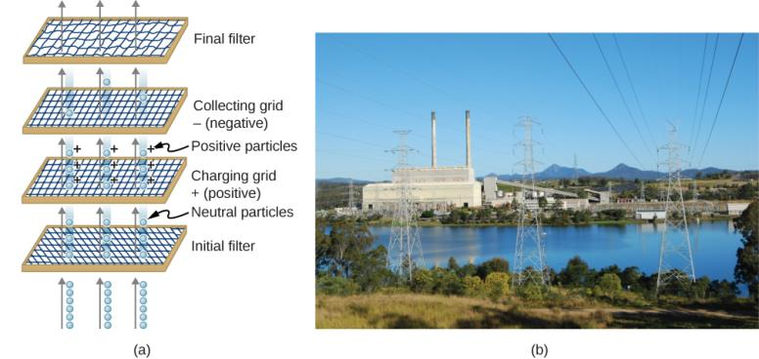
Figure 7.45
Schematic of an electrostatic precipitator. Air is passed through grids of opposite charge. The first grid charges airborne particles, while the second attracts and collects them.
The dramatic effect of electrostatic precipitators is seen by the absence of smoke from this power plant. (credit b: modification of work by “Cmdalgleish”/Wikimedia Commons)

Slide 47

Exercise 43

Slide 48
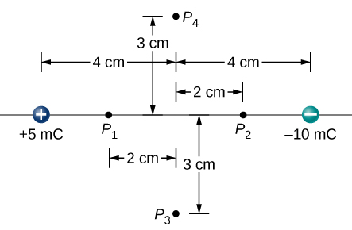
exercise 52

Slide 49
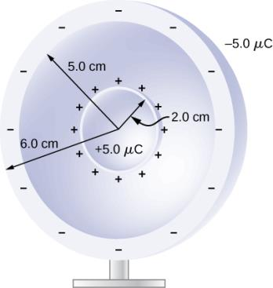
exercise 60

Slide 50

exercise 64

Slide 51
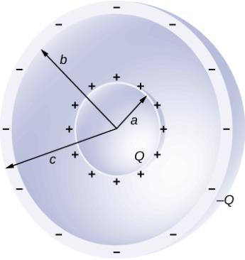
exercise 65

Slide 52
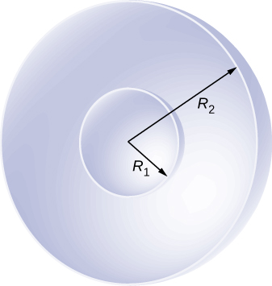
exercise 66

Slide 53
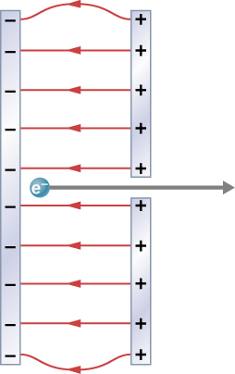
Figure 7.46
Parallel conducting plates with opposite charges on them create a relatively uniform electric field used to accelerate electrons to the right. Those that go through the hole can be used to make a TV or computer screen glow or to produce X-rays.

Slide 54
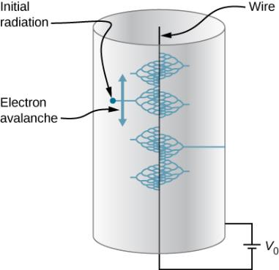
Exercise 71

Slide 55
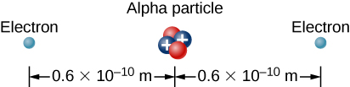
Exercise 73

Slide 56
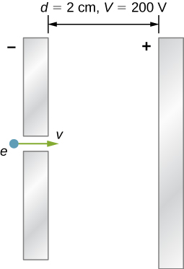
Exercise 77

Slide 57

This OpenStax ancillary resource is © Rice University under a CC-BY 4.0 International license; it may be reproduced or modified but must be attributed to OpenStax, Rice University and any changes must be noted.

