Slide 1


University Physics
Chapter 8 CAPACITANCE
PowerPoint Image Slideshow

Slide 2

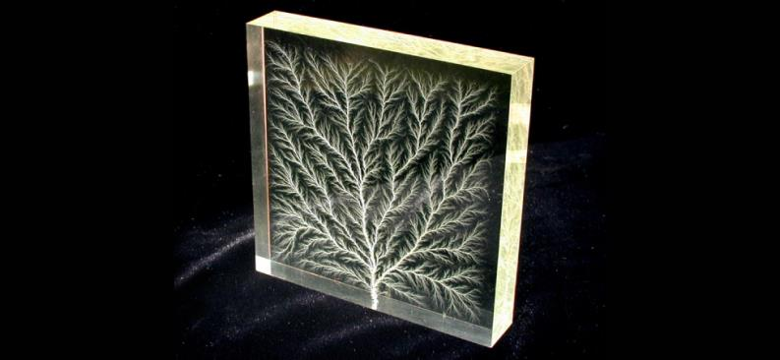
Figure 8.1
The tree-like branch patterns in this clear Plexiglas® block are known as a Lichtenberg figure, named for the German physicist Georg Christof Lichtenberg (1742–1799), who was the first to study these patterns. The “branches” are created by the dielectric breakdown produced by a strong electric field. (credit: modification of work by Bert Hickman)

Slide 3
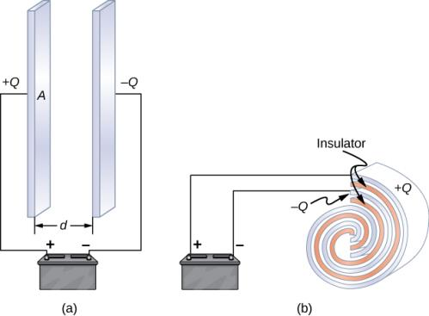
Figure 8.2
Both capacitors shown here were initially uncharged before being connected to a battery. They now have charges of +Q and −Q (respectively) on their plates.
A parallel-plate capacitor consists of two plates of opposite charge with area A separated by distance d.
A rolled capacitor has a dielectric material between its two conducting sheets (plates).

Slide 4
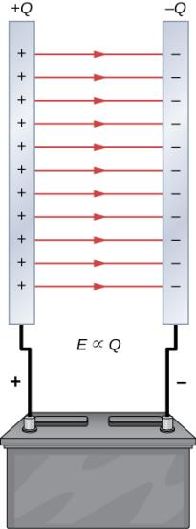
Figure 8.3
The charge separation in a capacitor shows that the charges remain on the surfaces of the capacitor plates. Electrical field lines in a parallel-plate capacitor begin with positive charges and end with negative charges. The magnitude of the electrical field in the space between the plates is in direct proportion to the amount of charge on the capacitor.

Slide 5
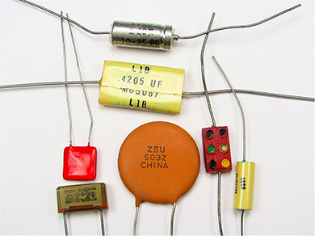
Figure 8.4
These are some typical capacitors used in electronic devices. A capacitor’s size is not necessarily related to its capacitance value.

Slide 6
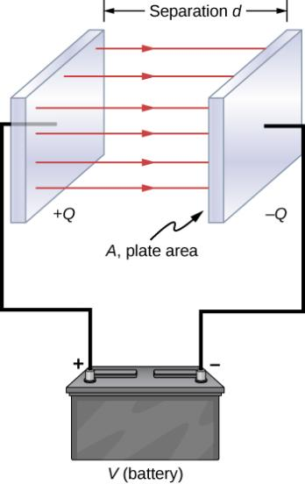
Figure 8.5
In a parallel-plate capacitor with plates separated by a distance d, each plate has the same surface area A.

Slide 7
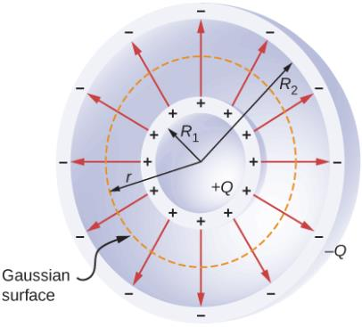
Figure 8.6
A spherical capacitor consists of two concentric conducting spheres. Note that the charges on a conductor reside on its surface.

Slide 8
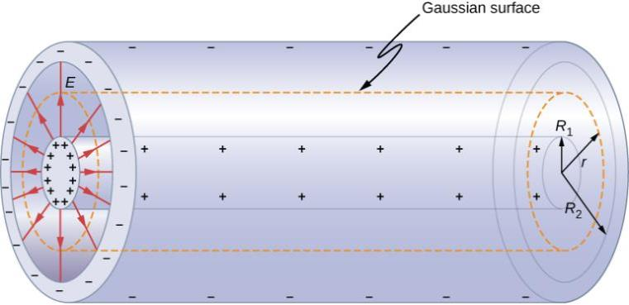
Figure 8.7
A cylindrical capacitor consists of two concentric, conducting cylinders. Here, the charge on the outer surface of the inner cylinder is positive (indicated by +) and the charge on the inner surface of the outer cylinder is negative (indicated by −).

Slide 9
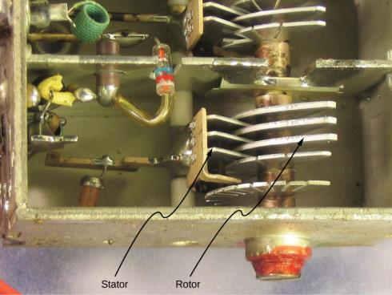
Figure 8.8
In a variable air capacitor, capacitance can be tuned by changing the effective area of the plates. (credit: modification of work by Robbie Sproule)

Slide 10

Figure 8.9
This shows three different circuit representations of capacitors. The symbol in (a) is the most commonly used one. The symbol in (b) represents an electrolytic capacitor. The symbol in (c) represents a variable-capacitance capacitor.

Slide 11
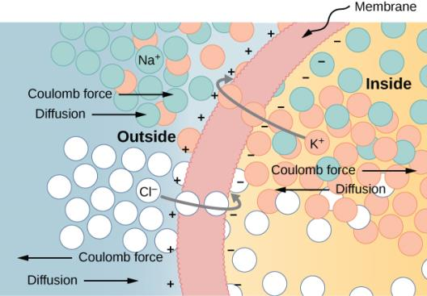
Figure 8.10
The semipermeable membrane of a biological cell has different concentrations of ions on its interior surface than on its exterior. Diffusion moves the K⁺ (potassium) and Cl– (chloride) ions in the directions shown, until the Coulomb force halts further transfer. In this way, the exterior of the membrane acquires a positive charge and its interior surface acquires a negative charge, creating a potential difference across the membrane. The membrane is normally impermeable to Na⁺ (sodium ions).

Slide 12
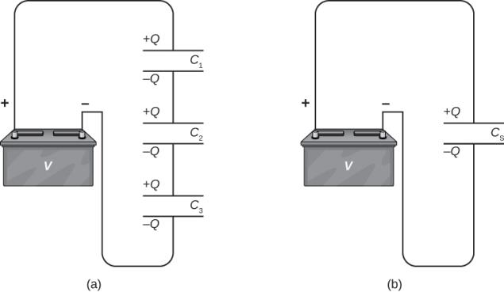
Figure 8.11
Three capacitors are connected in series. The magnitude of the charge on each plate is Q.
The network of capacitors in (a) is equivalent to one capacitor that has a smaller capacitance than any of the individual capacitances in (a), and the charge on its plates is Q.

Slide 13
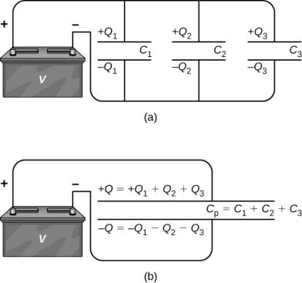
Figure 8.12
Three capacitors are connected in parallel. Each capacitor is connected directly to the battery.
The charge on the equivalent capacitor is the sum of the charges on the individual capacitors.

Slide 14
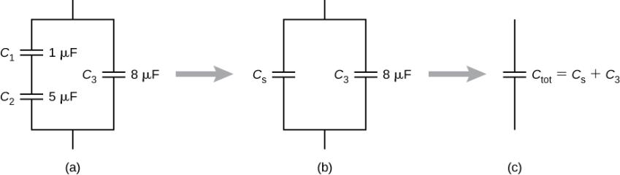
Figure 8.13
This circuit contains both series and parallel connections of capacitors.
C₁ and C₂ are in series; their equivalent capacitance is C_{S}.
The equivalent capacitance C_{S} is connected in parallel with C₃. Thus, the equivalent capacitance of the entire network is the sum of C_{S} and C₃.

Slide 15
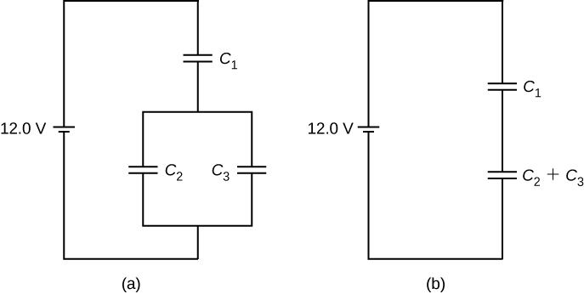
Figure 8.14
A capacitor combination.
An equivalent two-capacitor combination.

Slide 16
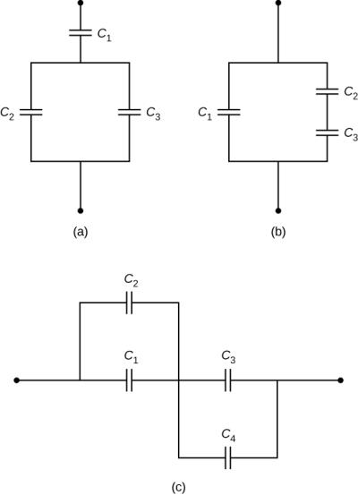
Exercise 8.5

Slide 17
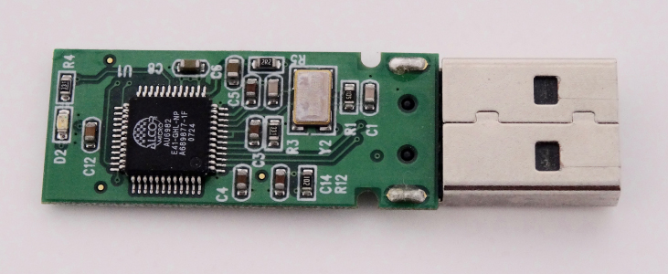
Figure 8.15
The capacitors on the circuit board for an electronic device follow a labeling convention that identifies each one with a code that begins with the letter “C.”

Slide 18
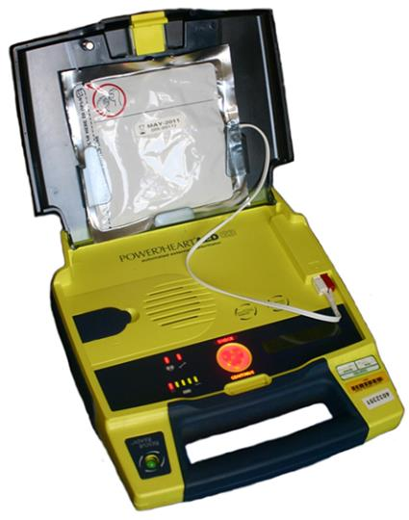
Figure 8.16
Automated external defibrillators are found in many public places. These portable units provide verbal instructions for use in the important first few minutes for a person suffering a cardiac attack.

Slide 19
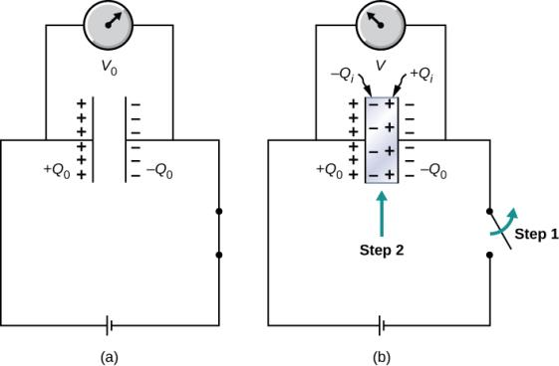
Figure 8.17
When fully charged, a vacuum capacitor has a voltage V₀ and charge Q₀ the charges remain on plate’s inner surfaces; the schematic indicates the sign of charge on each plate).
In step 1, the battery is disconnected. Then, in step 2, a dielectric (that is electrically neutral) is inserted into the charged capacitor. When the voltage across the capacitor is now measured, it is found that the voltage value has decreased to V = V₀/κ. The schematic indicates the sign of the induced charge that is now present on the surfaces of the dielectric material between the plates.

Slide 20
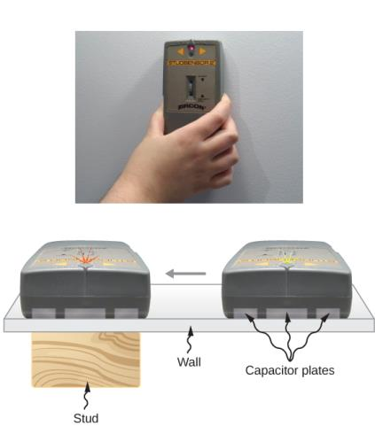
Figure 8.18
An electronic stud finder is used to detect wooden studs behind drywall.

Slide 21
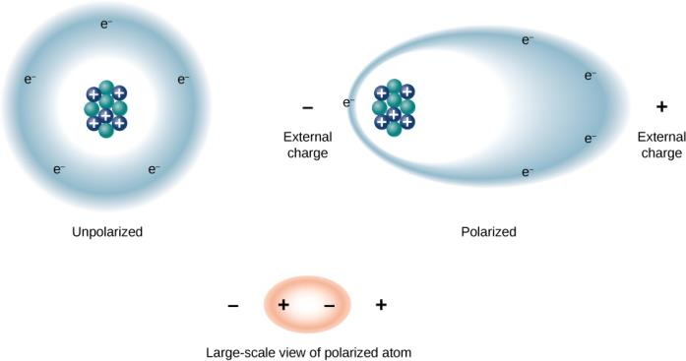
Figure 8.19
The concept of polarization: In an unpolarized atom or molecule, a negatively charged electron cloud is evenly distributed around positively charged centers, whereas a polarized atom or molecule has an excess of negative charge at one side so that the other side has an excess of positive charge. However, the entire system remains electrically neutral. The charge polarization may be caused by an external electrical field. Some molecules and atoms are permanently polarized (electric dipoles) even in the absence of an external electrical field (polar molecules and atoms).

Slide 22
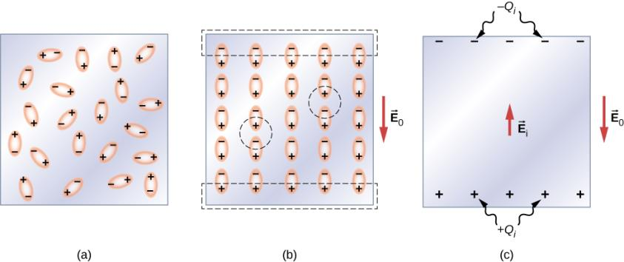
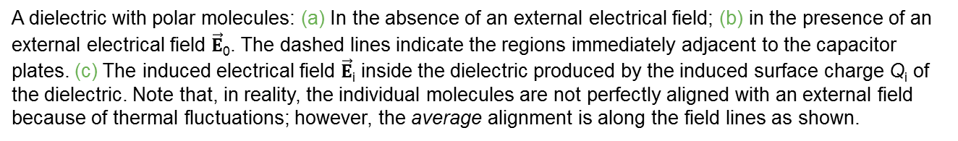
Figure 8.20
A dielectric with polar molecules: (a) In the absence of an external electrical field; (b) in the presence of an external electrical field $\vec{E}$₀. The dashed lines indicate the regions immediately adjacent to the capacitor plates. (c) The induced electrical field $\vec{E}$_{i} inside the dielectric produced by the induced surface charge Q_{i} of the dielectric. Note that, in reality, the individual molecules are not perfectly aligned with an external field because of thermal fluctuations; however, the average alignment is along the field lines as shown.

Slide 23
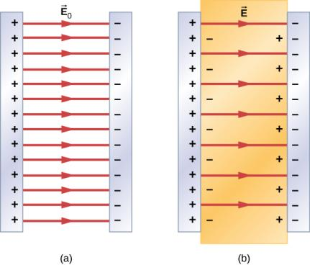
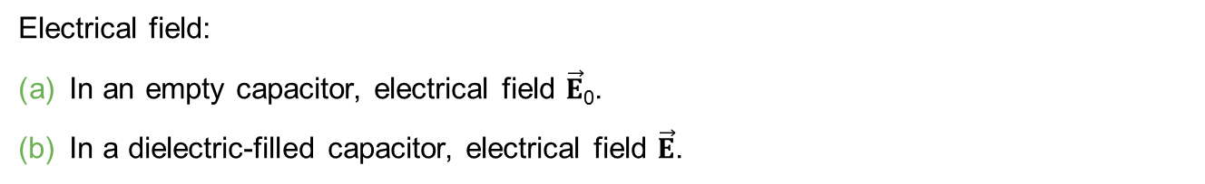
Figure 8.21
Electrical field:
In an empty capacitor, electrical field $\vec{E}$₀.
In a dielectric-filled capacitor, electrical field $\vec{E}$.

Slide 24
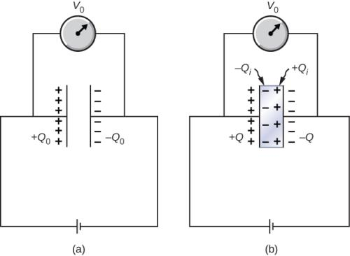
Figure 8.22
A dielectric is inserted into the charged capacitor while the capacitor remains connected to the battery.

Slide 25
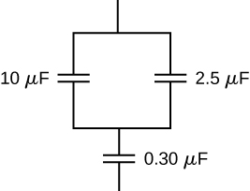
Exercise 33

Slide 26
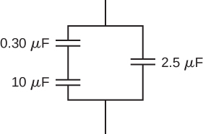
Exercise 36

Slide 27
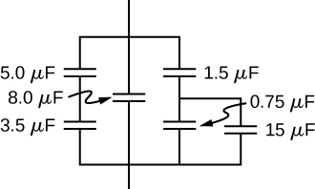
Exercise 37

Slide 28
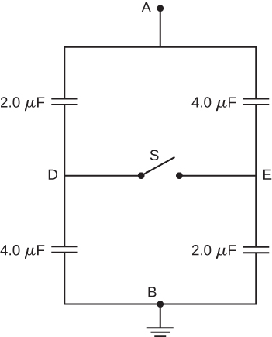
Exercise 78

Slide 29
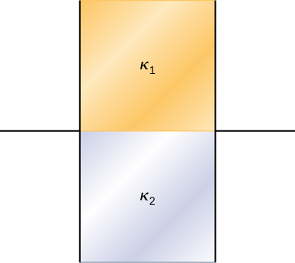
Exercise 82

Slide 30
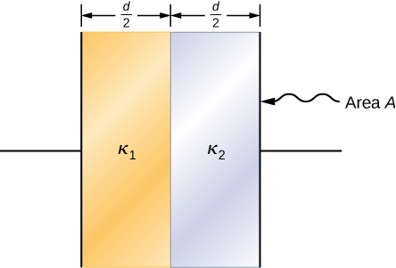
Exercise 83

Slide 31

This OpenStax ancillary resource is © Rice University under a CC-BY 4.0 International license; it may be reproduced or modified but must be attributed to OpenStax, Rice University and any changes must be noted.

