Slide 1
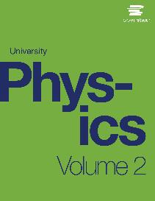

University Physics
Chapter 11 MAGNETIC FORCES AND FIELDS
PowerPoint Image Slideshow

Slide 2

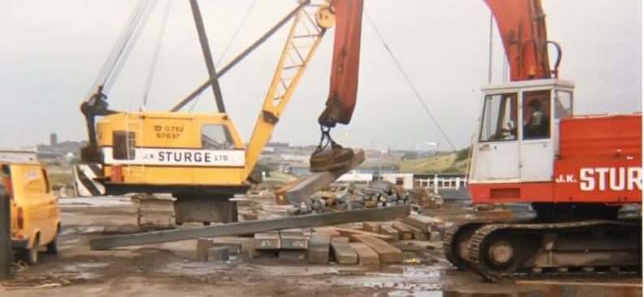
Figure 11.1
An industrial electromagnet is capable of lifting thousands of pounds of metallic waste. (credit: modification of work by “BedfordAl”/Flickr)

Slide 3
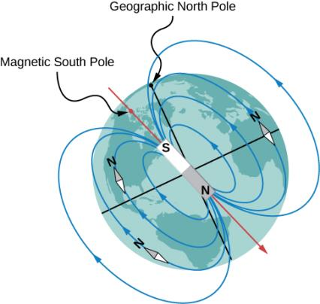
Figure 11.2
The north pole of a compass needle points toward the south pole of a magnet, which is how today’s magnetic field is oriented from inside Earth. It also points toward Earth’s geographic North Pole because the geographic North Pole is near the magnetic south pole.

Slide 4
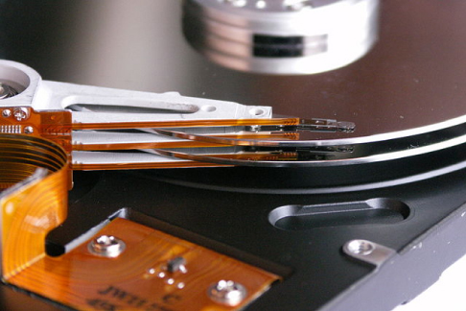
Figure 11.3
Engineering technology like computer storage would not be possible without a deep understanding of magnetism. (credit: Klaus Eifert)

Slide 5
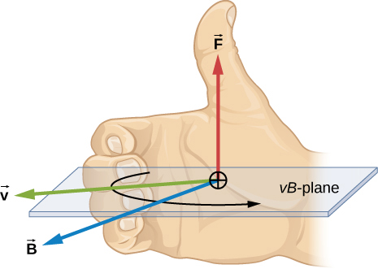
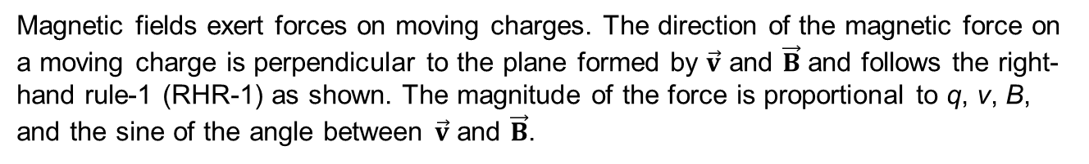
Figure 11.4
Magnetic fields exert forces on moving charges. The direction of the magnetic force on a moving charge is perpendicular to the plane formed by $\vec{v}$ and $\vec{B}$ and follows the right-hand rule-1 (RHR-1) as shown. The magnitude of the force is proportional to q, v, B, and the sine of the angle between $\vec{v}$ and $\vec{B}$.

Slide 6
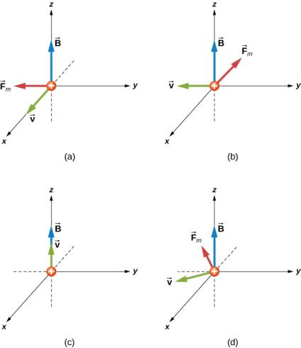
Figure 11.5
The magnetic forces on an alpha-particle moving in a uniform magnetic field. The field is the same in each drawing, but the velocity is different.

Slide 7
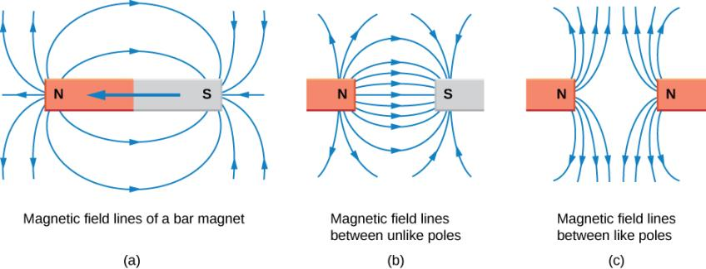
Figure 11.6
Magnetic field lines are defined to have the direction in which a small compass points when placed at a location in the field. The strength of the field is proportional to the closeness (or density) of the lines. If the interior of the magnet could be probed, the field lines would be found to form continuous, closed loops. To fit in a reasonable space, some of these drawings may not show the closing of the loops; however, if enough space were provided, the loops would be closed.

Slide 8
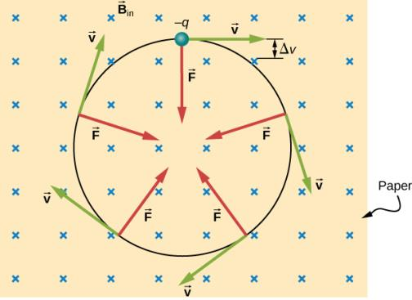
Figure 11.7
A negatively charged particle moves in the plane of the paper in a region where the magnetic field is perpendicular to the paper (represented by the small ×’s—like the tails of arrows). The magnetic force is perpendicular to the velocity, so velocity changes in direction but not magnitude. The result is uniform circular motion. (Note that because the charge is negative, the force is opposite in direction to the prediction of the right-hand rule.)

Slide 9
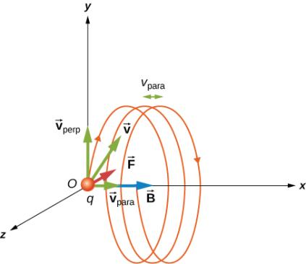
Figure 11.8
A charged particle moving with a velocity not in the same direction as the magnetic field. The velocity component perpendicular to the magnetic field creates circular motion, whereas the component of the velocity parallel to the field moves the particle along a straight line. The pitch is the horizontal distance between two consecutive circles. The resulting motion is helical.

Slide 10
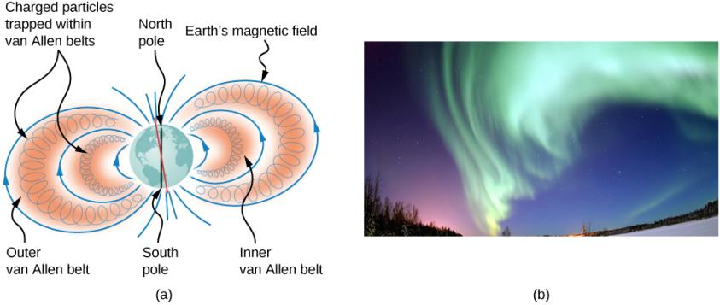
Figure 11.9
The Van Allen radiation belts around Earth trap ions produced by cosmic rays striking Earth’s atmosphere.
The magnificent spectacle of the aurora borealis, or northern lights, glows in the northern sky above Bear Lake near Eielson Air Force Base, Alaska. Shaped by Earth’s magnetic field, this light is produced by glowing molecules and ions of oxygen and nitrogen. (credit b: modification of work by USAF Senior Airman Joshua Strang)

Slide 11
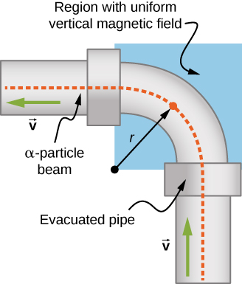
Figure 11.10
Top view of the beam deflector setup.

Slide 12
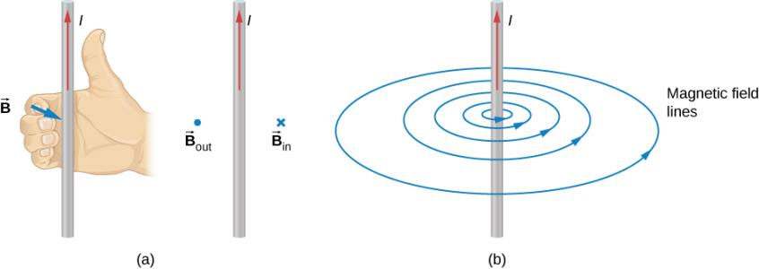
Figure 11.11
When the wire is in the plane of the paper, the field is perpendicular to the paper. Note the symbols used for the field pointing inward (like the tail of an arrow) and the field pointing outward (like the tip of an arrow).
A long and straight wire creates a field with magnetic field lines forming circular loops.

Slide 13
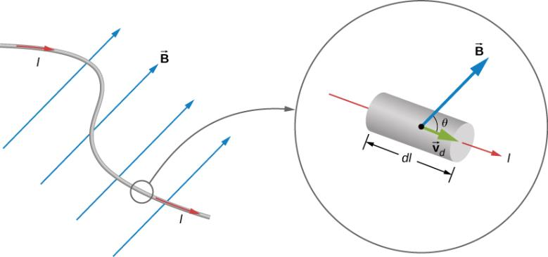
Figure 11.12
An infinitesimal section of current-carrying wire in a magnetic field.

Slide 14
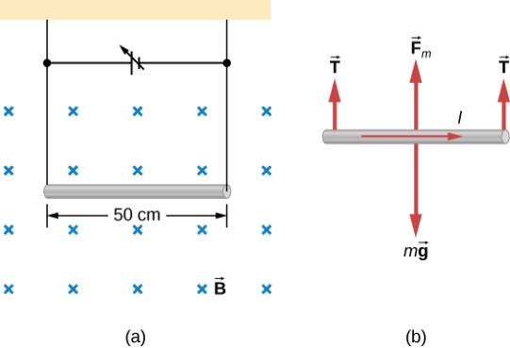
Figure 11.13
A wire suspended in a magnetic field.
The free-body diagram for the wire.

Slide 15
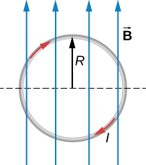
Figure 11.14
A loop of wire carrying a current in a magnetic field.

Slide 16
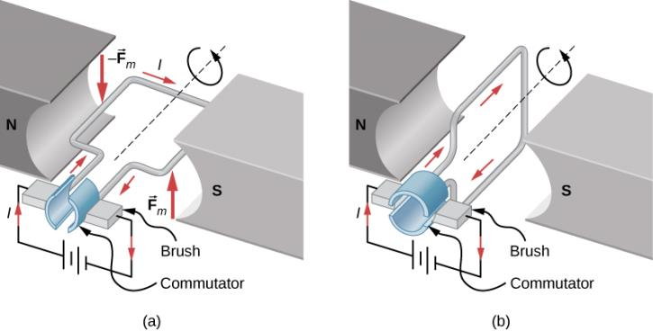
Figure 11.15
A simplified version of a dc electric motor.
The rectangular wire loop is placed in a magnetic field. The forces on the wires closest to the magnetic poles (N and S) are opposite in direction as determined by the right-hand rule-1. Therefore, the loop has a net torque and rotates to the position shown in (b).
The brushes now touch the commutator segments so that no current flows through the loop. No torque acts on the loop, but the loop continues to spin from the initial velocity given to it in part (a). By the time the loop flips over, current flows through the wires again but now in the opposite direction, and the process repeats as in part (a). This causes continual rotation of the loop.

Slide 17
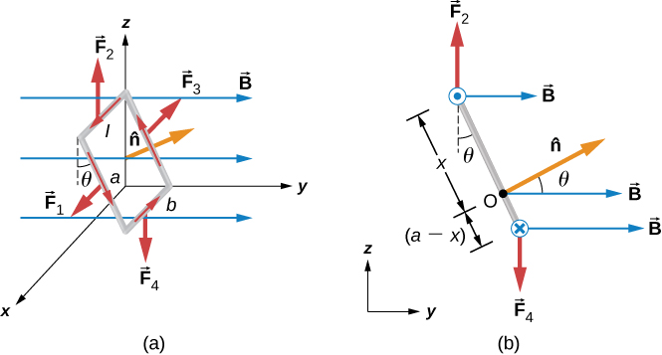
Figure 11.16
A rectangular current loop in a uniform magnetic field is subjected to a net torque but not a net force.
A side view of the coil.

Slide 18
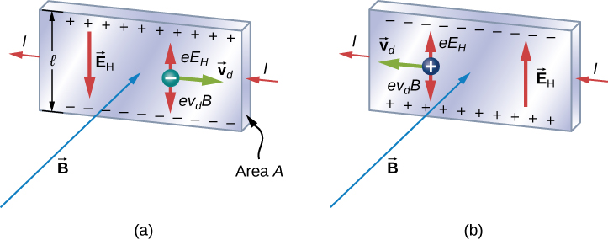
Figure 11.17
In the Hall effect, a potential difference between the top and bottom edges of the metal strip is produced when moving charge carriers are deflected by the magnetic field. (a) Hall effect for negative charge carriers; (b) Hall effect for positive charge carriers.

Slide 19
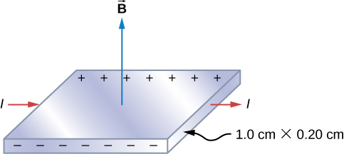
Figure 11.18
Finding the Hall potential in a silver ribbon in a magnetic field is shown.

Slide 20
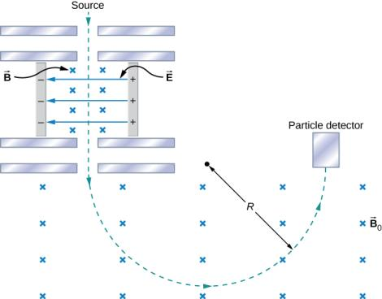
Figure 11.19
A schematic of the Bainbridge mass spectrometer, showing charged particles leaving a source, followed by a velocity selector where the electric and magnetic forces are balanced, followed by a region of uniform magnetic field where the particle is ultimately detected.

Slide 21
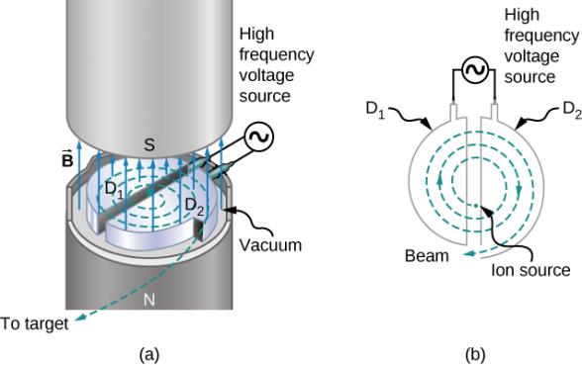
Figure 11.20
The inside of a cyclotron. A uniform magnetic field is applied as circulating protons travel through the dees, gaining energy as they traverse through the gap between the dees.

Slide 22
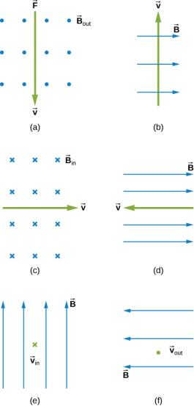
Exercise 15

Slide 23
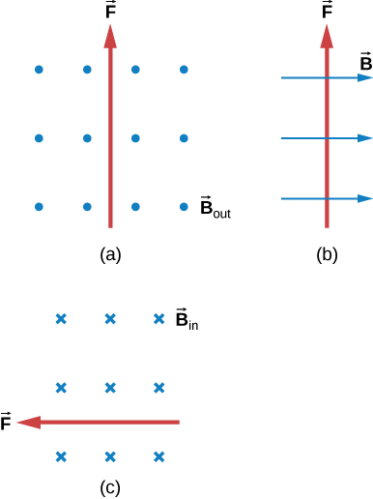
Exercise 17

Slide 24
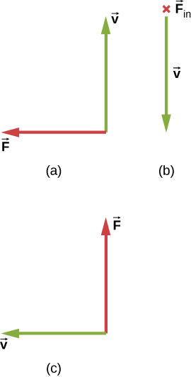
Exercise 19

Slide 25
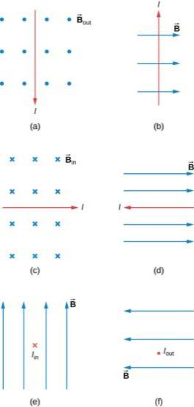
Exercise 33

Slide 26
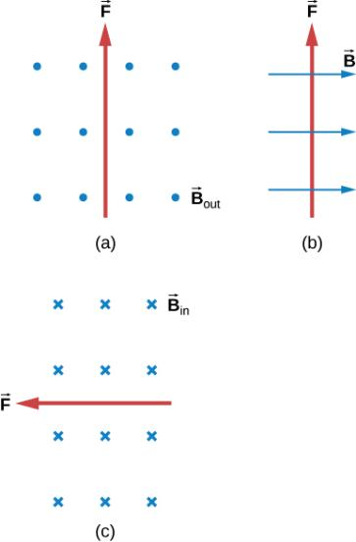
Exercise 34

Slide 27
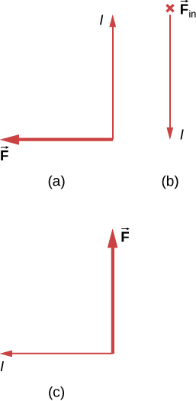
Exercise 35

Slide 28
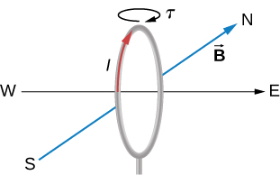
EXERCISE 46

Slide 29
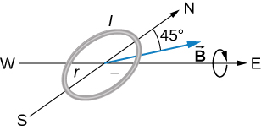
EXERCISE 47

Slide 30
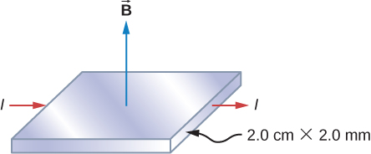
EXERCISE 49

Slide 31
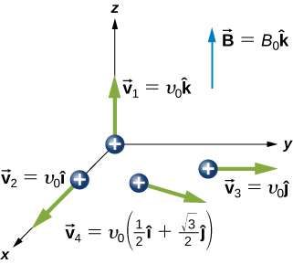
Exercise 62

Slide 32
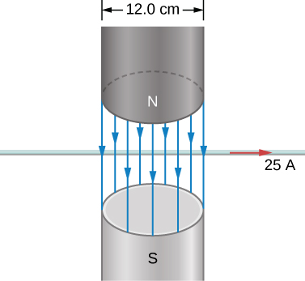
Exercise 82

Slide 33
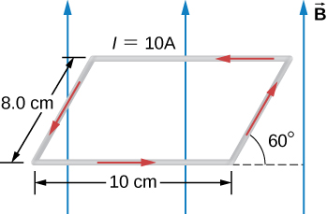
EXERCISE 83

Slide 34
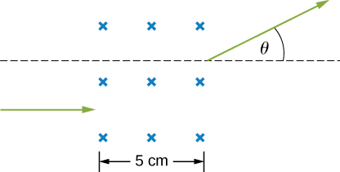
EXERCISE 104

Slide 35
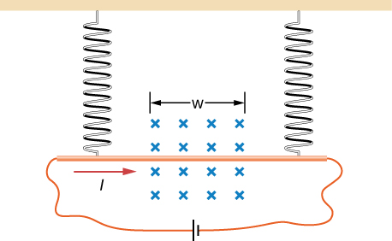
EXERCISE 106

Slide 36
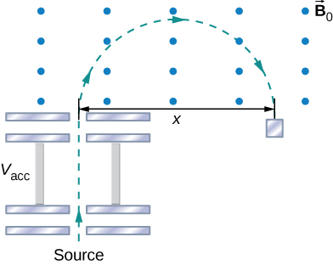
EXERCISE 107

Slide 37
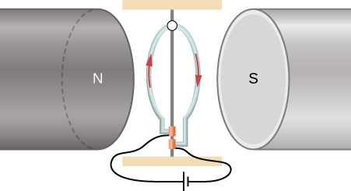
EXERCISE 108

Slide 38

This OpenStax ancillary resource is © Rice University under a CC-BY 4.0 International license; it may be reproduced or modified but must be attributed to OpenStax, Rice University and any changes must be noted.

