Slide 1
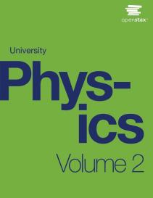

University Physics
Chapter 12 SOURCES OF MAGNETIC FIELDS
PowerPoint Image Slideshow

Slide 2

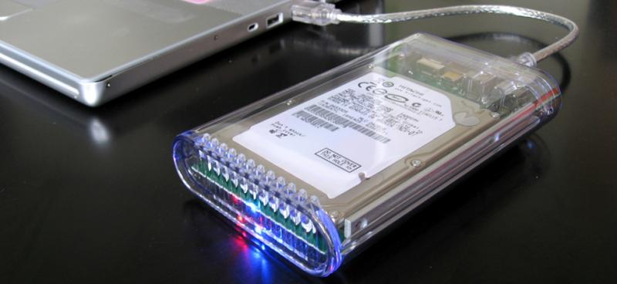
Figure 12.1
An external hard drive attached to a computer works by magnetically encoding information that can be stored or retrieved quickly. A key idea in the development of digital devices is the ability to produce and use magnetic fields in this way. (credit: modification of work by “Miss Karen”/Flickr)

Slide 3
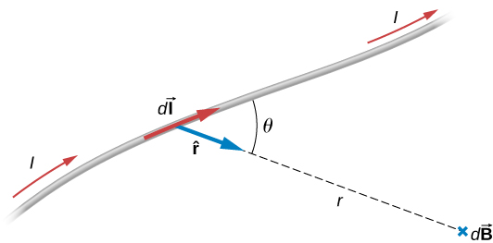
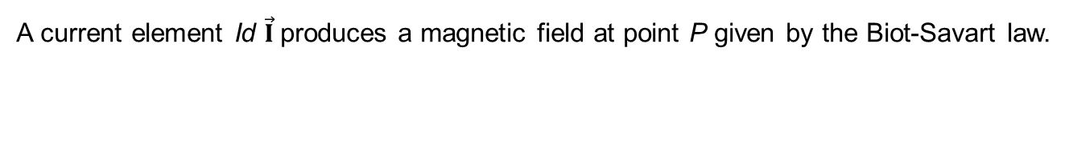
Figure 12.2
A current element Id $\vec{I}$produces a magnetic field at point P given by the Biot-Savart law.

Slide 4
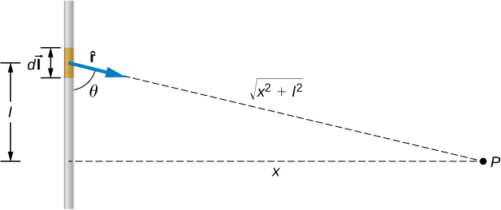
Figure 12.3
A small line segment carries a current I in the vertical direction. What is the magnetic field at a distance x from the segment?

Slide 5
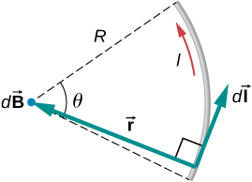
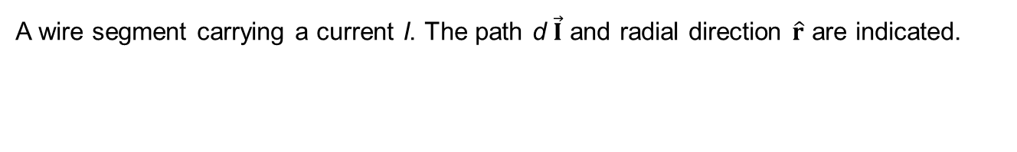
Figure 12.4
A wire segment carrying a current I. The path d $\vec{I}$ and radial direction $\hat{r}$ are indicated.

Slide 6

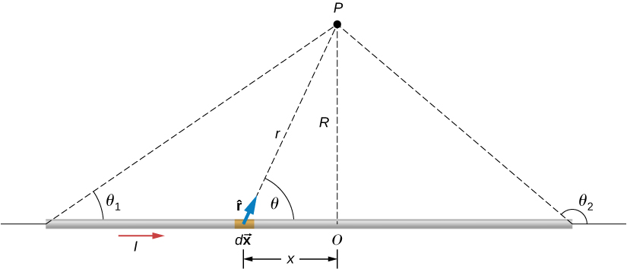
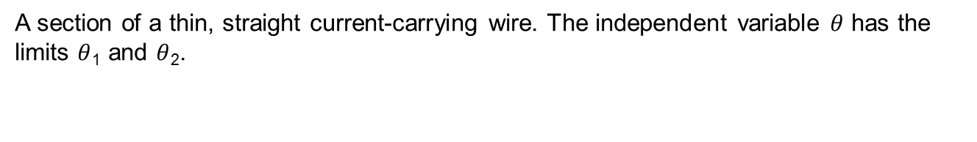
Figure 12.5
A section of a thin, straight current-carrying wire. The independent variable $θ$ has the limits $θ$₁ and $θ$₂.

Slide 7
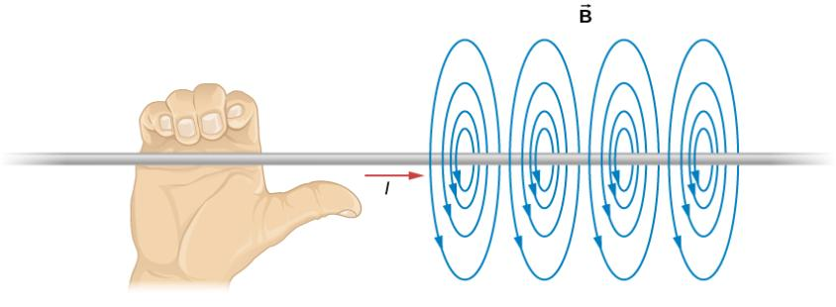
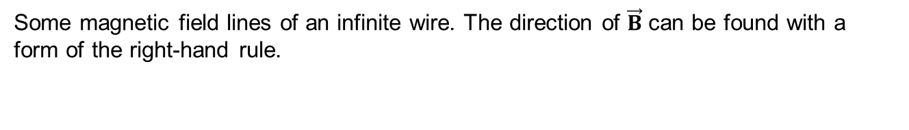
Figure 12.6
Some magnetic field lines of an infinite wire. The direction of $\vec{B}$ can be found with a form of the right-hand rule.

Slide 8
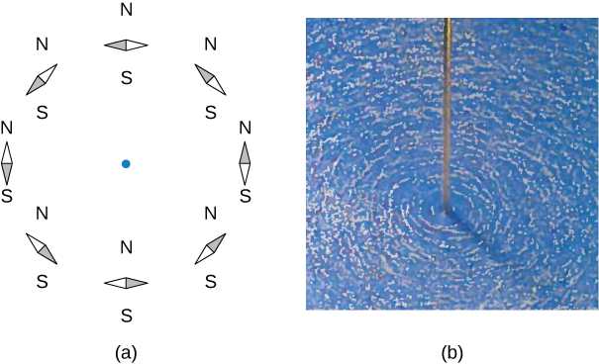
Figure 12.7
The shape of the magnetic field lines of a long wire can be seen using (a) small compass needles and (b) iron filings.

Slide 9
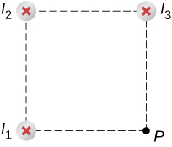
Figure 12.8
Three wires have current flowing into the page. The magnetic field is determined at the fourth corner of the square.

Slide 10
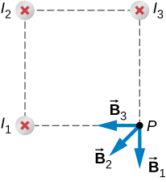
EXAMPLE 12.3

Slide 11
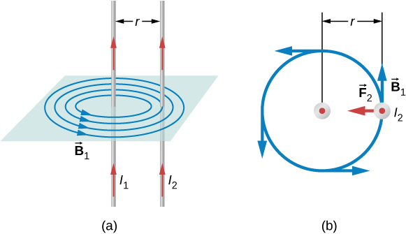
Figure 12.9
The magnetic field produced by a long straight conductor is perpendicular to a parallel conductor, as indicated by right-hand rule (RHR)-2.
A view from above of the two wires shown in (a), with one magnetic field line shown for wire 1. RHR-1 shows that the force between the parallel conductors is attractive when the currents are in the same direction. A similar analysis shows that the force is repulsive between currents in opposite directions.

Slide 12
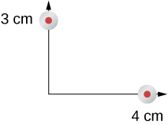
Figure 12.10
Two current-carrying wires at given locations with currents out of the page.

Slide 13
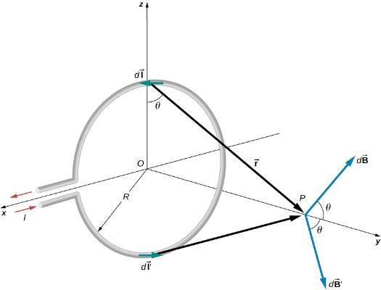
Figure 12.11
Determining the magnetic field at point P along the axis of a current-carrying loop of wire.

Slide 14
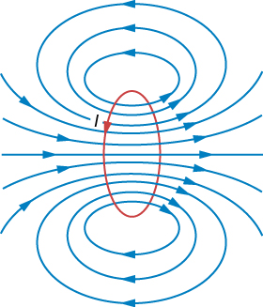
Figure 12.12
Sketch of the magnetic field lines of a circular current loop.

Slide 15
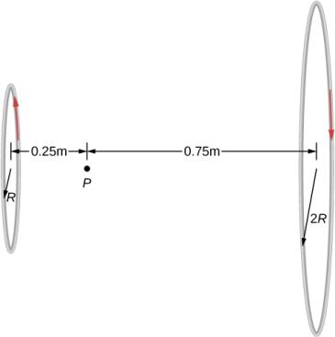
Figure 12.13
Two loops of different radii have the same current but flowing in opposite directions. The magnetic field at point P is measured to be zero.

Slide 16
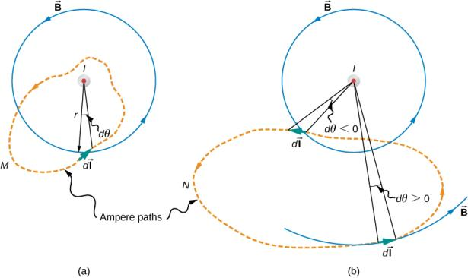
Figure 12.14
The current I of a long, straight wire is directed out of the page. The integral ∮dθ equals 2π and 0, respectively, for paths M and N.

Slide 17
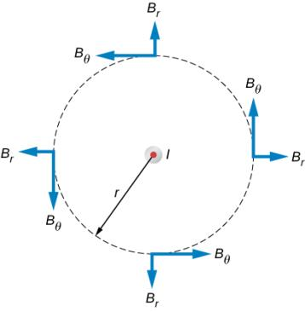
Figure 12.15
The possible components of the magnetic field B due to a current I, which is directed out of the page. The radial component is zero because the angle between the magnetic field and the path is at a right angle.

Slide 18
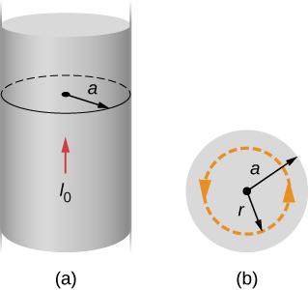
Figure 12.16
A model of a current-carrying wire of radius a and current I₀.
A cross-section of the same wire showing the radius a and the Ampère’s loop of radius r.

Slide 19
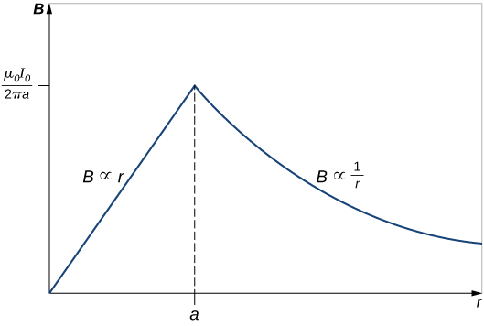
Figure 12.17
Variation of the magnetic field produced by a current I₀ in a long, straight wire of radius a.

Slide 20
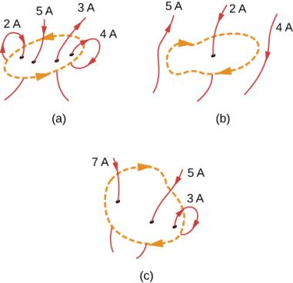
Figure 12.18
Current configurations and paths for Example 12.8.

Slide 21
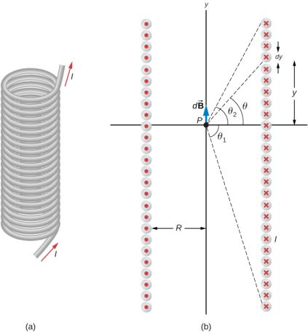
Figure 12.19
A solenoid is a long wire wound in the shape of a helix.
The magnetic field at the point P on the axis of the solenoid is the net field due to all of the current loops.

Slide 22
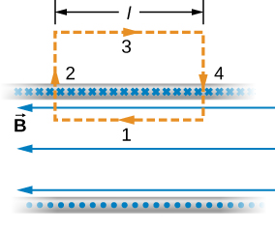
Figure 12.20
The path of integration used in Ampère’s law to evaluate the magnetic field of an infinite solenoid.

Slide 23
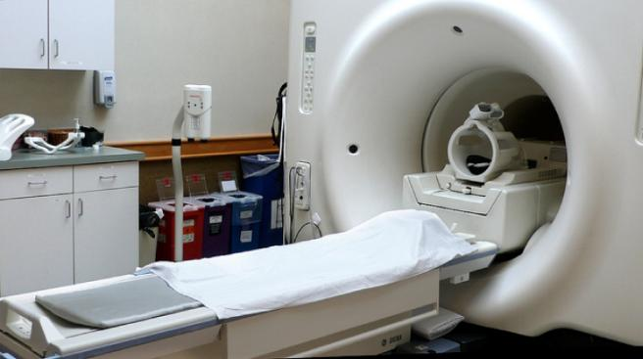
Figure 12.21
In an MRI machine, a large magnetic field is generated by the cylindrical solenoid surrounding the patient. (credit: Liz West)

Slide 24
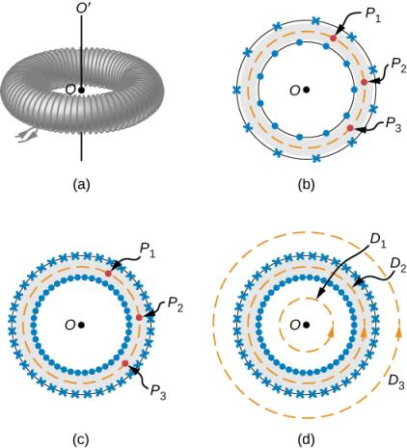
Figure 12.22
A toroid is a coil wound into a donut-shaped object.
A loosely wound toroid does not have cylindrical symmetry.
In a tightly wound toroid, cylindrical symmetry is a very good approximation.
Several paths of integration for Ampère’s law.

Slide 25
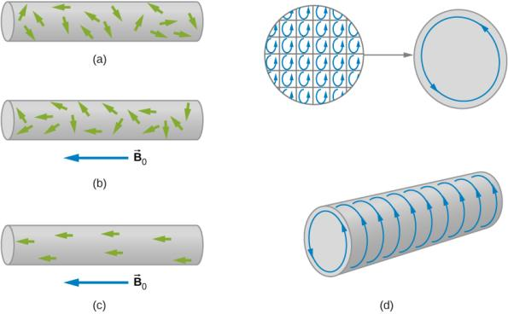
Figure 12.23
The alignment process in a paramagnetic material filling a solenoid (not shown).
Without an applied field, the magnetic dipoles are randomly oriented.
With a field, partial alignment occurs.
An equivalent representation of part (b).
The internal currents cancel, leaving an effective surface current that produces a magnetic field similar to that of a finite solenoid.

Slide 26
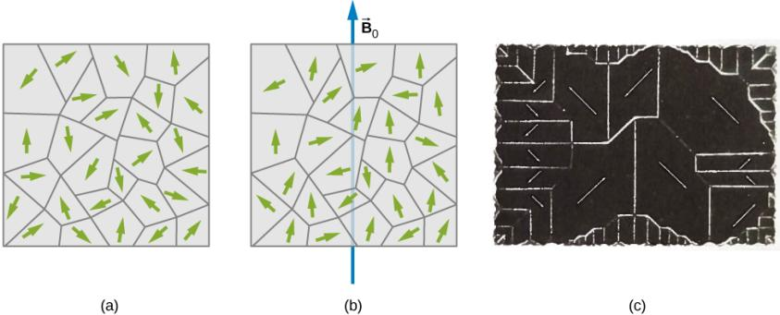
Figure 12.24
Domains are randomly oriented in an unmagnetized ferromagnetic sample such as iron. The arrows represent the orientations of the magnetic dipoles within the domains.
In an applied magnetic field, the domains align somewhat with the field.
The domains of a single crystal of nickel. The white lines show the boundaries of the domains. These lines are produced by iron oxide powder sprinkled on the crystal.

Slide 27
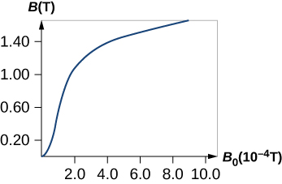
Figure 12.25
(a) The magnetic field B in annealed iron as a function of the applied field B₀.

Slide 28
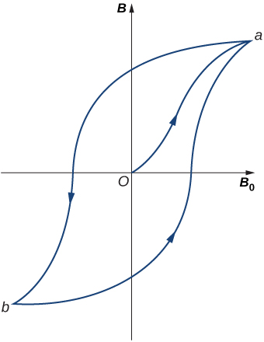
Figure 12.26
A typical hysteresis loop for a ferromagnet. When the material is first magnetized, it follows a curve from 0 to a. When B₀ is reversed, it takes the path shown from a to b. If B₀ is reversed again, the material follows the curve from b to a.

Slide 29
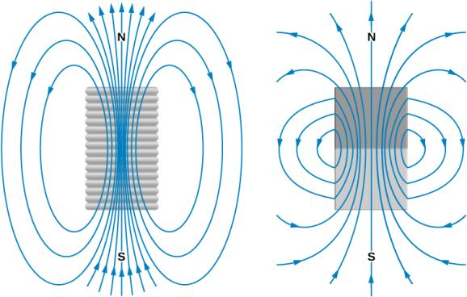
Figure 12.27
Comparison of the magnetic fields of a finite solenoid and a bar magnet.

Slide 30
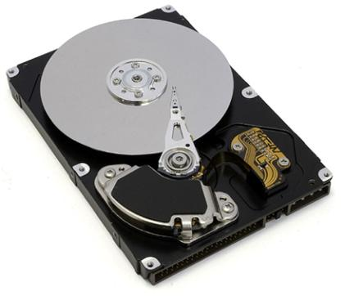
Figure 12.28
The inside of a hard disk drive. The silver disk contains the information, whereas the thin stylus on top of the disk reads and writes information to the disk.

Slide 31
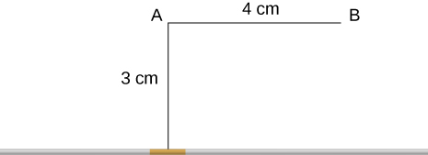
EXERCISE 16

Slide 32

Exercise 17

Slide 33
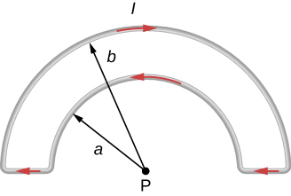
EXERCISE 18

Slide 34
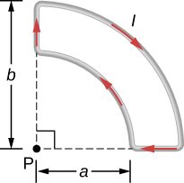
Exercise 19

Slide 35
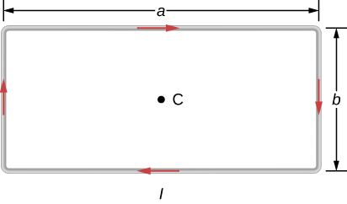
EXERCISE 20

Slide 36
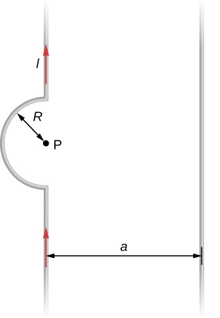
EXERCISE 21

Slide 37
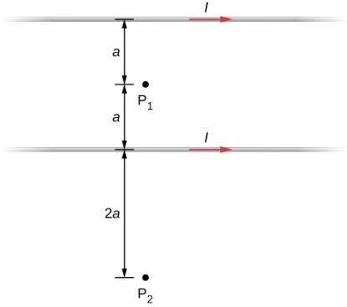
EXERCISE 27

Slide 38
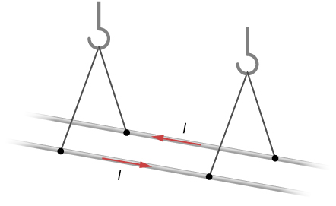
EXERCISE 32

Slide 39
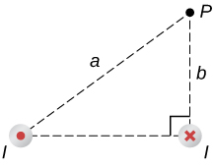
EXERCISE 33

Slide 40
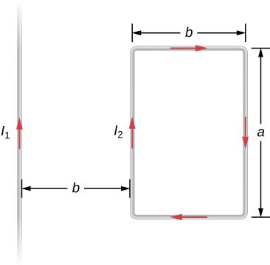
Exercise 34

Slide 41
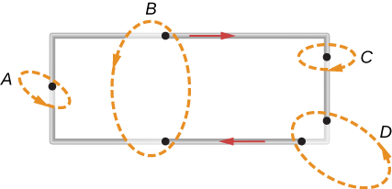
EXERCISE 41

Slide 42
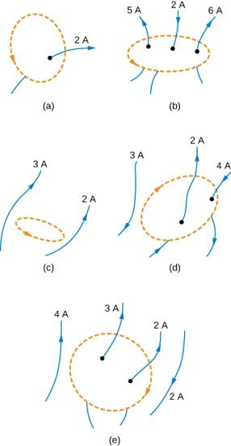
Exercise 42

Slide 43
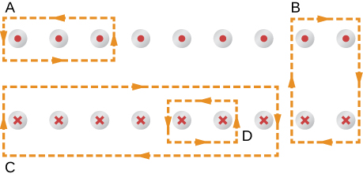
EXERCISE 43

Slide 44
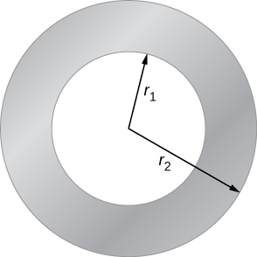
Exercise 46

Slide 45
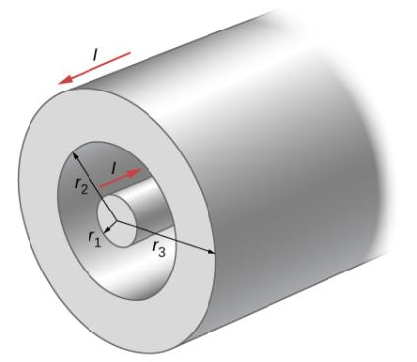
Exercise 48

Slide 46
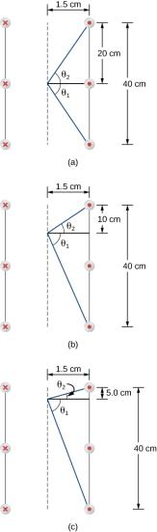
Exercise 52

Slide 47
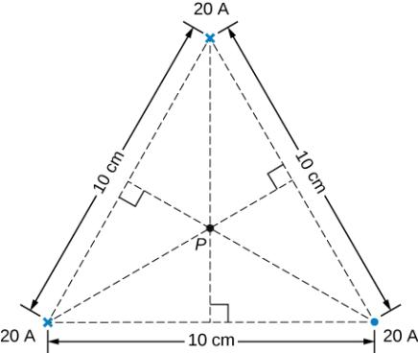
EXERCISE 65

Slide 48

Exercise 66

Slide 49

EXERCISE 67

Slide 50

EXERCISE 68

Slide 51

EXERCISE 69

Slide 52

EXERCISE 70

Slide 53

EXERCISE 75

Slide 54

EXERCISE 79

Slide 55

EXERCISE 80

Slide 56

Exercise 81

Slide 57

Exercise 82

Slide 58

EXERCISE 84

Slide 59

Exercise 86

Slide 60

EXERCISE 89

Slide 61

EXERCISE 90

Slide 62

This OpenStax ancillary resource is © Rice University under a CC-BY 4.0 International license; it may be reproduced or modified but must be attributed to OpenStax, Rice University and any changes must be noted.

