Slide 1
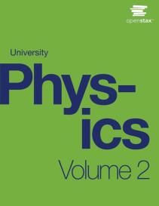

University Physics
Chapter 14 INDUCTANCE
PowerPoint Image Slideshow

Slide 2

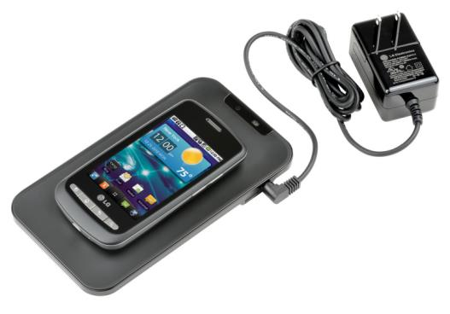
Figure 14.1
A smartphone charging mat contains a coil that receives alternating current, or current that is constantly increasing and decreasing. The varying current induces an emf in the smartphone, which charges its battery. Note that the black box containing the electrical plug also contains a transformer (discussed in Alternating-Current Circuits) that modifies the current from the outlet to suit the needs of the smartphone. (credit: modification of work by “LG”/Flickr)

Slide 3
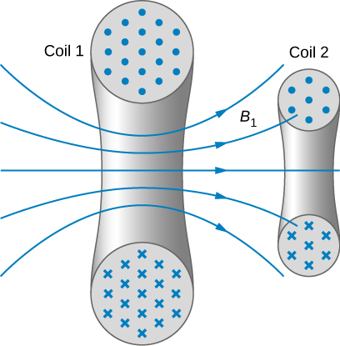
Figure 14.2
Some of the magnetic field lines produced by the current in coil 1 pass through coil 2.

Slide 4
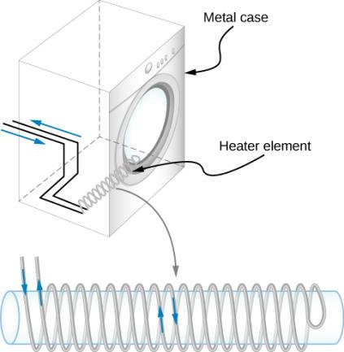
Figure 14.3
The heating coils of an electric clothes dryer can be counter-wound so that their magnetic fields cancel one another, greatly reducing the mutual inductance with the case of the dryer.

Slide 5
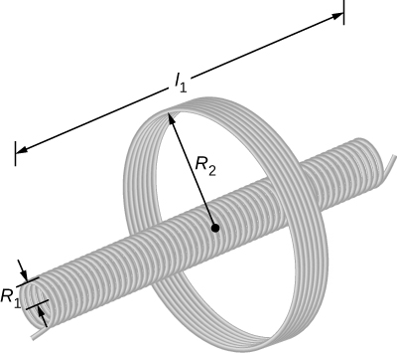
Figure 14.4
A solenoid surrounded by a coil.

Slide 6
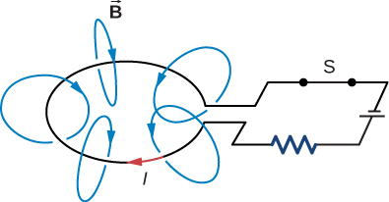
Figure 14.5
A magnetic field is produced by the current I in the loop. If I were to vary with time, the magnetic flux through the loop would also vary and an emf would be induced in the loop.

Slide 7
Figure 14.6
Symbol used to represent an inductor in a circuit.

Slide 8
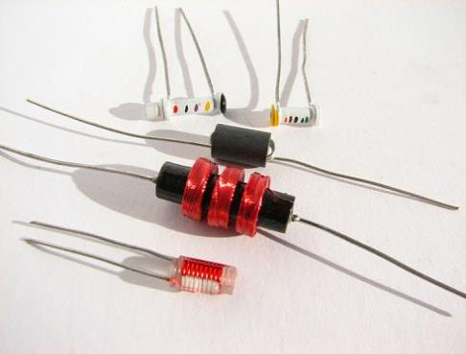
Figure 14.7
A variety of inductors. Whether they are encapsulated like the top three shown or wound around in a coil like the bottom-most one, each is simply a relatively long coil of wire. (credit: Windell Oskay)

Slide 9
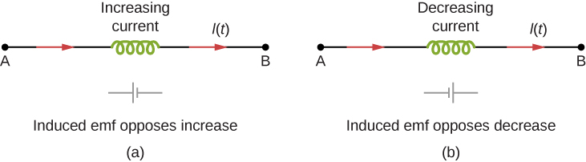
Figure 14.8
The induced emf across an inductor always acts to oppose the change in the current. This can be visualized as an imaginary battery causing current to flow to oppose the change in (a) and reinforce the change in (b).

Slide 10
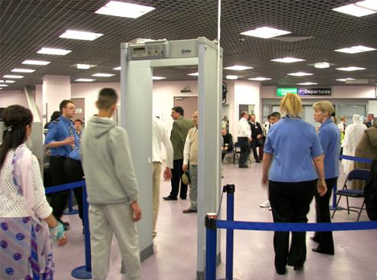
Figure 14.9
The familiar security gate at an airport not only detects metals, but can also indicate their approximate height above the floor. (credit: “Alexbuirds”/Wikimedia Commons)

Slide 11
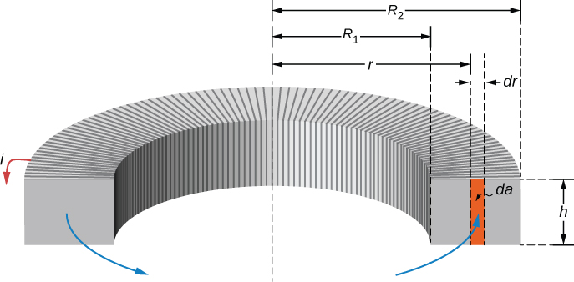
Figure 14.10
Calculating the self-inductance of a rectangular toroid.

Slide 12
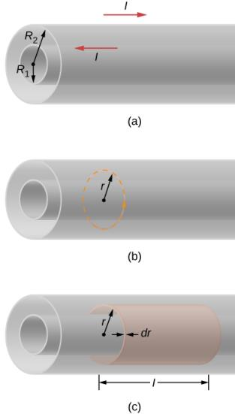
Figure 14.11
A coaxial cable is represented here by two hollow, concentric cylindrical conductors along which electric current flows in opposite directions.
The magnetic field between the conductors can be found by applying Ampère’s law to the dashed path.
The cylindrical shell is used to find the magnetic energy stored in a length l of the cable.

Slide 13
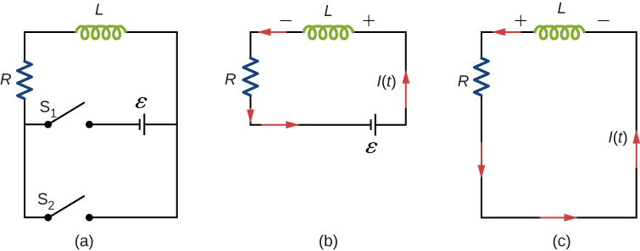
Figure 14.12
An RL circuit with switches S₁ and S₂.
The equivalent circuit with S₁ closed and S₂ open.
The equivalent circuit after S₁ is opened and S₂ is closed.

Slide 14
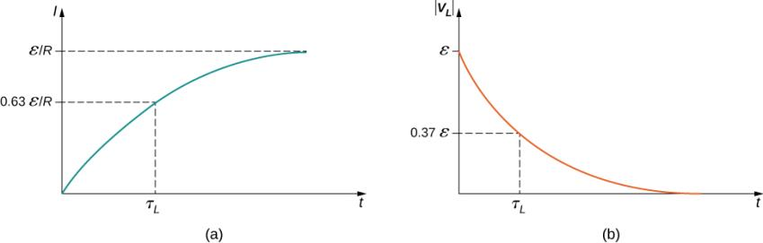
Figure 14.13
Time variation of (a) the electric current and (b) the magnitude of the induced voltage across the coil in the circuit of Figure 14.12(b).

Slide 15
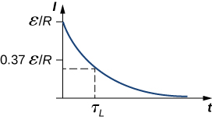
Figure 14.14
Time variation of electric current in the RL circuit of Figure 14.12(c). The induced voltage across the coil also decays exponentially.

Slide 16
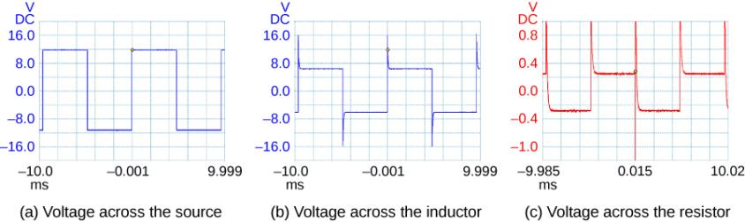
Figure 14.15
A generator in an RL circuit produces a square-pulse output in which the voltage oscillates between zero and some set value. These oscilloscope traces show (a) the voltage across the source; (b) the voltage across the inductor; (c) the voltage across the resistor.

Slide 17
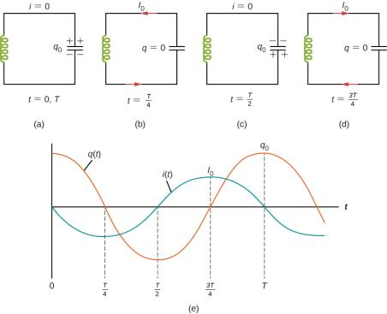
Figure 14.16
(a–d) The oscillation of charge storage with changing directions of current in an LC circuit. (e) The graphs show the distribution of charge and current between the capacitor and inductor.

Slide 18
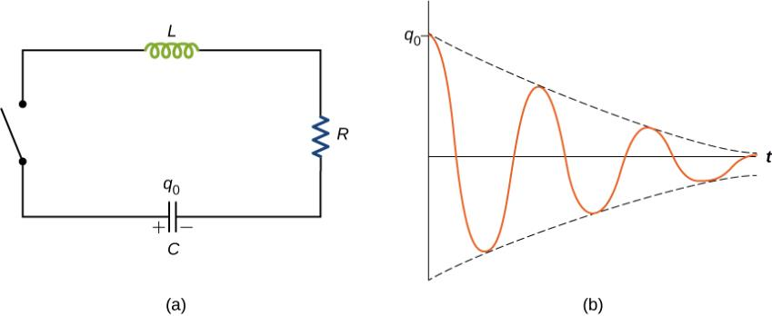
Figure 14.17
An RLC circuit. Electromagnetic oscillations begin when the switch is closed. The capacitor is fully charged initially.
Damped oscillations of the capacitor charge are shown in this curve of charge versus time, or q versus t. The capacitor contains a charge q₀ before the switch is closed.

Slide 19
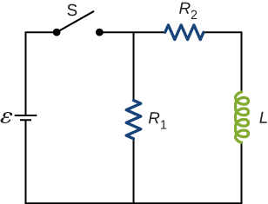
Exercise 19

Slide 20
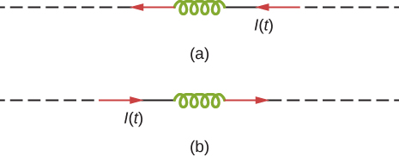
Exercise 36

Slide 21
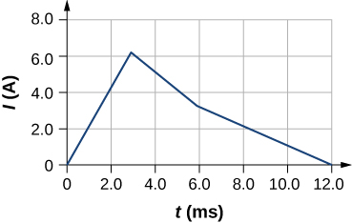
Exercise 42

Slide 22
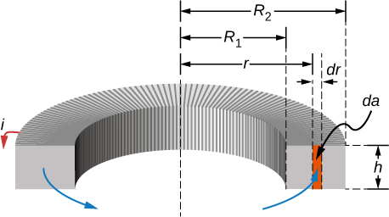
Exercise 44

Slide 23
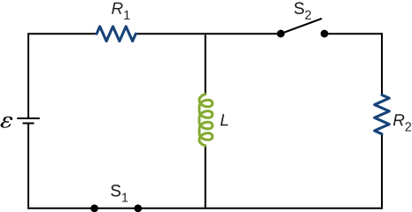
Exercise 53

Slide 24
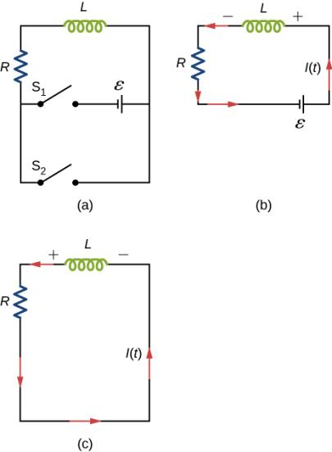
Exercise 54

Slide 25
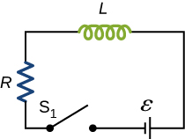
Exercise 55

Slide 26
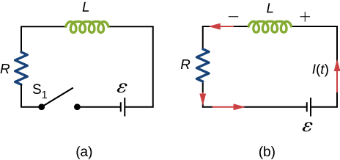
Exercise 56

Slide 27
Exercise 57

Slide 28
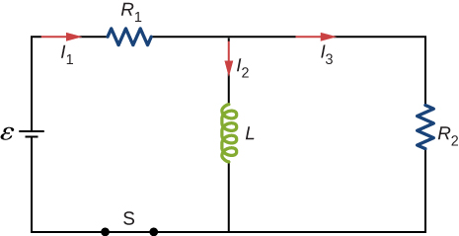
Exercise 58

Slide 29
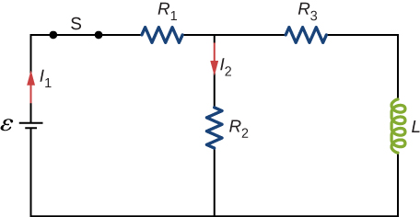
Exercise 59

Slide 30
Exercise 60

Slide 31

Exercise 61

Slide 32
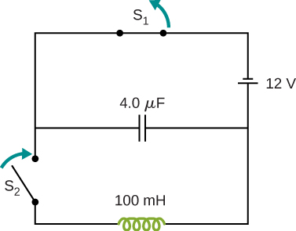
Exercise 68

Slide 33
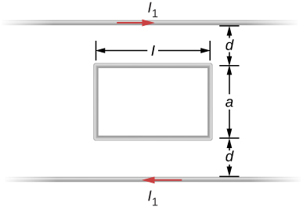
Exercise 75

Slide 34
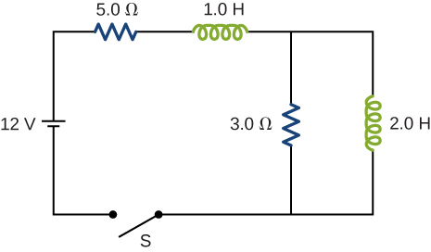
Exercise 79

Slide 35
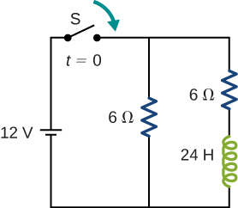
Exercise 84

Slide 36
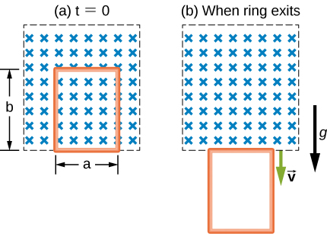
Exercise 86

Slide 37

This OpenStax ancillary resource is © Rice University under a CC-BY 4.0 International license; it may be reproduced or modified but must be attributed to OpenStax, Rice University and any changes must be noted.

