Slide 1


University Physics
Chapter 15 ALTERNATING-CURRENT CIRCUITS
PowerPoint Image Slideshow

Slide 2

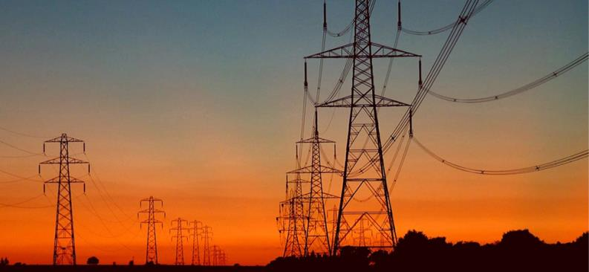
Figure 15.1
The current we draw into our houses is an alternating current (ac). Power lines transmit ac to our neighborhoods, where local power stations and transformers distribute it to our homes. In this chapter, we discuss how a transformer works and how it allows us to transmit power at very high voltages and minimal heating losses across the lines.

Slide 3
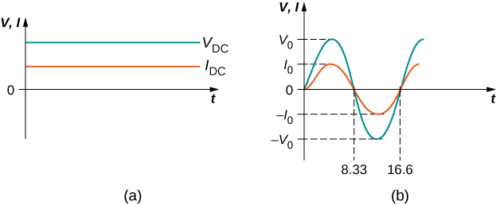
Figure 15.2
The dc voltage and current are constant in time, once the current is established.
The voltage and current versus time are quite different for ac power. In this example, which shows 60-Hz ac power and time t in milliseconds, voltage and current are sinusoidal and are in phase for a simple resistance circuit. The frequencies and peak voltages of ac sources differ greatly.

Slide 4
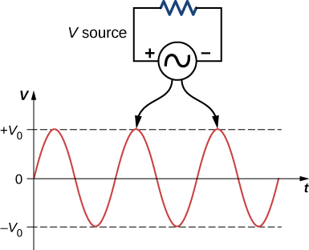
Figure 15.3
The potential difference V between the terminals of an ac voltage source fluctuates, so the source and the resistor have ac sine waves on top of each other. The mathematical expression for v is given by v = V₀ sin 𝜔t.

Slide 5
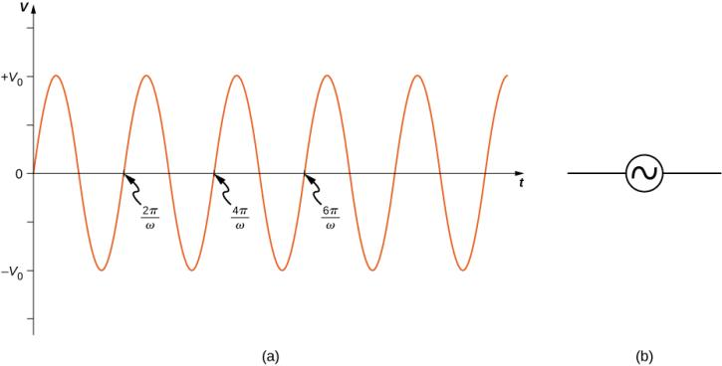
Figure 15.4
The output v(t) = V₀ sin 𝜔t of an ac generator.
Symbol used to represent an ac voltage source in a circuit diagram.

Slide 6
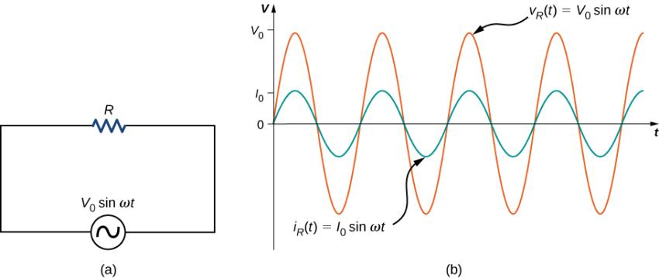
Figure 15.5
A resistor connected across an ac voltage source.
The current i_{R}(t) through the resistor and the voltage v_{R}(t) across the resistor. The two quantities are in phase.

Slide 7
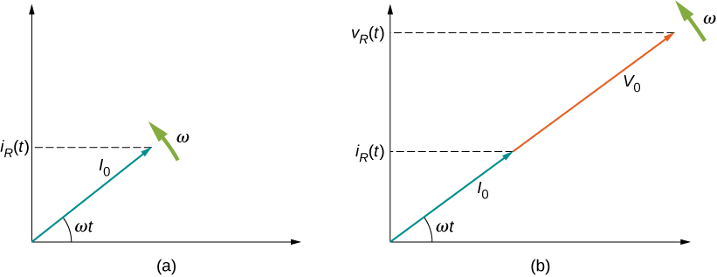
Figure 15.6
The phasor diagram representing the current through the resistor of Figure 15.5.
The phasor diagram representing both i_{R}(t) and v_{R}(t) .

Slide 8
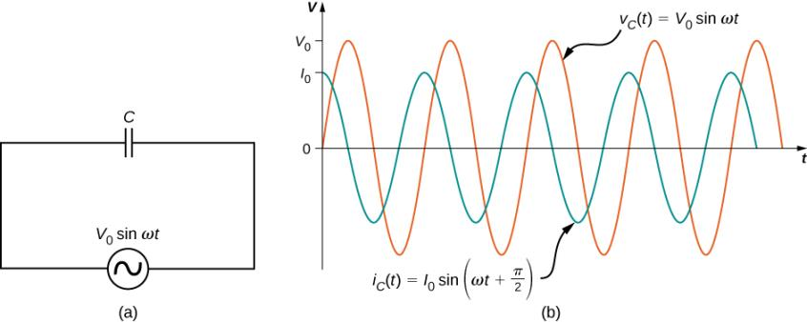
Figure 15.7
A capacitor connected across an ac generator.
The current i_{C}(t) through the capacitor and the voltage v_{C}(t) across the capacitor. Notice that i_{C}(t) leads v_{C}(t) by 𝜋/2 rad.

Slide 9
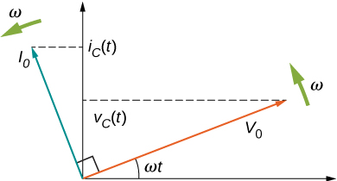
Figure 15.8
The phasor diagram for the capacitor of Figure 15.7. The current phasor leads the voltage phasor by 𝜋/2 rad as they both rotate with the same angular frequency.

Slide 10
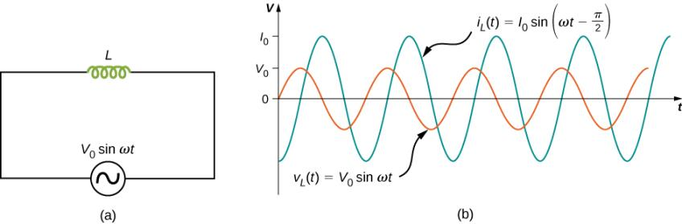
Figure 15.9
An inductor connected across an ac generator.
The current i_{L}(t) through the inductor and the voltage v_{L}(t) across the inductor. Here i_{L}(t) lags v_{L}(t) by 𝜋/2 rad.

Slide 11
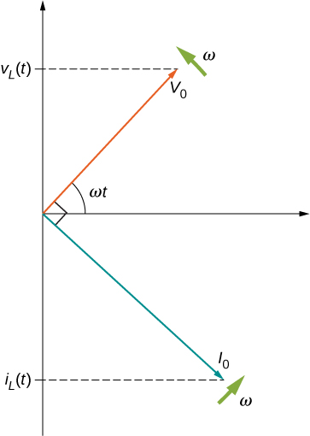
Figure 15.10
The phasor diagram for the inductor of Figure 15.9. The current phasor lags the voltage phasor by 𝜋/2 rad as they both rotate with the same angular frequency.

Slide 12
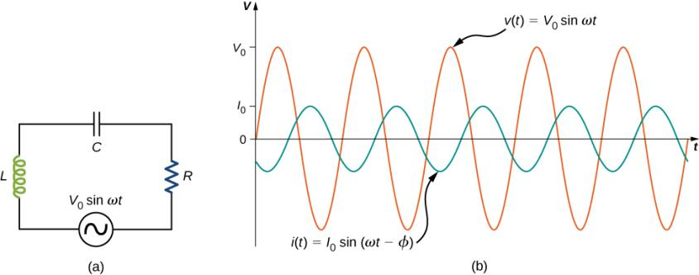
Figure 15.11
An RLC series circuit.
A comparison of the generator output voltage and the current. The value of the phase difference 𝜙 depends on the values of R, C, and L.

Slide 13
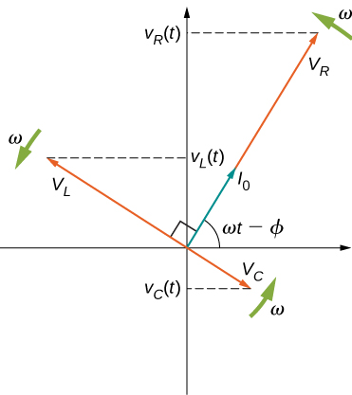
Figure 15.12
The phasor diagram for the RLC series circuit of Figure 15.11.

Slide 14
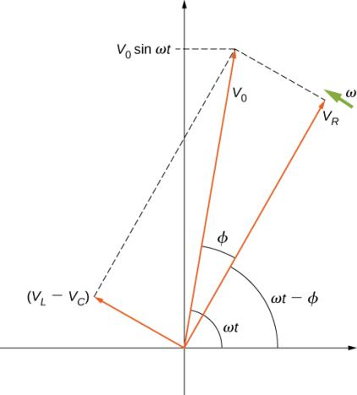
Figure 15.13
The resultant of the phasors for v_{L}(t) , v_{C}(t), and v_{R}(t) is equal to the phasor for v(t) = V₀ sin ωt. The i(t) phasor (not shown) is aligned with the v_{R}(t) phasor.

Slide 15
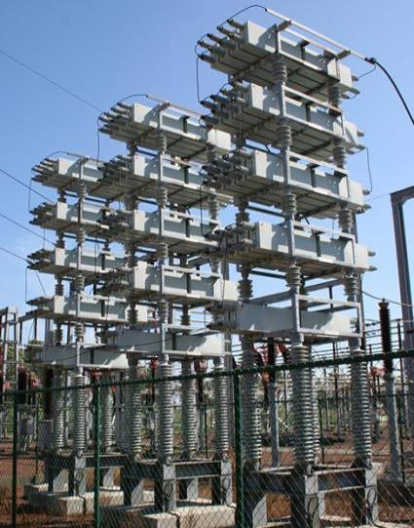
Figure 15.14
Power capacitors are used to balance the impedance of the effective inductance in transmission lines.

Slide 16
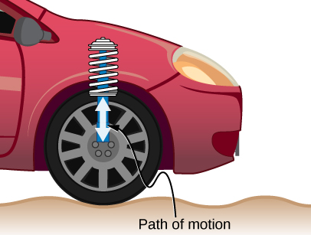
Figure 15.15
On a car, the shock absorber damps motion and dissipates energy. This is much like the resistance in an RLC circuit. The mass and spring determine the resonant frequency.

Slide 17
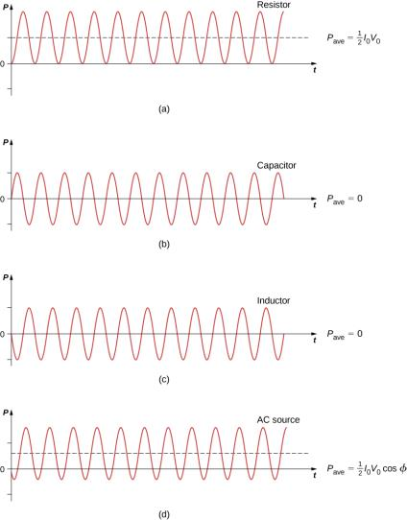
Figure 15.16
Graph of instantaneous power for various circuit elements. (a) For the resistor, P_{ave} = I₀V₀/2, whereas for (b) the capacitor and (c) the inductor, P_{ave} = 0. (d) For the source, P_{ave} = I₀V₀(cos 𝜙)/2, which may be positive, negative, or zero, depending on 𝜙.

Slide 18
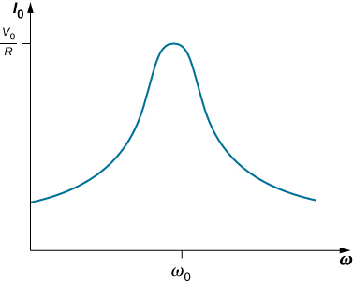
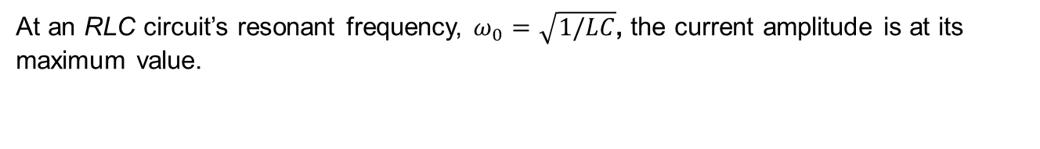
Figure 15.17
At an RLC circuit’s resonant frequency, $ω_{0}=\sqrt{1/LC}$, the current amplitude is at its maximum value.

Slide 19
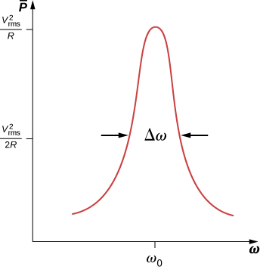
Figure 15.18
Like the current, the average power transferred from an ac generator to an RLC circuit peaks at the resonant frequency.

Slide 20

Figure 15.19
When a metal detector comes near a piece of metal, the self-inductance of one of its coils changes. This causes a shift in the resonant frequency of a circuit containing the coil. That shift is detected by the circuitry and transmitted to the diver by means of the headphones.

Slide 21
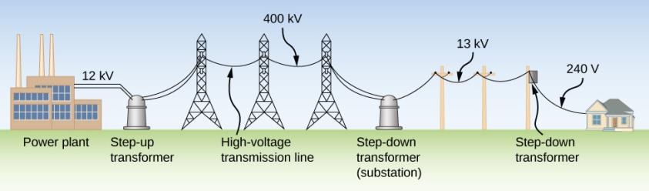
Figure 15.20
The rms voltage from a power plant eventually needs to be stepped down from 12 kV to 240 V so that it can be safely introduced into a home. A high-voltage transmission line allows a low current to be transmitted via a substation over long distances.

Slide 22
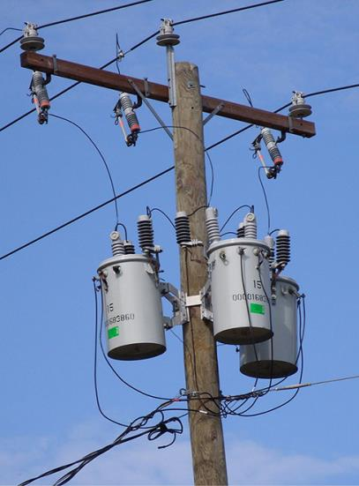
Figure 15.21
Transformers are used to step down the high voltages in transmission lines to the 110 to 220 V used in homes. (credit: modification of work by “Fortyseven”/Flickr)

Slide 23
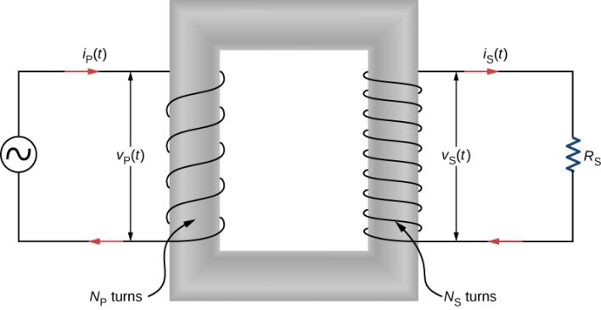
Figure 15.22
A step-up transformer (more turns in the secondary winding than in the primary winding). The two windings are wrapped around a soft iron core.

Slide 24
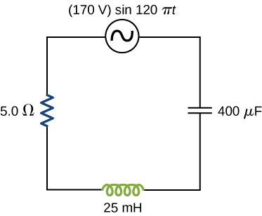
Exercise 29

Slide 25
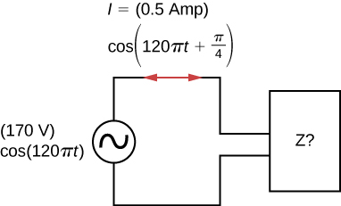
Exercise 43

Slide 26
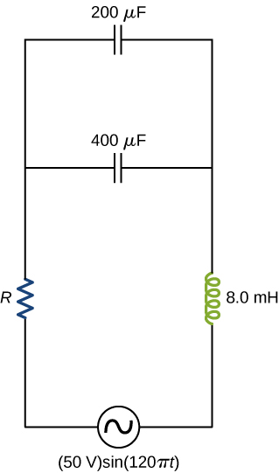
Exercise 55

Slide 27
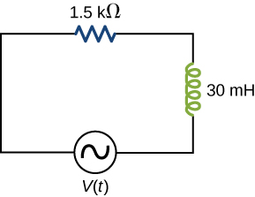
Exercise 62

Slide 28
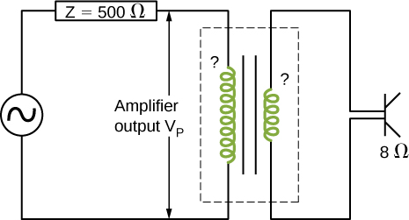
Exercise 66

Slide 29
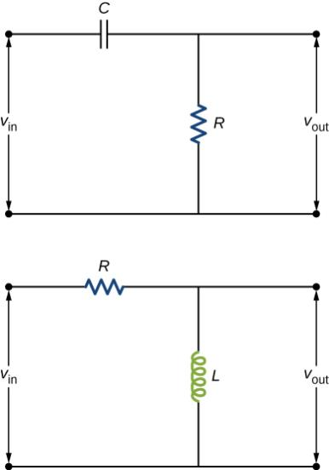
Exercise 71

Slide 30
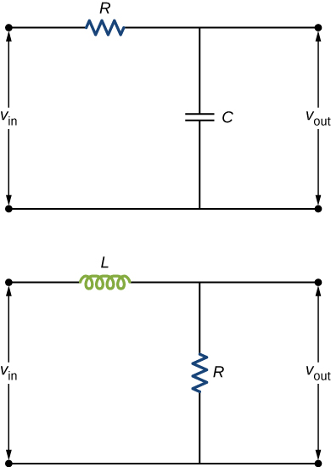
Exercise 72

Slide 31

This OpenStax ancillary resource is © Rice University under a CC-BY 4.0 International license; it may be reproduced or modified but must be attributed to OpenStax, Rice University and any changes must be noted.

