Slide 1
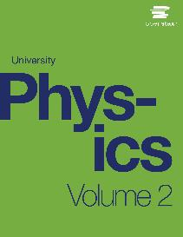

University Physics
Chapter 16 ELECTROMAGNETIC WAVES
PowerPoint Image Slideshow

Slide 2

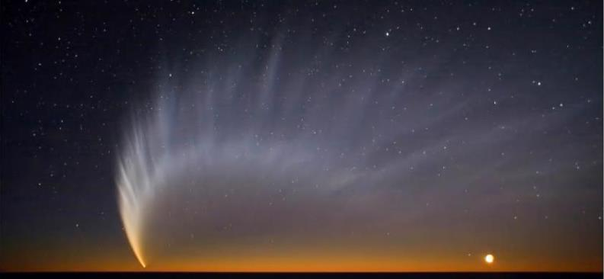
Figure 16.1
The pressure from sunlight predicted by Maxwell’s equations helped produce the tail of Comet McNaught. (credit: modification of work by Sebastian Deiries—ESO)

Slide 3
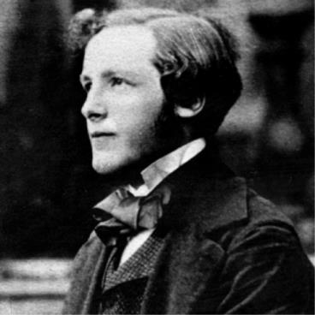
Figure 16.2
James Clerk Maxwell, a nineteenth-century physicist, developed a theory that explained the relationship between electricity and magnetism, and correctly predicted that visible light consists of electromagnetic waves.

Slide 4
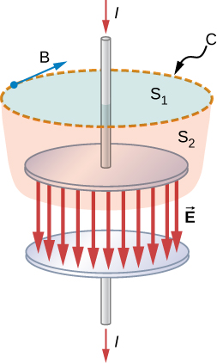
Figure 16.3
The currents through surface S₁ and surface S₂ are unequal, despite having the same boundary loop C.

Slide 5
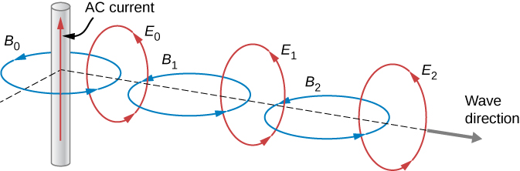
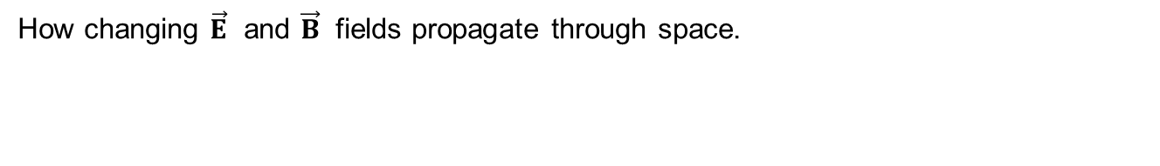
Figure 16.4
How changing $\vec{E}$ and $\vec{B}$ fields propagate through space.

Slide 6
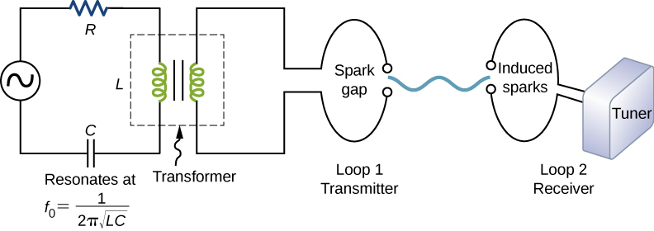
Figure 16.5
The apparatus used by Hertz in 1887 to generate and detect electromagnetic waves.

Slide 7
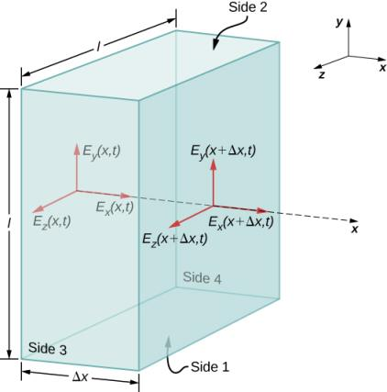
Figure 16.6
The surface of a rectangular box of dimensions l × l × Δx is our Gaussian surface. The electric field shown is from an electromagnetic wave propagating along the x-axis.

Slide 8
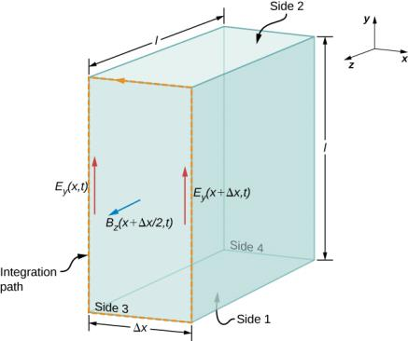
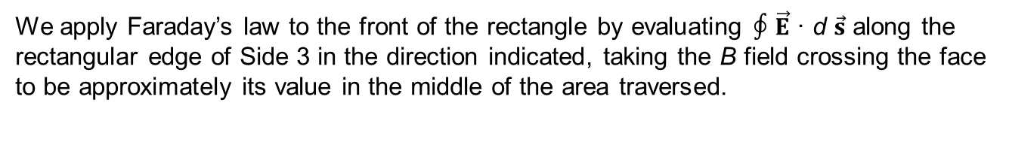
Figure 16.7
We apply Faraday’s law to the front of the rectangle by evaluating ∮ $\vec{E}$ · d $\vec{s}$ along the rectangular edge of Side 3 in the direction indicated, taking the B field crossing the face to be approximately its value in the middle of the area traversed.

Slide 9
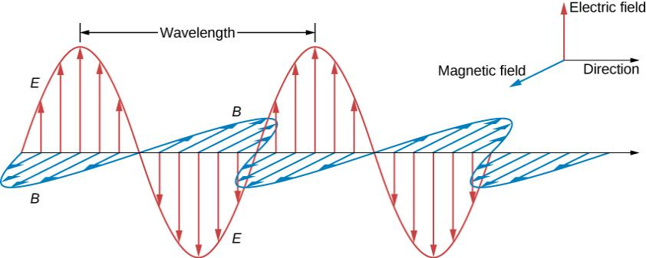
Figure 16.8
The plane wave solution of Maxwell’s equations has the B field directly proportional to the E field at each point, with the relative directions shown.

Slide 10
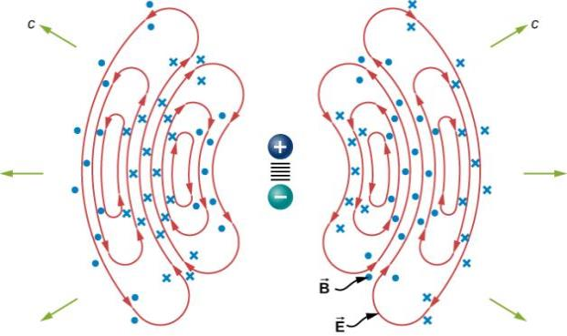
Figure 16.9
The oscillatory motion of the charges in a dipole antenna produces electromagnetic radiation.

Slide 11
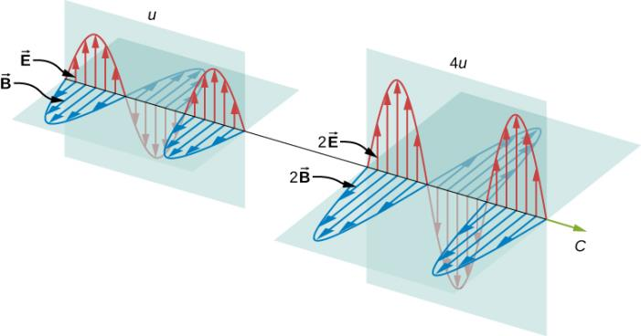
Figure 16.10
Energy carried by a wave depends on its amplitude. With electromagnetic waves, doubling the E fields and B fields quadruples the energy density u and the energy flux uc.

Slide 12
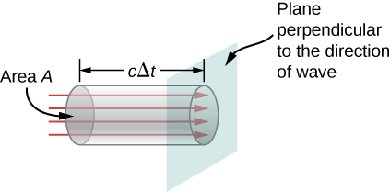
Figure 16.11
The energy uAcΔt contained in the electric and magnetic fields of the electromagnetic wave in the volume AcΔt passes through the area A in time Δt.

Slide 13
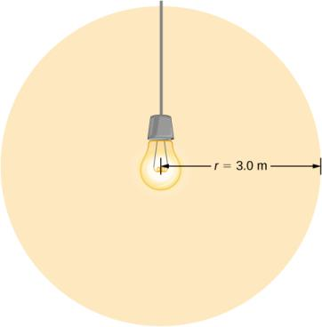
Example 16.4

Slide 14
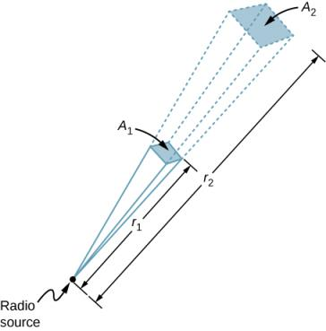
Figure 16.12
In three dimensions, a signal spreads over a solid angle as it travels outward from its source.

Slide 15
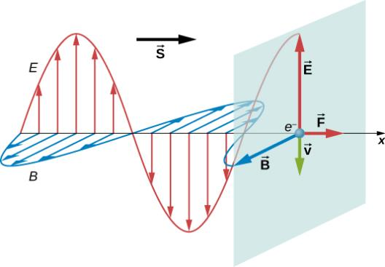
Figure 16.13
Electric and magnetic fields of an electromagnetic wave can combine to produce a force in the direction of propagation, as illustrated for the special case of electrons whose motion is highly damped by the resistance of a metal.

Slide 16
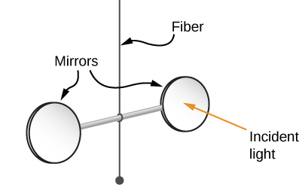
Figure 16.14
Simplified diagram of the central part of the apparatus Nichols and Hull used to precisely measure radiation pressure and confirm Maxwell’s prediction.

Slide 17
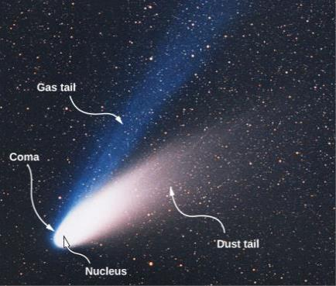
Figure 16.15
Evaporation of material being warmed by the Sun forms two tails, as shown in this photo of Comet Ison. (credit: modification of work by E. Slawik—ESO)

Slide 18
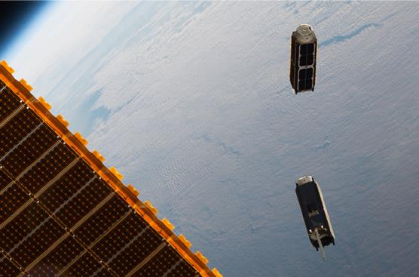
Figure 16.16
Two small CubeSat satellites deployed from the International Space Station in May, 2016. The solar sails open out when the CubeSats are far enough away from the Station.

Slide 19
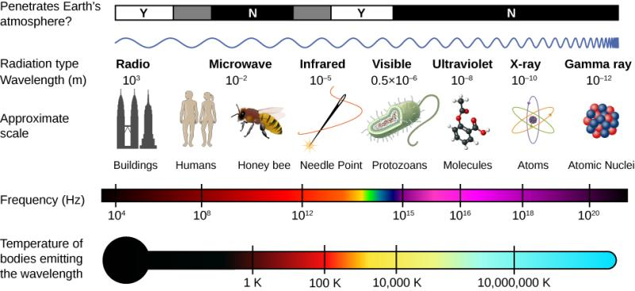
Figure 16.17
The electromagnetic spectrum, showing the major categories of electromagnetic waves.

Slide 20
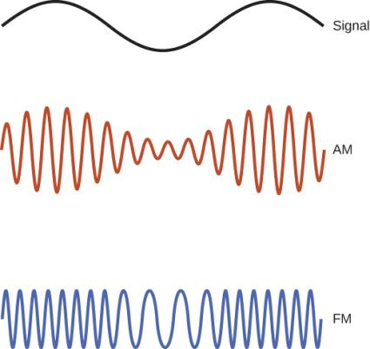
Figure 16.18
Electromagnetic waves are used to carry communications signals by varying the wave’s amplitude (AM), its frequency (FM), or its phase.

Slide 21
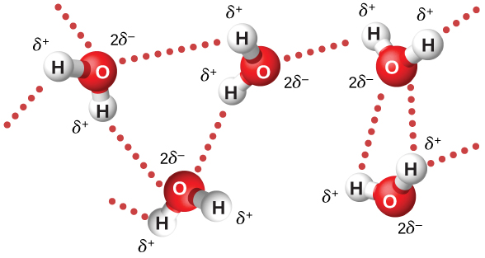
Figure 16.19
The oscillating electric field in a microwave oven exerts a torque on water molecules because of their dipole moment, and the torque reverses direction 4.90 × 10⁹ times per second. Interactions between the molecules distributes the energy being pumped into them. The 𝛿⁺ and 𝛿⁻ denote the charge distribution on the molecules.

Slide 22
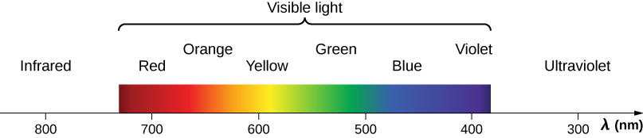
Figure 16.20
A small part of the electromagnetic spectrum that includes its visible components. The divisions between infrared, visible, and ultraviolet are not perfectly distinct, nor are those between the seven rainbow colors.

Slide 23
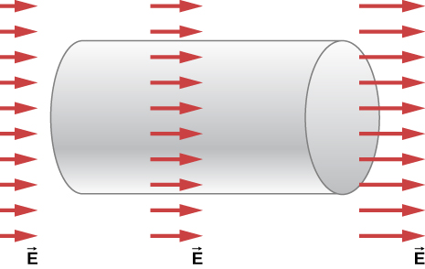
Exercise 2

Slide 24
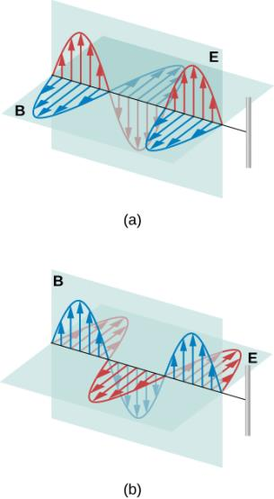
Exercise 5

Slide 25
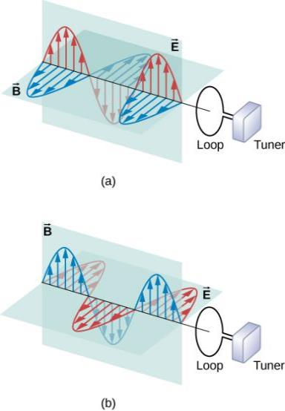
Exercise 6

Slide 26
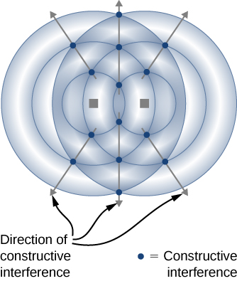
Exercise 8

Slide 27
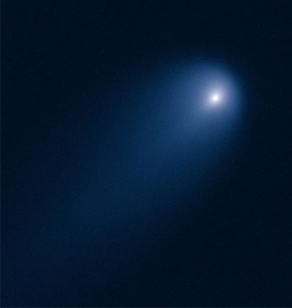
Figure 16.21
(credit: ESA, Hubble)

Slide 28
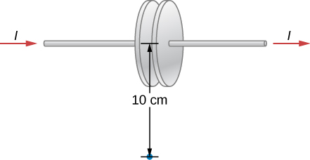
Exercise 36

Slide 29
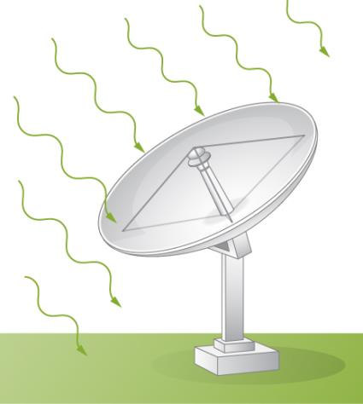
Exercise 63

Slide 30
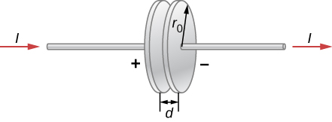
Exercise 106

Slide 31

This OpenStax ancillary resource is © Rice University under a CC-BY 4.0 International license; it may be reproduced or modified but must be attributed to OpenStax, Rice University and any changes must be noted.

