Slide 1
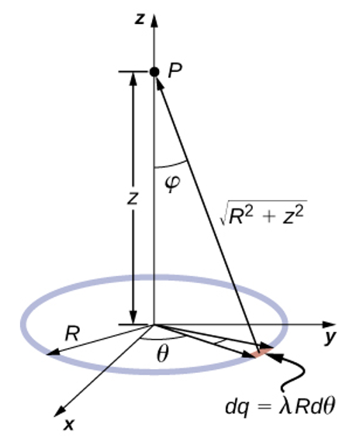
+5nC
(7,7)
Point P
(3,4)
-3nC
(coordinates are in meters)
(0,0)
+4nC
(9,-2)

Slide 2
Units are in cm
d
+
+
+
+
+
+
+
+
+
+
+
-
-
-
-
-
-
-
-
-
-
-
Depth = 4
v_{i}
Width = 2
z
Height = 1
45º
x
y
Unit are in cm
Depth = 4
R2
q
Height = 1
Top Width = 3
R1
z
45º
x
y
Bottom Width = 2

