Slide 1
10³ | 10² | 10¹ | 10⁰
9 | 7 | 3 | 8
 |  |  |  | 8 x 1 | 8
 |  |  |  | 3 x 10 | 30
 |  |  |  | 7 x 100 | 700
 |  |  |  | 9 x 1000 | 9000
 |  |  |  | Total | 9738

Slide 2
2⁷ | 2⁶ | 2⁵ | 2⁴ | 2³ | 2² | 2¹ | 2⁰
1 | 0 | 1 | 0 | 1 | 0 | 0 | 1
 |  |  |  |  |  |  |  | 1 x 1 | 1
 |  |  |  |  |  |  |  | 0 x 2 | 0
 |  |  |  |  |  |  |  | 0 x 4 | 0
 |  |  |  |  |  |  |  | 1 x 8 | 8
 |  |  |  |  |  |  |  | 0 x 16 | 0
 |  |  |  |  |  |  |  | 1 x 32 | 32
 |  |  |  |  |  |  |  | 0 x 64 | 0
 |  |  |  |  |  |  |  | 1 x 128 | 128
 |  |  |  |  |  |  |  | Total | 169

Slide 3
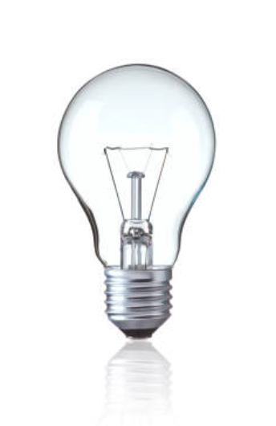

 | OFF | False | 0
 | ON | True | 1

