Slide 1
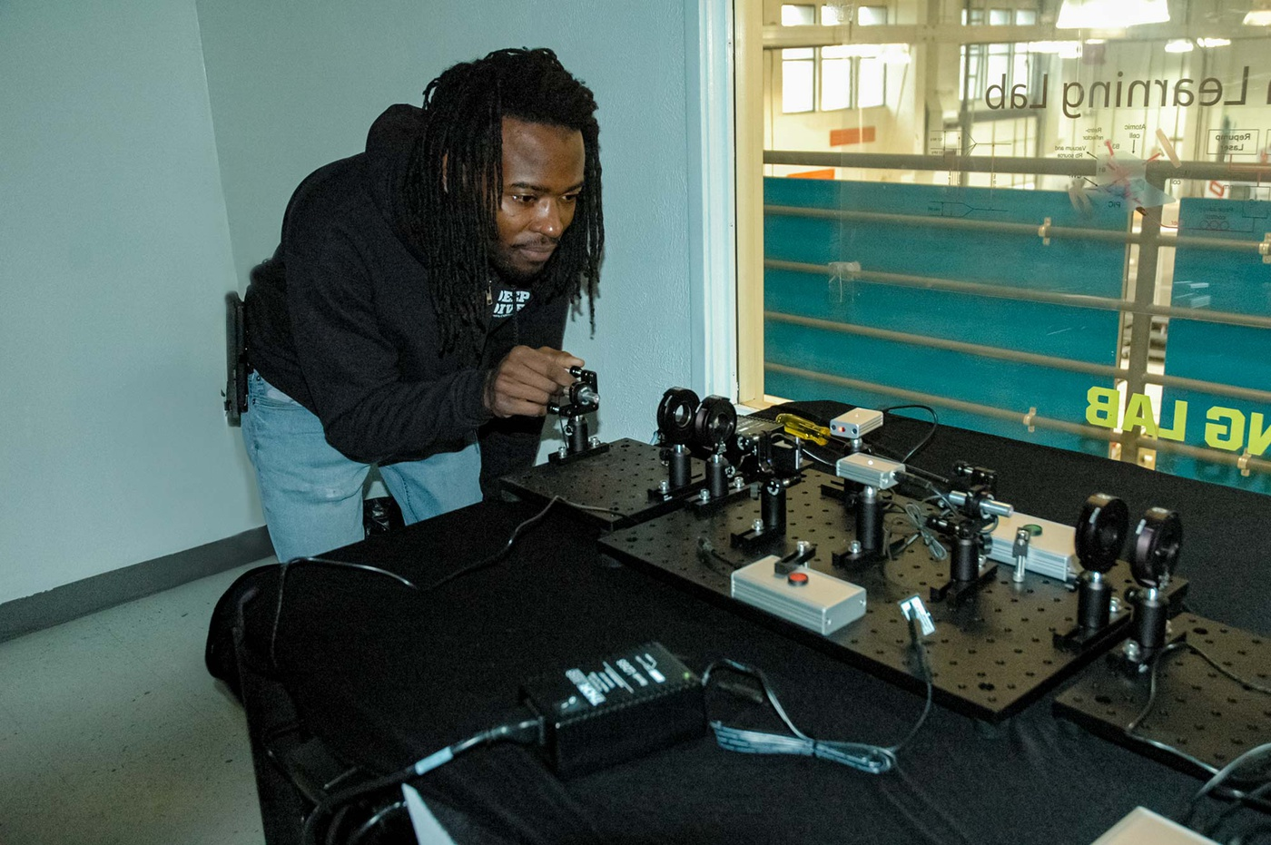
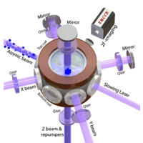
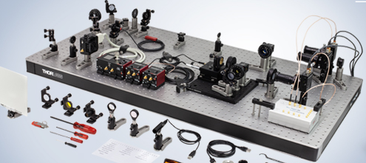
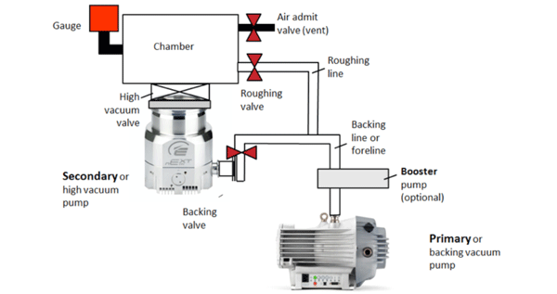

Quantum Learning Lab (QuLL)
Training lab for Quantum Workforce Development located at the FUSE Makerspace in downtown ABQ
First Cohort (9 Students) start September 29, 2025
Provide hands-on quantum experience for undergraduate students across the state
Enhance knowledge of early-stage researchers and entrepreneurs
Air Force Veteran – EJ Ishman
Immersive Hands-On Workforce Training (10-weeks)
Built on the success of CNM Ingenuity’s Deep Dive Bootcamps
No prior math/science needed
Focus on:
Optics and Photonics
Ultra-High Vacuum Systems
Quantum Phenomenon
Problem Solving, Documentation, Math, Statistics
Skills applicable to adjacent industries
Semiconductor, Solar Cell, Opto-Electronic Manufacturing
Workforce Certificate, plus credit towards academic degrees
Quantum Technician Bootcamp

