Slide 1
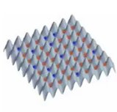
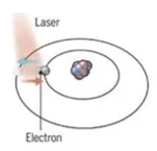
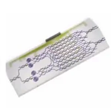
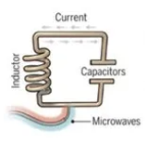
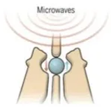























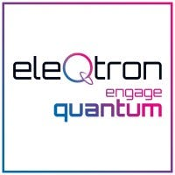






Neutral Atom | Trapped Ion | Photonics | Superconducting | Silicon Spin / Quantum Dots
Neutral atoms are cooled using tuned laser and store qubits within electron states. Interactions through excitation to Rydberg states. | Trapped Ion technology uses charged atomic particles, which can be confined and suspended in free space using electromagnetic fields. Qubits are stored in the stable electronic states of each ion. Lasers are used to induce coupling between qubits. | Photonic-based technology consists of superpositions of multiple photons in a light pulse. Qubits consist of so-called “squeeze states” consisting of superpositions of multiple photons in a light pulse | Resistance-free current oscillations back and forth around a circuit loop. An injected microwave signal excites the current into superposition states. | ”Artificial atoms” are made by adding an electron to a small piece of pure silicon. Microwaves control the electron’s quantum state.
Pros: Long coherence times. Strong connectivity including more than 2Q. External cryogenics not required. Cons: Requires ultra-high vacuum. Laser scaling challenges. | Pros: Extremely high gate fidelities and long coherence. No External cryogenics. Cons: Slow gate times / operations. Lowe connectivity between qubits. Requires ultra-high vacuum. Laser scaling challenges. | Pros: Extremely fast gate speeds and promising fidelities. No cryogenics or vacuum. Leverage existing CMOS fabs. Cons: Noise from photon loss. Each program requires custom chip. Photons don’t naturally interact so 2Q gate challenges. | Pros: High gate speeds and fidelities, Leverage existing lithographic processes. Cons: Requires cryogenic cooling. Short coherence times. Microwave interaction not well understood. | Pros: Leverage existing semiconductor technologies. Strong gate fidelities and speeds. Cons: Requires cryogenics. Only a few entangled gates with low coherence times. Interference and cross-talk challenges.

